Slide 1
ANOVA

Slide 2
What is ANOVA?
Analysis of variance (ANOVA) are the methods designed to compare multiple populations, or groups.
Sir Ronald A. Fisher in 1920’s used ANOVA in his experimental design.
In ANOVA, you take samples from each group to examine the effects of differences among two or more groups.
The criteria that distinguishes the groups are called factors of interest.
Factors contain levels.

Slide 3
When Anova
Dependent Var(y) | Independent Var(x) | Technique
Categorical | Categorical | Chi-Square
Continuous | Categorical | ANOVA
Continuous | Continuous | Regression

Slide 4
ANOVA Introduction
Analysis of Variance is a statistical procedure that can be used to test if significant differences exists in the means of different populations.
Consider three populations with means µ₁, µ₂, µ₃ respectively. Using sample results we can set up the following NULL and ALTERNATE hypotheses.
Test:
If µ₁, µ₂, µ₃ are means three populations then
H₀ : µ₁ = µ₂ =µ₃
H_{a} : µ₁ ≠ µ₂ ≠ µ₃
ANOVA is used to determine whether the observed differences in the sample means are large enough to reject the NULL hypothesis.

Slide 5
ANOVA Assumption
For each population, the response variable is normally distributed
The variance σ² of response variable is same for all the distributions.
The observations are independent of each other.

Slide 6
ANOVA Conceptual Overview
Sample means are close together when they come from one population when H₀ is true
X₁
µ
X₂
X₃
Sample means are not close together when they come from different populations when H₀ is not true
X₁
µ₁
µ₂
X₂
X₃
µ₃

Slide 7
ANOVA Conceptual Overview
Consider 3 populations with means µ₁, µ₂, µ₃ respectively and we have drawn one sample of size n from each.
If the means of the three populations are equal, we would expect sample means to be close together.
More the sample means differ more is the evidence that sample means differ.
In other words if variability amongst the sample means is small it supports NULL hypothesis, otherwise it supports H_{a}
If null hypothesis is true, then we can consider that each sample came from same normal distribution. In this case mean and variance would be
= (µ₁+µ₂+µ₃) and Var (σ²) = n(σ_{x̄}²)
This is called between treatments estimate.
(continued)

Slide 8
ANOVA Conceptual Overview
When H₀ is false, we have three sampling distributions. The means are not close together and the variance S_{x̄}² will be larger causing σ² to be larger.
In this case the pooled variance estimate is applied. Therefore
Var (σ²) = (s_{x̄}²+ s_{x̄}² +s_{x̄}² )/3
This is called within treatments estimate.
The ratio of between treatments estimate to within treatment estimate is called F ratio.
Larger the F ratio, more is evidence that the populations differ.

Slide 9
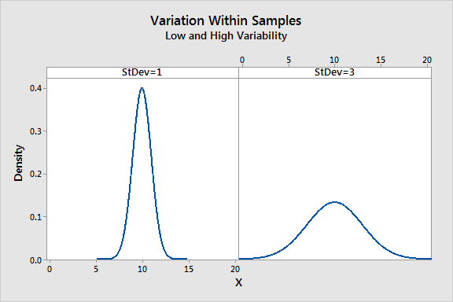
ANOVA F Value
Total variance is calculated within the group and across the group.
It’s the ratio of 2 variance
Variance are measure of desperation, how far data is moved from the mean
Larger value represents greater dispersion
F = Between the groups / Within groups
Larger the ratio, more likely it is that group have different mean (reject H0)

Slide 10
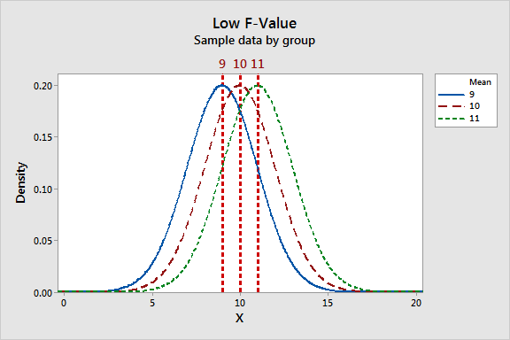
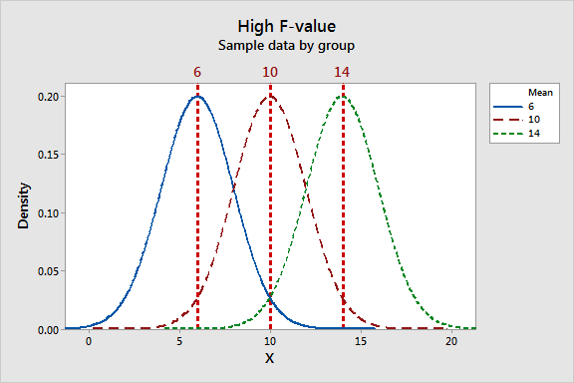
ANOVA F value : High/Low
Lower the f value, group means are
Close together with low variability
Within each group
The high F-value graph shows a case where the variability of group means is large relative to the within group variability.

Slide 11
Anova Treatment example
Example, let take the growth/yield of vegetable given based on fertilizer and after applying different types of fertilizers

Slide 12
Anova Before Treatment
There is no difference in the yield measure across 3 different ploughing area. Mean is same across all.

Slide 13
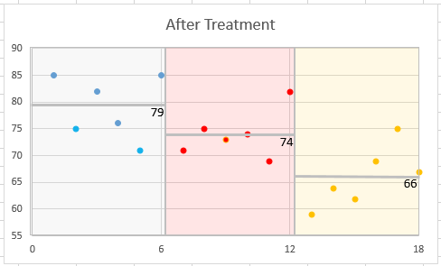
Anova After Treatment
Three different Ploughing area applied with fertilizers are showing different in the mean, this effect is called after treatment.

Slide 14
One Factor ANOVA
In one-way ANOVA, we partition the total variation as follows:
a. Variation due to differences among the groups (SSA), meaning it measures differences from group to group
b. Variation due to differences within the groups (SSW), meaning it measures random variation
Total Variation (SST)
Degrees of freedom= n -1, where n is the number of values in the group
Within Group Variation (SSW)
Degrees of freedom = c – 1, where c is the number of groups
Among Group Variation (SSB)
Degrees of freedom = n - c
Partitioning the total variation, SST = SSA + SSW

Slide 15
One Way Anova
Let us assume that there are c groups representing populations whose values are randomly and independently selected with mean 𝜇, 𝜇2, ..., 𝜇c follow a normal distribution, and have equal variances.
Null hypothesis states that there are no differences in the population means.
H₀: 𝜇₁ = 𝜇₂ = 𝜇₃ = ... = 𝜇_{c}
Alternative hypothesis states that at least one population mean is different from the other population means.
H_{A}: Not all 𝜇_{i} are equal (where i = 1, 2, ..., c).

Slide 16


ANOVA Introduction
Let X_{ij} is the i^{th} value in group j
n is the number of values in all the groups combined
c is the number of groups
J = (1,2,…, c) and i = (1,2,…, j)
nj is the number of values in group j and is the sample mean of group j
Grand mean = = ∑ ∑ (X_{ij} – X)² / n
When you divide these sum of squares by its respective degrees of freedom, we get the mean squares.
Total variation | Among group variation | Within group variation
SST = ∑_{j} ∑_{i} (X_{ij} – )² | SSA = ∑_{j} n_{j} ( – )² | SSW = ∑_{j} ∑_{i} (X_{ij} – )²
Mean squares* MST | Mean squares MSA | Mean squares MSW
MST = SST / (n – 1) | MSA = SSA / (c - 1) | MSW = SSW / (n – c)

Slide 17
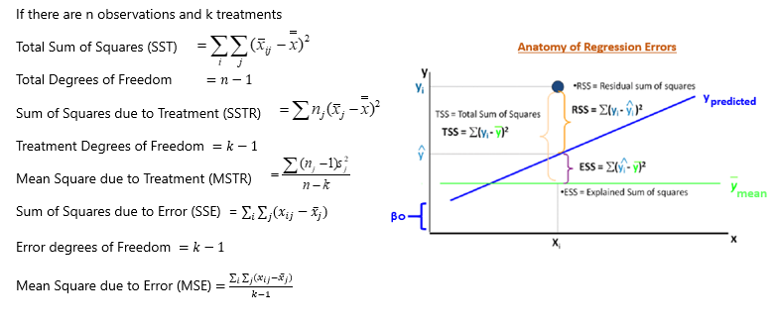
ANOVA Terminology

Slide 18
ANOVA Table
Analysis of Variance
Source of Variation | Degrees of Freedom | Sum of Squares | Mean Square Error | F | P
Treatment | k - 1 | SSTR | MSTR = SSTR/(k-1) | MSTR/MSE
Error | n - k | SSE | MSE = SSE/(n-k)
Total | n - 1 | SST
Factorial ANOVA is used when the experimenter wants to study the interaction effects among the treatments

Slide 19
One way ANOVA Business Case study
Business Case:
An operations manager wants to buy a new machine. He has been using 3 models and would like to go for one which produced minimum % no. of defects. He collected the following data:
% Number of defects produced
Machine 1 | Machine 2 | Machine 3
15 | 10 | 17
14 | 14 | 12
20 | 9 | 14
15 | 10 | 15
16 | 11 | 12

Slide 20
One way ANOVA Business Case study
Solution

Slide 21
One way ANOVA Business Case study
Solution

Slide 22
One way ANOVA Business Case study - Inference
F observed > F critical, so H0 is rejected. There is significant different in the types of machines.

Slide 23
Two Way ANOVA
Two-way classification is a mere extension of the one-way ANOVA.
You have two factors for which the population means have to be compared.
The testing procedure is exactly the same as One-way ANOVA except for the fact that you will be testing the population means for two factors.
Rows are treated as blocks and columns as treatments.
Two-way ANOVA is called as Randomized Block Design in experimental design parlance.

Slide 24

Two Way ANOVA Calculation
Total Sum of Squares (TSS) =
Column Sum of Square (CSS) = n X ∑ (X_{j} – X)²
Row Sum of Square (RSS) = m X ∑ (X_{i} – X)²
Error Sum of Squares (ESS) = TSS – CSS - RSS
Where,
Xij is the observation corresponding to row j and column I
X is the overall mean (Grand mean)
Xj is the j^{th} column mean
Xi is the i^{th} row mean

Slide 25
Two Factor Anova Summary table
Source of Variation | Sum of Squares | Degrees of Freedom | Mean Squares | F
Factor A | SSA | r – 1 | MSA = SSA /(r – 1) | MSA MSE
Factor B | SSB | c – 1 | MSB = SSB /(c – 1) | MSB MSE
AB (Interaction) | SSAB | (r – 1)(c – 1) | MSAB = SSAB / (r – 1)(c – 1) | MSAB MSE
Error | SSE | rc(n’ – 1) | MSE = SSE/rc(n’ – 1)
Total | SST | n – 1

Slide 26
Two Way Anova Case Study
Business Case:
A super market has a chain of 5 stores. The General Manager is seriously concerned about quality of service at each stores. He conducted a survey on customer perceived quality on each day of the week.
Customer Rating on quality
Week Day | S1 | S2 | S3 | S4 | S5
MON | 79 | 81 | 74 | 77 | 66
TUE | 78 | 86 | 89 | 97 | 86
WED | 81 | 87 | 84 | 94 | 82
THU | 80 | 83 | 81 | 88 | 83
FRI | 70 | 74 | 77 | 89 | 68

Slide 27
Two Way Anova Case Study - Solution

Slide 28
Two Way Anova Case Study - Solution
Inference : Fact 1 and 2, F observed is greater than F critical, reject H0 and Accept Ha.
Hence it proved, customer feed back quality varied based on the day and store

