Slide 1
Chi-square

Slide 2
What is Chi-Square
The Chi Square statistic is commonly used for testing relationships between categorical variables.
The null hypothesis of the Chi-Square test is that no relationship exists on the categorical variables in the population
they are independent.

Slide 3
When Chi-Square
Dependent Var(y) | Independent Var(x) | Technique
Categorical | Categorical | Chi-Square
Continuous | Categorical | ANOVA
Continuous | Continuous | Regression

Slide 4
Important Terms
Parametric Tests
The tests in which the population constants like mean, standard deviation, standard error, correlation coefficient, proportion etc. are used and data tend to follow one assumed or established distributions such as normal, binomial, Poisson etc.
Non Parametric Tests
The tests in which no constant of population is used. Data do not follow any specific distribution and no assumptions is made in these tests. Eg. To classify good better and best we do not allot arbitrary numbers or marks to each category.
Hypothesis:
It is a definitive statement about population parameter.

Slide 5
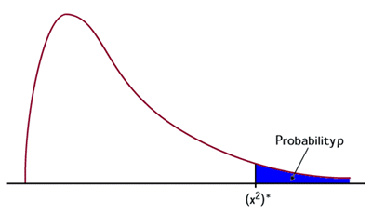
Chi Square (χ²) Test
The Chi Square test is a non-parametric Test
It tests relationship between two nominal variables
The statistic chi square is given by the equation and has a distribution as shown.
The conditions for using chi square
Data must be counts
The observations must be random and independent
None of the cells must have a count less than 5

Slide 6
Properties of Chi-Square Distribution
1. The mean and standard deviation of a chi-square distribution are k and √2k respectively, where k is the degrees of freedom.
2. As the degrees of freedom increases, the probability density function of a chi-square distribution approaches normal distribution.
3. Chi-square goodness of fit is one of the popular tests for checking whether a data follows a specific probability distribution.
4. Chi square test is a right tailed test.

Slide 7
Chi-square Goodness of fit tests
Goodness of fit tests are hypothesis tests that are used for comparing the observed distribution pf data with expected distribution of the data to decide whether there is any statistically significant difference between the observed distribution and a theoretical distribution (for example, normal, exponential, etc.) based on the comparison of observed frequencies in the data and the expected frequencies if the data follows a specified theoretical distribution.
Null hypothesis: | There is no statistically significant difference between the observed frequencies and the expected frequencies from a hypothesized distribution
Alternative hypothesis | There is statistically significant difference between the observed frequencies and the expected frequencies from a hypothesized distribution.

Slide 8
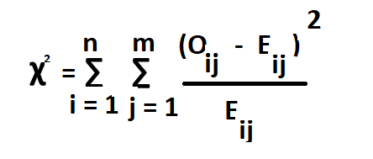
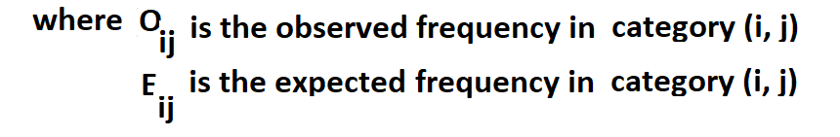
Chi-square Goodness of fit tests

Slide 9
Chi-Square One Way - Example
A1 airlines operated daily flights to several Indian cities. The operations manager believes that 30% of their passengers prefer vegan food, 45% prefer vegetarian food , 20% prefer non-veg food 5% request for Jain food.
A sample of 500 passengers was chosen to analyse the food preferences and the data is shown in the following table:
Food type | Vegan | Vegetarian | Non-Vegetarian | Jain
Number of passengers | 190 | 185 | 90 | 35

Slide 10
Solution
Null hypothesis : Probability distribution of the food preference is P(Vegan) = 0.30, P(Veg) = 0.45
P(Non-veg) = 0.20 P(Jain) = 0.05
Alternative hypothesis: Probability distribution of the food preference is not defined in the null hypothesis.

Slide 11
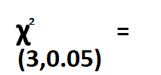
Chi-Square - Calculation
> qchisq(.95, df=3)
[1] 7.814728
7.814728
df = 4 -1 = 3
Since the chi-square calculated value > critical value, we reject the null hypothesis.
We conclude that probability distribution of the food preference is not defined in the null hypothesis

Slide 12
Chi-square Two Way
Example: A Cable service provider company is interested in checking whether or not the customer churn depends on customer segment. Use 5% as level of significance.
Customer Segment | Churned | Retained | Total
S1 | 15 | 142 | 157
S2 | 24 | 400 | 424
S3 | 30 | 389 | 419
Total | 69 | 931 | 1000

Slide 13
Chi-square tests of independence
Null hypothesis: | Customer segments and customer churn are independent
Alternative hypothesis | Customer segments and customer churn are not independent.
Customer Segment | Class | O_{ij} | E_{ij} = Row sum X col sum / Total Sum | Oij - Eij | O -E)^2 / E
S1 (I =1) | Churned (j = 1) | 15 | 11 | 4 | 1
S2 (I =2) | Churned (j = 1) | 24 | 29 | -5 | 1
S3 (I = 3) | Churned (j = 1) | 30 | 29 | 1 | 0
S1 (I =1) | Retained (j =2) | 142 | 146 | -4 | 0
S2 (I =2) | Retained (j =2) | 400 | 395 | 5 | 0
S3 (I = 3) | Retained (j =2) | 389 | 390 | -1 | 0
 |  |  | 1000 | 0 | 2
degrees of freedom = (r -1 ) * (c - 1)
= (3- 1) ( 2 - 1) = 2 ; > qchisq(.95, df=2)
[1] 5.991465
Chi Observed = 2
Chi critical for alpha 0.05 and DoF = 2 is 5.99
Since the chi-square calculated value (2) < critical value of 5.99, we reject the null hypothesis.
We conclude that customer segment and customer churn are not independent.

