Slide 1
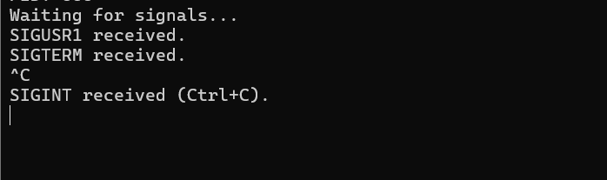
Practical (OSSP)
SESSION 6
TASK 1: Create a client-server application using Named Pipes (FIFOs). The client sends messages and the server processes and responds to them. Analyze FIFO behavior when multiple clients communicate simultaneously.
Code:

Slide 2
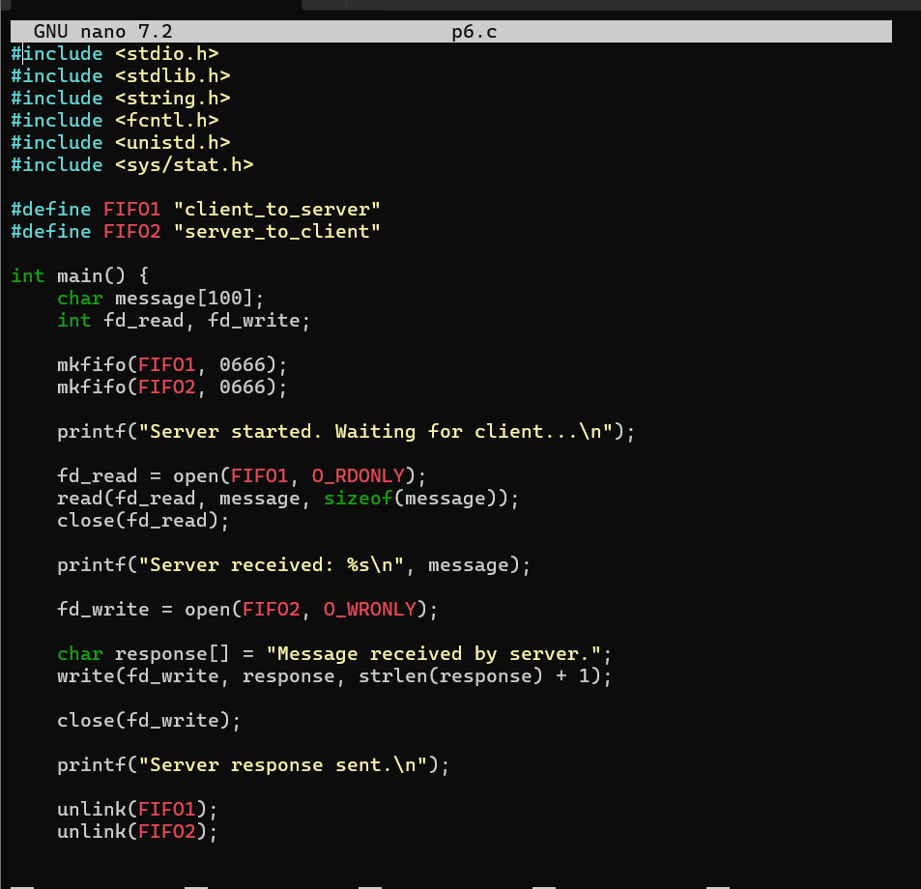
Code for client:

Slide 3
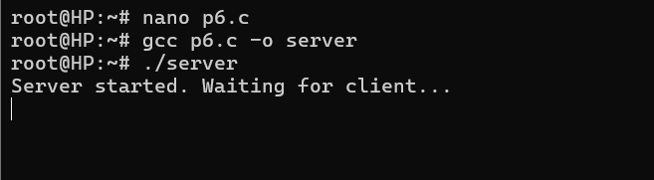
Output:

Slide 4
Observation:
To implement client-server communication using Named Pipes (FIFOs).
• The client sends messages through the FIFO and the server reads, processes, and sends a response.
• mkfifo(), open(), read(), and write() are used for inter-process communication.
• FIFO behavior changes when multiple clients communicate with the server.

Slide 5
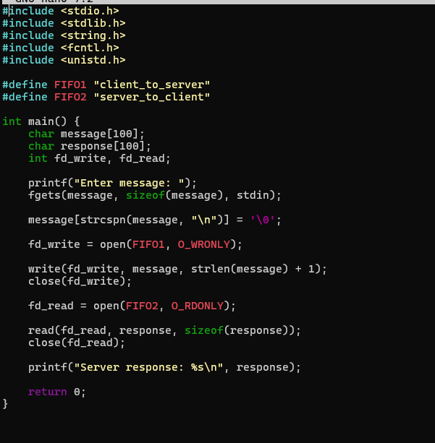
TASK 2: Create a POSIX signal handling program that captures SIGINT, SIGTERM, and SIGUSR1. Demonstrate asynchronous event handling and explain the role of signal handlers.
Code:

Slide 6
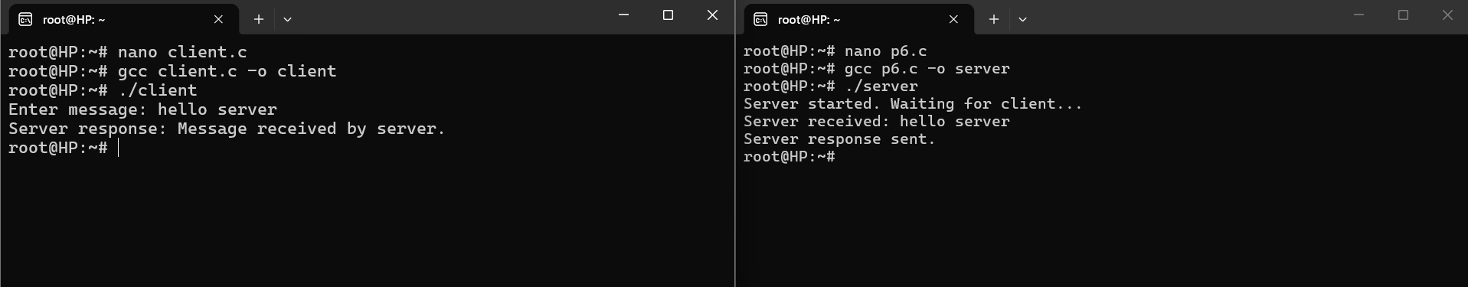
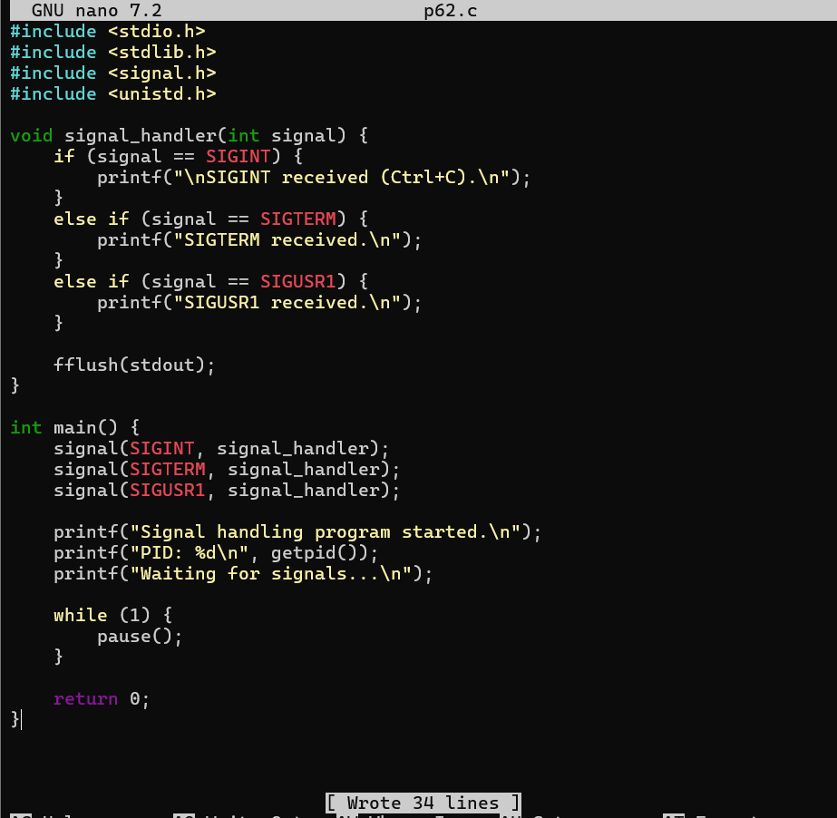
Output:

Slide 7
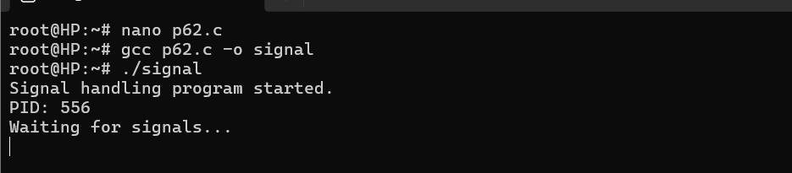
Output:

Slide 8
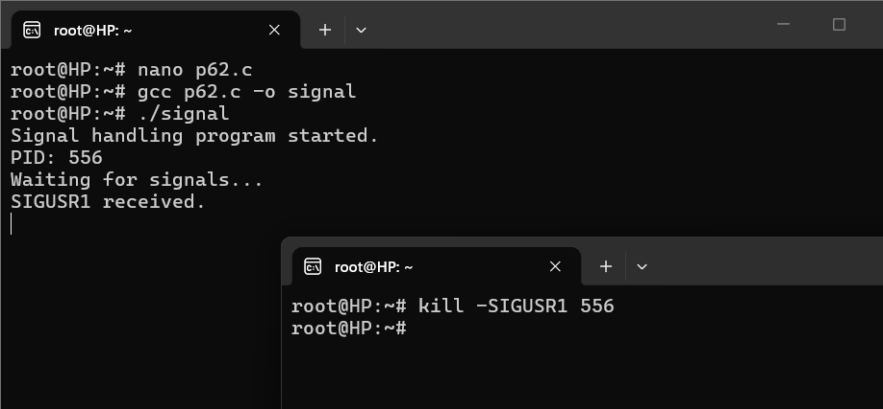
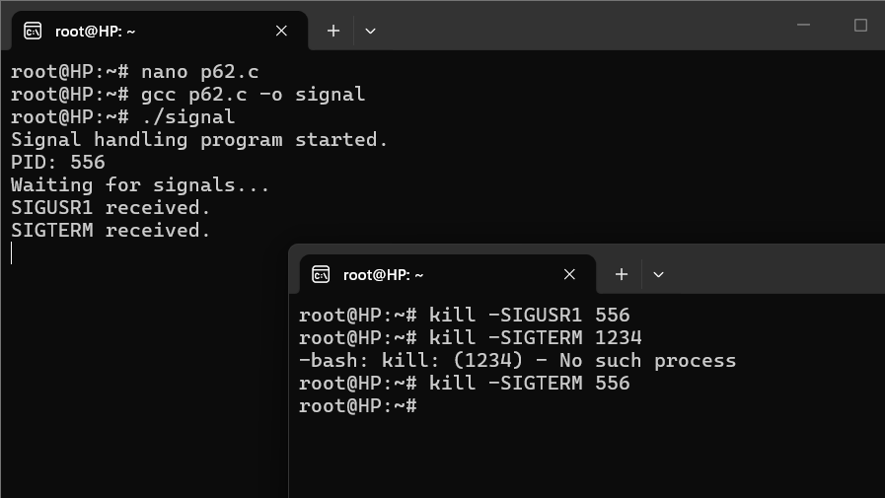
Output:

Slide 9
Observation:
To handle POSIX signals such as SIGINT, SIGTERM, and SIGUSR1 in C.
How a signal handler responds to signals sent to a running process. To use the kill command to send signals using a process ID (PID) and how pause() allows a process to wait for signals.

Slide 10
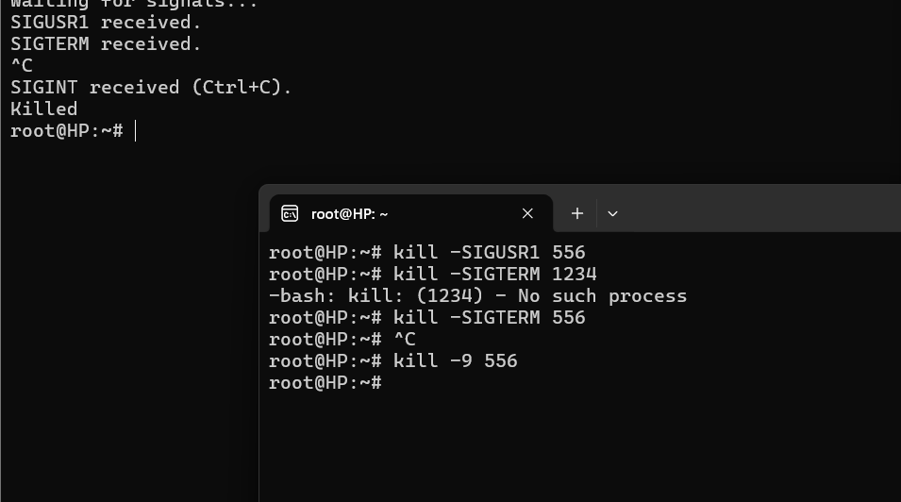
Output:

