Slide 1

News Articles Classification using Machine Learning Final Project
Group 4
Mynampati Prudvi || Sohitha || Vijay Agrawal

Slide 2
Problem
The Global News Group has 1000s of news items being fed daily to its news aggregation centers
They have a challenge of classifying the news articles into various categories such as “Sports”, “Entertainment”, “Politics”,”Business” etc.
It is currently a manual time consuming process that is impacting their business as competitors are able to publish it before them.

Slide 3
Solution
Supervised Machine Learning Algorithms and models, of course!

Slide 4
Goals
Predict Create a text classifier that will streamline the process of categorizing news publications.
Categorize the news articles as:
Politics
Entertainment
Sports
Technology
Business.

Slide 5
Contents
Business Understanding
Data Understanding
Data Preparation
Modeling
Evaluation
Conclusion

Slide 6
Contents
Business Understanding
Data Understanding
Data Preparation
Modeling
Evaluation
Conclusion

Slide 7
Business Understanding
Classification of news items is based on keywords in the article
Categories/Classes of the outcome are pre-determined (one of Politics, Entertainment, Sports, Technology, Business)
They all are of equal weights from Business standpoint

Slide 8
Contents
Business Understanding
Data Understanding
Data Preparation
Modeling
Evaluation
Conclusion

Slide 9

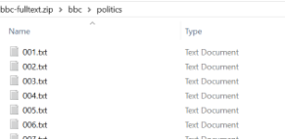
Data Understanding
Data Source: http://mlg.ucd.ie/datasets/bbc.html
Dataset consists of 2225 news articles extracted from the BBC website between 2004 and 2005
It is open-sourced and made available by Insight Resources
It contains categorized news articles in following folder structure:

Slide 10
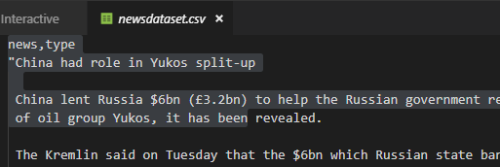
Data Preparation
Dataset consisted of 2000+ news articles in 5 folders, one for each category
A Python script was created to combine the articles into one CSV with 2 columns: “news” and “type”

Slide 11
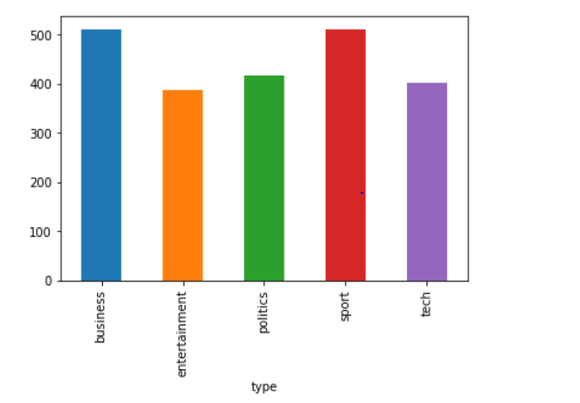
Data Understanding
Class Distribution
Class Distribution is even

Slide 12
Contents
Business Understanding
Data Understanding
Data Preparation
Modeling
Evaluation
Conclusion

Slide 13
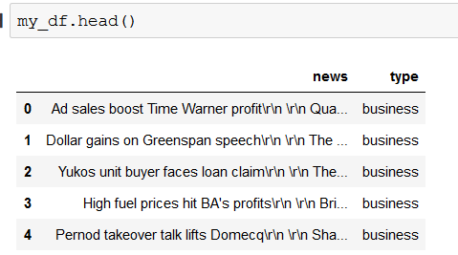
Data Preparation
List first 5 entries in dataframe to make sure it was loaded properly and review the various columns in the data frame

Slide 14
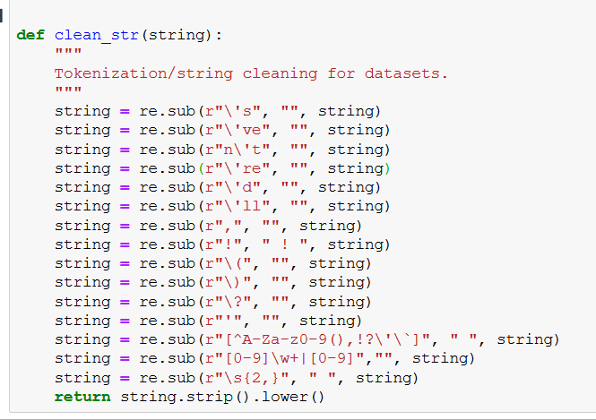
Data Preparation
Tokenization/string cleaning for datasets using Lemmatize function

Slide 15
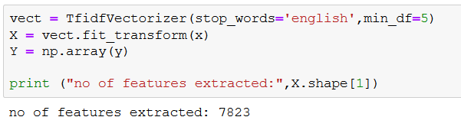
Data Preparation
Convert words in the news articles into numerical features using tfdif
min_df is the minimum numbers of documents a word must be present in to be kept, and we are setting it to 5.
stop_words is set to "english" to remove all common pronouns ("a", "the", ...) and further reduce the number of noisy features.
7823 high frequency words were made into features that influence the categorization

Slide 16
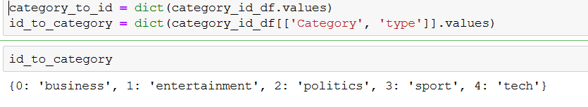
Data Preparation
Create a dictionary ( python data structure ) can easily convert category names into category_ids and vice-versa

Slide 17
Contents
Business Understanding
Data Understanding
Data Preparation
Modeling
Evaluation
Conclusion

Slide 18
Modeling
Logistic Regression
Feature
Feature + Default Depth
Decision Trees
Grid Search Hyperparameter
Resample data
Random Forest
Features +n_estimators=500, n_jobs=-1
Voting Classifier
Feature

Slide 19
Modeling
Logistic Regression
+
Feature
Logistic Regression
Feature
Feature + Default Depth
Decision Tree
+
Feature
Decision Trees
Grid Search Hyperparameter
Resample data
Random Forest
+
Feature
Random Forest
Features +n_estimators=500, n_jobs=-1
Logistic,Decision,Random
+
Feature
Voting Classifier
Feature

Slide 20
Modeling
Logistic Regression
+
Feature
Logistic Regression
Feature
Feature + Default Depth
Decision Tree
+
Feature
Decision Trees
Grid Search Hyperparameter
Logistic Regression with (98.2%) Accuracy
Resample data
Random Forest
+
Feature
Random Forest
Features +n_estimators=500, n_jobs=-1
Logistic,Decision,Random
+
Feature
Voting Classifier
Feature

Slide 21
Contents
Business Understanding
Data Understanding
Data Preparation
Modeling
Evaluation
Conclusion

Slide 22
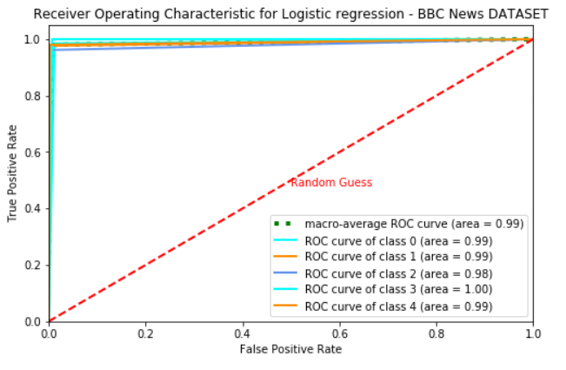
LOGISTIC REGRESSION
ROC Curve is near ideal
A small number of Politics articles are mis-categorized
Other articles mis-categorization is negligible and can be ignored
Class 0: 'Business' Class 1: 'Entertainment' Class 2: "Politics" Class 3: 'Sports' Class 4: 'Tech'

Slide 23
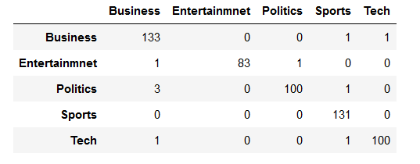
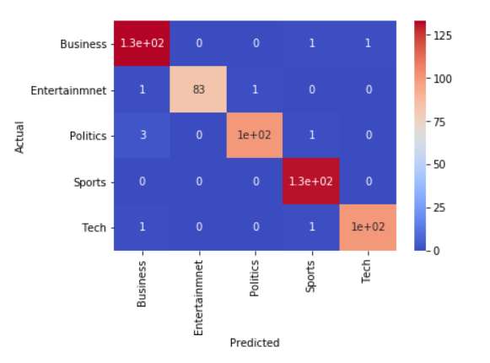
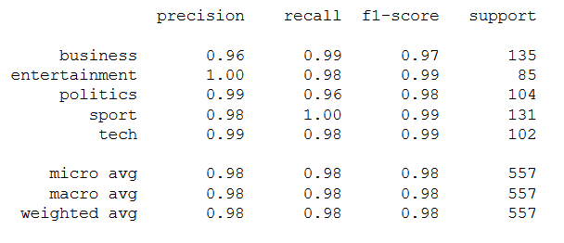
LOGISTIC REGRESSION
Accuracy Score : 0.982
Number of Articles : 557
Classes : 5(['business', 'entertainment', 'politics', 'sport', 'tech'])
Auc : 0.99
Prediction Count:
Correctly predicted | Wrong predicted
547 | 10

Slide 24
LOGISTIC REGRESSION - ANALYSIS
Accuracy Score : 0.982
Accuracy of are very high ( 98.2%).
There is no overfitting as accuracy scores are equally high on both train and test data
ROC curve is close to ideal as can be seen compared with random guess.
Recall, Precision and F1 score
Recall or Sensitivity or TPR (True Positive Rate) is very high (98%) measures the items correctly identified as positive out of total true positives
Precision is very high (98%) Number of items correctly identified as positive out of total items identified as positive
F1 score combines both the above with equal weightage (98%)
In this dataset, F1 score is of significance as the business needs do not have any weightage on recall or precision
Weighted Avg of F1 score on Data is 98

Slide 25
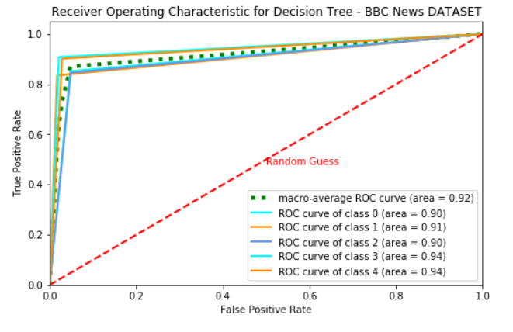
DECISION TREE - ROC WITHOUT MAXDEPTH
ROC Curve is good but not great
Politics articles are mis-categorized
Other articles mis-categorization is also present
Class 0: 'Business' Class 1: 'Entertainment' Class 2: "Politics" Class 3: 'Sports' Class 4: 'Tech'

Slide 26
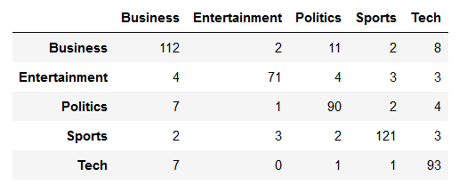
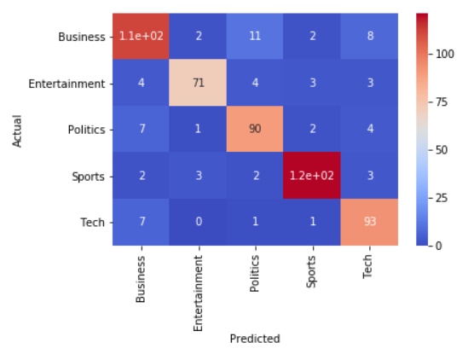
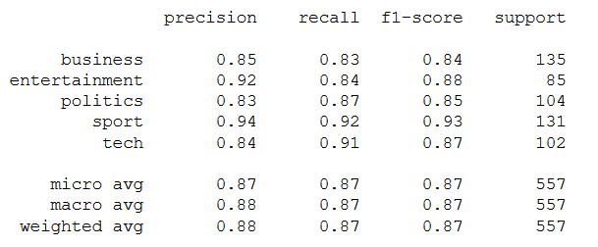
DECISION TREE - EVALUATION METRICS
Accuracy Score : 0.876
Number of Articles : 557
Classes : 5(['business', 'entertainment', 'politics', 'sport', 'tech'])
Auc : 0.92
Prediction Count:
Correctly predicted | Wrongly predicted
488 | 69

Slide 27
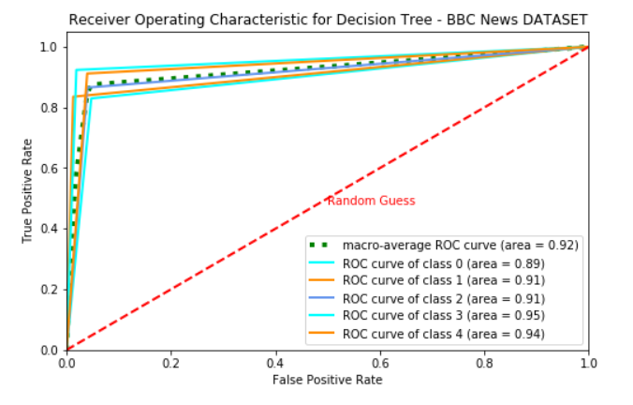
DECISION TREE - ROC WITH MAXDEPTH 36
No noticeable improvement with maxdepth

Slide 28
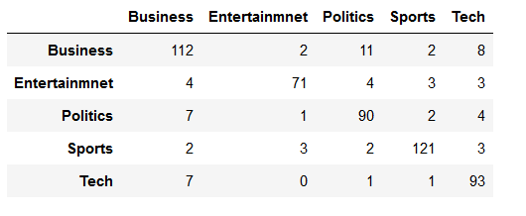
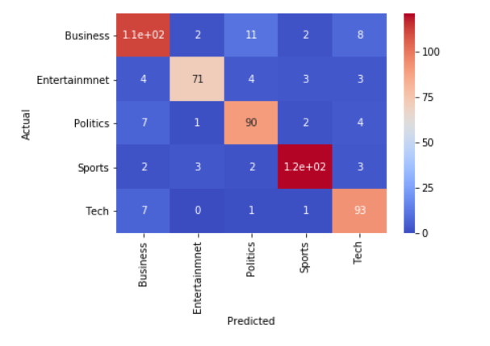

DECISION TREE (WITH MAXDEPTH) - EVALUATION METRICS
Accuracy Score : 0.874
Number of Articles : 557
Classes : 5(['business', 'entertainment', 'politics', 'sport', 'tech'])
Auc : 0.92
Prediction Count:
Correctly predicted | Wrong predicted
487 | 70

Slide 29
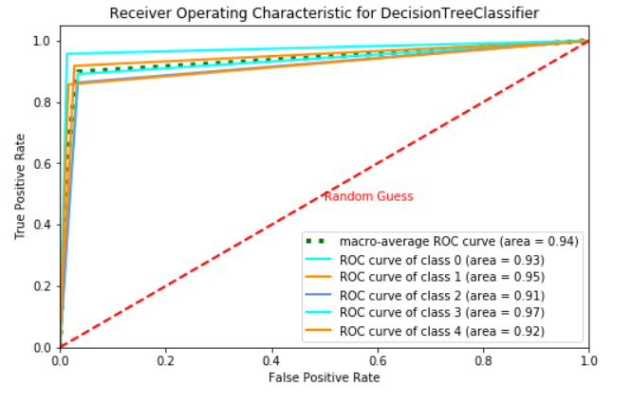
DECISION TREE (WITH BOOTSTRAP RESAMPLING) - ROC
Improvement in Accuracy
Class 0: 'Business' Class 1: 'Entertainment' Class 2: "Politics" Class 3: 'Sports' Class 4: 'Tech'

Slide 30
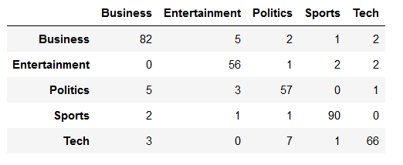
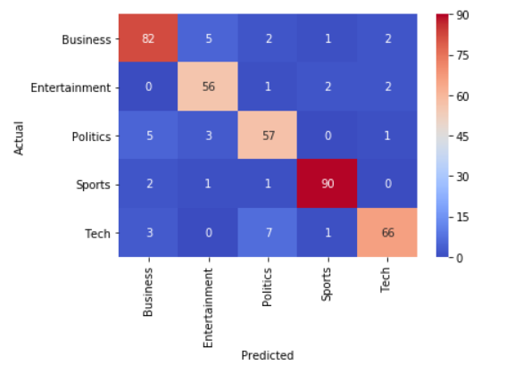
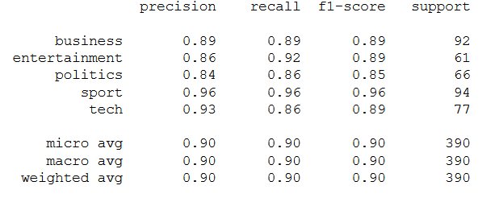
DECISION TREE (WITH BOOTSTRAP RESAMPLING) - MATRIX
Accuracy Score : 0.90
Number of Articles : 390
Classes : 5(['business', 'entertainment', 'politics', 'sport', 'tech'])
Auc : 0.94
Prediction Count:
Correctly predicted | Wrongly predicted
351 | 39

Slide 31
DECISION TREE ANALYSIS
Best Accuracy Score : 0.90
Decision Tree model overfits the data - train data accuracy was observed to be 100% whereas on test data it reduced to 87.4%
Using HyperParameters and GridSearch improves accuracy slightly (to 87.6%)
By using bootstrap resampling, accuracy improved to 90%
Articles from almost all categories are mis-classified. Though Business-Politics mis-classification was higher. With bootstrap resampling, mis-classification narrows down to mainly business and tech articles
Decision Tree has known limitation of overfitting

Slide 32
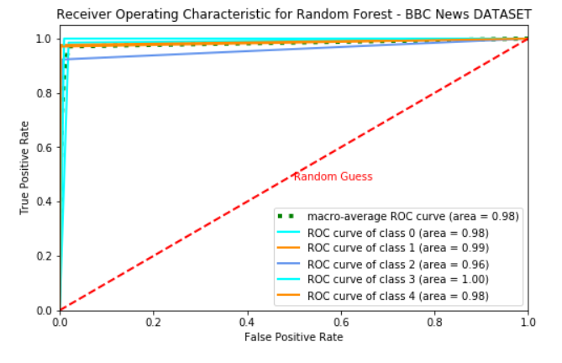
RANDOM FOREST - ROC
ROC Curve is close to ideal
Tech Articles getting mis-categorized as Business and vice-versa
Sports categorization is perfect
Class 0: 'Business' Class 1: 'Entertainment' Class 2: "Politics" Class 3: 'Sports' Class 4: 'Tech'

Slide 33
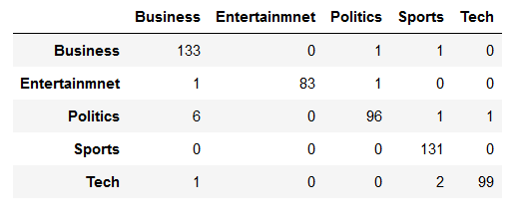
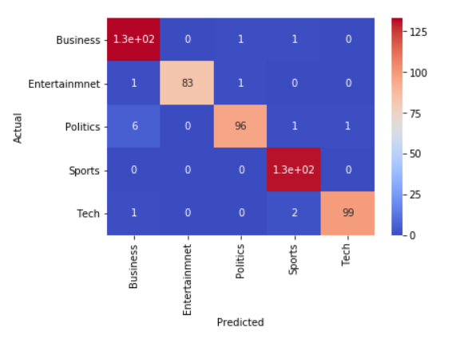

RANDOM FOREST - EVALUATION METRICS
Accuracy Score : 0.978
Number of Articles : 557
Classes : 5(['business', 'entertainment', 'politics', 'sport', 'tech'])
Auc : 0.98
Prediction Count:
Correctly predicted | Wrong predicted
545 | 12

Slide 34
RANDOM FOREST ANALYSIS
Accuracy Score : 0.973
Random Forest is providing excellent accuracy of ~97%
Business/Tech are the only minor areas of wrong classifications
Random Forest uses resampling internally hence resampling is not needed
Random Forest reduces variance compared to DT by using random subset of features and also by using multiple decision trees (a forest of trees) Hence its accuracy is better

Slide 35
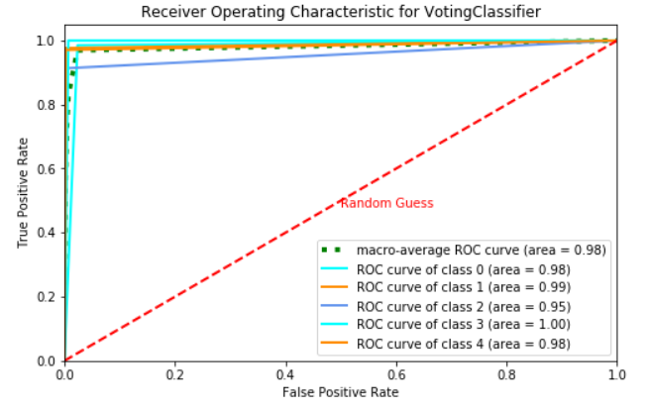
VOTING CLASSIFIER ENSEMBLE - ROC
ROC Curve is close to ideal
Tech Articles getting mis-categorized as Business and vice-versa
Sports categorization is perfect
Class 0: 'Business' Class 1: 'Entertainment' Class 2: "Politics" Class 3: 'Sports' Class 4: 'Tech'

Slide 36
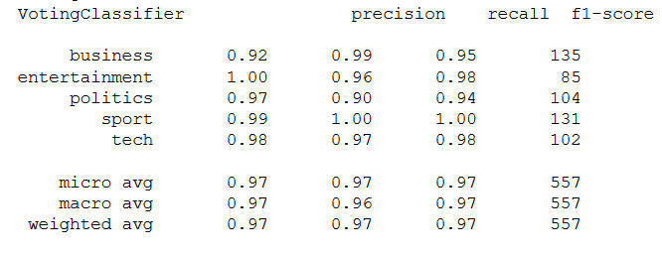
VOTING CLASSIFIER EVALUATION METRICS

Slide 37
VOTING CLASSIFIER ANALYSIS
Accuracy Score : 0.967
Voting Classifier is giving extremely good accuracy (~97%)
As data is equally weighted, soft voting works
Voting Classifier is resource intensive (takes time to compute)

Slide 38
EVALUATION METRICS COMPARISON
Model | Logistic Regression | Decision Tree | Decision Tree (GridSearch) | Decision Tree Resample | Random Forest | Voting Classifier Ensemble
Precision | 0.98 | 0.87 | 0.88 | 0.90 | 0.97 | 0.97
Recall | 0.98 | 0.87 | 0.87 | 0.90 | 0.97 | 0.97
F1-score | 0.98 | 0.87 | 0.87 | 0.90 | 0.97 | 0.97
Accuracy | 0.982 | 0.870 | 0.874 | 0.90 | 0.973 | 0.960

Slide 39
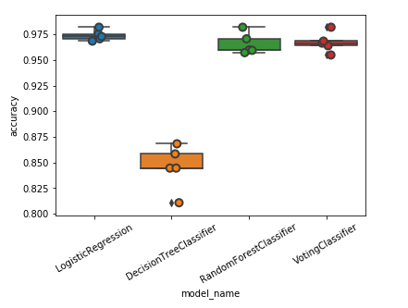
CROSS VALIDATION
5 different folds of 20% Data

Slide 40
Contents
Business Understanding
Data Understanding
Data Preparation
Modeling
Evaluation
Conclusion

Slide 41

Conclusion
ML Algorithm is able to Predict with > 98% accuracy category of any supplied news article
The articles that got mis-classified are “Business” and “Politics” categories. Upon close analysis, the nature of the mis-classified articles was such that it could
actually belong to any of them, hence it is acceptable error
The chosen algorithm (Logistic Regression) performs and scales well for
the small number of classifications as is the case in this dataset

Slide 42
NEXT STEPS AND FURTHER WORK
While this serves the categorization needs of the business, unsupervised learning can be leveraged to further classify into popular news personalities and titles - for example, in Entertainment, articles on popular stars
This can be taken further to prepare trends and timeseries to give readers a rich experience
Trends on popular news in each category, by various slicing and dicing such as by personalities, regions, languages etc can be done

Slide 43
Thank You!

