Slide 1
The goal
I Engineer. → I am an Engineer.
I name mayank. → My name is mayank.
When I six year old I break I leg.
→
When I was six years old, I broke my leg.
This is a perfectly fine sentence.
→
This is a perfectly fine sentence.

Slide 2
But wait…we need context
I engineer → I am an engineer
I engineer → I was an engineer
Context : I just got a job.
I engineer → I am an engineer
Context : I am retired
I engineer → I was an engineer

Slide 3
Models
transformer – basically a modified implementation of the Attention is all you need paper
Rnn with Bahdanau attention – transformer seems to be working better so this ppt will focus on that

Slide 4
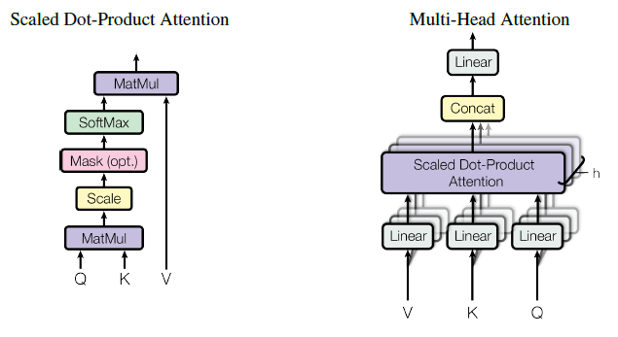
The architecture : multi-head attention
Masks indeed were used

Slide 5
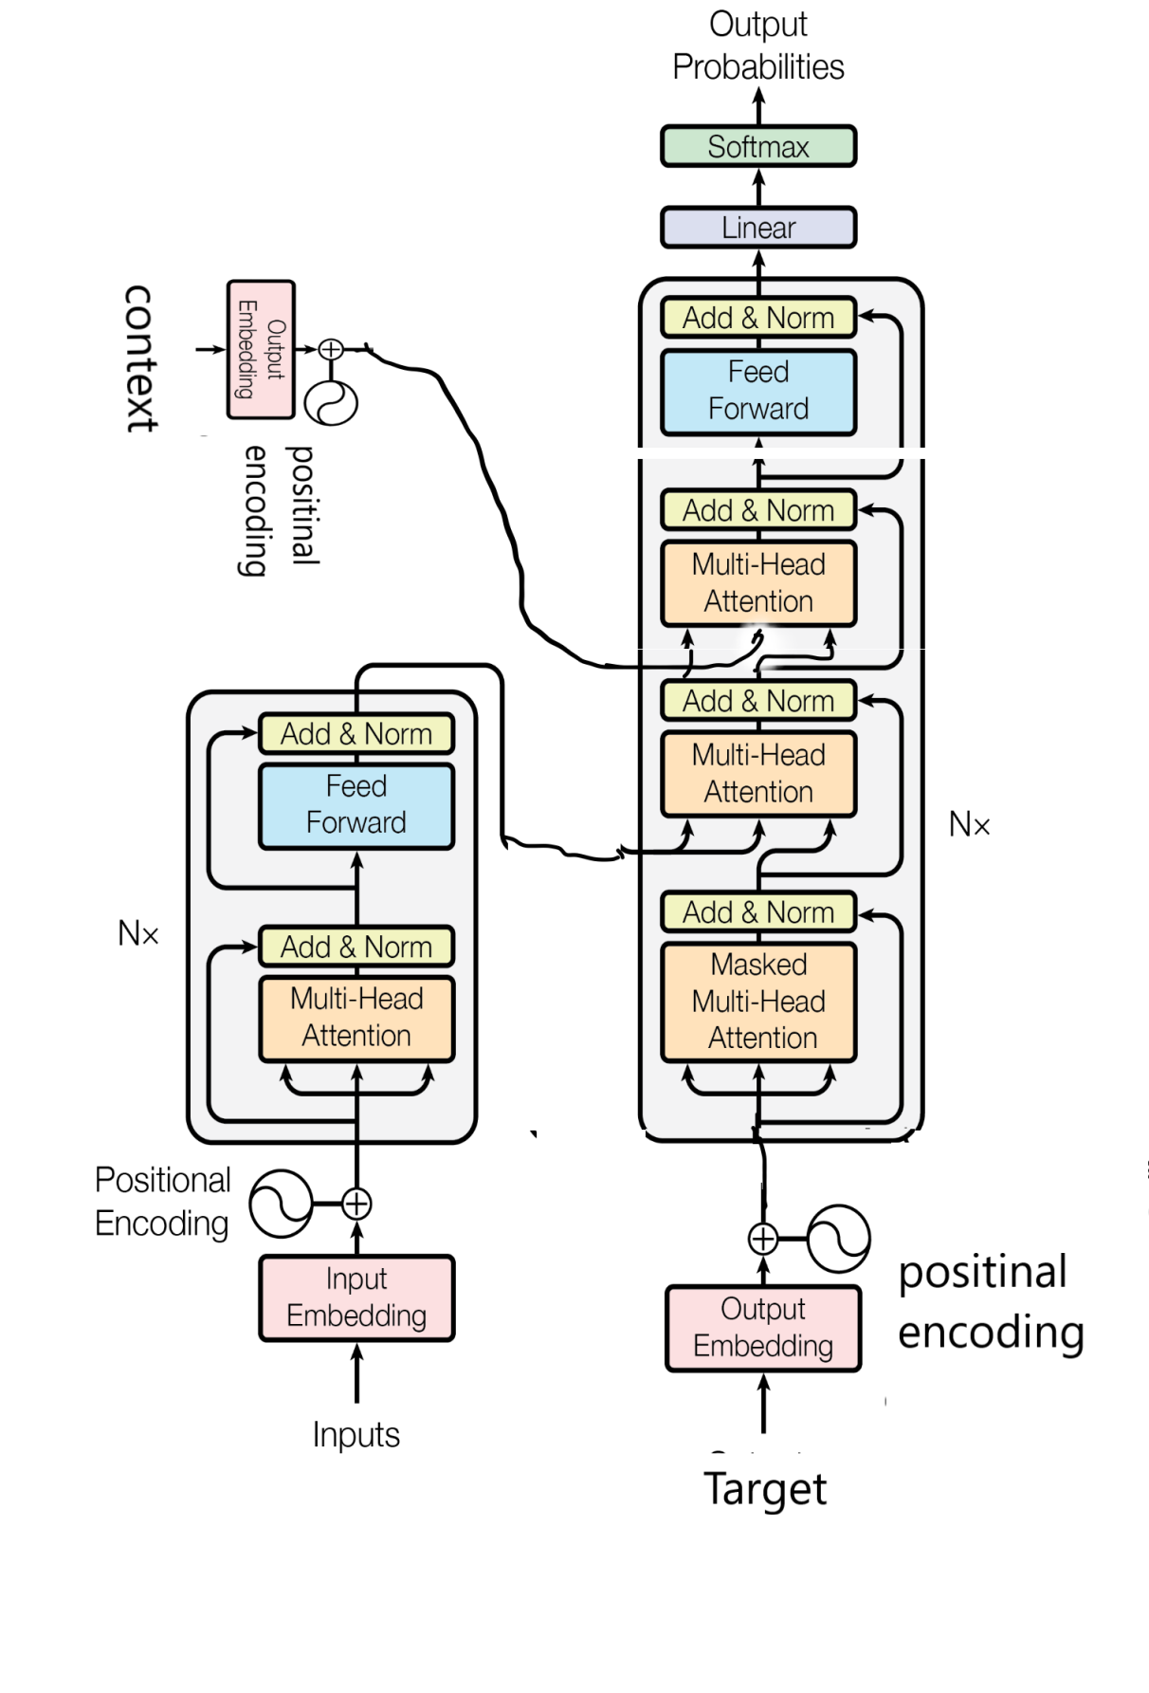
Paint 3d for the win

Slide 6
Hyperparameters
num_layers = 4
d_model = 512
dff = 2048
num_heads = 8
dropout_rate = 0.1

Slide 7
Loss
sparse cateogircal entropy
Optimizer
Adam with custom learning rate

Slide 8
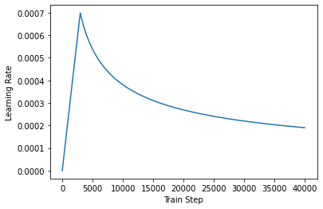
The learning rate

Slide 9
Tokenizer
Variable length, pads the vectors with 0 and makes all the lenghts equal to the max length in the batch
has a [START] and [END] automatically added in the start and end
vocab size is about 7000 for both input and target, I considered keeping the input vocab smaller but I wanted someone to able to input fully correct sentences as well. Like if someone is bothering to sign words like a an the it will allow them to do that
fun fact I am using the english tokenizer from a Portuguese to english trasnlator cause it was really good. Will make my own eventually but it will do for now.
Max number of tokens are currently set to 256, sentences bigger than that are filtered out

Slide 10
Training
Teacher forcing is being used – if the model predicts a wrong word its still given the right word as the next decoder input.
Target : [start] I am an engineer . [end]
Decoder input target : [start] I am an engineer .
ideal output : I am an engineer . [end]
Thus shifted target
A look ahead mask is used to prevent the model to look at future words
Model outputs an entire sentence worth of predictions at once
More specifically [BATCH_SIZE, tar_seq_length, vocab_size]
While calculating loss and accuracy padding is not considered

Slide 11
How is it doing
About 94% accuracy currently, which sounds great but considering the model could get about 60-70 accuracy by just doing output = input
Its not too great
For it to be a serious product we at least need 99% accuracy which will be the end goal for me.

Slide 12
Now the data
I have found it to be just as import as the model if not more.
The techincal format for the data is
context : I retired yesterday actually.
Input : I engineer
Output : I was an engineer

Slide 13
C4 200M
Now the first sentence in a conversation has no context to train for that we can use the c4 dataset after filtering out junk sentences (about ¾ is weird sentence I have removed) So we have about 50 Million sentences
Context: “”
Input : ruin_grammer(c4 sentence)
Output : c4 sentence

Slide 14
Ruin Grammer and modify line?
It takes a sentence and removes words like it a an the,
Turns different verb forms to their simpler version sat to sit
modify sentence turns I’ll to I will and standardizer's the sentences a bit for the tokenizer for eg mayank’s = mayank ‘s

Slide 15
Books
For dataset having context I just took a dataset with a lot of books totaling to about 4M sentences.
Turned the data into our format this way - >
Take all individual lines
Context 1: “”
Context 2 : line1
context 2 : line1 + line 2
And input and target are just those sentences with ruined and nor ruined grammer
Context has a max of 128 words after (oldest words are deleted to make space, will find a better way of doing it in the future)

Slide 16
Future plans
Bigger size – better grammer ruining
More smaller sentences
Context with partially incorrect grammer since in real use that might be the case
Randomness in grammer ruining
custom function to shuffle data
A handwritten (or myabe not) include dataset for fine tuning
Advanced :
Additional contexts based on location , person connected to account , wheater etc
Named entity recognition
Modified architectures as mentioned in take 3 and above
(In the notebook)

