Slide 1

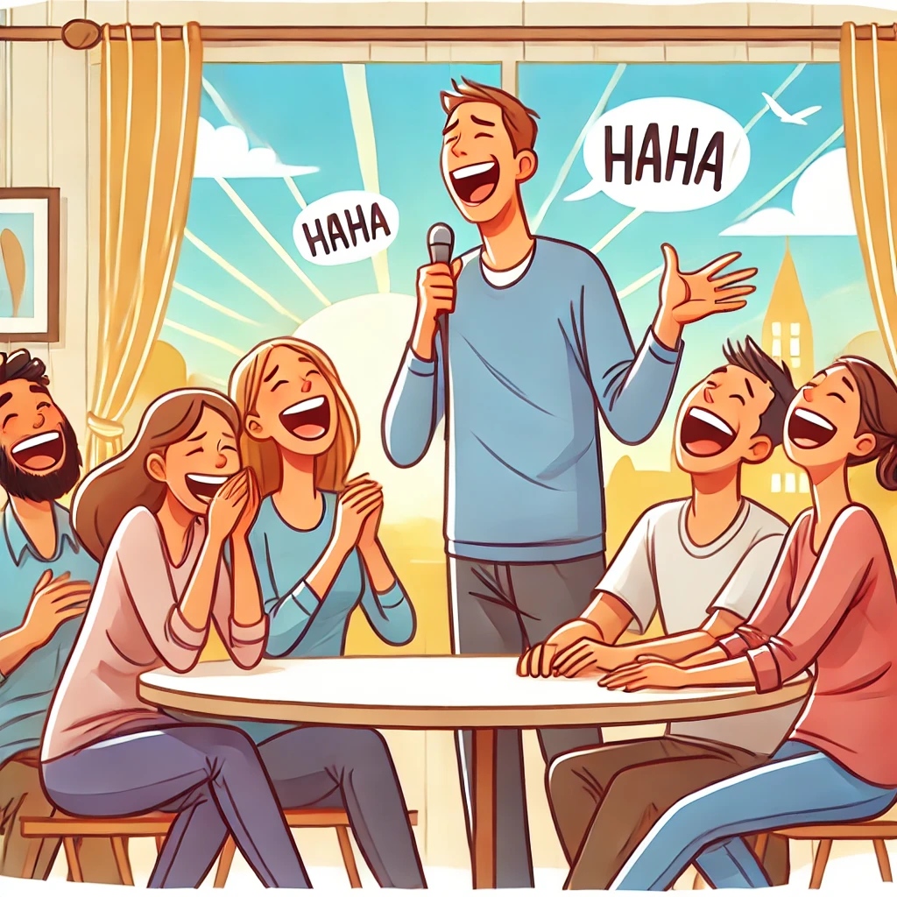
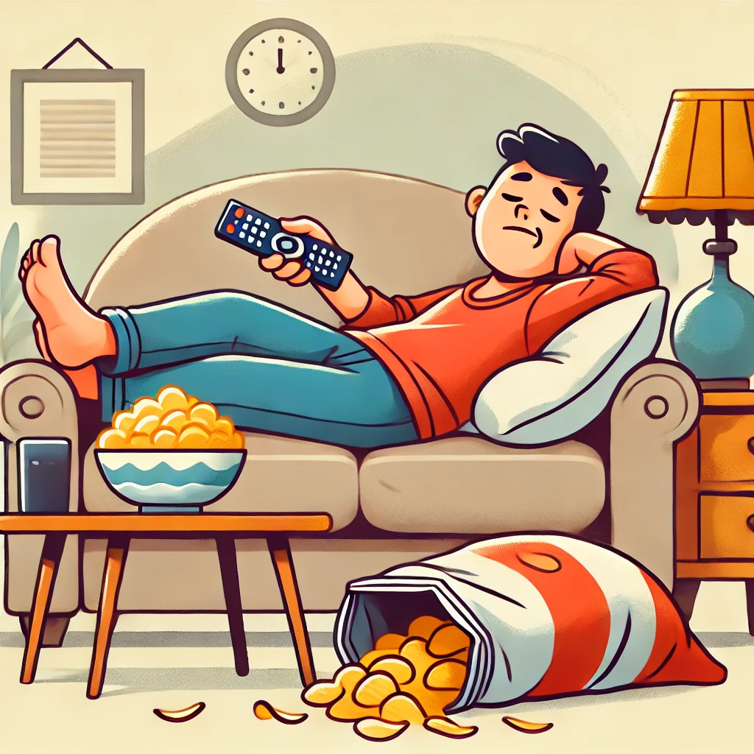

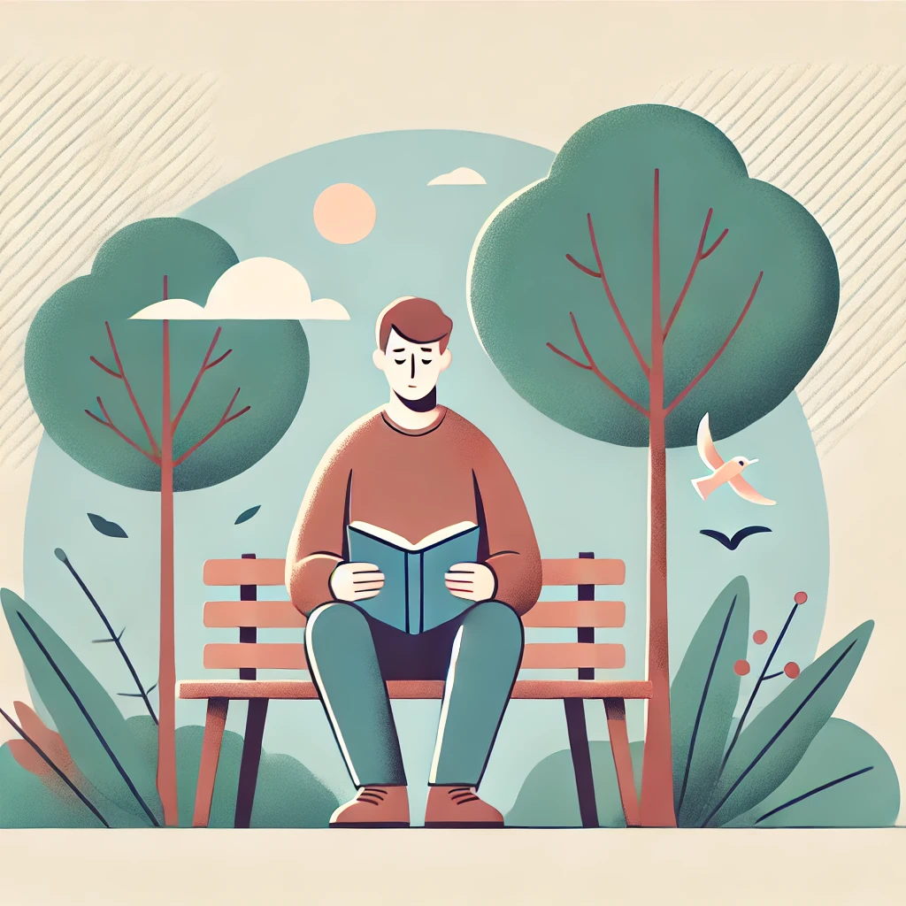
Let's talk about people's personalities!

Slide 2

Friendly
Friendly means kind and nice to others. Example: 'She is very friendly and always smiles at everyone.'

Slide 3
Quiet
Quiet means someone who doesn’t talk a lot. Example: 'He is a quiet person who loves reading books alone.'

Slide 4
Funny
Funny means someone who makes people laugh.
Example: ‘He is so funny; her jokes always make everyone laugh.'

Slide 5
Hard-working
Hard-working means someone who works a lot and puts in effort.
Example: 'He is very hard-working and always meets deadlines.'

Slide 6
Lazy
Lazy means someone who doesn’t like working.
Example: ‘He can be a bit lazy and prefers watching TV all day.'

Slide 7
Instructions:
1. Look at the adjectives below.
2. Decide if the word is positive (a good trait) or negative (a bad trait).
3. Write the word under the correct heading
Positive
Friendly
-
-
-
-
-
-
Adjectives
Friendly
Lazy
Hard-working
Funny
Rude
Quiet
Kind
- Mean
Negative
-
-
-
-
-

Slide 8
Practice
Task: Describe a person you know using this structure:
He/She is [positive adjective] and [positive adjective], but sometimes [negative adjective].

Slide 9
Short Play: “The Party Plan”
Scene: Two friends are planning a party. They are in the library, working on ideas.
Characters:
- Leo: enthusiastic, extroverted, disorganized
- Max: reliable, quiet, a bit critical

Slide 10
The Party Plan
Leo: I think we should have balloons, music, and a big welcome sign. It will look amazing!
Max: That sounds good. But who will buy the balloons? Who will make the sign?
Leo: Hmm... I didn’t think about that yet. We can decide later.
Max: It is better to decide now. We only have one week before the party.

Slide 11
The Party Plan (contd.)
Leo: You always want a plan. But sometimes, it is better to be creative.
Max: And you always forget things. Last time, you forgot the snacks.
Leo: That’s true. I will try to be more organised.
Max: Good. And I will try to listen to your ideas more.
Leo: Great! We are a good team.
Max: Yes. You bring the energy, and I bring the list.

Slide 12
Free Practice
Discussion Questions:
1. What makes someone friendly?
2. Is being quiet always good?
3. What positive traits might annoy you?

