Slide 1
3D Car Modeling

Slide 2
Overview
Determine ROI
Pose initialization and 3D vehicle model
3D vehicle model fitness evaluation score
Extract rear and front part of the vehicle
Align the extracted parts

Slide 3
Determine ROI
ROI is the vehicle
Determine foreground objects using background subtraction algorithms such as GMM
Foreground might contain some noise. Apply morphological operators to preprocess the foreground

Slide 4
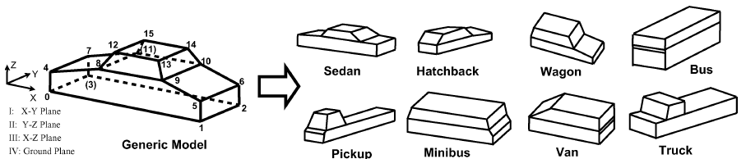
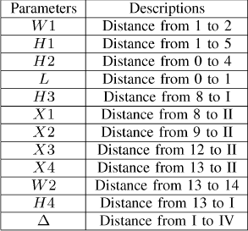
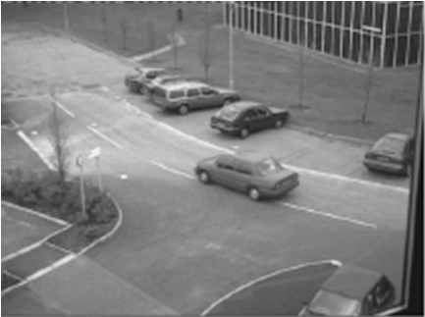
3-D Vehicle Modeling^{[Zhang et al. ‘12]}
  build vehicle model by using a pre-defined generic model, which can be extended to different types of vehicle.
  Estimated parameters:
H1
L
W1
15 parameters
12 shape parameters
3 pose
parameters
θ
orientation: θ
translation: X’,Y’
(X’,Y’)
Notes:
To build vehicle model, we use a pre-defined generic model, which can be extended to different types of vehicle.
This method is well described in Zhang’s paper in 2012.
In this generic model, there are ◎12 shape parameters, which define the shape and geometry of the vehicle,
And ◎ 3 pose parameters, which define orientation and translation of the vehicle.
Totally, there are ◎15 parameters we need to estimate simultaneously.

Slide 5
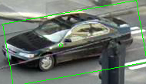
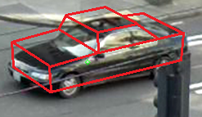
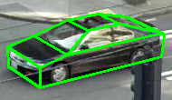
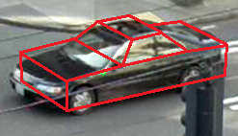
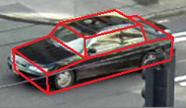
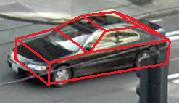
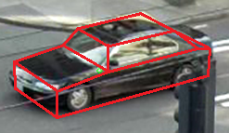
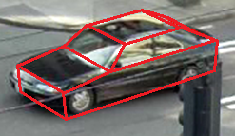
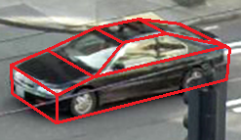
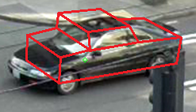
3D Vehicle Modeling^{[Zhang et al. ‘12]}
Steps:
Iterative Optimization (EMNA_{global})
Pose Initialization
Fitness Evaluation Score (FES)
3-D vehicle
model
15 parameters
4
5
3
iteration
7
2
1
8
6
Notes:
The steps of the parameters estimation are shown here
First, we have to initialize the pose of the vehicle, these pose are predicted by using previous tracking results
◎and then, estimate these 15 parameters in an iterative optimization, call EMNA global, by evaluating FES
◎Like this example, the parameters will converge after 8 iterations.
◎Finally, when it converges, we can get a well-fit 3d model

Slide 6

Fitness Evaluation Score
FES – measure how well the model fits
  idea: calculate the gradient perpendicular to projected line.
  (intensity of car body and road are very different)
  For each pixel S_{i} in the rectangle, calculate
FES in total
G(d)
d
S_{i}
β
α
w
L
G_{0,w}(d_{i}) : Gaussian distrib.
the higher FES means the better fitting
Notes:
FES is to measure how well the model fits, higher FES means better fitness of a model.
The idea is to calculate the gradient perpendicular to projected line segment. ◎
This is because the intensity of car and road are very different, the gradient should be very large along the direction perpendicular to the projected line.
To calculate FES, a model is projected onto the image, and projected lines are sampled like this. ◎
Then, each sampled point defines a virtual rectangle ◎
◎for each pixel in virtual rectangle, we calculate the gradient along the direction perpendicular to this line
So we calculate sin of beta◎ minus alpha◎, like this ◎
◎For each virtual rectangle, we give a Gaussian weight for each pixel , and sum up all of the FES of each pixel.
Finally, we sum up all of the virtual rectangles` FES. ◎
This FES represents the degree of fitness of a model, higher FES indicates better fitting.

Slide 7
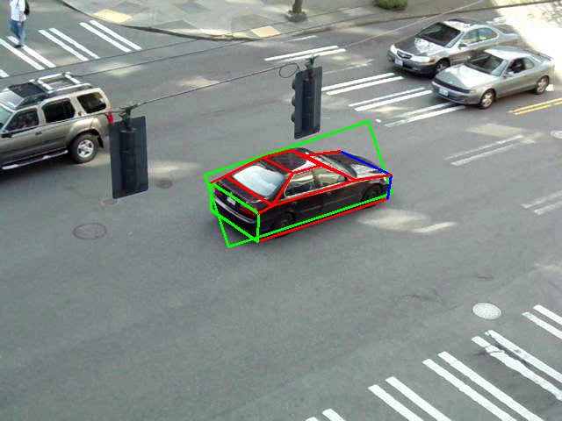


Extract front and rear parts of the car
Once 3D model is generated, extract the front and rear parts of the car.
Orientation of the extracted part may not be good for viewing.
Re-orient the extracted part for better visual experience.
Re-oriented extracted
rear panel
Extracted rear panel
(not good for viewing)
Detected car with 3D model

Slide 8
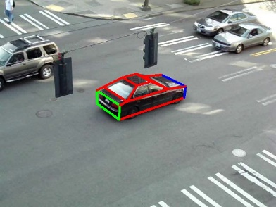
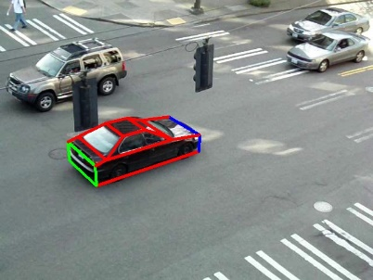
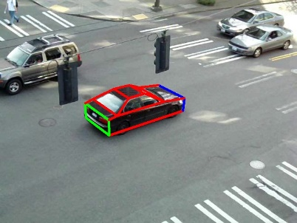






Results
Frame with 3D model
Extracted rear part (before correction)
Extracted rear part (after correction)

Slide 9
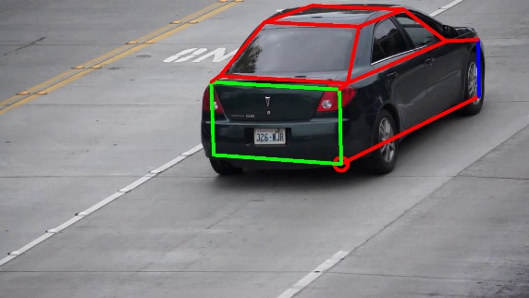
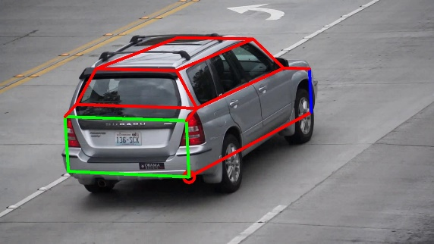
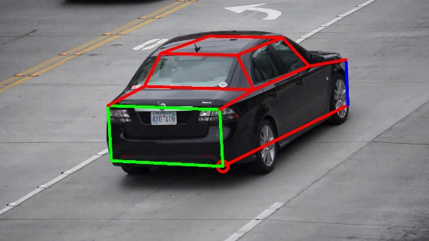
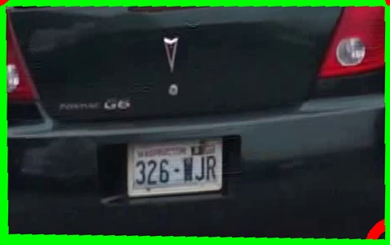
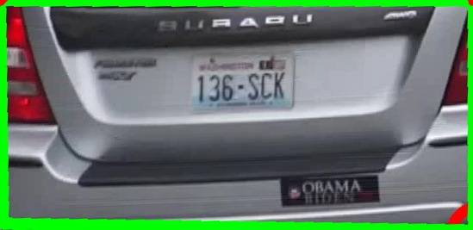
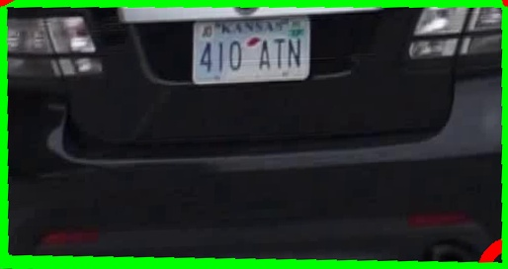
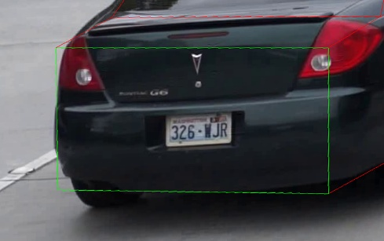
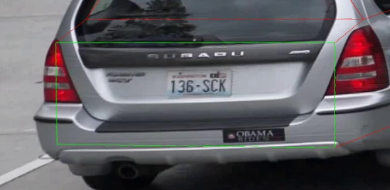
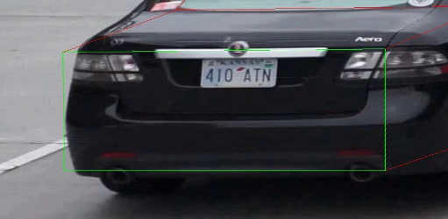
Results
Frame with 3D model
Extracted rear part
(after correction)
Extracted rear part
(after correction) + offset

