Slide 1
Hello guy!
My name is Myo Min Aung
Notes:
This is introduction note.

Slide 2
Software Development Lifecycle(SDLC) Overview

Slide 3
Before Software Development Lifecycle
First Stage
Customer has the business idea for our invoice application.
He’s going to reach out to multiple different tech companies until he finds one that he likes.
Finally, he’s going to meet our company’s product owner or our project manager.
They’re going to discuss terms of their agreement.
Sign a deal and accept the project.

Slide 4

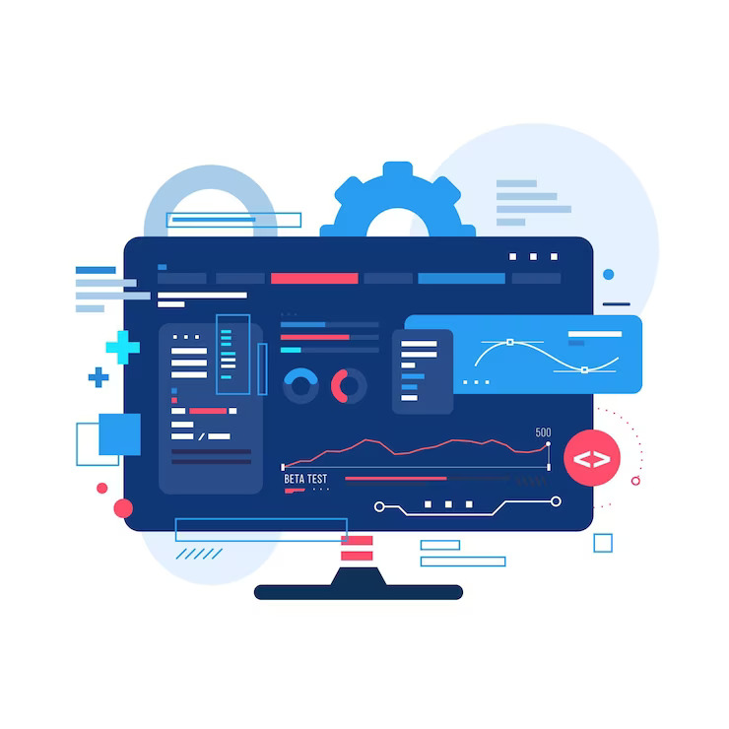
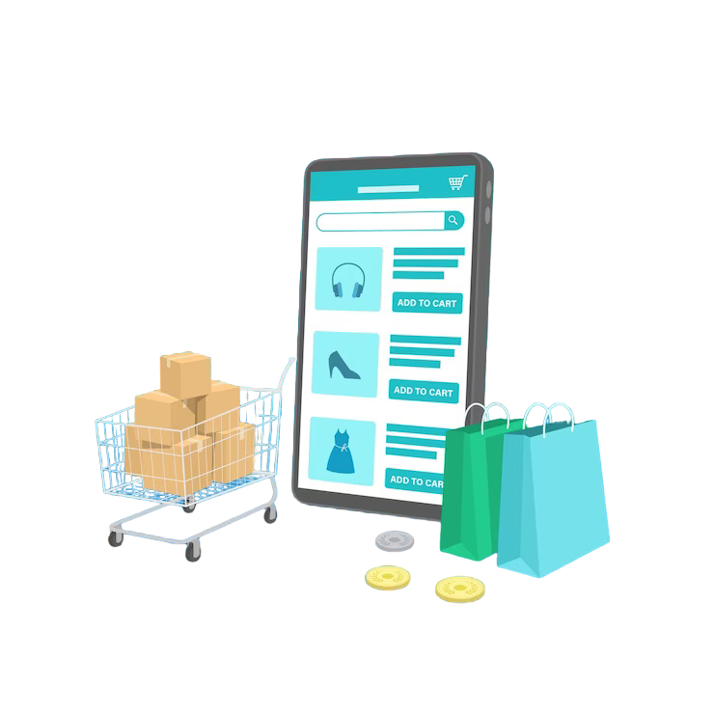

Market
Client’s business idea!
Software App
Online Store
John ( Customer )

Slide 5

Search for business app!
Can you help design an online business application??
??
David ( Developer )
John ( Customer )
(Software Development)

Slide 6

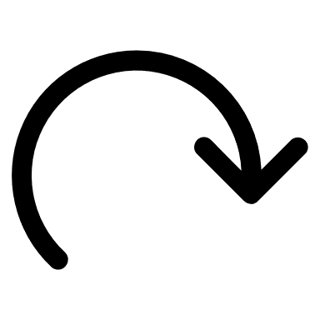
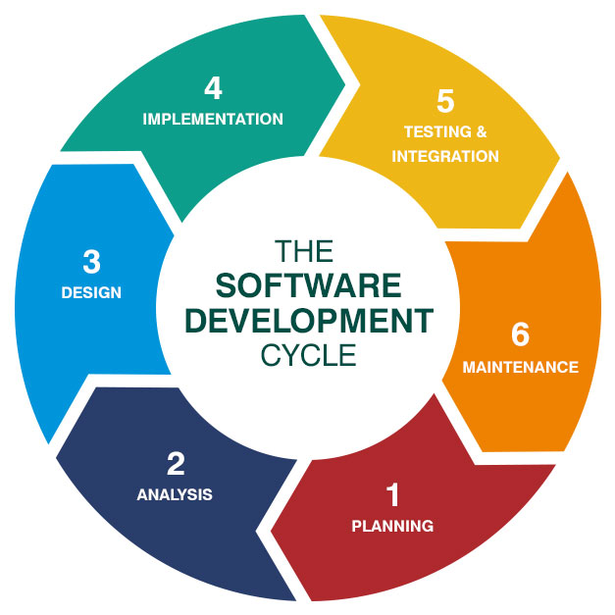
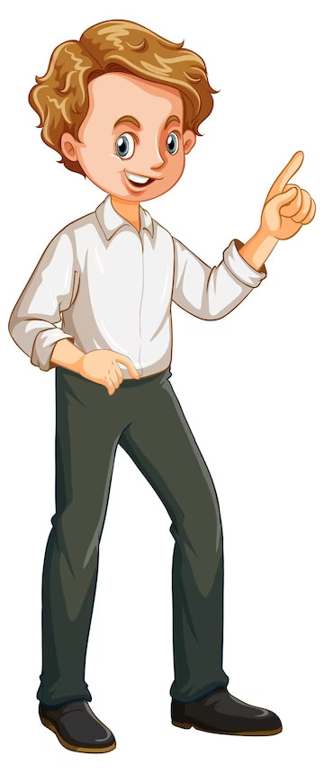

Understanding the SDLC
We Need to Understand
Software Development Life-Cycle
SDLC
Client ( Requirements)

Slide 7
Introduction to Software Development Lifecycle
Process steps
Planning Requirements
Requirement Analysis
Design
Implementation ( coding )
Testing
Deployment
Maintenance

Slide 8
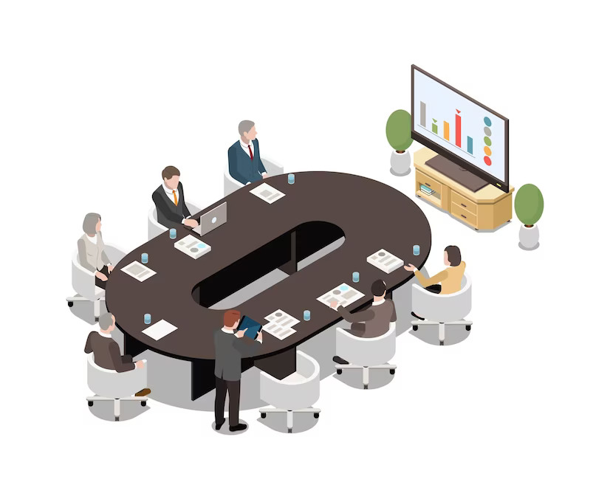


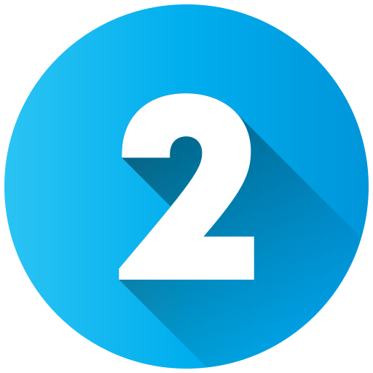

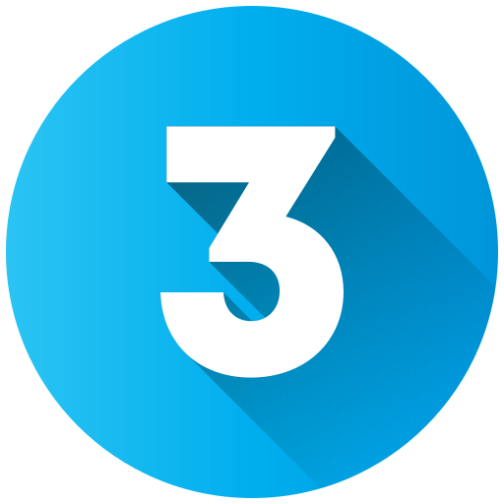




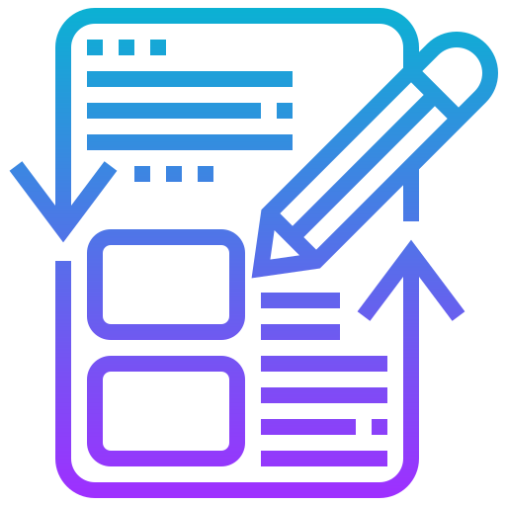

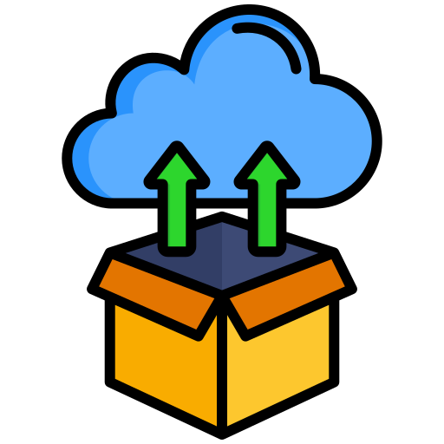

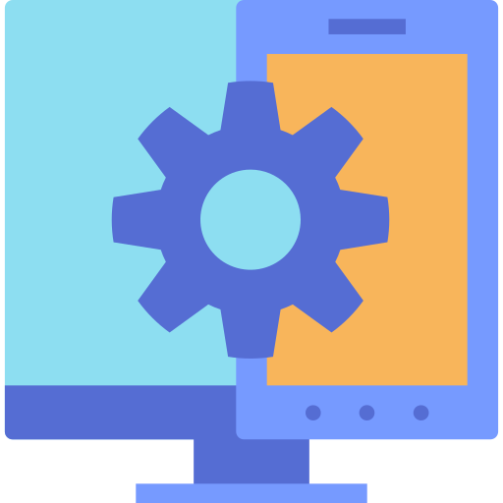
Terms & Conditions
Planning Requirements
Development Team
Requirement Analysis
Designing
Implementation
Clients
Testing
Deployment
Maintenance

Slide 9
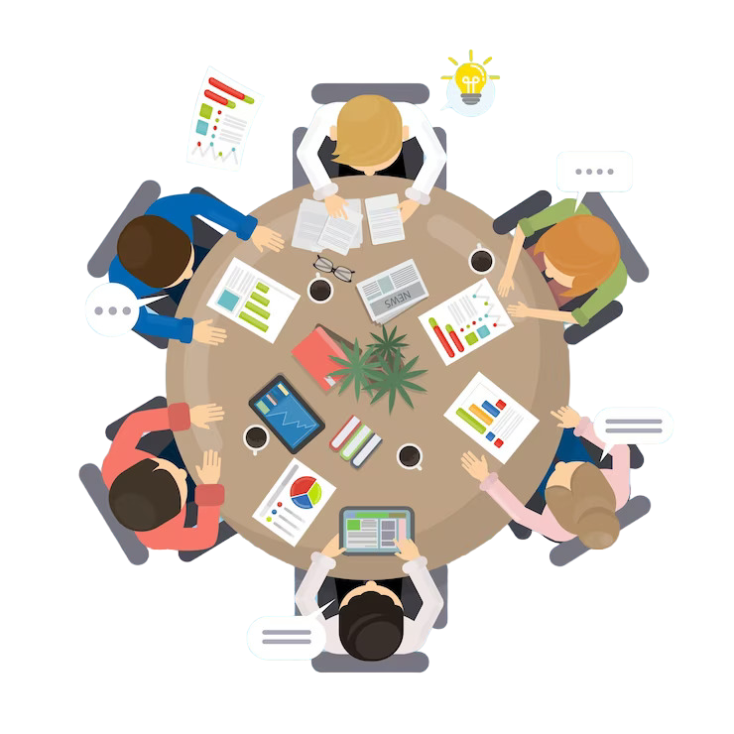
Planning Requirements
Discuss Requirements

Slide 10
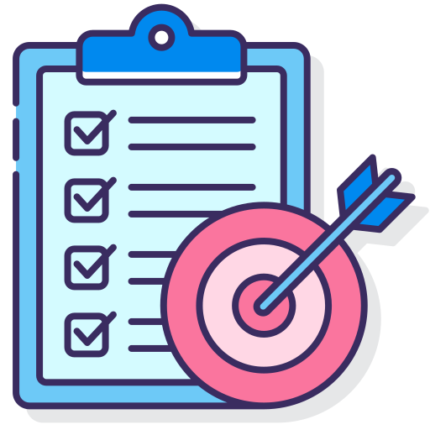


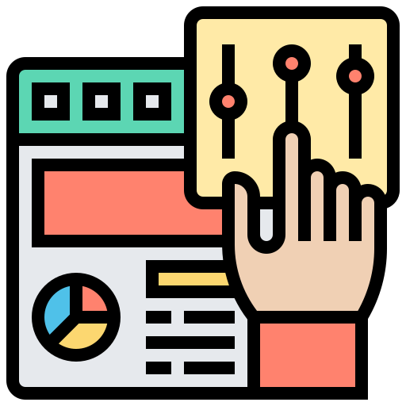
Planning Requirements
The purpose of the application
The details about the end-user of the Product
Key elements like format and attributes of the application for designing
And the overall user interfaces design of the software

Slide 11

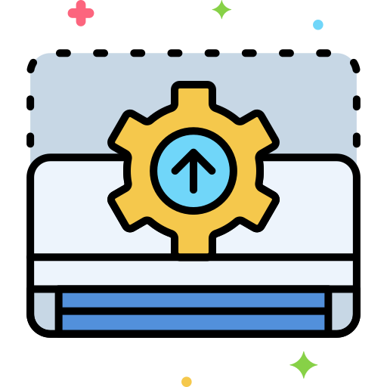

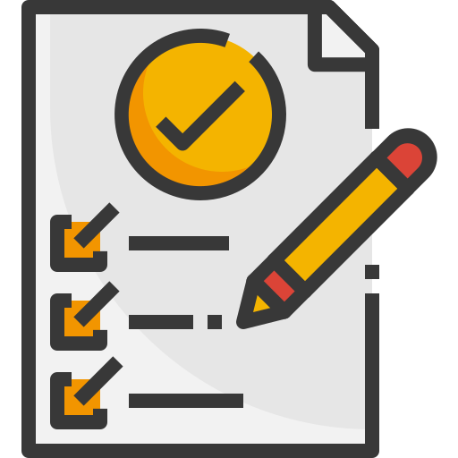
Requirement Analysis
Information about each element of design
Validating the installation
Calibrating the security protocols and risk analysis
Software Requirement Specification Document ( SRC )

Slide 12
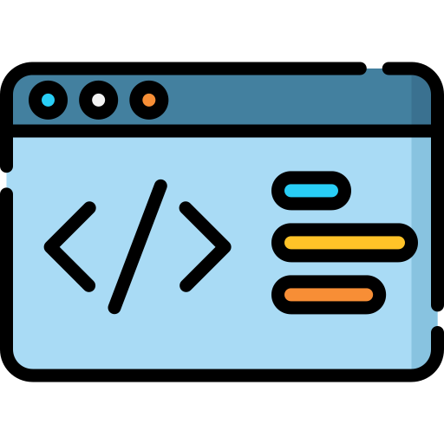
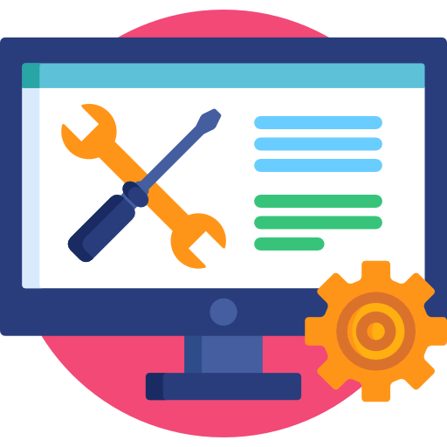

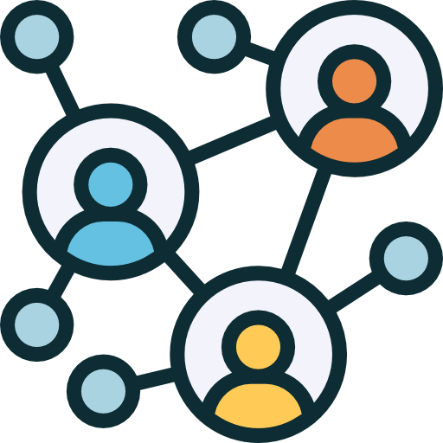


Design
Devise the system design following
Check feasibility with requirements
Client
Design Document Specification
( DDS document )
Stakeholders

Slide 13
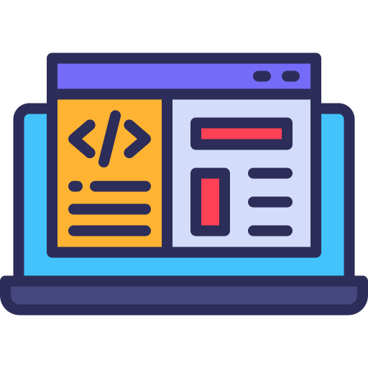
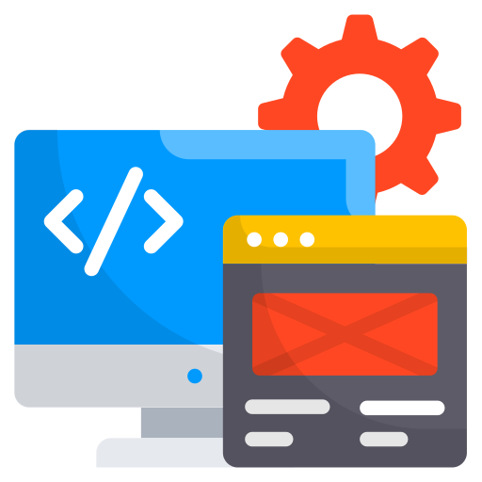

Implementation
Developers start writing the code using the Languages
Actual Implementation of the Software Product
Development tools like
Implement the code

Slide 14
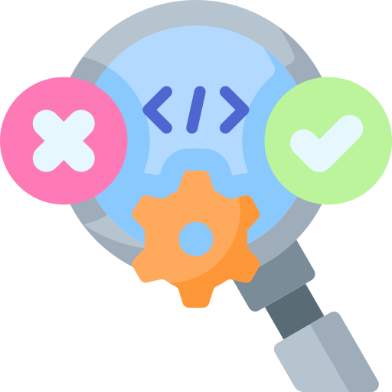
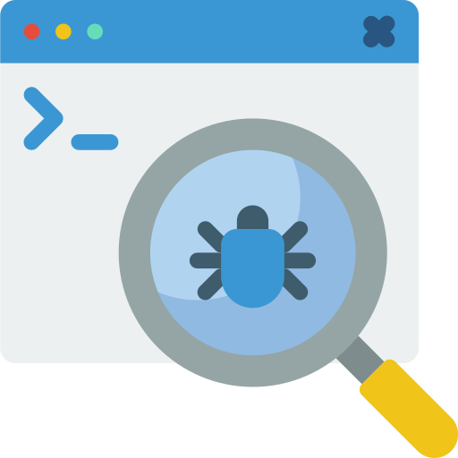
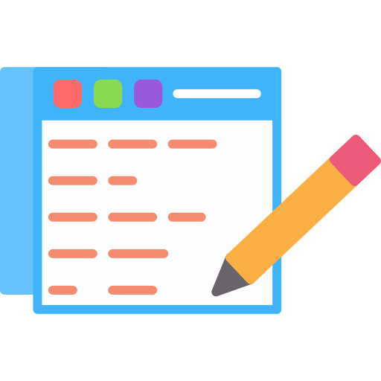
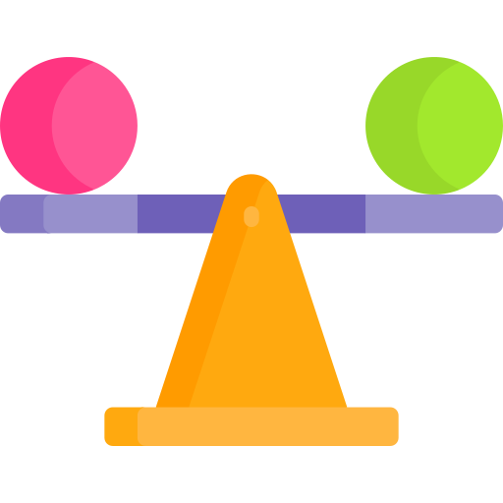
Testing
Deployed in multiple test environments to check the functioning
Testing team may find error or bugs
Continued till the system
Stable

Slide 15

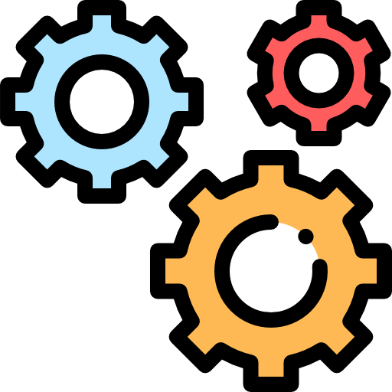
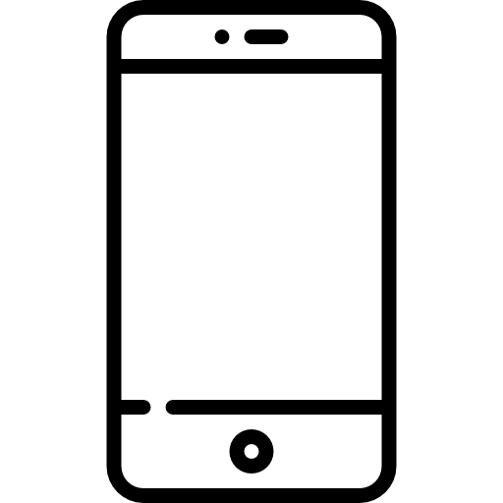
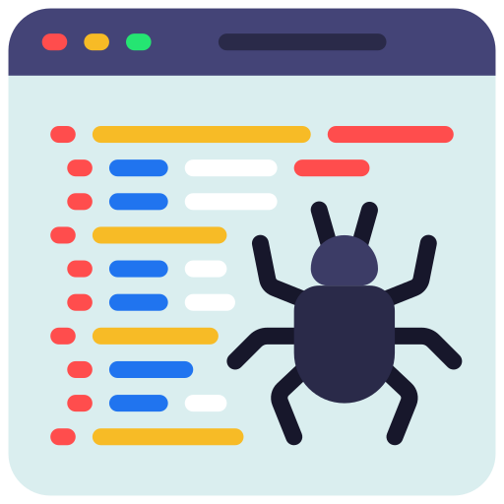

Deployment
Ready for deployment and consumers
Development team will setup installation link for the users
Debugging of the application is done on regular basis ( Fix Bugs )
Regular updates with enhanced features

Slide 16
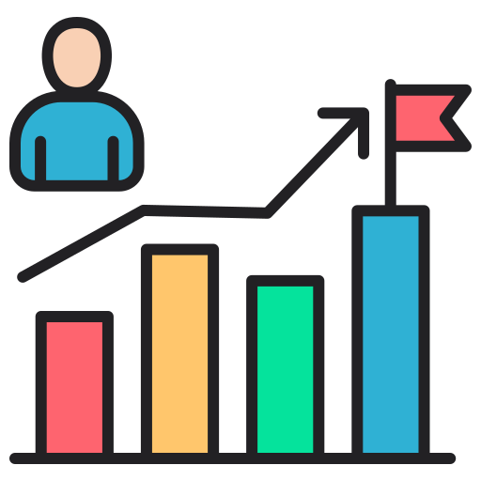


Maintenance
Let’s imagine that we’ve released and our app become so successful
We’re just getting millions of users logging in & registering and using this app
So, we need to maintain the servers in the environment they need to monitor
the load the stress everything coming on the servers

Slide 17
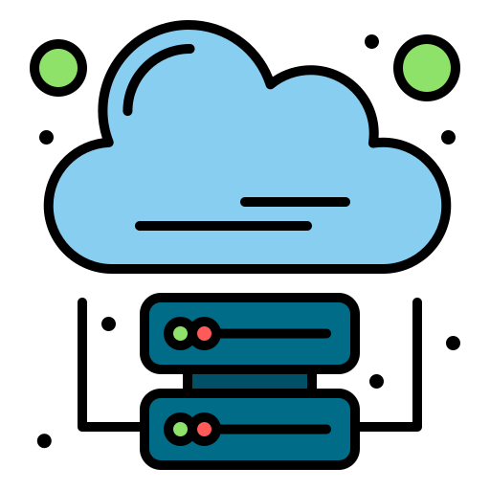
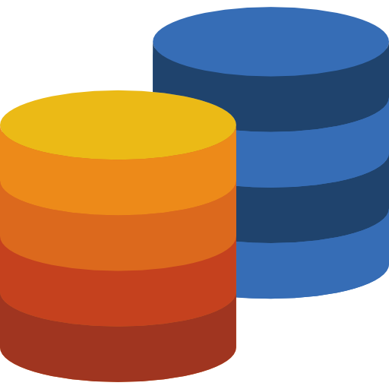
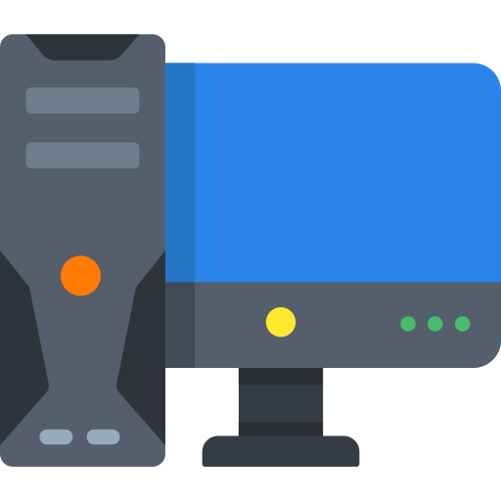
So, we need to make :
Larger servers
Larger databases
Faster computers
There’s a lot of stuff that goes under in the maintenance.

Slide 18
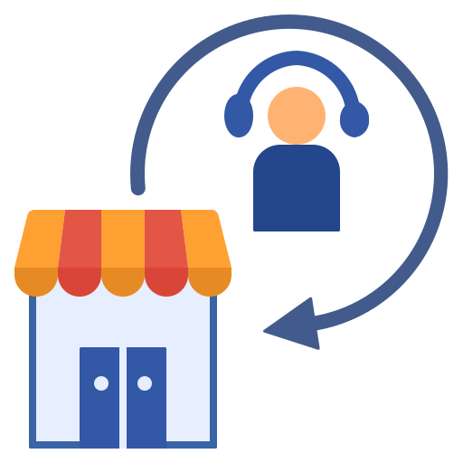
There will be bugs found in production, it’s called production support.
Production support
- Users will email with their issues
- You can stop and investigate what they’re complaining about or what their issue is figure it out
- Write up a bug
- Get it resolved and do another deployment to production with issues fixed

Slide 19
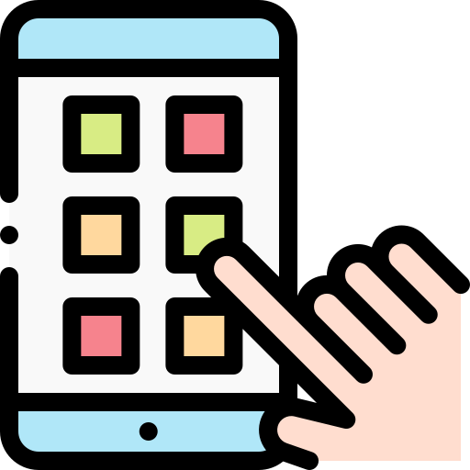

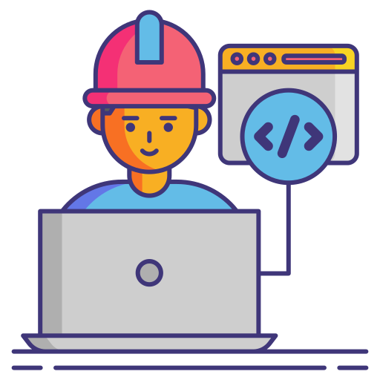
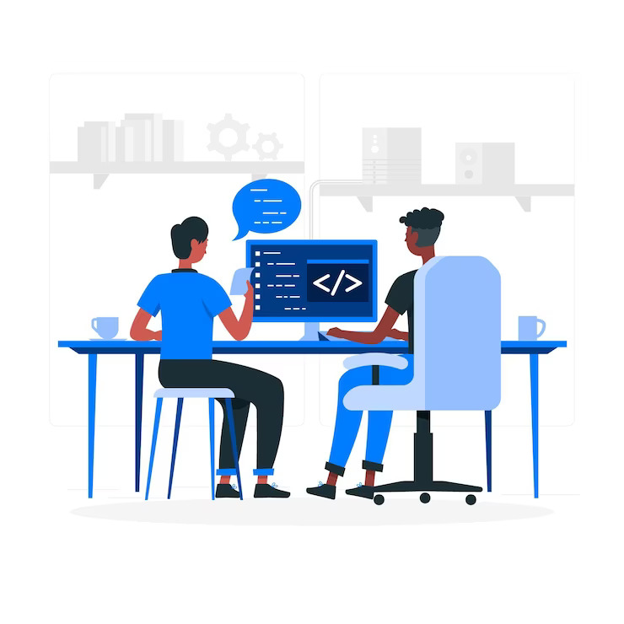

Understood how
software is developed
Best software Application
Give feedback
Development Team

Slide 20

THANKS!
Any questions?

