Slide 1
An introduction to ROS
Dingchao Liao
Centre for Research and Innovation in Software Engineering
Southwest University, Chongqing, China

Slide 2
Outline
ROS for what & What is ROS
Communication architecture of ROS

Slide 3
ROS for what
Implementation of Robot Cooperation based on ROS and Machine Vision
Goals
Technical route
Current progress

Slide 4
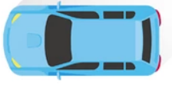
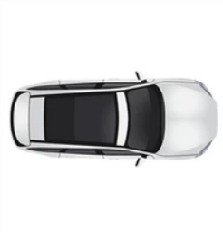
Our goals
Assemble two smart cars with commercially available materials.
Next, use machine vision to give the two cars the ability to collaborate.
Notes:
First of all , i wan t ...., as mention title, achive synergy , in the engineering implementation in robot, smart car is the ......
Which has no complicated mechanical structure like a drone or a humanoid robot, so we can focus more on its algorithm implementation.
our primary goal is to assemble two smart cars with commercially available materials. Next, we use machine vision to give the two cars the ability to work together. at the beginning is shown below:
When two smart cars meet on a narrow road, We need two cars to use machine vision only, in the most appropriate way, let one of the cars choose to give way to another car, another car waiting to pass, and finally make the two cars successfully pass the narrow passage

Slide 5
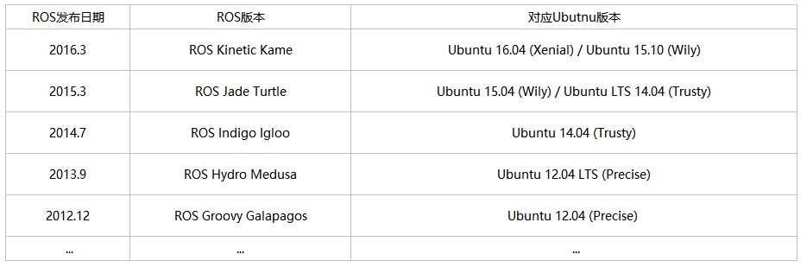
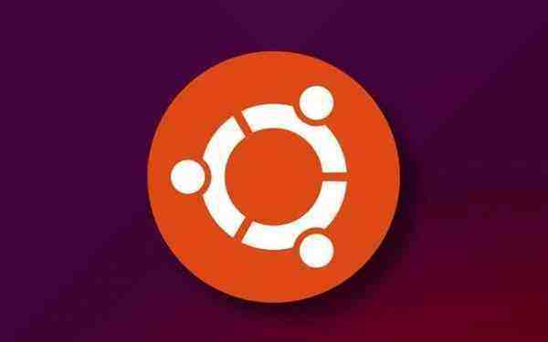



Techonical route
Software configuration
Ubuntu
ROS
OpenCV
OpenNI
What is ROS?
Robot Operating System (ROS).
A set of software libraries and tools that help we build robot applications.
Works well from drivers to state-of-the-art algorithms.
With powerful developer tools.
All open source.
Why ROS?
ROS was designed to be as distributed and modular as possible. so that we can use as much or as little of ROS as we desire.
In other words, ros's scalability is very good.
Ros is trying to develop specifications for robot design and development, which I think is also important.
Notes:
Combined with specific goals, our software configuration is as follows, first we need a master computer, or we call it host, we choose the operating system is Ubuntu operating system that matches the ros, then the most important software application It is ros, and it will be highlighted later. In addition, because we want to achieve the functions we need through machine vision, we have to use the powerful opencv and openni. If we need to give our car more powerful features later, maybe we need to add more applications.

Slide 6
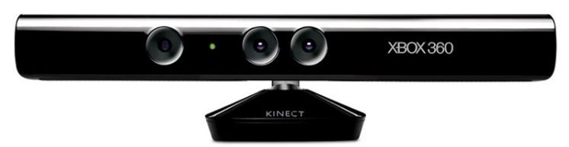
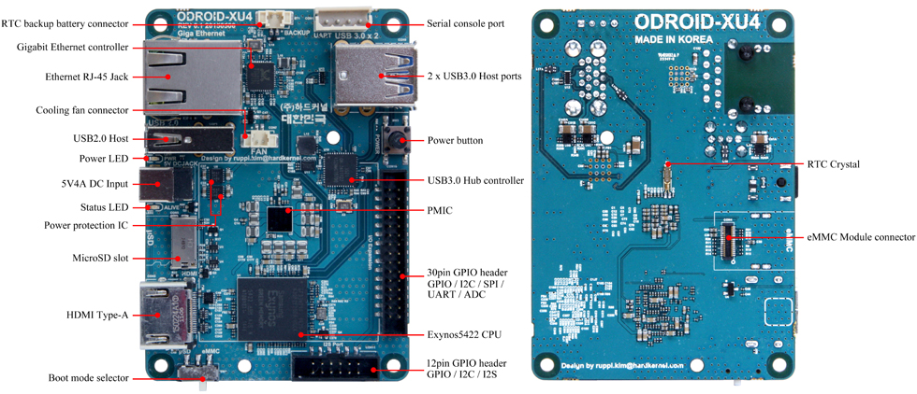
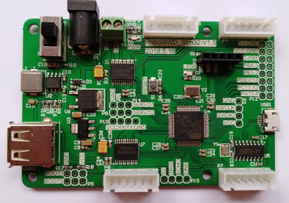
Techonical route
Hardwares needed
Kinect xbox 360
It has an rgb camera, and a depth sensors.
It fits well with Linux and ROS.
Suitable for SLAM
(simultaneous localization and mapping)
.
Odroid xu4
Stm32 moter driving board
we use it as a node of the ROS to complete the motor control function.
A powerful low-cost Single Board computer, It is small enough for robot development.
The ODROID-XU4 is an ARM device, which is the most widely used architecture for mobile devices.
Notes:
Next is the hardware requirements, because my partner will focus on the underlying hardware, I will only talk about the most important parts here, we use the host computer is odroid xu4, this is a very powerful single-board computer, It is more powerful than the popular rasberry pi, works well in complex coputing.
In addition, the most important sensor kinect to help us achieve machine vision, it has an rgb camera, and two depth sensors. It is well adapted to linux and ros, suitable for robots to model space, such as slam（simultaneous localization and mapping） work.

Slide 7
Techonical route
Imu
Ultrasonic Sensor
etc
Battery
Voltage conversion module
Stm32
other sensors
Odroid xu4
Ubuntu&ROS
DC motors
Kinect
OpenCV
Action of car
Space environment
Notes:
This is a general framework, we need a battery with voltage conversion module to power the host odroid xu4 and the lower coputer stm32 and our DC motor, Of course, our host computer is equipped with Ubuntu operating system and ros, as well as opencv, kinect depth vision sensor to sense the surrounding environment, and through the joint processing of opencv and ros, can complete the modeling of the surrounding environment, the lower computer is equipped with eg imu and ultrasonic sensors The sensor controls the DC motor to complete various actions of the car and can receive feedback from the encoder

Slide 8
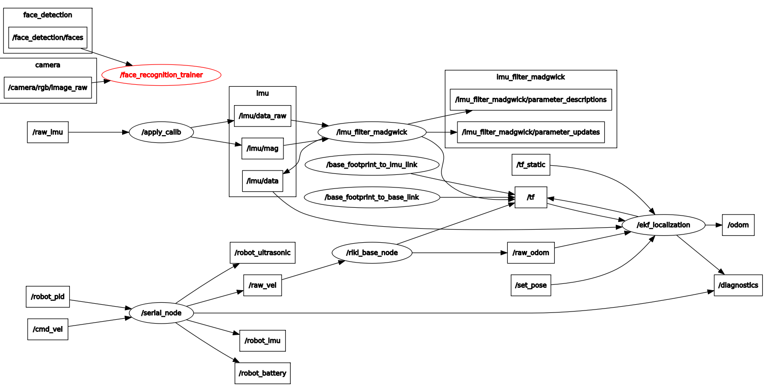
Current progress
Upper computer
Host computer
Notes:
Let's talk about the current progress. In the host computer, we have clarified the interface between ros and opencv. We have used ros to call opencv's powerful software packages, and realize the face recognition function through the webcam camera of the laptop. We will use the lower computer as a node. As you can see, the node subscribes to pid msg and speed control msg. Because we are equipped with various sensors in the lower computer, the seria node will issue various types of msg, waiting for call from other nodes. For example, our imu msg, because it is an important information reflecting the attitude of the robot, we focused on the processing of imu Msg from the beginning. In our project, our lower machine Imu released the pose information, which was processed by each node. We can accurately obtain the attitude information of the car, and combine the raw_vel velocity msg released by the lower computer to realize the state analysis of the robot in space.
In fact, you will find that the imu information released by my lower computer does not match the host computer subscription. This is caused by the inconsistency in the communication of the source code of our lower computer. After that, our work will correct these details. In addition, we will use The depth sensor implements the slaM function.
Next, my partner jianxin
Will introduce the control theory of the lower computer.

Slide 9
Communication architecture of ROS
1. Engineering structure of a ROS project.
2. Introduction of nodes.
3. How do nodes conmuinicate?

Slide 10
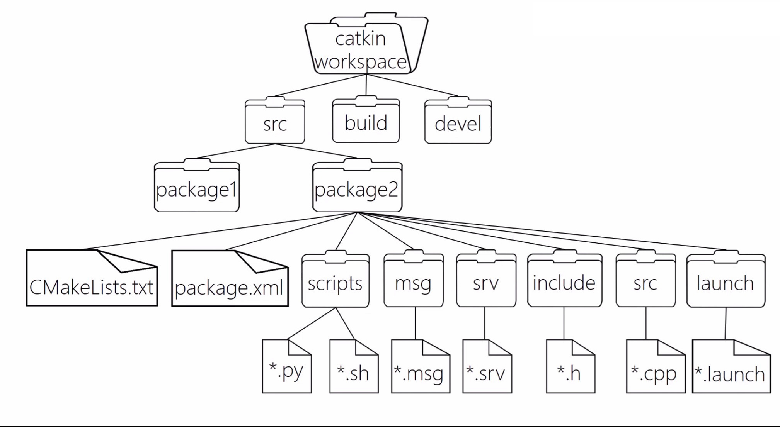
Engineering structure

Slide 11
Node in ROS & Process in OS
The nodes in ROS are similar to the processes in OS.
Each node is a specific program instance.
Master, the manager of nodes.
master
login
control
login
control
node1
node2
communicate

Slide 12
How do nodes communicate?
1.Topic
The most used communication method in ROS.
A name for a string of massage.
An asynchronous way of communication.
node1
/topic
node2
publish
subscribe

Slide 13
An example of ropic
node_
viewer
/camera_rgb
node_
camera
node_
processor
/camera_depth
node_
point clouds
A node can publish multiple topics.
But a topic can only be published by one node.
A topic can be subscribed by multiple nodes.
A node can also subscribe to multiple nodes.

Slide 14
How to implement a topic?
*.msg file
Its address is pcgname/msg/*.msg
This file is a structure containing various types of data.
The specific published topic is an object or instance of the class
eg.
For a simple example, if we let a node publish the location information of the robot, publish it at any time to form a specific topic, and another node subscribes to this information.

Slide 15
Publisher.cpp
#include <ros/ros.h> #include <topic_demo/gps.h> int main(int argc, char **argv) { ros::init(argc, argv, "talker"); ros::NodeHandle nh; topic_demo::gps msg; msg.x = 1.0; msg.y = 1.0; msg.state = "working"; ros::Publisher pub = nh.advertise<topic_demo::gps>("gps_info", 1); ros::Rate loop_rate(1.0); while (ros::ok()) {
msg.x = 1.03 * msg.x ; msg.y = 1.01 * msg.y; ROS_INFO("Talker: GPS: x = %f, y = %f ", msg.x ,msg.y); pub.publish(msg); loop_rate.sleep(); } return 0; }
gps.msg
string state
float32 x
foat32 y

Slide 16
How do nodes communicate?
2. Service
request
node 1
/service
node 2
reply
Client
Server
1. This is a synchronous way of communication.
2. Similar to the C/S communication model in computer networks.
3. This communication method is suitable for communication between nodes that are not used frequently.
4. This way is implemented by *. srv file

Slide 17
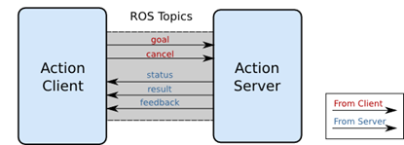
How do nodes communicate?
3. Action
1. Action is actually an improvement of the service communication method.
2. Defining an action requires three parts: goal, result, feedback.
3. This method is suitable for long-term controlled services.
4. This way is implemented by *.action file.

