Slide 1

E-commerce Website
Britium Gallery
Present by Team Rose

Slide 2

TEAM MEMBERS
HTOO AUNG YE YINT
EI SHWE SIN KYAW
PHYO MIN KHANT
PYAE HTOO KYAW

Slide 3
CONTENT
01
05
Roles & Permissions
Project Overview
02
06
Vision & Mission
System Flow
03
07
Technology Stack
Future Goals
04
Key Features
08
Conclusion

Slide 4


PROJECT OVERVIEW
Britium Gallery is an e-commerce platform for selling branded products across categories like fashion, shoes, bags, and perfumes. It is designed to deliver a user-friendly shopping experience with essential features for both customers and administrators.

Slide 5


VISION
To become a trusted and modern e-commerce platform that delivers a smooth, secure, and brand-focused online shopping experience for users across Myanmar and beyond.
MISSION
To build a user-friendly and scalable platform where customers can shop branded products easily, and admins can manage everything with useful features

Slide 6
TECHNOLOGY STACK
Frontend
Backend
Database
Other Tools
Angular
HTML, CSS, TypeScript
Web Socket
Spring Boot (Java)
API
Spring Security
OTP verification
MySQL
Supabase
Postman
GitHub
VS Code
IntelliJ IDEA
Excel
PowerPoint

Slide 7
USER KEY FEATURES
OTP Login & Registration
Product Browsing & Filtering
Shopping Cart & Checkout
Order History
Profile Management
Order Tracking
Return and Refund
Responsive Design

Slide 8
ADMIN KEY FEATURES
Dashboard Overview
Event Management
Policy Page Management
Order Management
Product Management
User Management
Discount Management
Role-Based Access

Slide 9
ROLES AND PERMISSIONS
MANAGER
WAREHOUSE STAFF
Oversee products, orders, warehouse, and monitor staff activity
Manage inventory, update stock levels, and process shipments
ADMIN
SALES & MARKETING
CUSTOMER SUPPORT
CUSTOMER
Full system access, manage all users, products, orders, discounts, and settings
Create/manage events, discounts, and marketing pages
Browse products, place orders, view order history, and manage their profile
Respond to inquiries, manage contact messages, assist with orders

Slide 10
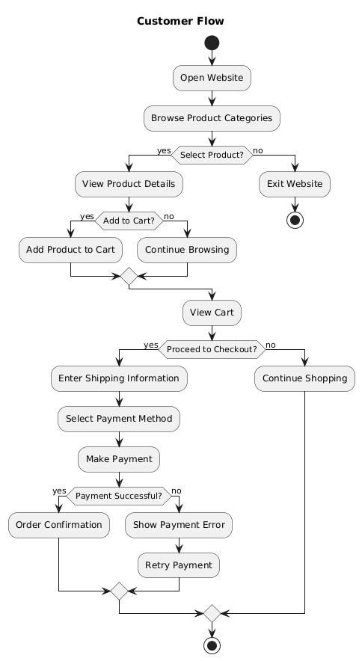
CUSTOMER FLOW

Slide 11
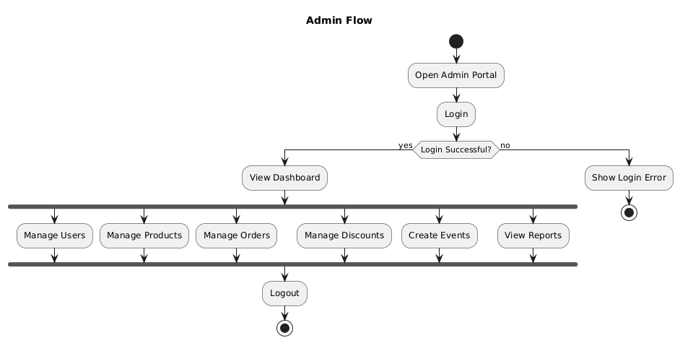
ADMIN FLOW

Slide 12
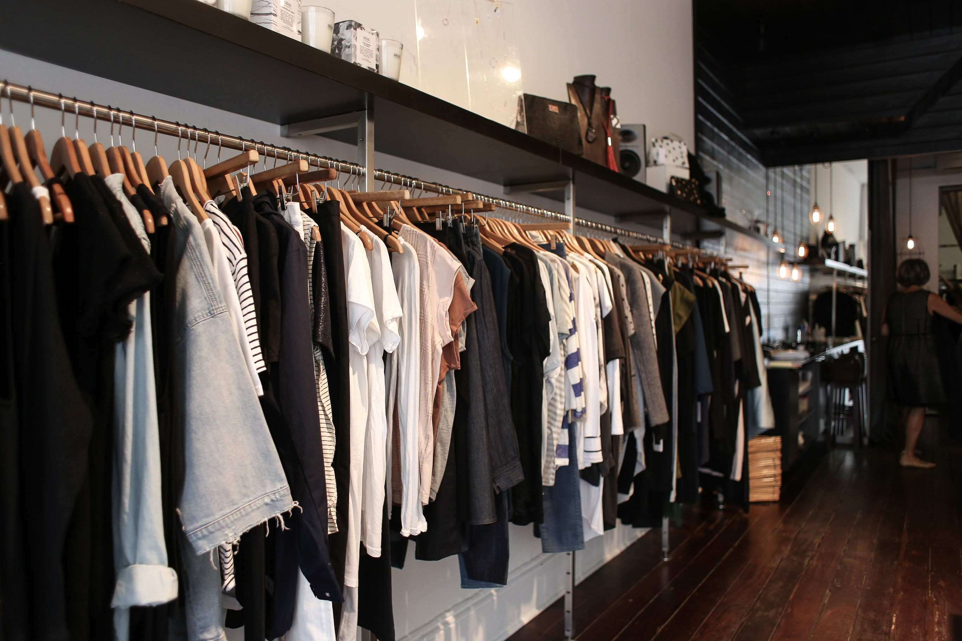
Demonstration

Slide 13
FUTURE GOALS
Add Blog System
FAQ & Help Center Page
Advertising & Announcements Page
Warehouse & Inventory Optimization
AI-Powered Product Recommendations
Enhanced User Experience & Interface

Slide 14

Conclusion
Britium Gallery delivers most of core features of a complete e-commerce system, supporting both customers and administrators. Looking ahead, we aim to enhance the platform with better warehouse tools, AI integration, improved user experience, and dedicated support and marketing features—ensuring long-term growth, engagement, and scalability.

Slide 15
Thank you!

