Slide 1
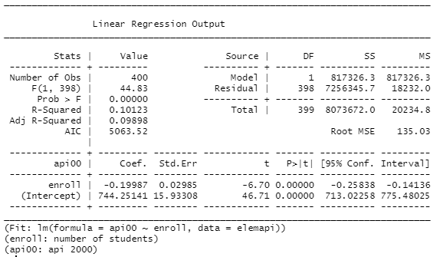
1
2
h i j k
a
b
c
d
e
f
g
3
l m n o p q
4

