Slide 1

Git and GitHub Basics
Myo Minn Oo

Slide 2
1. Version Control
a system
records changes to set of files over time
recall specific versions later.

Slide 3
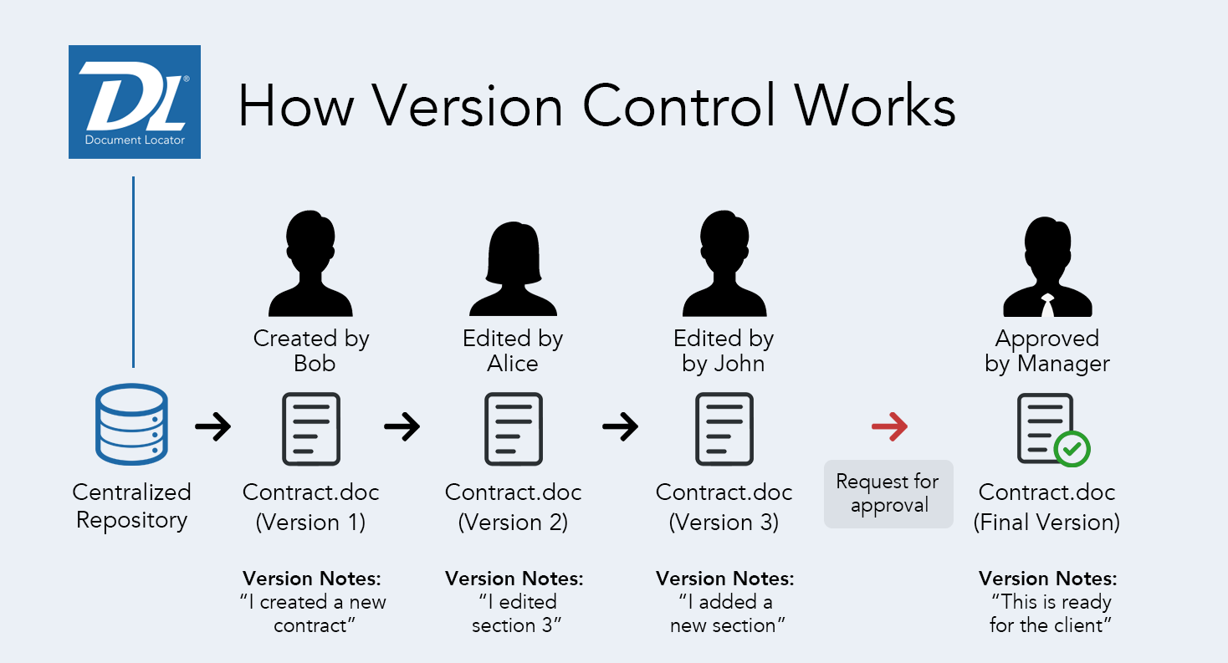
Source: https://www.documentlocator.com/img/knowledge/version-control-diagram.png

Slide 4
Why Use Version Control Software?
show the changes made to the code over time
allow to backtrack if necessary and undo those changes
all versions are stored on a central server

Slide 5
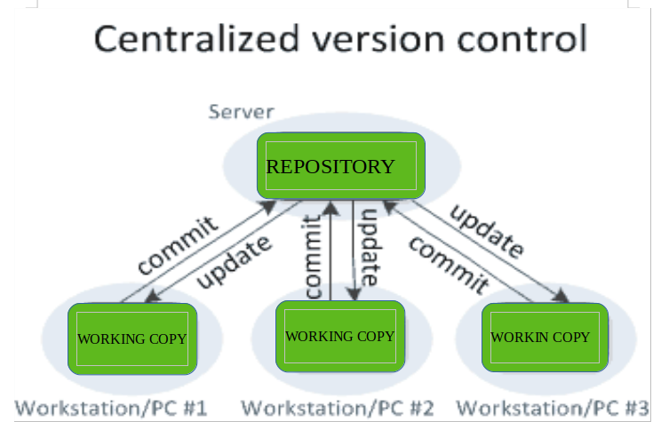
Source: Version Control Systems - https://www.geeksforgeeks.org/version-control-systems/

Slide 6
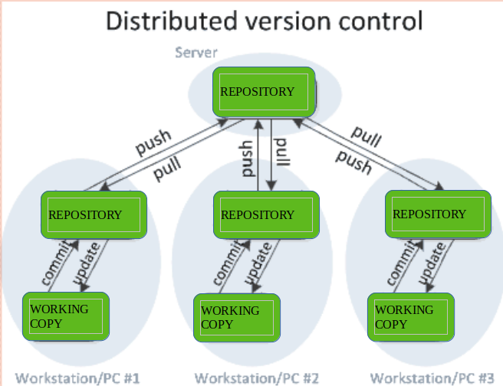
Source: Version Control Systems - https://www.geeksforgeeks.org/version-control-systems/

Slide 7

2. Git
free and open source
basis of distributed development
offer a full-fledged repository with complete history and full version-tracking capabilities
Allows a team of people to work together, all using the same files

Slide 8
Git repository
Working directory
Your local directory where you make the project (write code) and make changes to it.
Staging Area
An area where you first need to put your project before committing. This is used for code review by other team members.
Local Repository
Your local repository where you commit changes to the project before pushing them to central repository on Github.
Central Repository
Main project on the central server, a copy of which is with every team member as local repository.

Slide 9
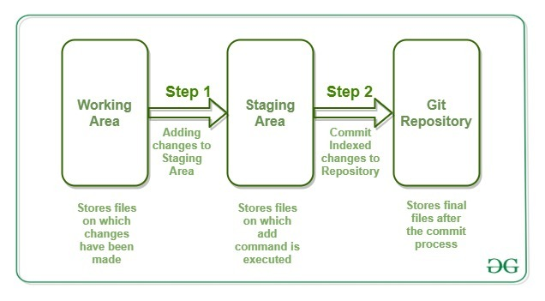
Source: An Ultimate Guide to Git and Github - https://www.geeksforgeeks.org/ultimate-guide-git-github/

Slide 10
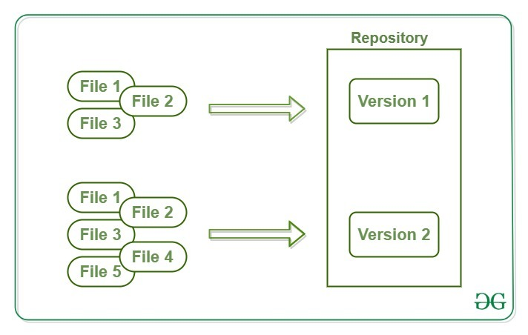
Source: An Ultimate Guide to Git and Github - https://www.geeksforgeeks.org/ultimate-guide-git-github/

Slide 11
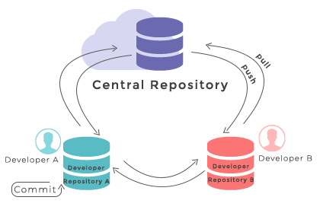
Source: W3docs - Git Repository | W3Docs Git Online Tutorial

Slide 12
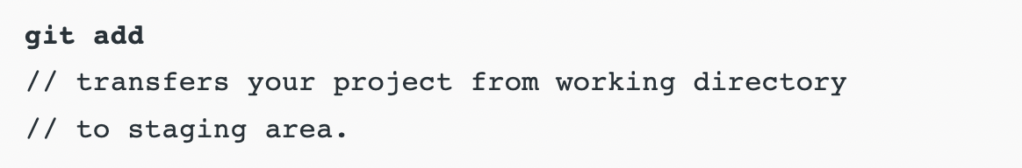
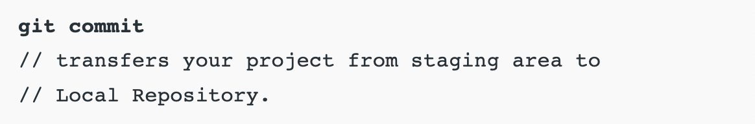
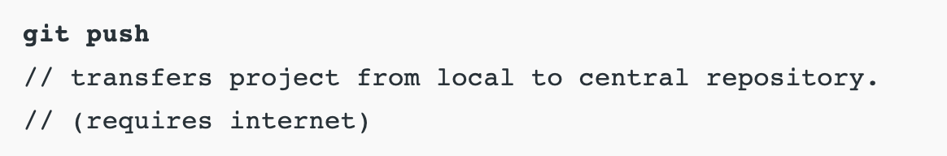
Some commands
which relate to repository structure:

Slide 13
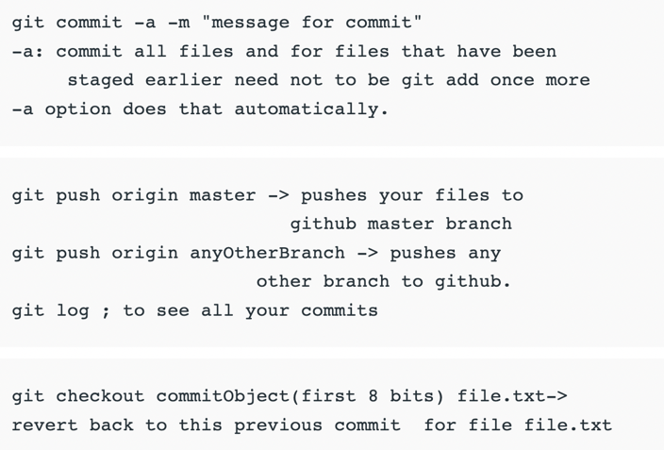
More commands

Slide 14

3. GitHub
a repository hosting service tool
features collaboration and access control
designed for the developers and to help them track their changes into a project through the repository.

Slide 15
Some features of GitHub
specifies milestone & labels to projects
comparison view between branches
publish and host websites
syntax highlight feature.
third-party API integrations for bug tracking and cloud hosting

Slide 16
Task 1
Log in to GitHub.com
Create a repository named “my-first-github”
Add README file
Commit the changes.

Slide 17
Task 2
Open GitHub Desktop
Clone your repo “my-first-github”
Edit README file
Commit changes & push to origin

Slide 18
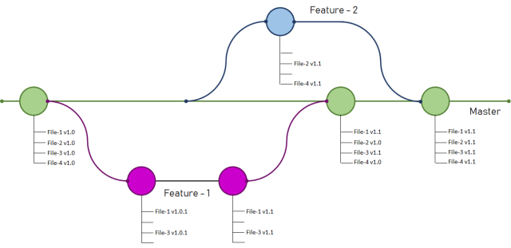
4. Git branch
branches are a part of daily development process
a snapshot of your changes
make unstable code harder to get merged into the main code base

Slide 19


Slide 20
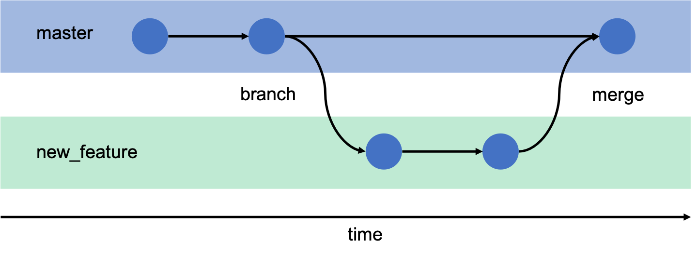

Slide 21
Task 3
Create a branch of your repo
Name it “edited”
Edit README file
Commit changes

Slide 22
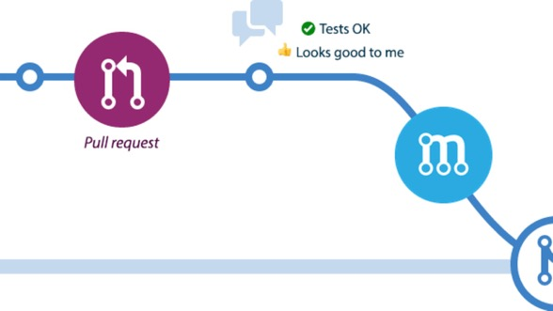
5. Pull request & merge
git's way of putting a forked history back together again
review code before merging into the main branch
merge to the main branch

Slide 23
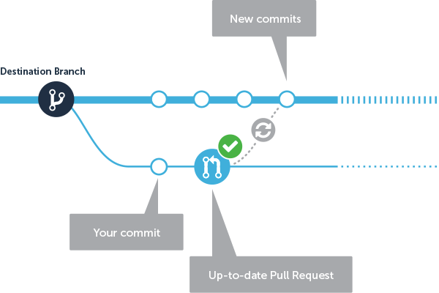

Slide 24
Task 4
Create a pull request on previous changes in task 3.
Review the changes
Confirm merge

Slide 25
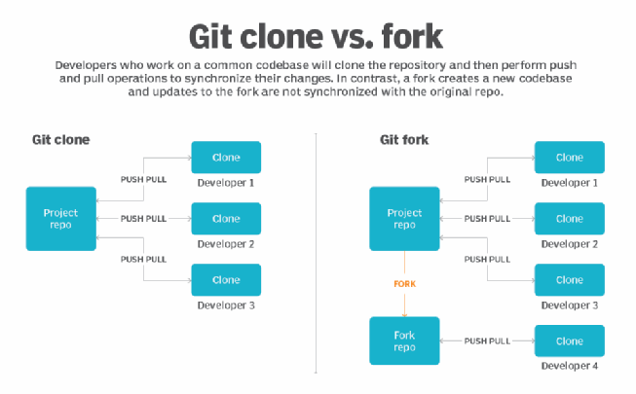

Slide 26
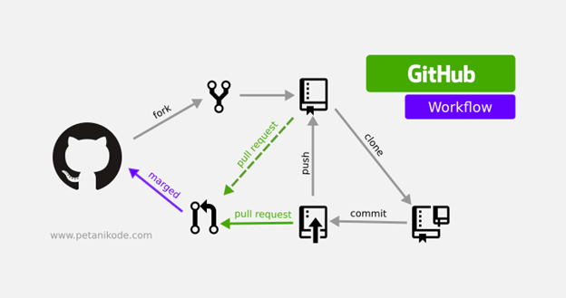
Source: W3docs - Git Repository | W3Docs Git Online Tutorial

Slide 27
Thanks!
Any questions?
You can find me at:
http://myominnoo.github.io/
dr.myominnoo@gmail.com

