Slide 1
CS489: Applied Software Development
Dental-Surgery Appointment webapp

Slide 2
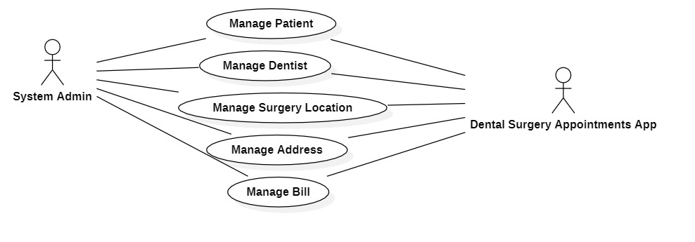
USE CASES

Slide 3
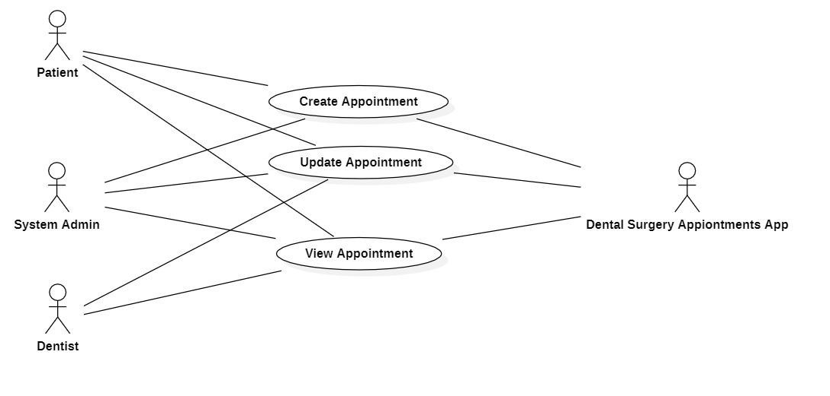
USE CASES

Slide 4
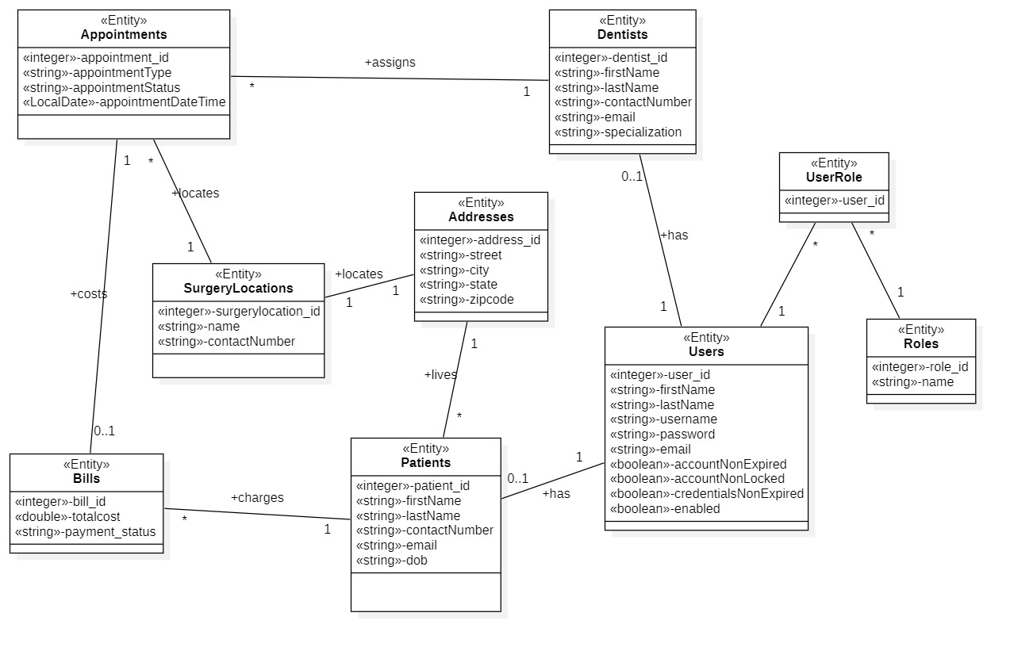
Domain model CLASSES

Slide 5
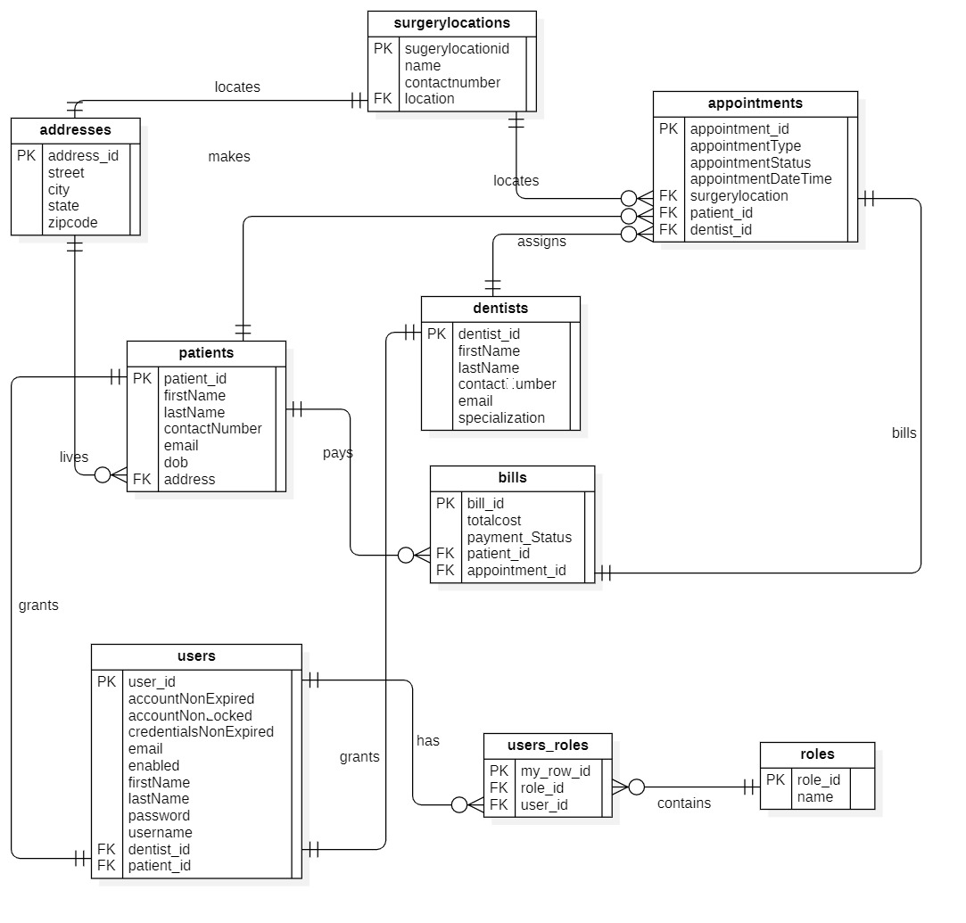
ER Diagram

Slide 6
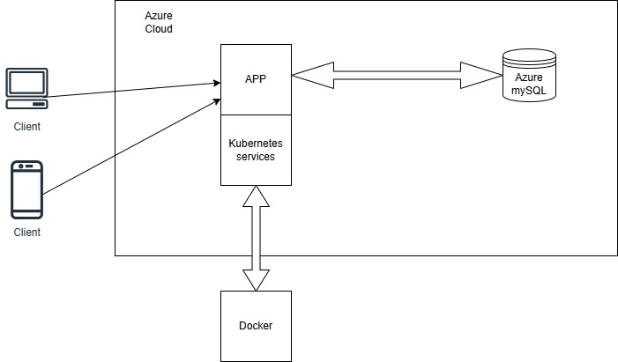
Architectural DIAGRAM

Slide 7
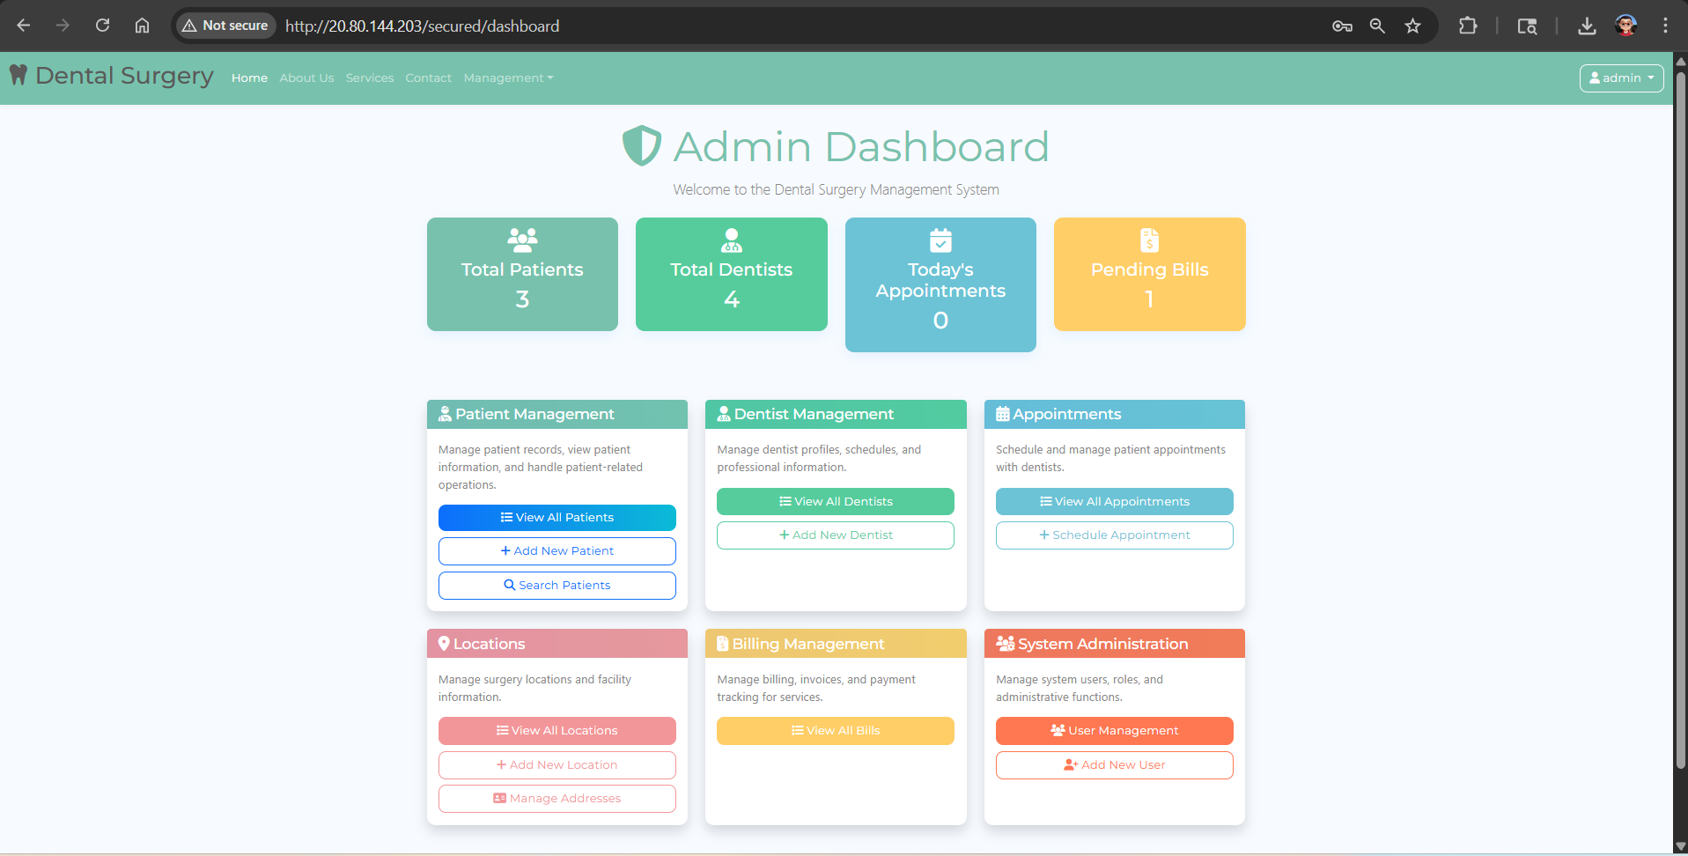
Admin’s Dashboard

Slide 8
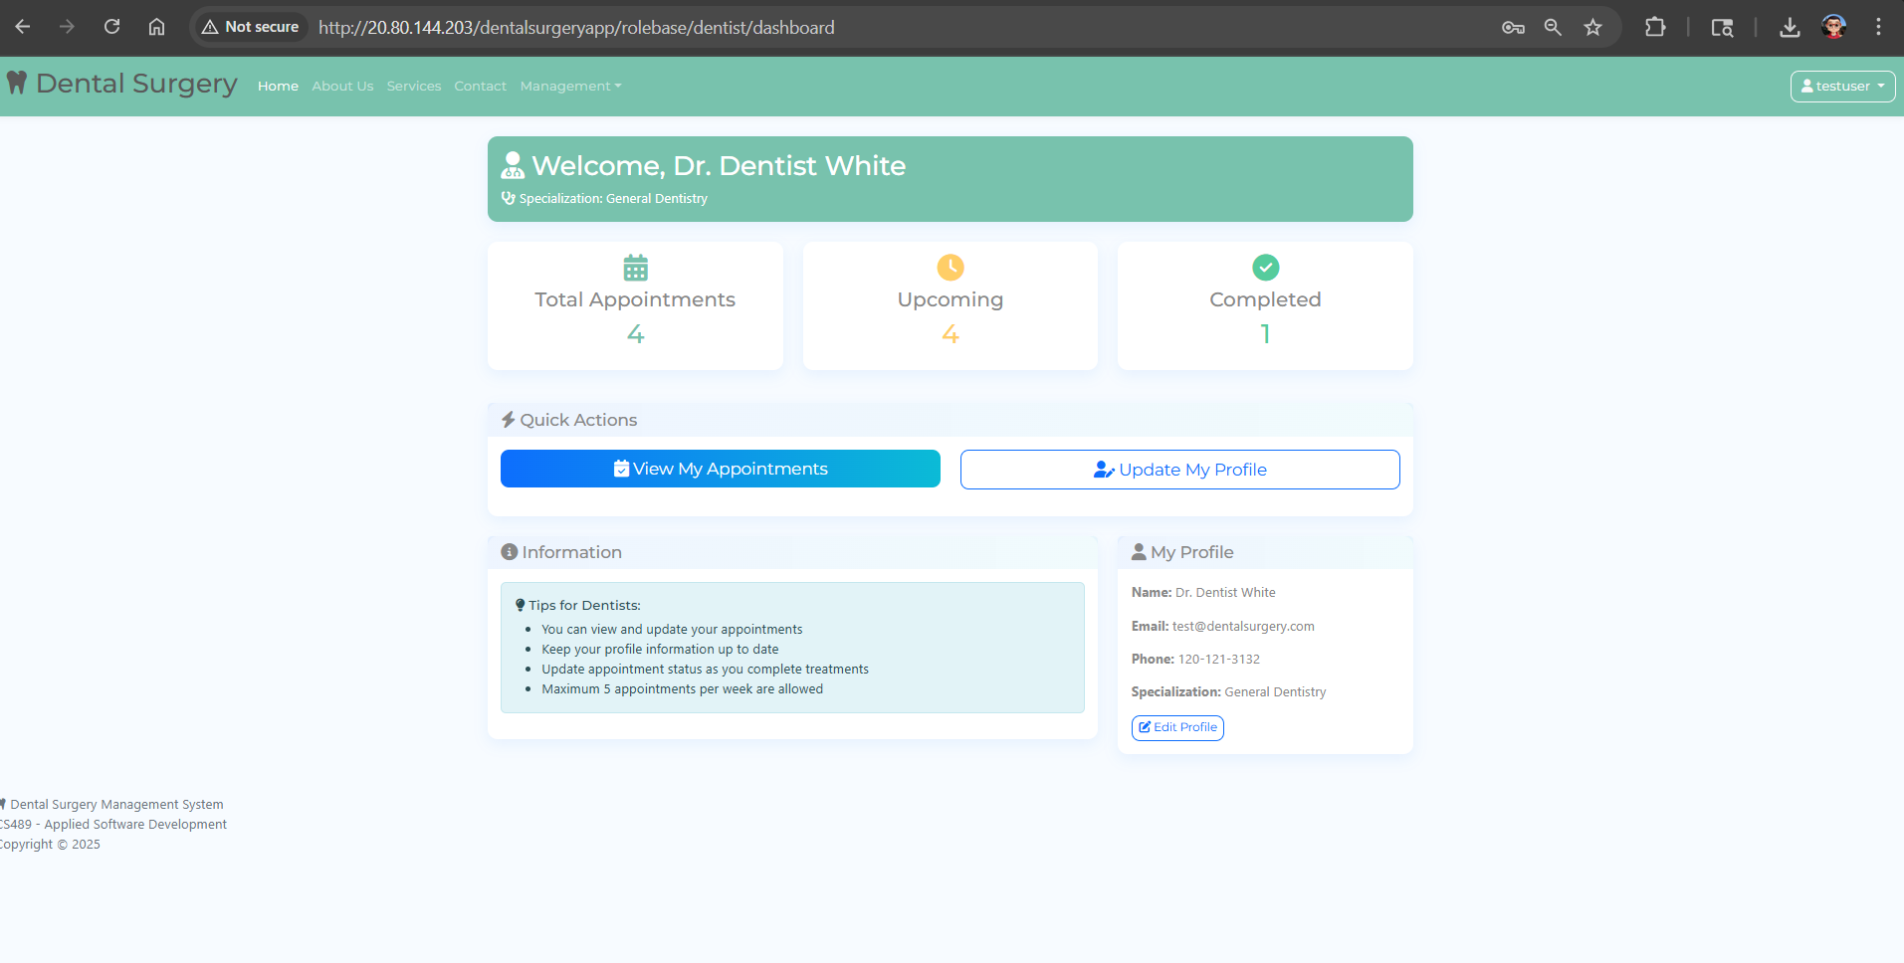
Dentist’s DASHBOARD

Slide 9
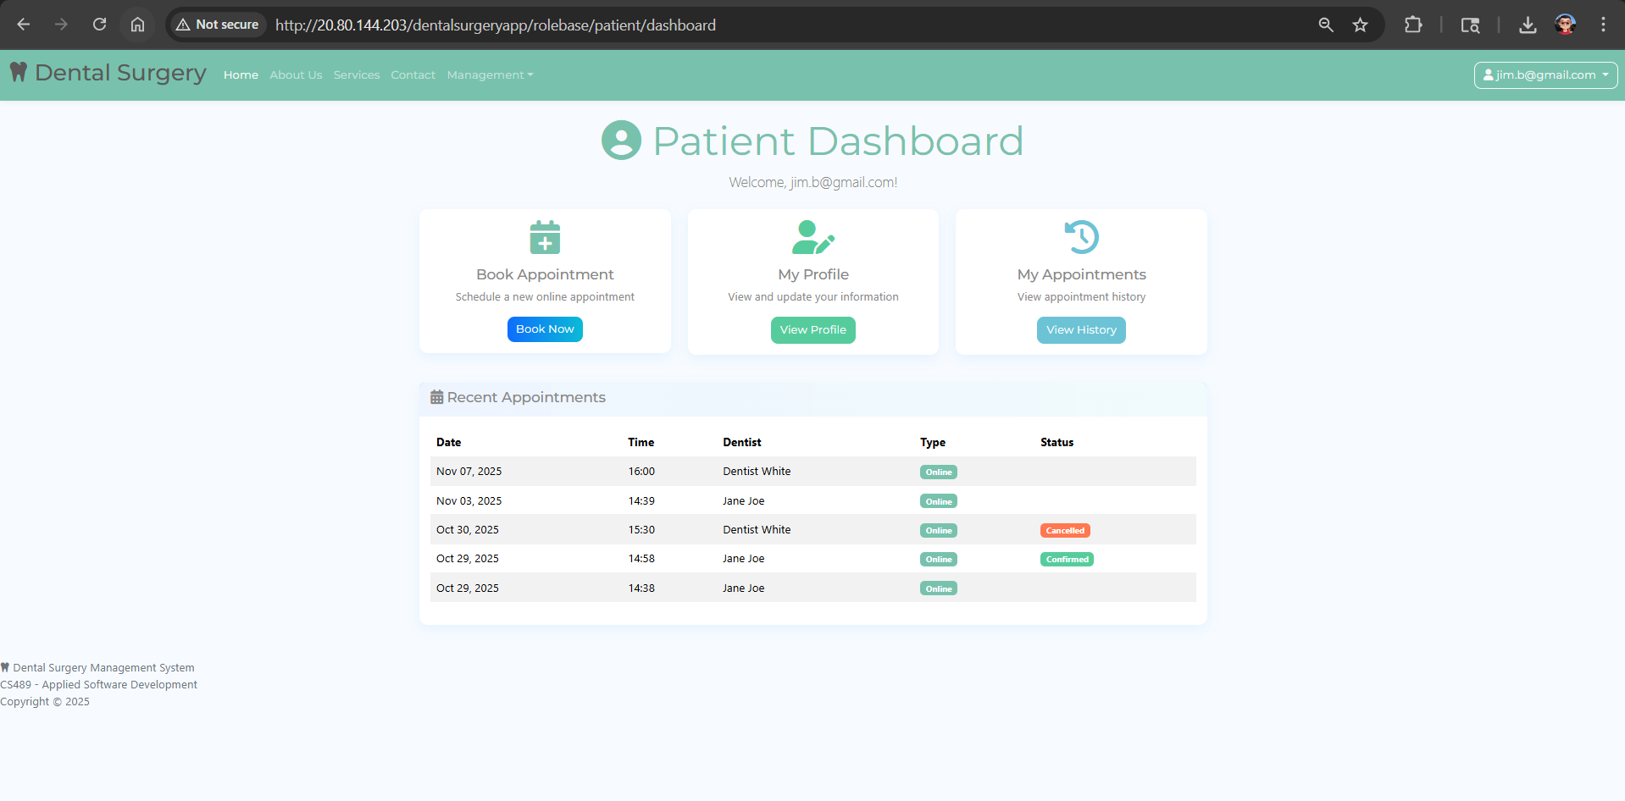
Patient’s DASHBOARD

Slide 10
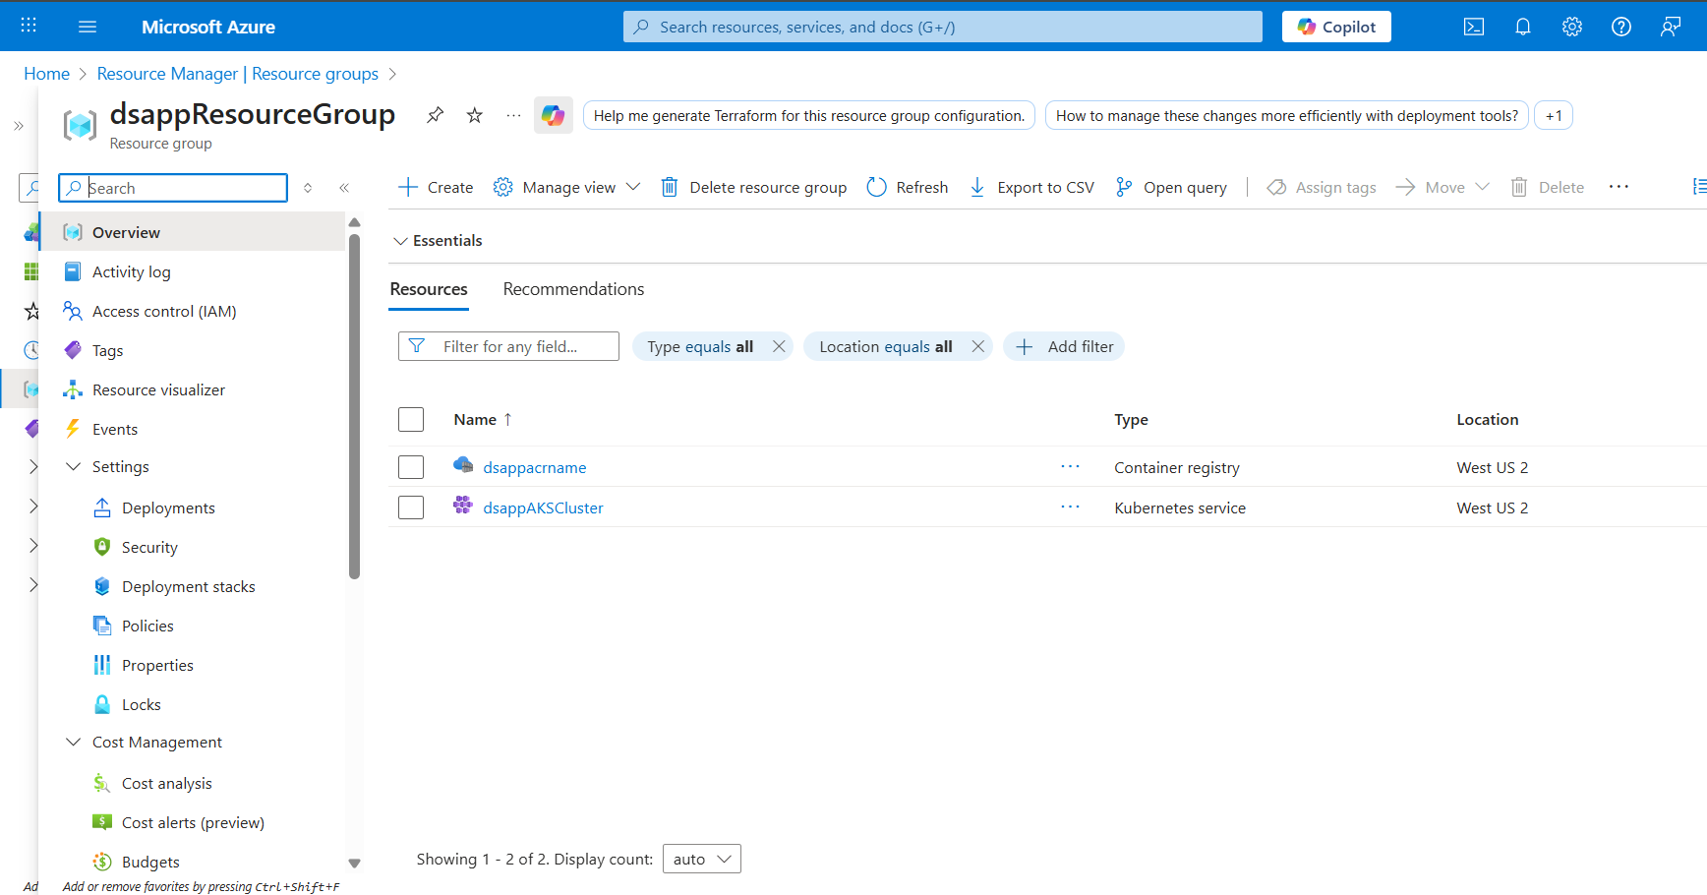
Azure Resource GROUP

Slide 11
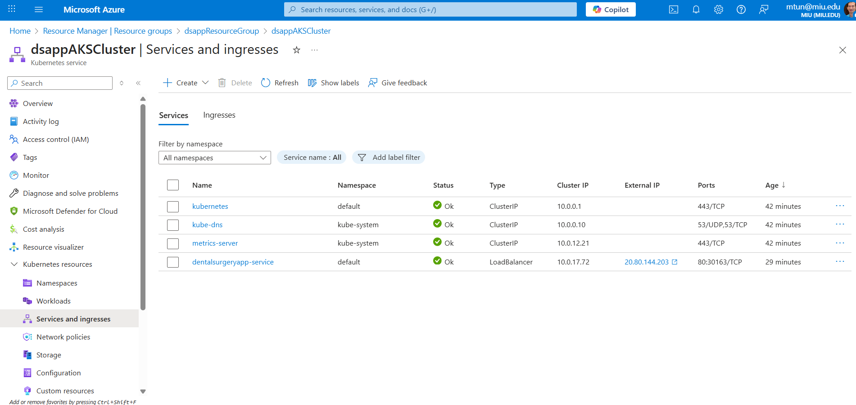
Azure K8s

Slide 12
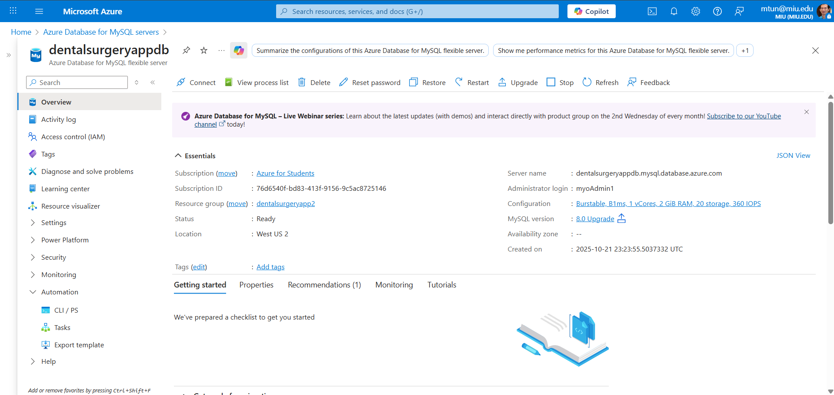
Azure MySQL DB

Slide 13
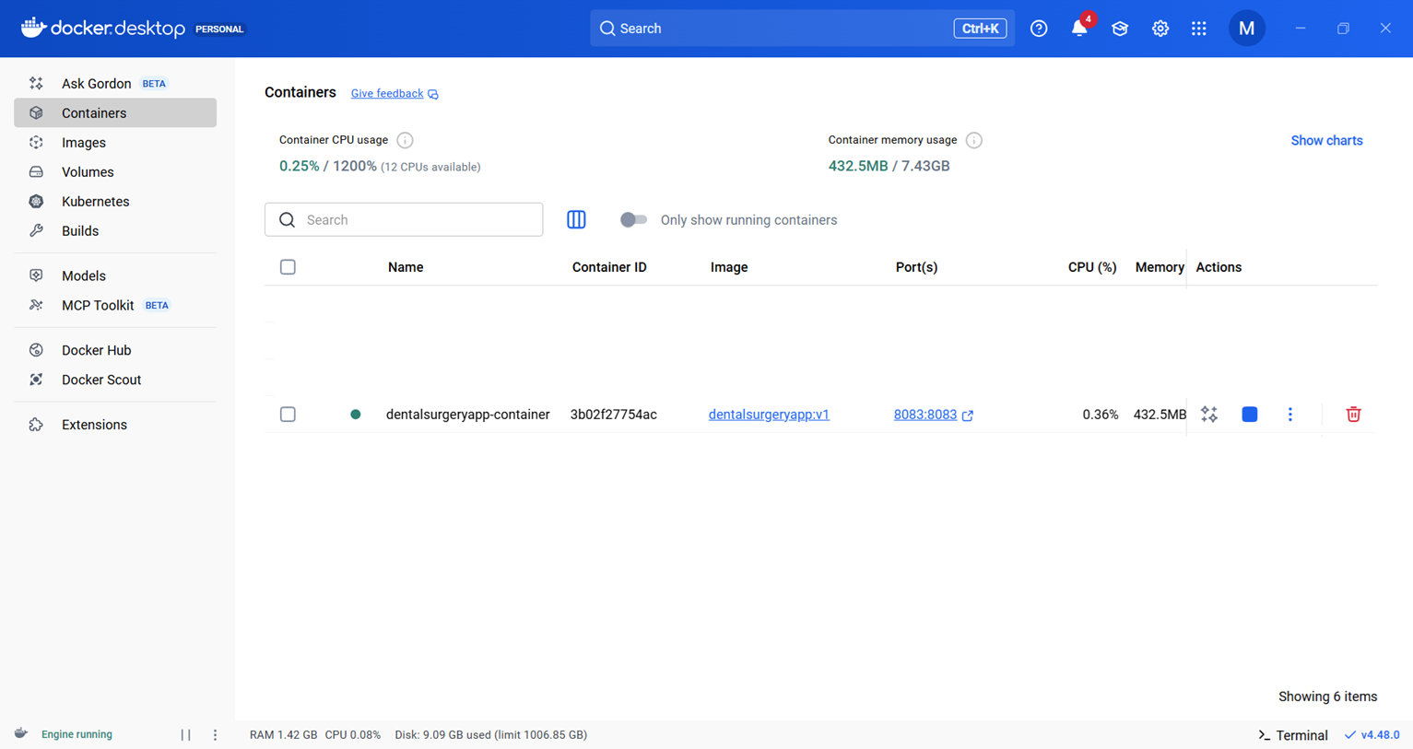
Docker container

Slide 14
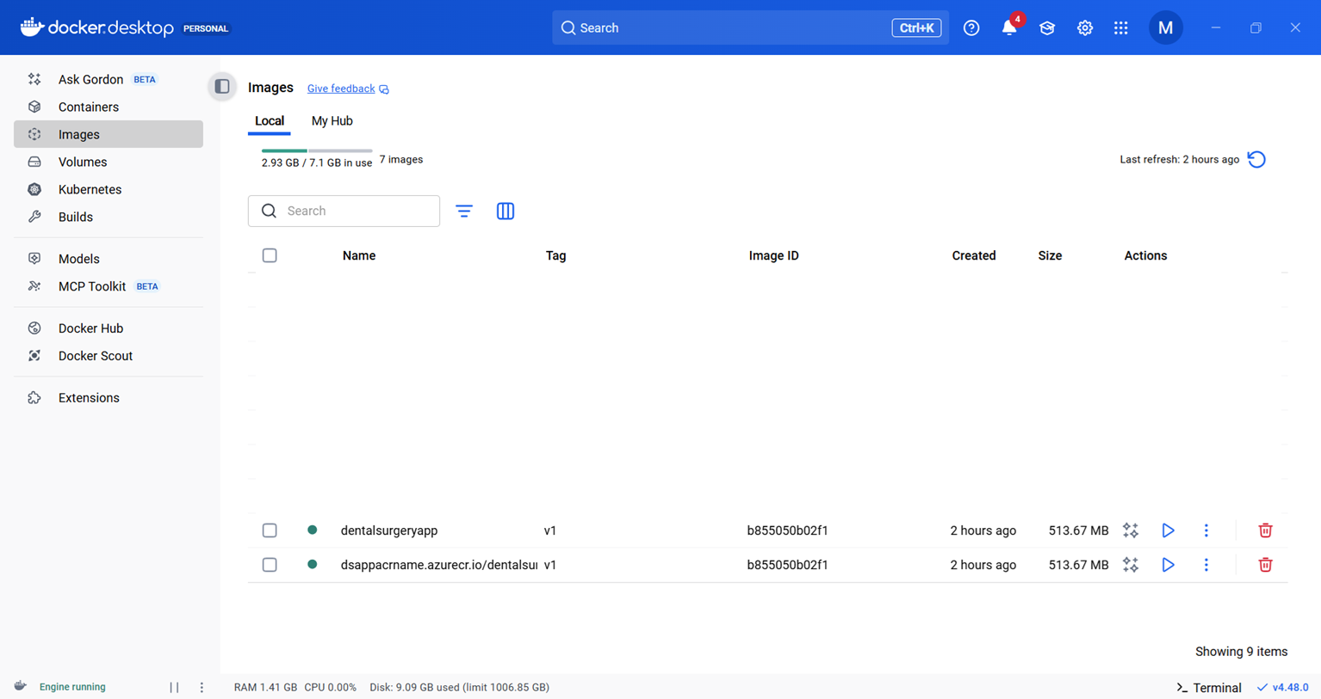
Docker image

