Slide 1
CS489: Applied Software Development
Dental-Surgery Appointment webapp

Slide 2
Functional requirements
A Patient can request appointments by call-in.
A Patient can request appointment from on-line.
Patients can cancel or change their appointments.
Office Manager can book the appointment for call-in Patient.
Dentists can view their appointments, Patients' details.
Dentist cannot be given more than 5 appointments in any given week.
Patient cannot request a new appointment, if there is an outstanding, unpaid bill for dental service
Appointment is at one of ADS’s surgery locations

Slide 3
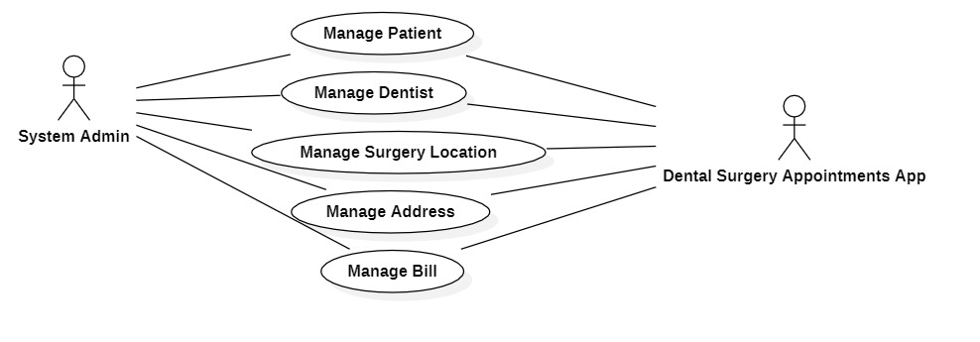
USE CASES

Slide 4
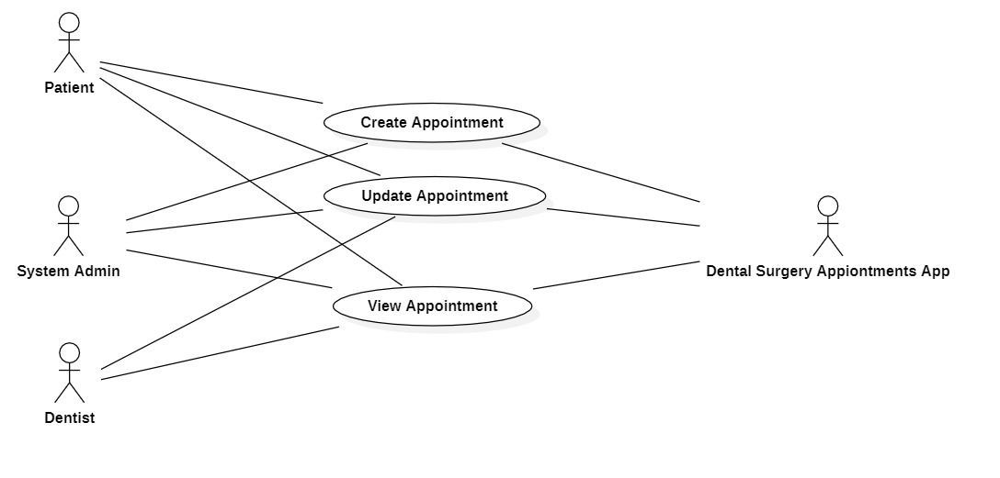
USE CASES

Slide 5
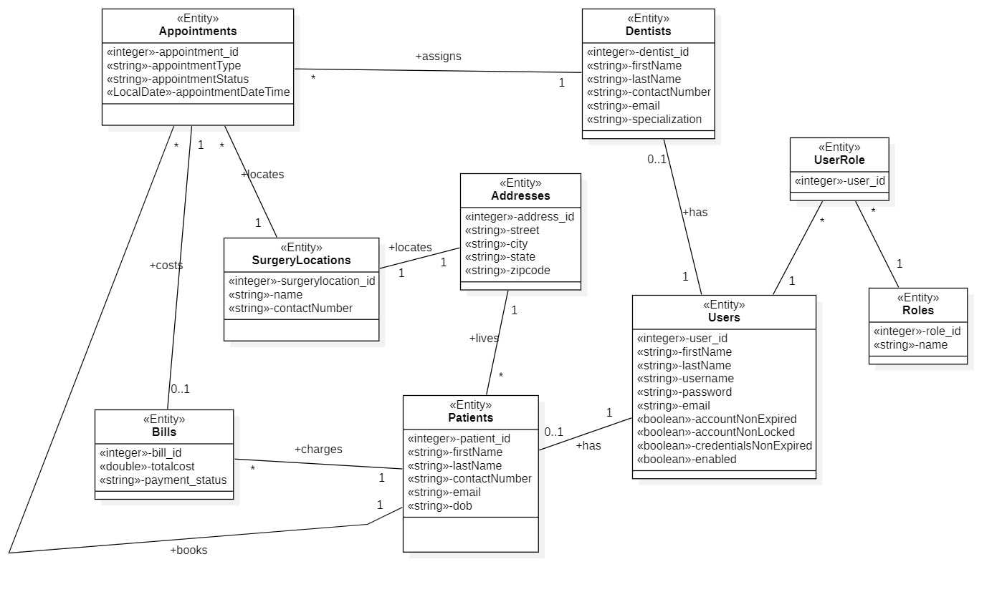
Domain model CLASSES

Slide 6
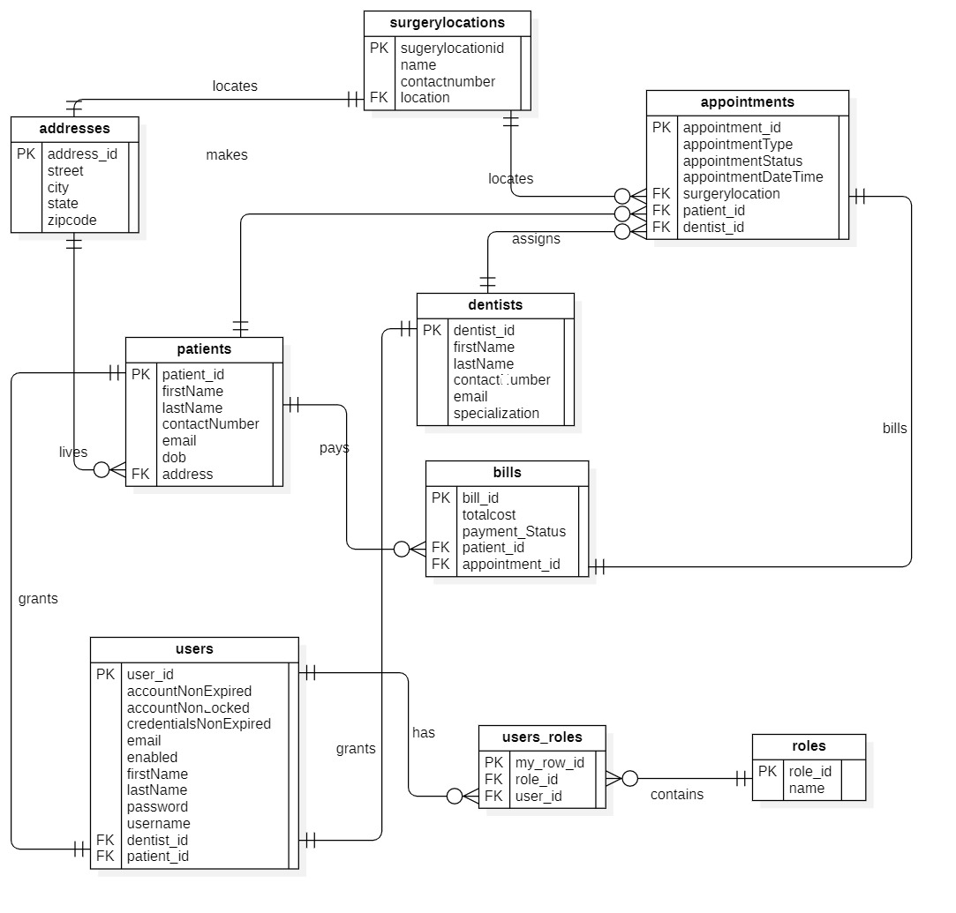
ER Diagram

Slide 7
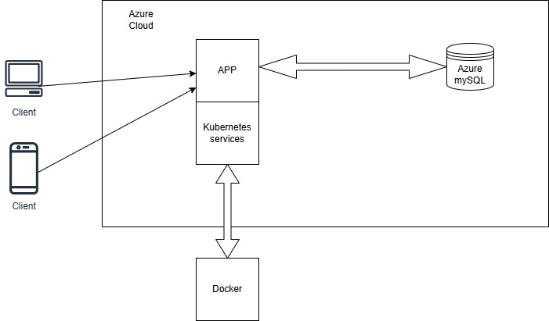
Architectural DIAGRAM

Slide 8
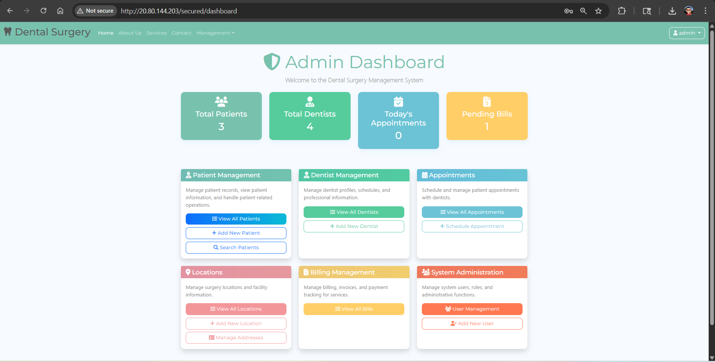
Admin’s Dashboard

Slide 9
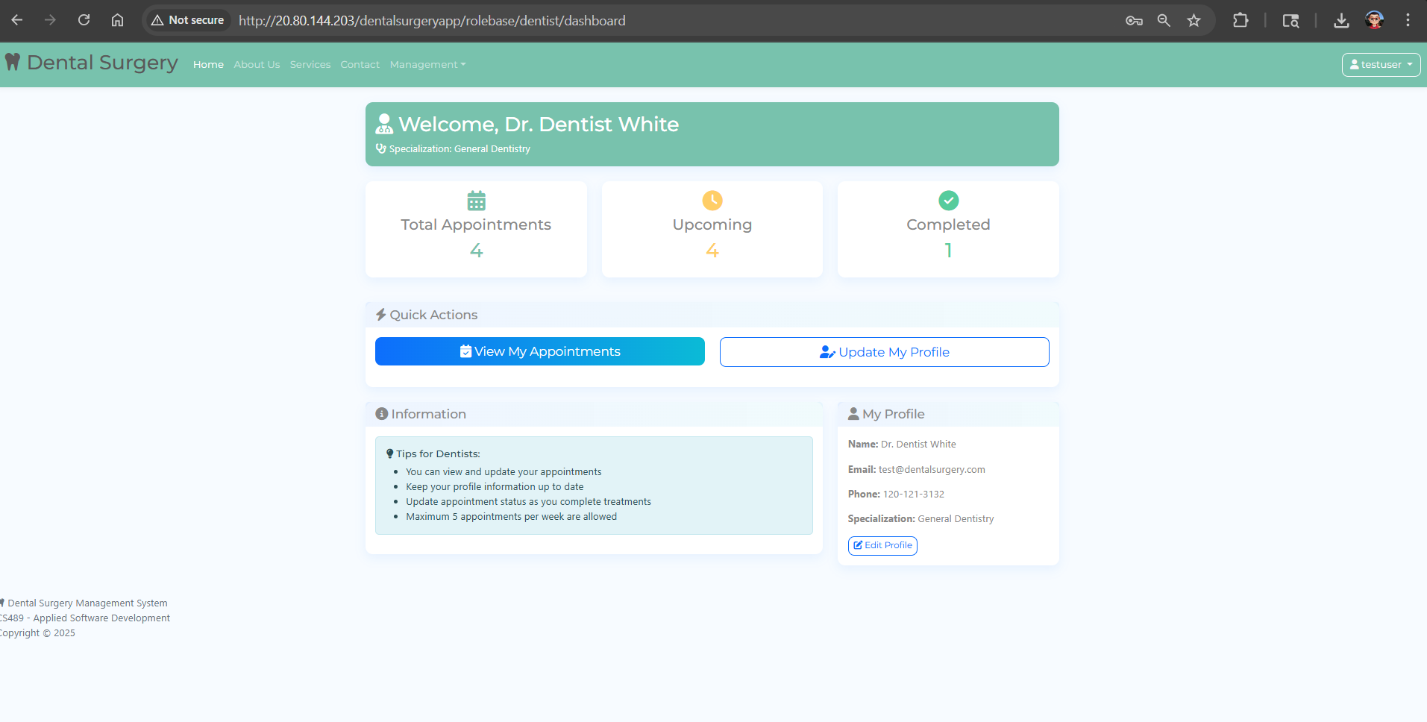
Dentist’s DASHBOARD

Slide 10
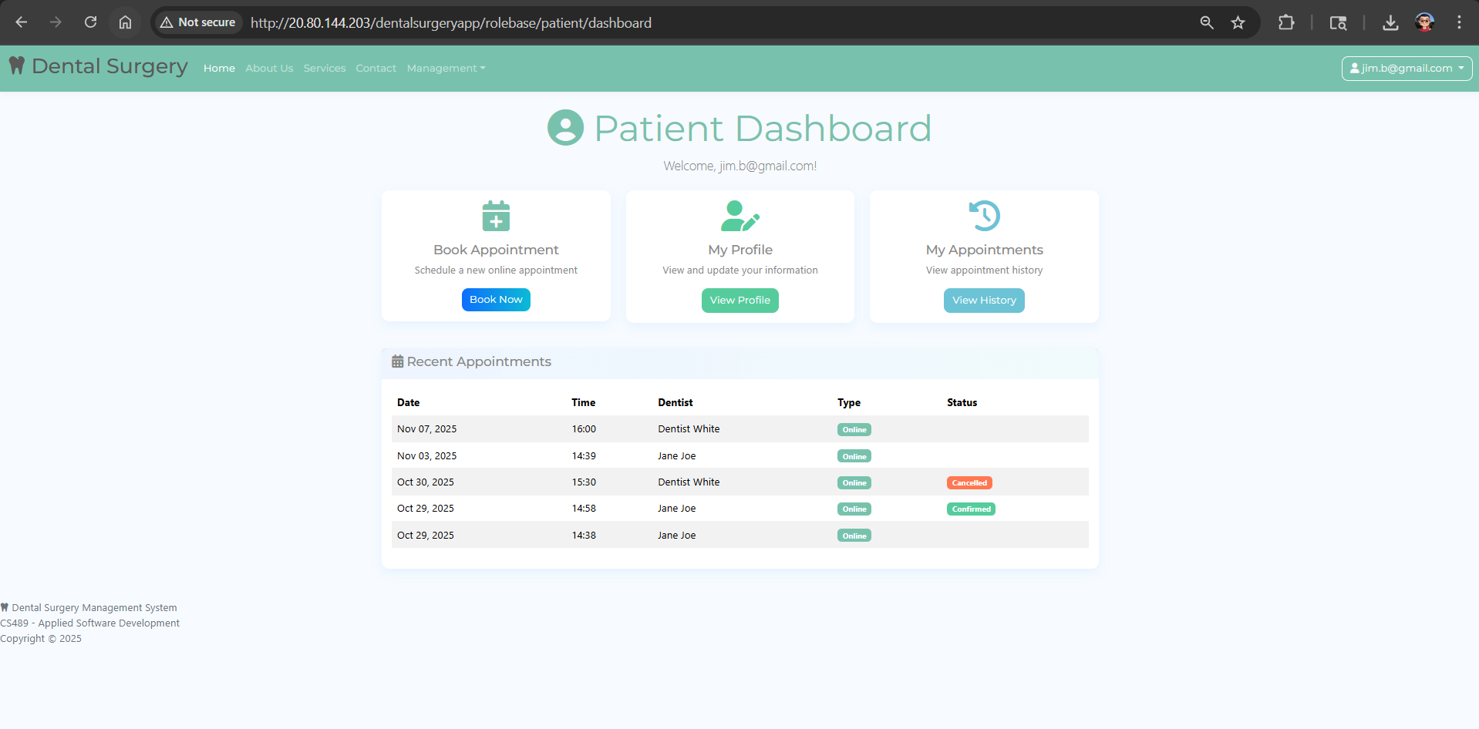
Patient’s DASHBOARD

Slide 11
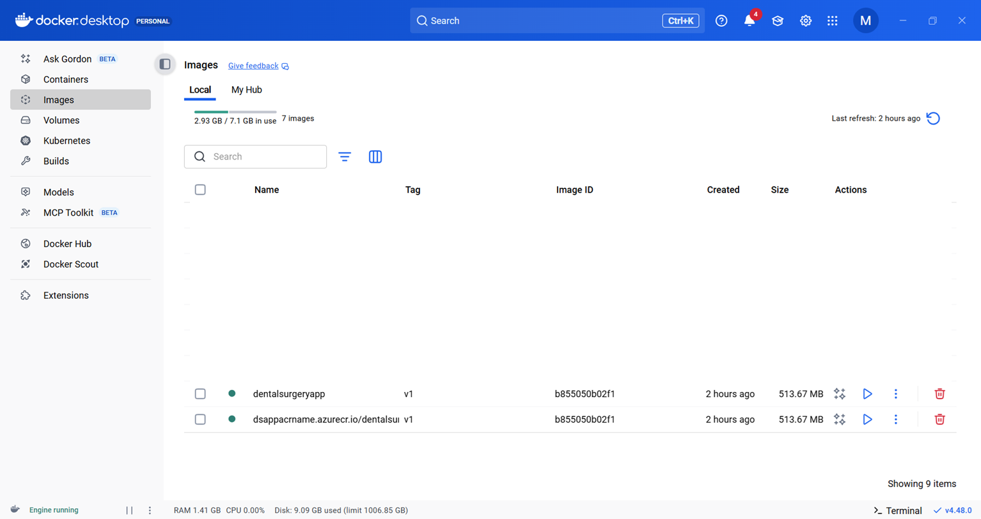
Docker image

Slide 12
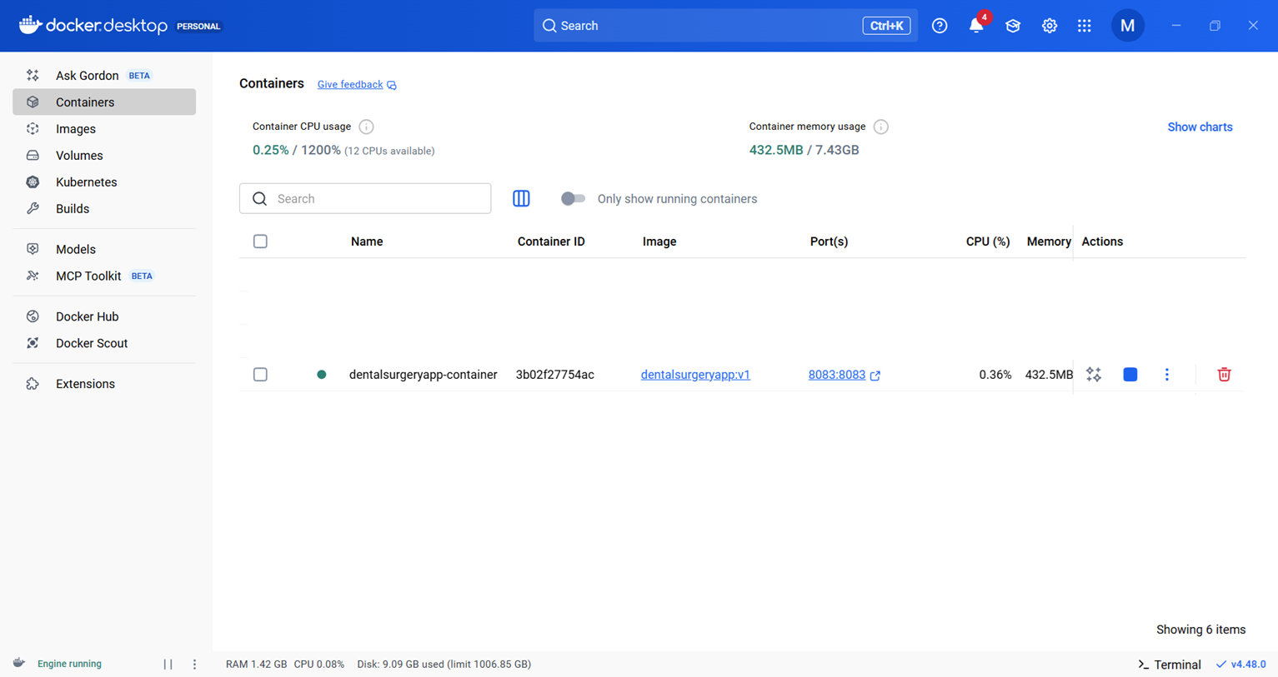
Docker container

Slide 13
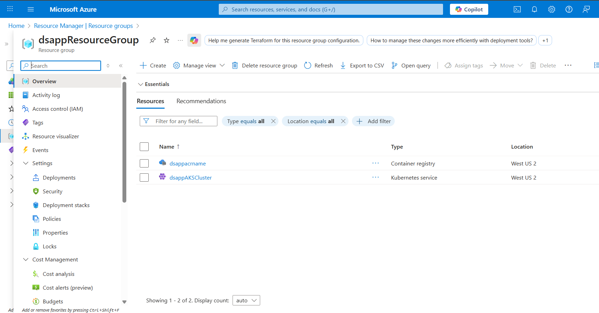
Azure Resource GROUP

Slide 14
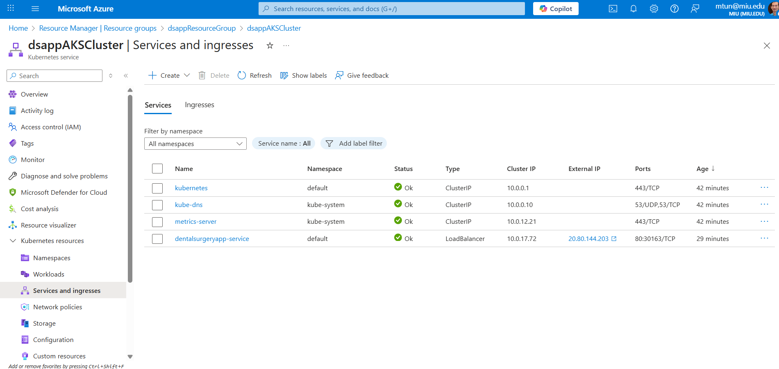
Azure K8s

Slide 15
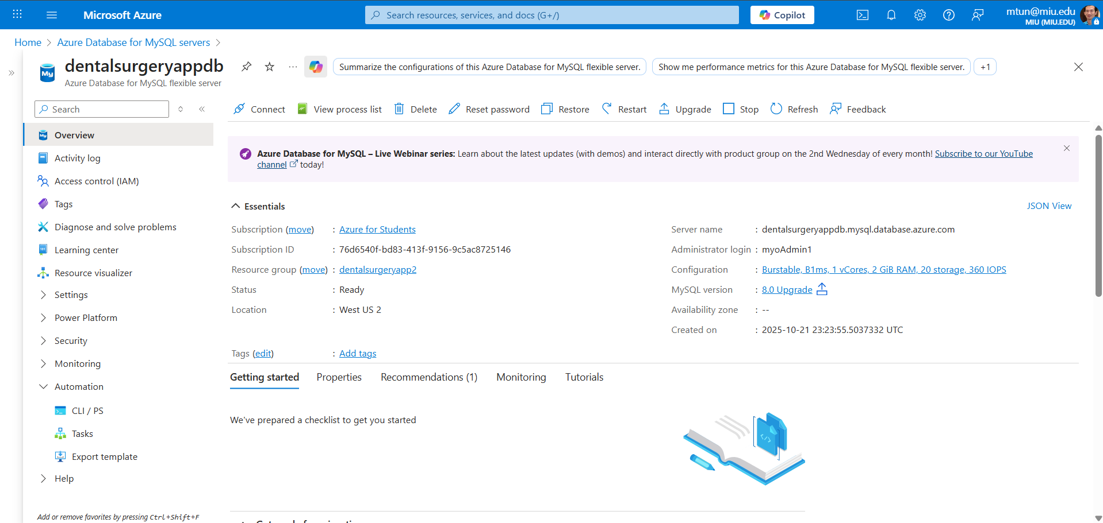
Azure MySQL DB

