Slide 1
Azure DevOps PR with LINE Notify
Jason Shen

Slide 2
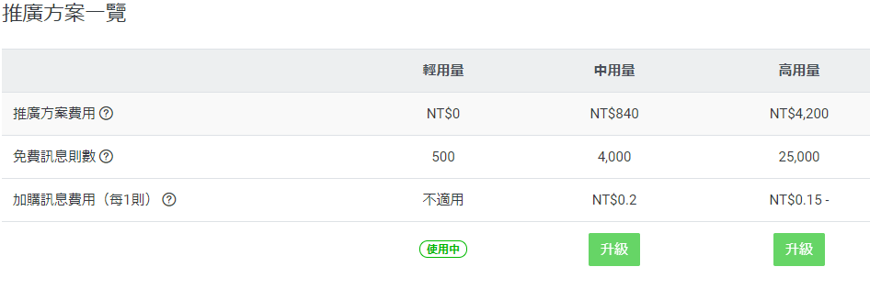
因為….LINE Bot

Slide 3
所以 LINE Notify
https://notify-bot.line.me/my/
https://www.evanlin.com/go-line-notify/
登錄服務
發行存取權杖
邀請LINE Notify 官方帳號進群組

Slide 4
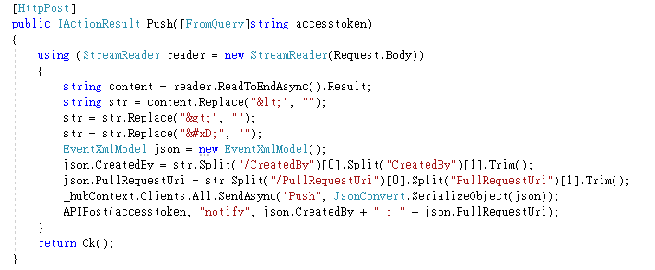
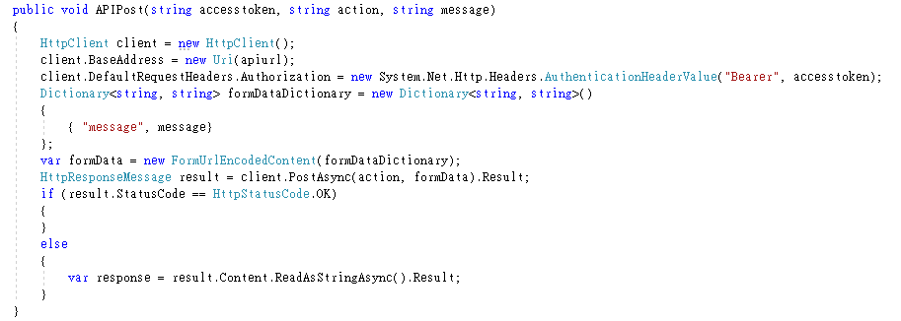
HEROKU - 轉發通知
1. https://dashboard.heroku.com/apps
2. https://www.huanlintalk.com/2018/07/deploy-aspnet-core-21-app-to-heroku.html
3. https://blog.poychang.net/line-notify-1-basic/

Slide 5
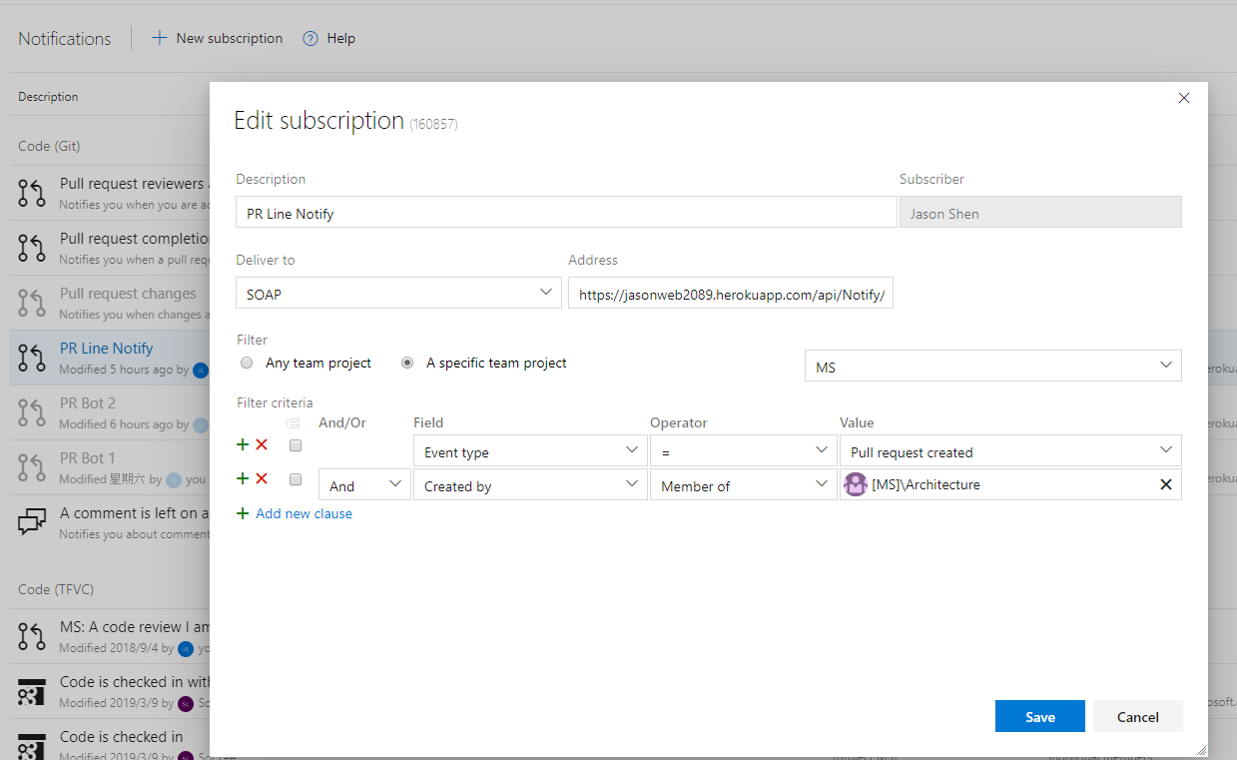
Azure DevOps subscription

Slide 6
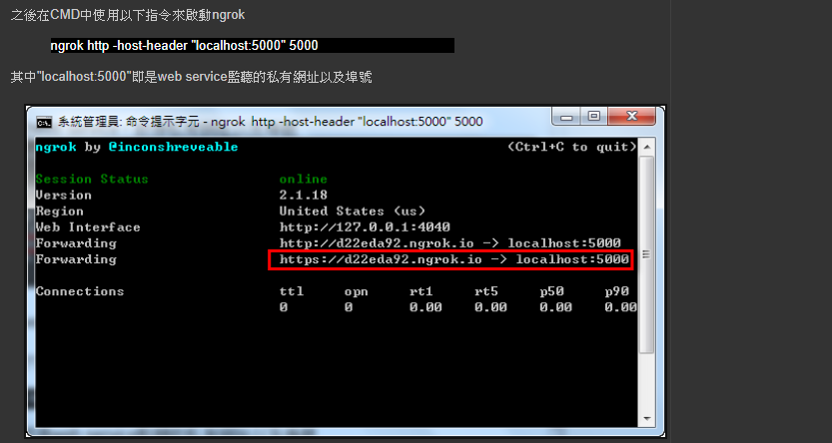
ngrok ( public url for building webhook )
https://ngrok.com/
https://cleanshadow.blogspot.com/2017/02/ngrokline-botwebhook.html

Slide 7
