Slide 1
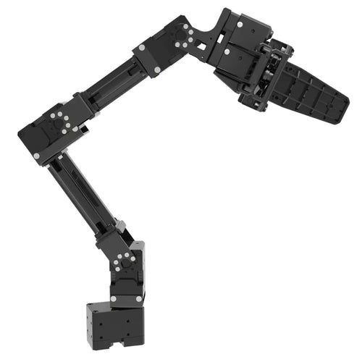
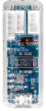
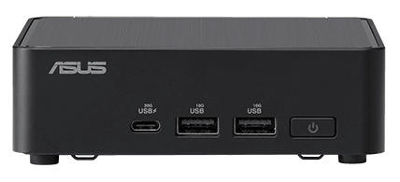
Leader Arm
Follower Arm
14
15
24
25
13
23
12
22
11
21
RS485/TTL
RS485/TTL
U2D2
USB
USB
U2D2
/leader/joint_states
@10Hz
/leader/online_joint_states
@100Hz
/follower/joint_states
@100Hz
leader_node
interpolation_node
leader_node

