Slide 1
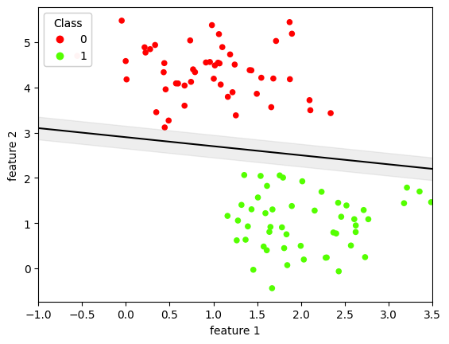
Support Vectors
margin

