Slide 1
iClouds
Theeraphol Wattanavekin
ID: 37-106902

Slide 2

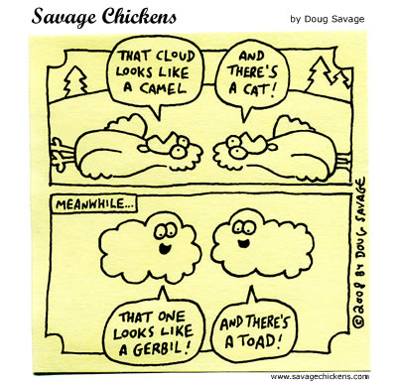
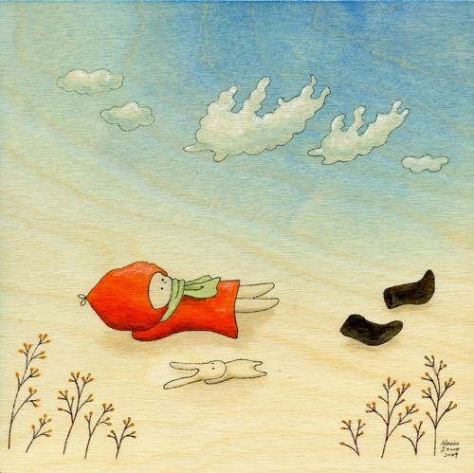
What iClouds really is?
“imagination on the Clouds”
Notes:
iClouds is the application giving you the answer what this cloud looks like from the cloud picture you provided.
I think some of you might have ever spent carefree moments looking at the clouds and let your mind wanders and even playing and guessing the shape of the clouds with your friends. Maybe you could see that cloud looks like a camel and you friend see the cat. This is very fun and one of the best way to relax yourself.
So,here instead of guessing by yourself what that cloud looks like, you can use my iClouds help you guess.
You can have a lot of fun and feel relax with my iClouds. Let’s go through your imagination and gain numerous ideas on the clouds.
You know? There are some famous novelist creating their new stories by letting the ideas go wild on the clouds. Even some cartoonist also imagine their new cartoon characters by looking at the clouds.
So, this is very cool I think. As you might know, even Steve Jobs also said “iCloud is the future”. Oops! But different icloud.

Slide 3
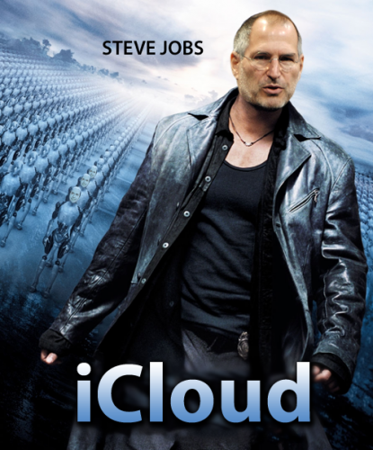
iClouds is our future!
Notes:
Nowadays, many service has provide on the cloud.
There are services that let you put your file on the cloud.

Slide 4
How?
Provide iClouds with cloud image → Answer what this cloud look like?
“Shape Matching and Object Recognition Using Shape Contexts” by S.Belongie, et al.
Cloud → Grayscale → Canny Edge Detection
Extract some sampling points
Calculate Shape Contexts of cloud and our known shape in database
Calculate Shape Distant between these two
Best matching pair = Smallest shape distant pair

Slide 5

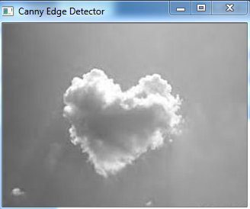
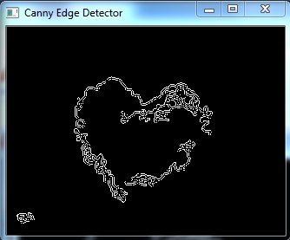
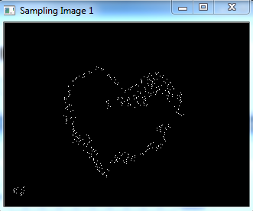
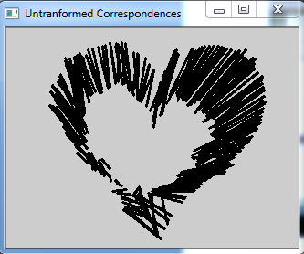
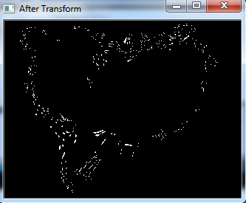
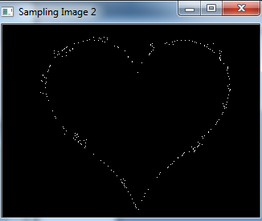
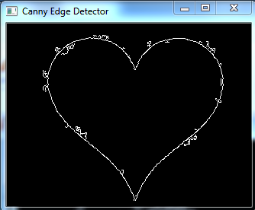

How?

Slide 6
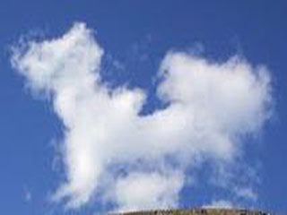
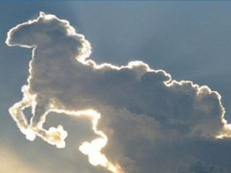











Show Time
My Clouds
Shape Information in Database
Notes:
I use the cloud which easily to detect edge and less noise.
Not practical but it is a good start.
We use these shape information to compare with the clouds.

Slide 7
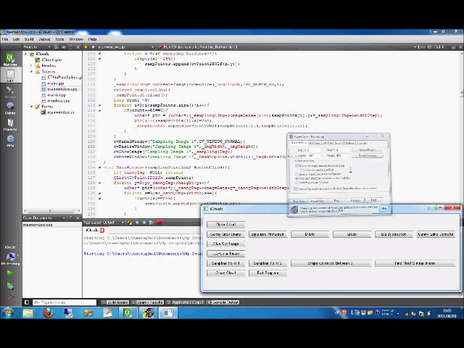
Show Time

Slide 8
THANK YOU VERY MUCH

