Slide 1
Drivers of Solar Panel Installation in the USA
Raphael Vazquez
Mark Yocum
Michael Young

Slide 2
What influences solar panel adoption in the USA?
Hypotheses:
Sunnier regions have more solar panels per person (more efficient use)
Wealthier regions have more solar panels per person (solar panels are expensive)
Regions with higher electricity prices have more solar panels per person (greater desire for substitutes)
Regions with better government incentives have more solar panels per person (cost burden lower)
Regions with higher education have more solar panels
Regions with democratic political affiliation have more solar panels per person (climate change is important)

Slide 3
Data Cleanup and Exploration
Source Data: Stanford Deep Solar Project
72537 rows (city-level) data with 169 columns of weather, government, and demographic data
Drop NaN values to reduce data set to 63847 rows
Perform analysis at city level, but need to group at county and state level for other analyses and graphing purposes
Location data from geocode API for county level (3019 counties)
Do not use geocode API for 60,000+ rows unless you have a high credit card limit and LOTS of time….
Encoding an issue! Original data in ANSI format due to special characters for some county names but needed ISO-8859-1 encoding to work across PC and MAC

Slide 4
Data Analysis
Test for significance – what matters for solar panel adoption?
Organize dataframe into those with solar (49940) and those without solar (13907)
Sample 1000 datapoints from each subset
Create function to calculate variable mean, create histogram, and test for significance
Per capita income
Daily solar radiation
Incentive Count
Electricity Price
Number of years of education
Voting percentage of democrats in 2016
Can only test for significance, not causality

Slide 5
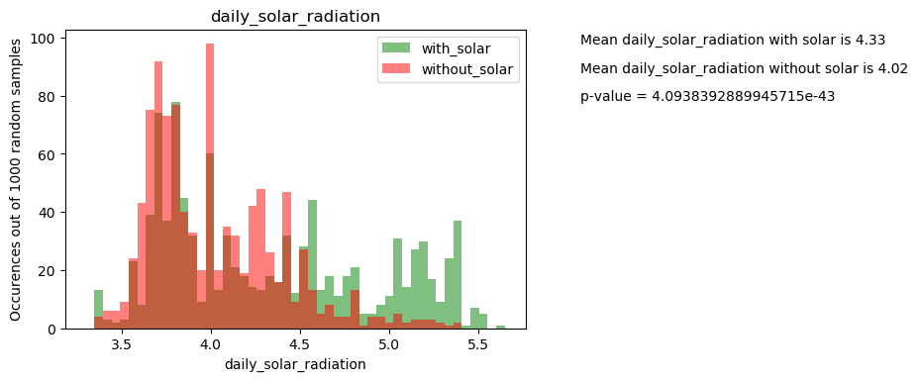
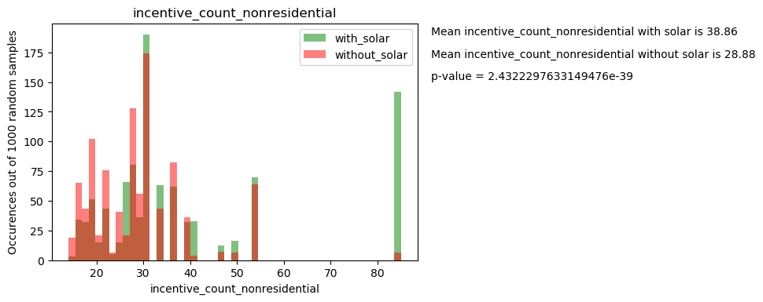
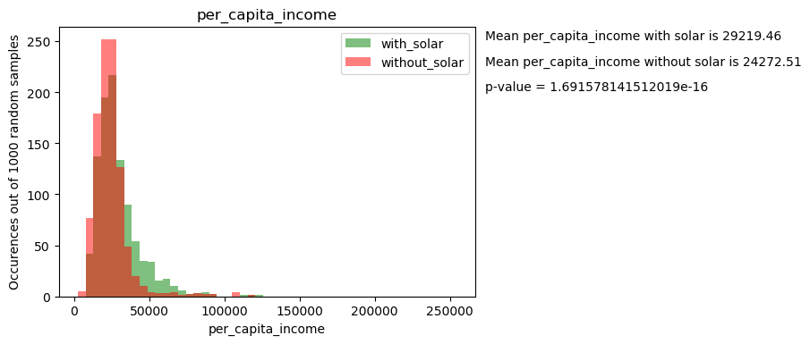
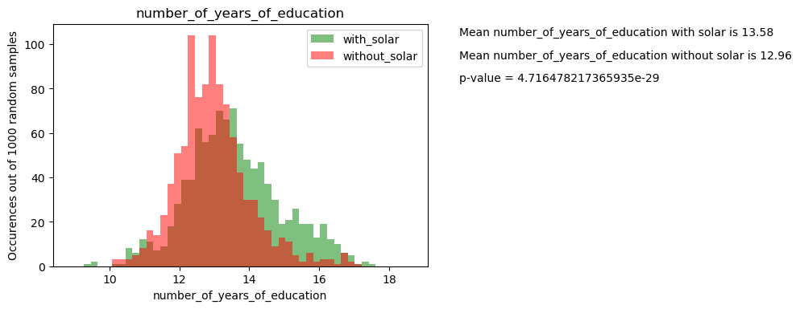
Histograms - examples

Slide 6
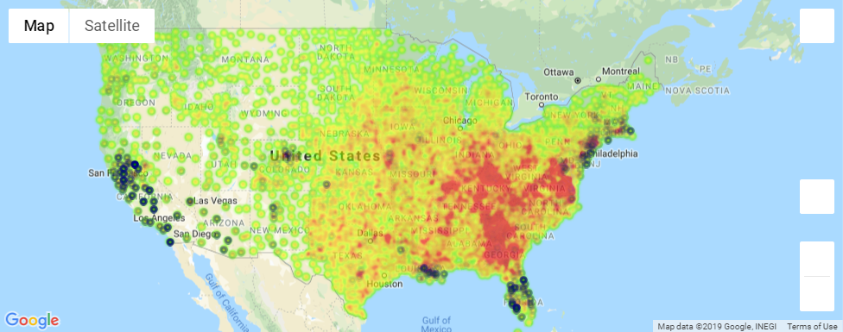
Map Visualization
Merge two dataframes by county and state: coordinate data + demographic data
Gmaps.figure() to create:
Heat_layer = independent variable (daily solar radiation, electricity prices, etc)
Symbol_layer = target variable (solar systems per person)
Daily Radiation = heatmap
Solar Systems per person = symbol

Slide 7
Discussion

Slide 8
Post Mortem

