Slide 1
Beneath the Mesa
Assessing Aquifer and Well Water Resources Across Sandoval County, New Mexico
Petar Djordjevic (PM) · Meckrem Yousef · James Wauneka
Dylan Gonzales · Micah Watkins
ENG 220 · Team 23 · Instructor: Ramiro Jordan
Notes:
About 45 seconds. Each team member introduces themselves by full name (rubric elevator-pitch item 1).
Timing guide for the in-class presentation, following the rubric. Elevator pitch, 2 minutes: Title 0:45, At a glance 1:15. Content, 7 minutes: Background 0:30, Research questions 0:30, Deliverables 0:20, Data 0:30, Methods 0:20, Member slides 0:25 each (2:05 total), Results 0:50, Findings 0:30, Limitations 0:15, Risks 0:30, Timeline 0:30, Links 0:05.
The circle in the bottom-right corner is where the presenter's camera goes; keep charts and text out of that corner.

Slide 2




The project at a glance
What we're building
What it does
Who benefits
A screening study of water resources across Sandoval County, with Cuba as the focus
An interactive app, a written report, and an open GitHub repository
Brings together public well, aquifer, and river data
Shows what's known about Cuba's groundwater, and where the data runs out
Cuba residents and village leaders
Rural communities that rely on wells
Agencies deciding where to monitor next
Peace engineering
Clear, shared information about a scarce resource helps communities make fair water decisions together.
Notes:
About 1 minute 15 seconds. This slide covers rubric elevator-pitch items 2 to 4: what the product is, what it does, and who benefits. The wording comes from the proposal's abstract; adjust it to how the team wants to say it, and keep the peace engineering point in your own words.
The circle in the bottom-right corner is where the presenter's camera goes; keep charts and text out of that corner.

Slide 3

Background
Where Sandoval County's water comes from: wells, rivers, and acequias
Why the county spans several aquifer systems
The concern: declining groundwater near Cuba
What this project set out to check
Map of the study area
Sandoval County with Cuba marked
Figure caption and source
Notes:
About 30 seconds. Rubric content item 1: the project and its goals. Replace the bullets with your own points. Add a map: Insert > Pictures, drop it over the dashed box, then delete the box.
The circle in the bottom-right corner is where the presenter's camera goes; keep charts and text out of that corner.

Slide 4

Research questions
1
Groundwater levels
How have groundwater levels changed at monitored wells in Sandoval County?
2
Cuba's aquifers
How do the Ojo Alamo Sandstone and San Jose Formation compare near Cuba?
MAIN QUESTION
Is Cuba's aquifer running out, and do public records say enough to tell?
3
Coverage and data gaps
Where is monitoring coverage strong, and where are the biggest data gaps?
Notes:
About 30 seconds. The main question is research question 3, and the three rows are research questions 1, 4, and 5, shortened to fit. The full list of six is in the report and on the app's home page. The proposal had nine; the three on water quality and acequias were dropped because the data weren't available.
The circle in the bottom-right corner is where the presenter's camera goes; keep charts and text out of that corner.

Slide 5






Deliverables
Deliverable
What it is
Owner
Due
Streamlit app
Interactive maps and charts of the data
Meckrem
Nov 14
FINAL DUE
Mon, Nov 16
Final report
Methods, findings, and figures in writing
Petar
Nov 14
Nov 14
App, report, and slides
Nov 15
Individual videos
Presentation slides
This deck, presented in class
Petar
Nov 14
Individual videos
Each member presents their own part
Everyone
Nov 15
Documentation site
How each stage was done, with links to everything
Petar
Nov 16
GitHub repository
Raw and cleaned data, scripts, and app code
Everyone
Nov 16
Notes:
About 20 seconds. Rubric content item 2: the specific deliverables. Owners and due dates match the timeline slide; change both together if a date moves.
The circle in the bottom-right corner is where the presenter's camera goes; keep charts and text out of that corner.

Slide 6



Data
Groundwater levels
Aquifer tests
Rio Puerco at Cuba
Well logs and geology
USGS: 9 wells, 1998–2026. NM Bureau of Geology: 87 wells, 1997–2019.
NM State Engineer: 179 tests from 1930 to 2008
USGS gage 08332525: 10 streamflow visits from 2019 to 2026
NM State Engineer: 6 well logs. USGS and NMGS maps of the two formations.
Full source links are on the last slide and in the project documentation.
Notes:
About 30 seconds. For each dataset: who published it, what it measures, the years covered, and how many wells or sites are in Sandoval County. Delete any card whose data the project didn't end up using.
The circle in the bottom-right corner is where the presenter's camera goes; keep charts and text out of that corner.

Slide 7




Methods
Collect
Clean
Analyze
Present
Report
Dylan Gonzales
James Wauneka
Micah Watkins
Meckrem Yousef
Petar Djordjevic
One or two lines on what this step did
One or two lines on what this step did
Trend statistics and 15 charts with labeled findings
One or two lines on what this step did
One or two lines on what this step did
Tools Python · pandas · Plotly · Streamlit · GitHub
Notes:
About 20 seconds. Rubric content item 3: problem-solving approach and methodology. A quick overview of the five stages. Each member explains their own stage in detail on the next five slides.
The circle in the bottom-right corner is where the presenter's camera goes; keep charts and text out of that corner.

Slide 8

Data collection
Dylan Gonzales
Data acquisition and dataset justification
What I did
The part of the project you were responsible for
Screenshot of your work
A data source page or the raw dataset
How I did it
Tools, sources, and main steps
Figure caption and source
What I learned
A challenge you hit and how you handled it
Notes:
About 25 seconds. Dylan Gonzales presents this slide (rubric content item 4: roles and responsibilities). Cover what you did, how you did it, and one thing you learned. Put a screenshot in the dashed box: a data source page or the raw dataset.
The circle in the bottom-right corner is where the presenter's camera goes; keep charts and text out of that corner.

Slide 9
Data cleaning
James Wauneka
Data cleaning and preprocessing
What I did
The part of the project you were responsible for
Screenshot of your work
The cleaning script, or the data before and after
How I did it
Tools, sources, and main steps
Figure caption and source
What I learned
A challenge you hit and how you handled it
Notes:
About 25 seconds. James Wauneka presents this slide (rubric content item 4: roles and responsibilities). Cover what you did, how you did it, and one thing you learned. Put a screenshot in the dashed box: the cleaning script, or the data before and after.
The circle in the bottom-right corner is where the presenter's camera goes; keep charts and text out of that corner.

Slide 10
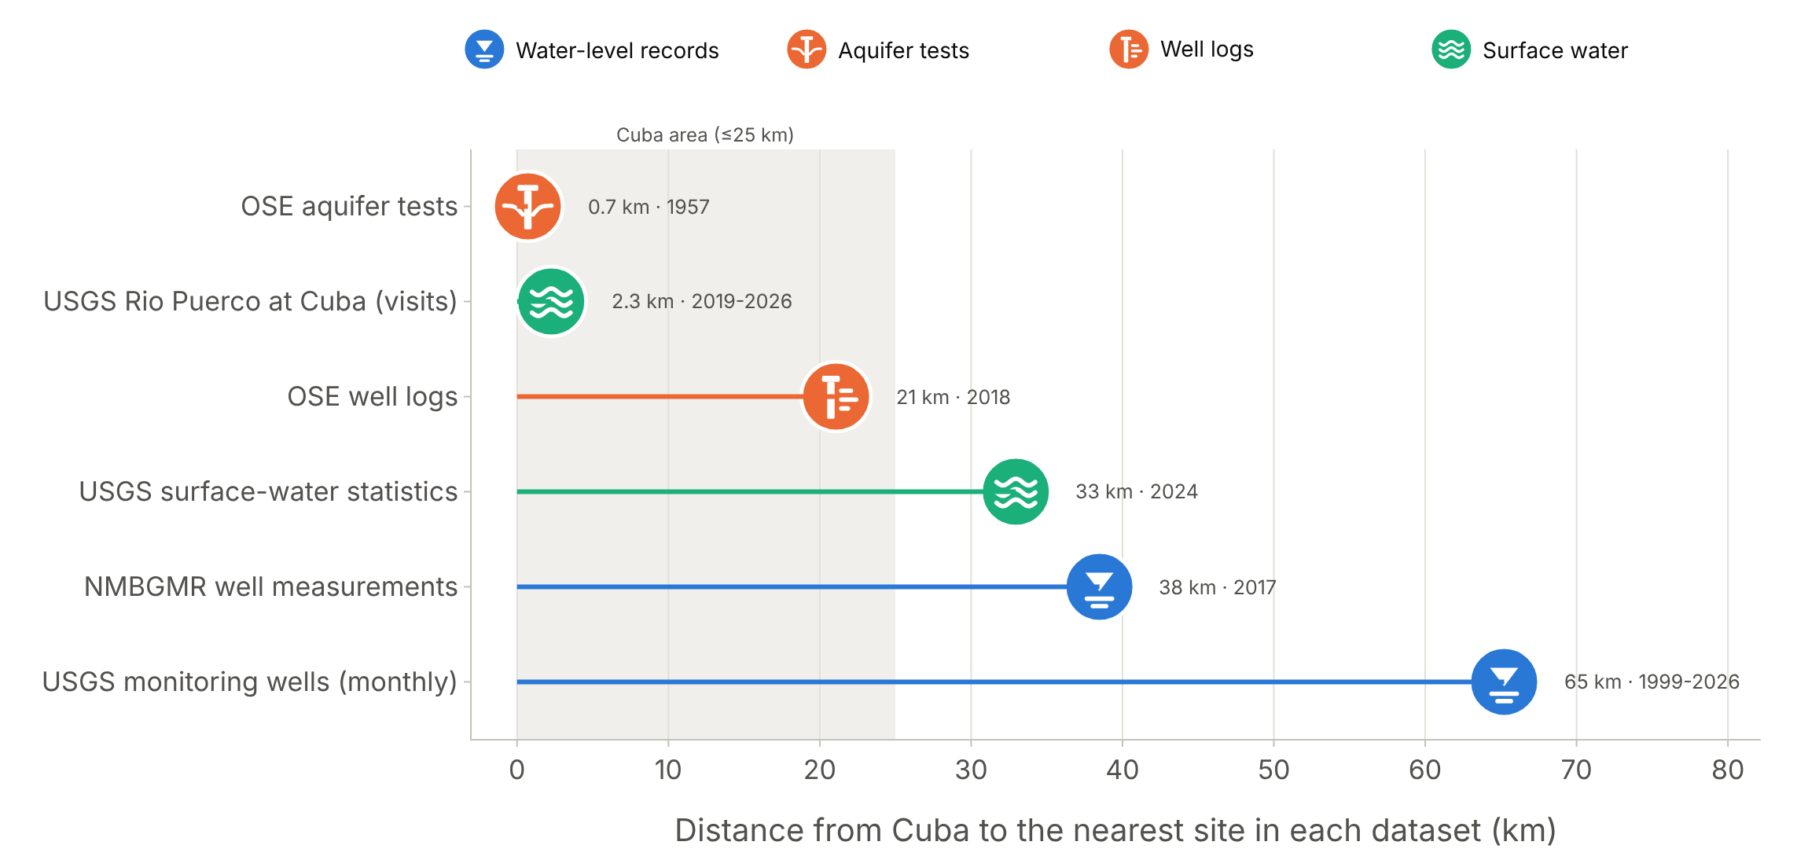
Analysis and visualizations
Micah Watkins
Analysis code and visualizations
What I did
Turned the cleaned data into 15 charts on the six research questions, used in the app, report, and docs.
How I did it
Python, pandas, and Plotly; one function per chart returns the figure, caption, scope, and labeled findings.
Nearest record of each kind to Cuba; only one-time tests lie within 25 km. Data: USGS, NMBGMR, NM OSE.
What I learned
Thin data needs honest charts: almost nothing measures Cuba's groundwater, so each chart states its scope.
Notes:
About 25 seconds. Micah Watkins presents this slide (rubric content item 4: roles and responsibilities). Cover what you did, how you did it, and one thing you learned. Put a screenshot in the dashed box: a chart from the analysis.
The circle in the bottom-right corner is where the presenter's camera goes; keep charts and text out of that corner.

Slide 11
Streamlit app
Meckrem Yousef
GitHub workflow and the Streamlit app
What I did
The part of the project you were responsible for
Screenshot of your work
A page of the live app
How I did it
Tools, sources, and main steps
Figure caption and source
What I learned
A challenge you hit and how you handled it
Notes:
About 25 seconds. Meckrem Yousef presents this slide (rubric content item 4: roles and responsibilities). Cover what you did, how you did it, and one thing you learned. Put a screenshot in the dashed box: a page of the live app.
The circle in the bottom-right corner is where the presenter's camera goes; keep charts and text out of that corner.

Slide 12
Report and documentation
Petar Djordjevic
Project manager: report, slides, and video
What I did
The part of the project you were responsible for
Screenshot of your work
The documentation site or a page of the report
How I did it
Tools, sources, and main steps
Figure caption and source
What I learned
A challenge you hit and how you handled it
Notes:
About 25 seconds. Petar Djordjevic presents this slide (rubric content item 4: roles and responsibilities). Cover what you did, how you did it, and one thing you learned. Put a screenshot in the dashed box: the documentation site or a page of the report.
The circle in the bottom-right corner is where the presenter's camera goes; keep charts and text out of that corner.

Slide 13

Results
— ft
Key number and what it measures
What this shows
Two or three sentences on the main pattern in the chart.
Chart, map, or app screenshot
Copy this slide for each result
Figure caption and source
Notes:
About 50 seconds across all results slides. Duplicate this slide (right-click > Duplicate Slide) for each chart. Rubric: the results slides must show graphs and screenshots of the outputs.
The circle in the bottom-right corner is where the presenter's camera goes; keep charts and text out of that corner.

Slide 14



Findings
What the data show
What they suggest
Too limited to tell
Measured results, with numbers
Likely explanations, stated as possibilities
Questions the data can't answer yet
Bottom line
One sentence that answers the main question
Notes:
About 30 seconds. Keep the three levels of certainty separate. The bottom line answers the main question from the research-questions slide.
The circle in the bottom-right corner is where the presenter's camera goes; keep charts and text out of that corner.

Slide 15

Limitations
Areas with few or no monitoring wells
Short or irregular water-level records
Data the project couldn't get
What a stronger study would need
Data coverage map
Where monitoring is dense, sparse, or absent
Figure caption and source
Notes:
About 15 seconds. Name the data gaps and what the results can't support.
The circle in the bottom-right corner is where the presenter's camera goes; keep charts and text out of that corner.

Slide 16






Risks and how we reduce them
Risk
How we reduce it
No records from Cuba's own wells
Ask the Village of Cuba and NM OSE for records; label every result as Cuba, county, or regional
Guardrails from our proposal
Sparse, uneven monitoring
Map where coverage is thin, trend only wells with long records, and state the gaps
Treat the concern about Cuba's aquifer as a question, not a conclusion
Keep Cuba as the main case study to stay on schedule
Use public data anyone can recheck
Errors in the raw data
Shared cleaning rules, a rerunnable script, and checks against the raw files
Overstating conclusions
Keep what the data show, suggest, and can't tell separate in every finding
Tight final weeks
Write the report and slides alongside the app, and track every deadline on the timeline
Notes:
About 30 seconds. Rubric content item 6: forecasting and mitigating project risks. The biggest risk is the first one: without the village's own well records, the project can't measure Cuba's depletion directly. The guardrails on the right come from the proposal's Scope Guardrails section.
The circle in the bottom-right corner is where the presenter's camera goes; keep charts and text out of that corner.

Slide 17
Timeline and milestones
Sep 21
Sep 28
Oct 5
Oct 12
Oct 19
Oct 26
Nov 2
Nov 9
Nov 16
Milestones
Team, topic, and roles (all)
Mon, Oct 12
First quarter · done
Project proposal (all)
Data collection (Dylan)
Fri, Oct 23
Midpoint · done
Data cleaning (James)
Analysis and visualizations (Micah)
Tue, Nov 3
Three-quarter
Streamlit app (Meckrem)
Final report (Petar)
Mon, Nov 16
Final due
Presentation slides (Petar)
Documentation site (Petar)
Individual videos (all)
Team (all)
Dylan
James
Micah
Meckrem
Petar
Course checkpoint
Notes:
About 30 seconds. Rubric content item 7: project timeline (Gantt chart) and milestones. Bar colors show who owns each task: blue for the whole team, one color per member. Before presenting, mark any milestone that has passed as done.
Tasks and dates: team, topic, and roles Sep 21 to Oct 12; proposal Oct 12 to Oct 23; data collection Oct 1 to Oct 29; data cleaning Oct 25 to Nov 6; analysis and visualizations Oct 30 to Nov 10; app and slides Oct 15 to Nov 14; final report Nov 3 to Nov 14; documentation site Oct 15 to Nov 16; individual videos Nov 9 to Nov 15. The same schedule is on the documentation site's Timeline page.
The circle in the bottom-right corner is where the presenter's camera goes; keep charts and text out of that corner.

Slide 18
Explore the data, code, and app
GitHub repository
github.com/pdjordj11/eng_220_aquifer_project
Streamlit app
eng220aquiferproject.streamlit.app
Documentation
pdjordj11.github.io/eng_220_aquifer_project
Datasets
github.com/pdjordj11/eng_220_aquifer_project/tree/main/data
Notes:
About 5 seconds. Rubric: the final slide must link to the datasets, the GitHub repository, and the Streamlit app. Once Dylan adds the exact download pages to the Data collection docs page, add them here too.
The circle in the bottom-right corner is where the presenter's camera goes; keep charts and text out of that corner.

