Slide 1
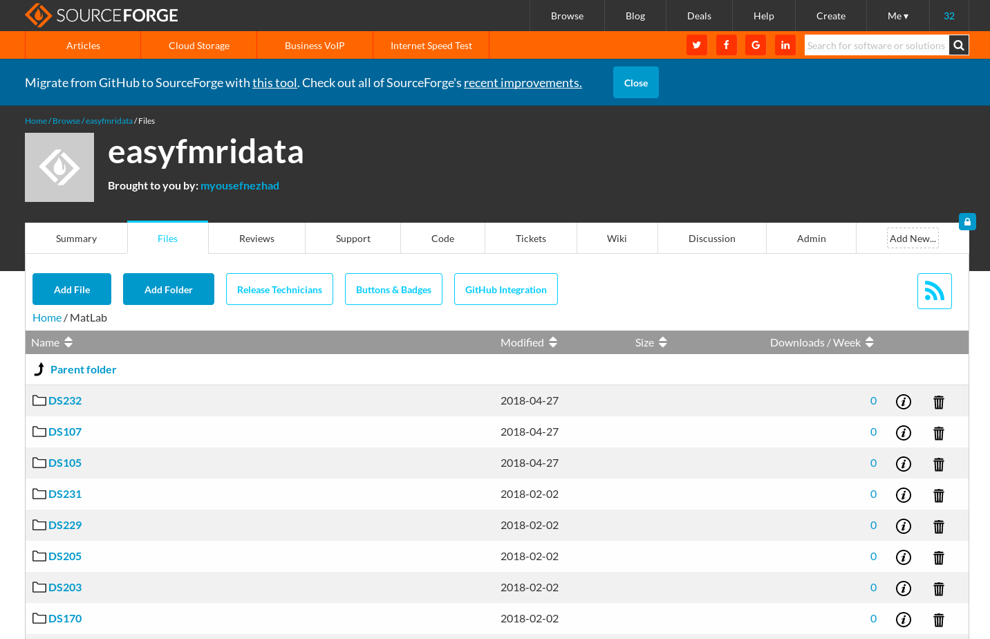
easy fMRI : DATA
Matlab + 40 dataset + 200 cognitive tasks + 1000 subjects
https://easyfmridata.github.io/
https://easyfmridata.sourceforge.io/

Slide 2
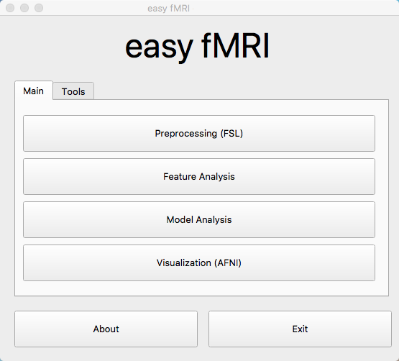
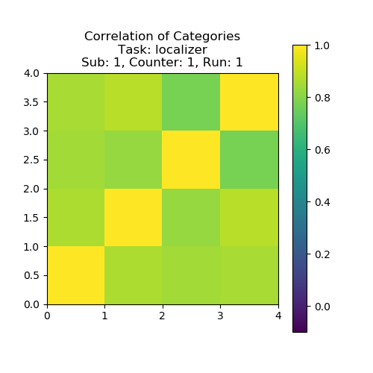
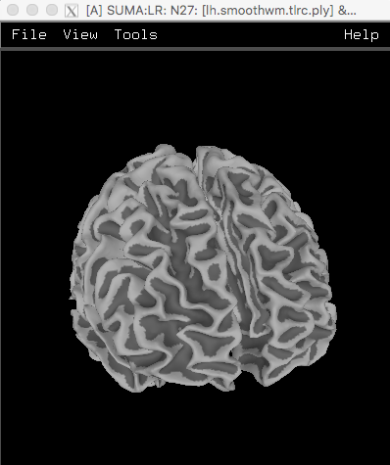
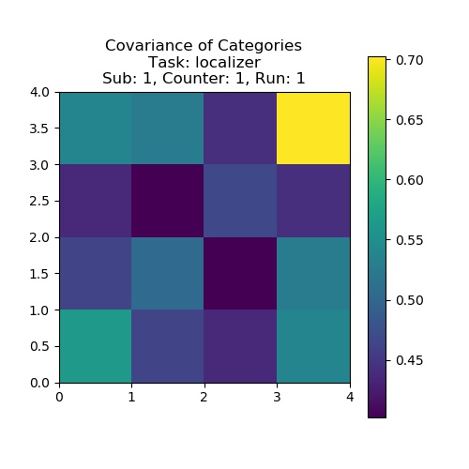
easy fMRI Project
Open Source + Free + Python + SK-Learn + MPI + Tensorflow
https://easyfmri.github.io/
https://easyfmri.sourceforge.io/

