Slide 1
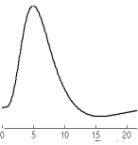
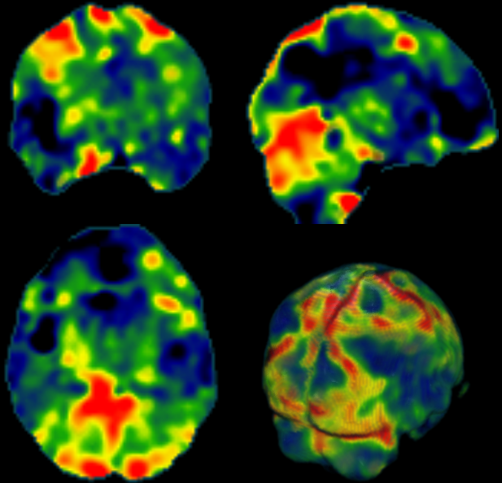
Highest probability
of capturing neural
activities
HRF signal relate to a stimulus
A Snapshot of neural activities
Time Points
Each time-point shows a snapshot

