Slide 1
xxxxxx夏令营
Personal Summary
xxxx
xxxx大学 xx工程学院
2022年2月16日

Slide 2
1.Personal Profile
Born: Feb.03,1998 Birthplace: Hunan Province
Educational Background:2013-2016 xxxxxxxxxx MiddleSchool
2016- present Dept. of Automobile Engineering, xxxxxUniversity of Technology
2020.2-6 Laboratory Internship Program, Shibaura Institute of Technology in Japan
GPA:3.3 RANK: Top 24% CET6:452
Highly motivated undergraduate in Automotive Engineering
Frequent user of C, Matlab, Python, Visual Basic, LaTeX programming
Advanced learner of English attaining CET 6
Excellent performance in academic competitions
Hopefully be exempt from examination for postgraduate study
·插入学校徽章

Slide 3

2.Honors and Awards
National MCM: First Prize
“Flexible job Shop Scheduling"
National MCM: First Prize
“Flexible job Shop Scheduling"
National MCM: First Prize
“Flexible job Shop Scheduling"
National MCM: First Prize
“Flexible job Shop Scheduling"
National MCM: First Prize
“Flexible job Shop Scheduling"
National MCM: First Prize
“Flexible job Shop Scheduling"
·插入学校徽章

Slide 4
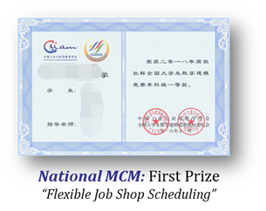


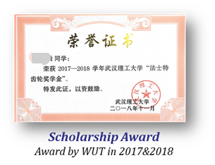


此页为参考
·插入学校徽章

Slide 5
3.Research Projects
3.1 A Novel SFLA for Dynamic Scheduling of the Flexible Robotic Cell
·插入学校徽章

Slide 6

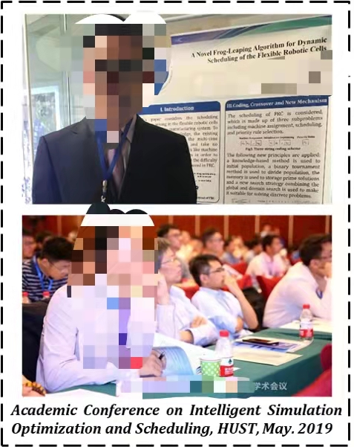
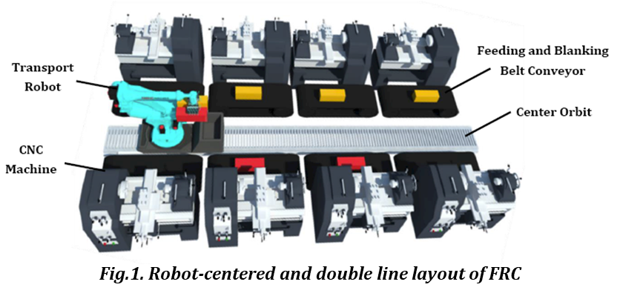

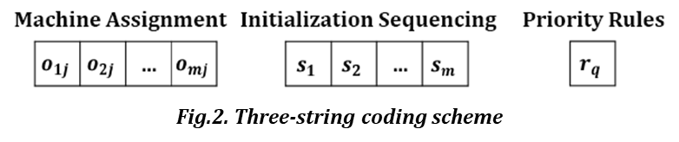
此页为参考
·插入学校徽章
Notes:
介绍科研经历
介绍调度会议等会议
介绍论文解决的问题

Slide 7
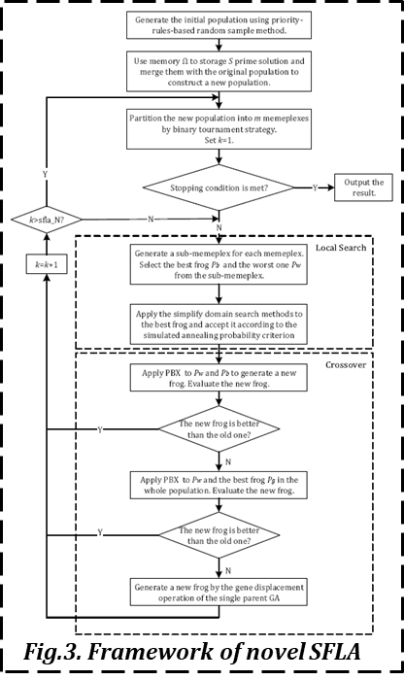
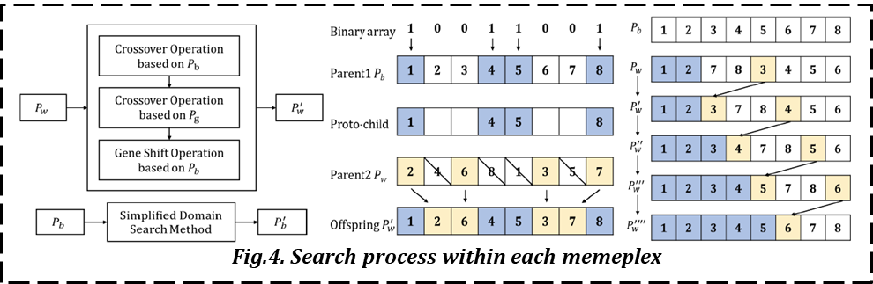
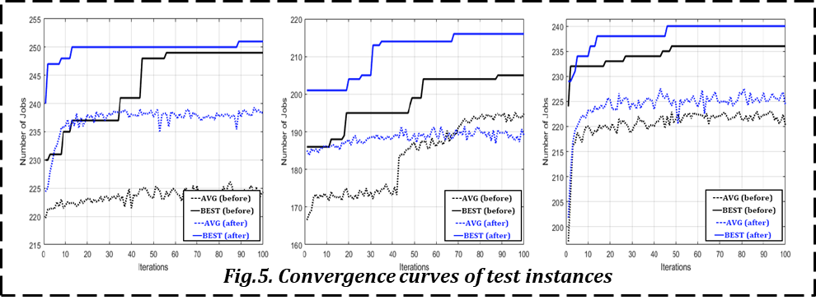
此页为参考
·插入学校徽章
Notes:
介绍论文的方法
介绍论文的效果

Slide 8

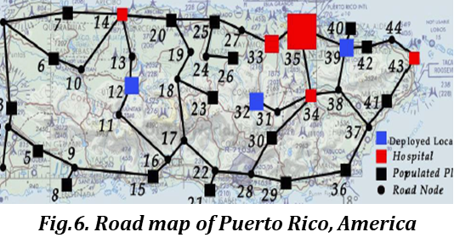
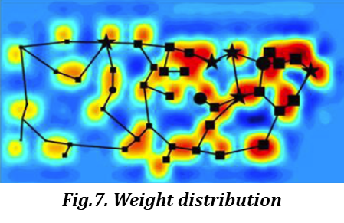
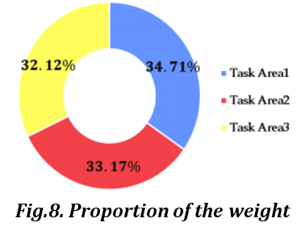
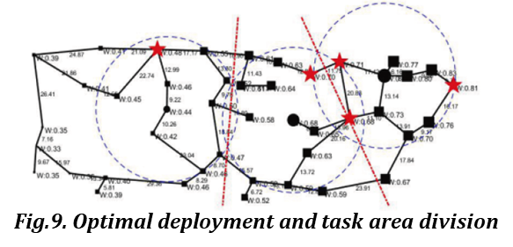
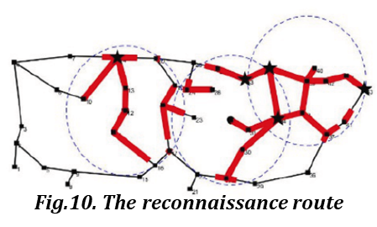
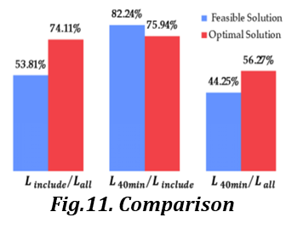
此页为参考
·插入学校徽章
Notes:
1）介绍问题，阐述问题的复杂性“救灾双层规划”
2）介绍一般的思路
3）介绍自己的思路
4）介绍求解结果

Slide 9

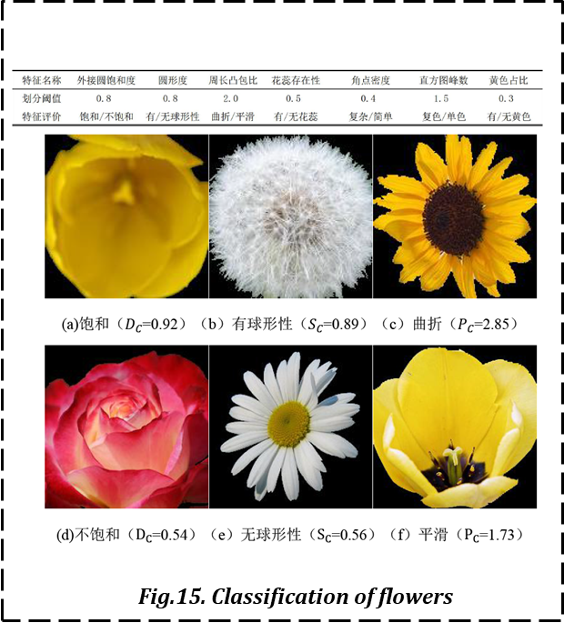
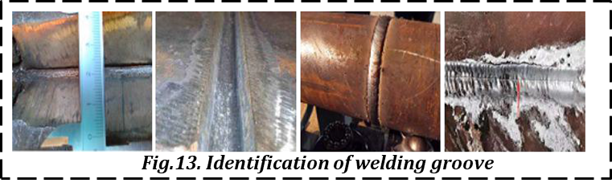
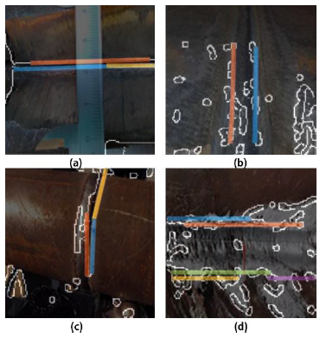
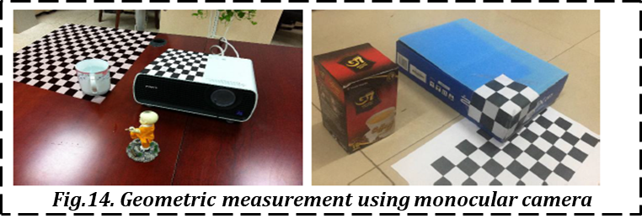
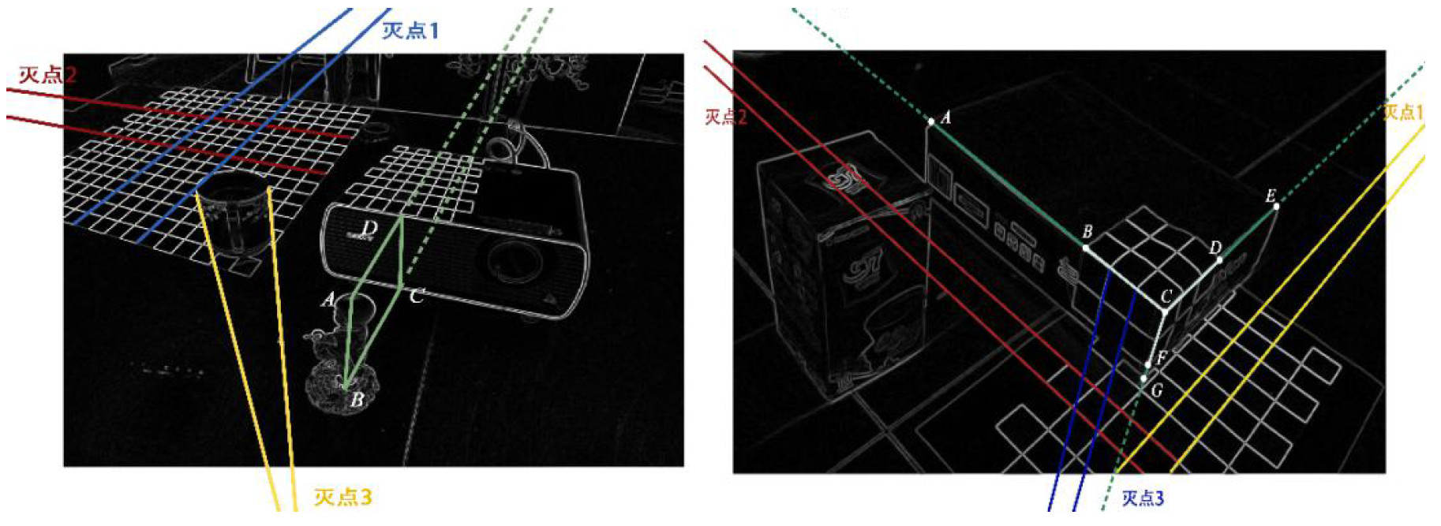
此页为参考
·插入学校徽章
Notes:
Studied modern optimization algorithms including GA, PSO, ACO, SVM, NN and cluster
Used Computer Vision and Pattern Recognition technique for classification tasks
Solved Combinatorial, Network Optimization and Integer Programming problems

Slide 10

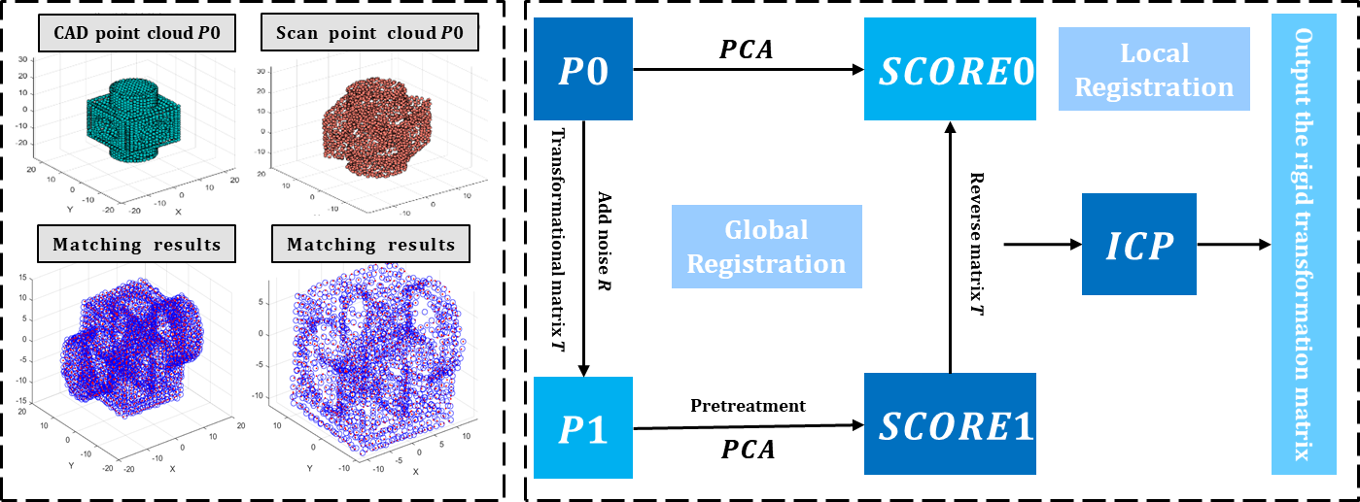
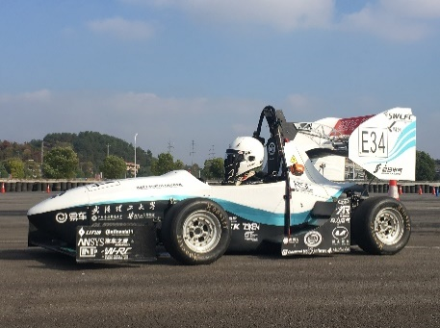
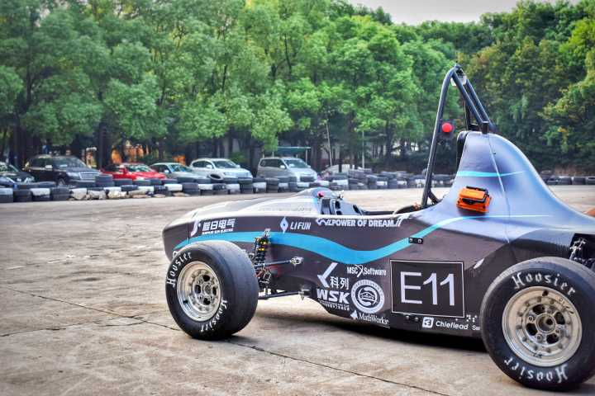
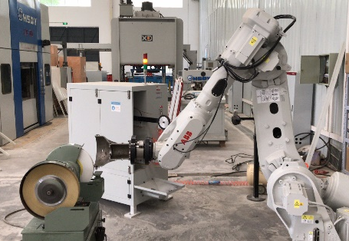
·插入学校徽章

Slide 11
4.Leadership Experience
·插入学校徽章

Slide 12

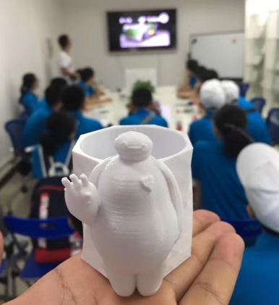
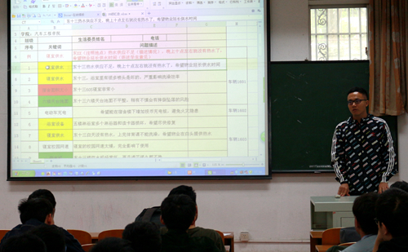
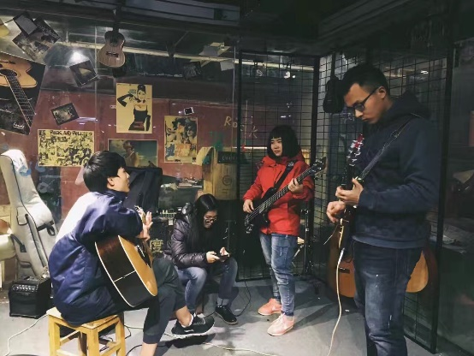
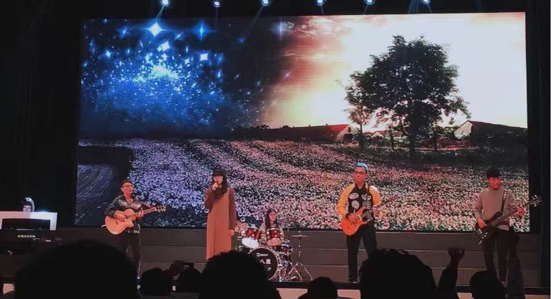
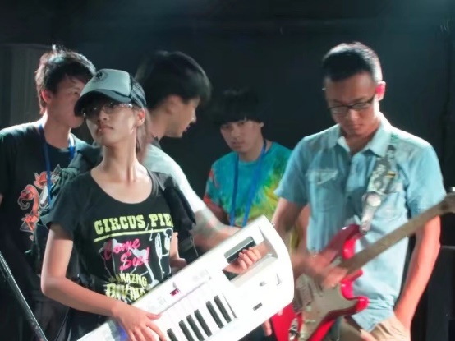
xxx Technology Society & xxx Students Union & XXX Guitar Society
·插入学校徽章
WUT Technology Society
Worked as the vice student president of the society with the mission to promote technological awareness and innovative ideas of students.
Hosted 6 tech workshops on topics like Photoshop Using to Circuit Board Welding for freshmen who want to get started and develop their skills.
WUT Students Union
Worked as a member of Students’ Union Committee to address issues related to the students’ daily life.
Represented 36,000 students in our school, campaigning for change to improve their student experience and helping to set the strategic direction of the college logistical departments.
WUT Guitar Society
Founded a band as the role of the tonic guitarist.
Performed in the WUT Rock Music Festival and various college galas

Slide 13
Thank You

Slide 14


