Slide 1
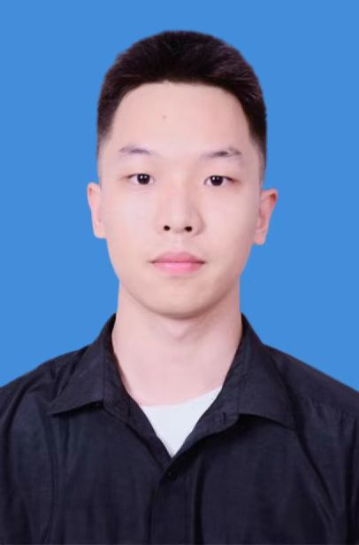
马宇佩
山西大学 | 自动化与软件学院 | 测控技术与仪器
基本信息
男 21岁 汉族 中共党员
电话/微信：13933838842 邮箱：13933838842@163.com
山西大学-自动化与软件学院 -测控技术与仪器（2023-2027）
个人简述
乐观善良、自律踏实的大三本科生，数理基础扎实，学习能力强，有良好项目基础和科研经历。
GPA 3.72/4.5
专业排名 2/69（2%）
科研经历
1、PGA-STGCN：基于物理先验与门控注意力的地铁车厢级客流预测网络
Tiangou Zhang, Si Li, et al, TINA: A Fair Inter-datacenter Transmission Mechanism with Deadline Guarantee, INFOCOM 2020, CCF A
[Under Review] Tiangou Zhang, Si Li, et al, Efficient Coflow Transmission for Distributed Stream Processing
[Work in Progress] Tiangou Zhang, Si Li, et al, Deeper Exercise Monitoring for Smart Gym using Fused RFID
2、基于深度学习的智能体判卷系统
3、智轨慧乘——基于深度学习的地铁车厢客流智能引导系统
2025.06 至今
2025.06 至今
竞赛经历
2020.8-2020.12
2020.07-2020.08
2020.05-2020.05
荣誉奖项
国家励志奖学金、一等奖学金、山西大学三好学生、优秀共青团员、体育/文艺类奖项若干等
语言与技能
语言：CET-4：504 CET-6：437
技能：出色的写作能力、与人相处的能力（互评成绩班级排名1/29） 等

Slide 2
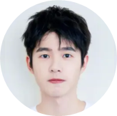
Tiangou Zhang
Information
Male Age 19
Tel/WeChat：123-4567-8900 E-mail：tiangou@std.uestc.edu.cn
University of Electronic Science and Technology of China (UESTC) (2018-2022)
School of Computer Science and Engineering - Computer Science and Technology
Weighted average 94.63, GPA: 3.96/4, ranking 1/713 (0.14%); Overall quality ranking 1/713 (0.14%)
Profile
Optimistic, kind and self-disciplined 3rd year undergraduates with a solid foundation in mathematics, strong learning ability, good project background and research experience.
Honors
National Scholarship, First-class Scholarship, Sichuan Comprehensive Quality A Certificate, Outstanding Communist Youth League Member, several awards in sports/arts, etc.
Research
Mobile Communications
Studying under Prof. Wenhao Wu, working in Mobile Comm, and still in the process of theoretical learning.
Network Transmission Optimization
Joined the Guangzhou Key Laboratory of Advanced Networks. Studying under Prof. Xing Qian.
1 paper accepted to INFOCOM 2020, 1 under review, and 1 work in progress.
Tiangou Zhang, Si Li, et al, TINA: A Fair Inter-datacenter Transmission Mechanism with Deadline Guarantee, INFOCOM 2020, CCF A
[Under Review] Tiangou Zhang, Si Li, et al, Efficient Coflow Transmission for Distributed Stream Processing
[Work in Progress] Tiangou Zhang, Si Li, et al, Deeper Exercise Monitoring for Smart Gym using Fused RFID
Unconventional superconductivity in magic-angle graphene superlattices
02/2021-now
10/2019-02/2021
12/2019-09/2020
Internship
SenseTime, Shanghai Algorithm Intern
Acted as an algorithm intern, participated in the development of SenseTime’s Progressive Care System, and designed models to achieve accurate analysis of patients’ sleep quality based on monitored indicators.
ByteDance, Beijing Front-end Intern
Acted as a front-end intern, participated in the development of a public welfare project group of ByteDance, and rated Excellent.
08/2020-12/2020
07/2020-08/2020
Projects
Summer Camp for Tencent Cloud Developer
Participated in cloud development of WeChat mini apps, and was awarded Outstanding Camper (5%).
05/2020
Experiences
QunGreen Volunteer Teaching Team founder/leader
UESTC RelaxingZone Online Culture Studio leader
07/2019-08/2019
09/2018-06/2020
Skills
English proficiency：CET-6: 590 IELTS: 7
Exceptional writing skills, Good with people (rank 1/29 in class mutual evaluation), etc.

