Slide 1
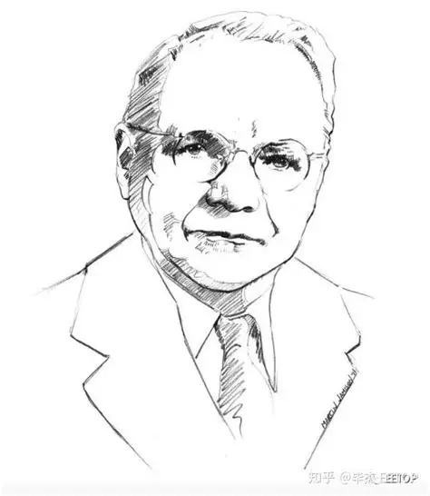
The Nyquist Stability Criterion
汇报人顺序：王浩锦、马宇佩
小组成员：马宇佩、王浩锦 图尔贡、秦谐民

Slide 2
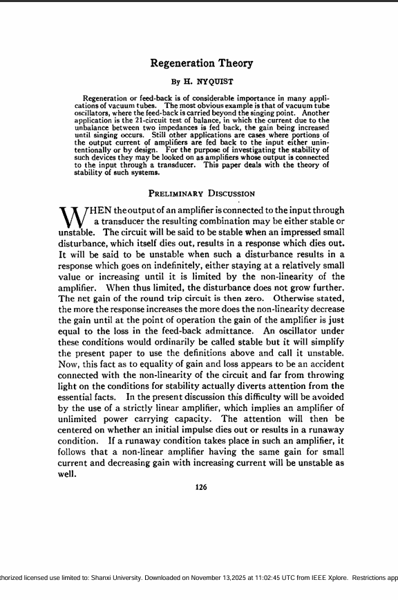
A stability test for time invariant linear systems can also be derived in the frequency domain. It is known as Nyquist stability criterion. It is based on the complex analysis result known as Cauchy’s principle of argument. Note that the system transfer function is a complex function. By applying Cauchy's principle of argument to the open-loop system transfer function, we will get information about stability of the closed-loop system transfer function and arrive at the Nyquist stability criterion (Nyquist, 1932). The importance of Nyquist stability lies in the fact that it can also be used to determine the relative degree of system stability by producing the so-called phase and gain stability margins. These stability margins are needed for frequency domain controller design techniques

Slide 3
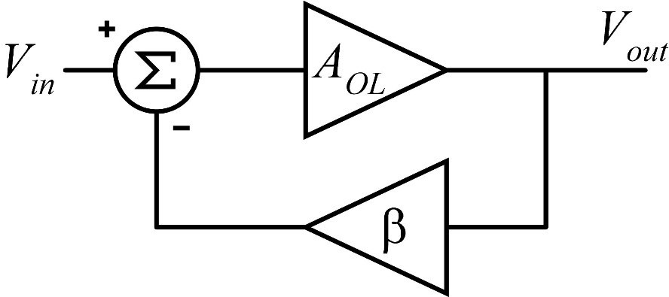
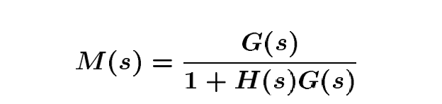
Feedback loop stability
We present only the essence of the Nyquist stability criterion .The Nyquist method is used for studying the stability of linear systems with pure time delay. For a SISO feedback system the closed-loop transfer function is given by
where represents the system and is the feedback element. Since the system poles are determined as those values at which its transfer function becomes infinity, it follows that the closed-loop system poles are obtained by solving the following equation which, in fact, represents the system characteristic equation.

Slide 4
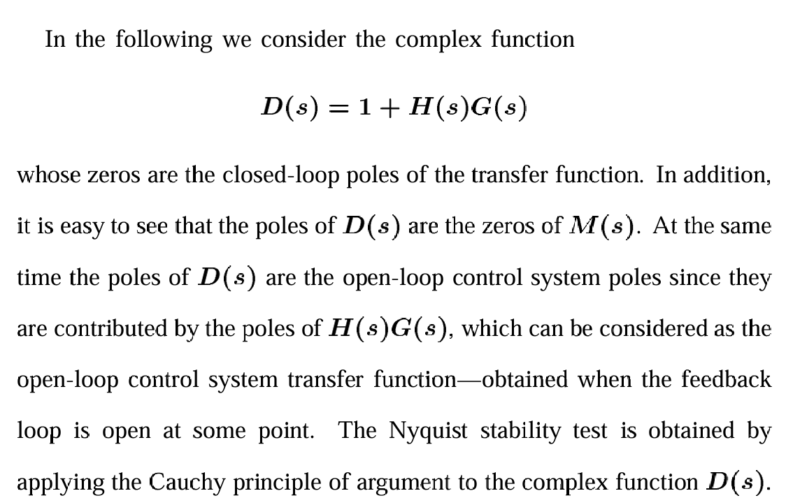

Slide 5
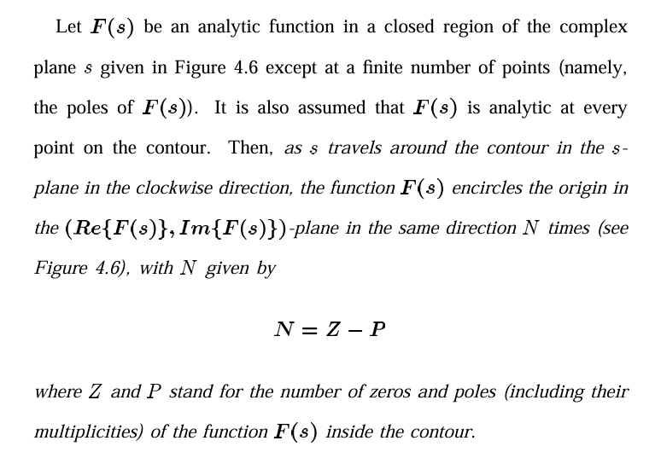
Cauchy's Principle of Argument

Slide 6
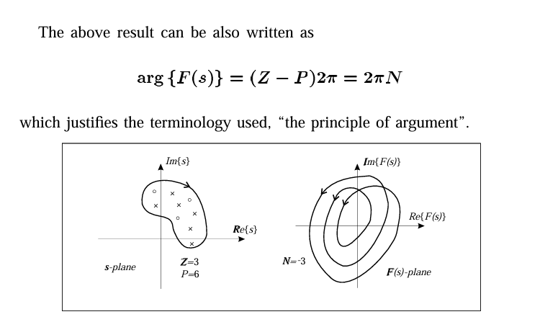

Slide 7
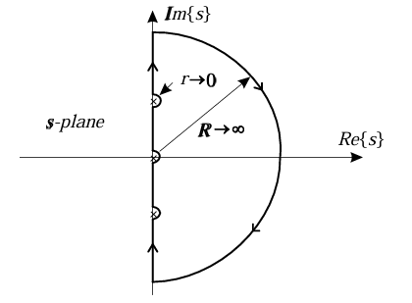
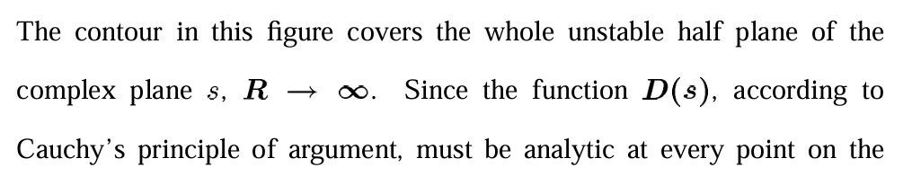
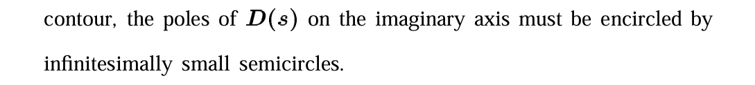
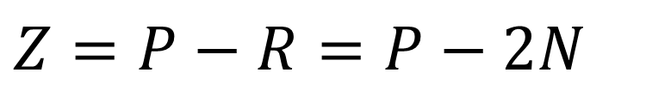
Nyquist Plot and stability criterion
$$Z=P−R=P−2N$$

Slide 8

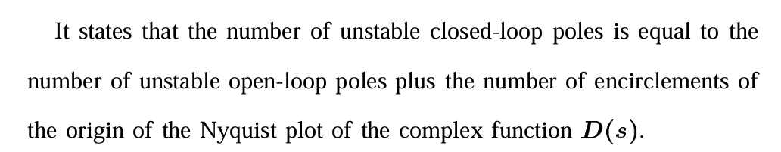
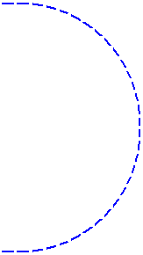
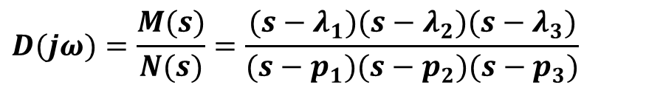
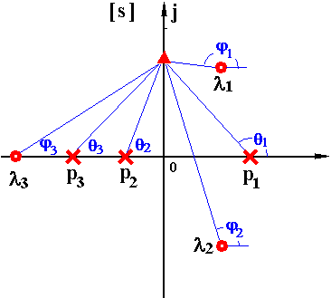
whose zeros are the closed-loop poles of the transfer function. In addition,it is easy to see that the poles of D(s) are the zeros of M(s).
$$D(jω)=\frac{M(s)}{N(s)}=\frac{(s−λ_{1})(s−λ_{2})(s−λ_{3})}{(s−p_{1})(s−p_{2})(s−p_{3})}$$
$$∠D(jω)=−2π(Z−P)=2π(P−Z)=2πR$$
$$Z=P−R$$

Slide 9
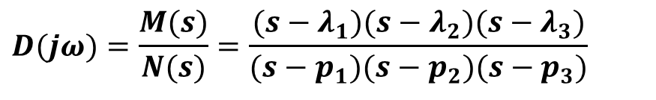
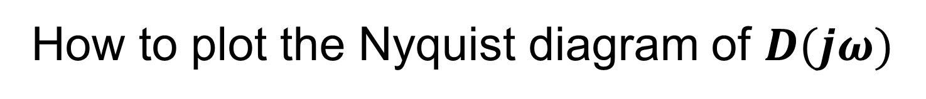
Question
How to plot the Nyquist diagram of $D(jω)$
$$D(jω)=\frac{M(s)}{N(s)}=\frac{(s−λ_{1})(s−λ_{2})(s−λ_{3})}{(s−p_{1})(s−p_{2})(s−p_{3})}$$

Slide 10
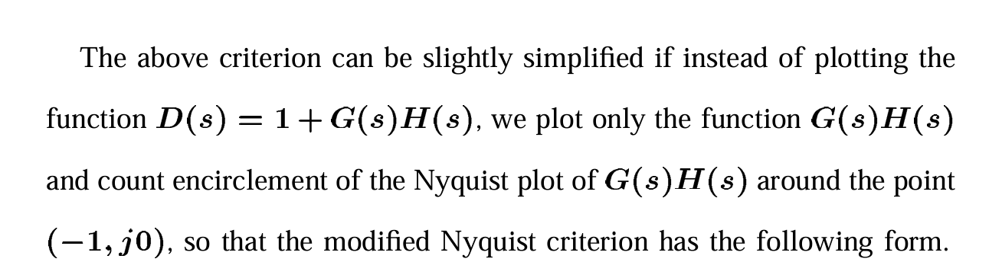
The ingenious aspect of the stability criterion

Slide 11
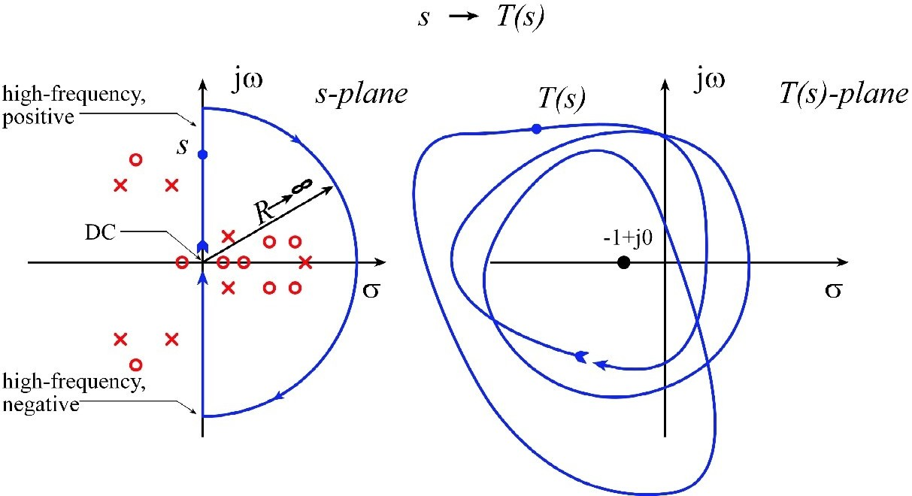

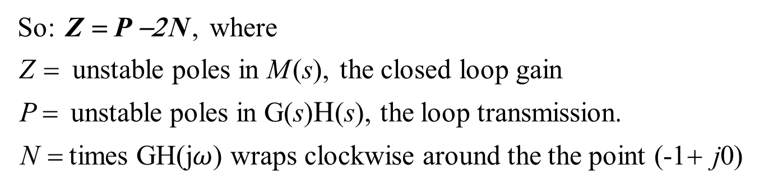

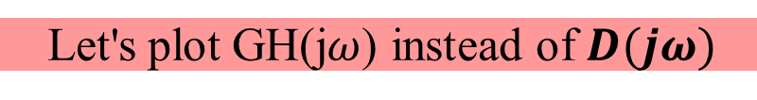
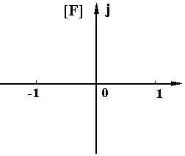


Nyquist's criterion
Let's plot GH(j$ω$) instead of $D(jω)$
So: Z = P −2 N , where
Z = unstable poles in M (s), the closed loop gain
P = unstable poles in G(s)Η(s), the loop transmission.
N = times GH(j$ω$) wraps clockwise around the the point (-1+ j0)

Slide 12
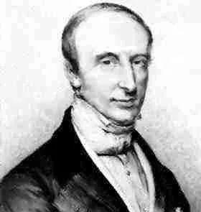
Finally
Thank you，Nyquist and Cauchy
for your great contribution！

Slide 13
Thank you everyone for listening

Slide 14
分工
马宇佩：资料收集、PPT制作、PPT讲解
王浩锦：PPT制作、PPT讲解
图尔贡：PPT制作与美化
秦谐民：PPT制作与美化

