Slide 1
Practical Big Data: Building a Seasonality Predictor
Adam Doyle
8/7/2015

Slide 2
Agenda
About Me
Machine Learning 101
Getting the Data
Developing the Model in R
Using the Model
Extending the Model
Questions

Slide 3




About Me

Slide 4
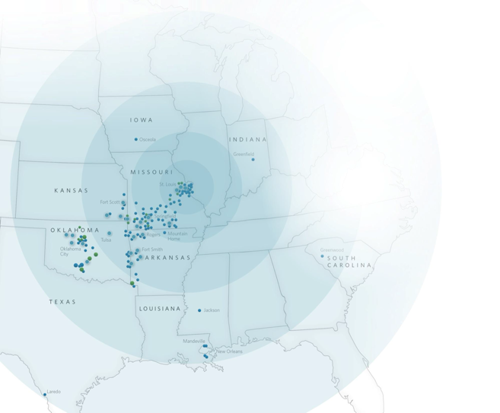
Mercy is the 7th largest Catholic health system in the U.S.
serving in 140 communities over a multi-state footprint through several touch points including outreach ministries and virtual care.
35 |  | Acute Care Hospitals
700 |  | Clinic and Outpatient Facilities
2,100 |  | Mercy Clinic Physicians
4,231 |  | Acute Licensed Beds
40,000 |  | Co-workers
22,486 |  | Births
158,768 |  | Acute Inpatient Discharges
150,595 |  | Surgeries (In/Outpatient)
650,702 |  | Emergency Visits
8,361,683 |  | Outpatient Visits
$4.48 billion |  | Operating Revenue
Notes:
Here are some facts about who Mercy is.
You might know the name Mercy from other places around the country, but if you aren’t near one of these dots, then it’s a different organization. We have a common heritage, but don’t have any business relationships related to the name.
The point is that we’re a fairly large healthcare system. In fact, we’re in the very top tier of customers for our EHR vendor, Epic. We’re large enough that we have to have three separate installations of their software to support our size, and one of those is the largest single installation that Epic had ever done at the time (7 years ago).
Virtual Care is one of our largest initiatives right now, building on a successful history with the nation’s largest centralized electronic ICU monitoring service. Remote monitoring and virtual access to specialists is a significant part of Mercy’s growth and commercialization strategy… which will obviously lead to even more data for us to play with.

Slide 5
Machine Learning 101
Classification
Clustering
Recommendation
Regression

Slide 6
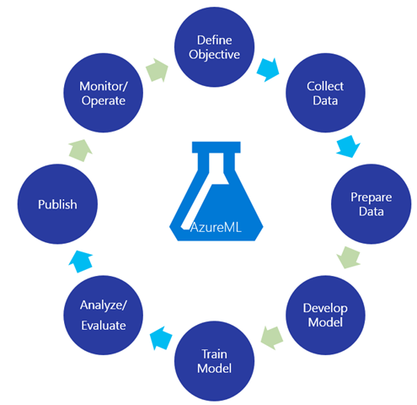
Machine Learning 101

Slide 7
The Problem
Can we forecast the daily number of patients seeking emergency department (ED) care in a general hospital according to calendar variables?

Slide 8
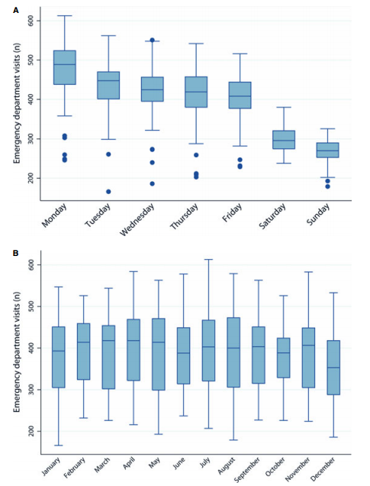
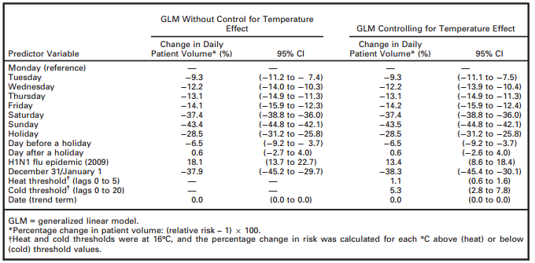
The Solution
Source: http://onlinelibrary.wiley.com/doi/10.1111/acem.12182/full

Slide 9
Getting the Data
Store in the rawest form on the Big Data platform
For this question, we need to get the counts of patients grouped by date.
The base data is enriched by comparing the date to a list of holidays.

Slide 10
The Data

Slide 11
Developing the Model in R
Predicting Total Patients
Features
Day of Week
Month of Year
Holidays (Day Before, Day Of, Day After)

Slide 12
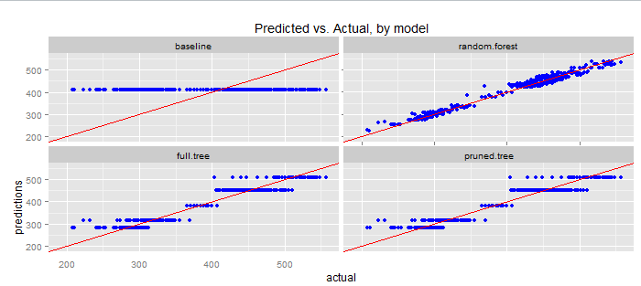
Developing the Model in R
Used four different models

Slide 13
Exporting the Model with PMML
XML-based format to exchange models
Use R to train/develop the model
Use Cascading to exercise the model

Slide 14
Using the Model
Create an application to exercise model.
using Cascading Pattern
Using Python Augustus
Other implementations
http://www.dmg.org/products.html

Slide 15
Extending the Model
Extend to different departments
Extend to different facilities
Weather (heat, rain, snow)
Refine time periods
Other major events

Slide 16
Questions?

Slide 17
References
Part 4a: Modelling – predicting the amount of rain
(http://www.r-bloggers.com/part-4a-modelling-predicting-the-amount-of-rain/
Forecasting Daily Emergency Department Visits Using Calendar Variables and Ambient Temperature Readings
(http://onlinelibrary.wiley.com/doi/10.1111/acem.12182/full)
Predicting R models with PMML: Revolution R Enterprise and ADAPA
(http://blog.revolutionanalytics.com/2011/03/predicting-r-models-with-pmml.html)

