Slide 1
Sv500 webserver
Updated list

Slide 2
Configuration
There are a total of four configuration files used on the device:
Maintenance history(maintain.db)
Account Management(user.db)
Device settings(setup.json)
InfluxDB settings(influx.json)
There are two types of reset:.
Administration > Service > Reset All
This deletes user.db and setup.json. Only the ntek account has access to the Administration menu.
Configuration > Reset
This deletes only setup.json, and is accessible only to the customer's administrator. The Configuration menu is accessible only to users with administrator privileges.

Slide 3
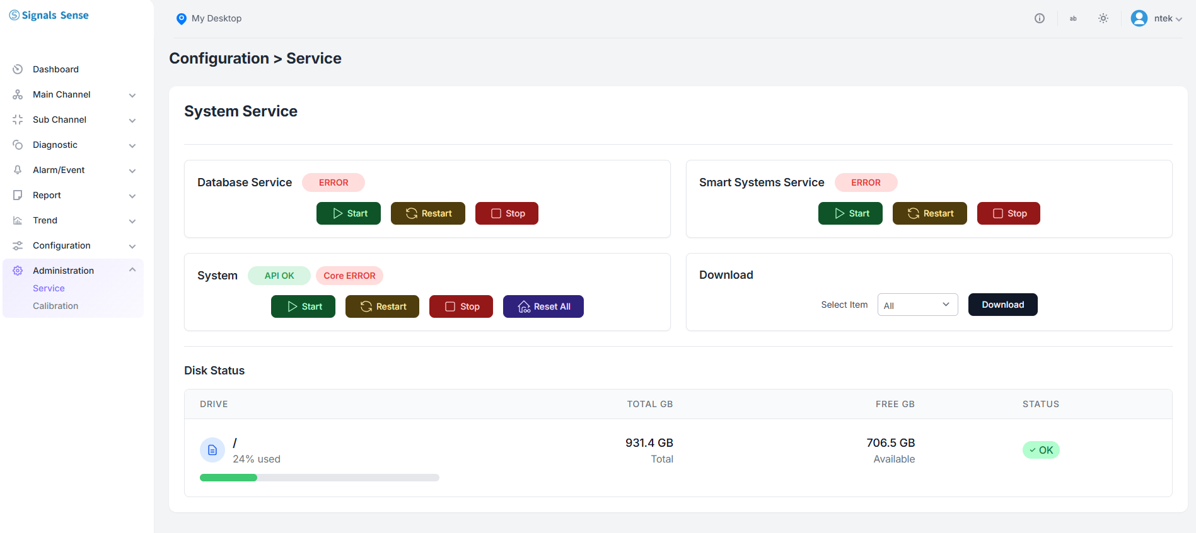
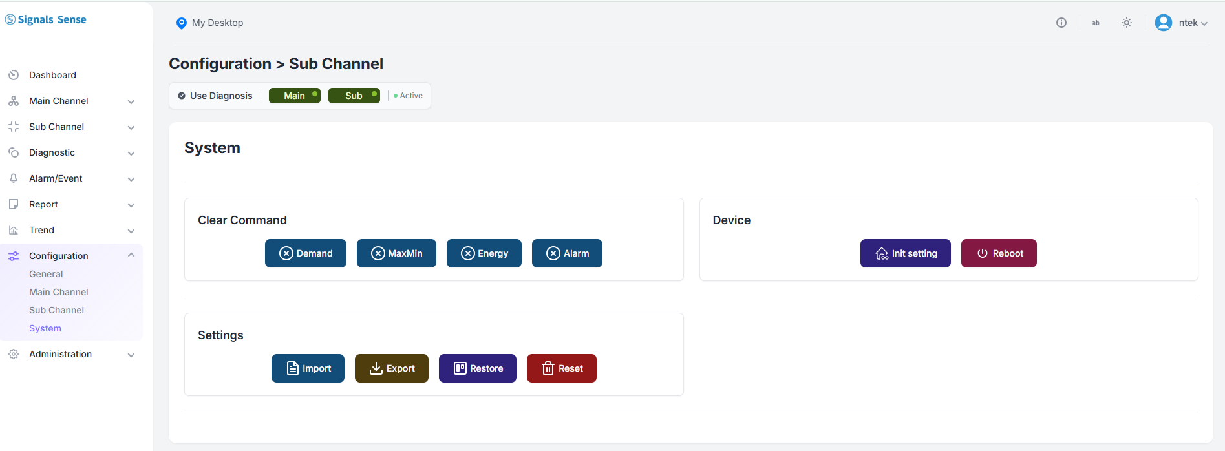
Reset position

Slide 4
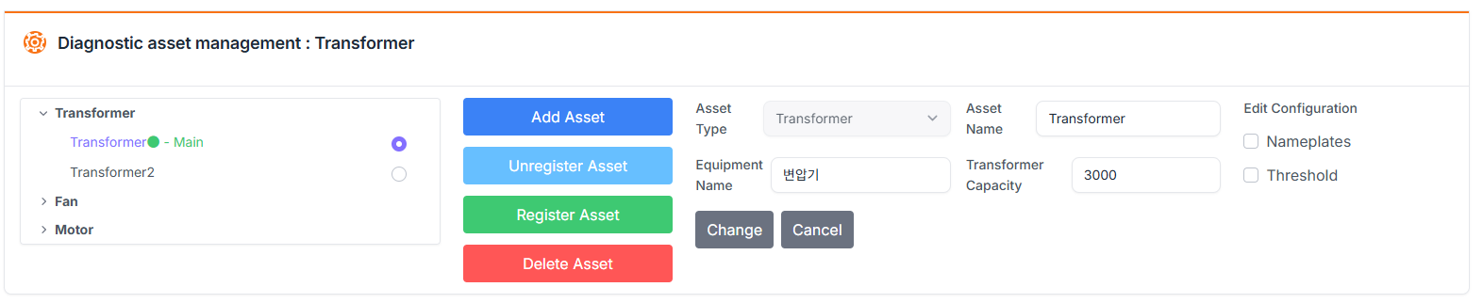
Added item
There are new items that have been added to the Configuration section.
In the configuration screen under Asset Management, you'll see that a new field for equipment name has been added. However, this information is not sent via the RestAPI — it's only saved in the setup.json configuration file.
The same applies to the Rated Capacity (Rated kVA) field that appears when the Asset Type is set to Transformer — it is also not transmitted via the RestAPI and is only stored in the setup.json configuration file. The Rated Capacity (Rated kVA) field is used for load factor calculation.

Slide 5
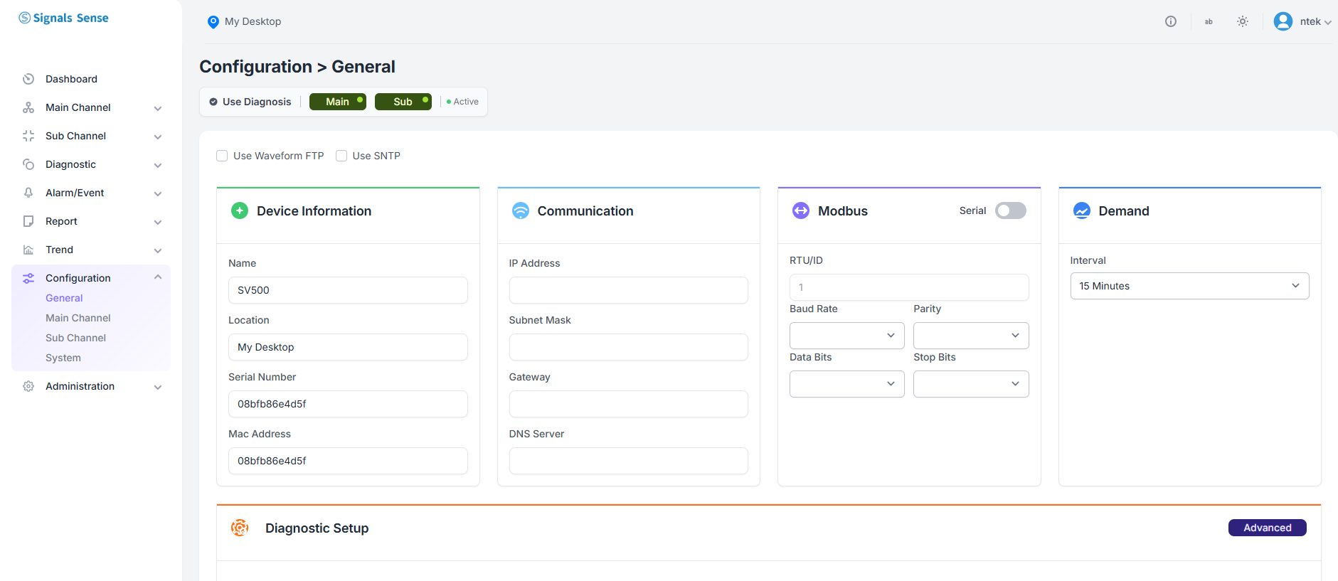
Changed position & added item
The location of the option to enable the diagnostic feature has been changed.
Device Information > Location : The Location field refers to the place where the equipment is installed. When set in the Configuration , it will be displayed at the top of the screen. If it is not set, nothing will be displayed. Like the other fields, this information is only saved in the setup.json file.

Slide 6
Changed position
You can restore the previous settings from this automatic backup using the restore button. Note that only one previous setting is kept in the automatic backup.

Slide 7
Fixed items
Change Voltage/Current Phase => Phasor Diagram | Applied
Restore function does not do anything in configuration | Applied
SNTP> TimeZone needs to be populated | Delete period, datetime Add timezone
At curtomer site, customer tried to change FTP folder name from Main to Main2 and saved changes but device did not updated the new value. Folder name was still Main after refresing webserver. | Bug fix for upload path change, automatic selection when upload path is not specified (Auto), and automatic handling of upload path.
Remove Device Model | Applied
Make Serial number, Mac,FW version, build Date READ ONLY. | Delete FW version, build date Make serial number, mac readonly
Name and Location can stay and user can edit. For future reference. | Add placeholder attribute
Starting current should be A (Not mA). | Applied
I Nominal => Rated Current (A) | Applied
V Nominal => Rated Voltage (V) | Applied
Remove 1 phase options ans Aron (x2) from Wiring Mode ListBox. Only 3P4W and 3P3W will left. | Applied
Sampling default values needs to be verified (8kHz, 10sec, 5min) | Applied
HoldOff time, HoldOff Time => Holdoff time | Applied
Session times out while I am working on configuration and I have to login again. F the user actively using the webserver it should not timeout. It should timeout after user stop working on GUI. | Fixed session-related errors and set the default session timeout to 1 hour.

Slide 8
Fixed items
Default Language English for non Korean and Japanese companies. This can be a setting parameter | When registering the ntek account with the admin password, you can now set the default language. The language set here will be used as the default language on the login screen.
What is the blue icon on the top left side of the view window. Looks like location icon. Can we have a title there like "SV500" it looks empty/blank. | If the location is not entered, the icon in the top header will be hidden.
Disk Status is displaying only application storage not the other partition. Please talk to Jinwoo. He would like to display the toal amount. | Configured to display disk status for both "/" and "/usr/local" paths (confirmed with Jinwoo).
I cloud not test Sampling values because I do not know how to reset those values to factory defaults. I thought Restore button sends the settings to factory defaults but nothing happens when I press Restore button. | Factory reset is not supported yet; only configuration deletion is available.
When I uncheck enable checkbox and go to dashboard and come back to this page again it is still enabled. Even if it is enabled it removes main channel from dashboard. I think there is a problem saving enable flag to settings file | Bug fixed and UX improved. Now, even if you navigate away from the page without clicking the save button, all changes are applied as of the last save.
I am sending you transparent Signals send logo to replace the logo at top-right of the window | Applied
Can you remove “PAGES” text located just below the logo? | Applied

Slide 9
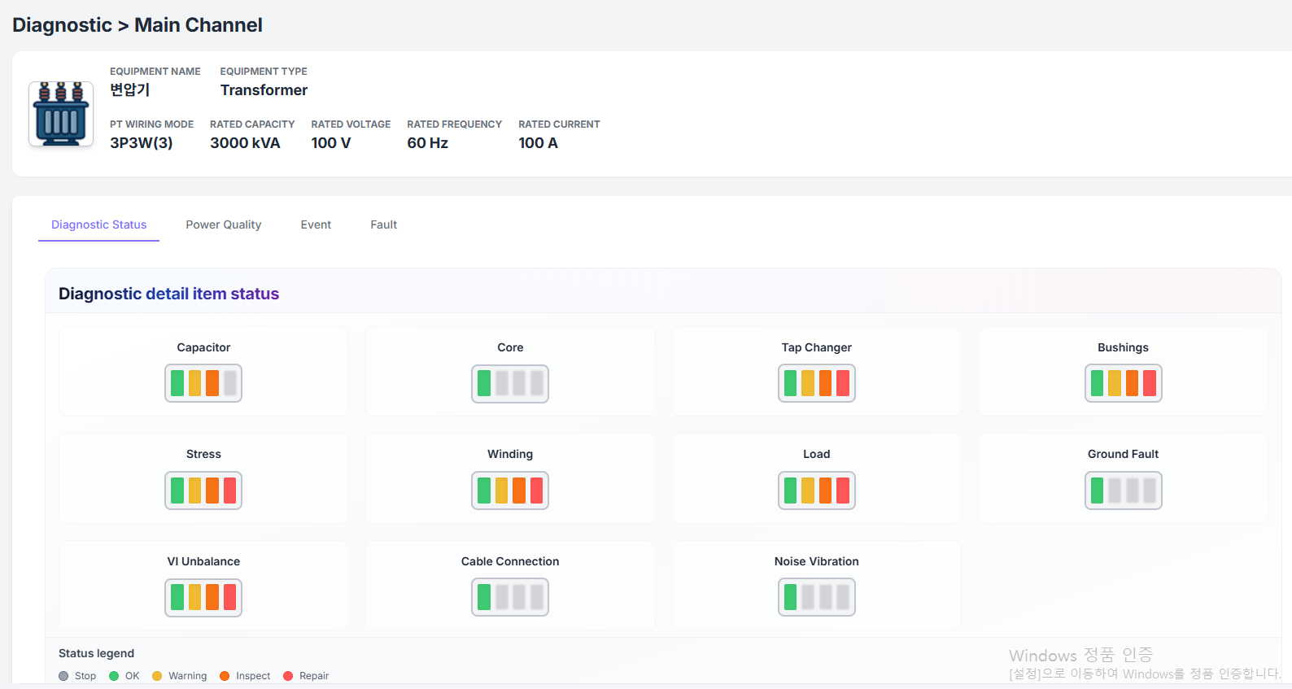
Improved UX Diagnostic
The UI/UX of the report and diagnosis screens has been improved.
The diagnosis status reflects the feedback from Vice President Kim Youngsik.

Slide 10
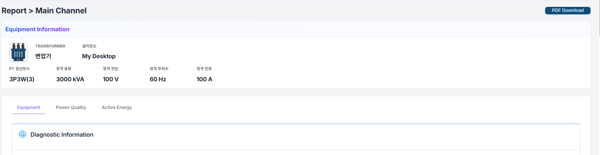
Improved UX Report
The UI/UX of the report and diagnosis screens has been improved.
Added installation location display to the equipment information. Reports are organized into tabs based on their type. When the PDF download button is clicked, a PDF preview view is launched, which includes all reports and initiates the download.

Slide 11
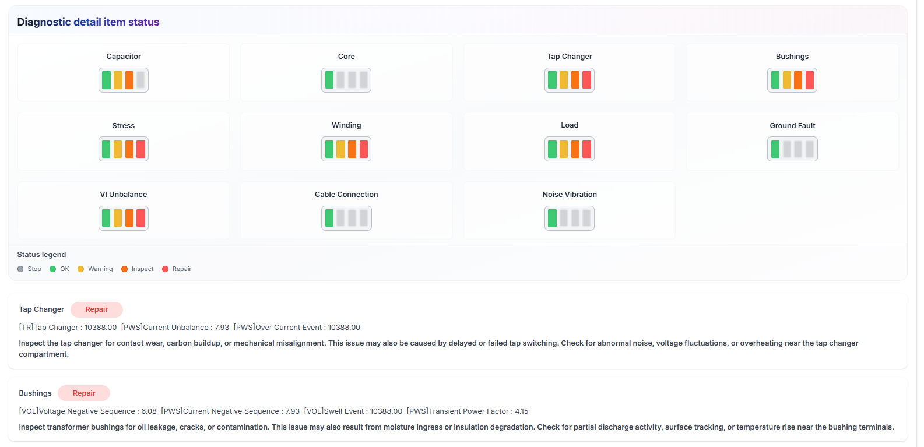
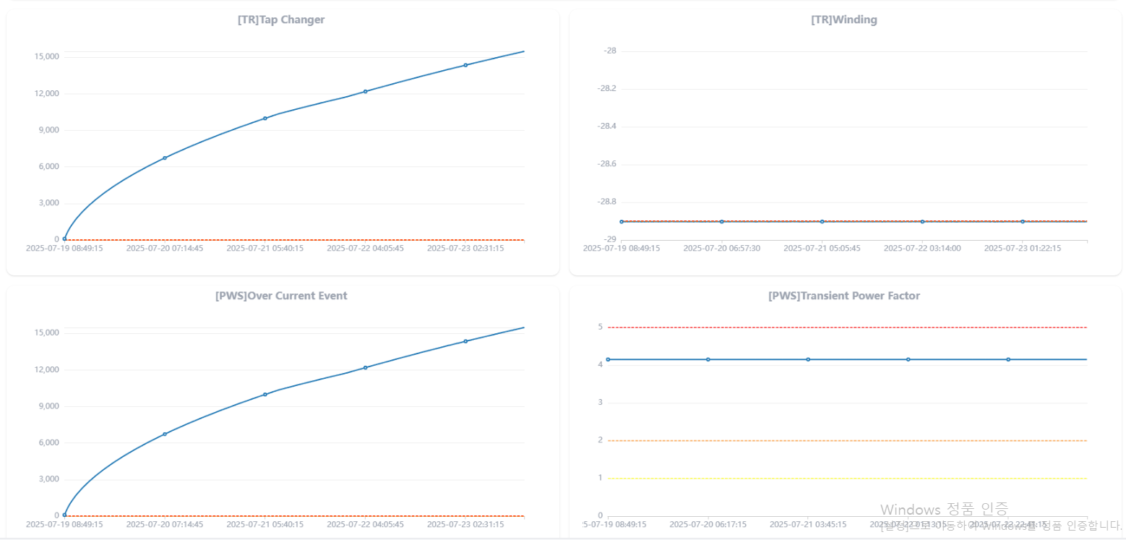
Improved UX Report
The UI/UX of the report and diagnosis screens has been improved.
Only the abnormal diagnosis detail items are shown with their corresponding data and descriptions, and a one-week trend chart is provided for each of those items.

