Slide 1
Machine Learning Overview
Evan Carey

Slide 2
Defining Machine Learning
‘Machine learning is essentially a form of applied statistics with increased emphasis on the use of computers to statistically estimate complicated functions and a decreased emphasis on proving confidence intervals around those functions’
- Deep Learning Book (https://www.deeplearningbook.org/contents/ml.html)
Using data, develop a ‘learning algorithm’ (our model).
Often the focus is prediction of an outcome, given inputs.
Finding patterns in the data versus finding generalizable trends in the data.

Slide 3
Defining a learning algorithm.
Using data, develop a ‘learning algorithm’ (our model).
What do we need to develop a learning algorithm?
Data
Model
Cost function
Optimization function

Slide 4
Classification / Regression / Clustering
Classification
Predicting class membership (or probabilities) among distinct classes.
Death (Yes / No)
Risk Strata (Low / Medium / High)
Regression
Predicting a continuous summary statistic (like the mean)
Hospital cost (Mean, median, 90th percentile)
Clustering
Identifying clusters in our data.
Project data into smaller dimensionality.
Clustering can be discrete or continuous.

Slide 5
Central Challenge to ML
The algorithm must perform well on new data it has never seen before
Next years data
New healthcare system
New patients
This concept is called generalization.

Slide 6
Under/overfitting and out of sample data
Given the data we have, how good is our model?
This is really just optimization.
Training error is how well we fit the training data.
Increased performance here sometimes decreases performance outside of our sample of data (overfitting)
In ML, we target generalization error
Generalization error is how well our algorithm fits data outside our sample.
But we don’t have any data outside our sample…
Can we pretend we do?

Slide 7
Validation approaches
If the new data does not come from the same data-generating distribution as the observed data, full stop.
If we assume the new data comes from the same data-generating distribution, then we can implement validation approaches.
Create multiple random samples from the data we have
Call one ‘training data’ and one ‘Validation’ data.
Actually we usually split into training / validation / testing (3 splits).
Optimization goal:
Minimize training error (high error = underfitting)
Minimize gap between training and testing error (big gap = overfitting)

Slide 8
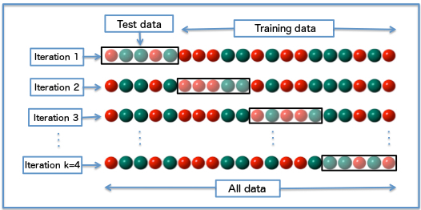
Creative Validation Approaches
Splitting by clusters.
Split by year, region, etc…
Cross validation.
By Fabian Flöck - Own work, CC BY-SA 3.0, https://commons.wikimedia.org/w/index.php?curid=51562781

Slide 9
Balancing under and overfitting
We can balance under and overfitting by making our model more/less complex. The deep learning book calls this ‘model capacity’
Increasing model capacity generally allows the model to fit more nuanced relationships.
In linear modeling – add more inputs, consider non-linear terms (polynomials), consider interactions…
What is the downside of increased model capacity?

Slide 10
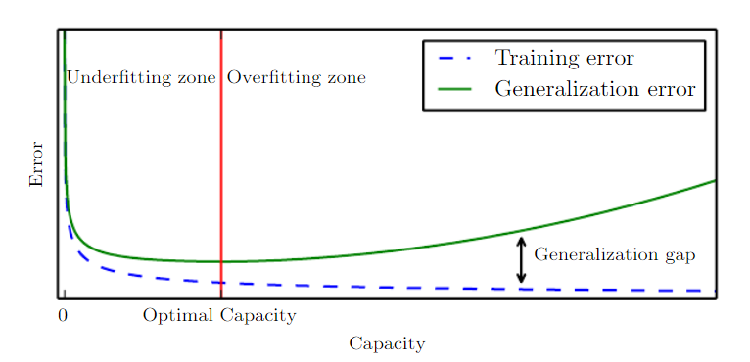
Balancing Underfitting / Overfitting
Deep learning book, figure 5.3
https://www.deeplearningbook.org/contents/ml.html

Slide 11
Model Parsimony
Among competing hypotheses that explain known observations equally well, choose the simplest one.
- Occam’s razor (c. 1287-1347)
Model Parsimony
Simpler is always better (as long as we still maximize generalization error…)
How do we implement model parsimony?

Slide 12
Regularization
Hard code preferences into the model.
I prefer Beta’s close to or equal to zero (parsimony)
However, if I find enough support for a relationship, it can stay.
How to I hard code that into my model?
What is an example you have learned of this in ML?
‘Regularization is any modification we make to a learning algorithm that is intended to reduce its generalization error nut not it’s training error.’
- Deep learning book, p 117

Slide 13
Hyperparameter tuning
Hyperparameters are ‘knobs’ we can use to tune an ML algorithm
We do not learn these from the training data, because…
It is too hard/impossible to optimize them directly OR
Their intent is to decrease generalization error (not training error), so it is not appropriate to learn them from the training data. Why is this true?
We often have multiple hyperparameters, and wish to tune across all of them. This is referred to as the ‘hyperparameter grid’.

Slide 14
Training / Validation / Testing splits.
Training data
Optimize the model to minimize training error
Validation data
Optimize hyperparameters to minimize generalization error
If we implement cross validation, this step is internalized to the model optimization.
Testing data
Estimate generalization error
How good will our model perform on previously unseen data?
Usually optimistic.

Slide 15
Some Binary classification models in scikit-learn
Logistic regression
Elastic net logistic regression (regularized)
Support Vector Machine
General SGD estimation (sklearn)
Can specify different loss functions
Nearest neighbor majority vote (non-parametric)
Random forests
Fully grown trees (not weak learners). Low bias, high variance per tree
Grow many trees (maybe in parallel?) to reduce variance.
Gradient boosting machine
Forest of weak learner trees (high bias, low variance)
Correct bias each new sequence.
Sequential method!

