Slide 1

SOC 1 OVERVIEW
Group 5
My Pham William Marty Sukruta Jadhav Reshma Maliakkal Cody Blanchard

Slide 2
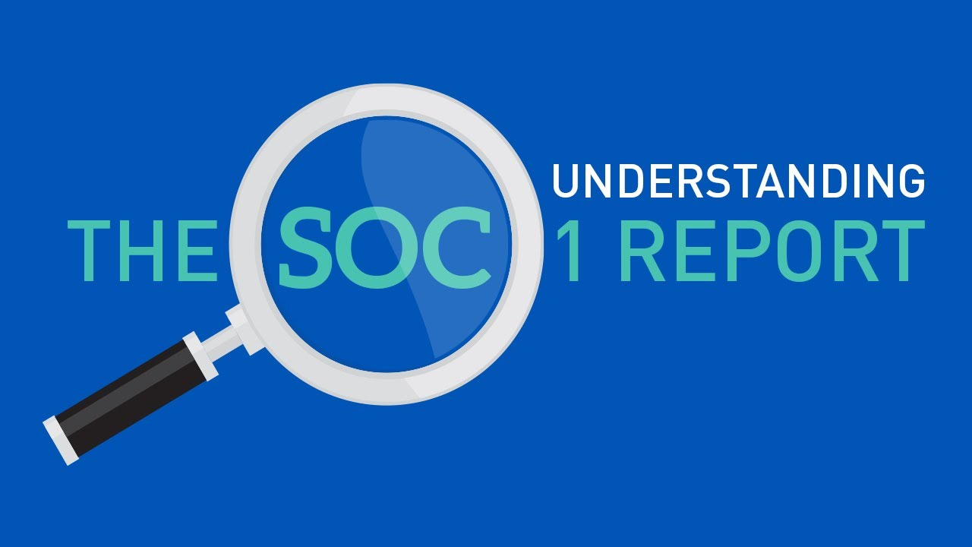
What is SOC 1?
A Service Organization Control 1 (SOC 1): a report on controls at a service organization which are relevant to user entities’ internal control over financial reporting.
Two types of SOC 1 reports (performed by a service auditor):
Type I (point-in-time): tests the design of the controls on a certain date (1 to 3 months)
Type II: tests the design and operating effectiveness of the controls over a specified period of time (usually 12 months)
Usage restriction: user organizations and their auditors
(aha.io)
Notes:
My

Slide 3
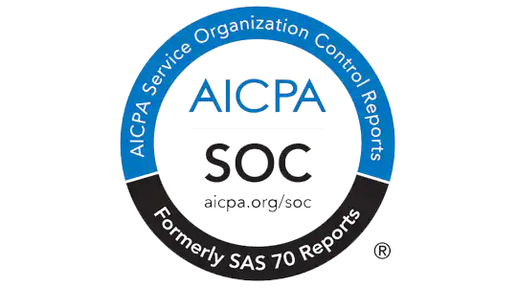
Why is It Required?
SOC 1 reports are required for organizations that perform a service that impacts another entity’s financial statements
Allows auditors to rely on the service organization’s internal controls when testing user entity accounts affected by the service organization
Examples: Cloud services, payroll processors, medical claim processors, data centers
Generally have to use Type II
(AICPA)
Notes:
Cody

Slide 4

Payroll Industry Report Items
Opinion: Summary of audit process and opinion of the auditor
Management Assertion: Aspects of business such as payroll processing, tax payment and filing
Transaction Assertion
Account balance assertion
Presentation and disclosure assertions
Description of the organizations’ systems
Control environment
Risk assessment
Payroll processing controls
Information system security and general computer controls
(ispartnersllc.com)
Notes:
Sukruta

Slide 5

Payroll Industry Report Items
Payroll processing control
New client implementation
Payroll processing
Payroll scheduling
Payroll distribution
Tax filing and payment controls
Control objectives and activities
(celergo.com)
Notes:
Sukruta

Slide 6
SOC 1 vs. SOX
Service Organization Control (SOC 1)
Audit of internal controls to make sure that data is secure, and there’s minimal waste (H&M SOC Audit Services, 2019, p. 2)
There to boost shareholder confidence (H&M SOC Audit Services, 2019, p. 2)
The Sarbanes-Oxley Act (SOX)
“Government-issued record keeping and financial information disclosure standard law” (H&M SOC Audit Services, 2019, p. 1)
Protects shareholders/general public from accounting fraud, potentially harmful corporation disclosures/practices, and miscalculated financial records (H&M SOC Audit Services, 2019, p. 1)
Notes:
Reshma

Slide 7
SOC 1 vs. SOX (cont.)
Service Organization Control (SOC 1)
Typically Used By:
Healthcare & medical practices
Data centers (H&M SOC Audit Services, 2019, p. 2)
Can be used to help financial decisions and can be used to help fill out a company’s SOX report (H&M SOC Audit Services, 2019, p. 2)
The Sarbanes-Oxley Act (SOX)
Typically Used By:
Publicly-traded companies
Private companies about to go public (H&M SOC Audit Services, 2019, p. 1)
Non-compliance:
Imprisonment
Fines (H&M SOC Audit Services, 2019, p. 1)
Notes:
Reshma

Slide 8
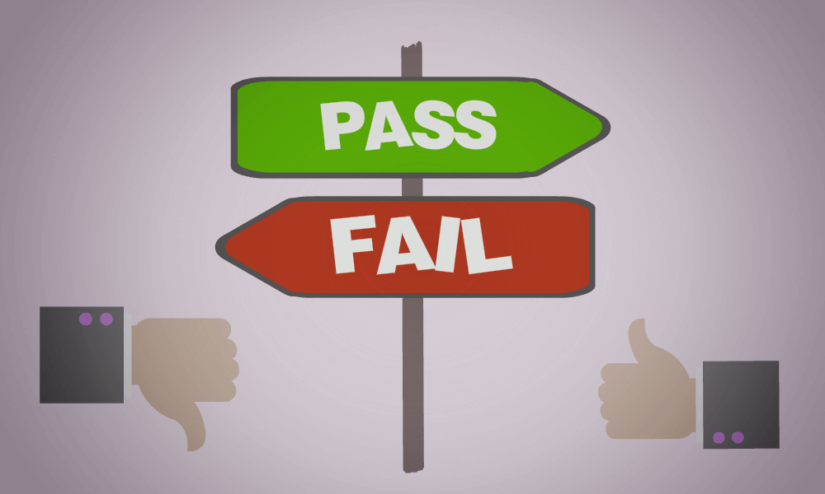
Auditor’s Opinion
Passing Criteria:
Auditor’s Opinion serves as one of the results of a SOC 1 Audit
Opinion is not based on pass/fail, but more on a threshold of Reasonable Assurance
They measure the following:
the description of the controls is presented fairly
the controls are designed effectively
the controls operate as intended over a specified period of time (Type II report only)
Opinion Types:
Unqualified Opinion: Consider unmodified or clean, means controls are described in a fair and accurate manner and operate effectively. (Ideal result)
Qualified Opinion: Close, but not quite. Controls mostly abide by the standards, but fall short in a few areas.
Notes:
William

Slide 9

Auditor’s Opinion
Opinion Types:
Adverse Opinion: The service organization materially failed one or more of the standards. This is essentially a fail.
Disclaimer of Opinion: Auditors issue unqualified, qualified, and adverse opinions when they are confident in the evidence they have to support their opinion. If this is not the case, then a Disclaimer of Opinion will be issued.
Implications
Qualified Report Opinion vs Going Concern
Going Concern: Could indicate that an organization is in financial peril or may meet its demise.
Qualified Report Opinion: Serves as a disclosure for material internal control weaknesses
Company can have Going Concern without Qualified Report Opinion and vice-versa.
(BWOLFZORNMPPA)
Notes:
William

Slide 10

SOC 1, so your company can be AUDIT can be!

Slide 11
References
Compliance on the IBM Cloud. (n.d.). Retrieved February 10, 2019, from https://www.ibm.com/cloud/compliance
Compliance. (n.d.). Retrieved February 10, 2019, from https://www.aha.io/legal/security/compliance
Hemmer, N. (2017, December 23). How Long Does a SOC Examination Take? Retrieved February 10, 2019, from https://linfordco.com/blog/how-long-does-a-soc-examination-take/
H&M SOC Audit Services. (2019). Difference Between SOX and SOC Compliance | Holbrook & Manter. [online] Available at: https://www.socauditservices.com/2017/03/28/soc-vs-sox/ [Accessed 7 Feb. 2019].
Kirkpatrick, J. (2019). Will I Pass a SOC 1? What if I Fail The Audit? Reasonable Assurance Explained. Retrieved from https://kirkpatrickprice.com/video/will-i-pass-the-audit-what-if-i-fail-the-audit-reasonable-assurance-explained/
Pierce, R. (2017, May 10). What is a SOC 1 Report? When Is it Required? Who Needs It? Retrieved February 10, 2019, from https://linfordco.com/blog/what-is-soc-1-report/
Pierce, R. (2018, February 14). SOC Qualified Opinions & Your Service Organization. Retrieved from https://linfordco.com/blog/qualified-opinions/
Presentation Question Slide. (n.d.). Retrieved February 10, 2019, from http://www.quickmeme.com/Presentation-Question-Slide
"Opinions, Opinions, Opinions: Understanding the Auditor's Opinion in a SOC Report | Assure Professional", 2019 https://assureprofessional.com/Blog/Opinions-Opinions-Opinions-Understanding-the-Auditors-Opinion-in-a-SOC-Report
Reporting on Controls at a Service Organization. (2016). Retrieved February 12, 2019, from https://www.aicpa.org/Research/Standards/AuditAttest/DownloadableDocuments/AT-00801.pdf
Anon, (2019). [ebook] Available at: https://dominionpayroll.com/wp-content/uploads/2013/06/SSAE16-2012.pdf [Accessed 13 Feb. 2019].
Management assertions in auditing. (n.d.). Retrieved from https://www.accountingtools.com/articles/what-are-management-assertions-in-auditing.html
Eight steps to writing a system description for your SOC report. (n.d.). Retrieved from https://www.plantemoran.com/explore-our-thinking/insight/2019/01/eight-steps-to-writing-a-system-description-for-your-soc-report
SOC 1 Compliance Considerations for Global Payroll Owners of Multinational Businesses. (n.d.). Retrieved February 10, 2019, from https://celergo.com/soc-1-compliance-multinational/
SSAE 16 Audits Allow Customers to Trust a Payroll Company’s Services. (n.d.). Retrieved February 10, 2019, from https://www.ispartnersllc.com/blog/ssae-16-audits-allow-customers-trust-payroll-companys-services/
What Going Concern Opinions Mean For Investors and How FASB’s Changes Affect Auditors. (n.d.). Retrieved February 10, 2019, from https://bwolfzornmppa.wordpress.com/tag/going-concern-disclosures/

