Slide 1
ACCESS MANAGEMENT
Group 5
Reshma Maliakkal My Pham
Sukruta Jadhav Cody Blanchard
William Marty

Slide 2

IBM CLOUD OVERVIEW
International Business Machines Corporation (IBM) was founded in New York on June 16, 1911.
5 segments of services: Cognitive Solutions, Global Business Services (GBS), Systems, Global Financing, Technology Services & Cloud Platforms
Our focus: IBM Cloud
Access management: user access management (UAM) or identity and access management (IAM)
A process of managing user identities and administering their access to IT resources such as systems, applications, files and networks (Martin)
(IBM)

Slide 3
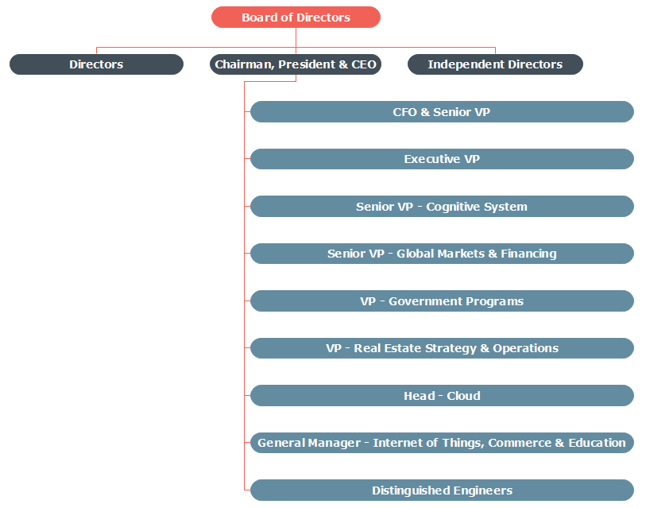
MANAGEMENT TEAM
(IBM)

Slide 4
RISK ASSESSMENT
Process Based Risks
Overarching Risks
Account Management
User Management
Role Management
Resource Management
Disasters
Legal Compliance
Cybersecurity
Physical Security

Slide 5
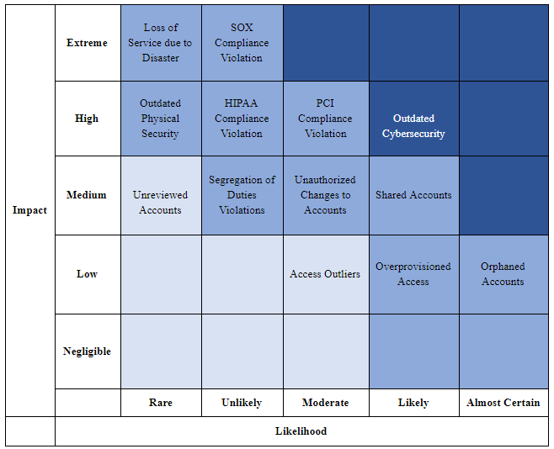
RISK MATRIX

Slide 6
MANAGEMENT CONTROL ASSESSMENT
The Chief Information Security Officer office announced that it is requiring internal and external customers’ accounts to have 15-character passwords as minimum
Leadership announce strategy to implement as many FedRAMP High Controls throughout environment
IBM’s IT Security Standards cover access control policy, user access management, user and system identities, access provisioning, managing privileged access, supplier support access, password management, certificate authentication, and more.

Slide 7
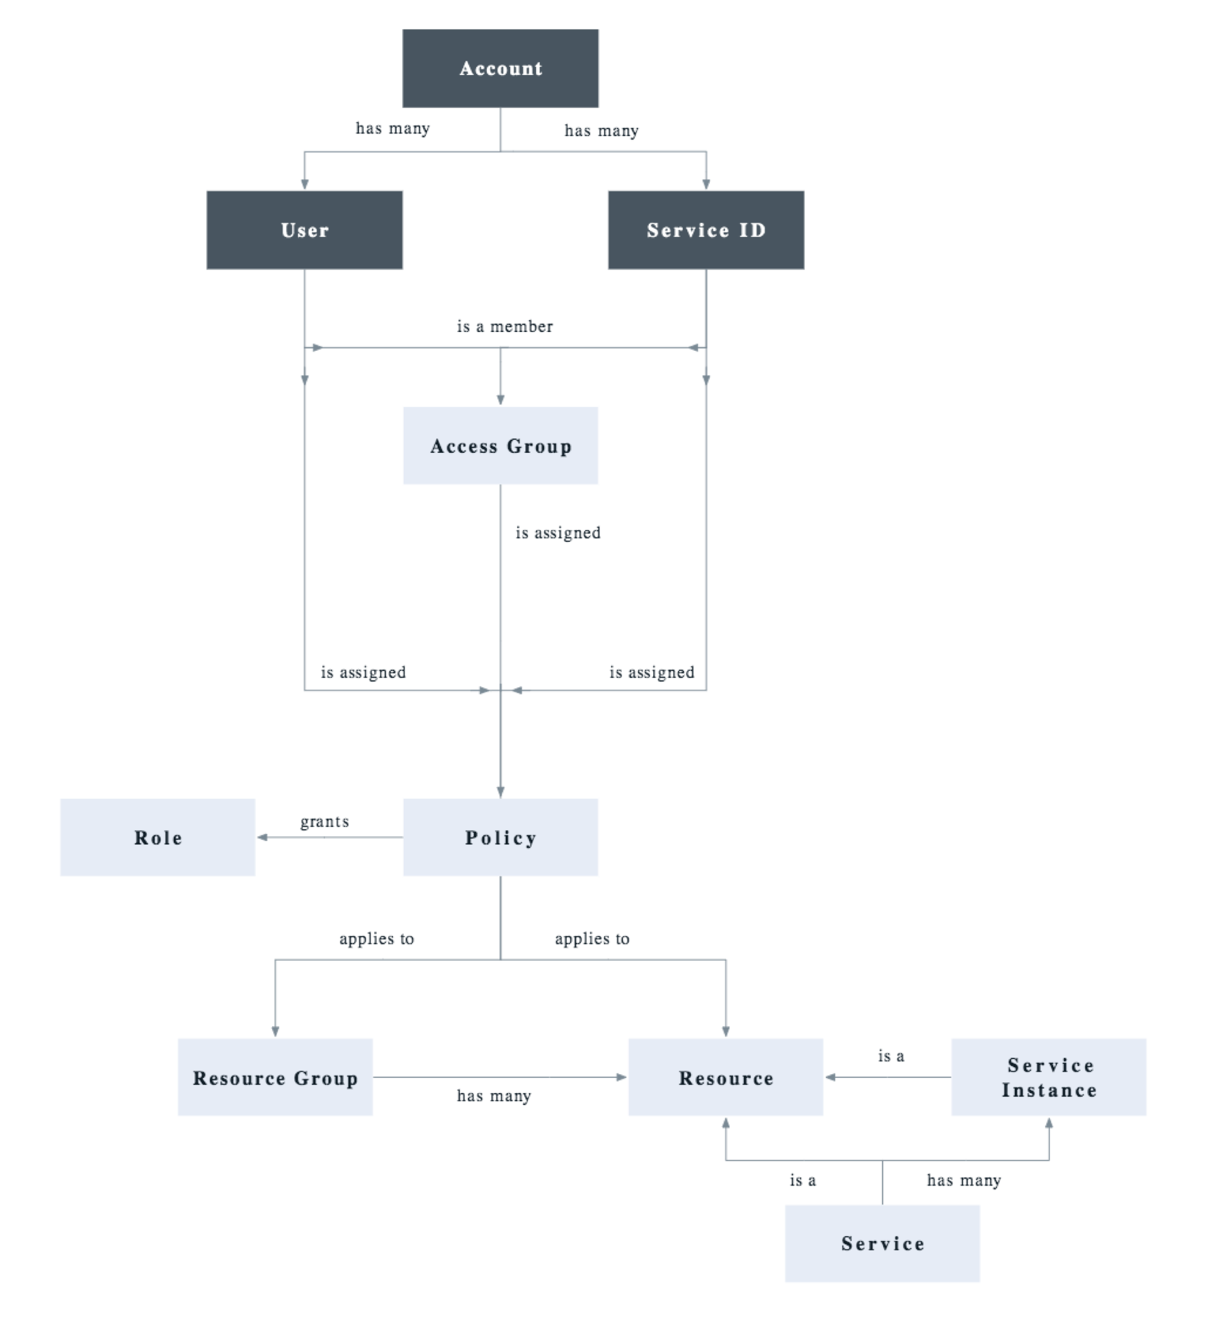
FLOW DIAGRAM
("IBM Cloud Identity And Access Management")

Slide 8
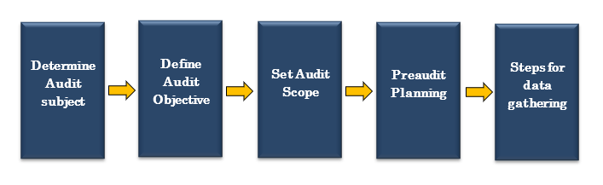
AUDIT PROGRAM
(ISACA)

Slide 9
AUDIT FIELDWORK
Access control policy and procedures
Account Management
Least Privilege
Remote Access
Information Flow
Session Control
Use of External Information Systems

Slide 10

RECOMMENDATIONS
Policy for use of portable storage devices
Better controls when removing temporary accounts
Company was compliant in all other areas
(Lynda)

Slide 11
WORKS CITED
“Audit Plan Activities: Step-by-Step.” ISACA,
m.isaca.org/COBIT/Documents/Audit-Plan-Activities_res_eng_0316.pdf.
Bresz, Frank, et al. “Identity and Access Management.” THE IIA,
chapters.theiia.org/montreal/ChapterDocuments/GTAG 9 - Identity and Access Management.pdf.
Cook, Bryan. “Top Reasons To Audit An IAM Program.” ISACANTX, www.isacantx.org/Presentations/April
040317 Top Reasons To Audit An IAM Program.pdf.
“Executive Bios.” IBM, newsroom.ibm.com/executive-bios.
“IBM Board of Directors.” IBM, www.ibm.com/investor/governance/board-of-directors.html.
"IBM Cloud Identity And Access Management". IBM Cloud, 2018,
https://console.bluemix.net/docs/iam/index.html#iamoverview. Accessed 1 May 2019.
“IBM Logos.” IBM, www.ibm.com/design/language/elements/logos/.
“International Business Machines Corp (IBM).” Reuters,
www.reuters.com/finance/stocks/company-profile/IBM.
Martin, James, and John Waters. “What Is IAM? Identity and Access Management Explained.” CSO, 9
Oct. 2018,
www.csoonline.com/article/2120384/what-is-iam-identity-and-access-management-explained.html.
Norris, Tim. "8 Critical Identity Risk Factors – And How To Manage Them". CSO Online,
https://www.csoonline.com/article/3216064/article.html.
Steiner-Williams, Judy. “Writing Recommendations.” Lynda.com - from LinkedIn, Lynda.com, 3 June
2014, www.lynda.com/Business-Skills-tutorials/Writing-Recommendations/156089-2.html.

