Slide 1
Decision Helper
Marie Piette
IST341
Final Project

Slide 2
Overview
About Me
Project motivation
Random Library
Demo
Future Tasks
Conclusion

Slide 3
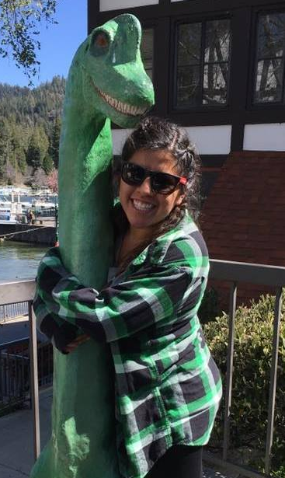
About Me
Marie Piette
JPL
2nd Year at CGU
Love friends, movies, and food

Slide 4
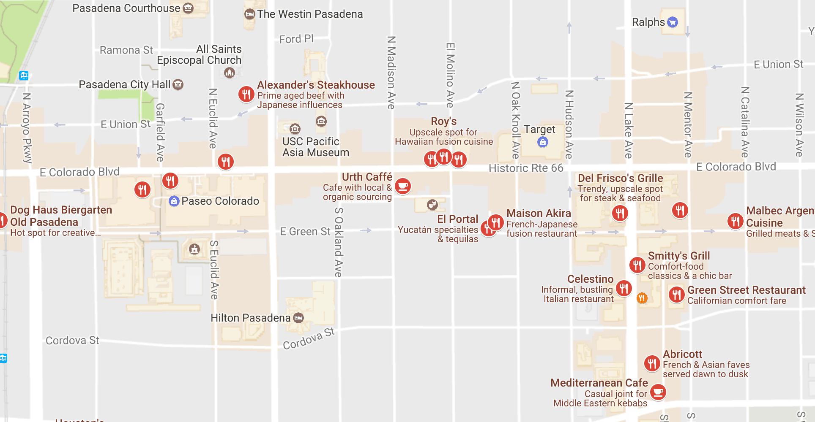
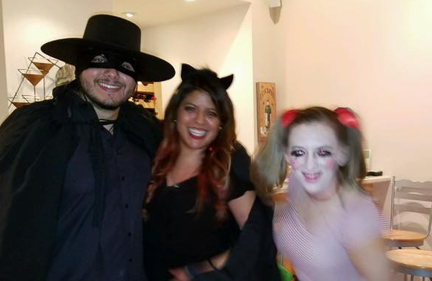
Project Motivation
“I wish there was a way we could have something choose randomly for us!”
Hangry!
*Can’t make a decision*

Slide 5
Python Program
Remembered all the programs we did for homework
Flip a coin
Rock, paper, scissors
Rock, paper, scissors, lizard, spock
“Random” Library
random.choice(), randint(), randrange (), random.shuffle(), etc.
Options!
Two choices
Three choices
More than three choices

Slide 6
DEMO

Slide 7
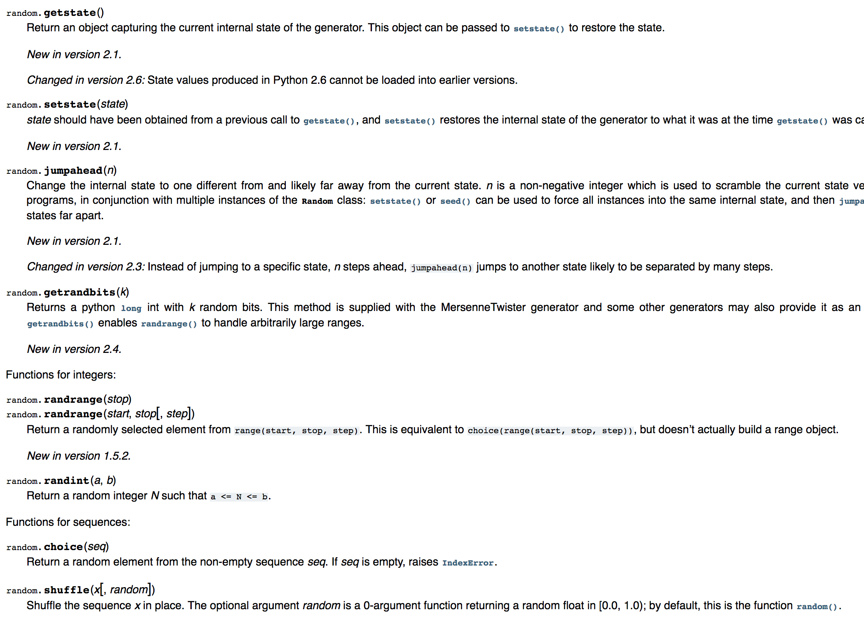

Future Tasks
Clean/refactor
Finish more types of decisions
Use more of “Random” Library
GitHub

Slide 8
Thank You!

