Slide 1
Vodafone BLM Strategic Analysis
BLM (Business Leadership Model) Five Looks Analysis
Target Operator
Market
Analysis Period
Report Date
Vodafone Germany
Germany
CQ4_2025
2026-02-13
01 Trends (PEST) | 02 Market/Customer ($APPEALS) | 03 Competition (Porter) | 04 Self (BMC) | SWOT Synthesis | 05 Opportunities (SPAN

Slide 2
Report Contents
TABLE OF CONTENTS
01
Executive Summary
Key findings and recommendations
02
Look at Trends
PEST Framework — macro environment
03
Look at Market
$APPEALS — market changes & customer needs
T
Tariff Analysis
Pricing comparison — mobile, fixed & convergence
04
Look at Competition
Porter's Five Forces — competitive landscape
05
Look at Self
BMC + Capability — internal assessment
06
SWOT Synthesis
Strengths, Weaknesses, Opportunities, Threats
07
Look at Opportunities
SPAN Matrix — opportunity selection
Summary & Provenance
2
08
Conclusions and data sources

Slide 3
Data Quality Overview
DATA QUALITY
Total Data Points
High Confidence
Medium Confidence
Low/Estimated
20
0
19
1
0%
Unique Sources: 14
Data Conflicts: 0
Coverage: Partial
Key Message: 20 data points tracked, 0 high-confidence (0%
3

Slide 4
Executive Summary
Trends
Macro environment: Favorable. Key opportunities: Regulatory Environment, National Digital Strategy. Key risks: Regulatory Environment, Nebenkostenprivileg (MDU cable TV bundling) abolished Industry is mature. (+0.3% YoY (CQ2_2025 -> CQ4_2025)
Market/Customer
Germany telecom market totals EUR 12.3B in quarterly revenue; competitive strengths in Availability, Assurances; Market outlook is favorable with more opportunities than threats.
Competition
In a 4-player market with medium competition intensity, Deutsche Telekom leads with 50% revenue share. Target operator holds 25% share. Strongest competitive force: Existing Competitors.
Self Assessment
Ranked #2 of 4 operators in market; revenue EUR 3,092M; EBITDA margin 36.2%; stable but facing challenges; key strength: Brand Strength; key challenge: Customer Service; Management outlook: Germany EBITDA: H2 performing better than H1, but FY26 will not return to positive growth. Key tailwinds: (1) MDU YoY base effect starting to fade from Q3; (2) 1&1 wholesale revenue reaching full run-rate by Q4; (3) MVNO base effects.
SWOT
SWOT analysis identifies 7 strengths, 5 weaknesses, 10 opportunities, and 4 threats. The recommended strategic posture is offensive (SO-dominant).
Opportunities
SPAN matrix positions 35 opportunities: 23 grow/invest, 4 acquire skills, 4 harvest, 4 avoid/exit. Focus resources on the 23 grow/invest items for maximum strategic impact.
Key Message: Five Looks analysis completed — see details in following sections
4

Slide 5
01 Look at Trends
PEST Framework — Macro Environment

Slide 6
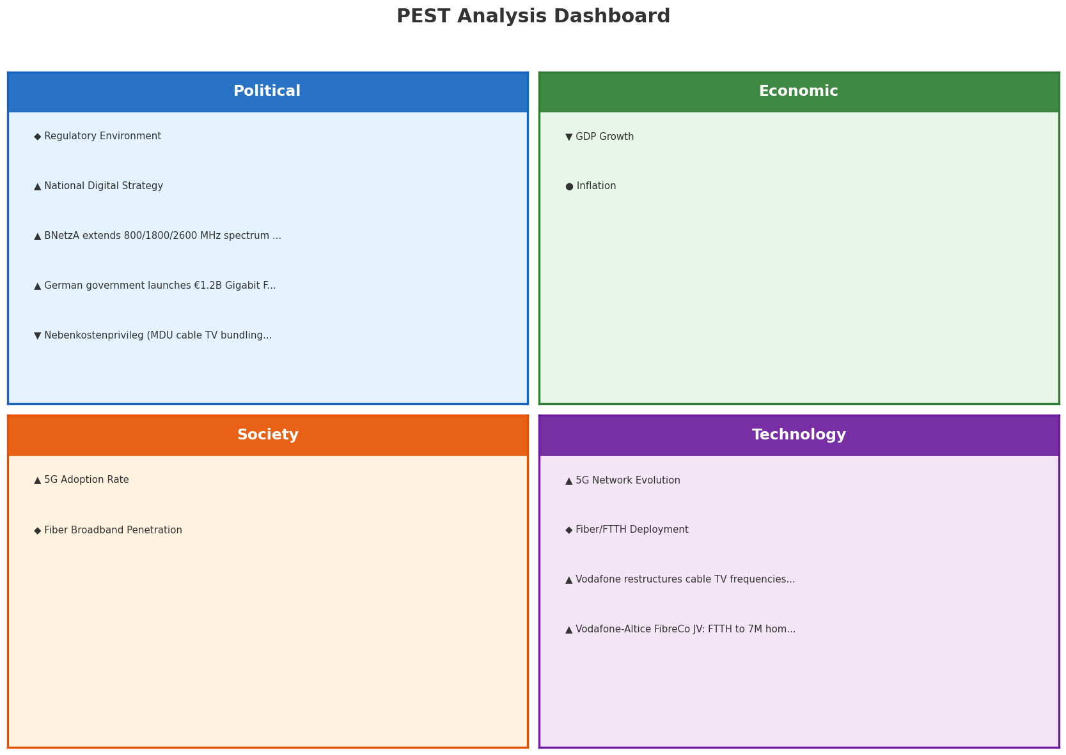
PEST Analysis Dashboard
MACRO ENVIRONMENT
Key Message: Macro environment: Favorable. Key opportunities: Regulatory Environment, National Digital Strategy. Key risks: Regulatory Environment, Nebenkostenprivileg (MDU cable TV bundling) abolished.
6

Slide 7
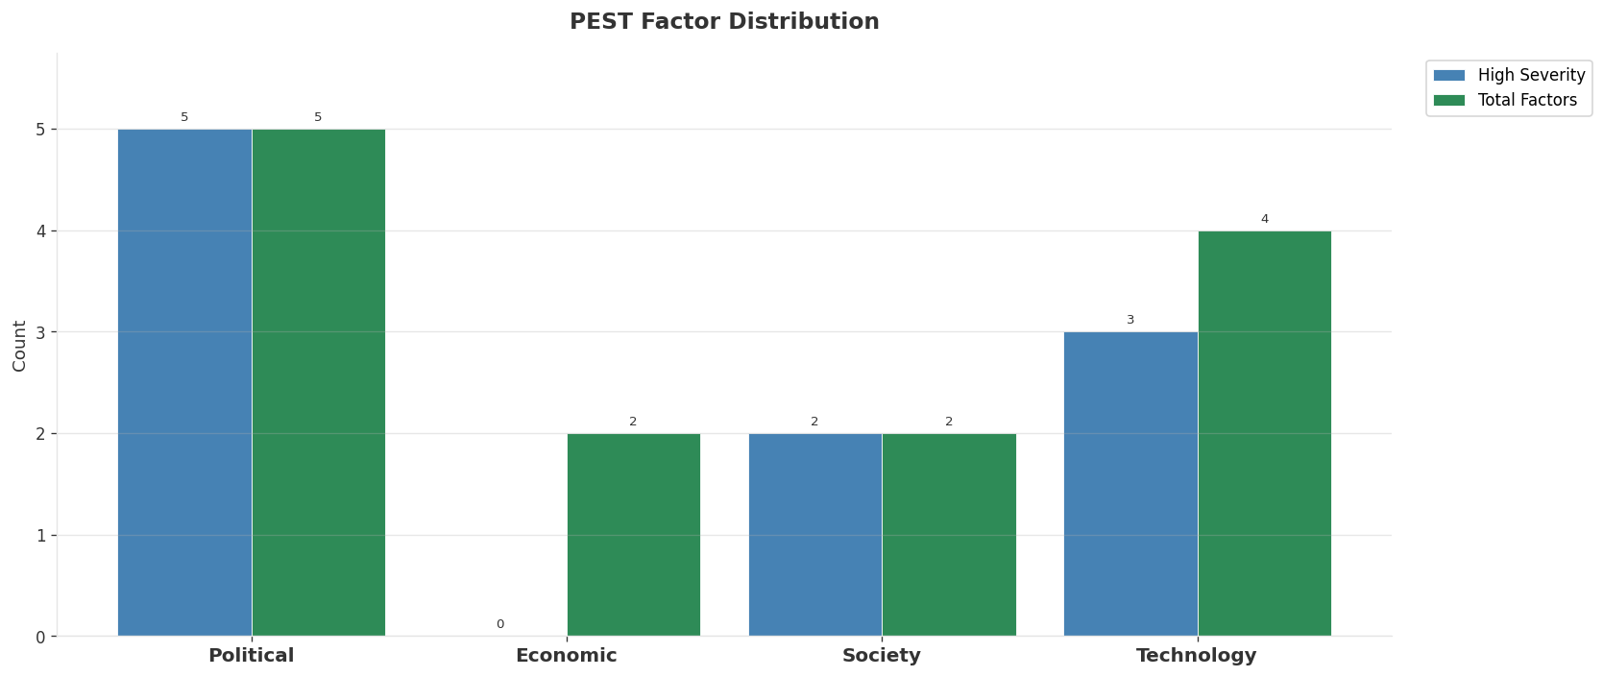
Industry Environment
INDUSTRY ANALYSIS
Market Size
Growth Rate
Concentration
Lifecycle
EUR 12.3B (quarterly, CQ4_2025
+0.3% YoY (CQ2_2025 -> CQ4_2025
CR4 = 100% (Deutsche Telekom: 50.3%, Vodafone Germany: 25.1%, Telefonica O2 Germany: 16.2%, 1&1 AG: 8.4%
mature
• New Business Models:
• FWA (Fixed Wireless Access) as fiber alternative
• Network-as-a-Service for enterprise verticals
• Wholesale/MVNO partnerships for coverage monetization
• Technology Revolution:
• 5G SA enabling network slicing and enterprise services
• AI/ML for network optimization and customer experience
• Open RAN for vendor diversification and cost reduction
Key Message: Macro environment: Favorable. Key opportunities: Regulatory Environment, National Digital Strategy. Key risks: Regulatory Environment, Nebenkostenprivileg (MDU cable TV bundling) abolished Industry is mature. (+0.3% YoY (CQ2_2025 -> CQ4_2025)
7

Slide 8
Value Transfer Trends
VALUE MIGRATION
• Value shifting from voice/SMS to data and digital services
• B2B/ICT growing faster than consumer segment
• Fiber displacing copper and cable broadband
Key Message: Macro environment: Favorable. Key opportunities: Regulatory Environment, National Digital Strategy. Key risks: Regulatory Environment, Nebenkostenprivileg (MDU cable TV bundling) abolished Industry is mature. (+0.3% YoY (CQ2_2025 -> CQ4_2025)
8

Slide 9
02 Look at Market
$APPEALS — Market Changes & Customer Needs

Slide 10
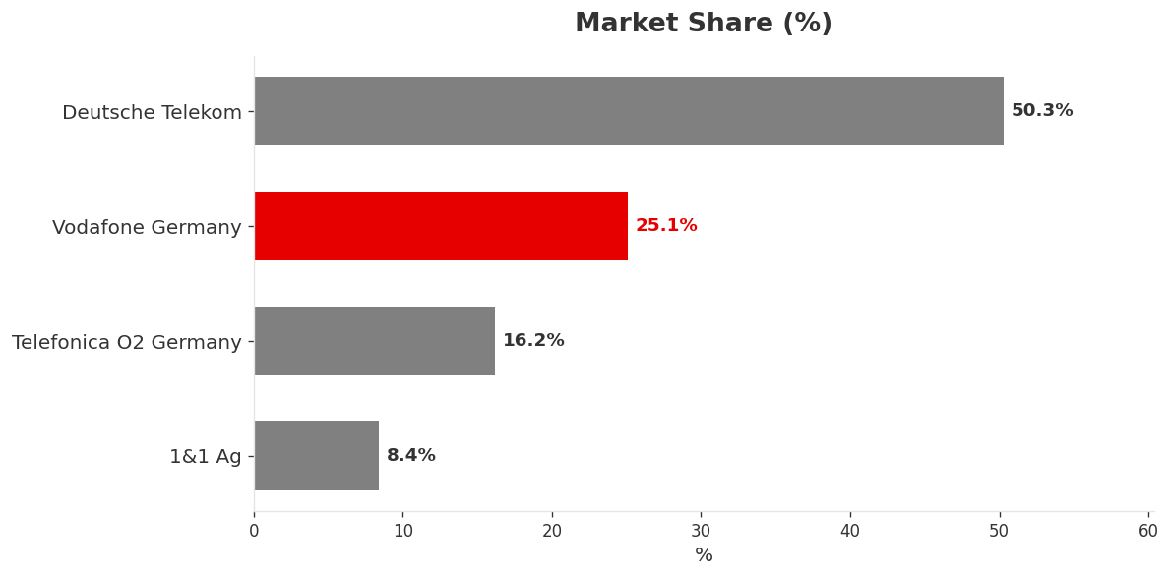
Market Change Panorama
MARKET OVERVIEW
Total Revenue (€M
Mobile Subs (K
Broadband Subs (K
Operators
12,327
143,100
31,420
4
Market Changes:
• Vodafone completes 1&1 customer migration: 12M users on network
• 1&1 completes OpenRAN migration, reaches 25% own network coverage
• Vodafone completes Skaylink acquisition for €175M
• Deutsche Telekom Q3 2025: revenue +1.5%, net profit +14.3%
Key Message: Germany telecom market totals EUR 12.3B in quarterly revenue; competitive strengths in Availability, Assurances; Market outlook is favorable with more opportunities than threats.
10

Slide 11
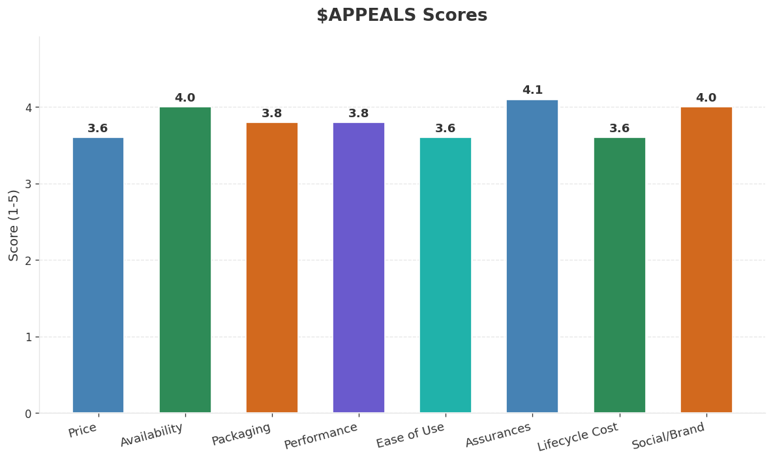
Customer Segments
SEGMENTATION
Consumer High-End
Size: ~13.9M subscribers | Trend: growing | Our Share: ~25% of postpaid
Needs: Premium 5G standalone experiences, Ultra-low latency gaming and VR
Consumer Mainstream
Size: ~51.2M subscribers | Trend: stable | Our Share: ~25% of postpaid
Needs: Better value convergent bundles, Transparent pricing without hidden fees
Consumer Price-Sensitive
Size: ~35.1M subscribers | Trend: shrinking | Our Share: ~19% of prepaid
Needs: Affordable unlimited data plans, No-contract flexibility
Consumer Youth
Size: ~17.2M subscribers | Trend: growing | Our Share: ~23% overall
Needs: Social media and streaming-optimized plans, eSIM and digital-first experience
Key Message: Germany telecom market totals EUR 12.3B in quarterly revenue; competitive strengths in Availability, Assurances; Market outlook is favorable with more opportunities than threats.
11

Slide 12
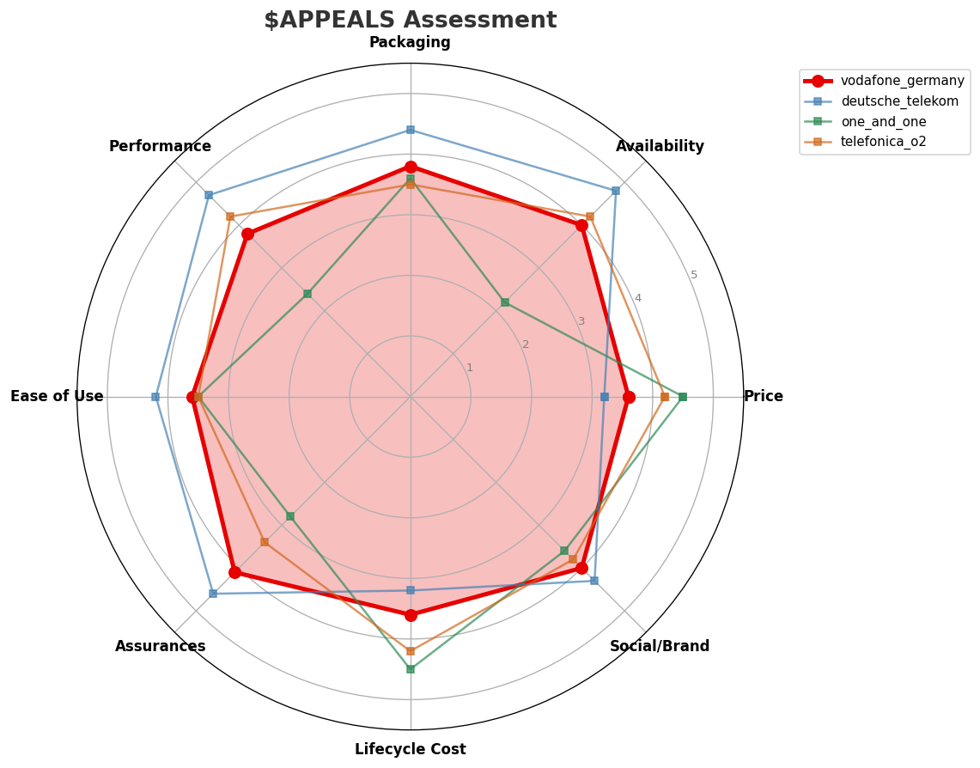
$APPEALS Assessment
CUSTOMER NEEDS
Key Message: Germany telecom market totals EUR 12.3B in quarterly revenue; competitive strengths in Availability, Assurances; Market outlook is favorable with more opportunities than threats.
12

Slide 13
Customer Value Migration
VALUE MIGRATION
Value migration is mixed: some segments trending up while price-sensitive segments face pressure. Differentiated strategy by segment recommended.
Opportunities:
• Vodafone completes 1&1 customer migration: 12M users on network
• Vodafone completes Skaylink acquisition for €175M
• Deutsche Telekom Q3 2025: revenue +1.5%, net profit +14.3%
• Vodafone restructures cable TV frequencies nationwide
Key Message: Germany telecom market totals EUR 12.3B in quarterly revenue; competitive strengths in Availability, Assurances; Market outlook is favorable with more opportunities than threats.
13

Slide 14
Tariff Analysis
Mobile, Fixed & Convergence Pricing Landscape

Slide 15
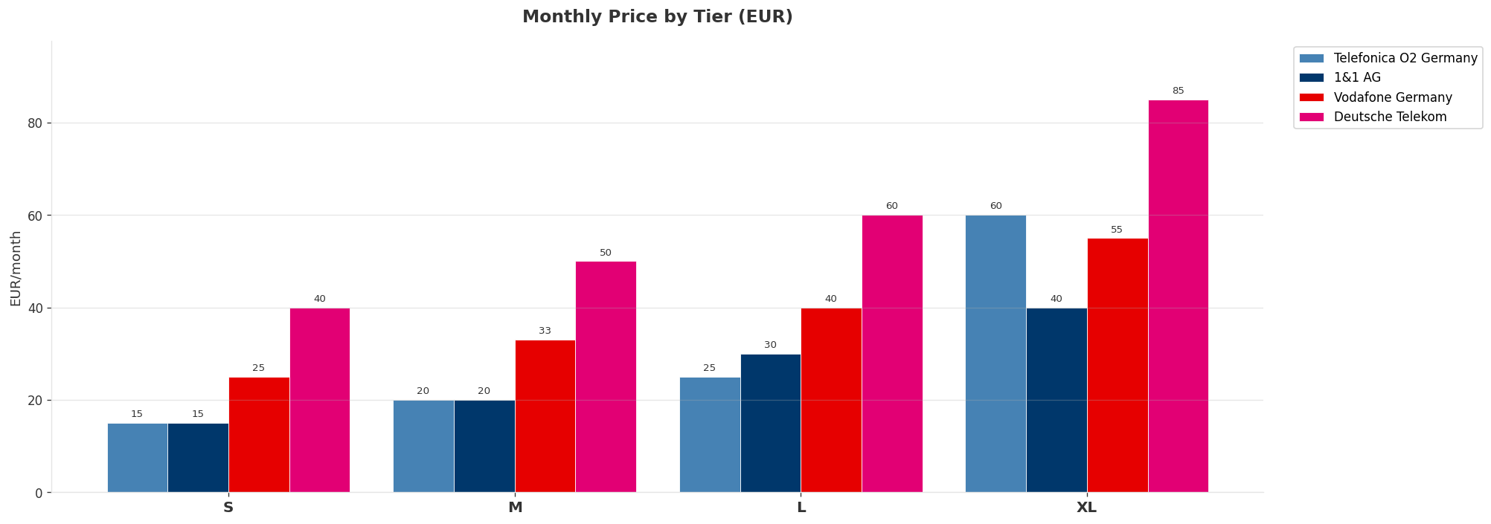
Mobile Postpaid Price Comparison
CROSS-OPERATOR TIER BENCHMARKING
Price Gaps:
• Tier S: EUR 25 gap — cheapest Telefonica O2 Germany, most expensive Deutsche Telekom
• Tier M: EUR 30 gap — cheapest Telefonica O2 Germany, most expensive Deutsche Telekom
• Tier L: EUR 35 gap — cheapest Telefonica O2 Germany, most expensive Deutsche Telekom
• Tier XL: EUR 45 gap — cheapest 1&1 AG, most expensive Deutsche Telekom
Key Message: Mobile postpaid tier comparison across all operators
15

Slide 16
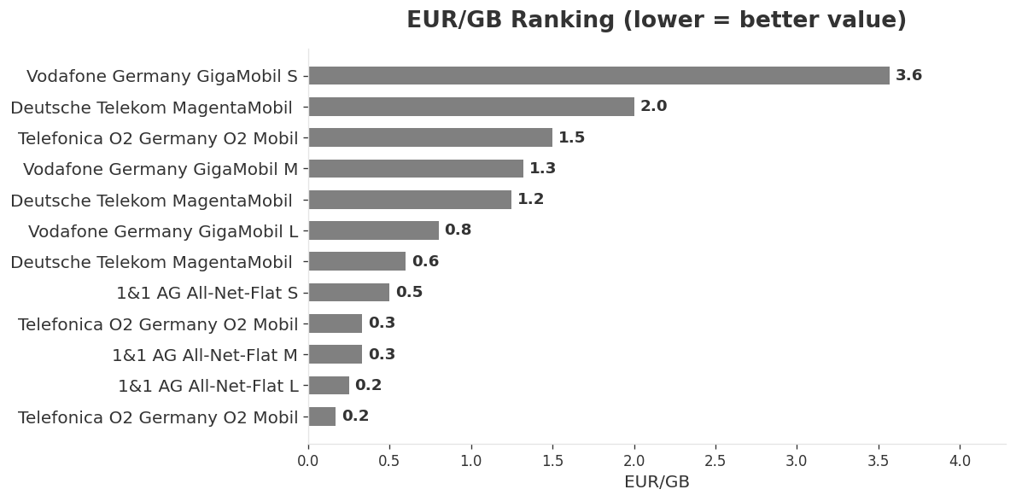
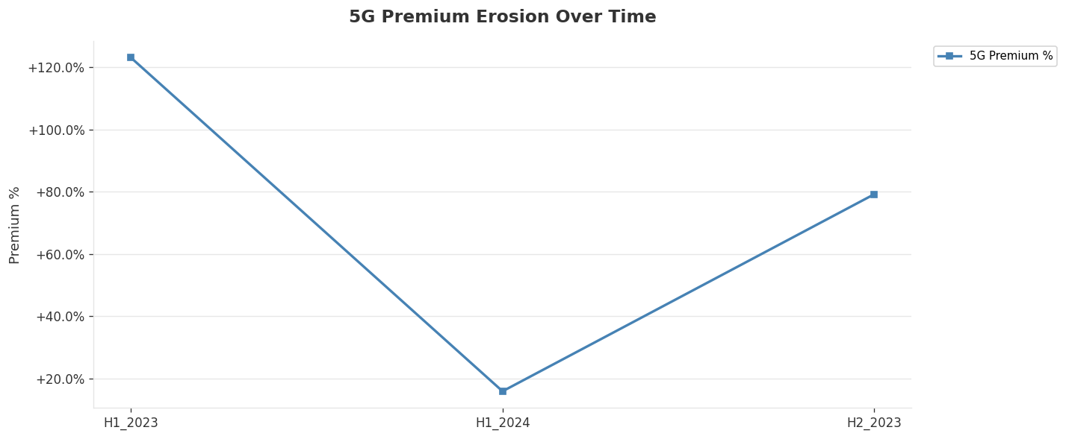
EUR/GB Value Analysis & 5G Premium Erosion
PRICING INTELLIGENCE
Key Message: Best value: Telefonica O2 Germany at EUR 0.17/GB | 5G premium fully eroded: all plans now include 5G as of H2_2025
16

Slide 17
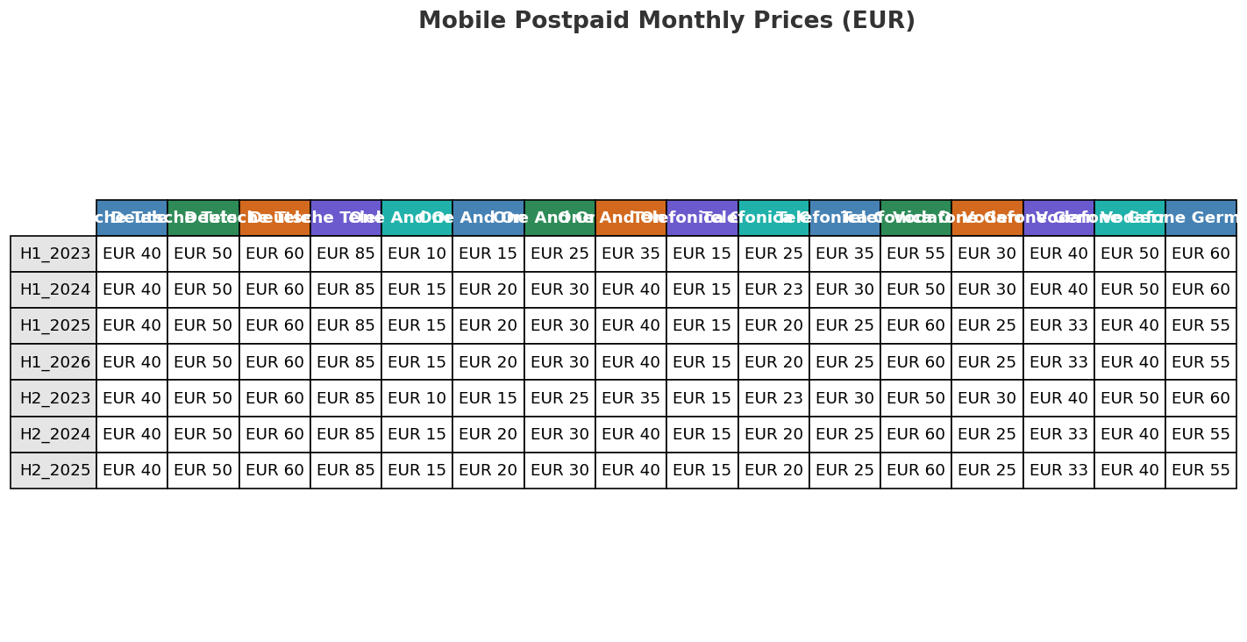
Price Evolution — Mobile Postpaid
H1_2023 TO H1_2026
Key Message: Price evolution across 7 snapshots — H1_2023 to H1_2026
17

Slide 18
Fixed & Convergence Pricing Landscape
DSL / CABLE / FIBER / FMC BUNDLES
DSL:
• Telefonica O2 Germany O2 my Home L: EUR 35/mo 100.0Mbps
• 1&1 AG 1&1 DSL 250: EUR 40/mo 250.0Mbps
• Deutsche Telekom MagentaZuhause L: EUR 45/mo 100.0Mbps
• Telefonica O2 Germany O2 my Home M: EUR 30/mo 50.0Mbps
FMC Bundles:
• Telefonica O2 Germany O2 All-in-One L: EUR 60/mo
• 1&1 AG 1&1 Kombi XL: EUR 60/mo
• Vodafone Germany GigaKombi Premium: EUR 80/mo
• Deutsche Telekom MagentaEINS Premium: EUR 120/mo
• Telefonica O2 Germany O2 All-in-One S: EUR 35/mo
• 1&1 AG 1&1 Kombi S: EUR 35/mo
• Vodafone Germany GigaKombi Basic: EUR 50/mo
• Deutsche Telekom MagentaEINS S: EUR 65/mo
Cable:
• Vodafone Germany GigaZuhause 500 Kabel: EUR 40/mo 500.0Mbps
• Deutsche Telekom MagentaZuhause XL Cable: EUR 50/mo 250.0Mbps
• Vodafone Germany GigaZuhause 250 Kabel: EUR 35/mo 250.0Mbps
• Vodafone Germany GigaZuhause 1000 Kabel: EUR 50/mo 1000.0Mbps
Fiber:
• Vodafone Germany GigaZuhause 500 Glasfaser: EUR 45/mo 500.0Mbps
• Telefonica O2 Germany O2 my Home Glasfaser L: EUR 45/mo 600.0Mbps
• Deutsche Telekom MagentaZuhause L Glasfaser: EUR 55/mo 500.0Mbps
• Telefonica O2 Germany O2 my Home Glasfaser M: EUR 35/mo 300.0Mbps
Key Message: Cheapest FMC bundle: Telefonica O2 Germany O2 All-in-One S at EUR 35/mo
18

Slide 19
03 Look at Competition
Porter's Five Forces — Competitive Landscape

Slide 20
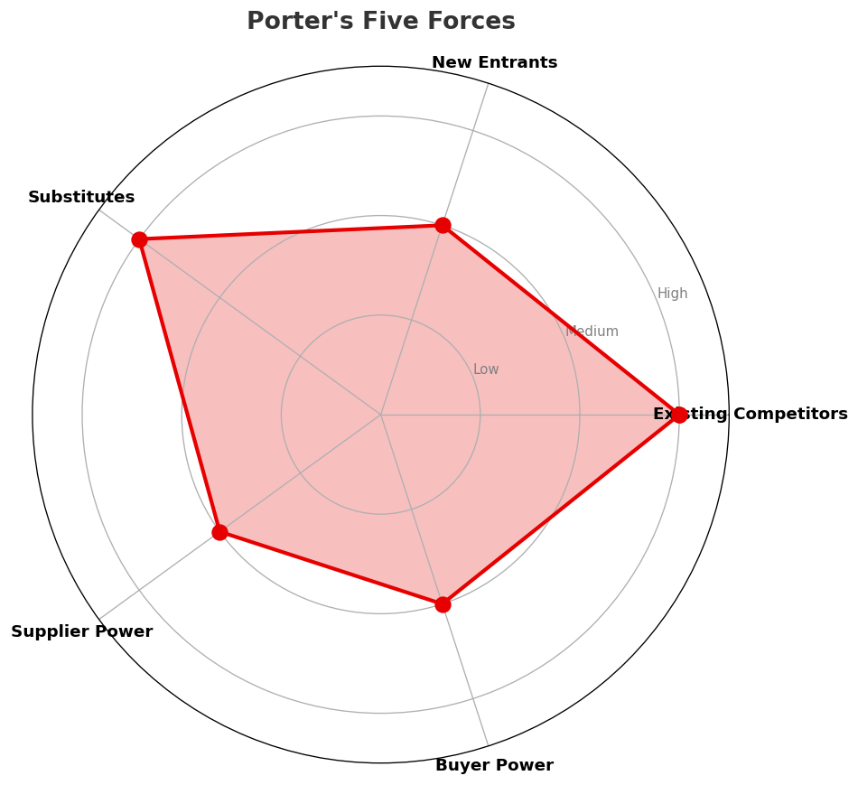
Porter's Five Forces
COMPETITIVE FORCES
Overall Intensity: MEDIUM
Key Message: In a 4-player market with medium competition intensity, Deutsche Telekom leads with 50% revenue share. Target operator holds 25% share. Strongest competitive force: Existing Competitors.
20

Slide 21
Competitor Analysis: Telefonica O2
COMPETITOR DEEP DIVE
Revenue
EBITDA
Margin
Capex/Rev
€2,000M
€650M
32.5%
25.0%
-3.4% YoY
Strengths
Weaknesses
• 5G Deployment: score 88 (market avg 75
• Network Coverage: score 85 (market avg 76
• Pricing Competitiveness: score 85 (market avg 78
• Enterprise Solutions: score 68 (market avg 74
• Product Innovation: score 70 (market avg 76
Strategy: Margin optimization / cost transformation; subscriber acquisition focus; 5G network leadership
Key Message: Competitor analysis: Telefonica O2
21

Slide 22
Competitor Analysis: Deutsche Telekom
COMPETITOR DEEP DIVE
Revenue
EBITDA
Margin
Capex/Rev
€6,200M
€2,610M
42.1%
19.4%
+1.1% YoY
Strengths
Weaknesses
• 5G Deployment: score 95 (market avg 75
• Brand Strength: score 90 (market avg 78
• Customer Service: score 82 (market avg 74
• Digital Services: score 85 (market avg 74
• Pricing Competitiveness: score 65 (market avg 78
Strategy: Revenue-led profitable growth; subscriber acquisition focus; strong B2B/enterprise push; 5G network leadership
Key Message: Competitor analysis: Deutsche Telekom
22

Slide 23
Competitor Analysis: One And One
COMPETITOR DEEP DIVE
Revenue
EBITDA
Margin
Capex/Rev
€1,035M
€126M
12.2%
38.6%
+0.1% YoY
Strengths
Weaknesses
• Pricing Competitiveness: score 90 (market avg 78
• 5G Deployment: score 40 (market avg 75
• Brand Strength: score 65 (market avg 78
• Digital Services: score 68 (market avg 74
• Enterprise Solutions: score 55 (market avg 74
Strategy: Market share expansion (investing for growth); subscriber acquisition focus
Key Message: Competitor analysis: One And One
23

Slide 24
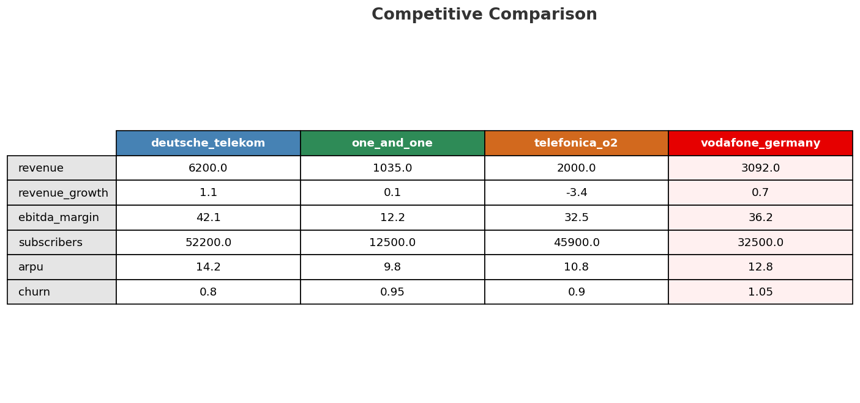
Competitive Landscape Summary
COMPETITION
Key Message: In a 4-player market with medium competition intensity, Deutsche Telekom leads with 50% revenue share. Target operator holds 25% share. Strongest competitive force: Existing Competitors.
24

Slide 25

Gap Analysis: Vodafone Germany vs Deutsche Telekom
COMPETITIVE GAP
Key Message: Gap analysis vs market leader Deutsche Telekom
25

Slide 26
New Entrants Threat
MARKET ENTRY
• Active new entrant: 1&1 AG: 1&1 AG is currently building/expanding its network presence
• 1&1 completes OpenRAN migration, reaches 25% own network coverage: All 1&1 mobile subscribers have migrated to its own OpenRAN 5G network (first in Europe). Approximately 1,500 own base stations operational, ~4,500 under construction. Achieved the 25% population coverage regulatory deadline target. Q3 2025 mobile net adds +40K (H1 roughly flat due to migration impact). 9-month CAPEX €228.7M primarily for network build-out.
• Entry barriers: High barriers: spectrum licensing, massive capex for network build, regulatory approvals, established brand loyalty
Key Message: New entrants threat level: medium
26

Slide 27
04 Look at Self
BMC + Capability Assessment

Slide 28
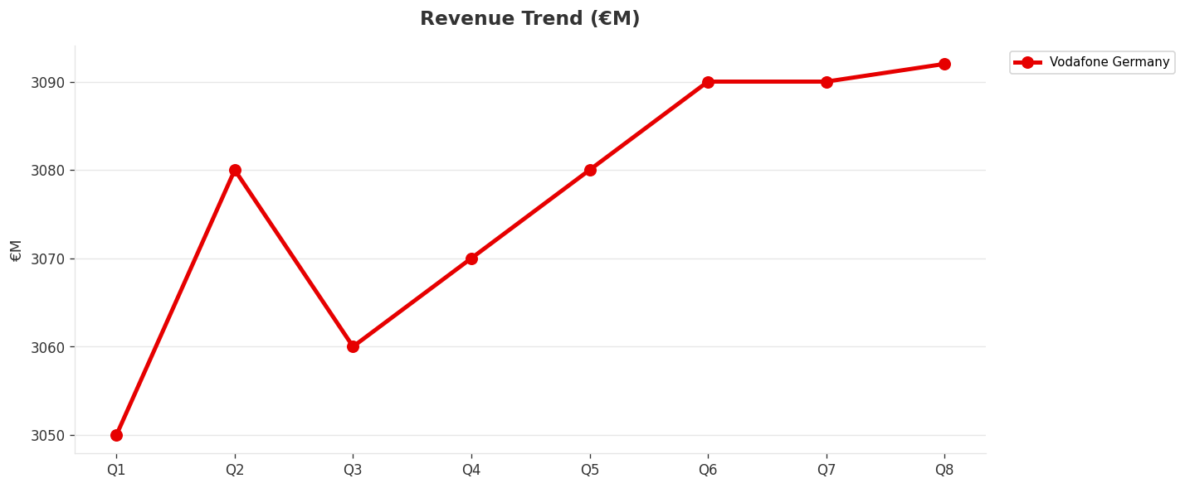
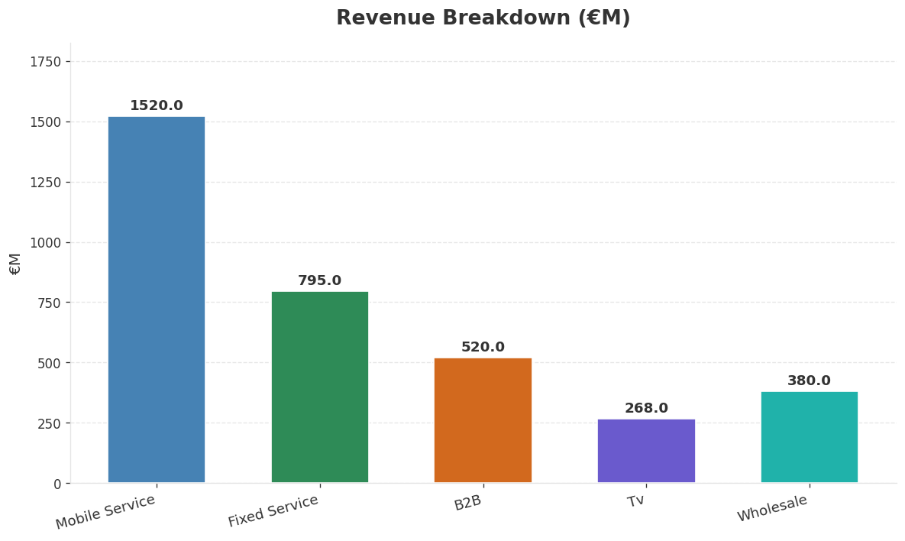
Operating Health Check
FINANCIAL HEALTH
Revenue
EBITDA
EBITDA Margin
Capex/Rev
€3,092M
€1,120M
36.2%
25.9%
+0.72% YoY
+1.5% YoY
Key Message: Ranked #2 of 4 operators in market; revenue EUR 3,092M; EBITDA margin 36.2%; stable but facing challenges; key strength: Brand Strength; key challenge: Customer Service; Management outlook: Germany EBITDA: H2 performing better than H1, but FY26 will not return to positive growth. Key tailwinds: (1) MDU YoY base effect starting to fade from Q3; (2) 1&1 wholesale revenue reaching full run-rate by Q4; (3) MVNO base effects.
28

Slide 29
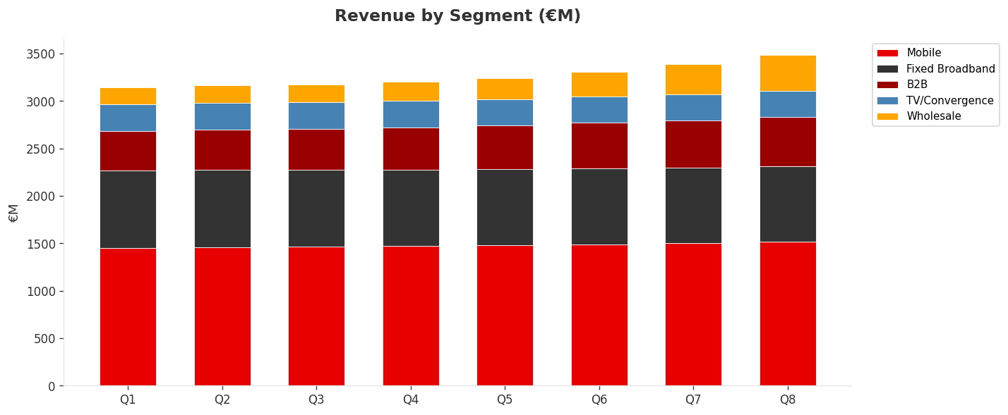
Revenue Composition Trend
SEGMENT REVENUE MIX OVER TIME
Key Message: Growing: Mobile, B2B, Wholesale | Declining: Fixed Broadband, TV/Convergence
29

Slide 30
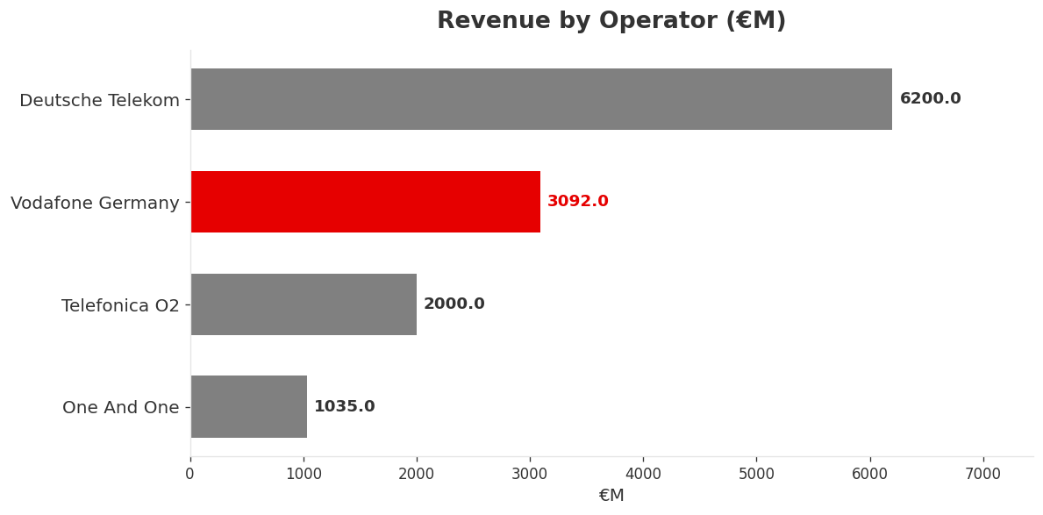
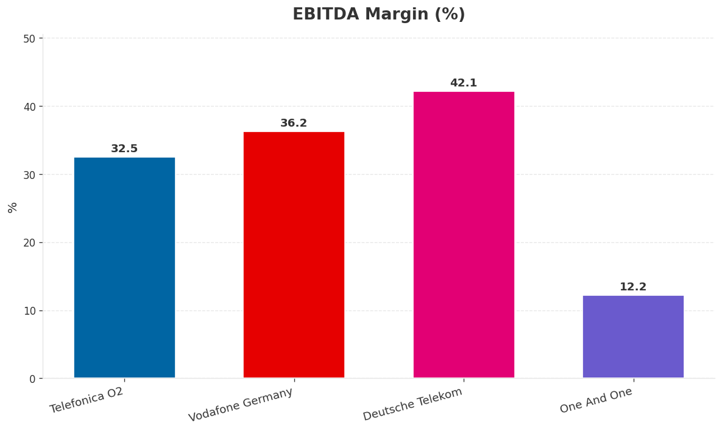
Revenue Comparison
COMPETITIVE BENCHMARKING
Key Message: Revenue and margin benchmarking across operators
30

Slide 31
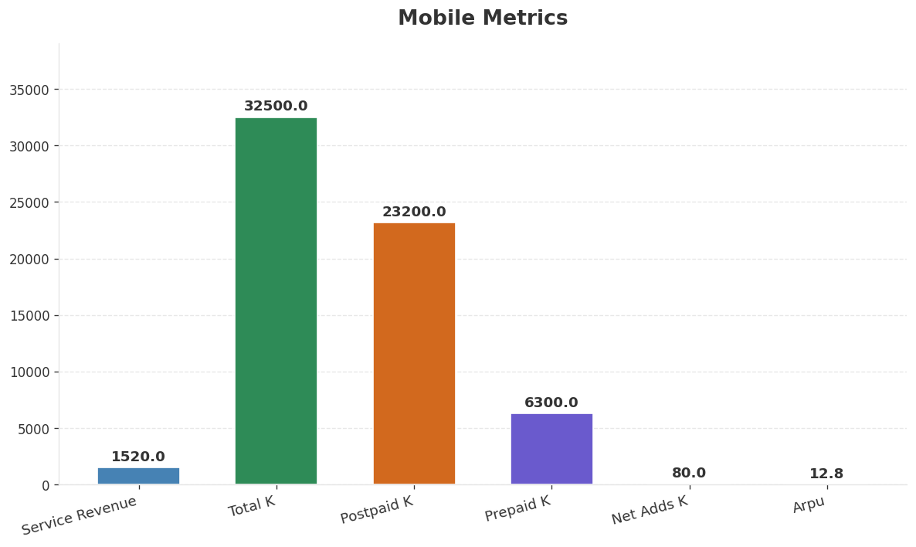
Segment Analysis: Mobile
SEGMENT PERFORMANCE
Service Revenue
Service Growth Pct
Total K
Postpaid K
€1,520M
2.8%
€32,500M
€23,200M
Health: STABLE
• revenue: improving
• subscribers: stable
• arpu: improving
• Vodafone Business Germany service revenue declined 1.8% in Q3 (Q2: -1.6%), widening decline. Reason: ARPU pressure on mobile contract renewals + core connectivity business under sustained pressure. Hi
• Mobile service revenue grew 2.8% in Q3 (Q2: 3.8%), growth decelerating. Reason: wholesale revenue growth partially offset by ARPU pressure and service provider payment timing. Post-1&1 migration, netw
• Vodafone completes 1&1 customer migration: 12M users on network
Key Message: Mobile service revenue at 1,520M; up 2.8% YoY; ARPU 12.8
31

Slide 32
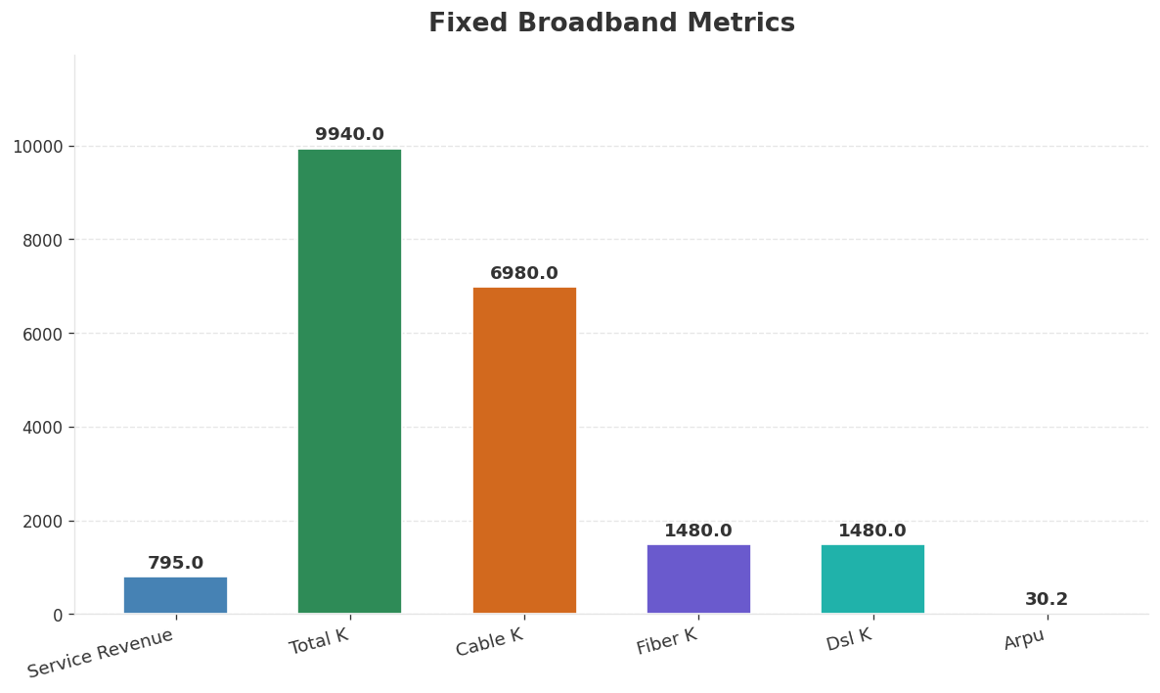
Segment Analysis: Fixed Broadband
SEGMENT PERFORMANCE
Service Revenue
Service Growth Pct
Total K
Net Adds K
€795M
-1.1%
€9,940M
-63
Health: STABLE
• revenue: stable
• subscribers: stable
• arpu: stable
• Broadband pricing strategy: another price increase in January 2026, adopting a 'more-for-more' approach. Fixed-line consumer revenue has stabilized. New customer broadband ARPU at a 3-year high (+21%
• Vodafone restructures cable TV frequencies nationwide
Key Message: Fixed service revenue 795.0M; growth -1.1% YoY; Fiber subs 1480K
32

Slide 33
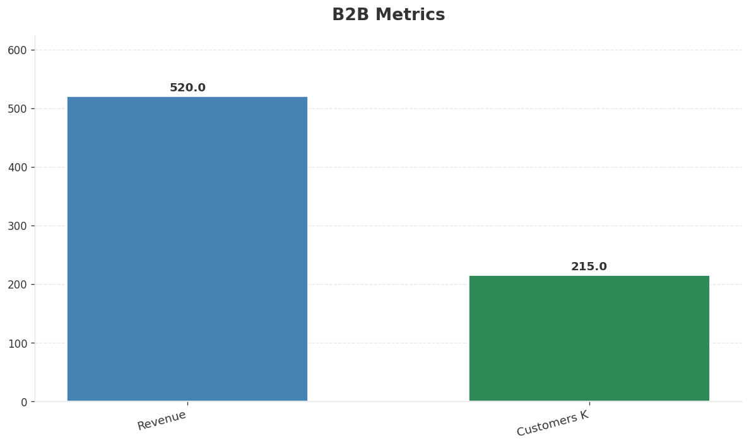
Segment Analysis: B2B
SEGMENT PERFORMANCE
Revenue
Growth Pct
Customers K
Share Of Revenue Pct
€520M
8.5%
€215M
16.8%
Health: STRONG
• revenue: improving
• customers: improving
• Vodafone Business Germany service revenue declined 1.8% in Q3 (Q2: -1.6%), widening decline. Reason: ARPU pressure on mobile contract renewals + core connectivity business under sustained pressure. Hi
• Vodafone completes Skaylink acquisition for €175M
• revenue increased 4.0% QoQ
Key Message: B2B revenue 520.0M; growth +8.5% YoY; 16.8% of total revenue
33

Slide 34
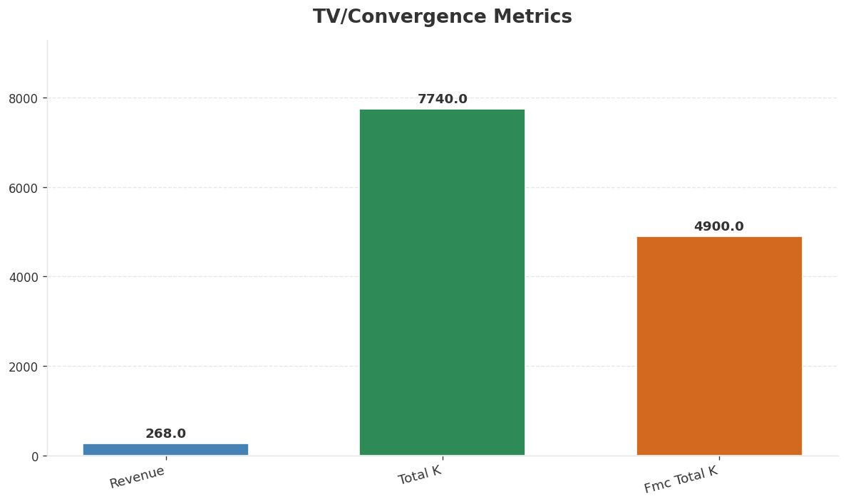
Segment Analysis: TV/Convergence
SEGMENT PERFORMANCE
Revenue
Total K
Net Adds K
Fmc Total K
€268M
€7,740M
-6
€4,900M
Health: STABLE
• revenue: stable
• subscribers: stable
• fmc_subscribers: improving
• Vodafone restructures cable TV frequencies nationwide
• fmc_subscribers increased 2.1% QoQ
Key Message: TV subscribers 7740K; FMC 4900K; FMC penetration 49.3%
34

Slide 35
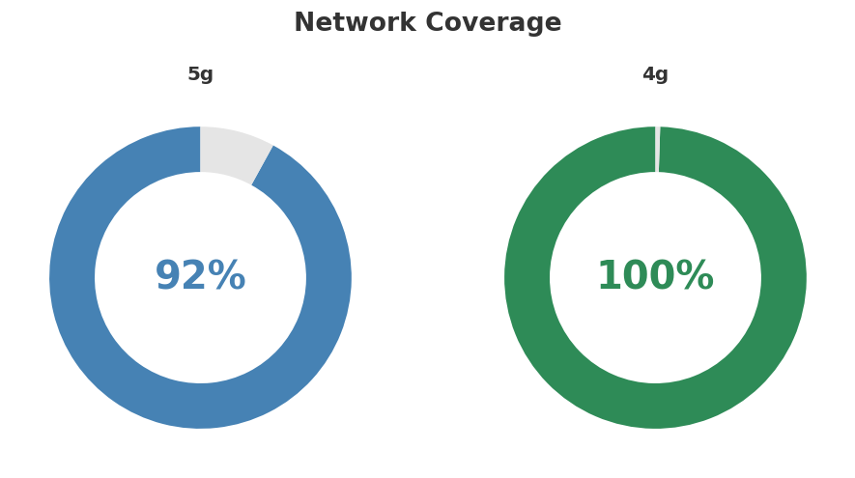
Network Analysis
INFRASTRUCTURE
Technology Mix:
Investment Direction: stable
• Edge Nodes: 12
• Core Vendor: Ericsson
• 5G Sa Status: Testing, planned 2026
• Spectrum Mhz: 700: 20, 1800: 50, 2100: 40, 2600: 20, 3600: 90
• Mobile Vendor: Ericsson + Nokia (non-standalone 5G
• 5G Base Stations: 18500
• Virtualization Pct: 45%
Key Message: Network infrastructure and coverage assessment
35

Slide 36
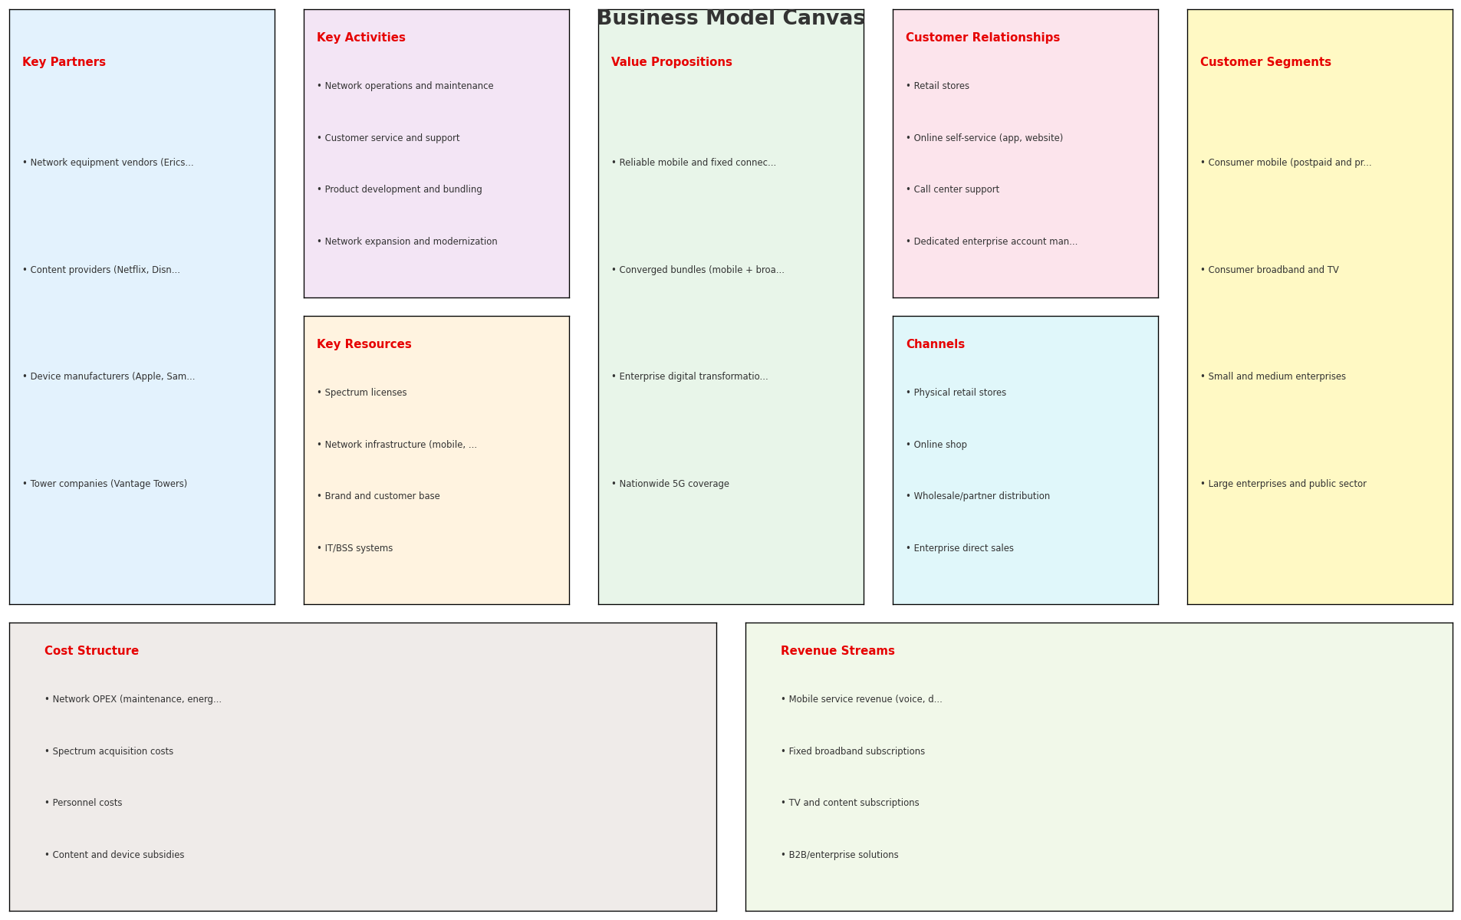
Business Model Canvas
BMC
Key Message: Business model canvas overview
36

Slide 37
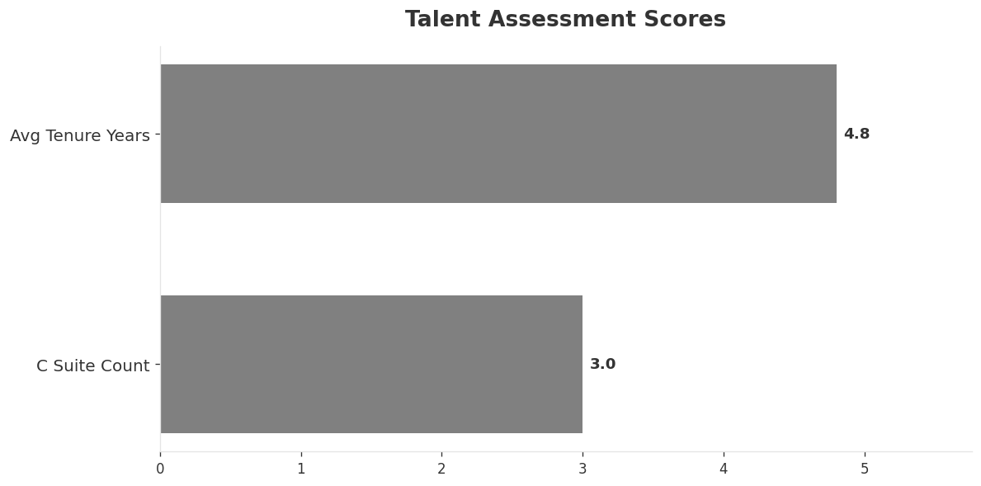
Organization & Talent
PEOPLE & CULTURE
Employees
C Suite Count
Avg Tenure Years
Key Leaders
14,500
3
4.8
['Marcel de Groot (CEO)', 'Anna Googel (CFO)', 'Gerhard Mack (CTO)']
Organization Culture:
Stable leadership team (avg tenure >3 years); Growth-oriented strategic posture; High-investment posture; Transformation-oriented culture under Vodafone Group direction; customer-centricity push via NPS programs; agile transformation in digital operations; German engineering tradition meets UK group culture.
Leadership Changes:
• Marcel de Groot: (
• Anna Googel: (
• Gerhard Mack: (
Key Message: Organization and talent assessment
37

Slide 38
Strengths, Weaknesses & Exposure Points
SELF ASSESSMENT
Strengths
Weaknesses
Exposure Points
• Brand Strength: score 82 (market avg 78
• Enterprise Solutions: score 82 (market avg 74
• Network Coverage: score 80 (market avg 76
• Strong EBITDA margin at 36.2%
• Revenue on growth trajectory
• Top 2 in revenue market ranking
• Customer Service: score 70 (market avg 74
• Pricing Competitiveness: score 72 (market avg 78
• 1&1 building own mobile network and migrating users off Vodafone wholesale: Loss of wholesale revenue as 1&1 users migrate to own network
• Heavy reliance on cable (DOCSIS) technology while market shifts to fiber: Technology perception gap as competitors lead fiber deployment
• Low fiber penetration compared to Deutsche Telekom: Competitive disadvantage in future-proof broadband
Key Message: Ranked #2 of 4 operators in market; revenue EUR 3,092M; EBITDA margin 36.2%; stable but facing challenges; key strength: Brand Strength; key challenge: Customer Service; Management outlook: Germany EBITDA: H2 performing better than H1, but FY26 will not return to positive growth. Key tailwinds: (1) MDU YoY base effect starting to fade from Q3; (2) 1&1 wholesale revenue reaching full run-rate by Q4; (3) MVNO base effects.
38

Slide 39
SWOT Synthesis
Strengths, Weaknesses, Opportunities & Threats

Slide 40

SWOT Analysis
STRATEGIC SYNTHESIS
SO:
Leverage 'Brand Strength: score 82 (market avg 78)' to ca...
WO:
Address weakness 'Customer Service: score 70 (market avg ...
ST:
Use strength 'Brand Strength: score 82 (market avg 78)' t...
WT:
Mitigate weakness 'Customer Service: score 70 (market avg...
Key Message: SWOT analysis identifies 7 strengths, 5 weaknesses, 10 opportunities, and 4 threats. The recommended strategic posture is offensive (SO-dominant).
40

Slide 41
05 Look at Opportunities
SPAN Matrix — Opportunity Selection

Slide 42
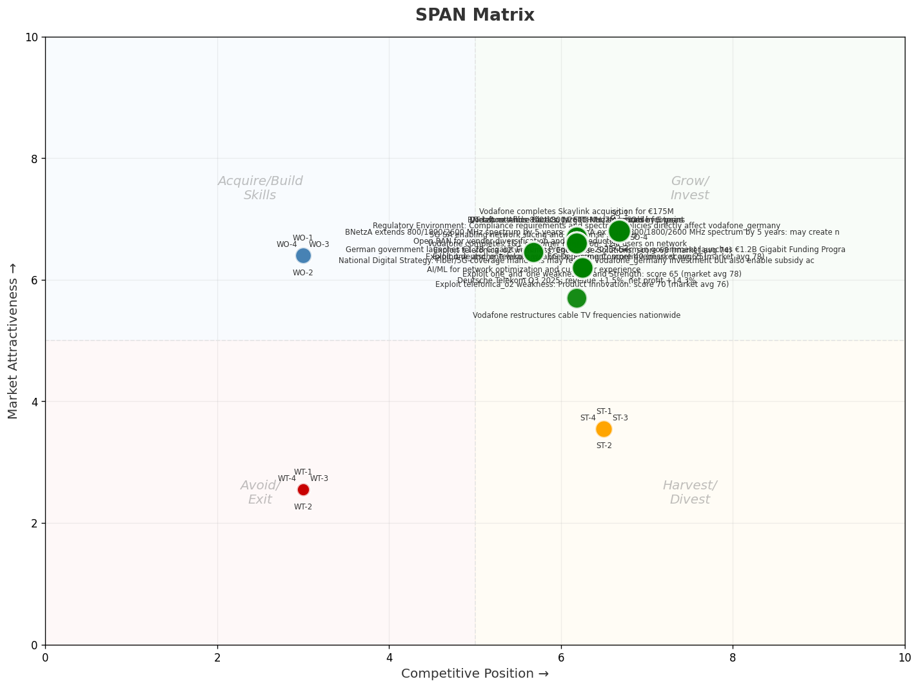
SPAN Matrix — Opportunity Positioning
OPPORTUNITY MAP
Key Message: SPAN matrix positions 35 opportunities: 23 grow/invest, 4 acquire skills, 4 harvest, 4 avoid/exit. Focus resources on the 23 grow/invest items for maximum strategic impact.
42

Slide 43
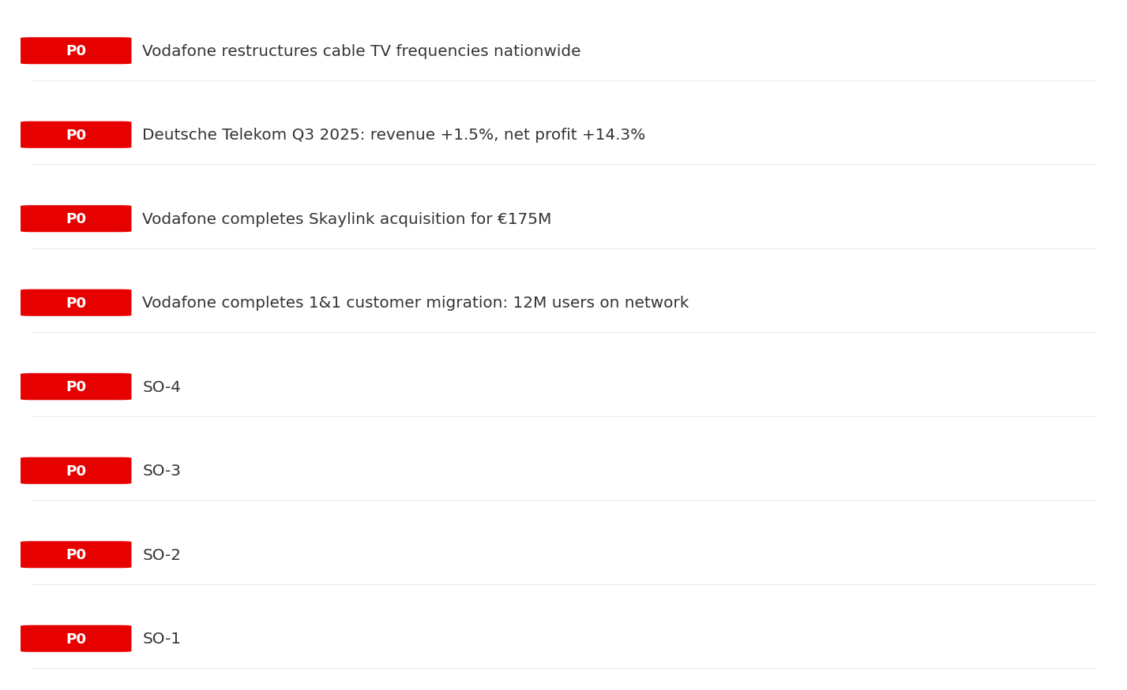
Opportunity Priority Ranking
PRIORITIES
Key Message: SPAN matrix positions 35 opportunities: 23 grow/invest, 4 acquire skills, 4 harvest, 4 avoid/exit. Focus resources on the 23 grow/invest items for maximum strategic impact.
43

Slide 44
Opportunity Details
DEEP DIVE
P0
SO-1
Market: N/A | Window:
Leverage 'Brand Strength: score 82 (market avg 78)' to capture the opportunity of 'Regulatory Environment: Compliance requirements and spectrum policies directly affect vodafone_germany'.
P0
SO-2
Market: N/A | Window:
Leverage 'Enterprise Solutions: score 82 (market avg 74)' to capture the opportunity of 'National Digital Strategy: Fiber/5G coverage mandates may require vodafone_germany investment but also enable subsidy access'.
P0
SO-3
Market: N/A | Window:
Leverage 'Network Coverage: score 80 (market avg 76)' to capture the opportunity of 'BNetzA extends 800/1800/2600 MHz spectrum by 5 years: BNetzA extends 800/1800/2600 MHz spectrum by 5 years: may create new market access or subsidy opportunities for vodafone_germany'.
P0
SO-4
Market: N/A | Window:
Leverage 'Strong EBITDA margin at 36.2%' to capture the opportunity of 'German government launches €1.2B Gigabit Funding Programme 2025: German government launches €1.2B Gigabit Funding Programme 2025: may create new market access or subsidy opportunities for vodafone_germany'.
Key Message: SPAN matrix positions 35 opportunities: 23 grow/invest, 4 acquire skills, 4 harvest, 4 avoid/exit. Focus resources on the 23 grow/invest items for maximum strategic impact.
44

Slide 45
Three Decisions
Strategy — Key Tasks — Execution

Slide 46
Decision 1: Define Strategy
OFFENSIVE
As The Squeezed Middle: close the leadership gap with aggressive growth in high-momentum segments
P0
P0
P1
P1
Growth Strategy
Competitive Strategy
Transformation Strategy
Customer Strategy
Close the gap to market leader — accelerate Mobile, B2B, TV/Convergence
Capitalize on competitive strengths to gain market share
Accelerate fiber transition — converged network as competitive moat
Optimize value extraction in stable segments: Fixed Broadband
- Gain 1-2pp revenue share
- Grow Mobile, B2B, TV/Convergence double-digit
- Outgrow competitors in key segments
- Increase service differentiation
- Fiber homepass coverage +20%
- FMC bundle attach rate 50%+
- Upsell rate +10% in Fixed Broadband
- Cross-sell convergence bundles
Key Message: As The Squeezed Middle, the strategic posture is Offensive. As The Squeezed Middle: close the leadership gap with aggres
46

Slide 47
Decision 2: Define Key Tasks
3 P0 (IMMEDIATE), 3 P1 (1-2 YEARS), 1 P2 (3-5 YEARS
P0
Network
Accelerate Fixed Network Upgrade
Homepass coverage +15% | Speed tier upgrades
Drive DOCSIS/Fiber rollout to increase homepass and improve quality scores
P0
Business
Accelerate Mobile Growth
Mobile revenue +10% YoY | Market share gain
Mobile at €1,520M showing strong momentum — invest to scale
P0
Business
Accelerate B2B Growth
B2B revenue +10% YoY | Market share gain
B2B at €520M showing strong momentum — invest to scale
P1
Network
5G Coverage Expansion
5G pop coverage target | 5G attach rate
Expand 5G population coverage to strengthen mobile competitive position
P1
Business
Opportunity Portfolio Execution
Launch 3+ priority initiatives | Pipeline contribution tracking
23 grow/invest opportunities identified — establish execution office
P1
Customer
Customer Experience Enhancement
NPS +5 points | First-call resolution rate 80%+
Improve digital touchpoints and service resolution to boost NPS
P2
Efficiency
Operational Efficiency & Automation
Process automation 30%+ | Cost-to-serve reduction
EBITDA margin 36.2% — maintain through smart automation and resource reallocatio
Key Message: 7 critical tasks: 3 P0 (immediate), 3 P1 (1-2 years), 1 P2 (3-5 years
47

Slide 48
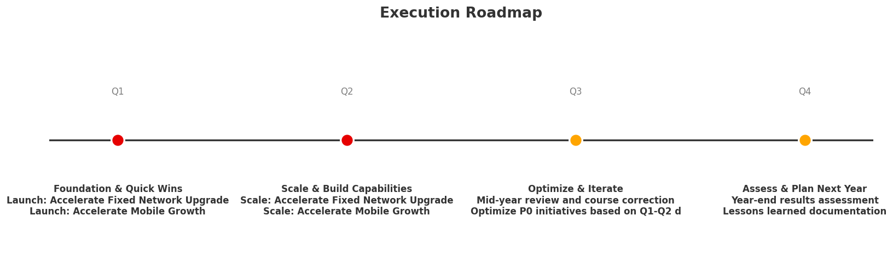
Decision 3: Define Execution
QUARTERLY ROADMAP & GOVERNANCE
Governance
Strategic Traps to Avoid
- Monthly Progress Review (Monthly
x Enter a price war
- Quarterly Strategic Checkpoint (Quarterly
x Attempt premium repositioning
- Mid-Year Strategic Adjustment (Semi-annual
x Delay core transformation
Key Risks & Mitigation
! Resource constraints delay P0 initiatives -- Ring-fence P0 budgets; establish escalation path for blockers
Key Message: Execute with discipline: monthly reviews, quarterly checkpoints, annual refresh
! Macro-economic slowdown reduces consumer spending -- Prepare value-tier offerings; shift mix toward B2B resilience
48

Slide 49
Analysis Summary
KEY TAKEAWAYS
01 Trends
Macro environment: Favorable. Key opportunities: Regulatory Environment, National Digital Strategy. Key risks: Regulatory Environment, Nebenkostenprivileg (MDU cable TV bundling) abolished Industry is mature. (+0.3% YoY (CQ2_2025 -> CQ4_2025)
02 Market
Germany telecom market totals EUR 12.3B in quarterly revenue; competitive strengths in Availability, Assurances; Market outlook is favorable with more opportunities than threats.
03 Competition
In a 4-player market with medium competition intensity, Deutsche Telekom leads with 50% revenue share. Target operator holds 25% share. Strongest competitive force: Existing Competitors.
04 Self
Ranked #2 of 4 operators in market; revenue EUR 3,092M; EBITDA margin 36.2%; stable but facing challenges; key strength: Brand Strength; key challenge: Customer Service; Management outlook: Germany EBITDA: H2 performing better than H1, but FY26 will not return to positive growth. Key tailwinds: (1) MDU YoY base effect starting to fade from Q3; (2) 1&1 wholesale revenue reaching full run-rate by Q4; (3) MVNO base effects.
SWOT
SWOT analysis identifies 7 strengths, 5 weaknesses, 10 opportunities, and 4 threats. The recommended strategic posture is offensive (SO-dominant).
05 Opportunities
SPAN matrix positions 35 opportunities: 23 grow/invest, 4 acquire skills, 4 harvest, 4 avoid/exit. Focus resources on the 23 grow/invest items for maximum strategic impact.
Key Message: Complete Five Looks analysis — see opportunity priorities for next steps
49

Slide 50
Data Provenance
SOURCES & METHODOLOGY
• telecom.db
• telecom.db
• telecom.db
• telecom.db
• telecom.db
• telecom.db
• telecom.db
• telecom.db
Key Message: All data points are traceable to original sources
50

Slide 51
Thank You
BLM Five Looks Strategic Analysis

