Slide 1
Default BLM Strategic Analysis
BLM (Business Leadership Model) Five Looks Analysis
Target Operator
Market
Analysis Period
Report Date
Proximus Be
Belgium
CQ4_2025
2026-02-14
01 Trends (PEST) | 02 Market/Customer ($APPEALS) | 03 Competition (Porter) | 04 Self (BMC) | SWOT Synthesis | 05 Opportunities (SPAN

Slide 2
Report Contents
TABLE OF CONTENTS
01
Executive Summary
Key findings and recommendations
02
Look at Trends
PEST Framework — macro environment
03
Look at Market
$APPEALS — market changes & customer needs
T
Tariff Analysis
Pricing comparison — mobile, fixed & convergence
04
Look at Competition
Porter's Five Forces — competitive landscape
05
Look at Self
BMC + Capability — internal assessment
06
SWOT Synthesis
Strengths, Weaknesses, Opportunities, Threats
07
Look at Opportunities
SPAN Matrix — opportunity selection
Summary & Provenance
2
08
Conclusions and data sources

Slide 3
Data Quality Overview
DATA QUALITY
Total Data Points
High Confidence
Medium Confidence
Low/Estimated
20
0
0
20
0%
Unique Sources: 0
Data Conflicts: 0
Coverage: Partial
Key Message: 20 data points tracked, 0 high-confidence (0%
3

Slide 4
Executive Summary
Trends
Macro environment: Favorable. Key opportunities: Regulatory Environment, National Digital Strategy. Key risks: Regulatory Environment, Fiber Broadband Penetration Industry is in late growth phase. (+3.2% YoY (CQ2_2025 -> CQ4_2025)
Market/Customer
Belgium telecom market totals EUR 2,479M in quarterly revenue; competitive strengths in Availability, Performance; Market faces significant competitive headwinds.
Competition
In a 3-player market with medium competition intensity, Proximus leads with 50% revenue share. Target operator holds 50% share. Strongest competitive force: Substitutes.
Self Assessment
Ranked #1 of 3 operators in market; revenue EUR 1,240M; EBITDA margin 32.3%; stable but facing challenges; key strength: Brand Strength; key challenge: Price Competitiveness; Management outlook: Proximus NXT cloud and cybersecurity services driving enterprise growth. Business mobile ARPU under pressure (-3.8% in Q4 2024).
SWOT
SWOT analysis identifies 9 strengths, 3 weaknesses, 2 opportunities, and 4 threats. The recommended strategic posture is offensive (SO-dominant).
Opportunities
SPAN matrix positions 19 opportunities: 10 grow/invest, 2 acquire skills, 4 harvest, 3 avoid/exit. Focus resources on the 10 grow/invest items for maximum strategic impact.
Key Message: Five Looks analysis completed — see details in following sections
4

Slide 5
01 Look at Trends
PEST Framework — Macro Environment

Slide 6
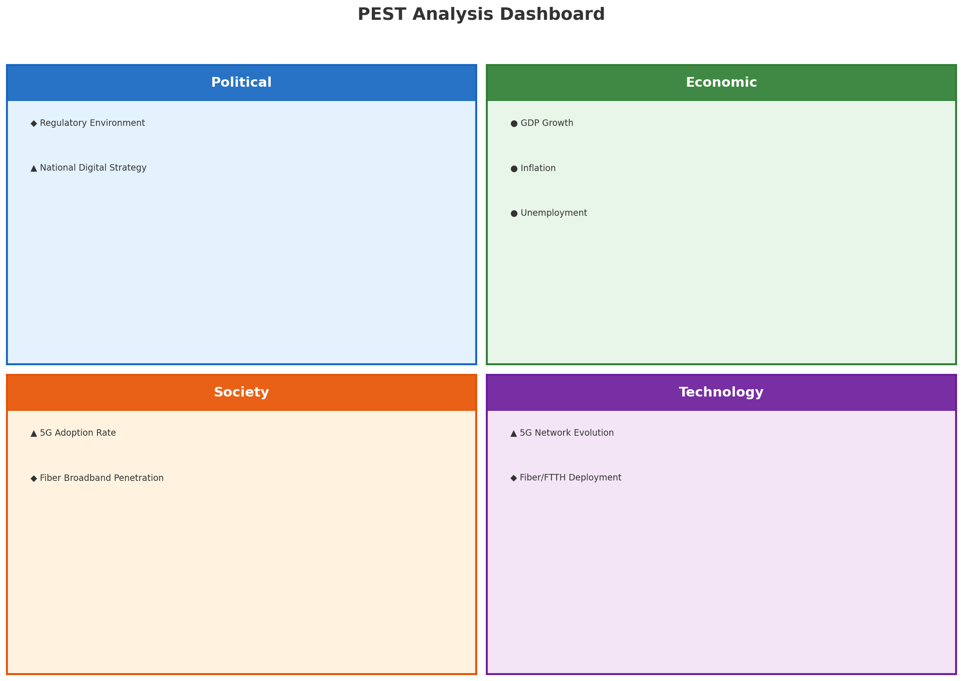
PEST Analysis Dashboard
MACRO ENVIRONMENT
Key Message: Macro environment: Favorable. Key opportunities: Regulatory Environment, National Digital Strategy. Key risks: Regulatory Environment, Fiber Broadband Penetration.
6

Slide 7
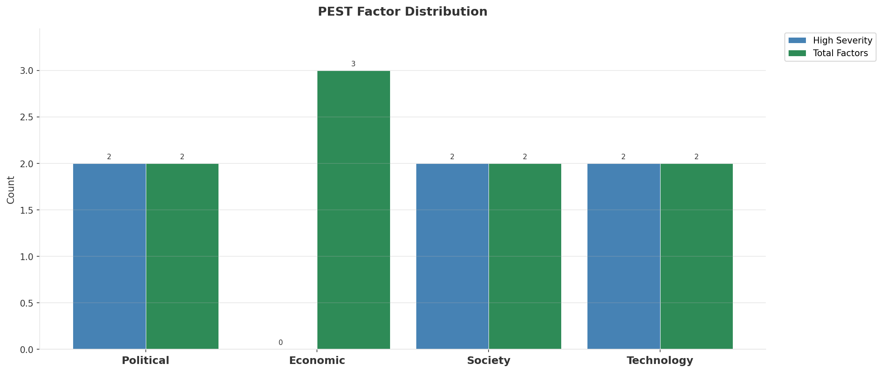
Industry Environment
INDUSTRY ANALYSIS
Market Size
Growth Rate
Concentration
Lifecycle
EUR 2.5B (quarterly, CQ4_2025
+3.2% YoY (CQ2_2025 -> CQ4_2025
CR4 = 100% (Proximus: 50.0%, Telenet: 29.6%, Orange Belgium: 20.3%
late_growth
• New Business Models:
• FWA (Fixed Wireless Access) as fiber alternative
• Network-as-a-Service for enterprise verticals
• Wholesale/MVNO partnerships for coverage monetization
• Technology Revolution:
• 5G SA enabling network slicing and enterprise services
• AI/ML for network optimization and customer experience
• Open RAN for vendor diversification and cost reduction
Key Message: Macro environment: Favorable. Key opportunities: Regulatory Environment, National Digital Strategy. Key risks: Regulatory Environment, Fiber Broadband Penetration Industry is in late growth phase. (+3.2% YoY (CQ2_2025 -> CQ4_2025)
7

Slide 8
Value Transfer Trends
VALUE MIGRATION
• Value shifting from voice/SMS to data and digital services
• B2B/ICT growing faster than consumer segment
• Fiber displacing copper and cable broadband
Key Message: Macro environment: Favorable. Key opportunities: Regulatory Environment, National Digital Strategy. Key risks: Regulatory Environment, Fiber Broadband Penetration Industry is in late growth phase. (+3.2% YoY (CQ2_2025 -> CQ4_2025)
8

Slide 9
02 Look at Market
$APPEALS — Market Changes & Customer Needs

Slide 10
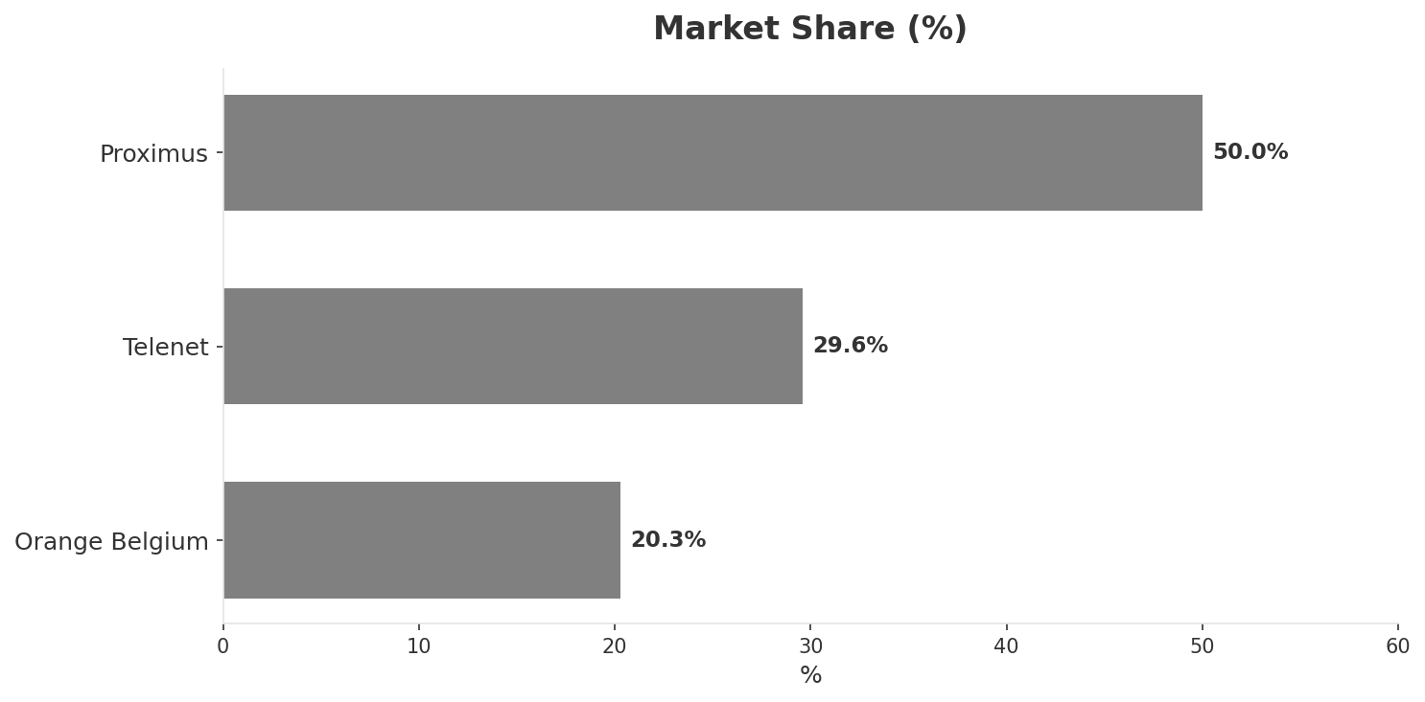
Market Change Panorama
MARKET OVERVIEW
Total Revenue (€M
Mobile Subs (K
Broadband Subs (K
Operators
2,479
12,108
5,124
3
Market Changes:
• Proximus EBITDA margin compression: 32.3% vs 36.7% (-4.4pp
• Telenet launches TADAAM unlimited mobile at EUR 25/month
• Proximus increases mobile data volumes — defensive response to DIGI
Key Message: Belgium telecom market totals EUR 2,479M in quarterly revenue; competitive strengths in Availability, Performance; Market faces significant competitive headwinds.
10

Slide 11
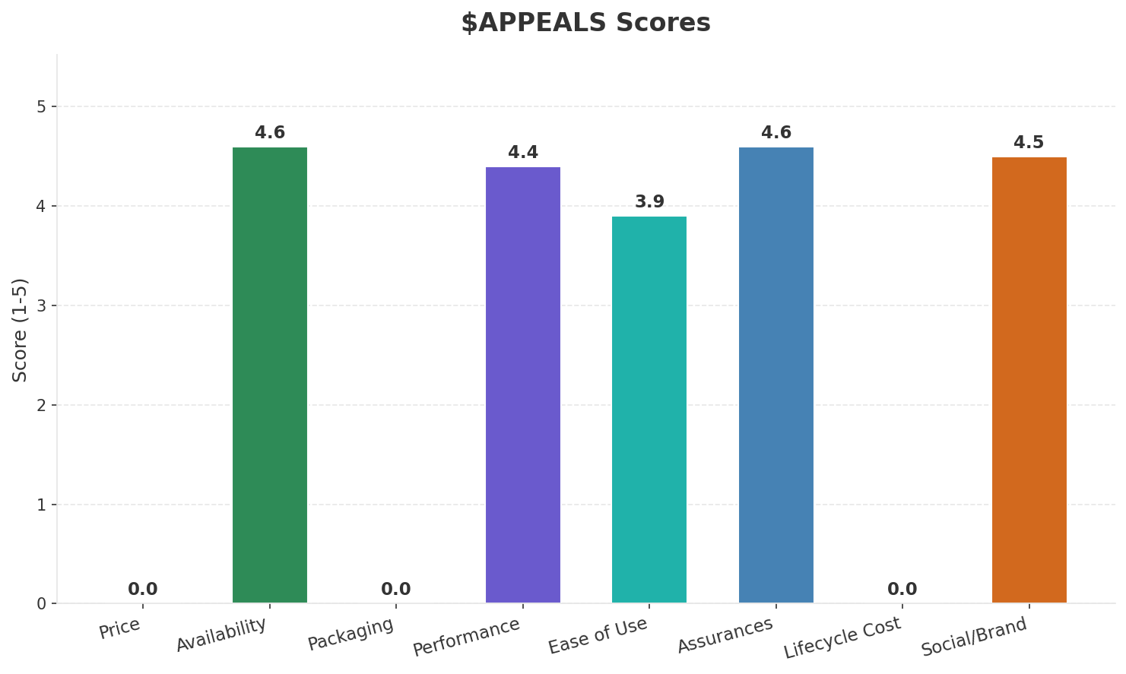
Customer Segments
SEGMENTATION
Consumer Premium Convergent
Trend: stable
Needs: Seamless multi-screen entertainment experience, Ultra-fast symmetric broadband for remote work
Consumer Mainstream
Size: ~6.3M subscribers | Trend: stable | Our Share: ~45% of postpaid
Needs: Affordable convergent bundles, Better mobile data allowances at reasonable prices
Consumer Price-Sensitive / MVNO
Trend: stable
Needs: Low-cost mobile-only plans, Prepaid flexibility without premium pricing
Enterprise & Government
Trend: stable
Needs: Private 5G networks for industrial sites, Multi-cloud connectivity and cybersecurity
Key Message: Belgium telecom market totals EUR 2,479M in quarterly revenue; competitive strengths in Availability, Performance; Market faces significant competitive headwinds.
11

Slide 12
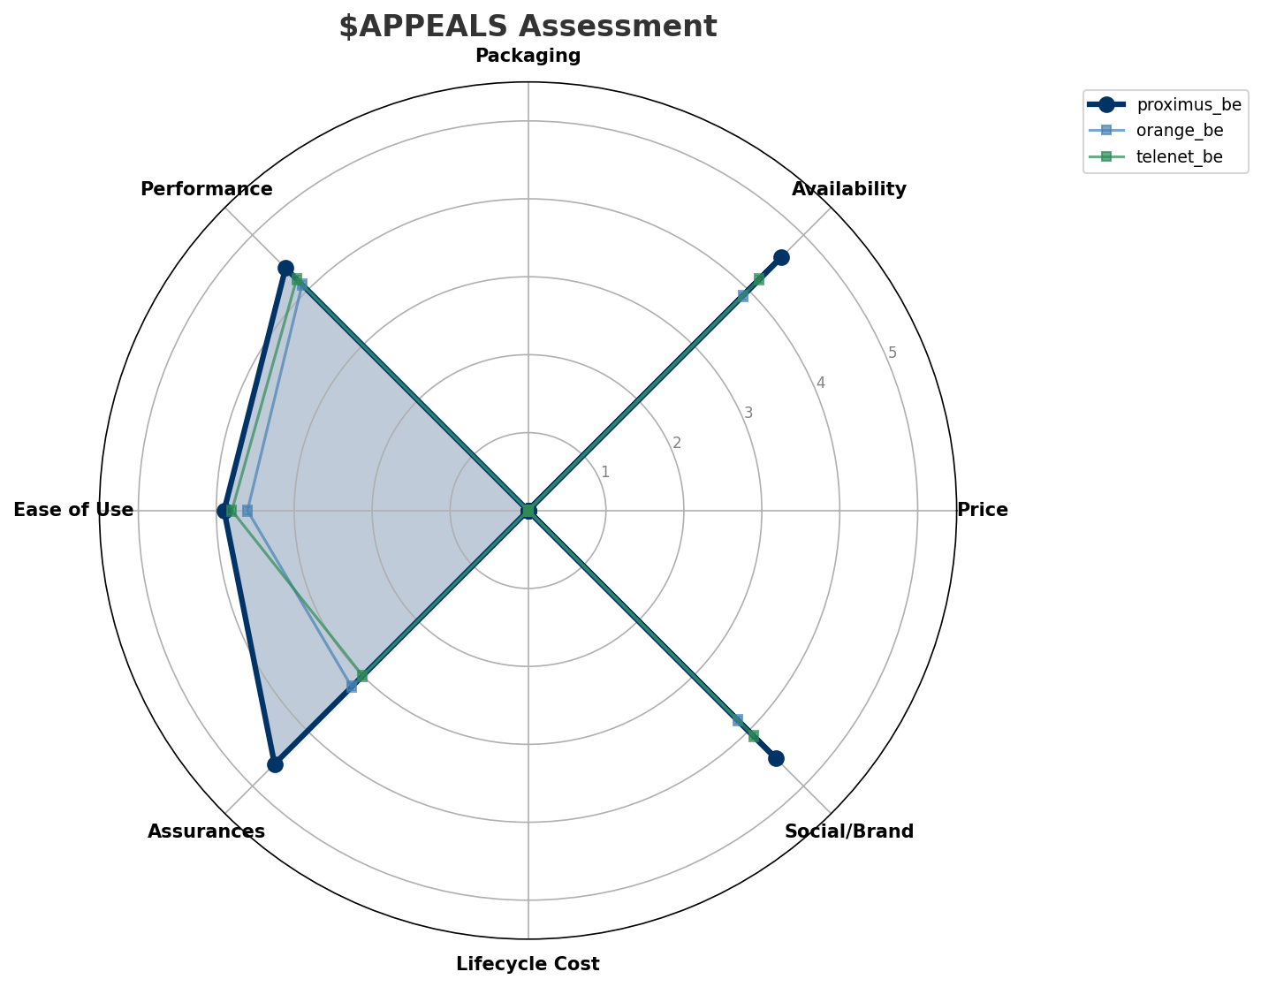
$APPEALS Assessment
CUSTOMER NEEDS
Key Message: Belgium telecom market totals EUR 2,479M in quarterly revenue; competitive strengths in Availability, Performance; Market faces significant competitive headwinds.
12

Slide 13
Customer Value Migration
VALUE MIGRATION
Value migration is mixed: some segments trending up while price-sensitive segments face pressure. Differentiated strategy by segment recommended.
Threats:
• Proximus EBITDA margin compression: 32.3% vs 36.7% (-4.4pp
• Telenet launches TADAAM unlimited mobile at EUR 25/month
Key Message: Belgium telecom market totals EUR 2,479M in quarterly revenue; competitive strengths in Availability, Performance; Market faces significant competitive headwinds.
13

Slide 14
Tariff Analysis
Mobile, Fixed & Convergence Pricing Landscape

Slide 15
Fixed & Convergence Pricing Landscape
DSL / CABLE / FIBER / FMC BUNDLES
Key Message: Fixed and convergence pricing overview
15

Slide 16
03 Look at Competition
Porter's Five Forces — Competitive Landscape

Slide 17
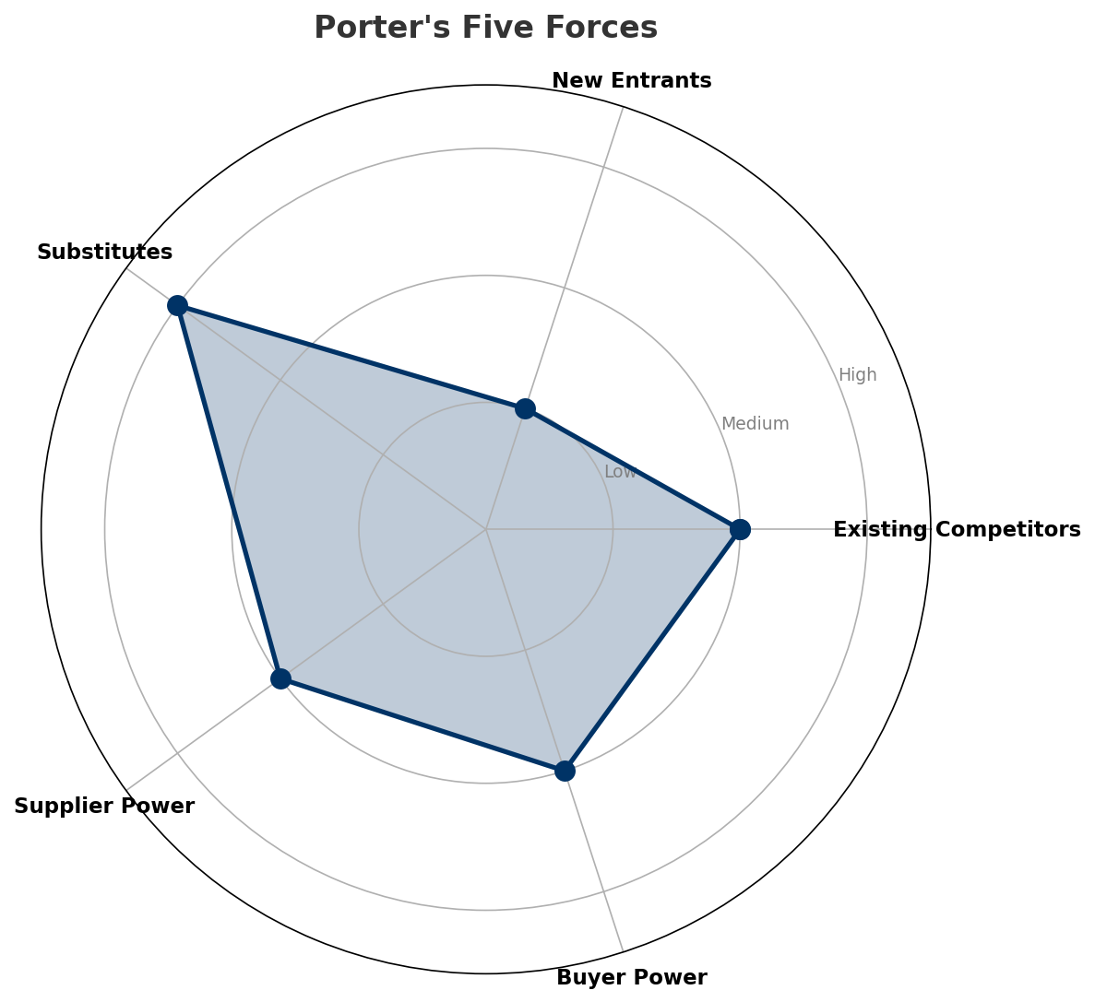
Porter's Five Forces
COMPETITIVE FORCES
Overall Intensity: MEDIUM
Key Message: In a 3-player market with medium competition intensity, Proximus leads with 50% revenue share. Target operator holds 50% share. Strongest competitive force: Substitutes.
17

Slide 18
Competitor Analysis: Orange Be
COMPETITOR DEEP DIVE
Revenue
EBITDA
Margin
Capex/Rev
€504M
€154M
30.6%
19.2%
-3.2% YoY
Strengths
Weaknesses
• Price Competitiveness: score 72 (market avg 64
• Brand Strength: score 75 (market avg 82
• Distribution: score 70 (market avg 80
• Enterprise Solutions: score 65 (market avg 72
• Network Coverage: score 78 (market avg 85
Strategy: Revenue-led profitable growth; subscriber acquisition focus
Key Message: Competitor analysis: Orange Be
18

Slide 19
Competitor Analysis: Telenet Be
COMPETITOR DEEP DIVE
Revenue
EBITDA
Margin
Capex/Rev
€735M
€340M
46.3%
38.1%
+0.3% YoY
Strengths
Weaknesses
• Enterprise Solutions: score 60 (market avg 72
Strategy: Market share expansion (investing for growth); subscriber acquisition focus
Key Message: Competitor analysis: Telenet Be
19

Slide 20
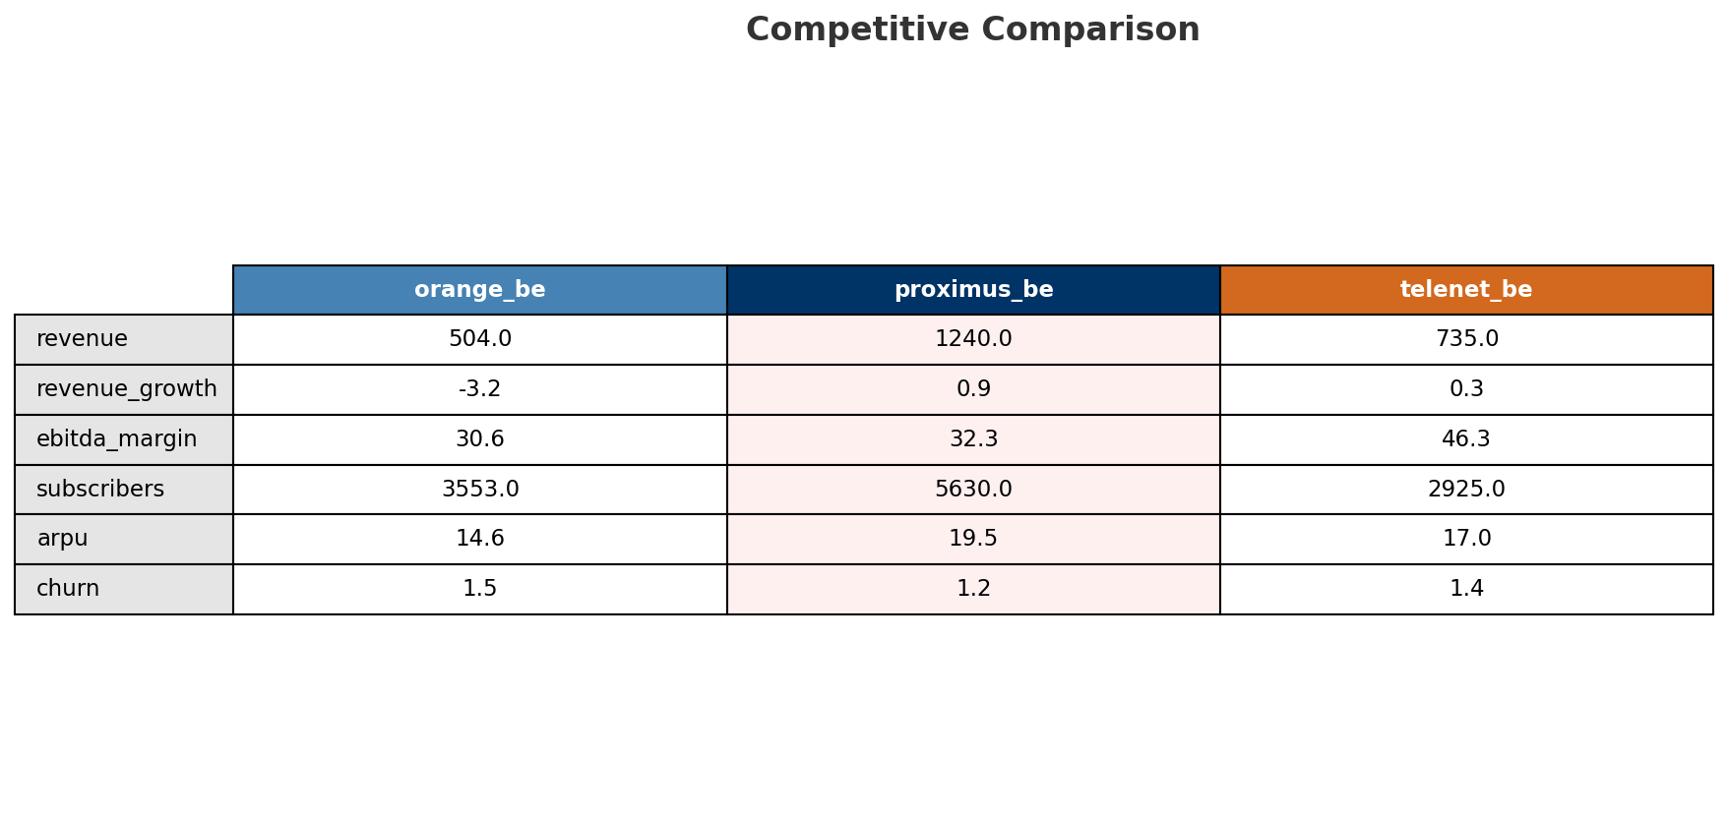
Competitive Landscape Summary
COMPETITION
Key Message: In a 3-player market with medium competition intensity, Proximus leads with 50% revenue share. Target operator holds 50% share. Strongest competitive force: Substitutes.
20

Slide 21
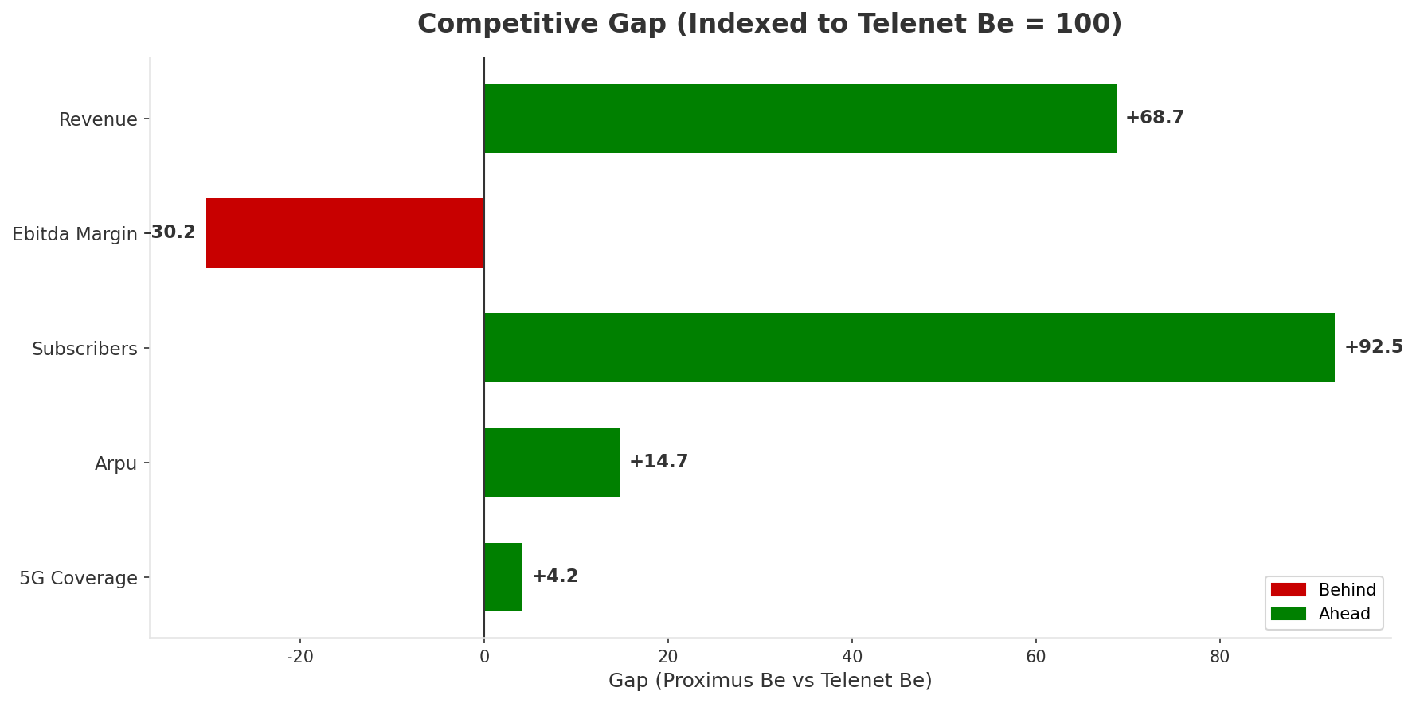
Gap Analysis: Proximus Be vs Telenet Be
COMPETITIVE GAP
Key Message: Gap analysis vs market leader Telenet Be
21

Slide 22
New Entrants Threat
MARKET ENTRY
• Entry barriers: High barriers: spectrum licensing, massive capex for network build, regulatory approvals, established brand loyalty
Key Message: New entrants threat level: low
22

Slide 23
04 Look at Self
BMC + Capability Assessment

Slide 24
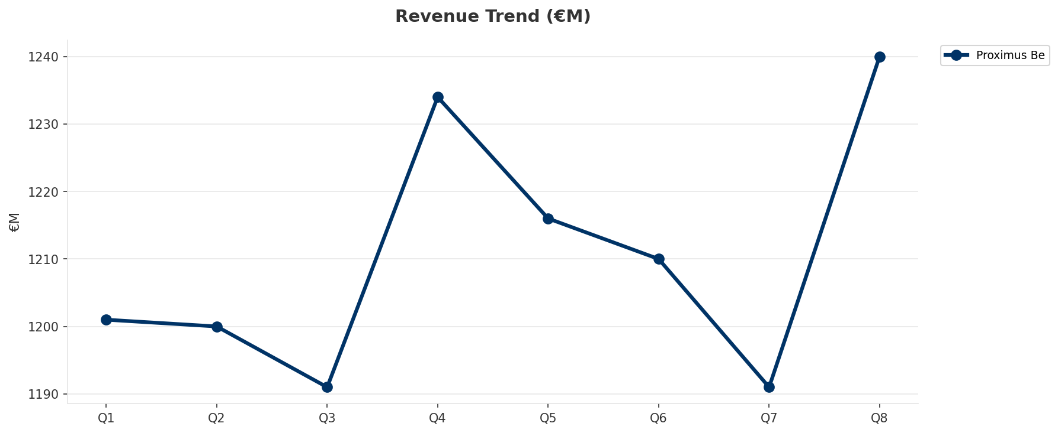
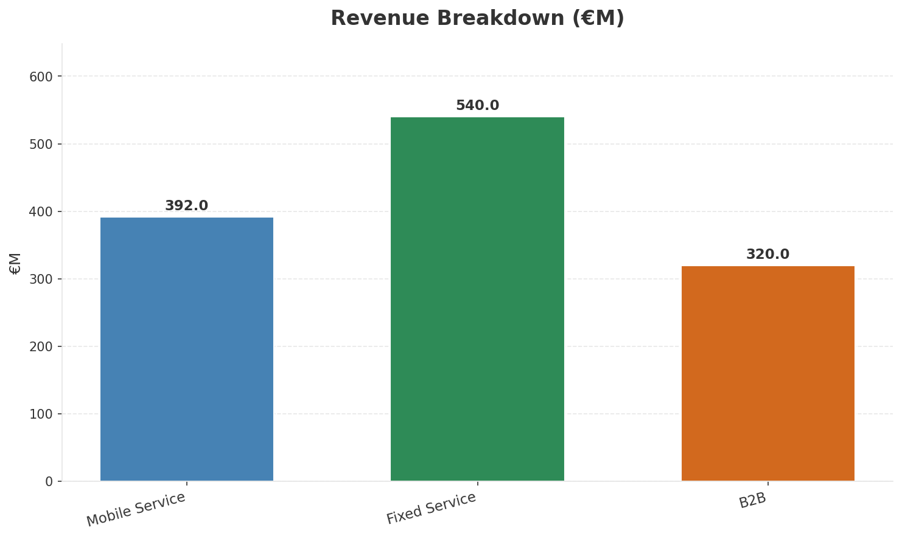
Operating Health Check
FINANCIAL HEALTH
Revenue
EBITDA
EBITDA Margin
Capex/Rev
€1,240M
€400M
32.3%
38.2%
+0.49% YoY
+2.0% YoY
CAGR: +1.8% | Decelerating Growth
Key Message: Ranked #1 of 3 operators in market; revenue EUR 1,240M; EBITDA margin 32.3%; stable but facing challenges; key strength: Brand Strength; key challenge: Price Competitiveness; Management outlook: Proximus NXT cloud and cybersecurity services driving enterprise growth. Business mobile ARPU under pressure (-3.8% in Q4 2024).
24

Slide 25
Market Share Evolution
REVENUE SHARE TREND
Proximus
Telenet
Orange Belgium
50.0% #1
29.6% #2
20.3% #3
-0.5pp stable
+0.4pp stable
+0.0pp stable
Market Concentration: HHI 3,794 (Highly Concentrated) | CR3: 100.0% | Trend: Stable
Subscriber share: Mobile: 46.5% (-0.3pp) | Broadband: 45.9% (+0.1pp
Key Message: Revenue share: 50.0% (#1); stable (-0.5pp); market is highly concentrated (HHI 3,794).
25

Slide 26
Momentum Dashboard
MULTI-QUARTER TREND ANALYSIS
Revenue
EBITDA
Margin
+1.8% CAGR
-3.3% CAGR
-5.0% CAGR
Decelerating Growth (48/100
Recovery (52/100
Flat (53/100
Key Message: Dominant momentum: Decelerating Growth — based on 3 KPI trend analyses
26

Slide 27
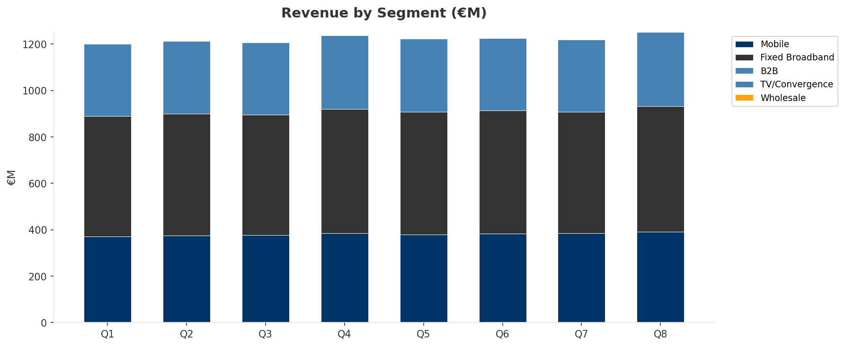
Revenue Composition Trend
SEGMENT REVENUE MIX OVER TIME
Key Message: Growing: Mobile, Fixed Broadband, B2B
27

Slide 28
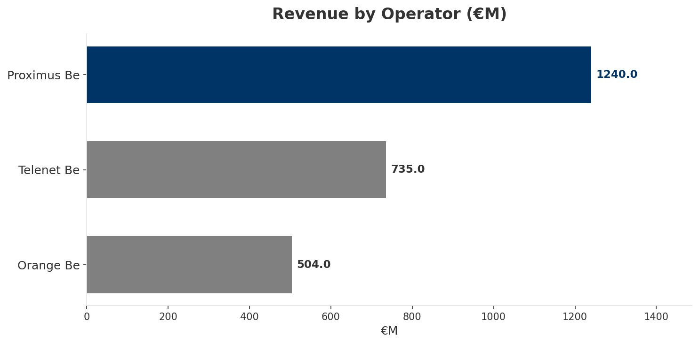
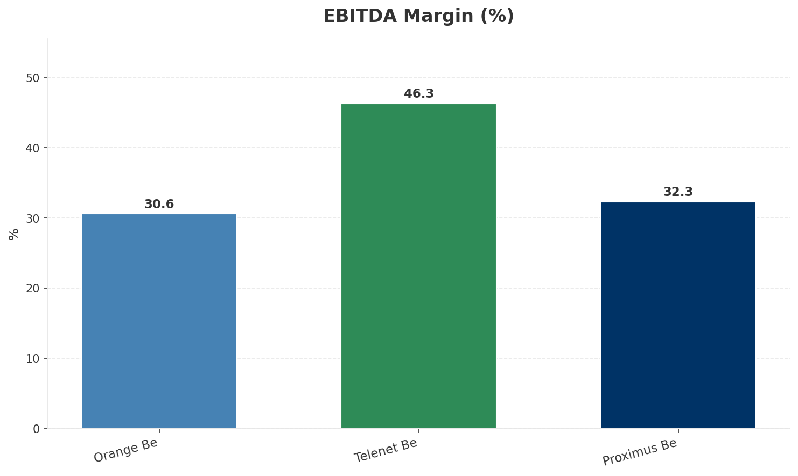
Revenue Comparison
COMPETITIVE BENCHMARKING
Key Message: Revenue and margin benchmarking across operators
28

Slide 29
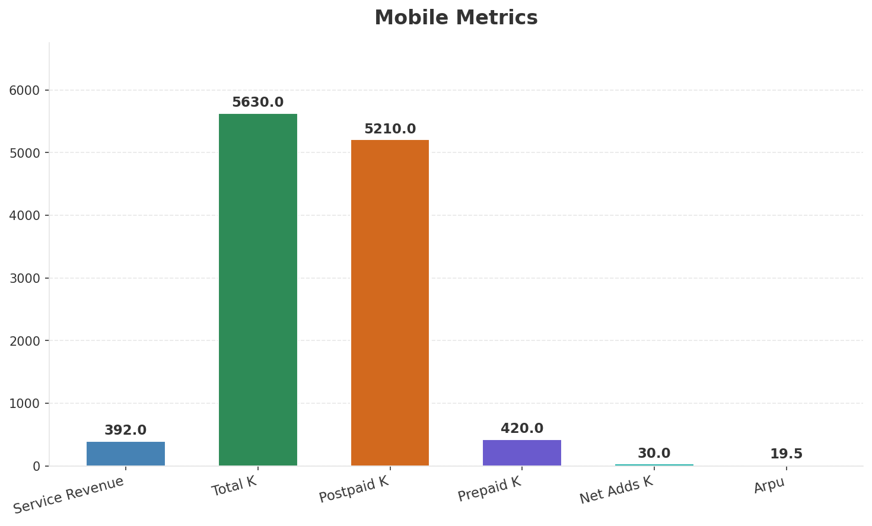
Segment Analysis: Mobile
SEGMENT PERFORMANCE
Service Revenue
Service Growth Pct
Total K
Postpaid K
€392M
1.8%
€5,630M
€5,210M
Health: STABLE
• revenue: improving
• subscribers: stable
• arpu: stable
• Residential mobile postpaid +122K net adds in 2024. Prepaid declining structurally. Responding to DIGI Belgium entry with data volume upgrades without price increases.
• Proximus NXT cloud and cybersecurity services driving enterprise growth. Business mobile ARPU under pressure (-3.8% in Q4 2024).
Key Message: Mobile service revenue at 392.0M; up 1.8% YoY; ARPU 19.5
29

Slide 30
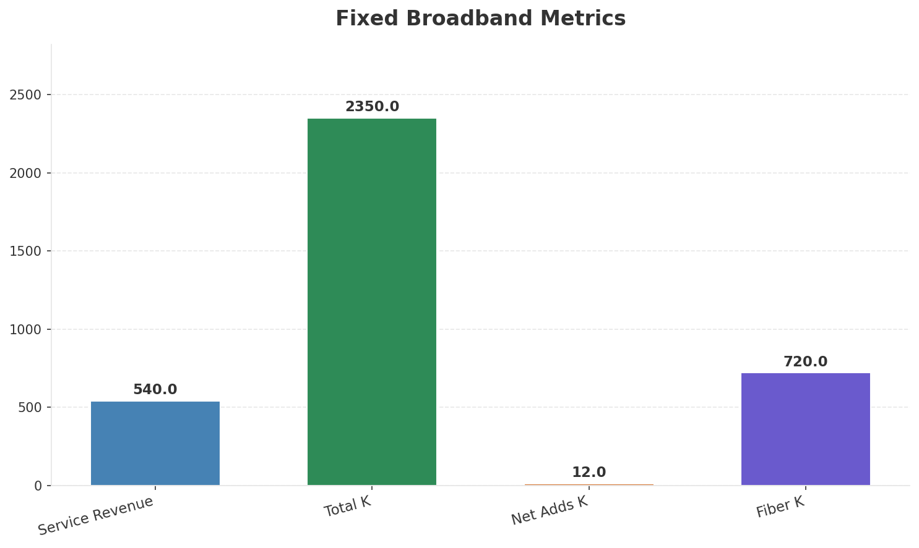
Segment Analysis: Fixed Broadband
SEGMENT PERFORMANCE
Service Revenue
Service Growth Pct
Total K
Net Adds K
€540M
0.9%
€2,350M
12
Health: STRONG
• revenue: improving
• subscribers: stable
• arpu: stable
• FY2024 Domestic revenue EUR 4,826M, EBITDA EUR 1,682M. 2025 guidance: broadly stable. Fiber take-up exceeding 50% in newly connected areas within 12 months. Convergent customer base growing 5%+ annual
• revenue increased 3.5% QoQ
Key Message: Fixed service revenue 540.0M; growth +0.9% YoY; Fiber subs 720K
30

Slide 31
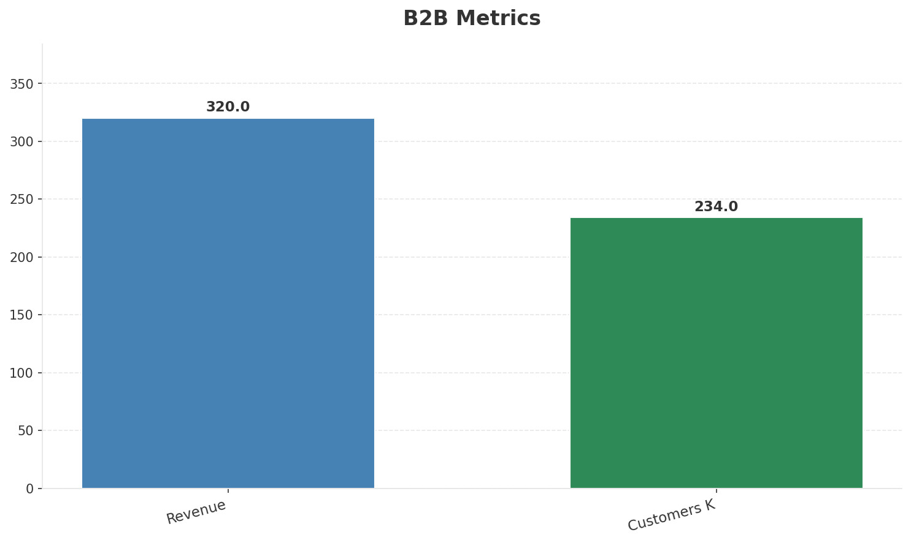
Segment Analysis: B2B
SEGMENT PERFORMANCE
Revenue
Growth Pct
Customers K
Share Of Revenue Pct
€320M
None
€234M
25.8%
Health: STRONG
• revenue: improving
• customers: stable
• Proximus NXT cloud and cybersecurity services driving enterprise growth. Business mobile ARPU under pressure (-3.8% in Q4 2024).
• revenue increased 3.2% QoQ
Key Message: B2B revenue 320.0M; 25.8% of total revenue
31

Slide 32
Segment Analysis: TV/Convergence
SEGMENT PERFORMANCE
Revenue
Total K
Net Adds K
Fmc Total K
None
€1,585M
None
None
Health: STABLE
• revenue: stable
• subscribers: stable
• fmc_subscribers: stable
Key Message: TV subscribers 1585K
32

Slide 33
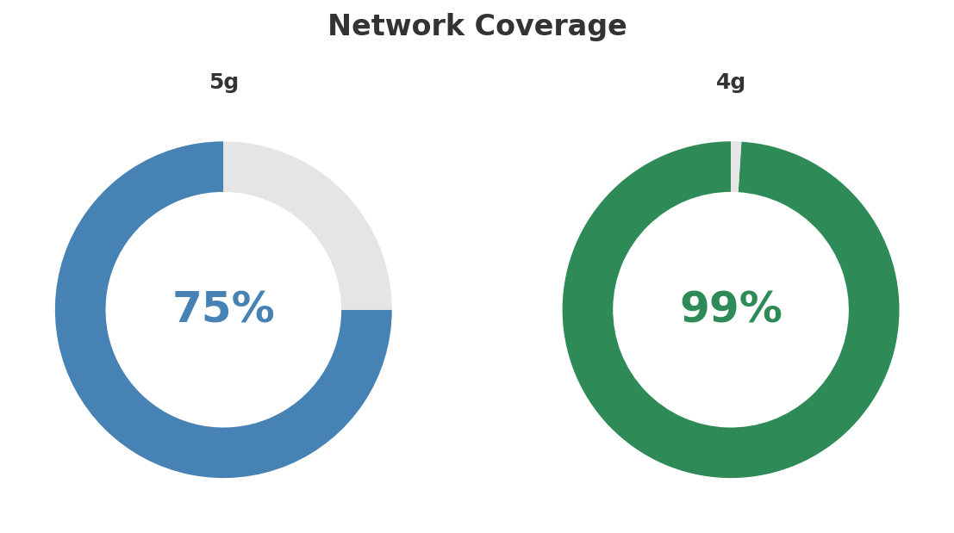
Network Analysis
INFRASTRUCTURE
Technology Mix:
Investment Direction: increasing
• Mobile Vendor: Nokia/Ericsson
• Spectrum Mhz: 310
• Core Vendor: Nokia
• 5G Sa Status: Deploying SA
• Fiber Technology: GPON/XGS-PON
Key Message: Network infrastructure and coverage assessment
33

Slide 34

Business Model Canvas
BMC
Key Message: Business model canvas overview
34

Slide 35
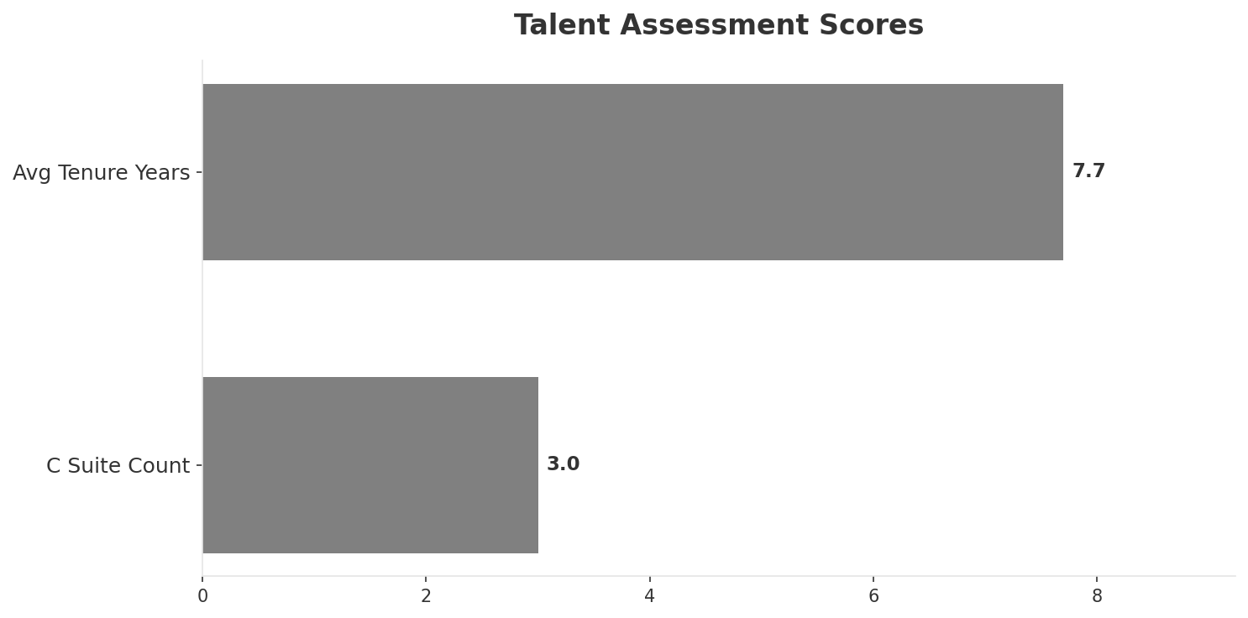
Organization & Talent
PEOPLE & CULTURE
Employees
C Suite Count
Avg Tenure Years
Key Leaders
12,500
3
7.7
['Guillaume Boutin (CEO)', 'Mark Reid (CFO)', 'Geert Standaert (CTO)']
Organization Culture:
Stable leadership team (avg tenure >3 years); Growth-oriented strategic posture; High-investment posture; Incumbent evolving under Bold2025 digital transformation; engineering excellence; strong social responsibility; complex stakeholder management (state ownership).
Leadership Changes:
• Guillaume Boutin: (
• Mark Reid: (
• Geert Standaert: (
Key Message: Organization and talent assessment
35

Slide 36
Strengths, Weaknesses & Exposure Points
SELF ASSESSMENT
Strengths
Weaknesses
Exposure Points
• Brand Strength: score 90 (market avg 82
• Distribution: score 88 (market avg 80
• Enterprise Solutions: score 92 (market avg 72
• Innovation: score 85 (market avg 79
• Network Coverage: score 92 (market avg 85
• Strong EBITDA margin at 32.3%
• Price Competitiveness: score 55 (market avg 64
• Massive fiber investment program (multi-billion EUR over decade): Elevated capex constraining free cash flow and dividend capacity
• State ownership (53.5% Belgian government) limits strategic flexibility: Political interference in strategic decisions and pricing
Key Message: Ranked #1 of 3 operators in market; revenue EUR 1,240M; EBITDA margin 32.3%; stable but facing challenges; key strength: Brand Strength; key challenge: Price Competitiveness; Management outlook: Proximus NXT cloud and cybersecurity services driving enterprise growth. Business mobile ARPU under pressure (-3.8% in Q4 2024).
36

Slide 37
SWOT Synthesis
Strengths, Weaknesses, Opportunities & Threats

Slide 38
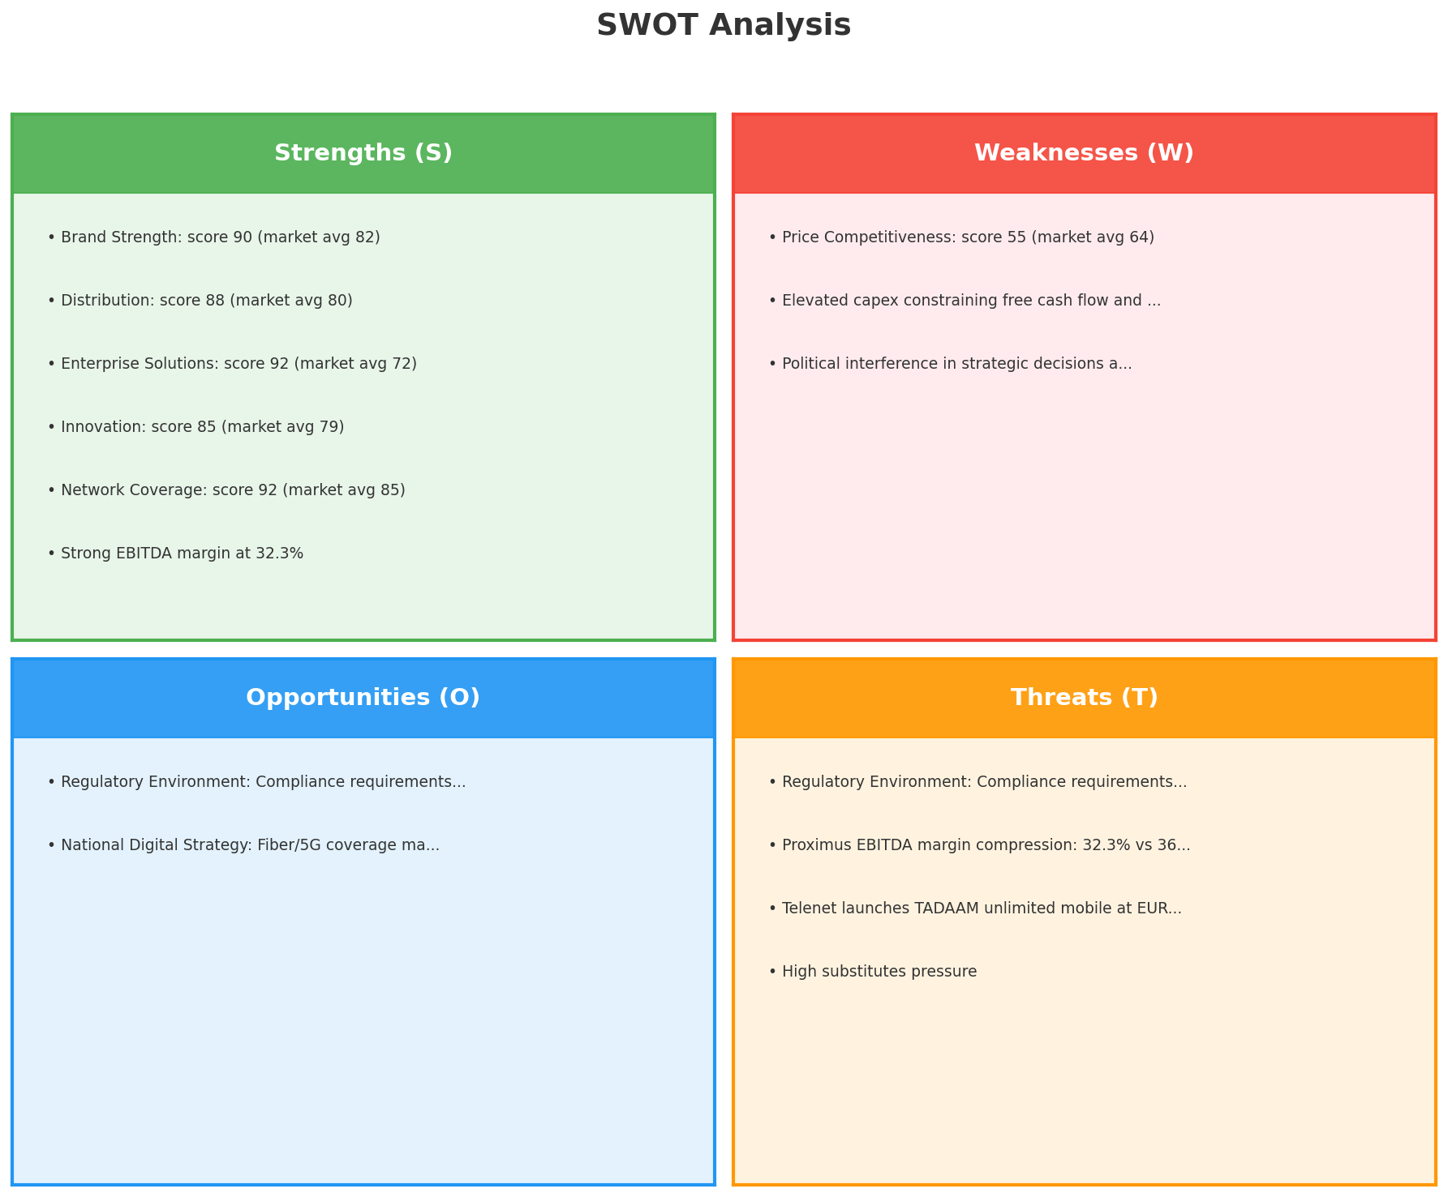
SWOT Analysis
STRATEGIC SYNTHESIS
SO:
Leverage 'Brand Strength: score 90 (market avg 82)' to ca...
WO:
Address weakness 'Price Competitiveness: score 55 (market...
ST:
Use strength 'Brand Strength: score 90 (market avg 82)' t...
WT:
Mitigate weakness 'Price Competitiveness: score 55 (marke...
Key Message: SWOT analysis identifies 9 strengths, 3 weaknesses, 2 opportunities, and 4 threats. The recommended strategic posture is offensive (SO-dominant).
38

Slide 39
05 Look at Opportunities
SPAN Matrix — Opportunity Selection

Slide 40
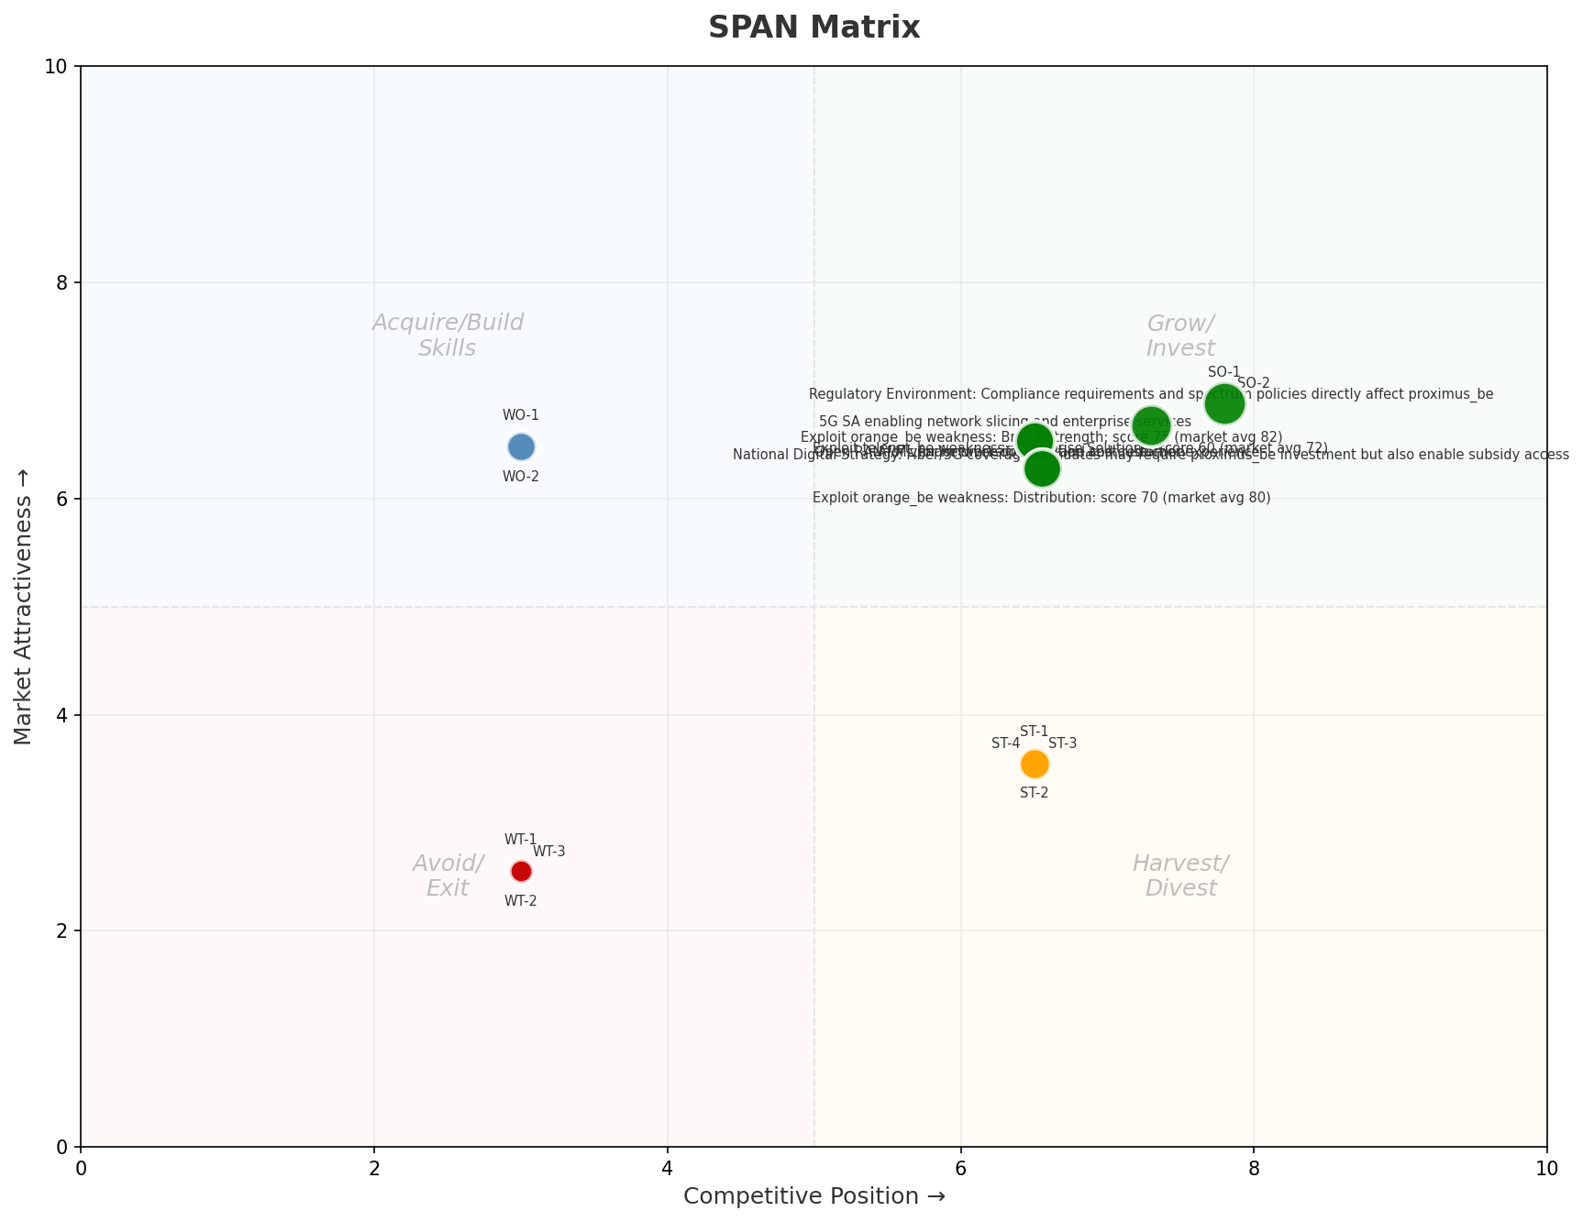
SPAN Matrix — Opportunity Positioning
OPPORTUNITY MAP
Key Message: SPAN matrix positions 19 opportunities: 10 grow/invest, 2 acquire skills, 4 harvest, 3 avoid/exit. Focus resources on the 10 grow/invest items for maximum strategic impact.
40

Slide 41
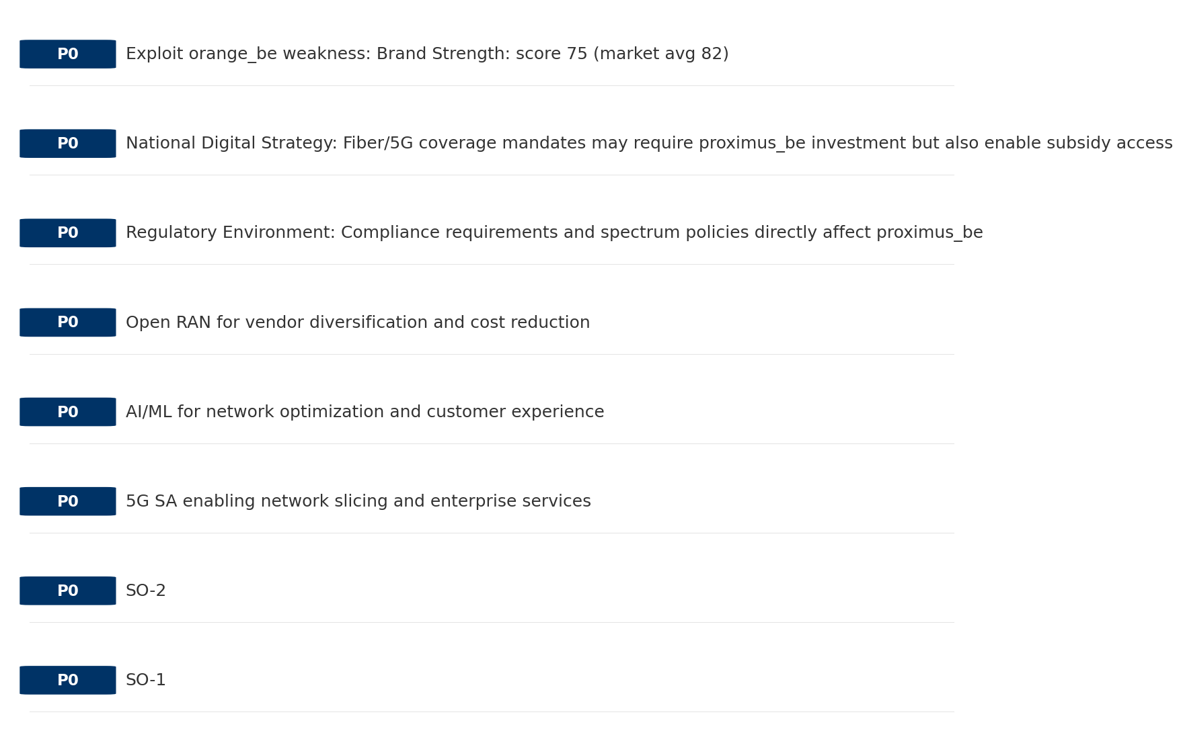
Opportunity Priority Ranking
PRIORITIES
Key Message: SPAN matrix positions 19 opportunities: 10 grow/invest, 2 acquire skills, 4 harvest, 3 avoid/exit. Focus resources on the 10 grow/invest items for maximum strategic impact.
41

Slide 42
Opportunity Details
DEEP DIVE
P0
SO-1
Market: N/A | Window:
Leverage 'Brand Strength: score 90 (market avg 82)' to capture the opportunity of 'Regulatory Environment: Compliance requirements and spectrum policies directly affect proximus_be'.
P0
SO-2
Market: N/A | Window:
Leverage 'Distribution: score 88 (market avg 80)' to capture the opportunity of 'National Digital Strategy: Fiber/5G coverage mandates may require proximus_be investment but also enable subsidy access'.
P0
5G SA enabling network slicing and enterprise services
Market: N/A | Window:
Technology trend: 5G SA enabling network slicing and enterprise services
P0
AI/ML for network optimization and customer experience
Market: N/A | Window:
Technology trend: AI/ML for network optimization and customer experience
Key Message: SPAN matrix positions 19 opportunities: 10 grow/invest, 2 acquire skills, 4 harvest, 3 avoid/exit. Focus resources on the 10 grow/invest items for maximum strategic impact.
42

Slide 43
Three Decisions
Strategy — Key Tasks — Execution

Slide 44
Decision 1: Define Strategy
DEFENSIVE
As The Dominant Leader: defend leadership through innovation and ecosystem lock-in
P0
P0
P1
P1
Growth Strategy
Competitive Strategy
Transformation Strategy
Customer Strategy
Defend leadership through ecosystem expansion in Mobile, Fixed Broadband, B2B
Shore up competitive position — address: Price Competitiveness: score 55 (market avg 64
Accelerate fiber transition — converged network as competitive moat
Optimize value extraction in stable segments: TV/Convergence, Wholesale
- Maintain #1 revenue share
- Grow Mobile, Fixed Broadband, B2B by 5-8% YoY
- Close Price Competitiveness: score 55 (market avg 64) gap within 12 months
- Reduce customer churn
- Fiber homepass coverage +20%
- FMC bundle attach rate 50%+
- Upsell rate +10% in TV/Convergence, Wholesale
- Cross-sell convergence bundles
Key Message: As The Dominant Leader, the strategic posture is Defensive. As The Dominant Leader: defend leadership through innovation
44

Slide 45
Decision 2: Define Key Tasks
3 P0 (IMMEDIATE), 3 P1 (1-2 YEARS), 1 P2 (3-5 YEARS
P0
Network
Accelerate Fixed Network Upgrade
Homepass coverage +15% | Speed tier upgrades
Drive DOCSIS/Fiber rollout to increase homepass and improve quality scores
P0
Business
Accelerate Mobile Growth
Mobile revenue +10% YoY | Market share gain
Mobile at €392M showing strong momentum — invest to scale
P0
Business
Accelerate Fixed Broadband Growth
Fixed Broadband revenue +10% YoY | Market share gain
Fixed Broadband at €540M showing strong momentum — invest to scale
P1
Network
5G Coverage Expansion
5G pop coverage target | 5G attach rate
Expand 5G population coverage to strengthen mobile competitive position
P1
Business
Opportunity Portfolio Execution
Launch 3+ priority initiatives | Pipeline contribution tracking
10 grow/invest opportunities identified — establish execution office
P1
Customer
Customer Experience Enhancement
NPS +5 points | First-call resolution rate 80%+
Improve digital touchpoints and service resolution to boost NPS
P2
Efficiency
Operational Efficiency & Automation
Process automation 30%+ | Cost-to-serve reduction
EBITDA margin 32.3% — maintain through smart automation and resource reallocatio
Key Message: 7 critical tasks: 3 P0 (immediate), 3 P1 (1-2 years), 1 P2 (3-5 years
45

Slide 46

Decision 3: Define Execution
QUARTERLY ROADMAP & GOVERNANCE
Governance
Strategic Traps to Avoid
- Monthly Progress Review (Monthly
x Delay core transformation
- Quarterly Strategic Checkpoint (Quarterly
- Mid-Year Strategic Adjustment (Semi-annual
Key Risks & Mitigation
! Resource constraints delay P0 initiatives -- Ring-fence P0 budgets; establish escalation path for blockers
Key Message: Execute with discipline: monthly reviews, quarterly checkpoints, annual refresh
! Macro-economic slowdown reduces consumer spending -- Prepare value-tier offerings; shift mix toward B2B resilience
46

Slide 47
Analysis Summary
KEY TAKEAWAYS
01 Trends
Macro environment: Favorable. Key opportunities: Regulatory Environment, National Digital Strategy. Key risks: Regulatory Environment, Fiber Broadband Penetration Industry is in late growth phase. (+3.2% YoY (CQ2_2025 -> CQ4_2025)
02 Market
Belgium telecom market totals EUR 2,479M in quarterly revenue; competitive strengths in Availability, Performance; Market faces significant competitive headwinds.
03 Competition
In a 3-player market with medium competition intensity, Proximus leads with 50% revenue share. Target operator holds 50% share. Strongest competitive force: Substitutes.
04 Self
Ranked #1 of 3 operators in market; revenue EUR 1,240M; EBITDA margin 32.3%; stable but facing challenges; key strength: Brand Strength; key challenge: Price Competitiveness; Management outlook: Proximus NXT cloud and cybersecurity services driving enterprise growth. Business mobile ARPU under pressure (-3.8% in Q4 2024).
SWOT
SWOT analysis identifies 9 strengths, 3 weaknesses, 2 opportunities, and 4 threats. The recommended strategic posture is offensive (SO-dominant).
05 Opportunities
SPAN matrix positions 19 opportunities: 10 grow/invest, 2 acquire skills, 4 harvest, 3 avoid/exit. Focus resources on the 10 grow/invest items for maximum strategic impact.
Key Message: Complete Five Looks analysis — see opportunity priorities for next steps
47

Slide 48
Data Provenance
SOURCES & METHODOLOGY
No provenance data recorded for this analysis
Key Message: All data points are traceable to original sources
48

Slide 49
Thank You
BLM Five Looks Strategic Analysis

