Slide 1
Default BLM Strategic Analysis
BLM (Business Leadership Model) Five Looks Analysis
Target Operator
Market
Analysis Period
Report Date
Free Fr
France
CQ4_2025
2026-02-15
01 Trends (PEST) | 02 Market/Customer ($APPEALS) | 03 Competition (Porter) | 04 Self (BMC) | SWOT Synthesis | 05 Opportunities (SPAN

Slide 2
Report Contents
TABLE OF CONTENTS
01
Executive Summary
Key findings and recommendations
02
Look at Trends
PEST Framework — macro environment
03
Look at Market
$APPEALS — market changes & customer needs
T
Tariff Analysis
Pricing comparison — mobile, fixed & convergence
04
Look at Competition
Porter's Five Forces — competitive landscape
05
Look at Self
BMC + Capability — internal assessment
06
SWOT Synthesis
Strengths, Weaknesses, Opportunities, Threats
07
Look at Opportunities
SPAN Matrix — opportunity selection
Summary & Provenance
2
08
Conclusions and data sources

Slide 3
Data Quality Overview
DATA QUALITY
Total Data Points
High Confidence
Medium Confidence
Low/Estimated
20
0
0
20
0%
Unique Sources: 0
Data Conflicts: 0
Coverage: Partial
Key Message: 20 data points tracked, 0 high-confidence (0%
3

Slide 4
Executive Summary
Trends
Macro environment: Favorable. Key opportunities: Regulatory Environment, National Digital Strategy. Key risks: Regulatory Environment, Fiber Broadband Penetration Industry is mature. (+1.9% YoY (CQ2_2025 -> CQ4_2025)
Market/Customer
France telecom market totals EUR 10.7B in quarterly revenue; competitive strengths in Availability, Performance; gaps in Assurances; Market outlook is favorable with more opportunities than threats.
Competition
In a 4-player market with medium competition intensity, Orange France leads with 43% revenue share. Target operator holds 16% share. Strongest competitive force: Existing Competitors.
Self Assessment
Ranked #4 of 4 operators in market; revenue EUR 1,740M; EBITDA margin 42.0%; stable but facing challenges; key strength: Brand Strength; key challenge: Customer Service; Management outlook: FY2024: France revenue EUR 6,530M (+8.2%), EBITDAaL EUR 2,600M (39.9% margin). Iliad Group crossed EUR 10B revenue milestone. Europe's 5th largest telco by subscribers (50.5M). 2025 OpFCF target EUR 2.0B.
SWOT
SWOT analysis identifies 7 strengths, 7 weaknesses, 5 opportunities, and 4 threats. The recommended strategic posture is improvement-focused (WO-dominant).
Opportunities
SPAN matrix positions 28 opportunities: 16 grow/invest, 4 acquire skills, 4 harvest, 4 avoid/exit. Focus resources on the 16 grow/invest items for maximum strategic impact.
Key Message: Five Looks analysis completed — see details in following sections
4

Slide 5
01 Look at Trends
PEST Framework — Macro Environment

Slide 6

PEST Analysis Dashboard
MACRO ENVIRONMENT
Key Message: Macro environment: Favorable. Key opportunities: Regulatory Environment, National Digital Strategy. Key risks: Regulatory Environment, Fiber Broadband Penetration.
6

Slide 7
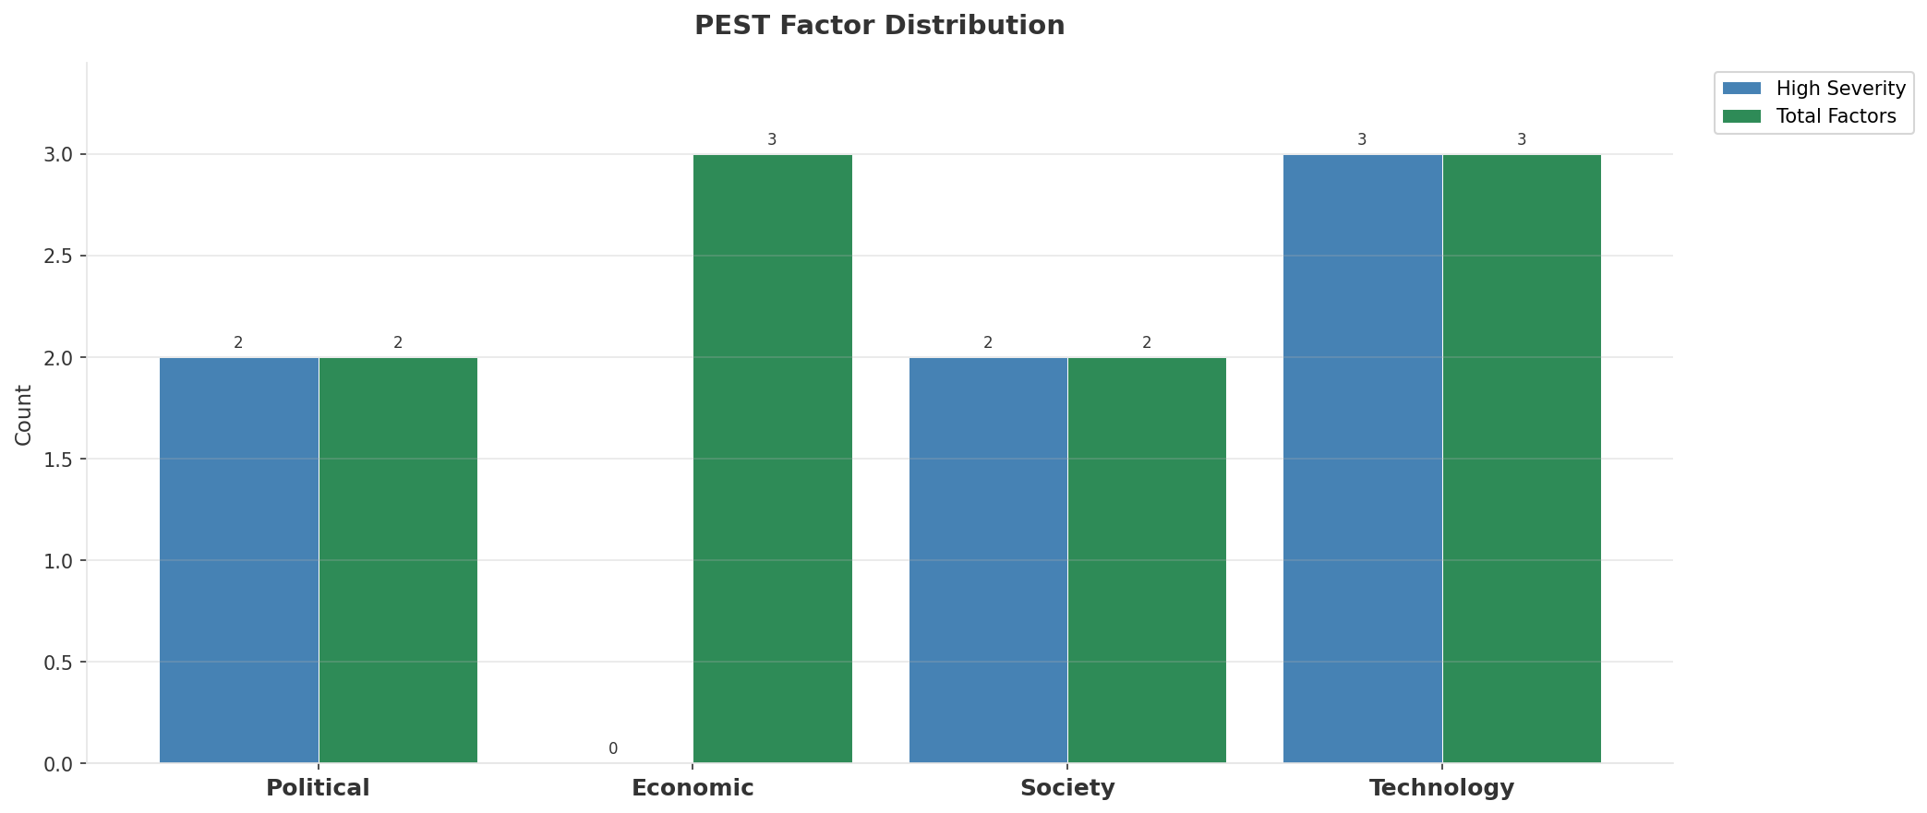
Industry Environment
INDUSTRY ANALYSIS
Market Size
Growth Rate
Concentration
Lifecycle
EUR 10.7B (quarterly, CQ4_2025
+1.9% YoY (CQ2_2025 -> CQ4_2025
CR4 = 100% (Orange France: 42.9%, SFR (Altice France): 21.6%, Bouygues Telecom: 19.2%, Free (Iliad): 16.3%
mature
• New Business Models:
• FWA (Fixed Wireless Access) as fiber alternative
• Network-as-a-Service for enterprise verticals
• Wholesale/MVNO partnerships for coverage monetization
• Technology Revolution:
• 5G SA enabling network slicing and enterprise services
• AI/ML for network optimization and customer experience
• Open RAN for vendor diversification and cost reduction
Key Message: Macro environment: Favorable. Key opportunities: Regulatory Environment, National Digital Strategy. Key risks: Regulatory Environment, Fiber Broadband Penetration Industry is mature. (+1.9% YoY (CQ2_2025 -> CQ4_2025)
7

Slide 8
Value Transfer Trends
VALUE MIGRATION
• Value shifting from voice/SMS to data and digital services
• B2B/ICT growing faster than consumer segment
• Fiber displacing copper and cable broadband
Key Message: Macro environment: Favorable. Key opportunities: Regulatory Environment, National Digital Strategy. Key risks: Regulatory Environment, Fiber Broadband Penetration Industry is mature. (+1.9% YoY (CQ2_2025 -> CQ4_2025)
8

Slide 9
02 Look at Market
$APPEALS — Market Changes & Customer Needs

Slide 10
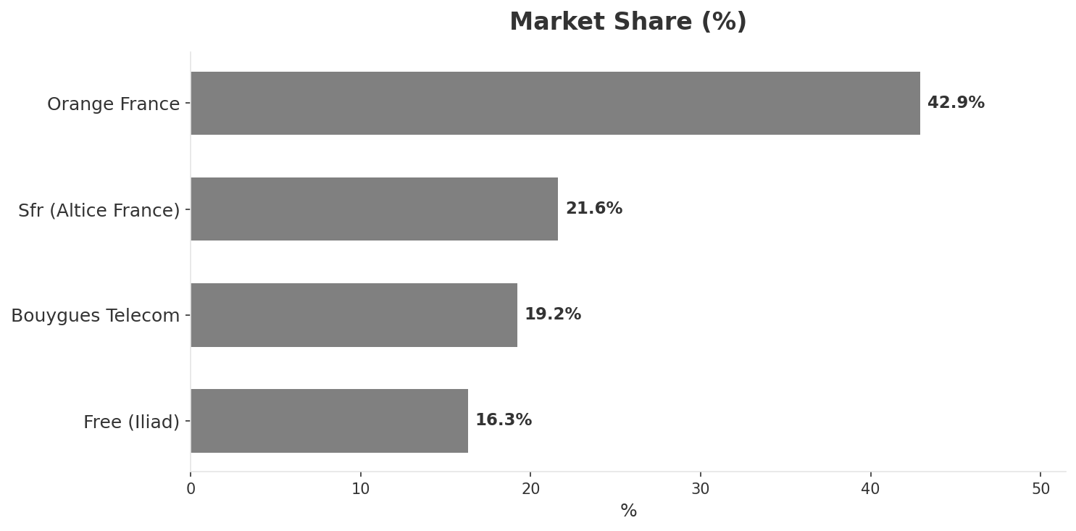
Market Change Panorama
MARKET OVERVIEW
Total Revenue (€M
Mobile Subs (K
Broadband Subs (K
Operators
10,670
76,120
31,190
4
Market Changes:
• SFR (Altice France) revenue decline 9.4% YoY
• Orange, Bouygues, Free bid EUR 17B for SFR assets — rejected
• Iliad announces EUR 3B AI investment — Scaleway, OpCore, Kyutai
• Altice France restructures EUR 24B debt — creditors take 45% stake
Key Message: France telecom market totals EUR 10.7B in quarterly revenue; competitive strengths in Availability, Performance; gaps in Assurances; Market outlook is favorable with more opportunities than threats.
10

Slide 11
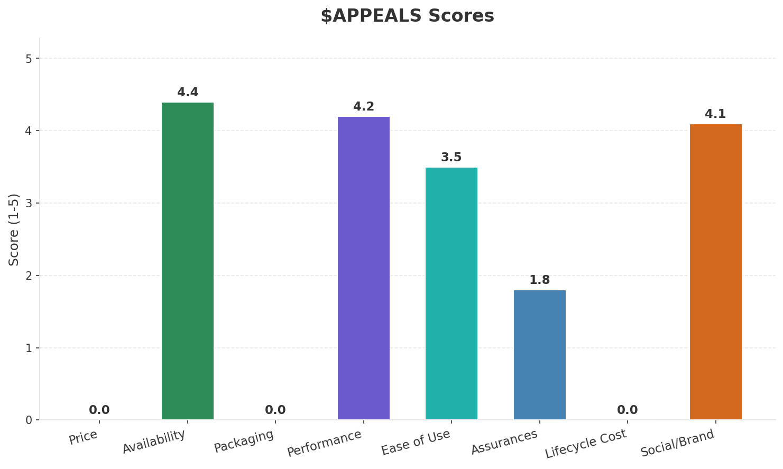
Customer Segments
SEGMENTATION
Consumer Premium Convergent
Trend: stable
Needs: Seamless multi-screen entertainment experience (TV, mobile, home), Ultra-fast symmetric fiber for remote work and gaming
Consumer Value-Seeking
Trend: stable
Needs: Transparent low-cost unlimited mobile plans, Affordable fiber broadband without long contracts
Consumer SIM-Only / MVNO
Trend: stable
Needs: Ultra-low-cost mobile-only connectivity, Flexible prepaid/no-contract options
Enterprise & Public Sector
Trend: stable
Needs: Private 5G networks for Industry 4.0, Multi-cloud connectivity and SD-WAN
Key Message: France telecom market totals EUR 10.7B in quarterly revenue; competitive strengths in Availability, Performance; gaps in Assurances; Market outlook is favorable with more opportunities than threats.
11

Slide 12
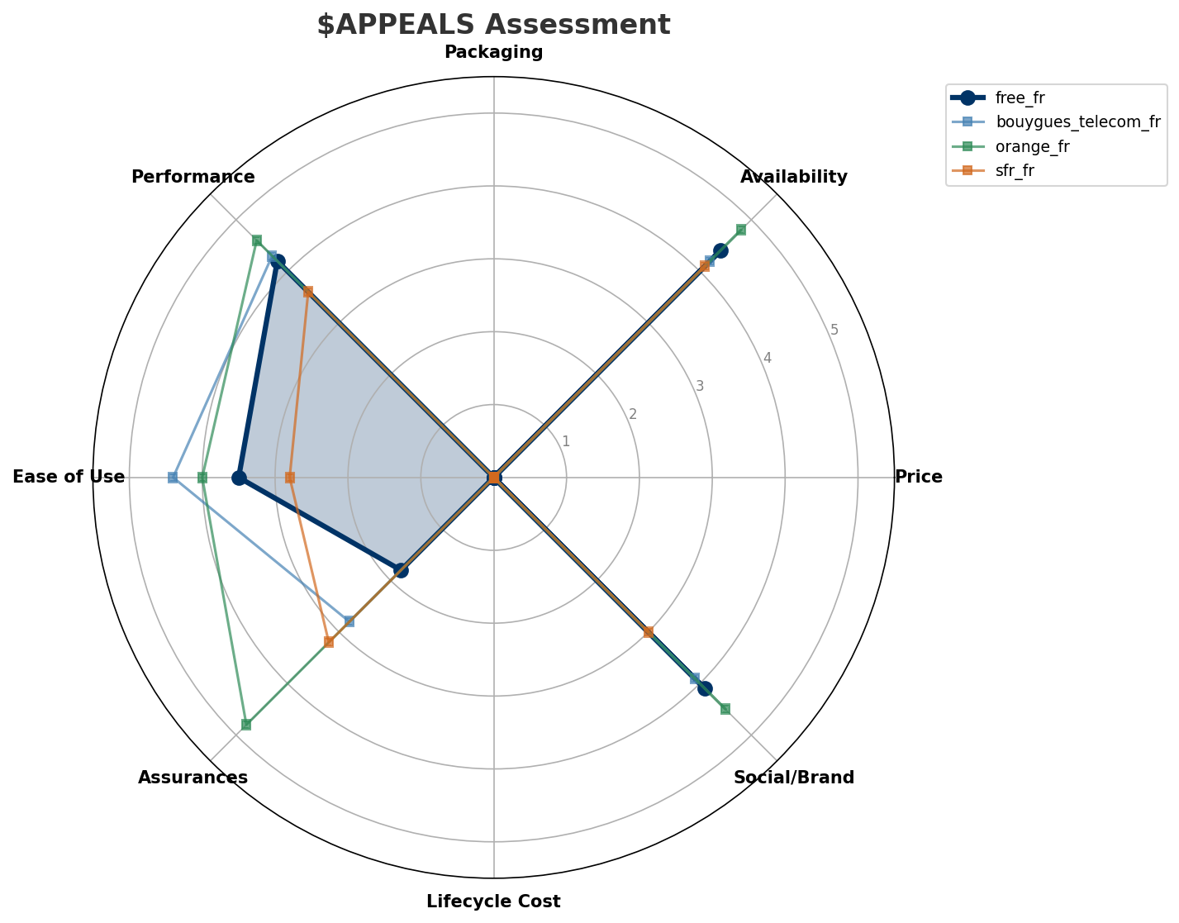
$APPEALS Assessment
CUSTOMER NEEDS
Key Message: France telecom market totals EUR 10.7B in quarterly revenue; competitive strengths in Availability, Performance; gaps in Assurances; Market outlook is favorable with more opportunities than threats.
12

Slide 13
Customer Value Migration
VALUE MIGRATION
Value migration trending downward: price competition intensifying. Defend high-value customers and optimize cost base.
Opportunities:
• SFR (Altice France) revenue decline 9.4% YoY
• Iliad announces EUR 3B AI investment — Scaleway, OpCore, Kyutai
• Altice France restructures EUR 24B debt — creditors take 45% stake
Key Message: France telecom market totals EUR 10.7B in quarterly revenue; competitive strengths in Availability, Performance; gaps in Assurances; Market outlook is favorable with more opportunities than threats.
13

Slide 14
Tariff Analysis
Mobile, Fixed & Convergence Pricing Landscape

Slide 15
Fixed & Convergence Pricing Landscape
DSL / CABLE / FIBER / FMC BUNDLES
Key Message: Fixed and convergence pricing overview
15

Slide 16
03 Look at Competition
Porter's Five Forces — Competitive Landscape

Slide 17

Porter's Five Forces
COMPETITIVE FORCES
Overall Intensity: MEDIUM
Key Message: In a 4-player market with medium competition intensity, Orange France leads with 43% revenue share. Target operator holds 16% share. Strongest competitive force: Existing Competitors.
17

Slide 18
Competitor Analysis: Bouygues Telecom Fr
COMPETITOR DEEP DIVE
Revenue
EBITDA
Margin
Capex/Rev
€2,050M
€540M
26.3%
18.5%
+1.9% YoY
Strengths
Weaknesses
• Customer Service: score 88 (market avg 73
• Enterprise Solutions: score 55 (market avg 62
Strategy: Revenue-led profitable growth; subscriber acquisition focus
Key Message: Competitor analysis: Bouygues Telecom Fr
18

Slide 19
Competitor Analysis: Sfr Fr
COMPETITOR DEEP DIVE
Revenue
EBITDA
Margin
Capex/Rev
€2,300M
€750M
32.6%
19.1%
-9.1% YoY
Strengths
Weaknesses
• Brand Strength: score 60 (market avg 78
• Customer Service: score 55 (market avg 73
• Digital Experience: score 68 (market avg 80
• Distribution: score 72 (market avg 79
Strategy: Margin optimization / cost transformation; ARPU-led value strategy
Key Message: Competitor analysis: Sfr Fr
19

Slide 20
Competitor Analysis: Orange Fr
COMPETITOR DEEP DIVE
Revenue
EBITDA
Margin
Capex/Rev
€4,580M
€1,625M
35.5%
16.8%
+0.2% YoY
Strengths
Weaknesses
• Brand Strength: score 90 (market avg 78
• Customer Service: score 80 (market avg 73
• Distribution: score 92 (market avg 79
• Enterprise Solutions: score 95 (market avg 62
• Price Competitiveness: score 55 (market avg 76
Strategy: Revenue-led profitable growth; subscriber acquisition focus; strong B2B/enterprise push
Key Message: Competitor analysis: Orange Fr
20

Slide 21
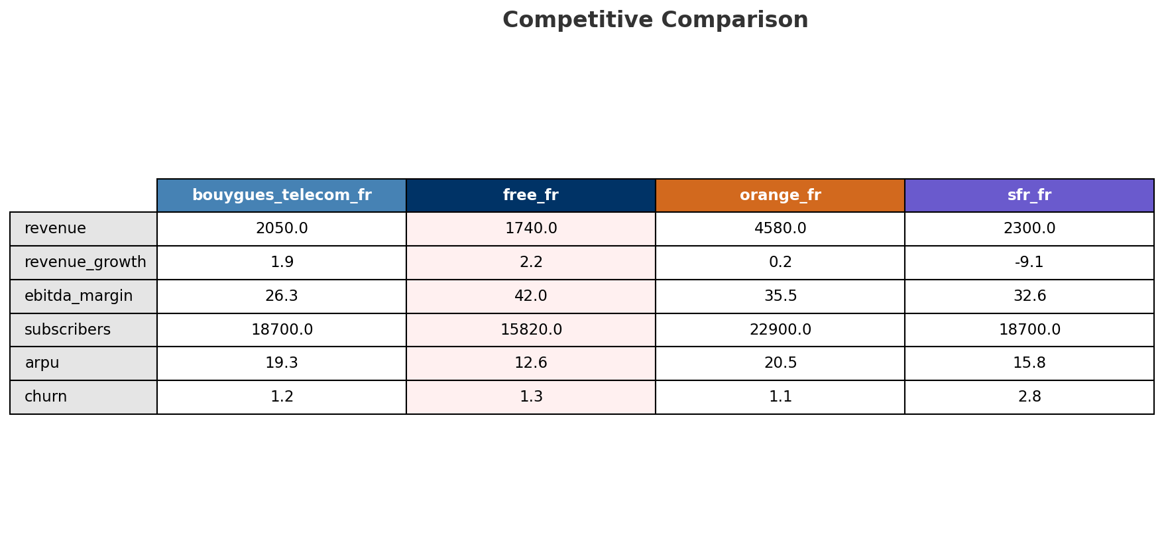
Competitive Landscape Summary
COMPETITION
Key Message: In a 4-player market with medium competition intensity, Orange France leads with 43% revenue share. Target operator holds 16% share. Strongest competitive force: Existing Competitors.
21

Slide 22
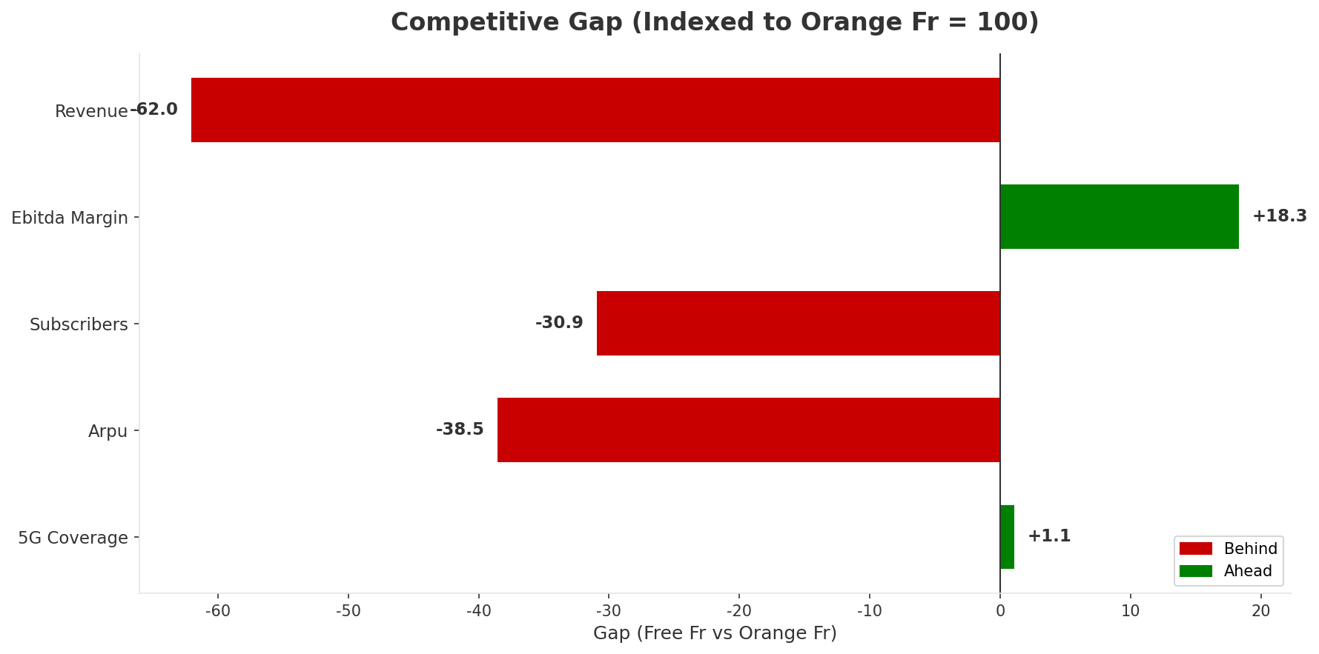
Gap Analysis: Free Fr vs Orange Fr
COMPETITIVE GAP
Key Message: Gap analysis vs market leader Orange Fr
22

Slide 23
New Entrants Threat
MARKET ENTRY
• Entry barriers: High barriers: spectrum licensing, massive capex for network build, regulatory approvals, established brand loyalty
Key Message: New entrants threat level: low
23

Slide 24
04 Look at Self
BMC + Capability Assessment

Slide 25
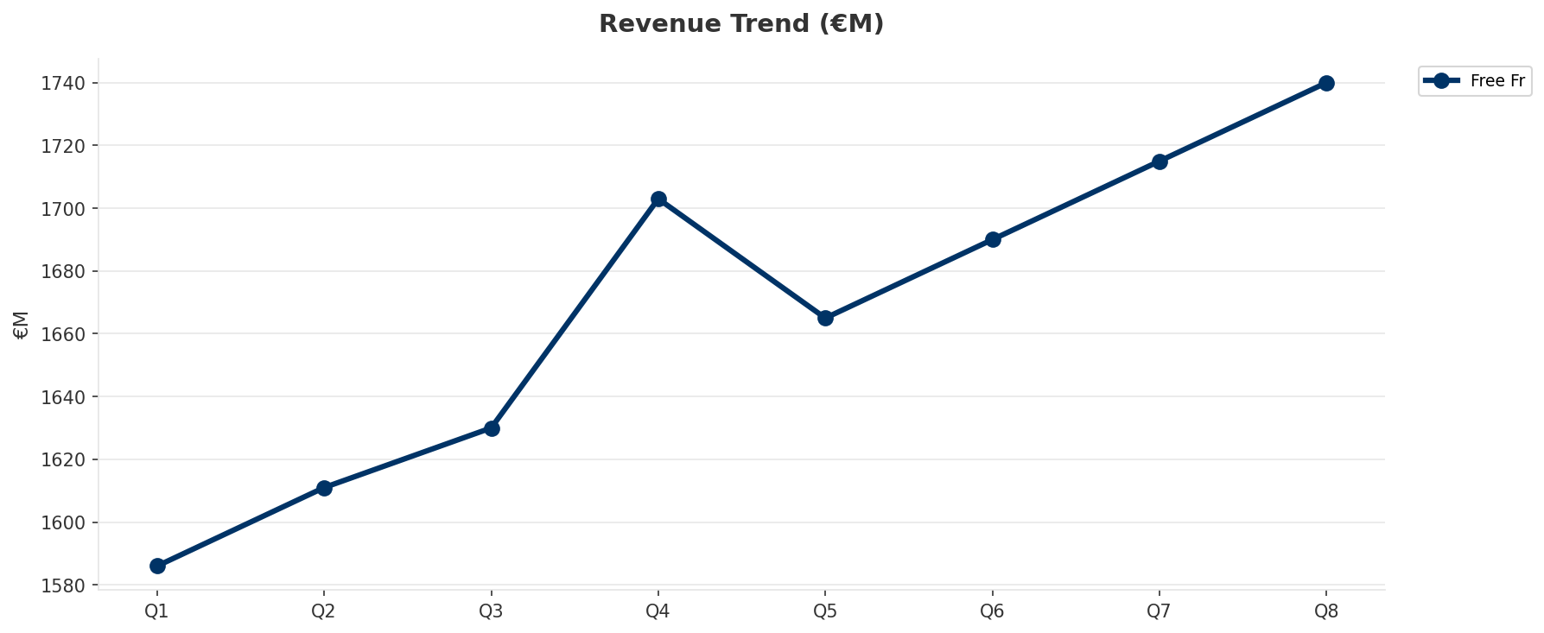
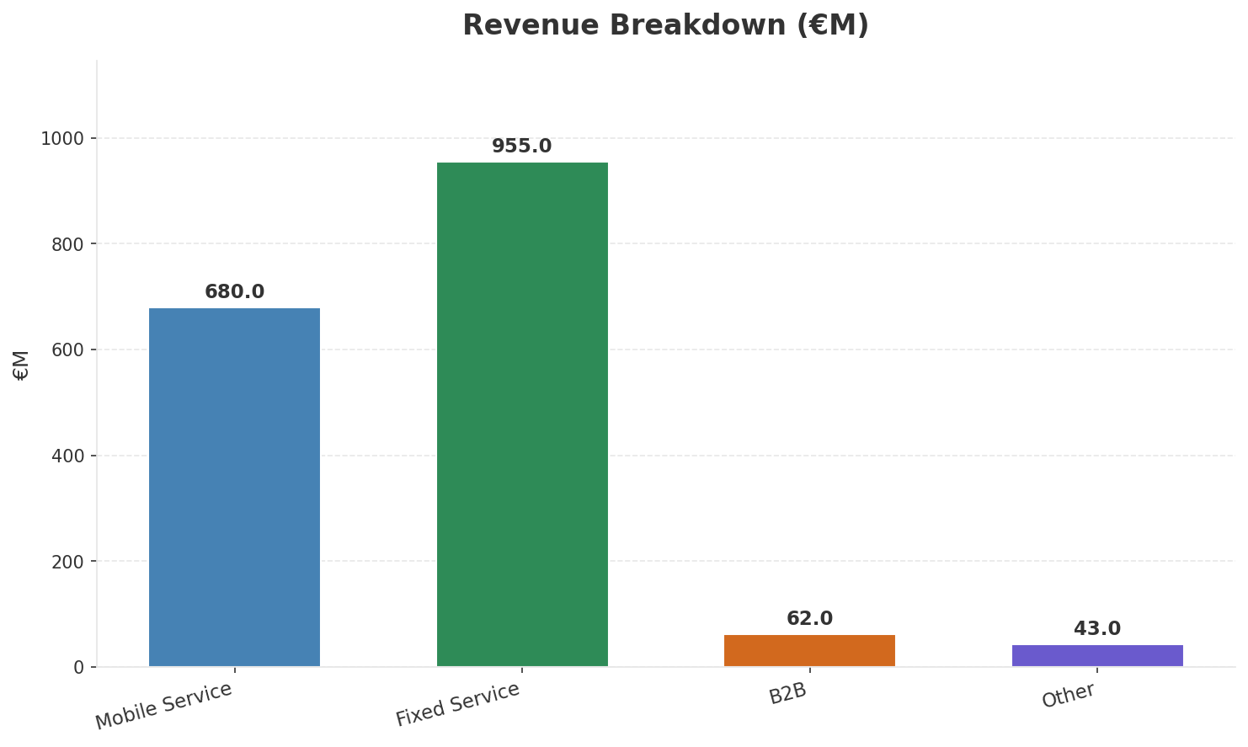
Operating Health Check
FINANCIAL HEALTH
Revenue
EBITDA
EBITDA Margin
Capex/Rev
€1,740M
€730M
42.0%
19.5%
+2.17% YoY
+2.1% YoY
CAGR: +5.4% | Decelerating Growth
Key Message: Ranked #4 of 4 operators in market; revenue EUR 1,740M; EBITDA margin 42.0%; stable but facing challenges; key strength: Brand Strength; key challenge: Customer Service; Management outlook: FY2024: France revenue EUR 6,530M (+8.2%), EBITDAaL EUR 2,600M (39.9% margin). Iliad Group crossed EUR 10B revenue milestone. Europe's 5th largest telco by subscribers (50.5M). 2025 OpFCF target EUR 2.0B.
25

Slide 26
Market Share Evolution
REVENUE SHARE TREND
Orange France
SFR (Altice France
Bouygues Telecom
Free (Iliad
42.9% #1
21.6% #2
19.2% #3
16.3% #4
+1.2pp gaining
-3.3pp losing
+0.9pp gaining
+1.2pp gaining
Market Concentration: HHI 2,942 (Highly Concentrated) | CR3: 83.7% | Trend: Stable
Subscriber share: Mobile: 20.8% (+0.2pp) | Broadband: 24.8% (+0.1pp
Key Message: Revenue share: 16.3% (#4); gaining (+1.2pp); market is highly concentrated (HHI 2,942).
26

Slide 27
Momentum Dashboard
MULTI-QUARTER TREND ANALYSIS
Revenue
EBITDA
Margin
+5.4% CAGR
+12.4% CAGR
+6.7% CAGR
Decelerating Growth (41/100
Decelerating Growth (26/100
Decelerating Growth (37/100
Key Message: Dominant momentum: Decelerating Growth — based on 3 KPI trend analyses
27

Slide 28
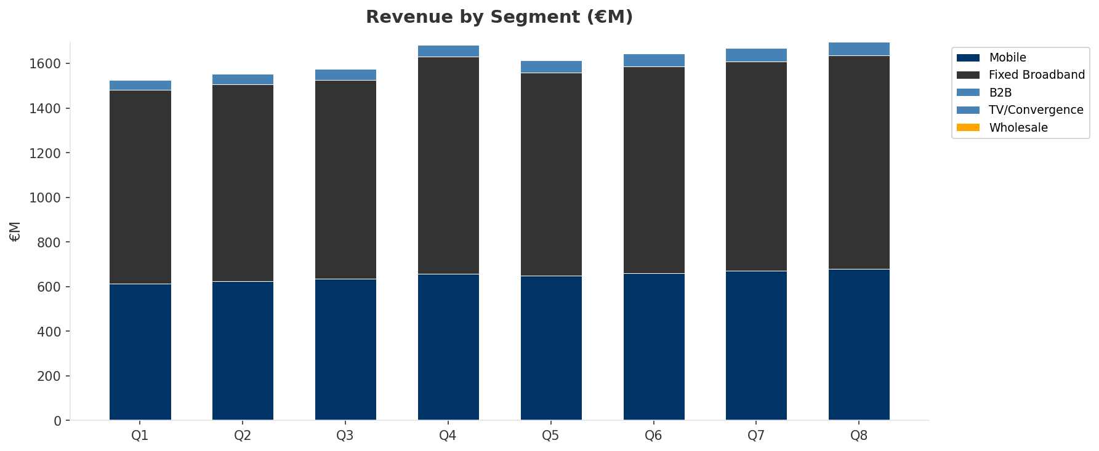
Revenue Composition Trend
SEGMENT REVENUE MIX OVER TIME
Key Message: Growing: Mobile, Fixed Broadband, B2B
28

Slide 29
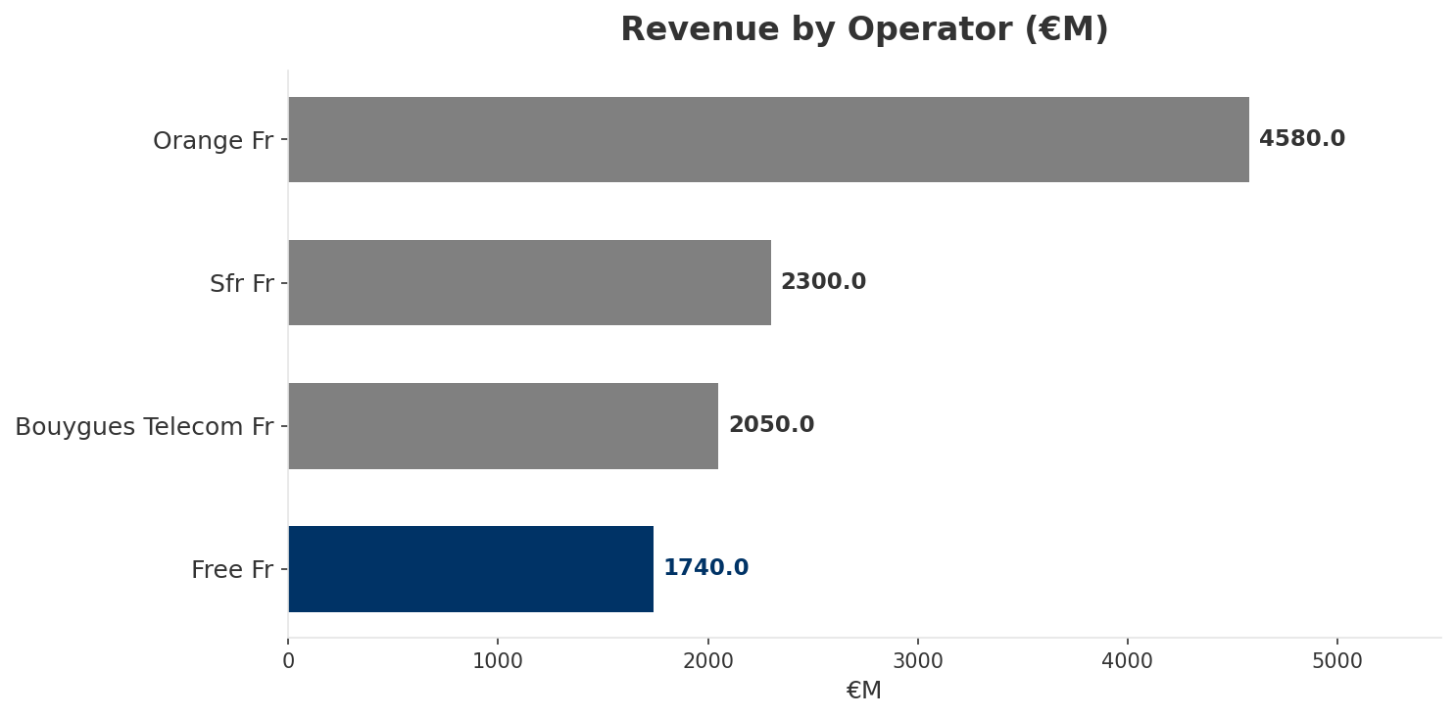
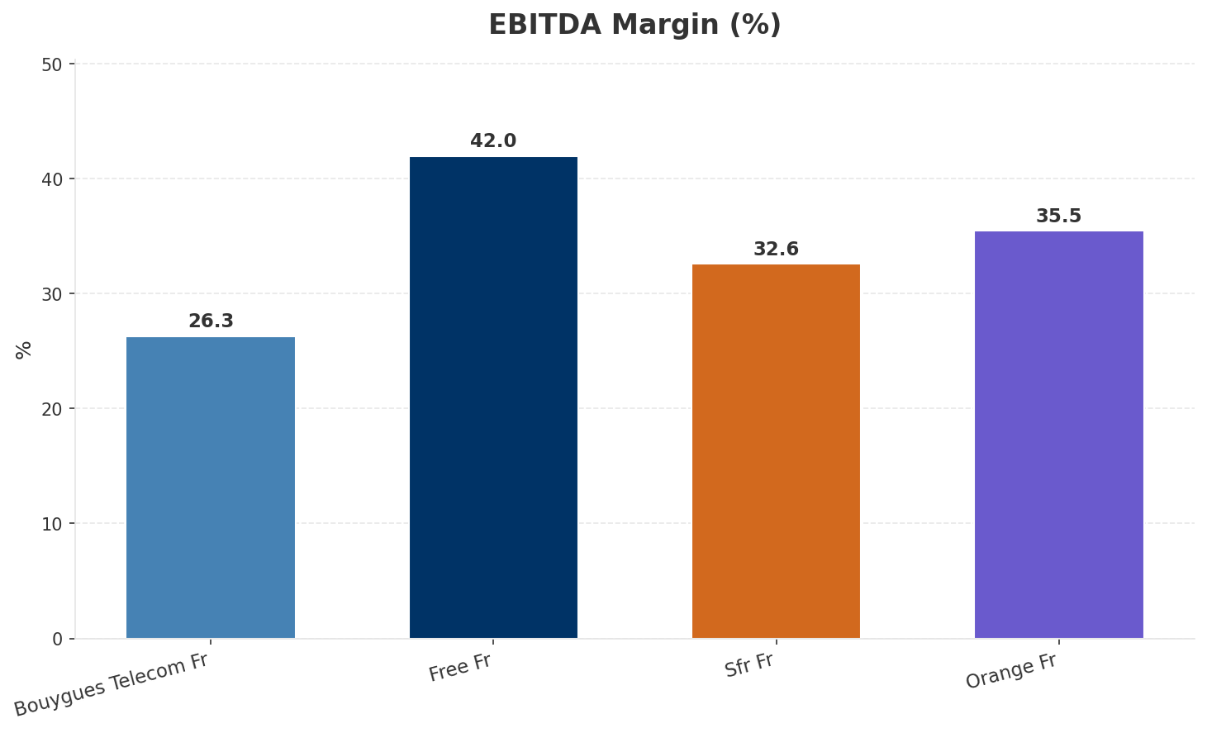
Revenue Comparison
COMPETITIVE BENCHMARKING
Key Message: Revenue and margin benchmarking across operators
29

Slide 30
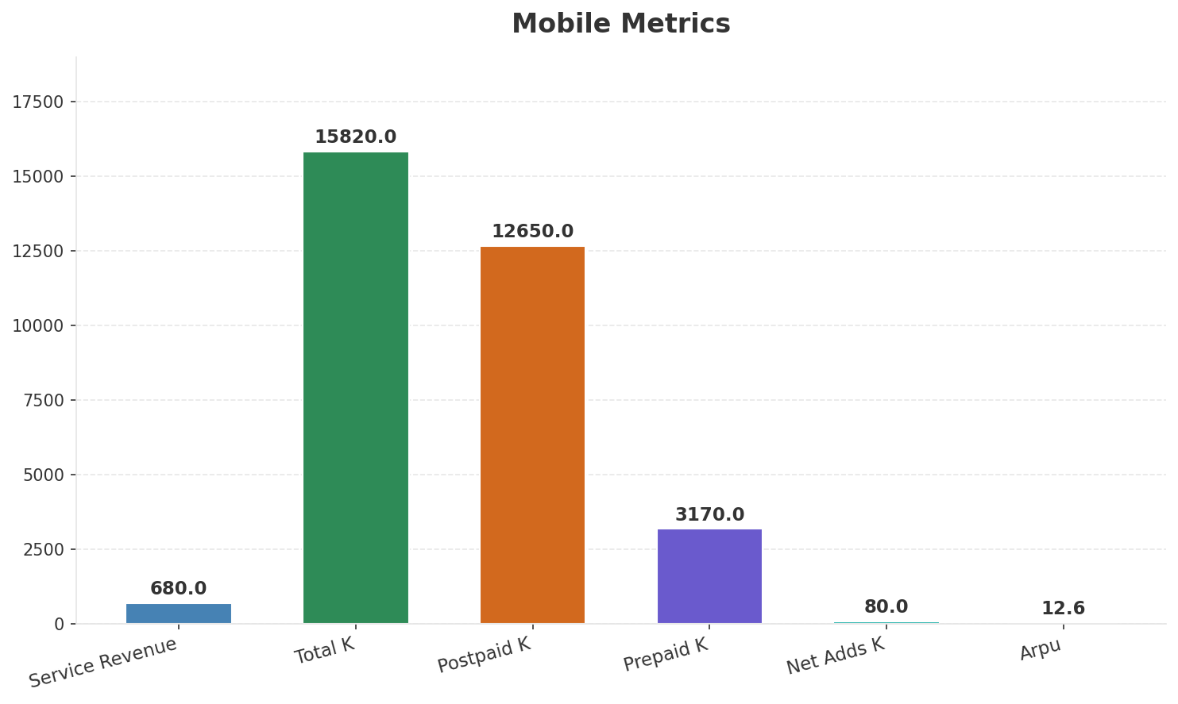
Segment Analysis: Mobile
SEGMENT PERFORMANCE
Service Revenue
Service Growth Pct
Total K
Postpaid K
€680M
3.3%
€15,820M
€12,650M
Health: STABLE
• revenue: improving
• subscribers: stable
• arpu: stable
• Mobile subs 15.5M (+668K net adds in 2024). 5G SA launched nationwide Sep 2024. Mobile ARPU EUR 12.3 (+1.8% YoY). Convergent discount driving improved retention but slight ARPU dilution.
Key Message: Mobile service revenue at 680.0M; up 3.3% YoY; ARPU 12.6
30

Slide 31
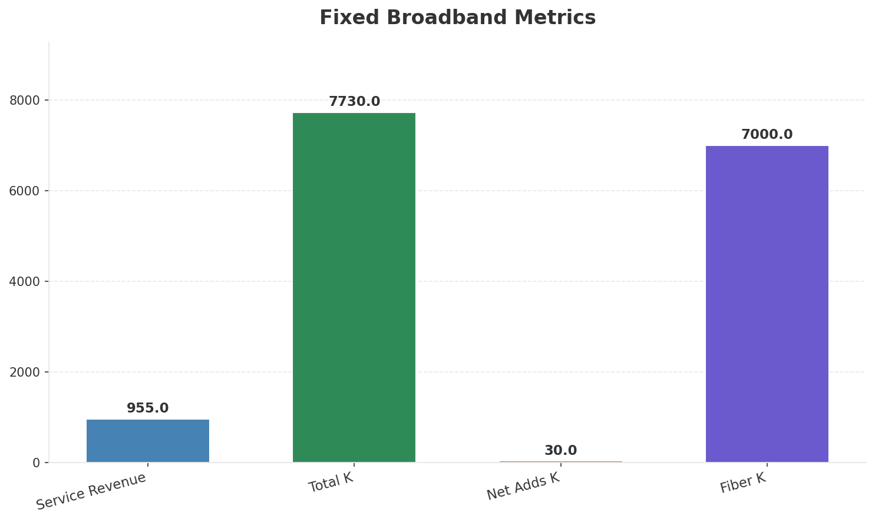
Segment Analysis: Fixed Broadband
SEGMENT PERFORMANCE
Service Revenue
Service Growth Pct
Total K
Net Adds K
€955M
-1.7%
€7,730M
30
Health: STABLE
• revenue: improving
• subscribers: stable
• arpu: stable
• Freebox subs 7.6M. Fiber take-up 81.7% (6.4M FTTH active). Fixed ARPU EUR 37.0 (+4.5% YoY). Freebox Ultra driving ARPU uplift. 37M+ premises connectable across group.
Key Message: Fixed service revenue 955.0M; growth -1.7% YoY; Fiber subs 7000K
31

Slide 32
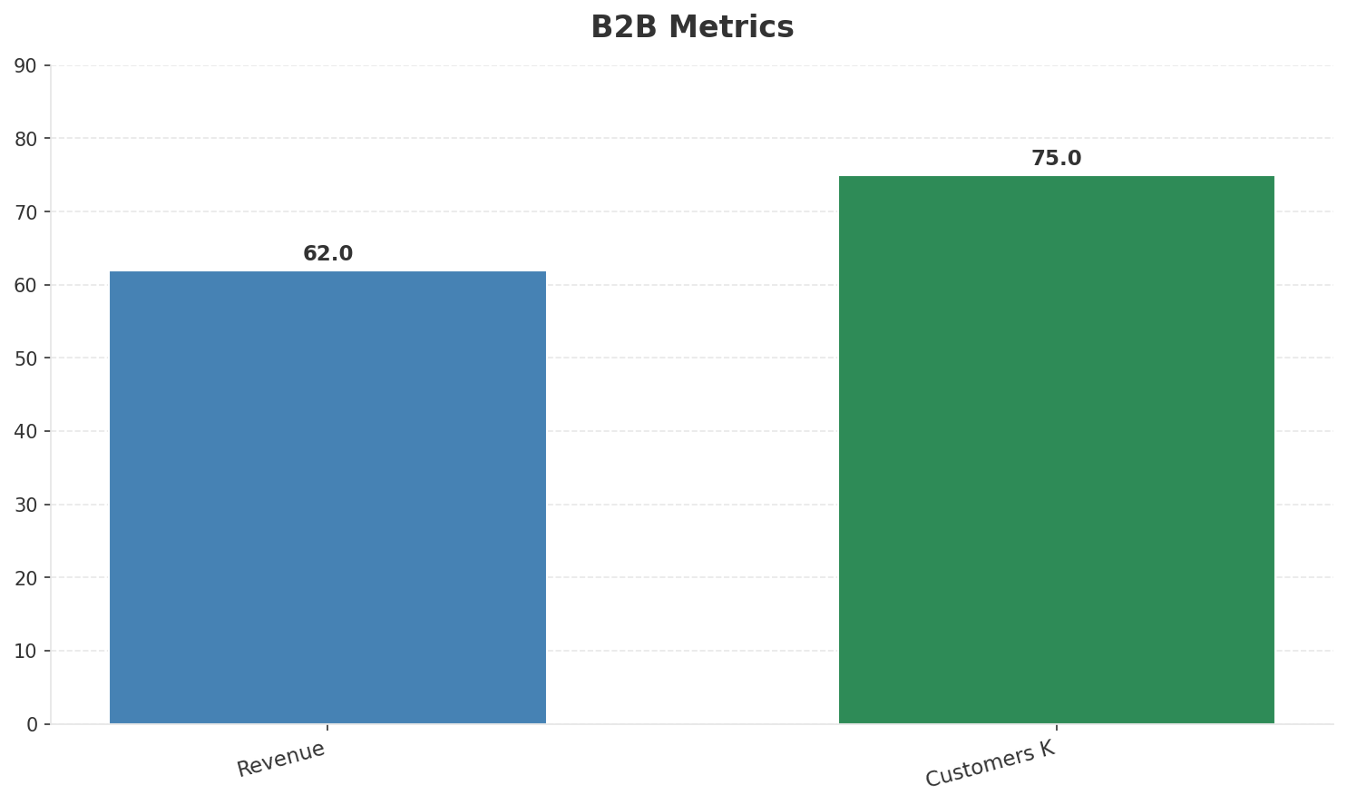
Segment Analysis: B2B
SEGMENT PERFORMANCE
Revenue
Growth Pct
Customers K
Share Of Revenue Pct
€62M
None
75
3.6%
Health: STRONG
• revenue: improving
• customers: improving
• revenue increased 3.3% QoQ
• customers increased 7.1% QoQ
Key Message: B2B revenue 62.0M; 3.6% of total revenue
32

Slide 33
Segment Analysis: TV/Convergence
SEGMENT PERFORMANCE
Revenue
Total K
Net Adds K
Fmc Total K
None
€7,090M
None
None
Health: STABLE
• revenue: stable
• subscribers: stable
• fmc_subscribers: stable
Key Message: TV subscribers 7090K
33

Slide 34
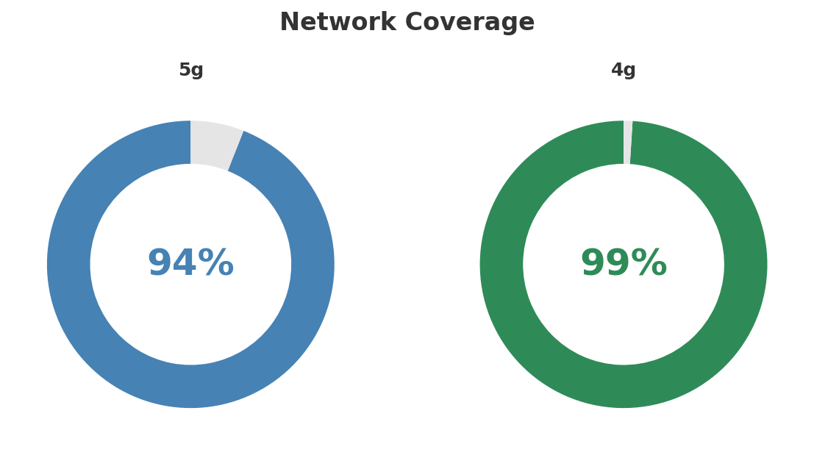
Network Analysis
INFRASTRUCTURE
Technology Mix:
Investment Direction: increasing
• Mobile Vendor: Nokia
• Spectrum Mhz: 310
• Core Vendor: Nokia
• 5G Sa Status: 5G SA launched Sep 2024
• Fiber Technology: GPON/XGS-PON
Key Message: Network infrastructure and coverage assessment
34

Slide 35

Business Model Canvas
BMC
Key Message: Business model canvas overview
35

Slide 36
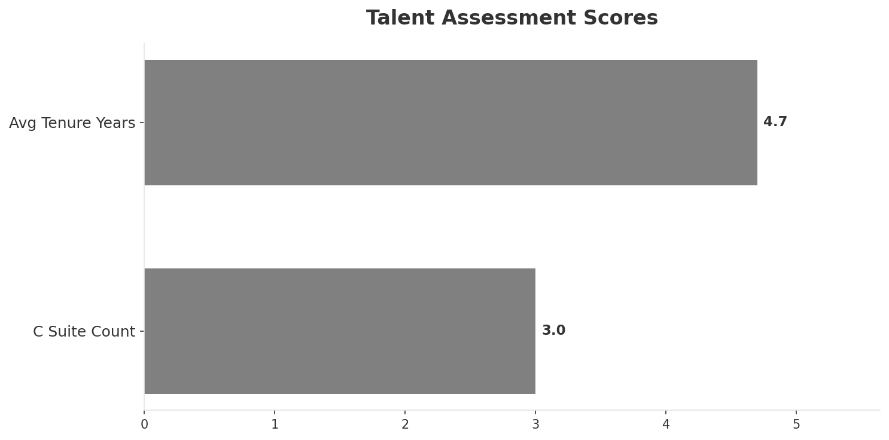
Organization & Talent
PEOPLE & CULTURE
Employees
C Suite Count
Avg Tenure Years
Key Leaders
10,300
3
4.7
['Nicolas Thomas (CEO, Free (France OpCo))', 'Thomas Reynaud (CEO, Iliad Group)', 'Thomas Robin (CFO, Free (France OpCo))']
Organization Culture:
Stable leadership team (avg tenure >3 years); Entrepreneurial and engineering-driven. Xavier Niel's disruptive DNA. Innovation-focused (hardware R&D in-house). Lean organization. Startup mentality at scale.
Leadership Changes:
• Nicolas Thomas: (
• Thomas Reynaud: (
• Thomas Robin: (
Key Message: Organization and talent assessment
36

Slide 37
Strengths, Weaknesses & Exposure Points
SELF ASSESSMENT
Strengths
Weaknesses
Exposure Points
• Brand Strength: score 82 (market avg 78
• Digital Experience: score 90 (market avg 80
• Innovation: score 92 (market avg 78
• Price Competitiveness: score 95 (market avg 76
• Strong EBITDA margin at 42.0%
• Revenue on growth trajectory
• Customer Service: score 70 (market avg 73
• Distribution: score 72 (market avg 79
• Enterprise Solutions: score 35 (market avg 62
• Ranked #4 in revenue among competitors
• Aggressive pricing model constrains ARPU growth: Revenue per user significantly below Orange and Bouygues
• Limited B2B/enterprise presence despite Free Pro launch: Missing large and growing revenue pool in enterprise ICT
• Reliance on price disruption in mature market with decreasing headroom: Limited ability to raise prices without losing brand positioning
Key Message: Ranked #4 of 4 operators in market; revenue EUR 1,740M; EBITDA margin 42.0%; stable but facing challenges; key strength: Brand Strength; key challenge: Customer Service; Management outlook: FY2024: France revenue EUR 6,530M (+8.2%), EBITDAaL EUR 2,600M (39.9% margin). Iliad Group crossed EUR 10B revenue milestone. Europe's 5th largest telco by subscribers (50.5M). 2025 OpFCF target EUR 2.0B.
37

Slide 38
SWOT Synthesis
Strengths, Weaknesses, Opportunities & Threats

Slide 39
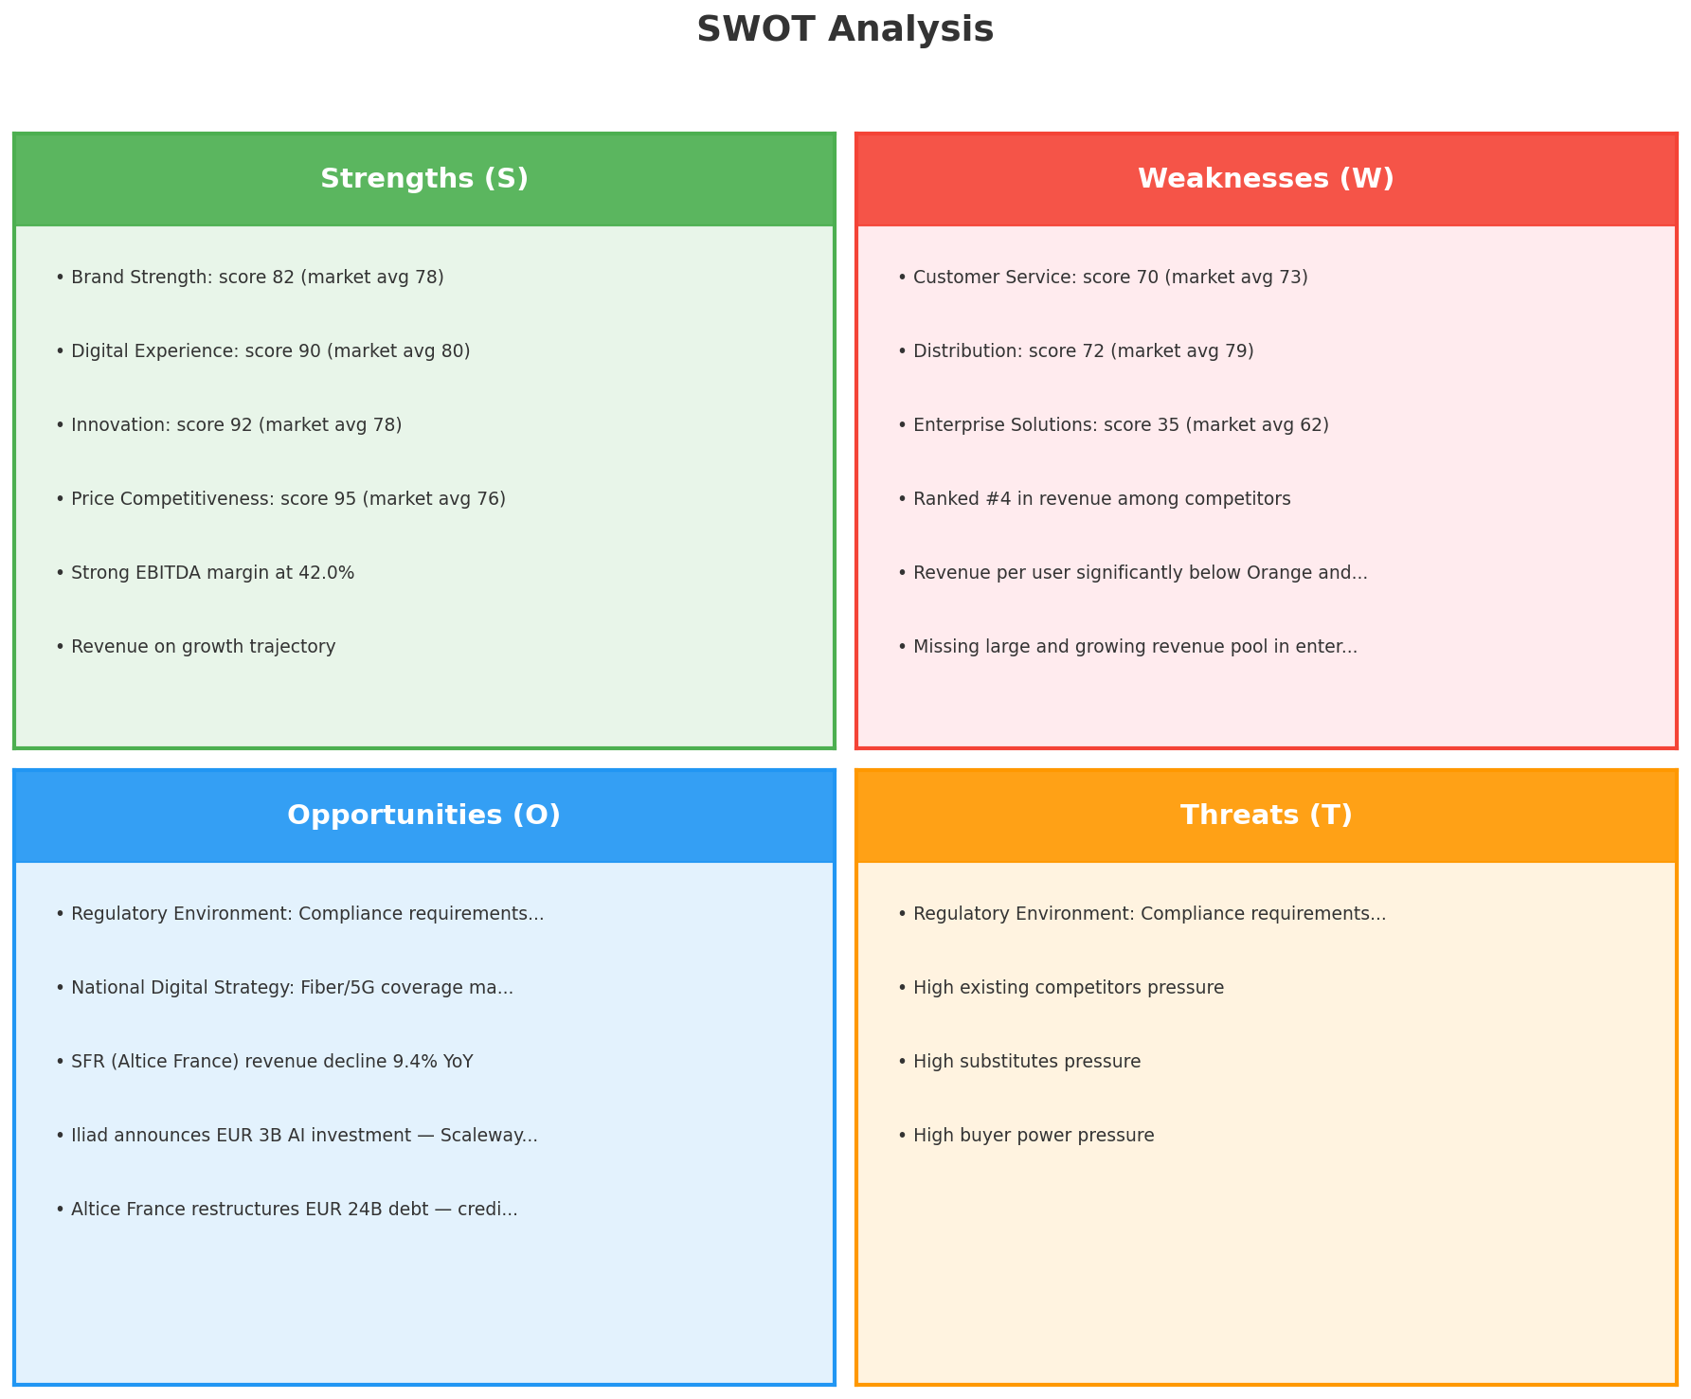
SWOT Analysis
STRATEGIC SYNTHESIS
SO:
Leverage 'Brand Strength: score 82 (market avg 78)' to ca...
WO:
Address weakness 'Customer Service: score 70 (market avg ...
ST:
Use strength 'Brand Strength: score 82 (market avg 78)' t...
WT:
Mitigate weakness 'Customer Service: score 70 (market avg...
Key Message: SWOT analysis identifies 7 strengths, 7 weaknesses, 5 opportunities, and 4 threats. The recommended strategic posture is improvement-focused (WO-dominant).
39

Slide 40
05 Look at Opportunities
SPAN Matrix — Opportunity Selection

Slide 41
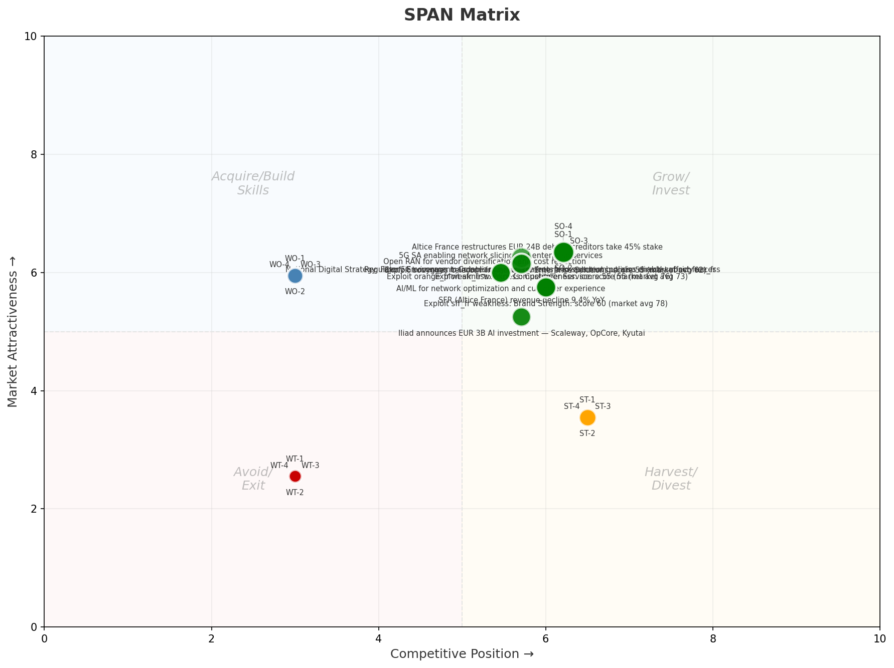
SPAN Matrix — Opportunity Positioning
OPPORTUNITY MAP
Key Message: SPAN matrix positions 28 opportunities: 16 grow/invest, 4 acquire skills, 4 harvest, 4 avoid/exit. Focus resources on the 16 grow/invest items for maximum strategic impact.
41

Slide 42
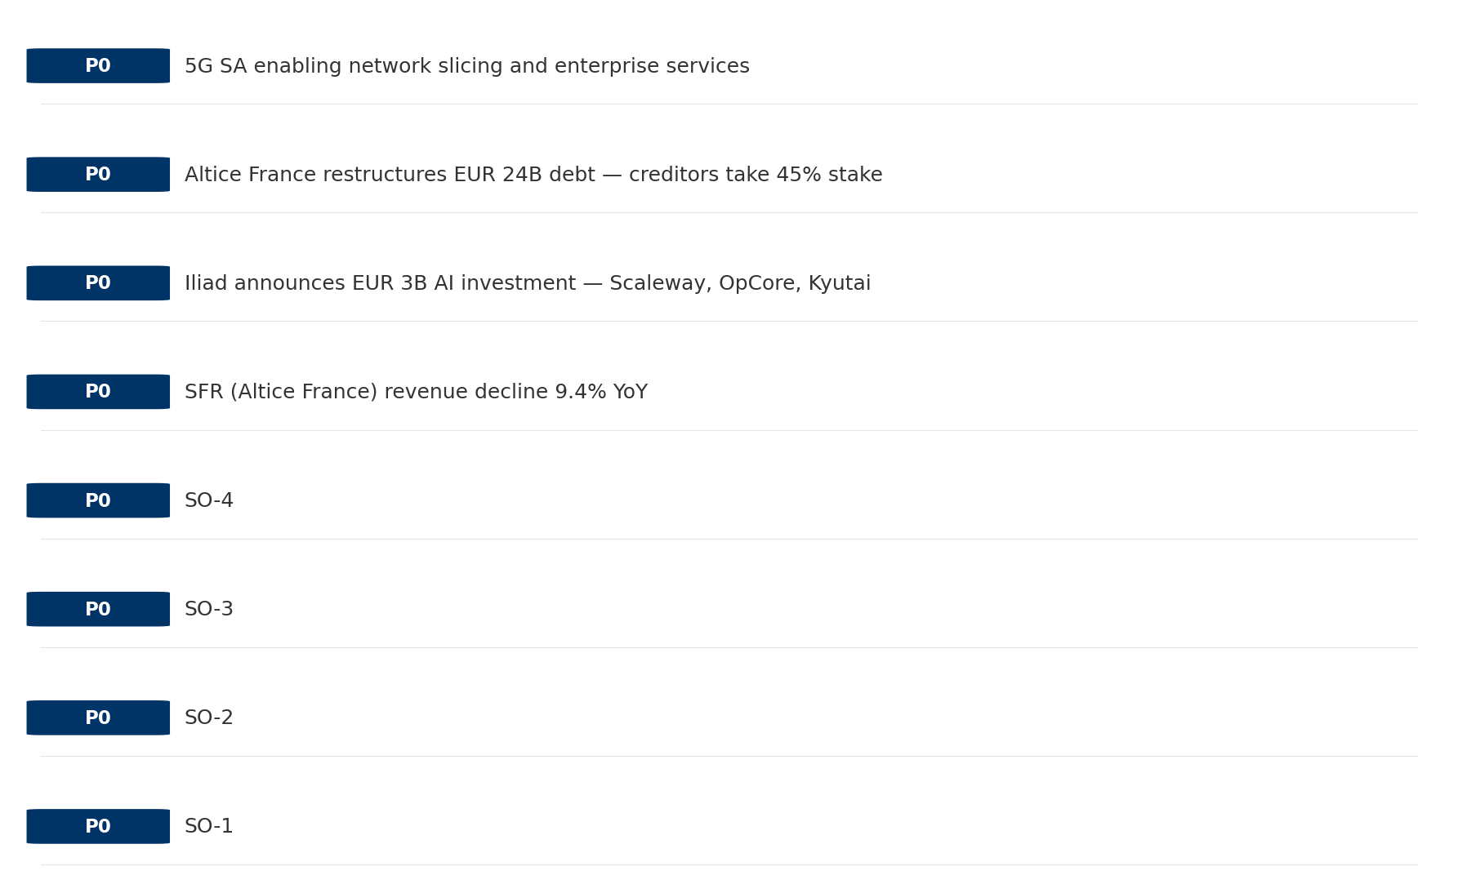
Opportunity Priority Ranking
PRIORITIES
Key Message: SPAN matrix positions 28 opportunities: 16 grow/invest, 4 acquire skills, 4 harvest, 4 avoid/exit. Focus resources on the 16 grow/invest items for maximum strategic impact.
42

Slide 43
Opportunity Details
DEEP DIVE
P0
SO-1
Market: N/A | Window:
Leverage 'Brand Strength: score 82 (market avg 78)' to capture the opportunity of 'Regulatory Environment: Compliance requirements and spectrum policies directly affect free_fr'.
P0
SO-2
Market: N/A | Window:
Leverage 'Digital Experience: score 90 (market avg 80)' to capture the opportunity of 'National Digital Strategy: Fiber/5G coverage mandates may require free_fr investment but also enable subsidy access'.
P0
SO-3
Market: N/A | Window:
Leverage 'Innovation: score 92 (market avg 78)' to capture the opportunity of 'SFR (Altice France) revenue decline 9.4% YoY'.
P0
SO-4
Market: N/A | Window:
Leverage 'Price Competitiveness: score 95 (market avg 76)' to capture the opportunity of 'Iliad announces EUR 3B AI investment — Scaleway, OpCore, Kyutai'.
Key Message: SPAN matrix positions 28 opportunities: 16 grow/invest, 4 acquire skills, 4 harvest, 4 avoid/exit. Focus resources on the 16 grow/invest items for maximum strategic impact.
43

Slide 44
Three Decisions
Strategy — Key Tasks — Execution

Slide 45
Decision 1: Define Strategy
OFFENSIVE
As The Squeezed Middle: differentiate and grow through focused investment in competitive advantages
P0
P0
P1
P1
Growth Strategy
Competitive Strategy
Transformation Strategy
Customer Strategy
Focused growth in high-momentum segments: Mobile, Fixed Broadband, B2B
Capitalize on competitive strengths to gain market share
Accelerate fiber transition — converged network as competitive moat
Optimize value extraction in stable segments: TV/Convergence, Wholesale
- Grow Mobile, Fixed Broadband, B2B above market rate
- Improve segment profitability
- Outgrow competitors in key segments
- Increase service differentiation
- Fiber homepass coverage +20%
- FMC bundle attach rate 50%+
- Upsell rate +10% in TV/Convergence, Wholesale
- Cross-sell convergence bundles
Key Message: As The Squeezed Middle, the strategic posture is Offensive. As The Squeezed Middle: differentiate and grow through focus
45

Slide 46
Decision 2: Define Key Tasks
3 P0 (IMMEDIATE), 3 P1 (1-2 YEARS), 1 P2 (3-5 YEARS
P0
Network
Accelerate Fixed Network Upgrade
Homepass coverage +15% | Speed tier upgrades
Drive DOCSIS/Fiber rollout to increase homepass and improve quality scores
P0
Business
Accelerate Mobile Growth
Mobile revenue +10% YoY | Market share gain
Mobile at €680M showing strong momentum — invest to scale
P0
Business
Accelerate Fixed Broadband Growth
Fixed Broadband revenue +10% YoY | Market share gain
Fixed Broadband at €955M showing strong momentum — invest to scale
P1
Network
5G Coverage Expansion
5G pop coverage target | 5G attach rate
Expand 5G population coverage to strengthen mobile competitive position
P1
Business
Opportunity Portfolio Execution
Launch 3+ priority initiatives | Pipeline contribution tracking
16 grow/invest opportunities identified — establish execution office
P1
Customer
Customer Experience Enhancement
NPS +5 points | First-call resolution rate 80%+
Improve digital touchpoints and service resolution to boost NPS
P2
Efficiency
Operational Efficiency & Automation
Process automation 30%+ | Cost-to-serve reduction
EBITDA margin 42.0% — maintain through smart automation and resource reallocatio
Key Message: 7 critical tasks: 3 P0 (immediate), 3 P1 (1-2 years), 1 P2 (3-5 years
46

Slide 47

Decision 3: Define Execution
QUARTERLY ROADMAP & GOVERNANCE
Governance
Strategic Traps to Avoid
- Monthly Progress Review (Monthly
x Enter a price war
- Quarterly Strategic Checkpoint (Quarterly
x Attempt premium repositioning
- Mid-Year Strategic Adjustment (Semi-annual
x Delay core transformation
Key Risks & Mitigation
! Resource constraints delay P0 initiatives -- Ring-fence P0 budgets; establish escalation path for blockers
Key Message: Execute with discipline: monthly reviews, quarterly checkpoints, annual refresh
! Macro-economic slowdown reduces consumer spending -- Prepare value-tier offerings; shift mix toward B2B resilience
47

Slide 48
Analysis Summary
KEY TAKEAWAYS
01 Trends
Macro environment: Favorable. Key opportunities: Regulatory Environment, National Digital Strategy. Key risks: Regulatory Environment, Fiber Broadband Penetration Industry is mature. (+1.9% YoY (CQ2_2025 -> CQ4_2025)
02 Market
France telecom market totals EUR 10.7B in quarterly revenue; competitive strengths in Availability, Performance; gaps in Assurances; Market outlook is favorable with more opportunities than threats.
03 Competition
In a 4-player market with medium competition intensity, Orange France leads with 43% revenue share. Target operator holds 16% share. Strongest competitive force: Existing Competitors.
04 Self
Ranked #4 of 4 operators in market; revenue EUR 1,740M; EBITDA margin 42.0%; stable but facing challenges; key strength: Brand Strength; key challenge: Customer Service; Management outlook: FY2024: France revenue EUR 6,530M (+8.2%), EBITDAaL EUR 2,600M (39.9% margin). Iliad Group crossed EUR 10B revenue milestone. Europe's 5th largest telco by subscribers (50.5M). 2025 OpFCF target EUR 2.0B.
SWOT
SWOT analysis identifies 7 strengths, 7 weaknesses, 5 opportunities, and 4 threats. The recommended strategic posture is improvement-focused (WO-dominant).
05 Opportunities
SPAN matrix positions 28 opportunities: 16 grow/invest, 4 acquire skills, 4 harvest, 4 avoid/exit. Focus resources on the 16 grow/invest items for maximum strategic impact.
Key Message: Complete Five Looks analysis — see opportunity priorities for next steps
48

Slide 49
Data Provenance
SOURCES & METHODOLOGY
No provenance data recorded for this analysis
Key Message: All data points are traceable to original sources
49

Slide 50
Thank You
BLM Five Looks Strategic Analysis

