Slide 1
Default BLM Strategic Analysis
BLM (Business Leadership Model) Five Looks Analysis
Target Operator
Market
Analysis Period
Report Date
Iliad It
Italy
CQ4_2025
2026-02-15
01 Trends (PEST) | 02 Market/Customer ($APPEALS) | 03 Competition (Porter) | 04 Self (BMC) | SWOT Synthesis | 05 Opportunities (SPAN

Slide 2
Report Contents
TABLE OF CONTENTS
01
Executive Summary
Key findings and recommendations
02
Look at Trends
PEST Framework — macro environment
03
Look at Market
$APPEALS — market changes & customer needs
T
Tariff Analysis
Pricing comparison — mobile, fixed & convergence
04
Look at Competition
Porter's Five Forces — competitive landscape
05
Look at Self
BMC + Capability — internal assessment
06
SWOT Synthesis
Strengths, Weaknesses, Opportunities, Threats
07
Look at Opportunities
SPAN Matrix — opportunity selection
Summary & Provenance
2
08
Conclusions and data sources

Slide 3
Data Quality Overview
DATA QUALITY
Total Data Points
High Confidence
Medium Confidence
Low/Estimated
20
0
0
20
0%
Unique Sources: 0
Data Conflicts: 0
Coverage: Partial
Key Message: 20 data points tracked, 0 high-confidence (0%
3

Slide 4
Executive Summary
Trends
Macro environment: Mixed. Key opportunities: Regulatory Environment, National Digital Strategy. Key risks: Regulatory Environment, Fiber Broadband Penetration Industry is mature. (-0.7% YoY (CQ2_2025 -> CQ4_2025)
Market/Customer
Italy telecom market totals EUR 5,755M in quarterly revenue; competitive strengths in Social/Brand; gaps in Assurances; Market outlook is favorable with more opportunities than threats.
Competition
In a 4-player market with medium competition intensity, TIM (Telecom Italia) leads with 43% revenue share. Target operator holds 6% share. Strongest competitive force: Existing Competitors.
Self Assessment
Ranked #4 of 4 operators in market; revenue EUR 325.0M; EBITDA margin 33.2%; stable but facing challenges; key strength: Customer Service; key challenge: Distribution; Management outlook: FY2024: Revenue EUR 1,145M (+8%), EBITDAaL EUR 308M (+24.5%, margin 26.9%). Leader in net adds 7 consecutive years. 11.64M mobile subs. Mobile-first, expanding into fixed.
SWOT
SWOT analysis identifies 6 strengths, 9 weaknesses, 5 opportunities, and 5 threats. The recommended strategic posture is cautious (WT-dominant).
Opportunities
SPAN matrix positions 28 opportunities: 0 grow/invest, 8 acquire skills, 8 harvest, 12 avoid/exit. Focus resources on the 0 grow/invest items for maximum strategic impact.
Key Message: Five Looks analysis completed — see details in following sections
4

Slide 5
01 Look at Trends
PEST Framework — Macro Environment

Slide 6
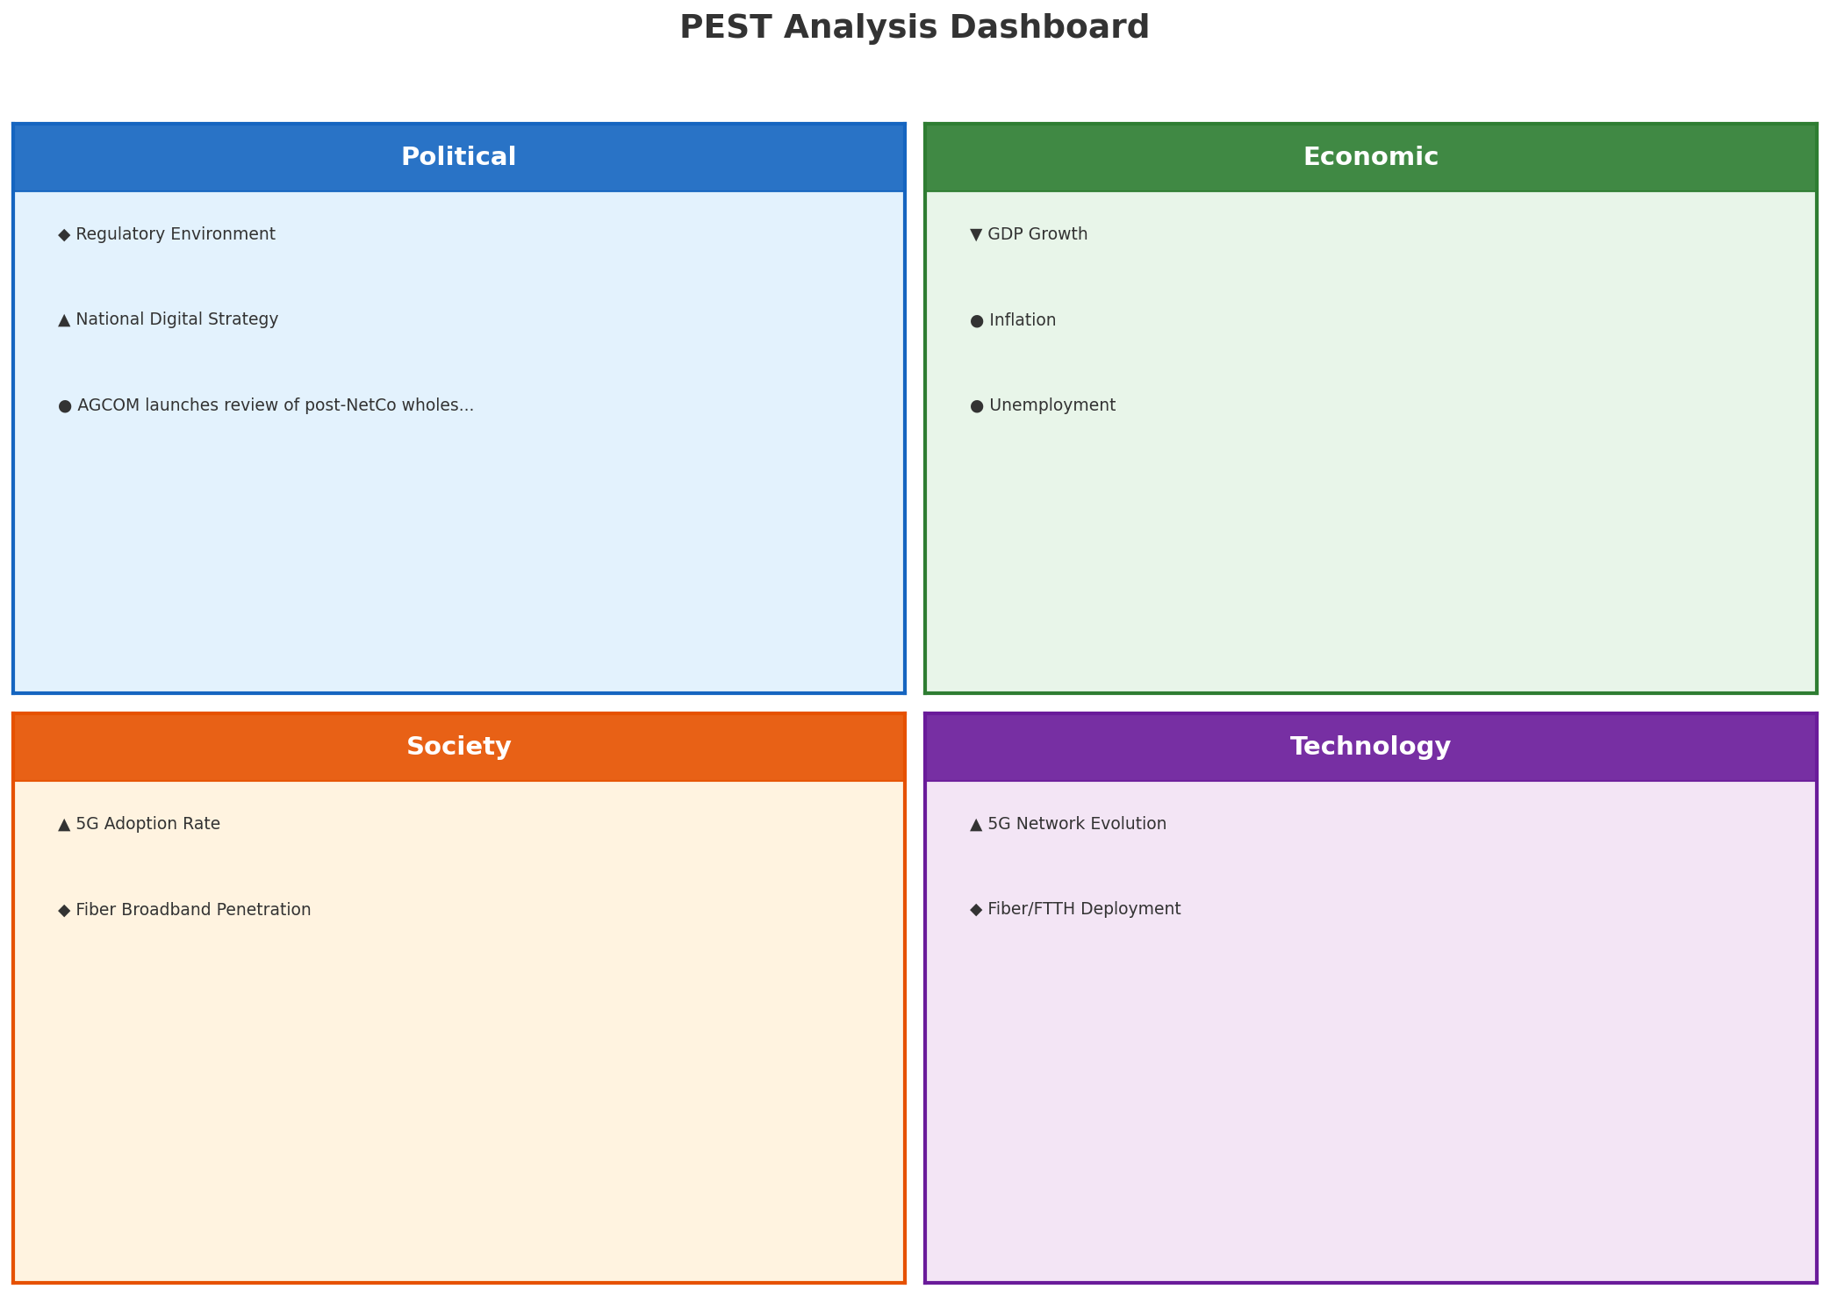
PEST Analysis Dashboard
MACRO ENVIRONMENT
Key Message: Macro environment: Mixed. Key opportunities: Regulatory Environment, National Digital Strategy. Key risks: Regulatory Environment, Fiber Broadband Penetration.
6

Slide 7
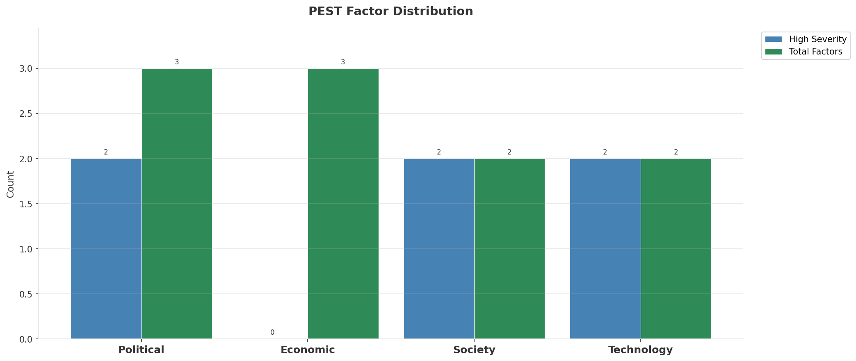
Industry Environment
INDUSTRY ANALYSIS
Market Size
Growth Rate
Concentration
Lifecycle
EUR 5.8B (quarterly, CQ4_2025
-0.7% YoY (CQ2_2025 -> CQ4_2025
CR4 = 100% (TIM (Telecom Italia): 43.4%, Vodafone Italia / Fastweb: 30.6%, WindTre: 20.3%, Iliad Italia: 5.6%
mature
• New Business Models:
• FWA (Fixed Wireless Access) as fiber alternative
• Network-as-a-Service for enterprise verticals
• Wholesale/MVNO partnerships for coverage monetization
• Technology Revolution:
• 5G SA enabling network slicing and enterprise services
• AI/ML for network optimization and customer experience
• Open RAN for vendor diversification and cost reduction
Key Message: Macro environment: Mixed. Key opportunities: Regulatory Environment, National Digital Strategy. Key risks: Regulatory Environment, Fiber Broadband Penetration Industry is mature. (-0.7% YoY (CQ2_2025 -> CQ4_2025)
7

Slide 8
Value Transfer Trends
VALUE MIGRATION
• Value shifting from voice/SMS to data and digital services
• B2B/ICT growing faster than consumer segment
• Fiber displacing copper and cable broadband
Key Message: Macro environment: Mixed. Key opportunities: Regulatory Environment, National Digital Strategy. Key risks: Regulatory Environment, Fiber Broadband Penetration Industry is mature. (-0.7% YoY (CQ2_2025 -> CQ4_2025)
8

Slide 9
02 Look at Market
$APPEALS — Market Changes & Customer Needs

Slide 10
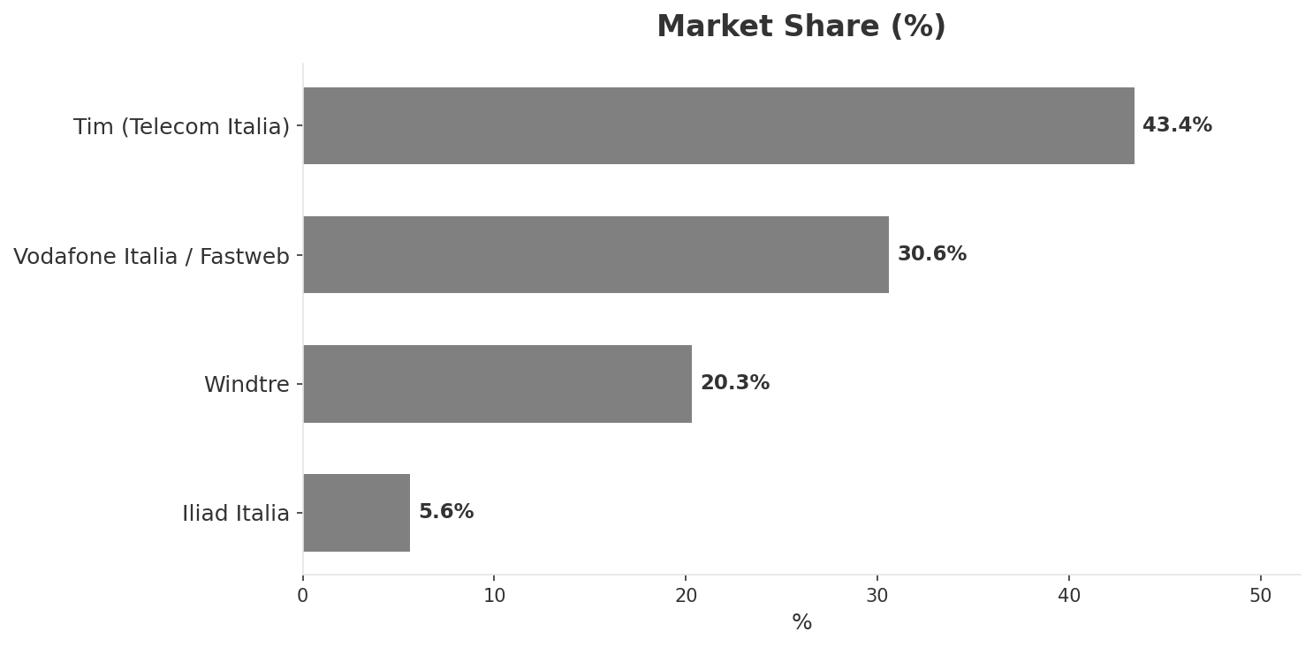
Market Change Panorama
MARKET OVERVIEW
Total Revenue (€M
Mobile Subs (K
Broadband Subs (K
Operators
5,755
77,700
16,430
4
Market Changes:
• Vodafone Italia / Fastweb revenue growth 60.0% YoY
• Iliad Italia revenue growth 7.6% YoY
• Iliad Italia EBITDA margin improvement: 33.2% vs 30.4% (+2.8pp
• CK Hutchison explores sale of European telecom assets including WindTre
Key Message: Italy telecom market totals EUR 5,755M in quarterly revenue; competitive strengths in Social/Brand; gaps in Assurances; Market outlook is favorable with more opportunities than threats.
10

Slide 11
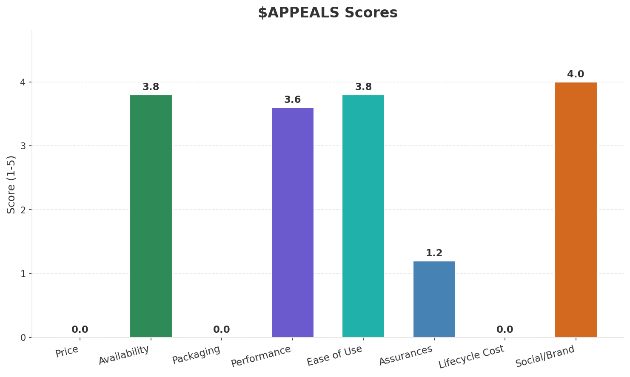
Customer Segments
SEGMENTATION
Consumer Premium Convergent
Trend: stable
Needs: Reliable fiber broadband across all regions (North/South gap), Seamless fixed-mobile convergent bundles
Consumer Value-Seeking
Trend: stable
Needs: Affordable unlimited mobile data plans, Simple, transparent pricing
Consumer Digital-First / Young
Trend: stable
Needs: Ultra-competitive SIM-only plans with large data, eSIM and digital-first onboarding
Enterprise & Public Sector
Trend: stable
Needs: Digitalization of Italian SMEs (vast majority of businesses), Cloud migration and cybersecurity services
Key Message: Italy telecom market totals EUR 5,755M in quarterly revenue; competitive strengths in Social/Brand; gaps in Assurances; Market outlook is favorable with more opportunities than threats.
11

Slide 12
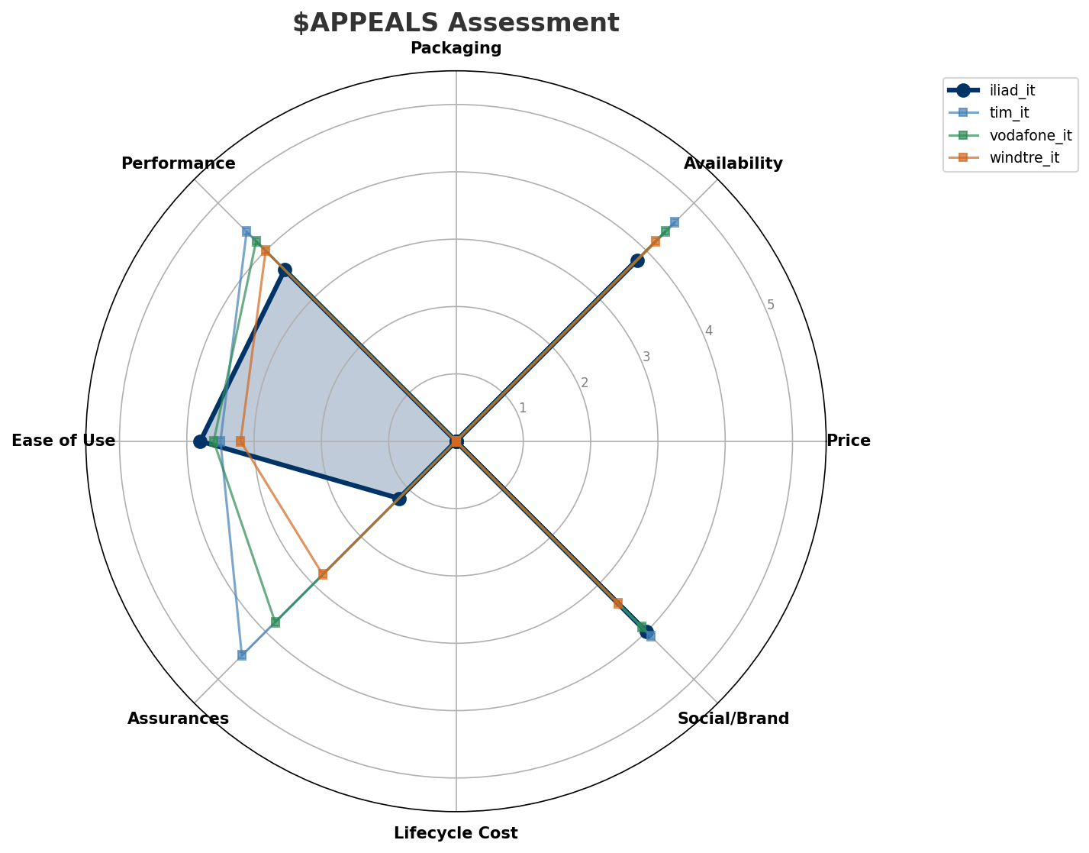
$APPEALS Assessment
CUSTOMER NEEDS
Key Message: Italy telecom market totals EUR 5,755M in quarterly revenue; competitive strengths in Social/Brand; gaps in Assurances; Market outlook is favorable with more opportunities than threats.
12

Slide 13
Customer Value Migration
VALUE MIGRATION
Value migration trending upward: customers willing to pay more for premium connectivity and convergent bundles. Focus on upselling and cross-selling opportunities.
Opportunities:
Threats:
• Iliad Italia revenue growth 7.6% YoY
• Iliad Italia EBITDA margin improvement: 33.2% vs 30.4% (+2.8pp
• CK Hutchison explores sale of European telecom assets including WindTre
• Vodafone Italia / Fastweb revenue growth 60.0% YoY
Key Message: Italy telecom market totals EUR 5,755M in quarterly revenue; competitive strengths in Social/Brand; gaps in Assurances; Market outlook is favorable with more opportunities than threats.
13

Slide 14
Tariff Analysis
Mobile, Fixed & Convergence Pricing Landscape

Slide 15
Fixed & Convergence Pricing Landscape
DSL / CABLE / FIBER / FMC BUNDLES
Key Message: Fixed and convergence pricing overview
15

Slide 16
03 Look at Competition
Porter's Five Forces — Competitive Landscape

Slide 17

Porter's Five Forces
COMPETITIVE FORCES
Overall Intensity: MEDIUM
Key Message: In a 4-player market with medium competition intensity, TIM (Telecom Italia) leads with 43% revenue share. Target operator holds 6% share. Strongest competitive force: Existing Competitors.
17

Slide 18
Competitor Analysis: Vodafone It
COMPETITOR DEEP DIVE
Revenue
EBITDA
Margin
Capex/Rev
€1,760M
€650M
36.9%
21.0%
+64.2% YoY
Strengths
Weaknesses
• Enterprise Solutions: score 75 (market avg 61
• Price Competitiveness: score 60 (market avg 72
Strategy: Revenue-led profitable growth; ARPU-led value strategy
Key Message: Competitor analysis: Vodafone It
18

Slide 19
Competitor Analysis: Windtre It
COMPETITOR DEEP DIVE
Revenue
EBITDA
Margin
Capex/Rev
€1,170M
€430M
36.8%
18.8%
-1.5% YoY
Strengths
Weaknesses
• Price Competitiveness: score 78 (market avg 72
• Brand Strength: score 68 (market avg 77
• Customer Service: score 65 (market avg 70
• Digital Experience: score 70 (market avg 76
• Enterprise Solutions: score 55 (market avg 61
Strategy: Margin optimization / cost transformation; ARPU-led value strategy
Key Message: Competitor analysis: Windtre It
19

Slide 20
Competitor Analysis: Tim It
COMPETITOR DEEP DIVE
Revenue
EBITDA
Margin
Capex/Rev
€2,500M
€950M
38.0%
14.2%
-0.9% YoY
Strengths
Weaknesses
• Brand Strength: score 82 (market avg 77
• Distribution: score 88 (market avg 79
• Enterprise Solutions: score 90 (market avg 61
• Network Coverage: score 92 (market avg 85
• Price Competitiveness: score 55 (market avg 72
Strategy: Margin optimization / cost transformation; ARPU-led value strategy; strong B2B/enterprise push
Key Message: Competitor analysis: Tim It
20

Slide 21
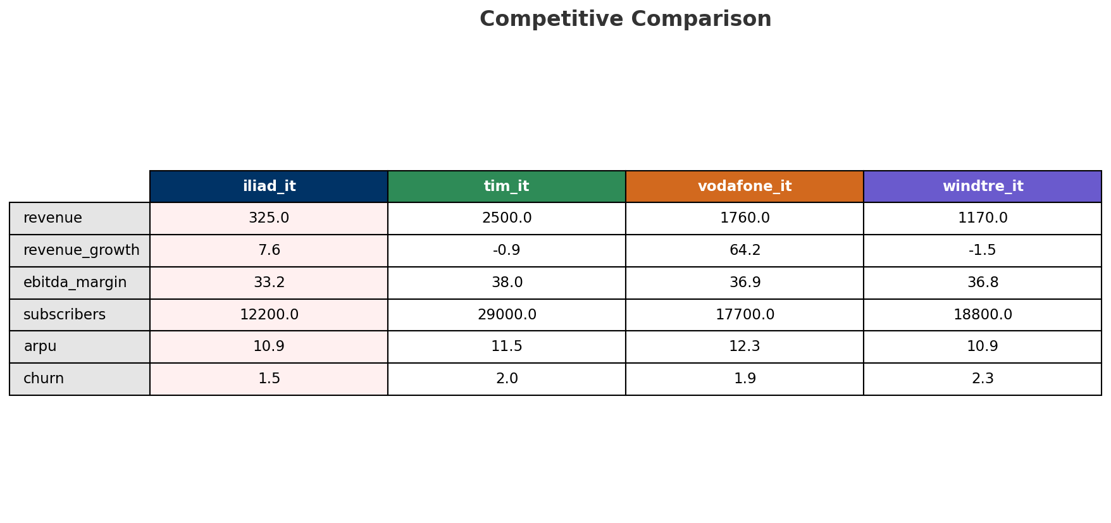
Competitive Landscape Summary
COMPETITION
Key Message: In a 4-player market with medium competition intensity, TIM (Telecom Italia) leads with 43% revenue share. Target operator holds 6% share. Strongest competitive force: Existing Competitors.
21

Slide 22
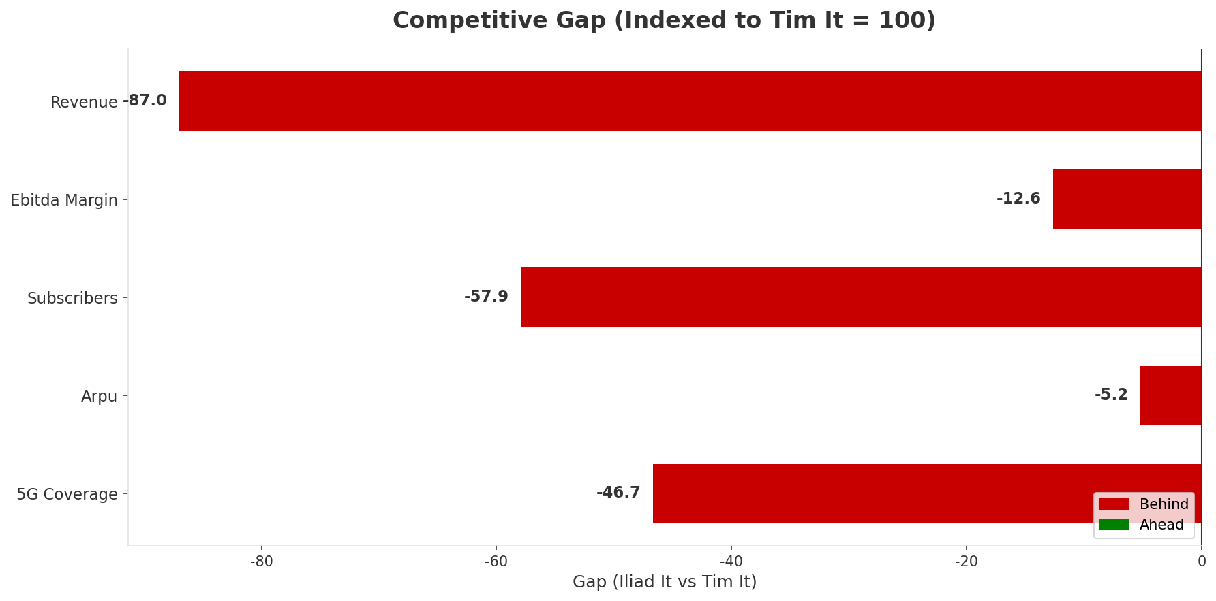
Gap Analysis: Iliad It vs Tim It
COMPETITIVE GAP
Key Message: Gap analysis vs market leader Tim It
22

Slide 23
New Entrants Threat
MARKET ENTRY
• Entry barriers: High barriers: spectrum licensing, massive capex for network build, regulatory approvals, established brand loyalty
Key Message: New entrants threat level: low
23

Slide 24
04 Look at Self
BMC + Capability Assessment

Slide 25
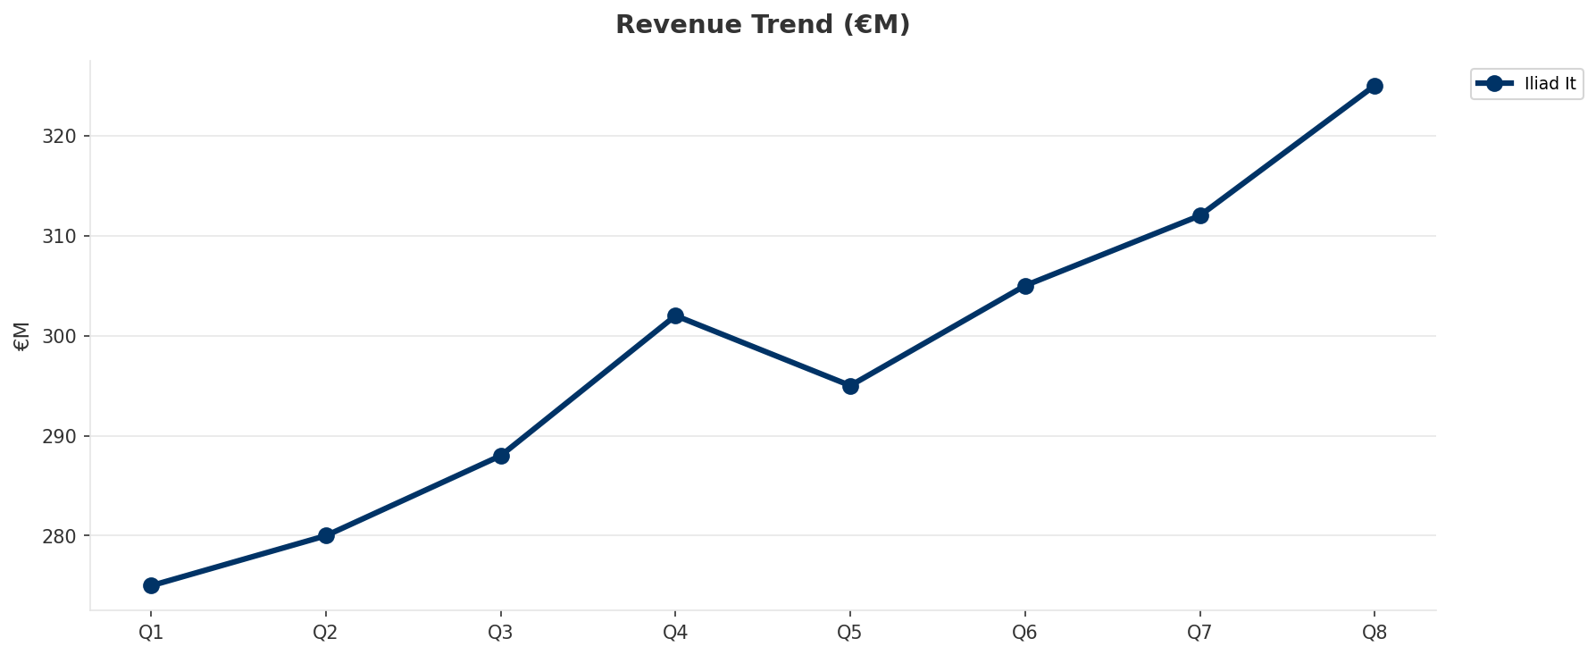
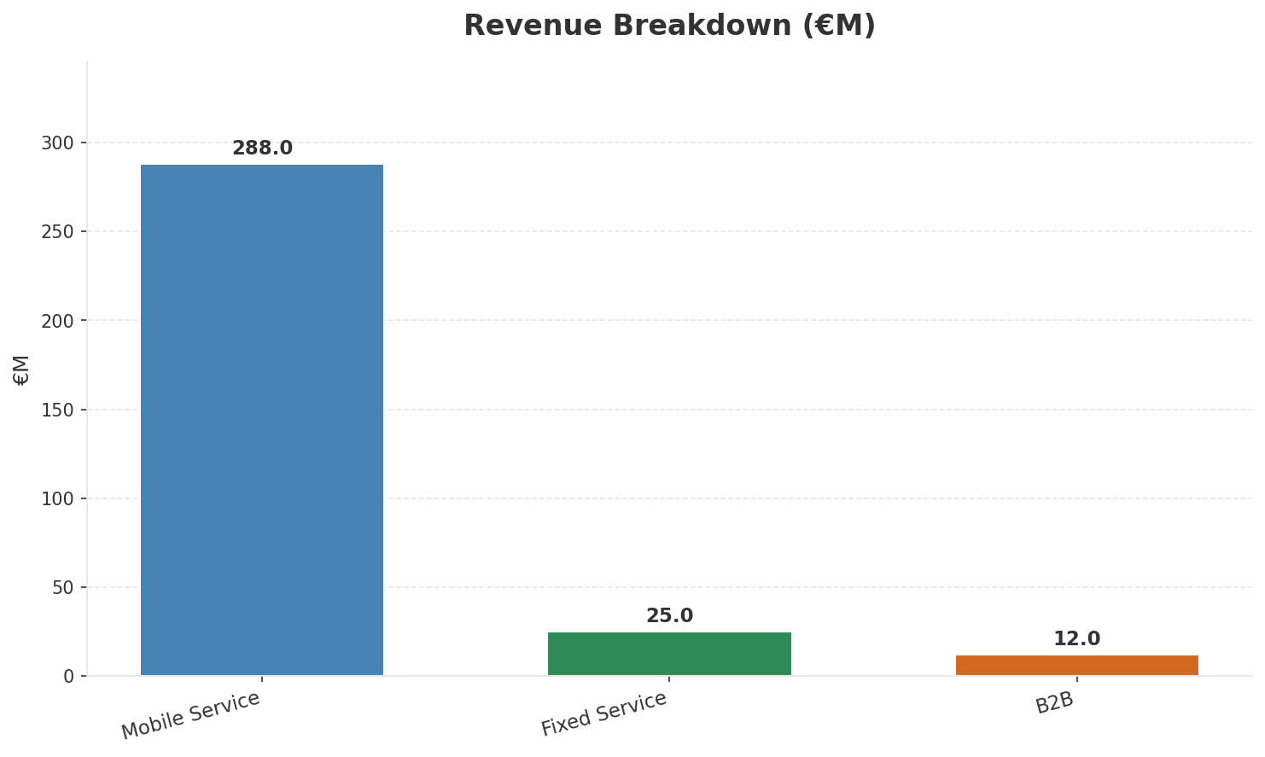
Operating Health Check
FINANCIAL HEALTH
Revenue
EBITDA
EBITDA Margin
Capex/Rev
€325M
€108M
33.2%
23.1%
+7.62% YoY
+20.0% YoY
CAGR: +10.0% | Accelerating Growth
Key Message: Ranked #4 of 4 operators in market; revenue EUR 325.0M; EBITDA margin 33.2%; stable but facing challenges; key strength: Customer Service; key challenge: Distribution; Management outlook: FY2024: Revenue EUR 1,145M (+8%), EBITDAaL EUR 308M (+24.5%, margin 26.9%). Leader in net adds 7 consecutive years. 11.64M mobile subs. Mobile-first, expanding into fixed.
25

Slide 26
Market Share Evolution
REVENUE SHARE TREND
TIM (Telecom Italia
Vodafone Italia / Fastweb
WindTre
Iliad Italia
43.4% #1
30.6% #2
20.3% #3
5.7% #4
-7.0pp losing
+9.3pp gaining
-2.7pp losing
+0.4pp stable
Market Concentration: HHI 3,268 (Highly Concentrated) | CR3: 94.3% | Trend: Fragmenting
Subscriber share: Mobile: 15.7% (+1.8pp) | Broadband: 3.4% (+1.9pp
Key Message: Revenue share: 5.7% (#4); stable (+0.4pp); market is highly concentrated (HHI 3,268); fragmenting.
26

Slide 27
Momentum Dashboard
MULTI-QUARTER TREND ANALYSIS
Revenue
EBITDA
Margin
+10.0% CAGR
+30.3% CAGR
+18.4% CAGR
Accelerating Growth (51/100
Accelerating Growth (48/100
Decelerating Growth (46/100
Key Message: Dominant momentum: Accelerating Growth — based on 3 KPI trend analyses
27

Slide 28
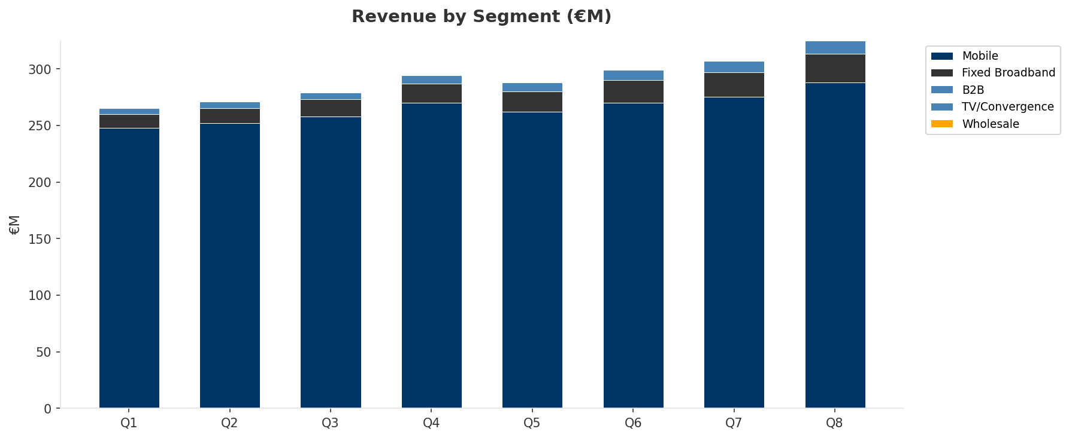
Revenue Composition Trend
SEGMENT REVENUE MIX OVER TIME
Key Message: Growing: Mobile, Fixed Broadband, B2B
28

Slide 29
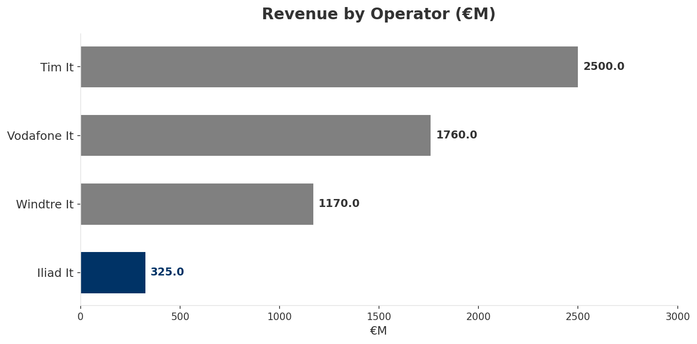
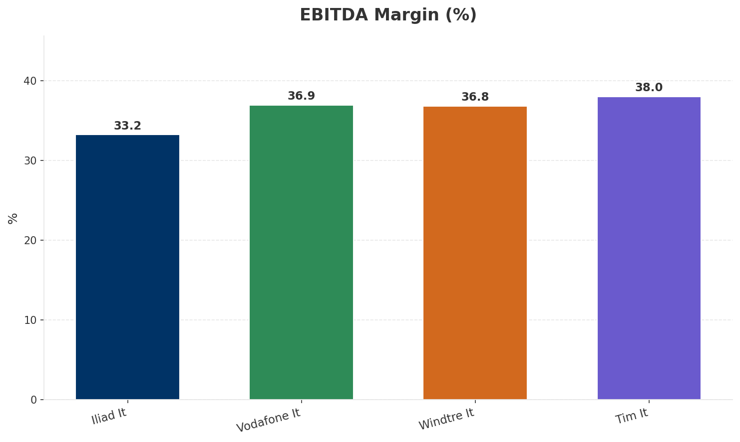
Revenue Comparison
COMPETITIVE BENCHMARKING
Key Message: Revenue and margin benchmarking across operators
29

Slide 30
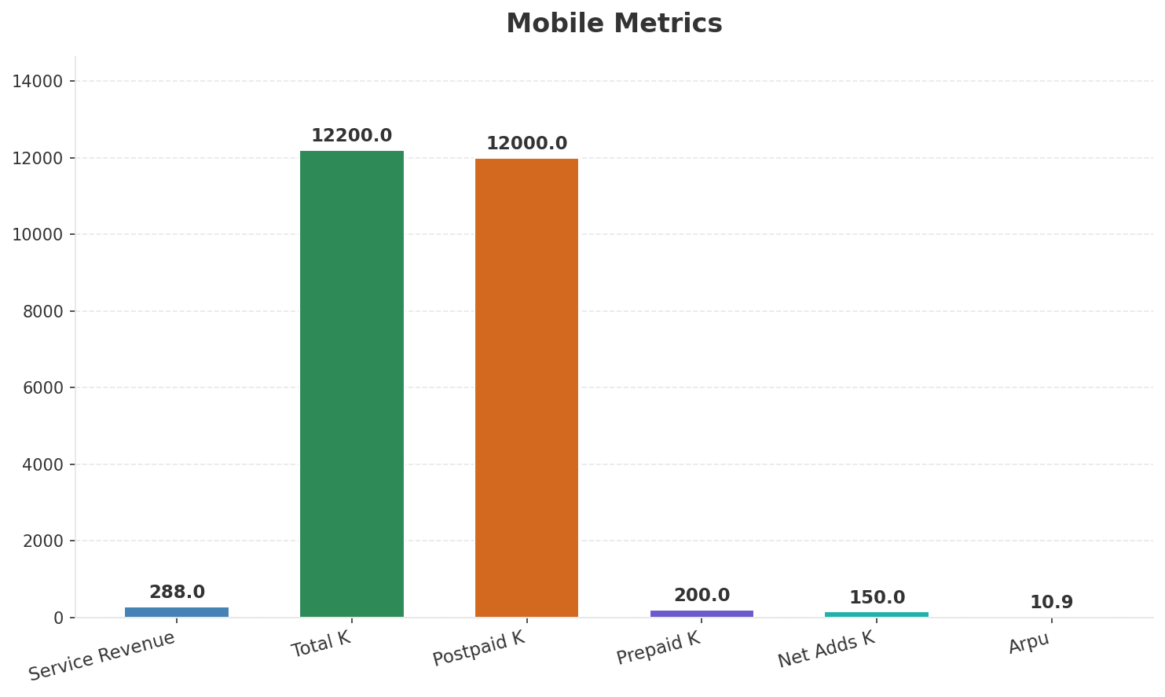
Segment Analysis: Mobile
SEGMENT PERFORMANCE
Service Revenue
Service Growth Pct
Total K
Postpaid K
€288M
6.7%
€12,200M
€12,000M
Health: STRONG
• revenue: improving
• subscribers: improving
• arpu: stable
• FY2024: Revenue EUR 1,145M (+8%), EBITDAaL EUR 308M (+24.5%, margin 26.9%). Leader in net adds 7 consecutive years. 11.64M mobile subs. Mobile-first, expanding into fixed.
• revenue increased 4.7% QoQ
Key Message: Mobile service revenue at 288.0M; up 6.7% YoY; ARPU 10.9
30

Slide 31
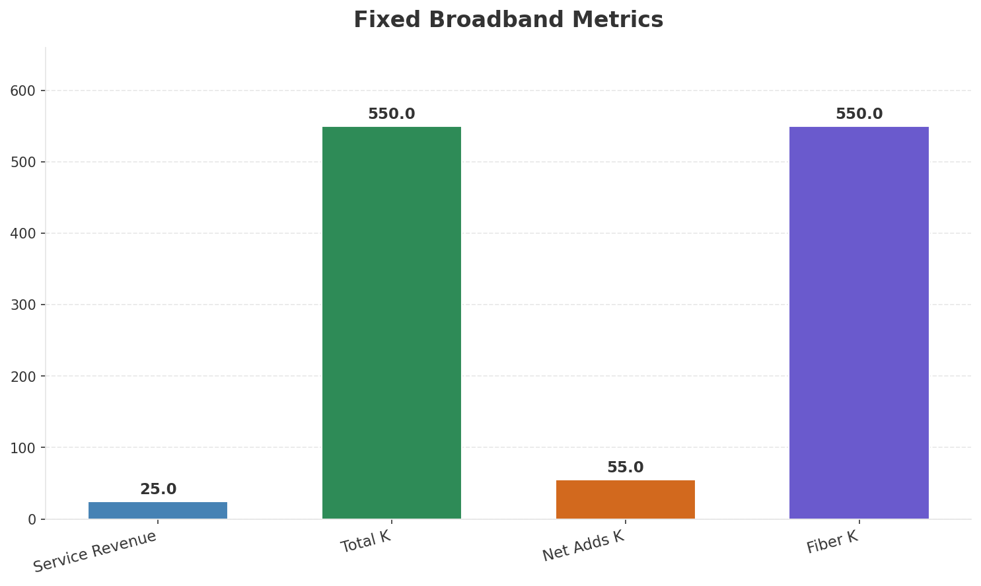
Segment Analysis: Fixed Broadband
SEGMENT PERFORMANCE
Service Revenue
Service Growth Pct
Total K
Net Adds K
€25M
47.1%
€550M
55
Health: STRONG
• revenue: improving
• subscribers: improving
• arpu: stable
• FY2024: Revenue EUR 1,145M (+8%), EBITDAaL EUR 308M (+24.5%, margin 26.9%). Leader in net adds 7 consecutive years. 11.64M mobile subs. Mobile-first, expanding into fixed.
• Fixed broadband 349K fiber subscribers at end-2024 via Open Fiber and FiberCop wholesale. Targeting 1M+ fiber subs by 2026. Iliad Box launched with Iliad Group Freebox technology.
• revenue increased 13.6% QoQ
Key Message: Fixed service revenue 25.0M; growth +47.1% YoY; Fiber subs 550K
31

Slide 32
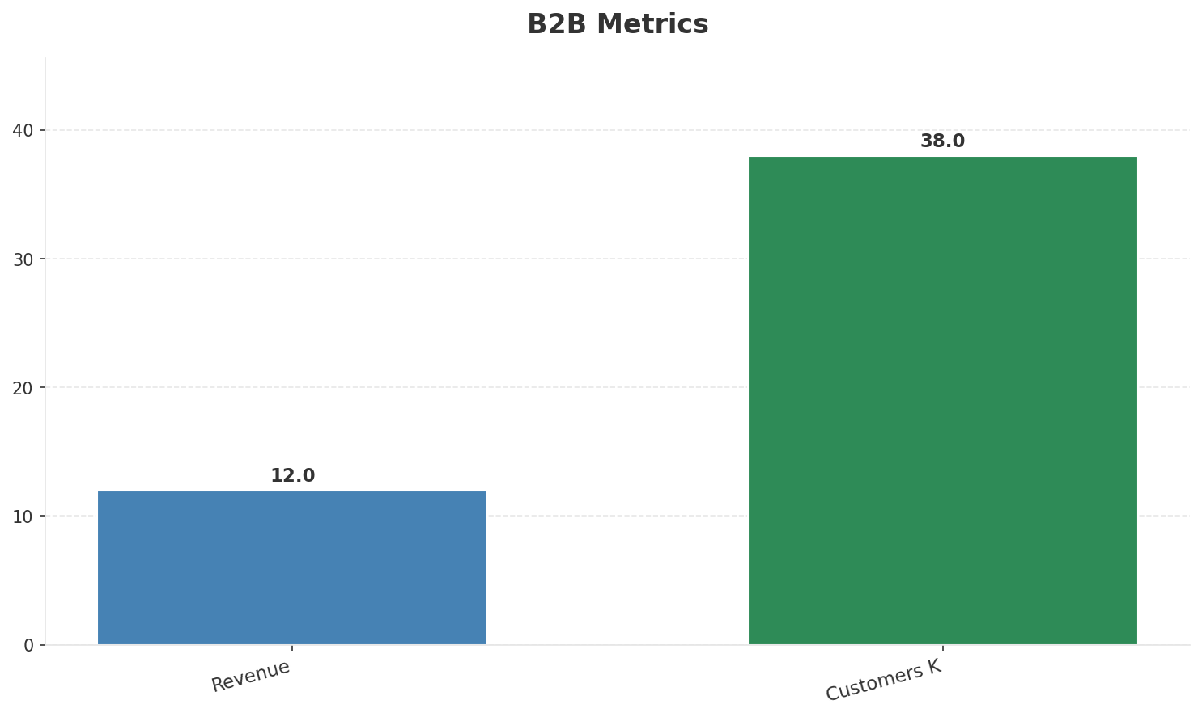
Segment Analysis: B2B
SEGMENT PERFORMANCE
Revenue
Growth Pct
Customers K
Share Of Revenue Pct
€12M
None
38
3.7%
Health: STRONG
• revenue: improving
• customers: improving
• revenue increased 20.0% QoQ
• customers increased 11.8% QoQ
Key Message: B2B revenue 12.0M; 3.7% of total revenue
32

Slide 33
Segment Analysis: TV/Convergence
SEGMENT PERFORMANCE
Revenue
Total K
Net Adds K
Fmc Total K
None
None
None
None
Health: STABLE
• revenue: stable
• subscribers: stable
• fmc_subscribers: stable
Key Message: Insufficient data for TV/convergence assessment
33

Slide 34
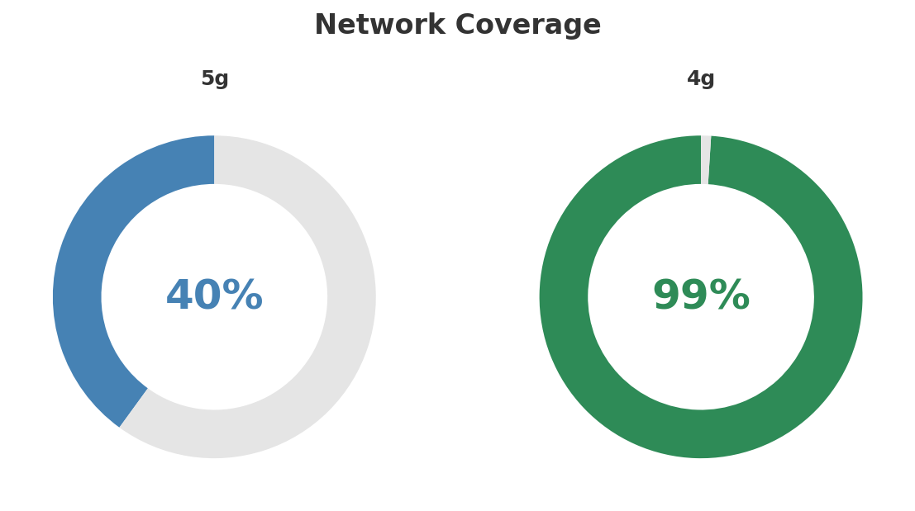
Network Analysis
INFRASTRUCTURE
Technology Mix:
Investment Direction: increasing
• Mobile Vendor: Nokia
• Spectrum Mhz: 280
• Core Vendor: Nokia
• 5G Sa Status: NSA deploying
• Own Sites: 6800
• Roaming Partner: WindTre
Key Message: Network infrastructure and coverage assessment
34

Slide 35

Business Model Canvas
BMC
Key Message: Business model canvas overview
35

Slide 36
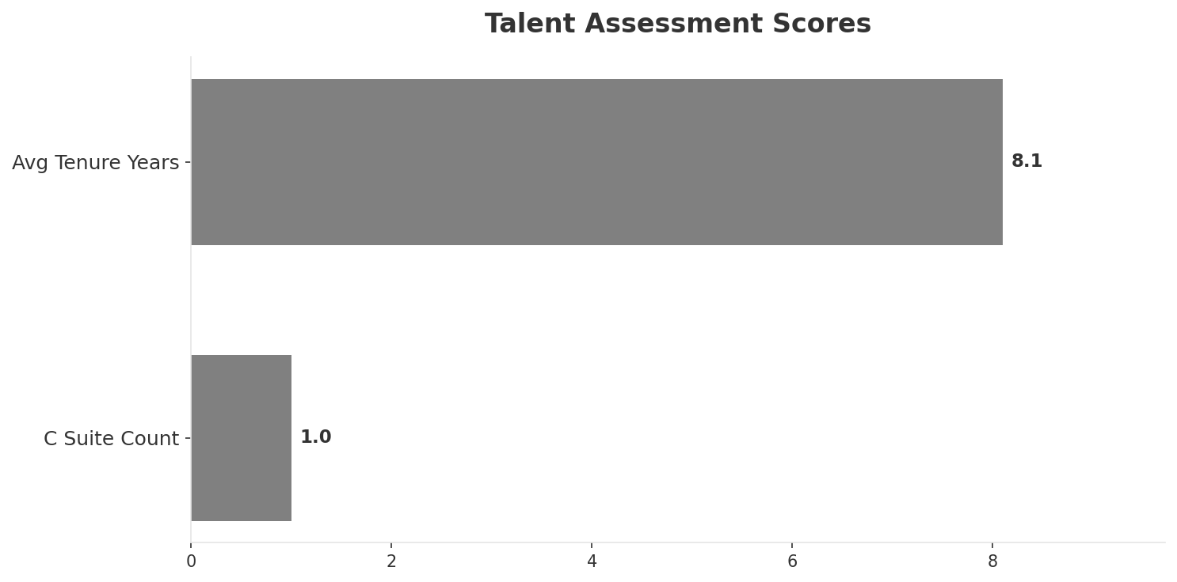
Organization & Talent
PEOPLE & CULTURE
Employees
C Suite Count
Avg Tenure Years
Key Leaders
3,500
1
8.1
['Benedetto Levi (CEO, Iliad Italia)']
Organization Culture:
Stable leadership team (avg tenure >3 years); Growth-oriented strategic posture; High-investment posture; Disruptive challenger DNA from Iliad Group. Engineering-first. Lean and agile. Innovation-focused. Startup culture at growing scale.
Leadership Changes:
• Benedetto Levi: (
Key Message: Organization and talent assessment
36

Slide 37
Strengths, Weaknesses & Exposure Points
SELF ASSESSMENT
Strengths
Weaknesses
Exposure Points
• Customer Service: score 75 (market avg 70
• Digital Experience: score 88 (market avg 76
• Innovation: score 85 (market avg 72
• Price Competitiveness: score 95 (market avg 72
• Strong EBITDA margin at 33.2%
• Revenue on growth trajectory
• Distribution: score 65 (market avg 79
• Enterprise Solutions: score 25 (market avg 61
• Network Coverage: score 75 (market avg 85
• Network Quality: score 72 (market avg 81
• Ranked #4 in revenue among competitors
• 5G coverage gap at only 40.0%
• Still building own network; relies on WindTre roaming for coverage: Network quality perception gap vs established operators
• Fixed broadband heavily dependent on wholesale fiber access: Limited control over fixed broadband quality and pricing
• Low ARPU model in market with already depressed pricing: Revenue per user among lowest in Europe
Key Message: Ranked #4 of 4 operators in market; revenue EUR 325.0M; EBITDA margin 33.2%; stable but facing challenges; key strength: Customer Service; key challenge: Distribution; Management outlook: FY2024: Revenue EUR 1,145M (+8%), EBITDAaL EUR 308M (+24.5%, margin 26.9%). Leader in net adds 7 consecutive years. 11.64M mobile subs. Mobile-first, expanding into fixed.
37

Slide 38
SWOT Synthesis
Strengths, Weaknesses, Opportunities & Threats

Slide 39
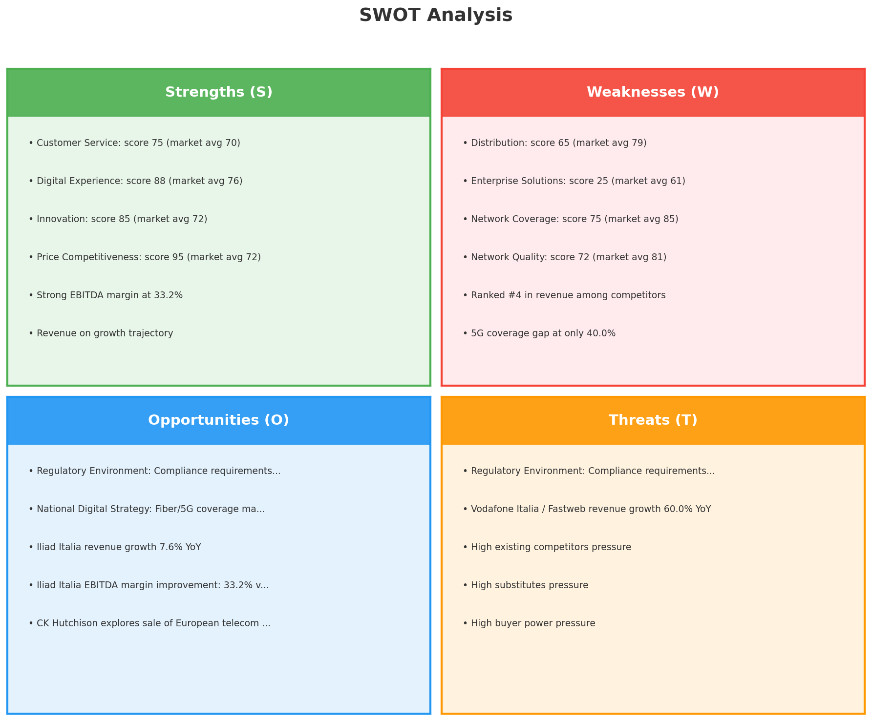
SWOT Analysis
STRATEGIC SYNTHESIS
SO:
Leverage 'Customer Service: score 75 (market avg 70)' to ...
WO:
Address weakness 'Distribution: score 65 (market avg 79)'...
ST:
Use strength 'Customer Service: score 75 (market avg 70)'...
WT:
Mitigate weakness 'Distribution: score 65 (market avg 79)...
Key Message: SWOT analysis identifies 6 strengths, 9 weaknesses, 5 opportunities, and 5 threats. The recommended strategic posture is cautious (WT-dominant).
39

Slide 40
05 Look at Opportunities
SPAN Matrix — Opportunity Selection

Slide 41
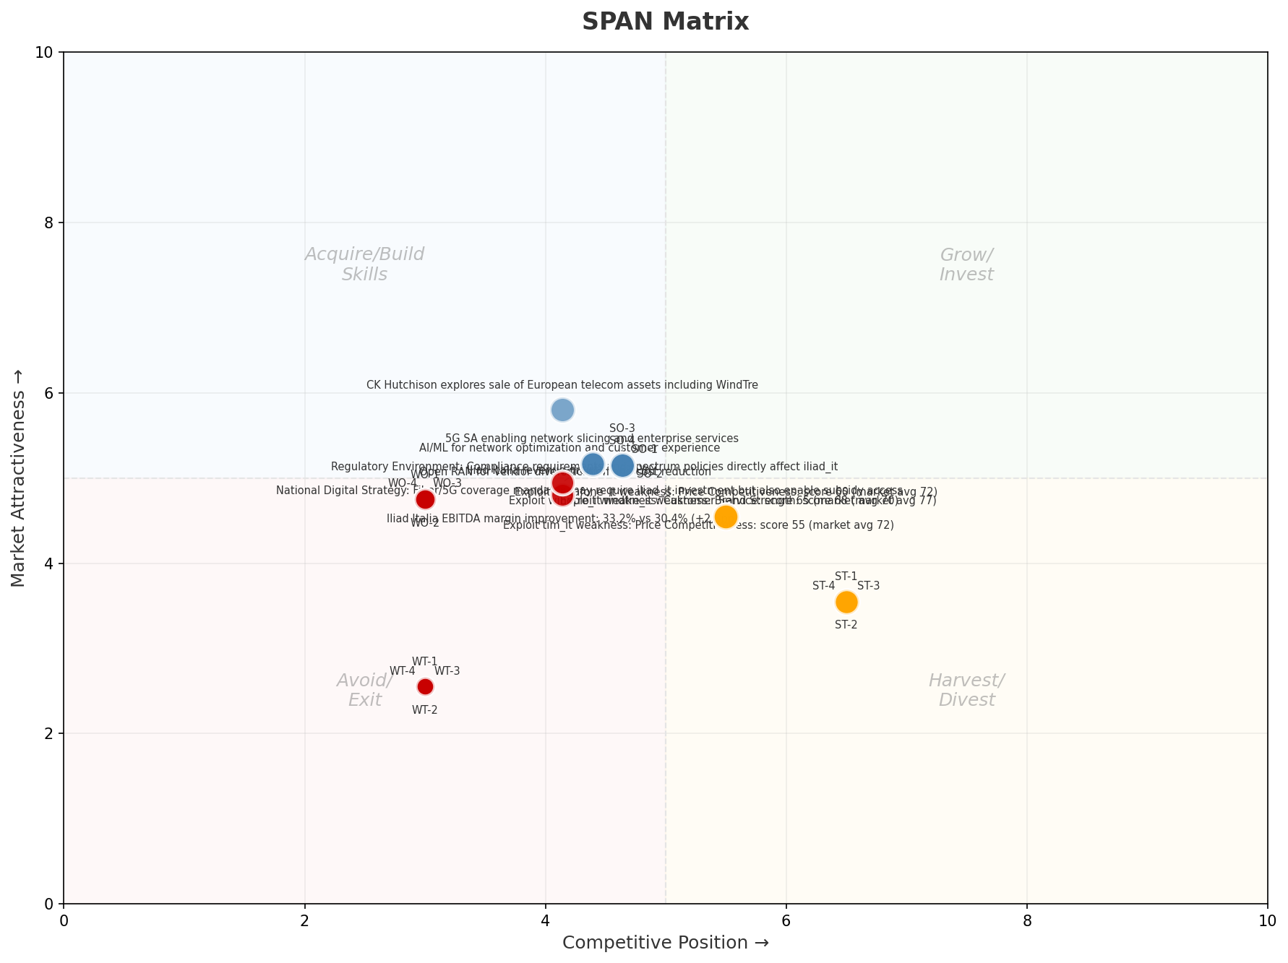
SPAN Matrix — Opportunity Positioning
OPPORTUNITY MAP
Key Message: SPAN matrix positions 28 opportunities: 0 grow/invest, 8 acquire skills, 8 harvest, 12 avoid/exit. Focus resources on the 0 grow/invest items for maximum strategic impact.
41

Slide 42
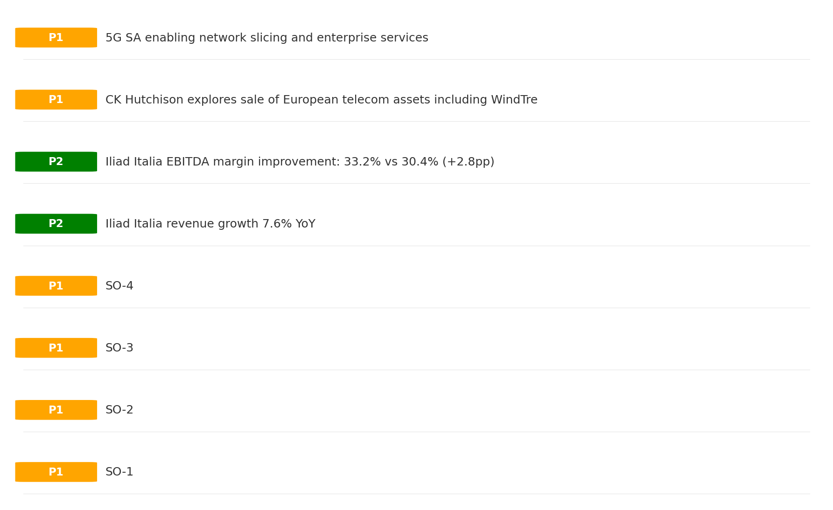
Opportunity Priority Ranking
PRIORITIES
Key Message: SPAN matrix positions 28 opportunities: 0 grow/invest, 8 acquire skills, 8 harvest, 12 avoid/exit. Focus resources on the 0 grow/invest items for maximum strategic impact.
42

Slide 43
Opportunity Details
DEEP DIVE
P1
SO-1
Market: N/A | Window:
Leverage 'Customer Service: score 75 (market avg 70)' to capture the opportunity of 'Regulatory Environment: Compliance requirements and spectrum policies directly affect iliad_it'.
P1
SO-2
Market: N/A | Window:
Leverage 'Digital Experience: score 88 (market avg 76)' to capture the opportunity of 'National Digital Strategy: Fiber/5G coverage mandates may require iliad_it investment but also enable subsidy access'.
P1
SO-3
Market: N/A | Window:
Leverage 'Innovation: score 85 (market avg 72)' to capture the opportunity of 'Iliad Italia revenue growth 7.6% YoY'.
P1
SO-4
Market: N/A | Window:
Leverage 'Price Competitiveness: score 95 (market avg 72)' to capture the opportunity of 'Iliad Italia EBITDA margin improvement: 33.2% vs 30.4% (+2.8pp)'.
Key Message: SPAN matrix positions 28 opportunities: 0 grow/invest, 8 acquire skills, 8 harvest, 12 avoid/exit. Focus resources on the 0 grow/invest items for maximum strategic impact.
43

Slide 44
Three Decisions
Strategy — Key Tasks — Execution

Slide 45
Decision 1: Define Strategy
TURNAROUND
As The Squeezed Middle: stabilize core business, then selectively invest for turnaround
P0
P0
P1
P1
Growth Strategy
Competitive Strategy
Transformation Strategy
Customer Strategy
Focused growth in high-momentum segments: Mobile, Fixed Broadband, B2B
Shore up competitive position — address: Distribution: score 65 (market avg 79
Accelerate fiber transition — converged network as competitive moat
Optimize value extraction in stable segments: TV/Convergence, Wholesale
- Grow Mobile, Fixed Broadband, B2B above market rate
- Improve segment profitability
- Close Distribution: score 65 (market avg 79) gap within 12 months
- Reduce customer churn
- Fiber homepass coverage +20%
- FMC bundle attach rate 50%+
- Upsell rate +10% in TV/Convergence, Wholesale
- Cross-sell convergence bundles
Key Message: As The Squeezed Middle, the strategic posture is Turnaround. As The Squeezed Middle: stabilize core business, then selec
45

Slide 46
Decision 2: Define Key Tasks
3 P0 (IMMEDIATE), 2 P1 (1-2 YEARS), 1 P2 (3-5 YEARS
P0
Network
Accelerate Fixed Network Upgrade
Homepass coverage +15% | Speed tier upgrades
Drive DOCSIS/Fiber rollout to increase homepass and improve quality scores
P0
Business
Accelerate Mobile Growth
Mobile revenue +10% YoY | Market share gain
Mobile at €288M showing strong momentum — invest to scale
P0
Business
Accelerate Fixed Broadband Growth
Fixed Broadband revenue +10% YoY | Market share gain
Fixed Broadband at €25M showing strong momentum — invest to scale
P1
Network
5G Coverage Expansion
5G pop coverage target | 5G attach rate
Expand 5G population coverage to strengthen mobile competitive position
P1
Customer
Customer Experience Enhancement
NPS +5 points | First-call resolution rate 80%+
Improve digital touchpoints and service resolution to boost NPS
P2
Efficiency
Operational Efficiency & Automation
Process automation 30%+ | Cost-to-serve reduction
EBITDA margin 33.2% — maintain through smart automation and resource reallocatio
Key Message: 6 critical tasks: 3 P0 (immediate), 2 P1 (1-2 years), 1 P2 (3-5 years
46

Slide 47

Decision 3: Define Execution
QUARTERLY ROADMAP & GOVERNANCE
Governance
Strategic Traps to Avoid
- Monthly Progress Review (Monthly
x Enter a price war
- Quarterly Strategic Checkpoint (Quarterly
x Attempt premium repositioning
- Mid-Year Strategic Adjustment (Semi-annual
x Delay core transformation
Key Risks & Mitigation
! Resource constraints delay P0 initiatives -- Ring-fence P0 budgets; establish escalation path for blockers
Key Message: Execute with discipline: monthly reviews, quarterly checkpoints, annual refresh
! Macro-economic slowdown reduces consumer spending -- Prepare value-tier offerings; shift mix toward B2B resilience
47

Slide 48
Analysis Summary
KEY TAKEAWAYS
01 Trends
Macro environment: Mixed. Key opportunities: Regulatory Environment, National Digital Strategy. Key risks: Regulatory Environment, Fiber Broadband Penetration Industry is mature. (-0.7% YoY (CQ2_2025 -> CQ4_2025)
02 Market
Italy telecom market totals EUR 5,755M in quarterly revenue; competitive strengths in Social/Brand; gaps in Assurances; Market outlook is favorable with more opportunities than threats.
03 Competition
In a 4-player market with medium competition intensity, TIM (Telecom Italia) leads with 43% revenue share. Target operator holds 6% share. Strongest competitive force: Existing Competitors.
04 Self
Ranked #4 of 4 operators in market; revenue EUR 325.0M; EBITDA margin 33.2%; stable but facing challenges; key strength: Customer Service; key challenge: Distribution; Management outlook: FY2024: Revenue EUR 1,145M (+8%), EBITDAaL EUR 308M (+24.5%, margin 26.9%). Leader in net adds 7 consecutive years. 11.64M mobile subs. Mobile-first, expanding into fixed.
SWOT
SWOT analysis identifies 6 strengths, 9 weaknesses, 5 opportunities, and 5 threats. The recommended strategic posture is cautious (WT-dominant).
05 Opportunities
SPAN matrix positions 28 opportunities: 0 grow/invest, 8 acquire skills, 8 harvest, 12 avoid/exit. Focus resources on the 0 grow/invest items for maximum strategic impact.
Key Message: Complete Five Looks analysis — see opportunity priorities for next steps
48

Slide 49
Data Provenance
SOURCES & METHODOLOGY
No provenance data recorded for this analysis
Key Message: All data points are traceable to original sources
49

Slide 50
Thank You
BLM Five Looks Strategic Analysis

