Slide 1
Default BLM Strategic Analysis
BLM (Business Leadership Model) Five Looks Analysis
Target Operator
Market
Analysis Period
Report Date
Odido Nl
Netherlands
CQ4_2025
2026-02-14
01 Trends (PEST) | 02 Market/Customer ($APPEALS) | 03 Competition (Porter) | 04 Self (BMC) | SWOT Synthesis | 05 Opportunities (SPAN

Slide 2
Report Contents
TABLE OF CONTENTS
01
Executive Summary
Key findings and recommendations
02
Look at Trends
PEST Framework — macro environment
03
Look at Market
$APPEALS — market changes & customer needs
T
Tariff Analysis
Pricing comparison — mobile, fixed & convergence
04
Look at Competition
Porter's Five Forces — competitive landscape
05
Look at Self
BMC + Capability — internal assessment
06
SWOT Synthesis
Strengths, Weaknesses, Opportunities, Threats
07
Look at Opportunities
SPAN Matrix — opportunity selection
Summary & Provenance
2
08
Conclusions and data sources

Slide 3
Data Quality Overview
DATA QUALITY
Total Data Points
High Confidence
Medium Confidence
Low/Estimated
20
0
0
20
0%
Unique Sources: 0
Data Conflicts: 0
Coverage: Partial
Key Message: 20 data points tracked, 0 high-confidence (0%
3

Slide 4
Executive Summary
Trends
Macro environment: Mixed. Key opportunities: Regulatory Environment, National Digital Strategy. Key risks: Regulatory Environment, Fiber Broadband Penetration Industry is mature. (+1.3% YoY (CQ2_2025 -> CQ4_2025)
Market/Customer
Netherlands telecom market totals EUR 3,055M in quarterly revenue; competitive strengths in Availability, Performance; gaps in Assurances; Market presents a balanced mix of opportunities and challenges.
Competition
In a 3-player market with medium competition intensity, KPN leads with 48% revenue share. Target operator holds 20% share. Strongest competitive force: Existing Competitors.
Self Assessment
Ranked #3 of 3 operators in market; revenue EUR 605.0M; EBITDA margin 39.7%; stable but facing challenges; key strength: Digital Experience; key challenge: Brand Strength; Management outlook: FY2024 revenue EUR 2.3B (+1.6%), EBITDA EUR 881M (+2.9%, margin 38.1%). Mobile service revenue growing above market rate driven by 5G upsell and postpaid migration.
SWOT
SWOT analysis identifies 7 strengths, 6 weaknesses, 3 opportunities, and 5 threats. The recommended strategic posture is defensive (ST-dominant).
Opportunities
SPAN matrix positions 23 opportunities: 9 grow/invest, 6 acquire skills, 4 harvest, 4 avoid/exit. Focus resources on the 9 grow/invest items for maximum strategic impact.
Key Message: Five Looks analysis completed — see details in following sections
4

Slide 5
01 Look at Trends
PEST Framework — Macro Environment

Slide 6
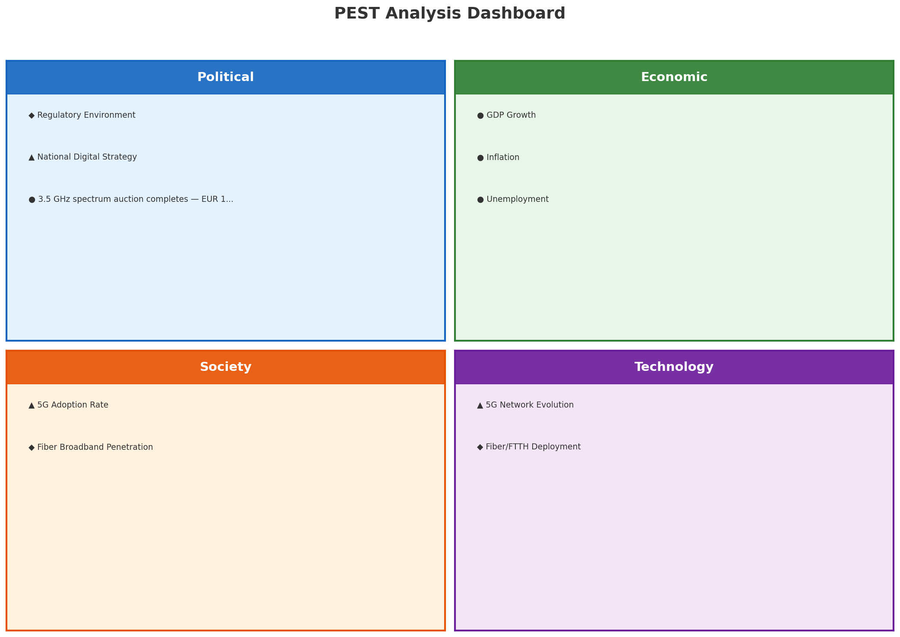
PEST Analysis Dashboard
MACRO ENVIRONMENT
Key Message: Macro environment: Mixed. Key opportunities: Regulatory Environment, National Digital Strategy. Key risks: Regulatory Environment, Fiber Broadband Penetration.
6

Slide 7
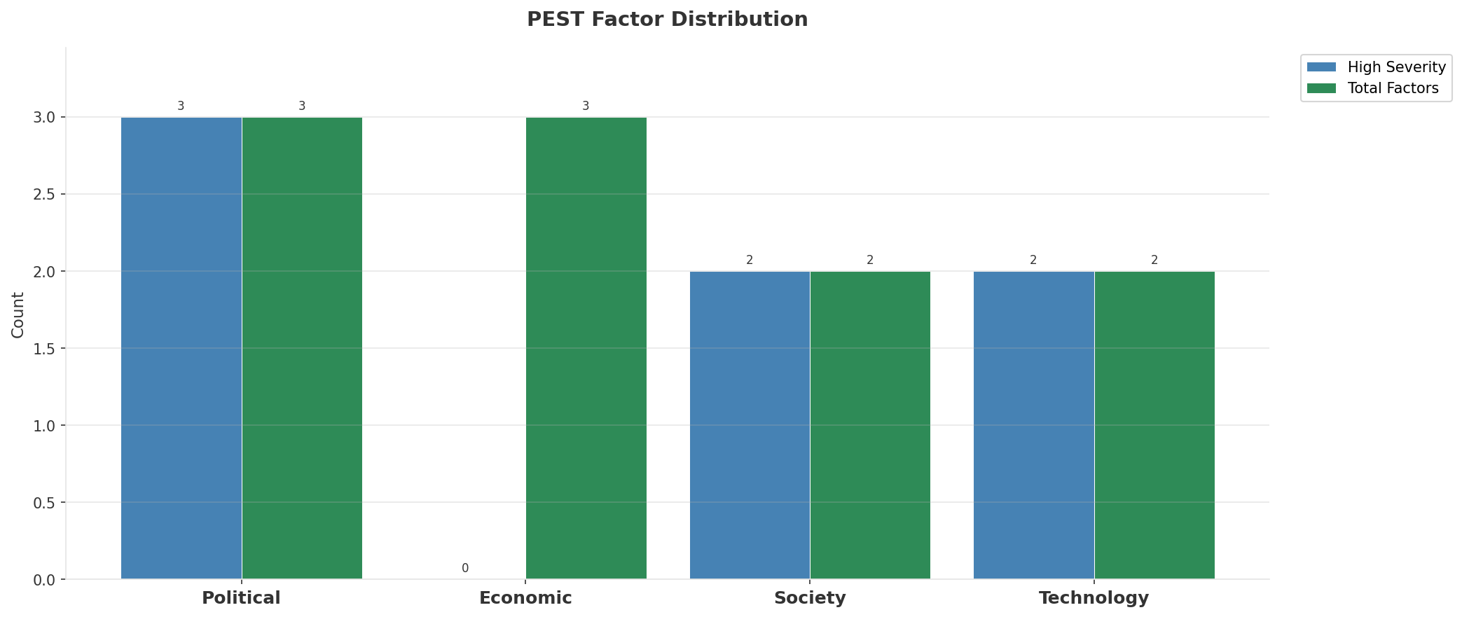
Industry Environment
INDUSTRY ANALYSIS
Market Size
Growth Rate
Concentration
Lifecycle
EUR 3.1B (quarterly, CQ4_2025
+1.3% YoY (CQ2_2025 -> CQ4_2025
CR4 = 100% (KPN: 48.0%, VodafoneZiggo: 32.2%, Odido: 19.8%
mature
• New Business Models:
• FWA (Fixed Wireless Access) as fiber alternative
• Network-as-a-Service for enterprise verticals
• Wholesale/MVNO partnerships for coverage monetization
• Technology Revolution:
• 5G SA enabling network slicing and enterprise services
• AI/ML for network optimization and customer experience
• Open RAN for vendor diversification and cost reduction
Key Message: Macro environment: Mixed. Key opportunities: Regulatory Environment, National Digital Strategy. Key risks: Regulatory Environment, Fiber Broadband Penetration Industry is mature. (+1.3% YoY (CQ2_2025 -> CQ4_2025)
7

Slide 8
Value Transfer Trends
VALUE MIGRATION
• Value shifting from voice/SMS to data and digital services
• B2B/ICT growing faster than consumer segment
• Fiber displacing copper and cable broadband
Key Message: Macro environment: Mixed. Key opportunities: Regulatory Environment, National Digital Strategy. Key risks: Regulatory Environment, Fiber Broadband Penetration Industry is mature. (+1.3% YoY (CQ2_2025 -> CQ4_2025)
8

Slide 9
02 Look at Market
$APPEALS — Market Changes & Customer Needs

Slide 10
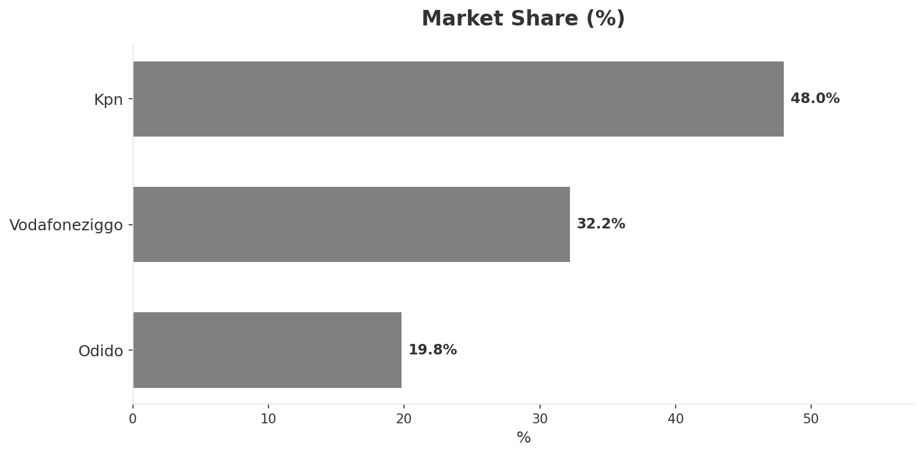
Market Change Panorama
MARKET OVERVIEW
Total Revenue (€M
Mobile Subs (K
Broadband Subs (K
Operators
3,055
17,280
7,010
3
Market Changes:
• Odido postpones EUR 1B Amsterdam IPO
• VodafoneZiggo cuts 400 jobs due to disappointing revenue
• KPN fiber homepass exceeds 5.5M — majority of NL now on fiber
Key Message: Netherlands telecom market totals EUR 3,055M in quarterly revenue; competitive strengths in Availability, Performance; gaps in Assurances; Market presents a balanced mix of opportunities and challenges.
10

Slide 11
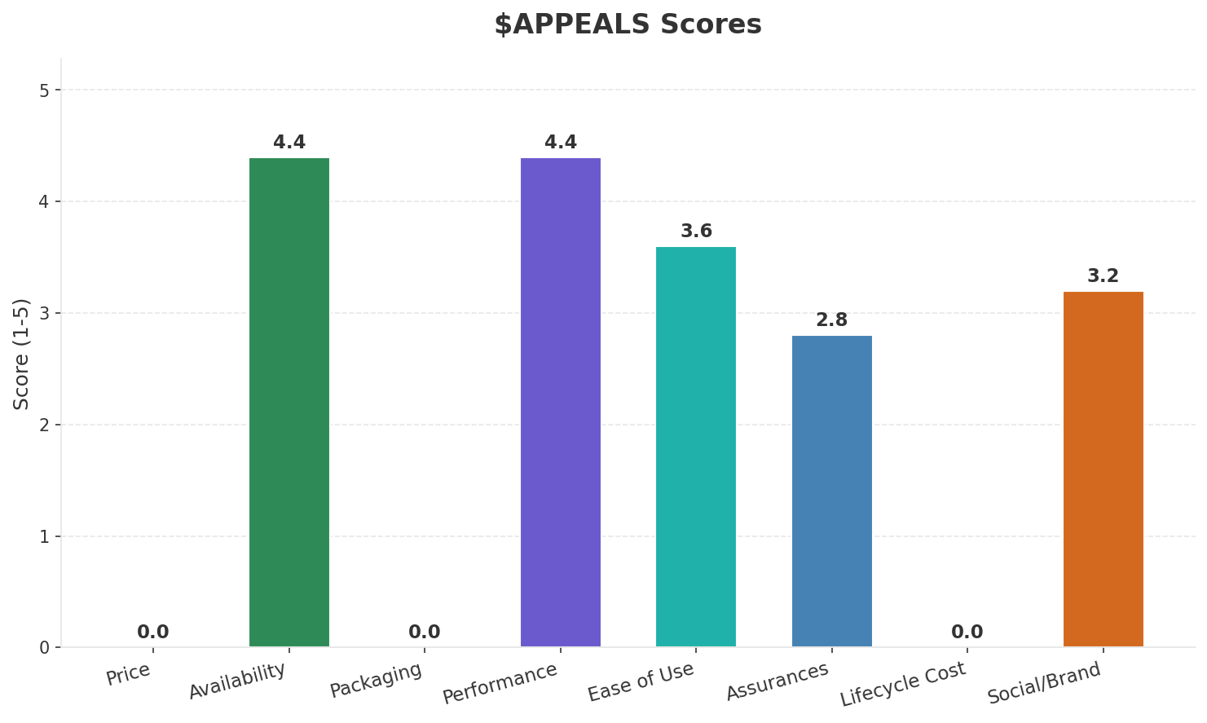
Customer Segments
SEGMENTATION
Consumer Premium
Trend: stable
Needs: Seamless converged fixed-mobile bundles, Ultra-reliable 5G standalone connectivity
Consumer Mainstream
Size: ~8.3M subscribers | Trend: stable | Our Share: ~38% of postpaid
Needs: Better value-for-money unlimited data plans, Transparent pricing without hidden costs
Consumer Price-Sensitive
Size: ~1.5M subscribers | Trend: shrinking | Our Share: ~86% of prepaid
Needs: Affordable SIM-only plans, No-frills connectivity
Enterprise & SME
Trend: stable
Needs: Private 5G network solutions, SD-WAN and cloud connectivity
Key Message: Netherlands telecom market totals EUR 3,055M in quarterly revenue; competitive strengths in Availability, Performance; gaps in Assurances; Market presents a balanced mix of opportunities and challenges.
11

Slide 12
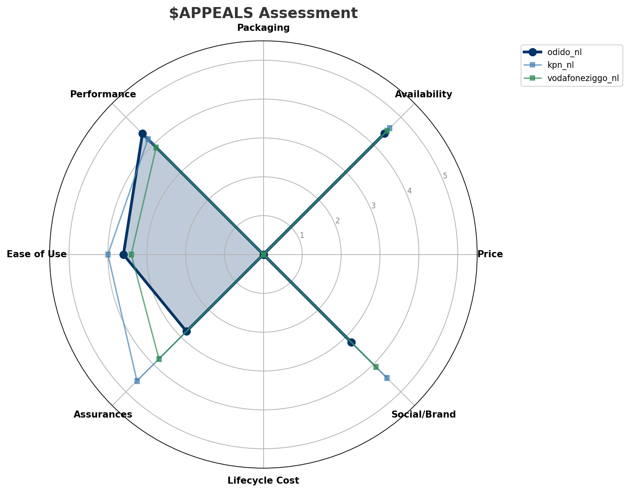
$APPEALS Assessment
CUSTOMER NEEDS
Key Message: Netherlands telecom market totals EUR 3,055M in quarterly revenue; competitive strengths in Availability, Performance; gaps in Assurances; Market presents a balanced mix of opportunities and challenges.
12

Slide 13
Customer Value Migration
VALUE MIGRATION
Limited data to assess value migration trends
Opportunities:
Threats:
• VodafoneZiggo cuts 400 jobs due to disappointing revenue
• Odido postpones EUR 1B Amsterdam IPO
• KPN fiber homepass exceeds 5.5M — majority of NL now on fiber
Key Message: Netherlands telecom market totals EUR 3,055M in quarterly revenue; competitive strengths in Availability, Performance; gaps in Assurances; Market presents a balanced mix of opportunities and challenges.
13

Slide 14
Tariff Analysis
Mobile, Fixed & Convergence Pricing Landscape

Slide 15
Fixed & Convergence Pricing Landscape
DSL / CABLE / FIBER / FMC BUNDLES
Key Message: Fixed and convergence pricing overview
15

Slide 16
03 Look at Competition
Porter's Five Forces — Competitive Landscape

Slide 17
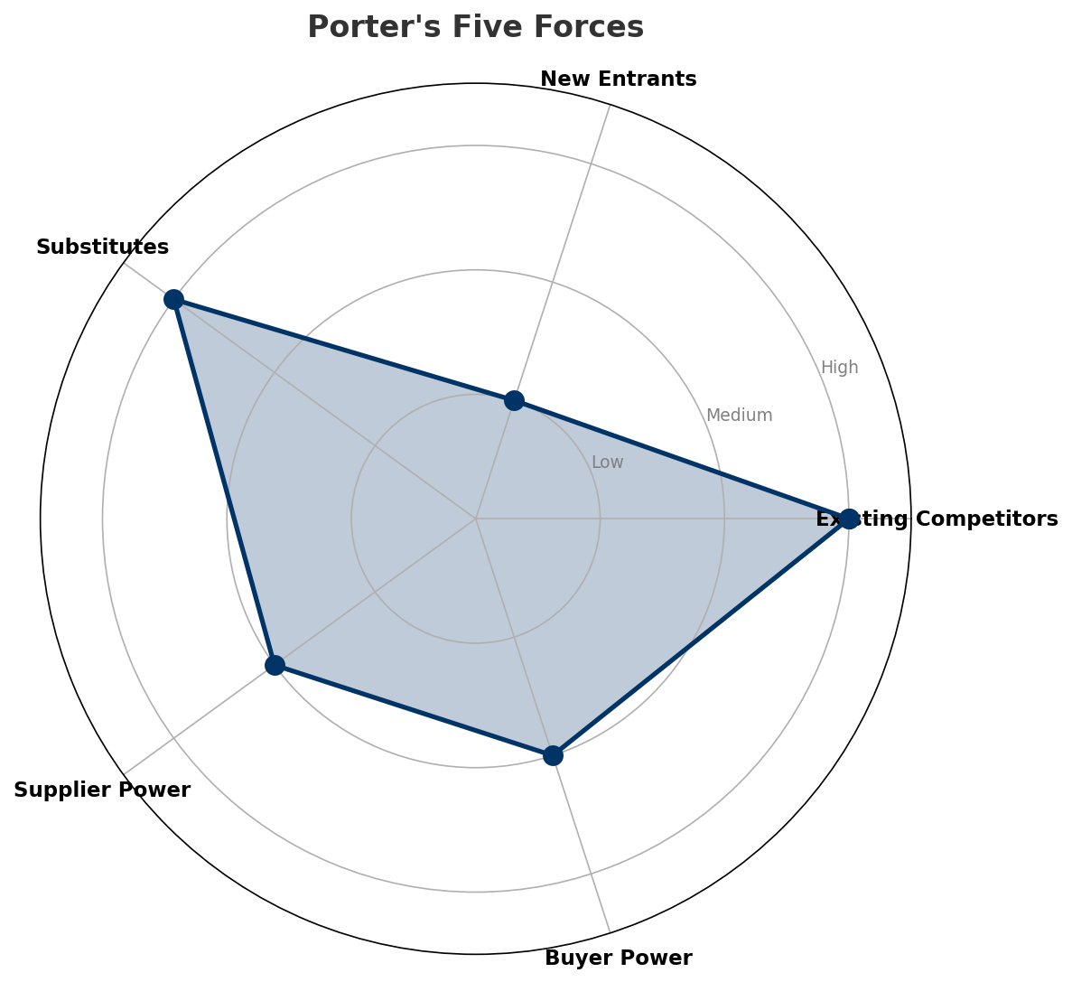
Porter's Five Forces
COMPETITIVE FORCES
Overall Intensity: MEDIUM
Key Message: In a 3-player market with medium competition intensity, KPN leads with 48% revenue share. Target operator holds 20% share. Strongest competitive force: Existing Competitors.
17

Slide 18
Competitor Analysis: Vodafoneziggo Nl
COMPETITOR DEEP DIVE
Revenue
EBITDA
Margin
Capex/Rev
€985M
€440M
44.7%
20.8%
-1.7% YoY
Strengths
Weaknesses
• Customer Service: score 68 (market avg 73
• Digital Experience: score 72 (market avg 78
• Innovation: score 70 (market avg 77
• Network Quality: score 78 (market avg 84
Strategy: Defensive cost restructuring; subscriber acquisition focus
Key Message: Competitor analysis: Vodafoneziggo Nl
18

Slide 19
Competitor Analysis: Kpn Nl
COMPETITOR DEEP DIVE
Revenue
EBITDA
Margin
Capex/Rev
€1,465M
€666M
45.4%
20.8%
+3.0% YoY
Strengths
Weaknesses
• Brand Strength: score 90 (market avg 79
• Customer Service: score 80 (market avg 73
• Distribution: score 88 (market avg 82
• Enterprise Solutions: score 92 (market avg 74
• Price Competitiveness: score 62 (market avg 71
Strategy: Revenue-led profitable growth; subscriber acquisition focus; strong B2B/enterprise push
Key Message: Competitor analysis: Kpn Nl
19

Slide 20
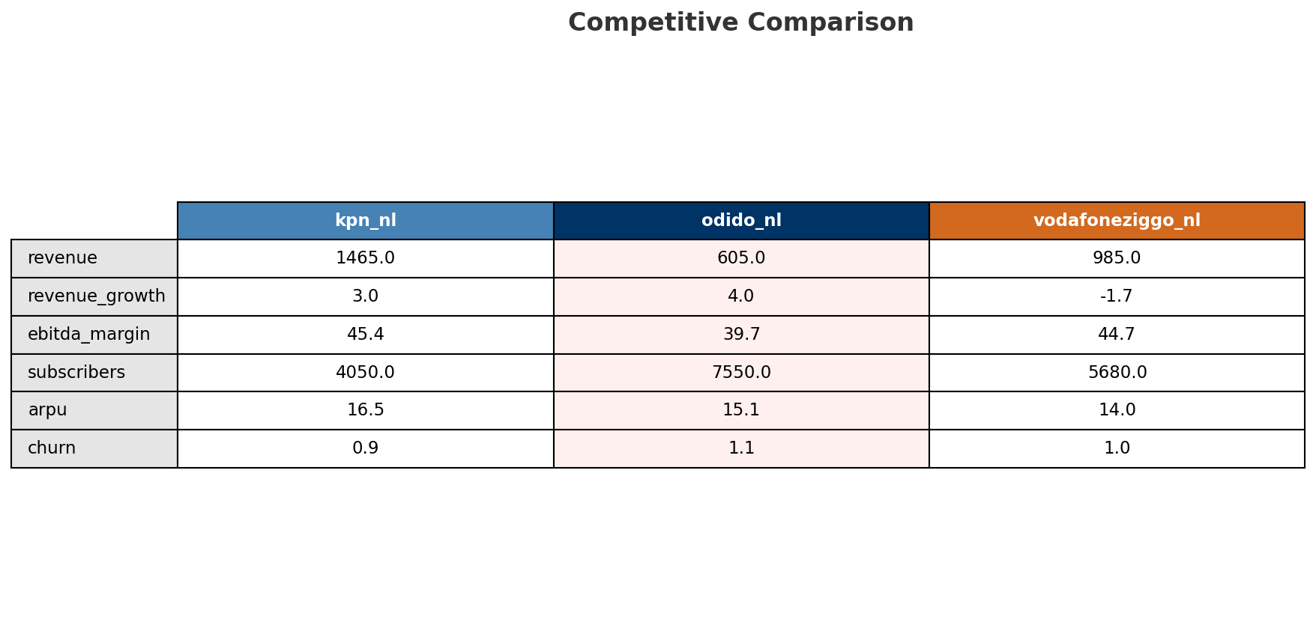
Competitive Landscape Summary
COMPETITION
Key Message: In a 3-player market with medium competition intensity, KPN leads with 48% revenue share. Target operator holds 20% share. Strongest competitive force: Existing Competitors.
20

Slide 21
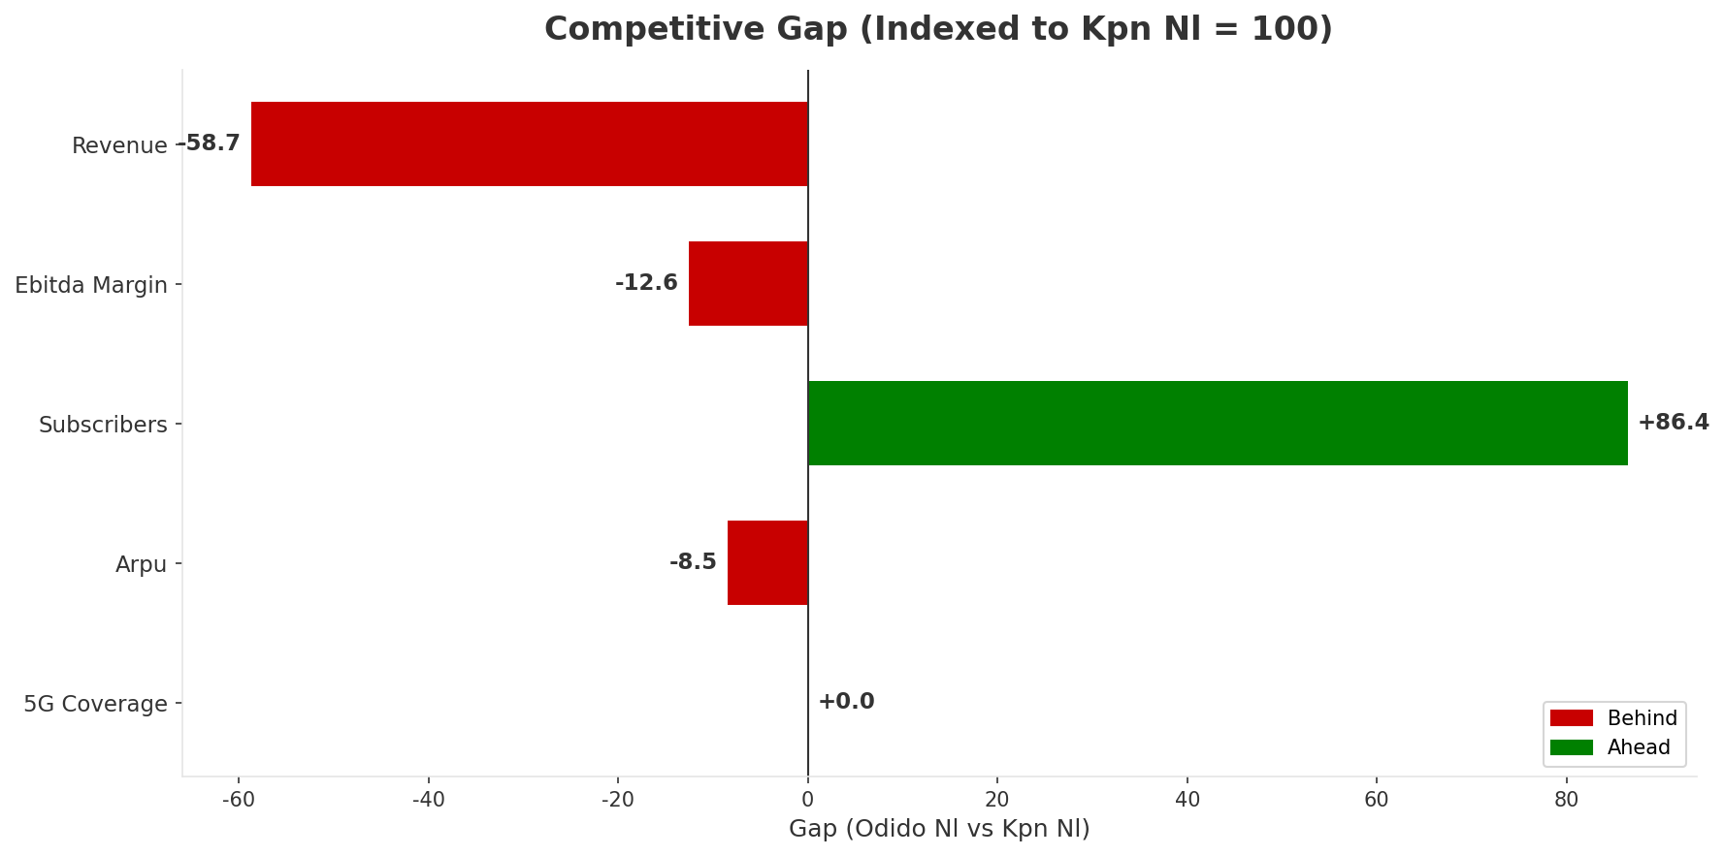
Gap Analysis: Odido Nl vs Kpn Nl
COMPETITIVE GAP
Key Message: Gap analysis vs market leader Kpn Nl
21

Slide 22
New Entrants Threat
MARKET ENTRY
• Entry barriers: High barriers: spectrum licensing, massive capex for network build, regulatory approvals, established brand loyalty
Key Message: New entrants threat level: low
22

Slide 23
04 Look at Self
BMC + Capability Assessment

Slide 24
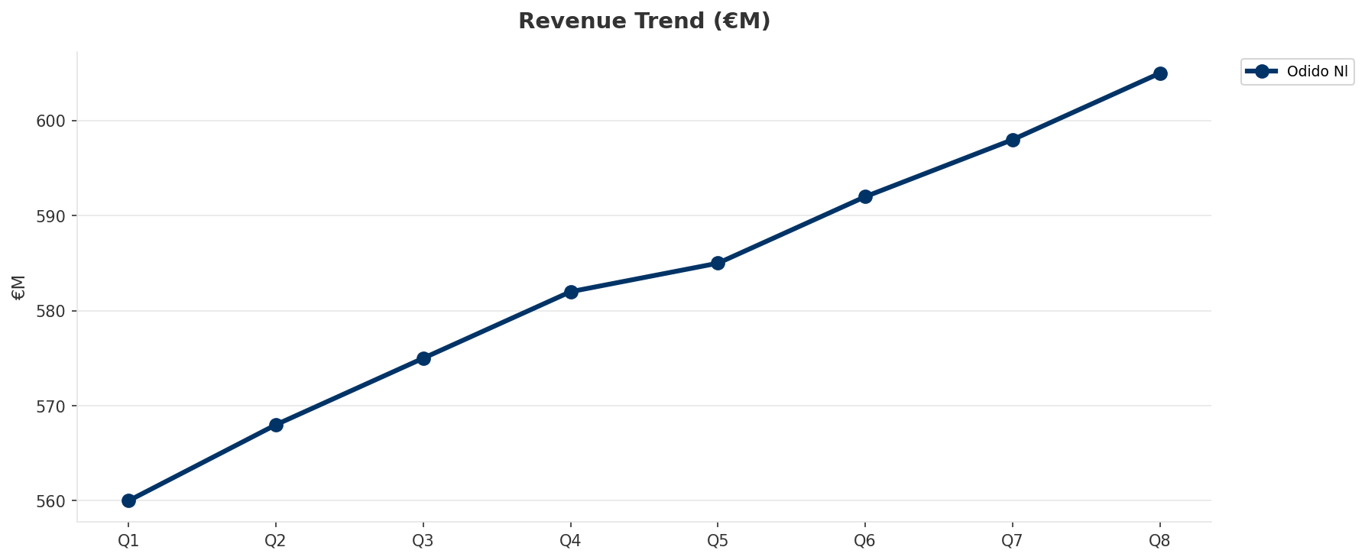
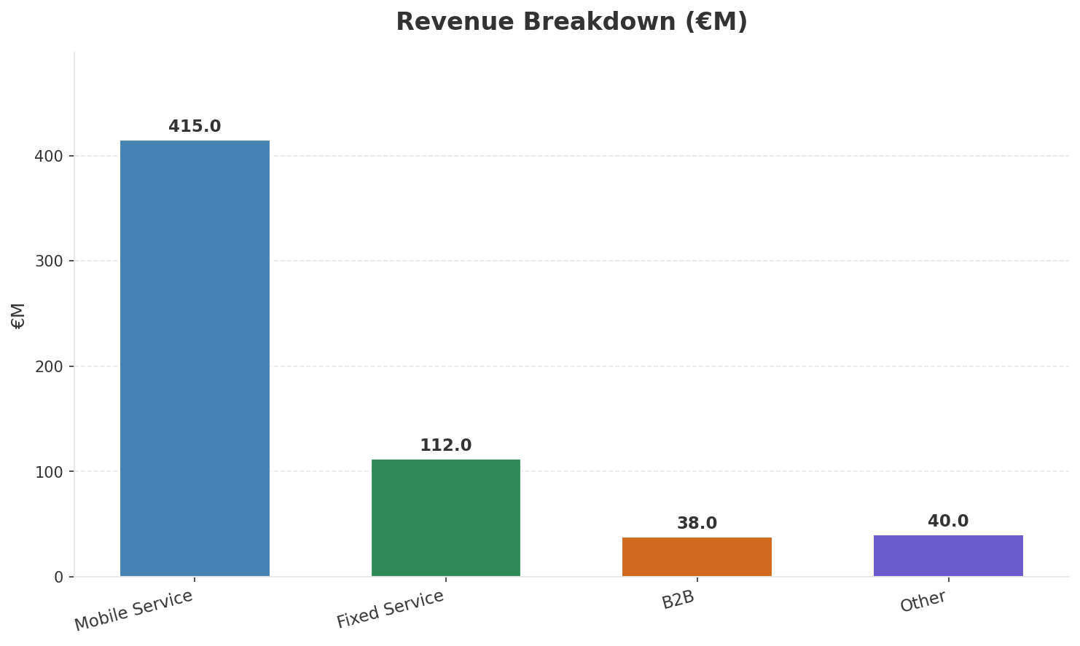
Operating Health Check
FINANCIAL HEALTH
Revenue
EBITDA
EBITDA Margin
Capex/Rev
€605M
€240M
39.7%
19.8%
+3.95% YoY
+5.3% YoY
CAGR: +4.5% | Decelerating Growth
Key Message: Ranked #3 of 3 operators in market; revenue EUR 605.0M; EBITDA margin 39.7%; stable but facing challenges; key strength: Digital Experience; key challenge: Brand Strength; Management outlook: FY2024 revenue EUR 2.3B (+1.6%), EBITDA EUR 881M (+2.9%, margin 38.1%). Mobile service revenue growing above market rate driven by 5G upsell and postpaid migration.
24

Slide 25
Market Share Evolution
REVENUE SHARE TREND
KPN
VodafoneZiggo
Odido
48.0% #1
32.2% #2
19.8% #3
+1.6pp gaining
-2.5pp losing
+0.9pp gaining
Market Concentration: HHI 3,731 (Highly Concentrated) | CR3: 100.0% | Trend: Stable
Subscriber share: Mobile: 43.7% (+1.4pp) | Broadband: 16.0% (+3.5pp
Key Message: Revenue share: 19.8% (#3); gaining (+0.9pp); market is highly concentrated (HHI 3,731).
25

Slide 26
Momentum Dashboard
MULTI-QUARTER TREND ANALYSIS
Revenue
EBITDA
Margin
+4.5% CAGR
+7.1% CAGR
+2.5% CAGR
Decelerating Growth (48/100
Decelerating Growth (49/100
Stabilizing (50/100
Key Message: Dominant momentum: Decelerating Growth — based on 3 KPI trend analyses
26

Slide 27
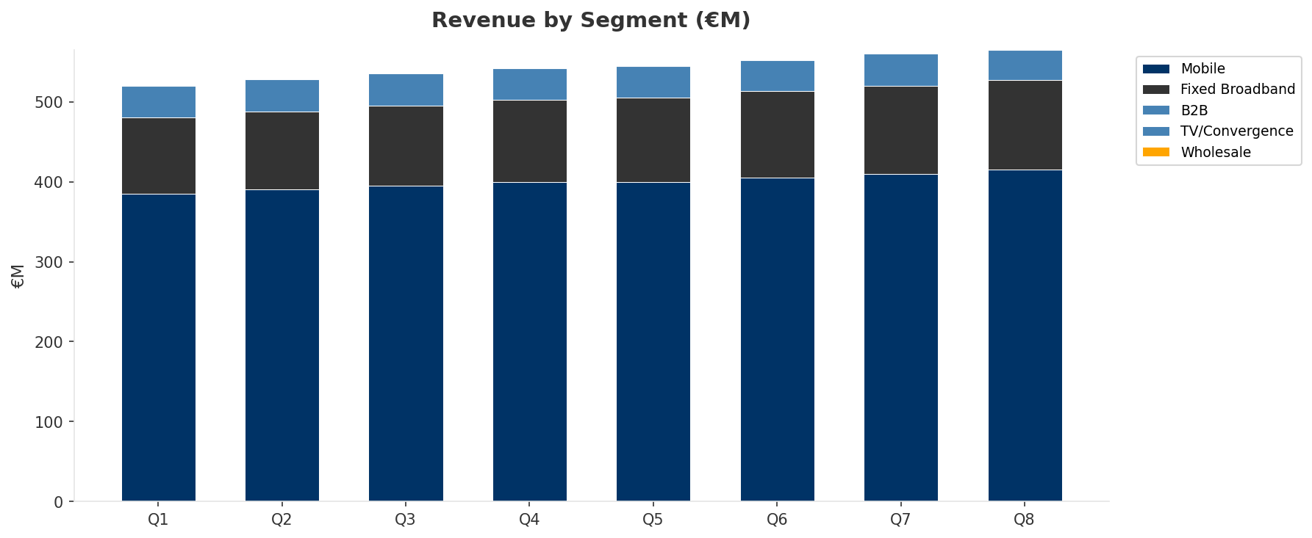
Revenue Composition Trend
SEGMENT REVENUE MIX OVER TIME
Key Message: Growing: Mobile, Fixed Broadband | Declining: B2B
27

Slide 28
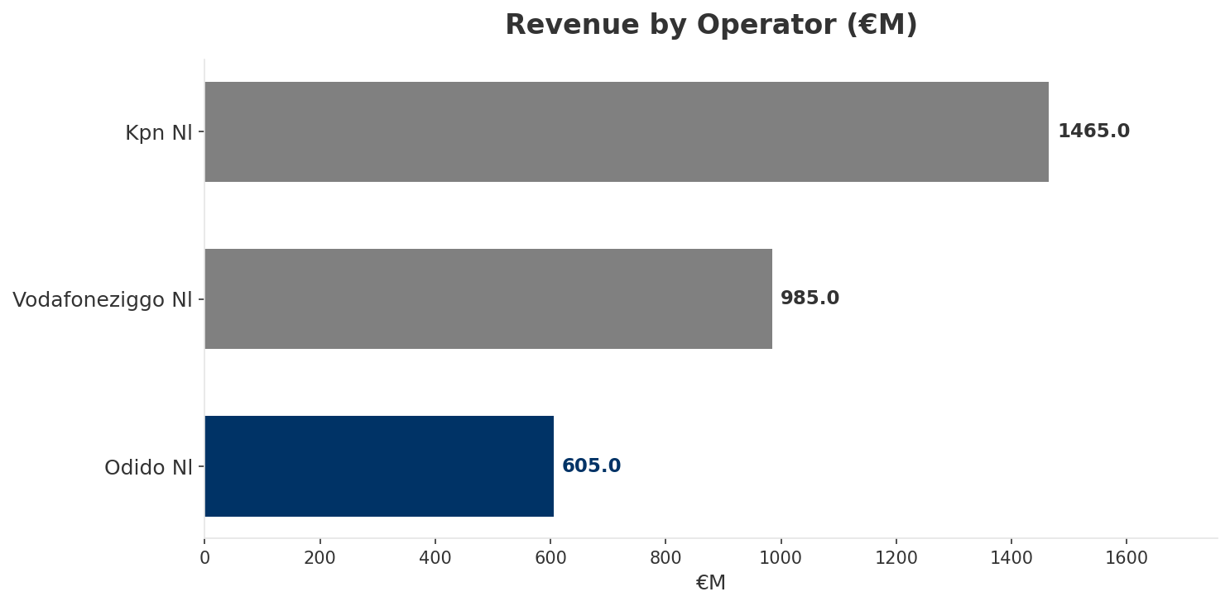
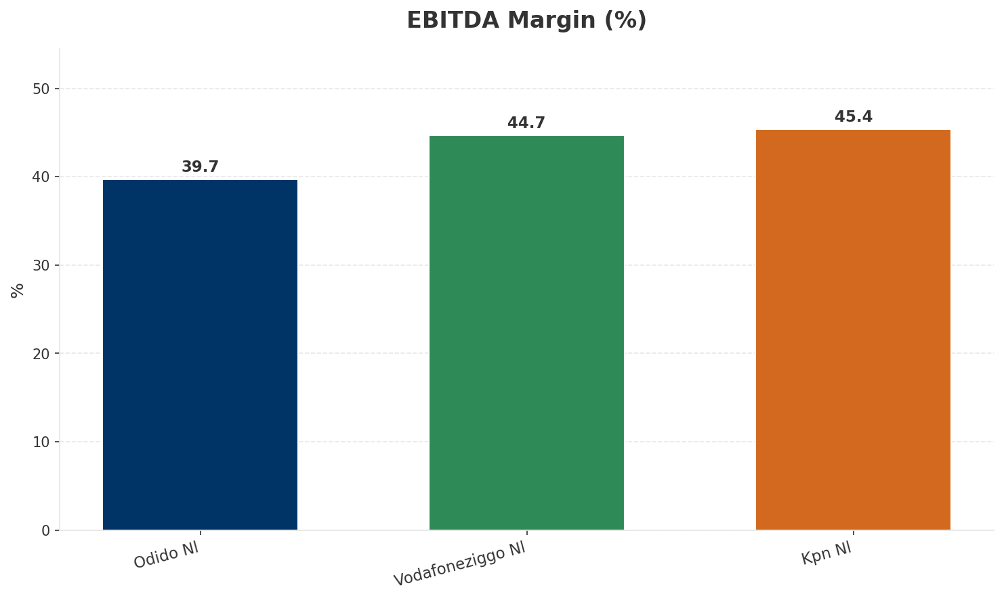
Revenue Comparison
COMPETITIVE BENCHMARKING
Key Message: Revenue and margin benchmarking across operators
28

Slide 29
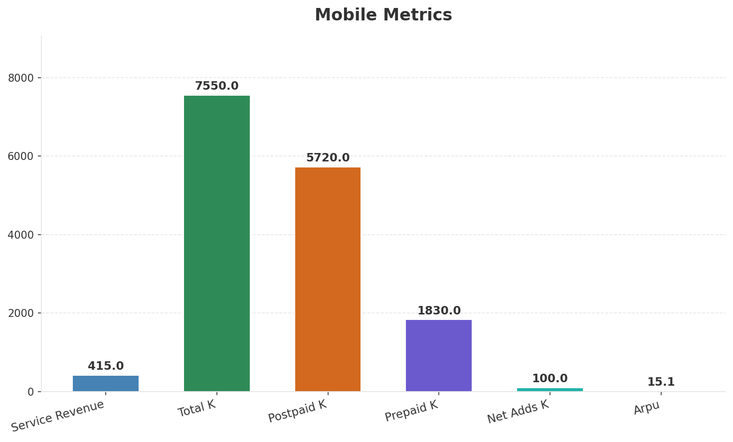
Segment Analysis: Mobile
SEGMENT PERFORMANCE
Service Revenue
Service Growth Pct
Total K
Postpaid K
€415M
3.8%
€7,550M
€5,720M
Health: STABLE
• revenue: improving
• subscribers: improving
• arpu: stable
• FY2024 revenue EUR 2.3B (+1.6%), EBITDA EUR 881M (+2.9%, margin 38.1%). Mobile service revenue growing above market rate driven by 5G upsell and postpaid migration.
• Broadband customer base crossed 1 million in Q1 2025 via FWA and wholesale fiber. Growing fixed revenue stream diversifying mobile-centric business.
Key Message: Mobile service revenue at 415.0M; up 3.8% YoY; ARPU 15.1
29

Slide 30
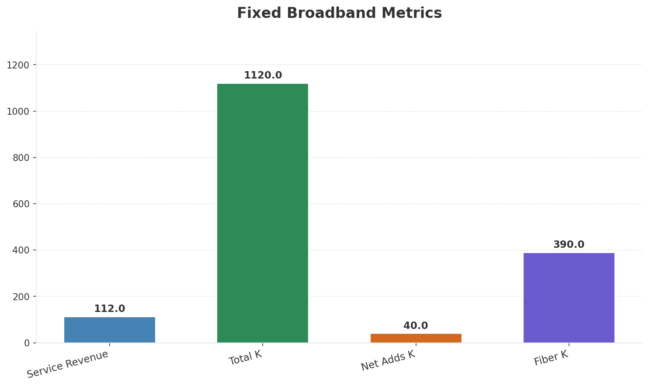
Segment Analysis: Fixed Broadband
SEGMENT PERFORMANCE
Service Revenue
Service Growth Pct
Total K
Net Adds K
€112M
9.8%
€1,120M
40
Health: STABLE
• revenue: improving
• subscribers: improving
• arpu: stable
• Broadband customer base crossed 1 million in Q1 2025 via FWA and wholesale fiber. Growing fixed revenue stream diversifying mobile-centric business.
• subscribers increased 3.7% QoQ
Key Message: Fixed service revenue 112.0M; growth +9.8% YoY; Fiber subs 390K
30

Slide 31
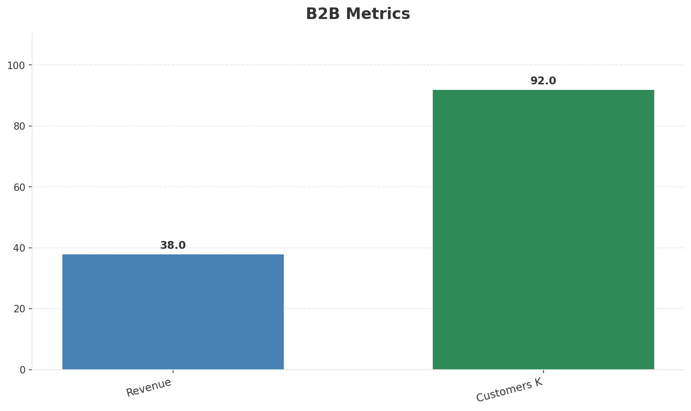
Segment Analysis: B2B
SEGMENT PERFORMANCE
Revenue
Growth Pct
Customers K
Share Of Revenue Pct
€38M
None
92
6.3%
Health: WEAKENING
• revenue: declining
• customers: improving
• Broadband customer base crossed 1 million in Q1 2025 via FWA and wholesale fiber. Growing fixed revenue stream diversifying mobile-centric business.
• revenue decreased 5.0% QoQ
Key Message: B2B revenue 38.0M; 6.3% of total revenue
31

Slide 32
Segment Analysis: TV/Convergence
SEGMENT PERFORMANCE
Revenue
Total K
Net Adds K
Fmc Total K
None
0
None
None
Health: STABLE
• revenue: stable
• subscribers: stable
• fmc_subscribers: stable
Key Message: TV subscribers 0K
32

Slide 33
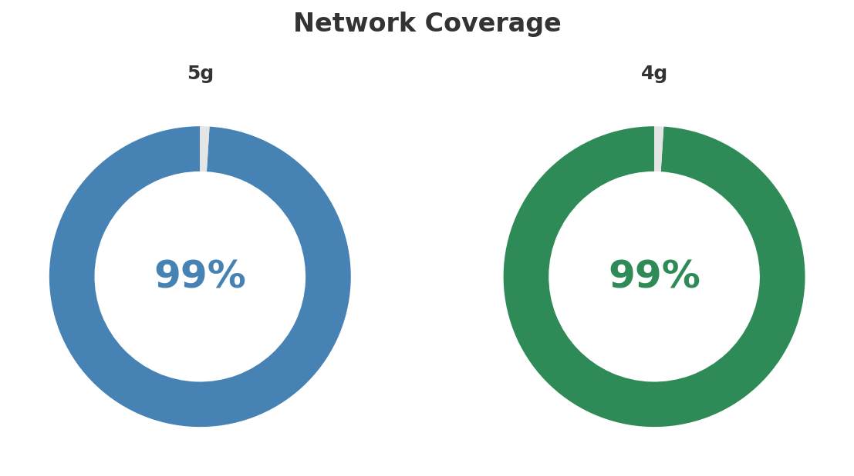
Network Analysis
INFRASTRUCTURE
Technology Mix:
Investment Direction: stable
• Mobile Vendor: Ericsson
• Spectrum Mhz: 400
• Core Vendor: Nokia
• 5G Sa Status: Deploying
Key Message: Network infrastructure and coverage assessment
33

Slide 34

Business Model Canvas
BMC
Key Message: Business model canvas overview
34

Slide 35
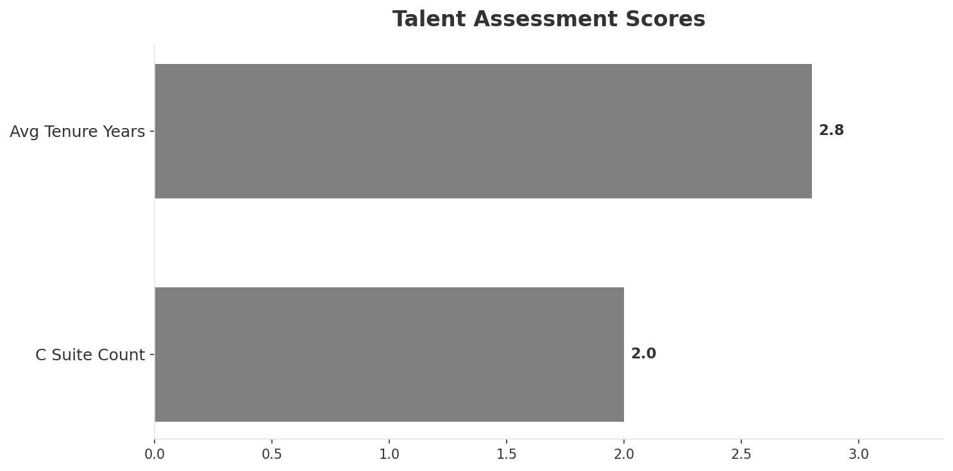
Organization & Talent
PEOPLE & CULTURE
Employees
C Suite Count
Avg Tenure Years
Key Leaders
2,200
2
2.8
['Soren Abildgaard (CEO)', 'Gero Niemeyer (CFO)']
Organization Culture:
Entrepreneurial post-rebrand culture; digital-first and agile; PE-backed focus on performance and profitability.
Leadership Changes:
• Soren Abildgaard: (
• Gero Niemeyer: (
Key Message: Organization and talent assessment
35

Slide 36
Strengths, Weaknesses & Exposure Points
SELF ASSESSMENT
Strengths
Weaknesses
Exposure Points
• Digital Experience: score 85 (market avg 78
• Innovation: score 82 (market avg 77
• Network Quality: score 88 (market avg 84
• Price Competitiveness: score 78 (market avg 71
• Strong EBITDA margin at 39.7%
• Revenue on growth trajectory
• Brand Strength: score 65 (market avg 79
• Distribution: score 72 (market avg 82
• Enterprise Solutions: score 55 (market avg 74
• Brand rebrand from established T-Mobile to new Odido brand: Customer confusion and potential churn during brand transition
• No owned fixed broadband infrastructure: Cannot offer true converged bundles without wholesale access
• Ownership transition from Deutsche Telekom to PE consortium: Potential underinvestment risk under PE ownership model
Key Message: Ranked #3 of 3 operators in market; revenue EUR 605.0M; EBITDA margin 39.7%; stable but facing challenges; key strength: Digital Experience; key challenge: Brand Strength; Management outlook: FY2024 revenue EUR 2.3B (+1.6%), EBITDA EUR 881M (+2.9%, margin 38.1%). Mobile service revenue growing above market rate driven by 5G upsell and postpaid migration.
36

Slide 37
SWOT Synthesis
Strengths, Weaknesses, Opportunities & Threats

Slide 38
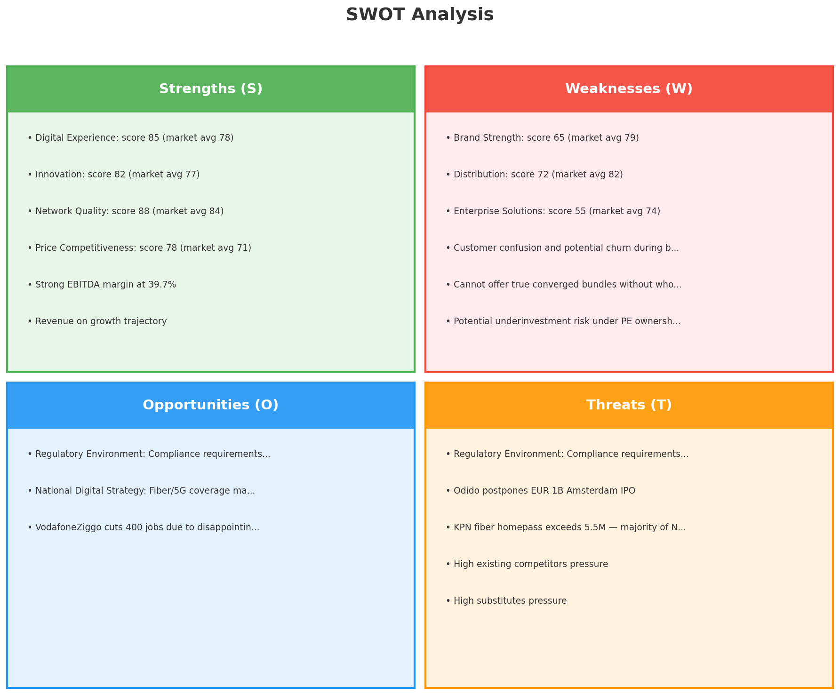
SWOT Analysis
STRATEGIC SYNTHESIS
SO:
Leverage 'Digital Experience: score 85 (market avg 78)' t...
WO:
Address weakness 'Brand Strength: score 65 (market avg 79...
ST:
Use strength 'Digital Experience: score 85 (market avg 78...
WT:
Mitigate weakness 'Brand Strength: score 65 (market avg 7...
Key Message: SWOT analysis identifies 7 strengths, 6 weaknesses, 3 opportunities, and 5 threats. The recommended strategic posture is defensive (ST-dominant).
38

Slide 39
05 Look at Opportunities
SPAN Matrix — Opportunity Selection

Slide 40
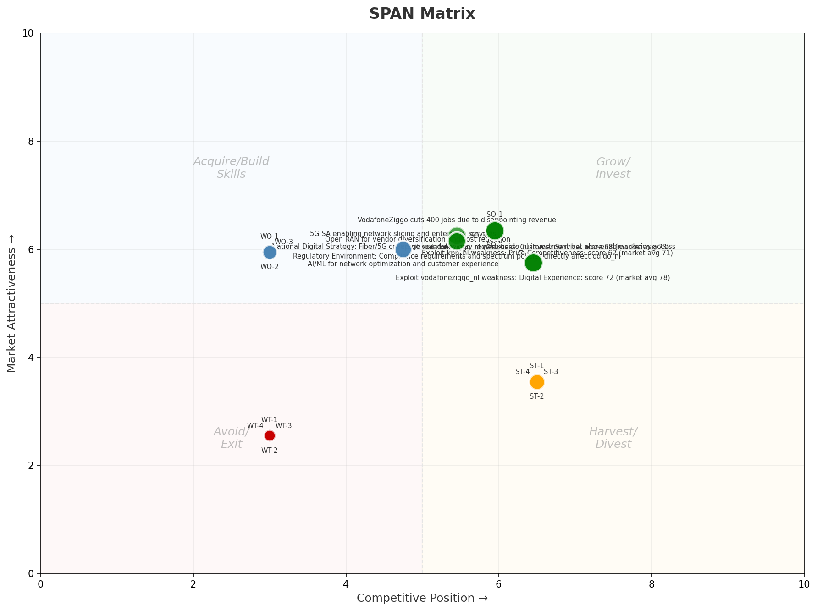
SPAN Matrix — Opportunity Positioning
OPPORTUNITY MAP
Key Message: SPAN matrix positions 23 opportunities: 9 grow/invest, 6 acquire skills, 4 harvest, 4 avoid/exit. Focus resources on the 9 grow/invest items for maximum strategic impact.
40

Slide 41
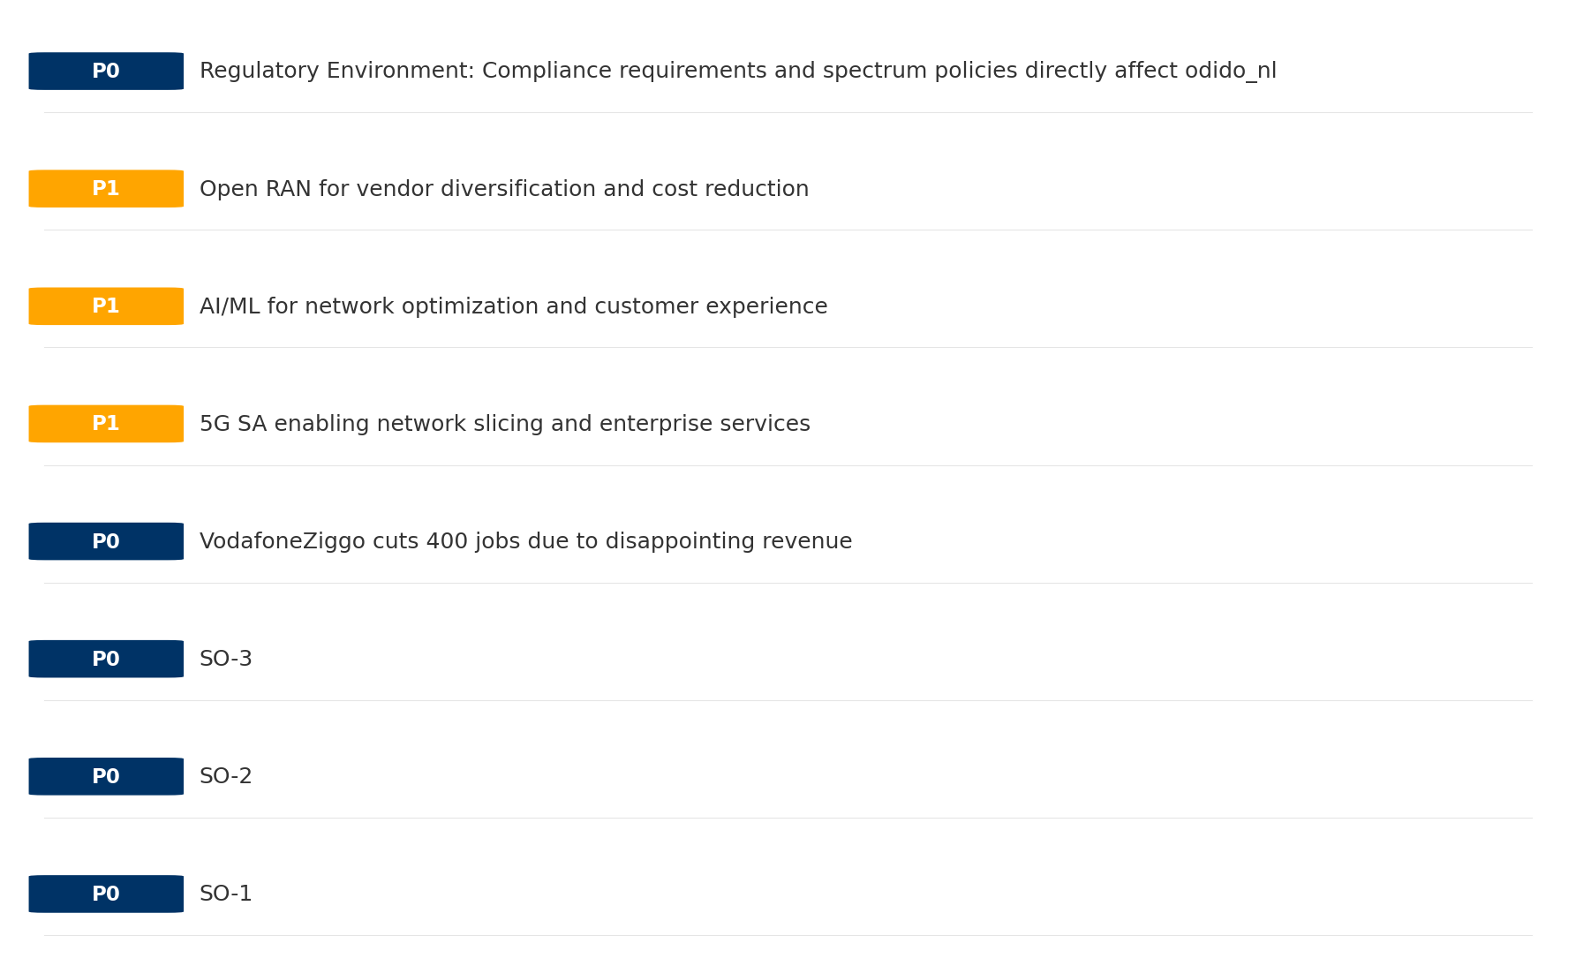
Opportunity Priority Ranking
PRIORITIES
Key Message: SPAN matrix positions 23 opportunities: 9 grow/invest, 6 acquire skills, 4 harvest, 4 avoid/exit. Focus resources on the 9 grow/invest items for maximum strategic impact.
41

Slide 42
Opportunity Details
DEEP DIVE
P0
SO-1
Market: N/A | Window:
Leverage 'Digital Experience: score 85 (market avg 78)' to capture the opportunity of 'Regulatory Environment: Compliance requirements and spectrum policies directly affect odido_nl'.
P0
SO-2
Market: N/A | Window:
Leverage 'Innovation: score 82 (market avg 77)' to capture the opportunity of 'National Digital Strategy: Fiber/5G coverage mandates may require odido_nl investment but also enable subsidy access'.
P0
SO-3
Market: N/A | Window:
Leverage 'Network Quality: score 88 (market avg 84)' to capture the opportunity of 'VodafoneZiggo cuts 400 jobs due to disappointing revenue'.
P0
VodafoneZiggo cuts 400 jobs due to disappointing revenue
Market: N/A | Window:
VodafoneZiggo cuts 400 jobs due to disappointing revenue
Key Message: SPAN matrix positions 23 opportunities: 9 grow/invest, 6 acquire skills, 4 harvest, 4 avoid/exit. Focus resources on the 9 grow/invest items for maximum strategic impact.
42

Slide 43
Three Decisions
Strategy — Key Tasks — Execution

Slide 44
Decision 1: Define Strategy
DEFENSIVE
As The Squeezed Middle: stabilize core business, then selectively invest for turnaround
P0
P0
P1
P0
Growth Strategy
Competitive Strategy
Transformation Strategy
Customer Strategy
Focused growth in high-momentum segments: Mobile, Fixed Broadband
Shore up competitive position — address: Brand Strength: score 65 (market avg 79
Accelerate fiber transition — converged network as competitive moat
Urgent customer retention in B2B — stop value erosion
- Grow Mobile, Fixed Broadband above market rate
- Improve segment profitability
- Close Brand Strength: score 65 (market avg 79) gap within 12 months
- Reduce customer churn
- Fiber homepass coverage +20%
- FMC bundle attach rate 50%+
- Reduce B2B churn by 20%
- Improve segment ARPU
Key Message: As The Squeezed Middle, the strategic posture is Defensive. As The Squeezed Middle: stabilize core business, then select
44

Slide 45
Decision 2: Define Key Tasks
4 P0 (IMMEDIATE), 3 P1 (1-2 YEARS), 1 P2 (3-5 YEARS
P0
Network
Accelerate Fixed Network Upgrade
Homepass coverage +15% | Speed tier upgrades
Drive DOCSIS/Fiber rollout to increase homepass and improve quality scores
P0
Business
Accelerate Mobile Growth
Mobile revenue +10% YoY | Market share gain
Mobile at €415M showing strong momentum — invest to scale
P0
Business
Accelerate Fixed Broadband Growth
Fixed Broadband revenue +10% YoY | Market share gain
Fixed Broadband at €112M showing strong momentum — invest to scale
P0
Customer
Customer Retention — B2B
Churn reduction 20% | Save rate improvement
Urgent: B2B showing decline — deploy retention programs
P1
Network
5G Coverage Expansion
5G pop coverage target | 5G attach rate
Expand 5G population coverage to strengthen mobile competitive position
P1
Business
Opportunity Portfolio Execution
Launch 3+ priority initiatives | Pipeline contribution tracking
9 grow/invest opportunities identified — establish execution office
P1
Customer
Customer Experience Enhancement
NPS +5 points | First-call resolution rate 80%+
Improve digital touchpoints and service resolution to boost NPS
P2
Efficiency
Operational Efficiency & Automation
Process automation 30%+ | Cost-to-serve reduction
Key Message: 8 critical tasks: 4 P0 (immediate), 3 P1 (1-2 years), 1 P2 (3-5 years
EBITDA margin 39.7% — maintain through smart automation and resource reallocatio
45

Slide 46

Decision 3: Define Execution
QUARTERLY ROADMAP & GOVERNANCE
Governance
Strategic Traps to Avoid
- Monthly Progress Review (Monthly
x Enter a price war
- Quarterly Strategic Checkpoint (Quarterly
x Attempt premium repositioning
- Mid-Year Strategic Adjustment (Semi-annual
x Delay core transformation
Key Risks & Mitigation
! Resource constraints delay P0 initiatives -- Ring-fence P0 budgets; establish escalation path for blockers
Key Message: Execute with discipline: monthly reviews, quarterly checkpoints, annual refresh
! Macro-economic slowdown reduces consumer spending -- Prepare value-tier offerings; shift mix toward B2B resilience
46

Slide 47
Analysis Summary
KEY TAKEAWAYS
01 Trends
Macro environment: Mixed. Key opportunities: Regulatory Environment, National Digital Strategy. Key risks: Regulatory Environment, Fiber Broadband Penetration Industry is mature. (+1.3% YoY (CQ2_2025 -> CQ4_2025)
02 Market
Netherlands telecom market totals EUR 3,055M in quarterly revenue; competitive strengths in Availability, Performance; gaps in Assurances; Market presents a balanced mix of opportunities and challenges.
03 Competition
In a 3-player market with medium competition intensity, KPN leads with 48% revenue share. Target operator holds 20% share. Strongest competitive force: Existing Competitors.
04 Self
Ranked #3 of 3 operators in market; revenue EUR 605.0M; EBITDA margin 39.7%; stable but facing challenges; key strength: Digital Experience; key challenge: Brand Strength; Management outlook: FY2024 revenue EUR 2.3B (+1.6%), EBITDA EUR 881M (+2.9%, margin 38.1%). Mobile service revenue growing above market rate driven by 5G upsell and postpaid migration.
SWOT
SWOT analysis identifies 7 strengths, 6 weaknesses, 3 opportunities, and 5 threats. The recommended strategic posture is defensive (ST-dominant).
05 Opportunities
SPAN matrix positions 23 opportunities: 9 grow/invest, 6 acquire skills, 4 harvest, 4 avoid/exit. Focus resources on the 9 grow/invest items for maximum strategic impact.
Key Message: Complete Five Looks analysis — see opportunity priorities for next steps
47

Slide 48
Data Provenance
SOURCES & METHODOLOGY
No provenance data recorded for this analysis
Key Message: All data points are traceable to original sources
48

Slide 49
Thank You
BLM Five Looks Strategic Analysis

