Slide 1
Default BLM Strategic Analysis
BLM (Business Leadership Model) Five Looks Analysis
Target Operator
Market
Analysis Period
Report Date
Play Pl
Poland
CQ4_2025
2026-02-15
01 Trends (PEST) | 02 Market/Customer ($APPEALS) | 03 Competition (Porter) | 04 Self (BMC) | SWOT Synthesis | 05 Opportunities (SPAN

Slide 2
Report Contents
TABLE OF CONTENTS
01
Executive Summary
Key findings and recommendations
02
Look at Trends
PEST Framework — macro environment
03
Look at Market
$APPEALS — market changes & customer needs
T
Tariff Analysis
Pricing comparison — mobile, fixed & convergence
04
Look at Competition
Porter's Five Forces — competitive landscape
05
Look at Self
BMC + Capability — internal assessment
06
SWOT Synthesis
Strengths, Weaknesses, Opportunities, Threats
07
Look at Opportunities
SPAN Matrix — opportunity selection
Summary & Provenance
2
08
Conclusions and data sources

Slide 3
Data Quality Overview
DATA QUALITY
Total Data Points
High Confidence
Medium Confidence
Low/Estimated
20
0
0
20
0%
Unique Sources: 0
Data Conflicts: 0
Coverage: Partial
Key Message: 20 data points tracked, 0 high-confidence (0%
3

Slide 4
Executive Summary
Trends
Macro environment: Favorable. Key opportunities: Regulatory Environment, National Digital Strategy. Key risks: Regulatory Environment, Fiber Broadband Penetration Industry is in late growth phase. (+5.9% YoY (CQ2_2025 -> CQ4_2025)
Market/Customer
Poland telecom market totals PLN 10.1B in quarterly revenue; competitive strengths in Availability, Performance; gaps in Assurances; Market presents a balanced mix of opportunities and challenges.
Competition
In a 4-player market with medium competition intensity, Orange Polska leads with 34% revenue share. Target operator holds 27% share. Strongest competitive force: Existing Competitors.
Self Assessment
Ranked #2 of 4 operators in market; revenue PLN 2,730M; EBITDA margin 40.3%; overall healthy operations; key strength: Digital Experience; key challenge: Distribution; Management outlook: FY2024: Revenue PLN 10,190M (~EUR 2,398M). Q4 growth 3.2%. 13.3M mobile + 2.1M fixed subscribers. UPC Poland integration complete. PSO open access fiber JV operational.
SWOT
SWOT analysis identifies 5 strengths, 5 weaknesses, 3 opportunities, and 5 threats. The recommended strategic posture is cautious (WT-dominant).
Opportunities
SPAN matrix positions 23 opportunities: 6 grow/invest, 9 acquire skills, 4 harvest, 4 avoid/exit. Focus resources on the 6 grow/invest items for maximum strategic impact.
Key Message: Five Looks analysis completed — see details in following sections
4

Slide 5
01 Look at Trends
PEST Framework — Macro Environment

Slide 6
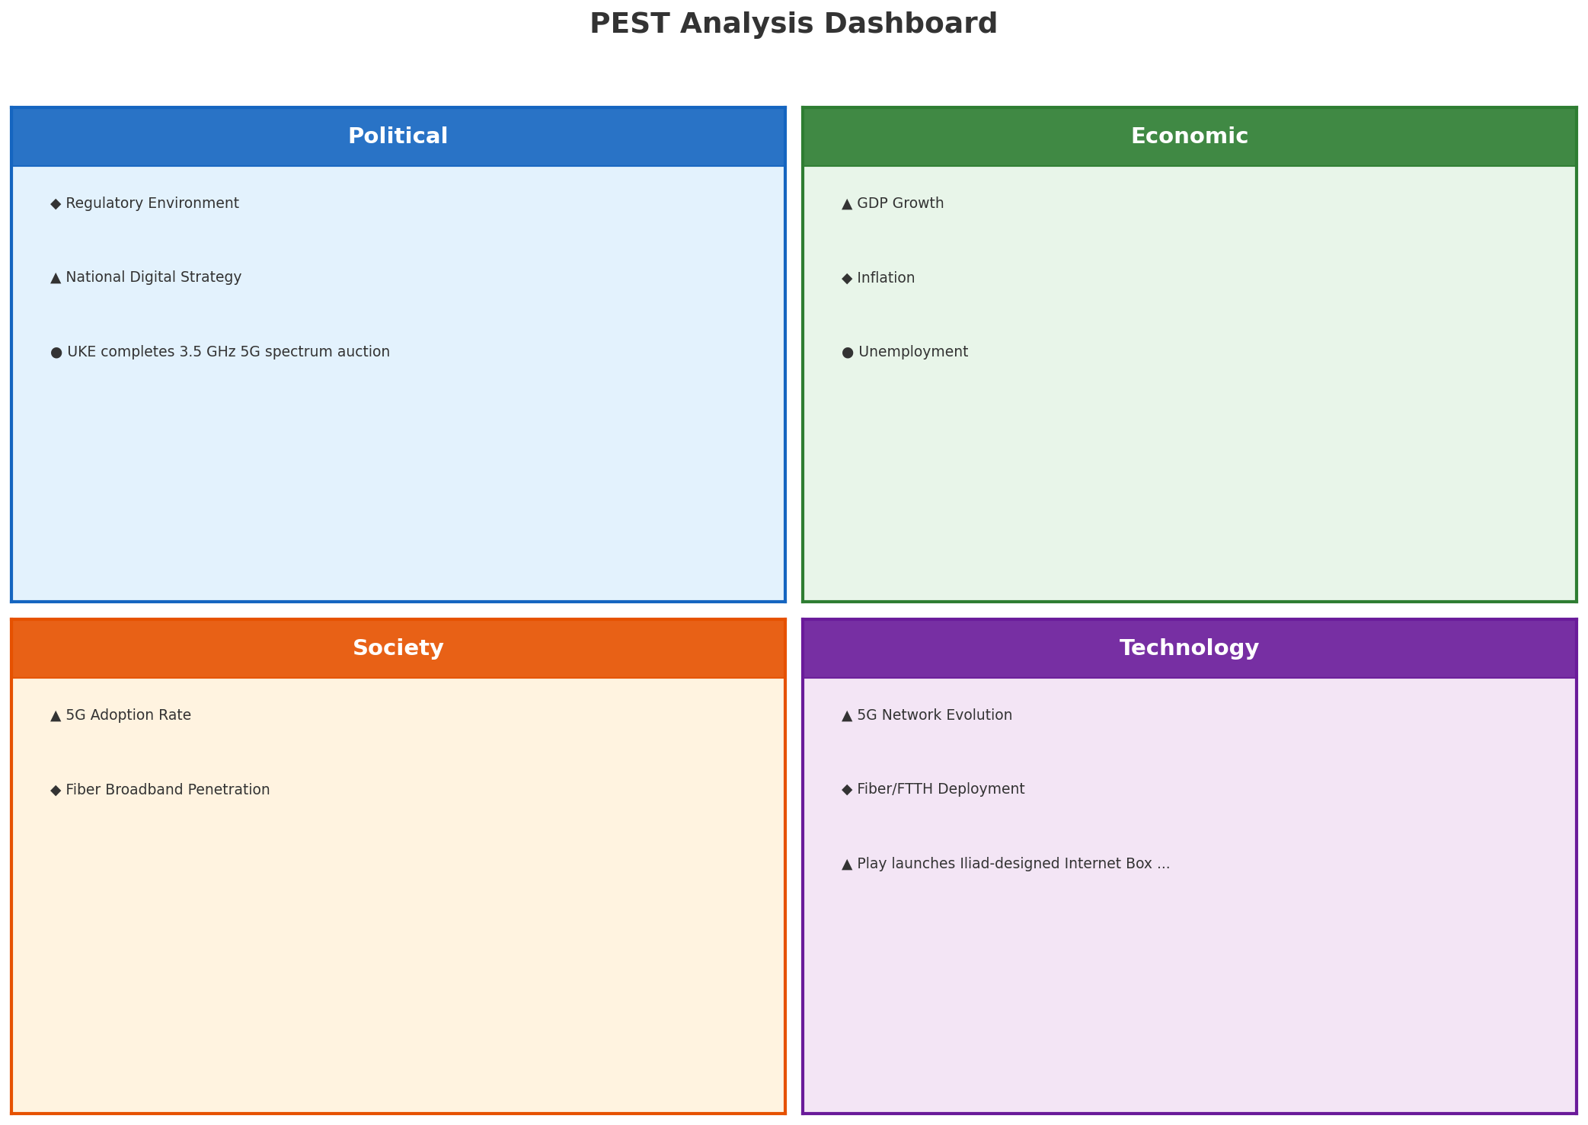
PEST Analysis Dashboard
MACRO ENVIRONMENT
Key Message: Macro environment: Favorable. Key opportunities: Regulatory Environment, National Digital Strategy. Key risks: Regulatory Environment, Fiber Broadband Penetration.
6

Slide 7
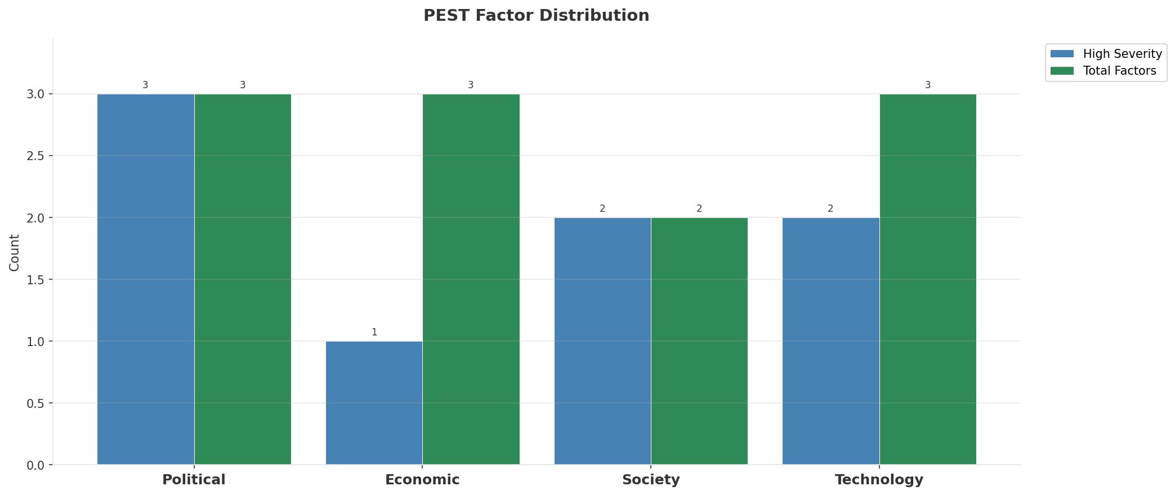
Industry Environment
INDUSTRY ANALYSIS
Market Size
Growth Rate
Concentration
Lifecycle
PLN 10.1B (quarterly, CQ4_2025
+5.9% YoY (CQ2_2025 -> CQ4_2025
CR4 = 100% (Orange Polska: 34.2%, Play (Iliad Poland): 27.0%, T-Mobile Polska: 20.0%, Plus (Polkomtel / Cyfrowy Polsat): 18.8%
late_growth
• New Business Models:
• FWA (Fixed Wireless Access) as fiber alternative
• Network-as-a-Service for enterprise verticals
• Wholesale/MVNO partnerships for coverage monetization
• Technology Revolution:
• 5G SA enabling network slicing and enterprise services
• AI/ML for network optimization and customer experience
• Open RAN for vendor diversification and cost reduction
Key Message: Macro environment: Favorable. Key opportunities: Regulatory Environment, National Digital Strategy. Key risks: Regulatory Environment, Fiber Broadband Penetration Industry is in late growth phase. (+5.9% YoY (CQ2_2025 -> CQ4_2025)
7

Slide 8
Value Transfer Trends
VALUE MIGRATION
• Value shifting from voice/SMS to data and digital services
• B2B/ICT growing faster than consumer segment
• Fiber displacing copper and cable broadband
Key Message: Macro environment: Favorable. Key opportunities: Regulatory Environment, National Digital Strategy. Key risks: Regulatory Environment, Fiber Broadband Penetration Industry is in late growth phase. (+5.9% YoY (CQ2_2025 -> CQ4_2025)
8

Slide 9
02 Look at Market
$APPEALS — Market Changes & Customer Needs

Slide 10
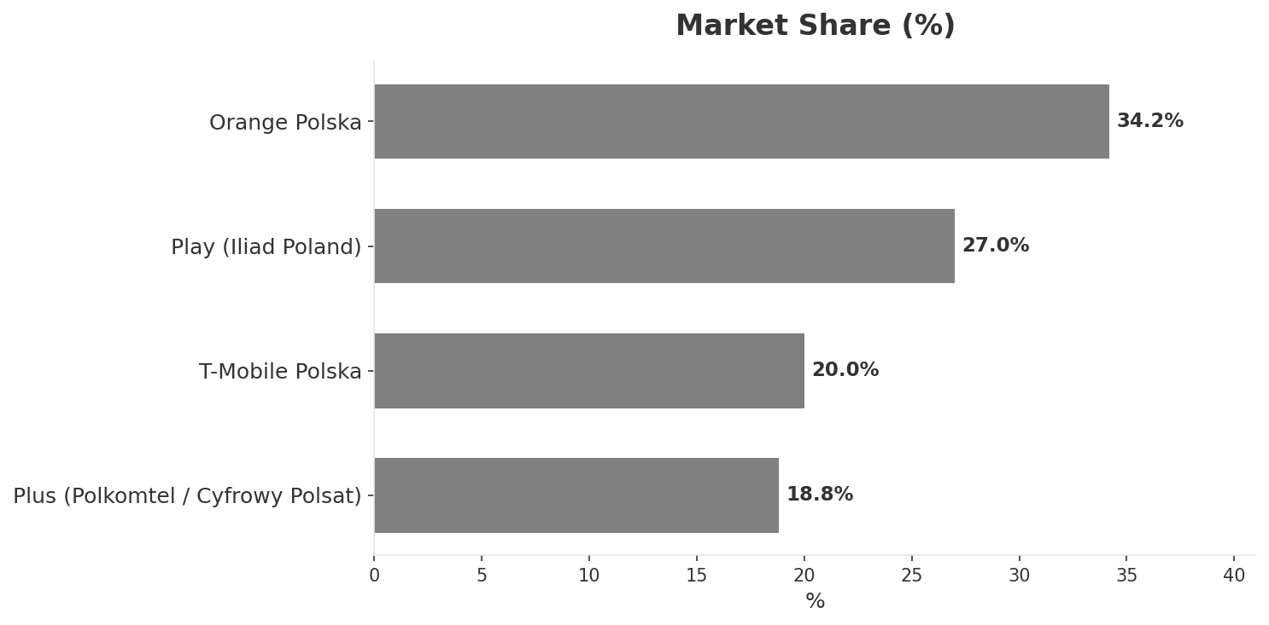
Market Change Panorama
MARKET OVERVIEW
Total Revenue (€M
Mobile Subs (K
Broadband Subs (K
Operators
10,110
51,590
9,170
4
Market Changes:
• T-Mobile Polska revenue increase 5.2% QoQ (PLN 2,020M vs PLN 1,920M
• Plus (Polkomtel / Cyfrowy Polsat) revenue increase 6.7% QoQ (PLN 1,900M vs PLN 1,780M
• Polsat Plus Group leadership change — Solorz succession
Key Message: Poland telecom market totals PLN 10.1B in quarterly revenue; competitive strengths in Availability, Performance; gaps in Assurances; Market presents a balanced mix of opportunities and challenges.
10

Slide 11
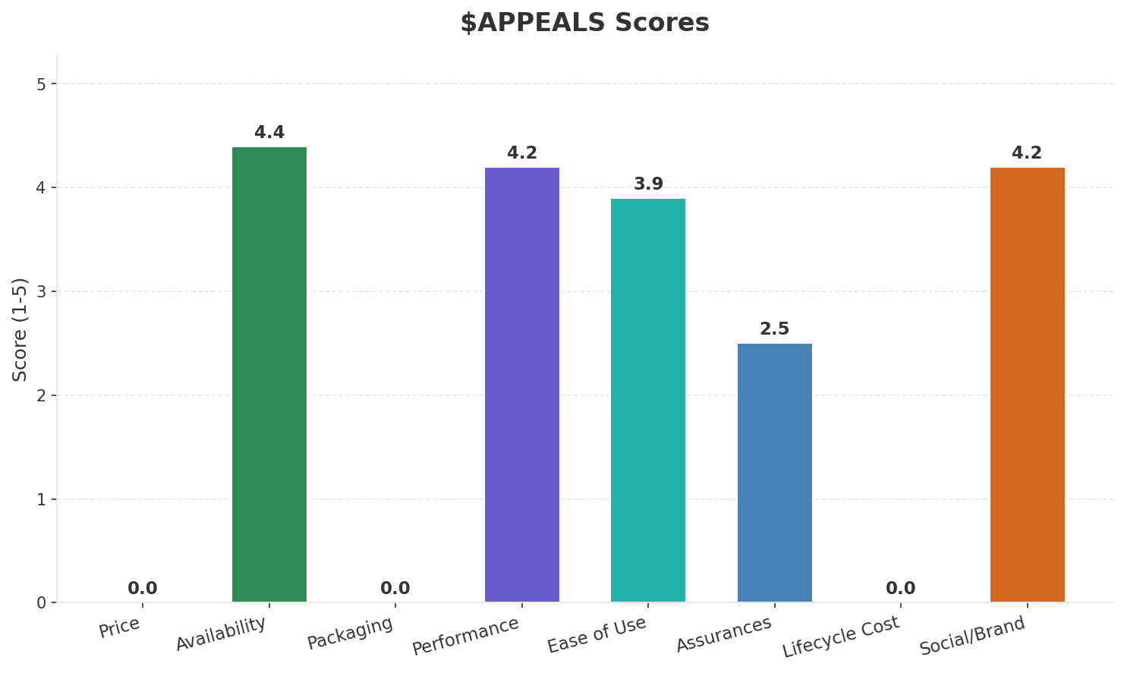
Customer Segments
SEGMENTATION
Consumer Premium Convergent
Trend: stable
Needs: True quad-play convergence (mobile + broadband + TV + fixed line), Reliable fiber broadband across smaller cities and rural areas
Consumer Mainstream
Size: ~20.7M subscribers | Trend: stable | Our Share: ~29% of postpaid
Needs: Better mobile data allowances at competitive prices, Affordable unlimited mobile plans
Consumer Price-Sensitive / Prepaid
Trend: stable
Needs: Low-cost prepaid connectivity, Flexible no-contract plans
Enterprise & Government
Trend: stable
Needs: Private 5G networks for manufacturing and logistics, Cloud and cybersecurity managed services
Key Message: Poland telecom market totals PLN 10.1B in quarterly revenue; competitive strengths in Availability, Performance; gaps in Assurances; Market presents a balanced mix of opportunities and challenges.
11

Slide 12
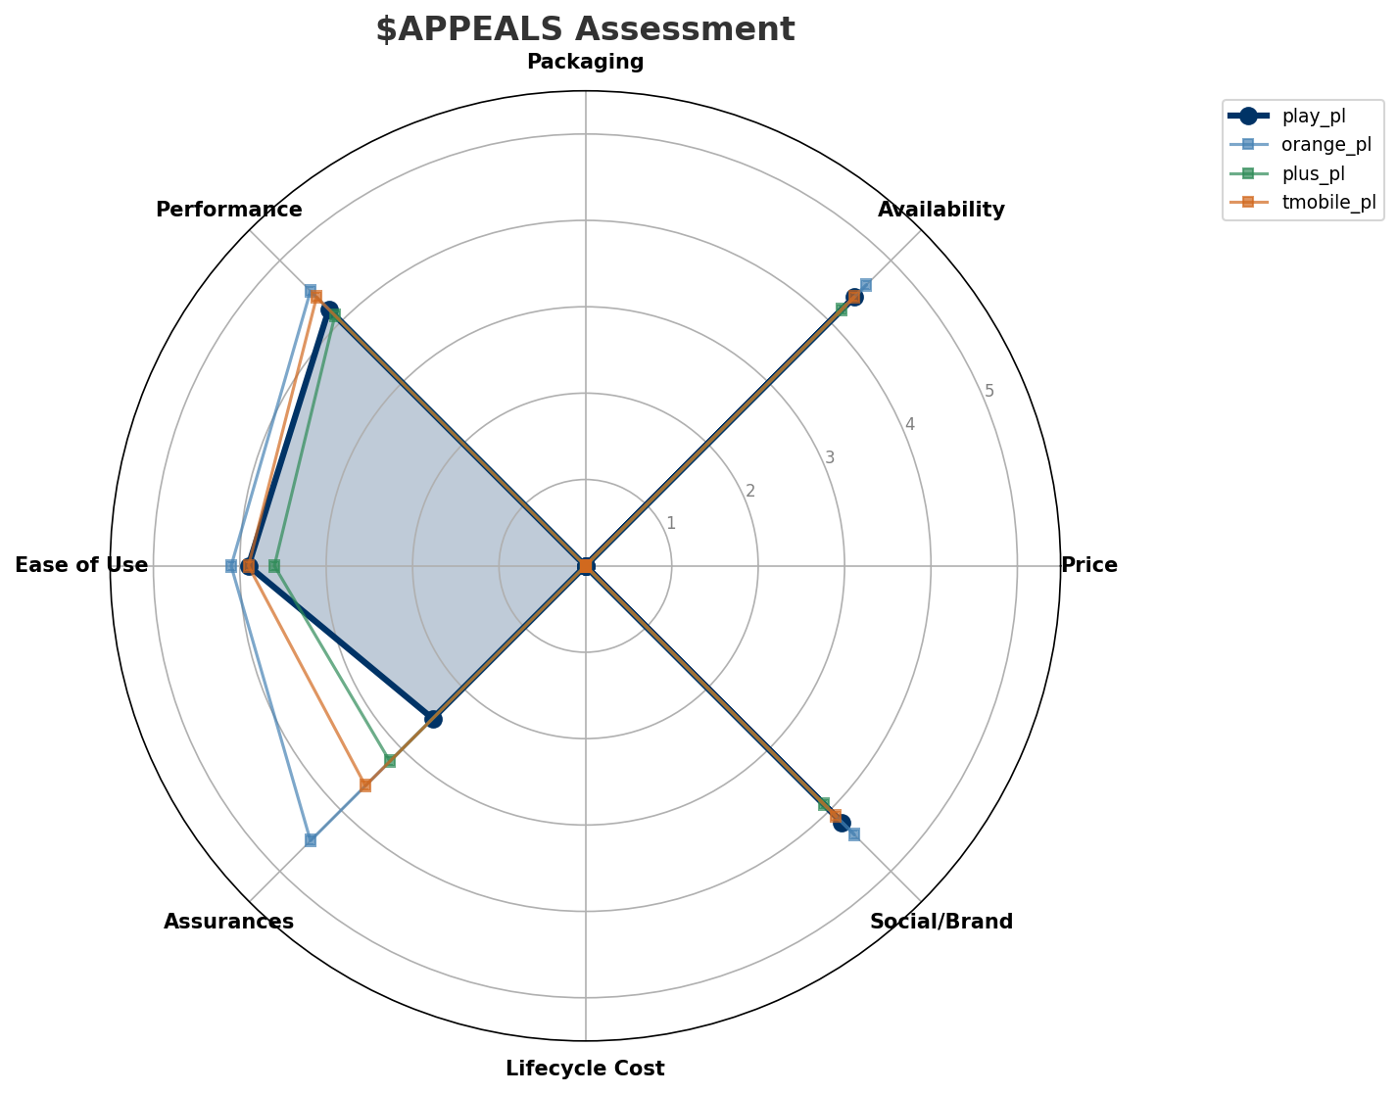
$APPEALS Assessment
CUSTOMER NEEDS
Key Message: Poland telecom market totals PLN 10.1B in quarterly revenue; competitive strengths in Availability, Performance; gaps in Assurances; Market presents a balanced mix of opportunities and challenges.
12

Slide 13
Customer Value Migration
VALUE MIGRATION
Value migration trending upward: customers willing to pay more for premium connectivity and convergent bundles. Focus on upselling and cross-selling opportunities.
Opportunities:
Threats:
• Polsat Plus Group leadership change — Solorz succession
• T-Mobile Polska revenue increase 5.2% QoQ (PLN 2,020M vs PLN 1,920M
• Plus (Polkomtel / Cyfrowy Polsat) revenue increase 6.7% QoQ (PLN 1,900M vs PLN 1,780M
Key Message: Poland telecom market totals PLN 10.1B in quarterly revenue; competitive strengths in Availability, Performance; gaps in Assurances; Market presents a balanced mix of opportunities and challenges.
13

Slide 14
Tariff Analysis
Mobile, Fixed & Convergence Pricing Landscape

Slide 15
Fixed & Convergence Pricing Landscape
DSL / CABLE / FIBER / FMC BUNDLES
Key Message: Fixed and convergence pricing overview
15

Slide 16
03 Look at Competition
Porter's Five Forces — Competitive Landscape

Slide 17
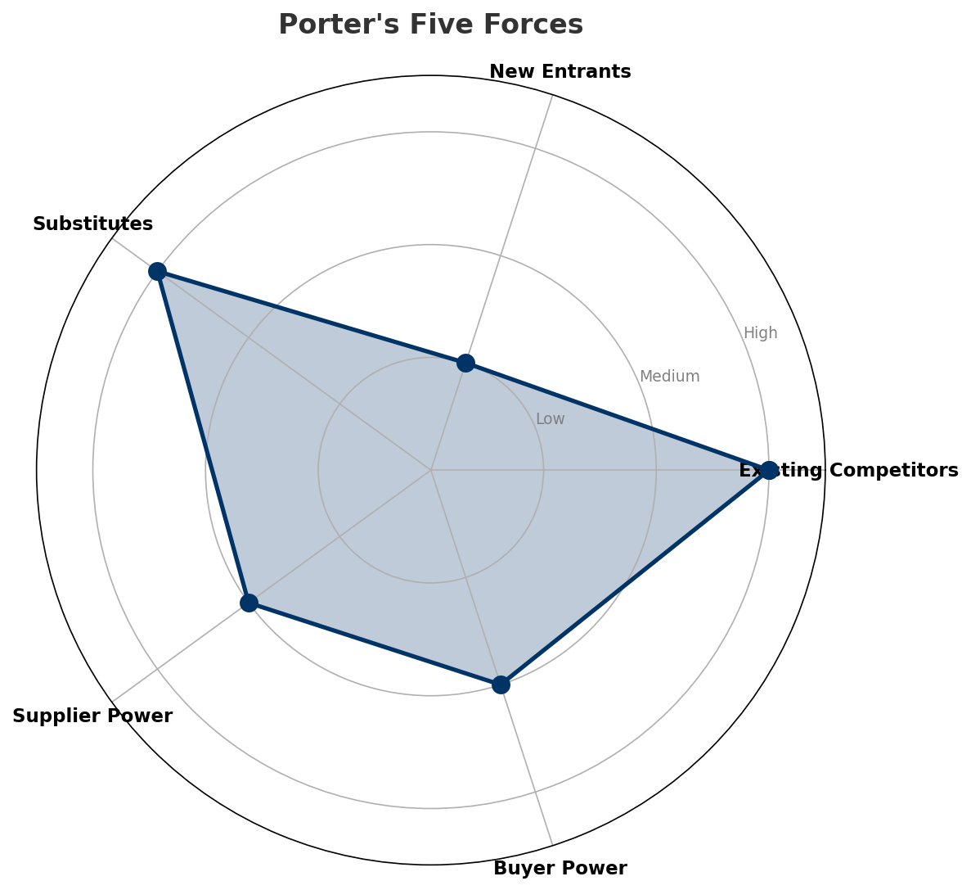
Porter's Five Forces
COMPETITIVE FORCES
Overall Intensity: MEDIUM
Key Message: In a 4-player market with medium competition intensity, Orange Polska leads with 34% revenue share. Target operator holds 27% share. Strongest competitive force: Existing Competitors.
17

Slide 18
Competitor Analysis: Plus Pl
COMPETITOR DEEP DIVE
Revenue
EBITDA
Margin
Capex/Rev
€1,900M
€674M
35.5%
20.0%
+2.4% YoY
Strengths
Weaknesses
• Brand Strength: score 78 (market avg 83
• Customer Service: score 72 (market avg 78
• Digital Experience: score 72 (market avg 80
• Innovation: score 68 (market avg 77
Strategy: Market share expansion (investing for growth); ARPU-led value strategy
Key Message: Competitor analysis: Plus Pl
18

Slide 19
Competitor Analysis: Tmobile Pl
COMPETITOR DEEP DIVE
Revenue
EBITDA
Margin
Capex/Rev
€2,020M
€760M
37.6%
20.0%
+2.8% YoY
Strengths
Weaknesses
Strategy: Revenue-led profitable growth; subscriber acquisition focus
Key Message: Competitor analysis: Tmobile Pl
19

Slide 20
Competitor Analysis: Orange Pl
COMPETITOR DEEP DIVE
Revenue
EBITDA
Margin
Capex/Rev
€3,460M
€1,130M
32.7%
20.8%
+1.9% YoY
Strengths
Weaknesses
• Distribution: score 88 (market avg 83
• Enterprise Solutions: score 90 (market avg 69
• Innovation: score 82 (market avg 77
• Price Competitiveness: score 65 (market avg 72
Strategy: Revenue-led profitable growth; subscriber acquisition focus; strong B2B/enterprise push
Key Message: Competitor analysis: Orange Pl
20

Slide 21
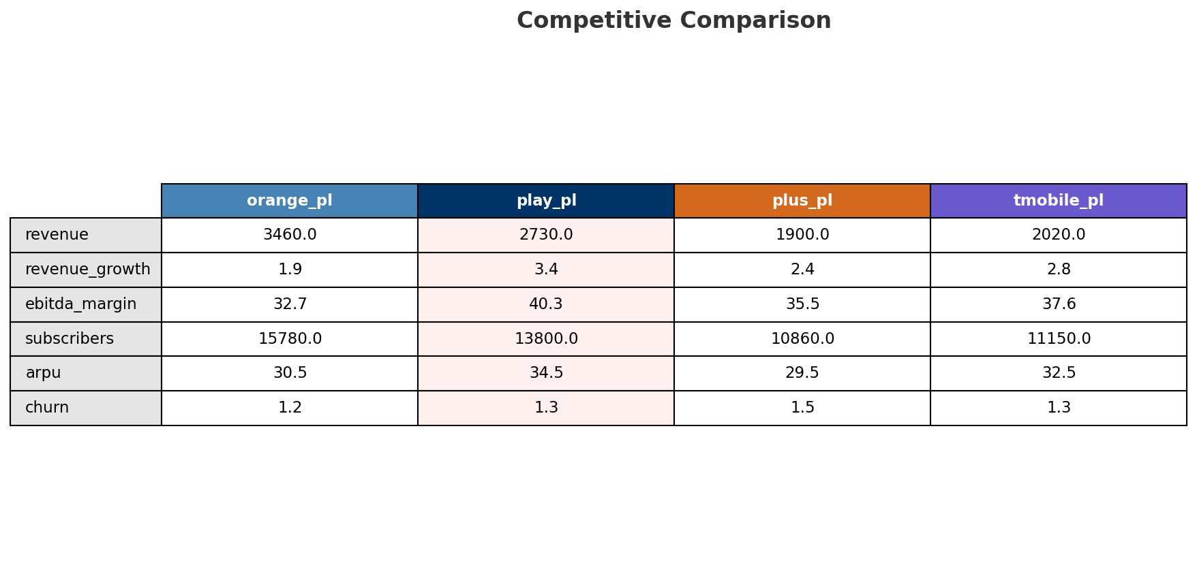
Competitive Landscape Summary
COMPETITION
Key Message: In a 4-player market with medium competition intensity, Orange Polska leads with 34% revenue share. Target operator holds 27% share. Strongest competitive force: Existing Competitors.
21

Slide 22
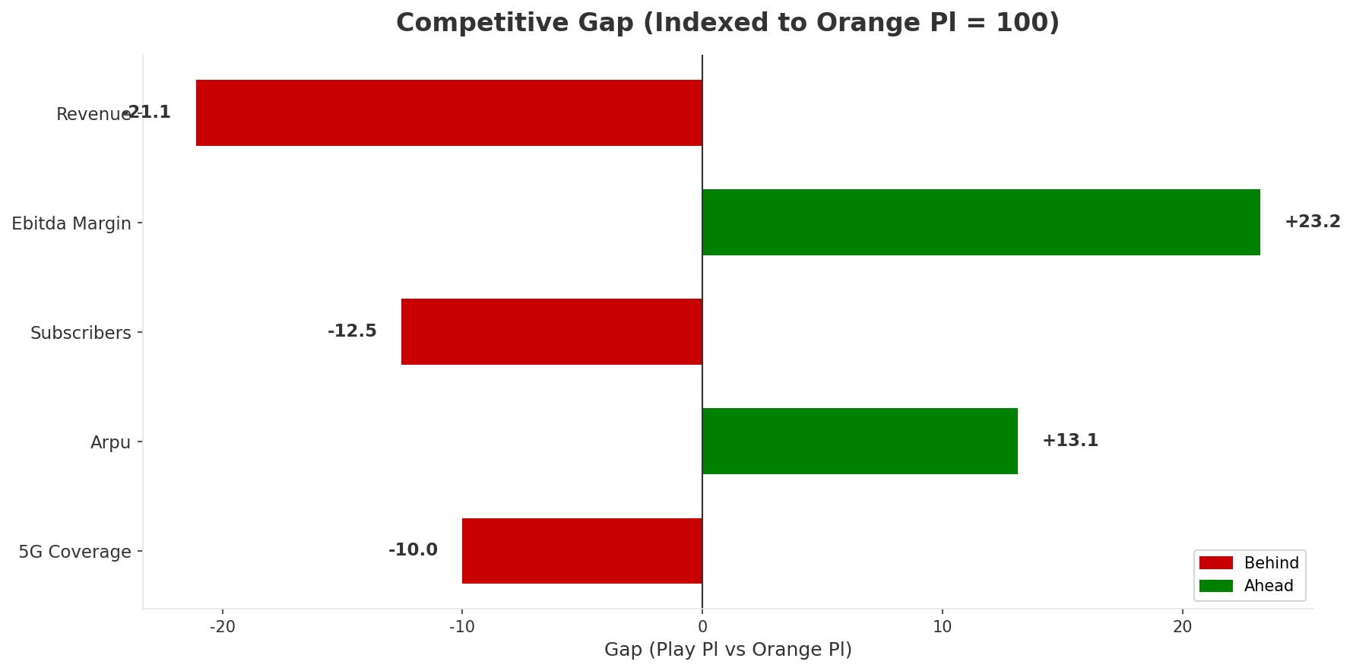
Gap Analysis: Play Pl vs Orange Pl
COMPETITIVE GAP
Key Message: Gap analysis vs market leader Orange Pl
22

Slide 23
New Entrants Threat
MARKET ENTRY
• Entry barriers: High barriers: spectrum licensing, massive capex for network build, regulatory approvals, established brand loyalty
Key Message: New entrants threat level: low
23

Slide 24
04 Look at Self
BMC + Capability Assessment

Slide 25
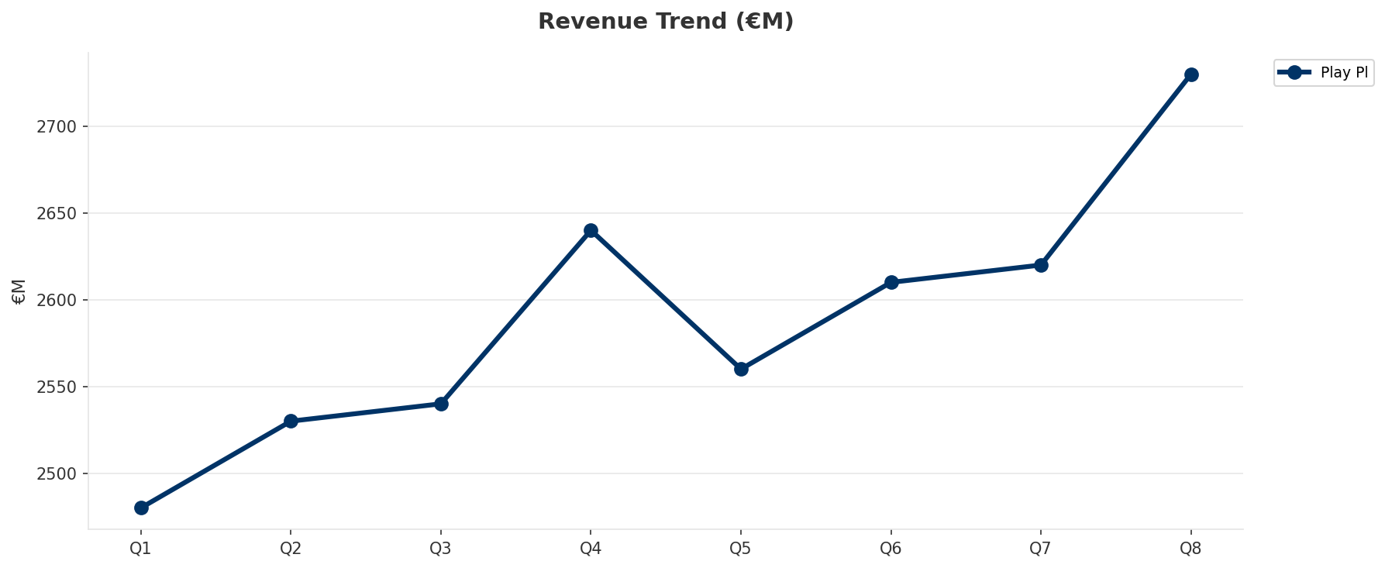
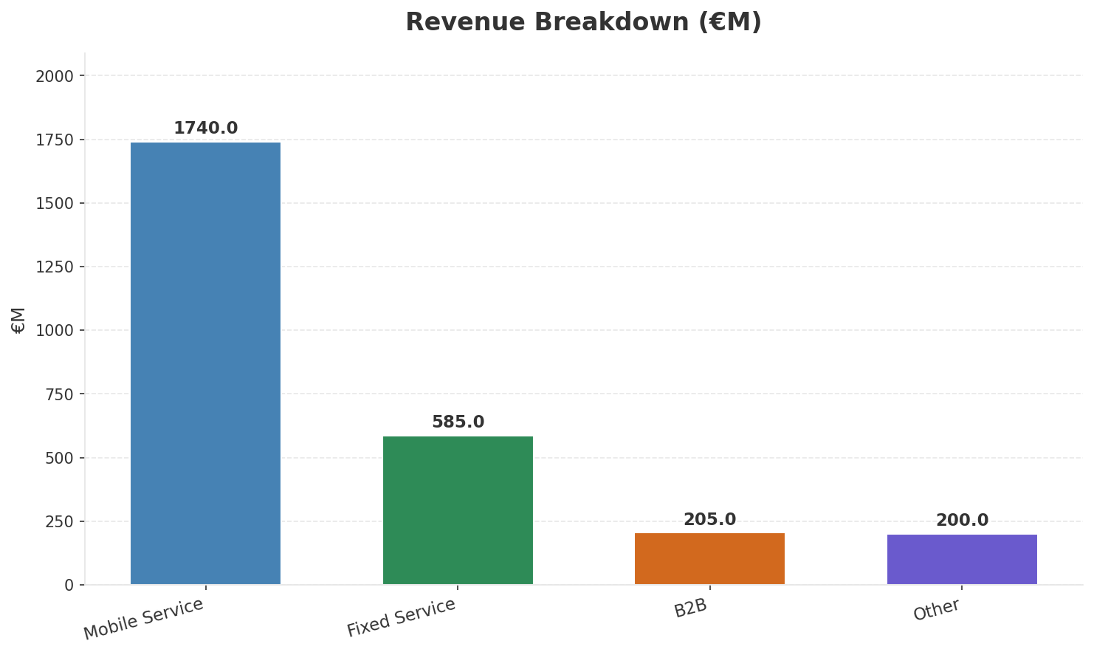
Operating Health Check
FINANCIAL HEALTH
Revenue
EBITDA
EBITDA Margin
Capex/Rev
€2,730M
€1,100M
40.3%
20.5%
+3.41% YoY
+4.3% YoY
CAGR: +5.6% | Accelerating Growth
Key Message: Ranked #2 of 4 operators in market; revenue PLN 2,730M; EBITDA margin 40.3%; overall healthy operations; key strength: Digital Experience; key challenge: Distribution; Management outlook: FY2024: Revenue PLN 10,190M (~EUR 2,398M). Q4 growth 3.2%. 13.3M mobile + 2.1M fixed subscribers. UPC Poland integration complete. PSO open access fiber JV operational.
25

Slide 26
Market Share Evolution
REVENUE SHARE TREND
Orange Polska
Play (Iliad Poland
T-Mobile Polska
Plus (Polkomtel / Cyfrowy Polsat
34.2% #1
27.0% #2
20.0% #3
18.8% #4
-0.2pp stable
-0.2pp stable
+0.1pp stable
+0.3pp stable
Market Concentration: HHI 2,653 (Highly Concentrated) | CR3: 81.2% | Trend: Stable
Subscriber share: Mobile: 26.8% (+1.1pp) | Broadband: 24.5% (+1.5pp
Key Message: Revenue share: 27.0% (#2); stable (-0.2pp); market is highly concentrated (HHI 2,653).
26

Slide 27
Momentum Dashboard
MULTI-QUARTER TREND ANALYSIS
Revenue
EBITDA
Margin
+5.6% CAGR
+8.1% CAGR
+2.3% CAGR
Accelerating Growth (51/100
Accelerating Growth (50/100
Flat (49/100
Key Message: Dominant momentum: Accelerating Growth — based on 3 KPI trend analyses
27

Slide 28
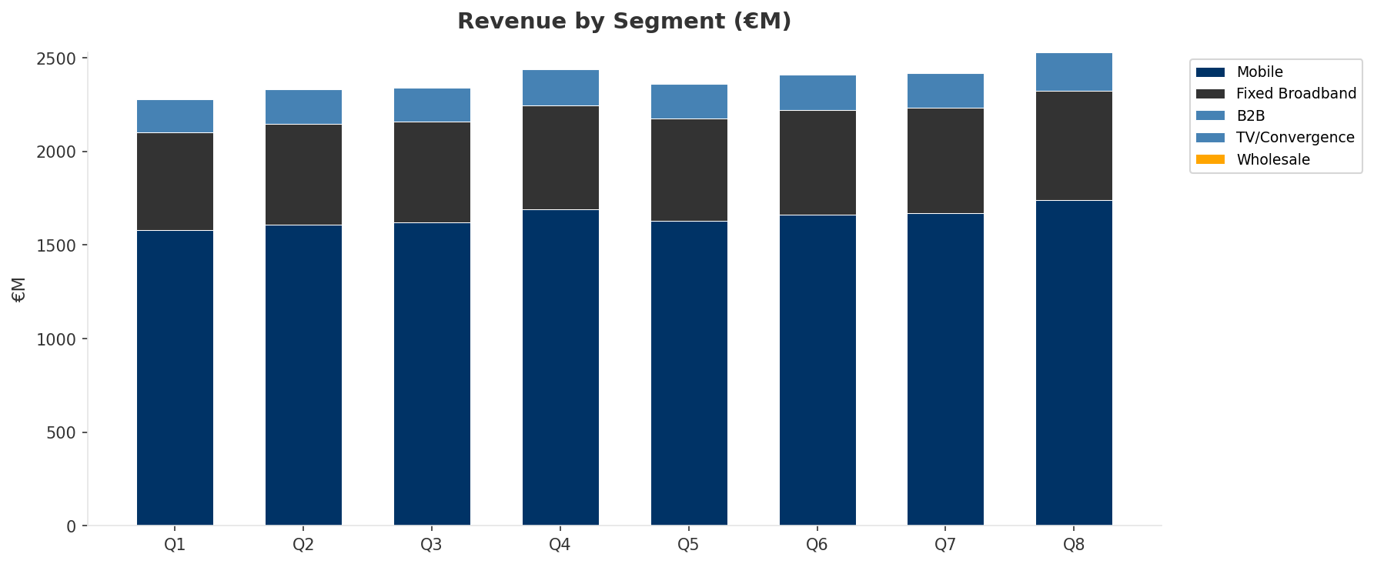
Revenue Composition Trend
SEGMENT REVENUE MIX OVER TIME
Key Message: Growing: Mobile, Fixed Broadband, B2B
28

Slide 29
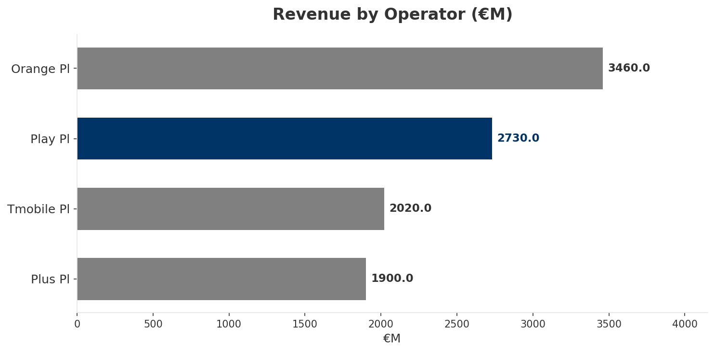
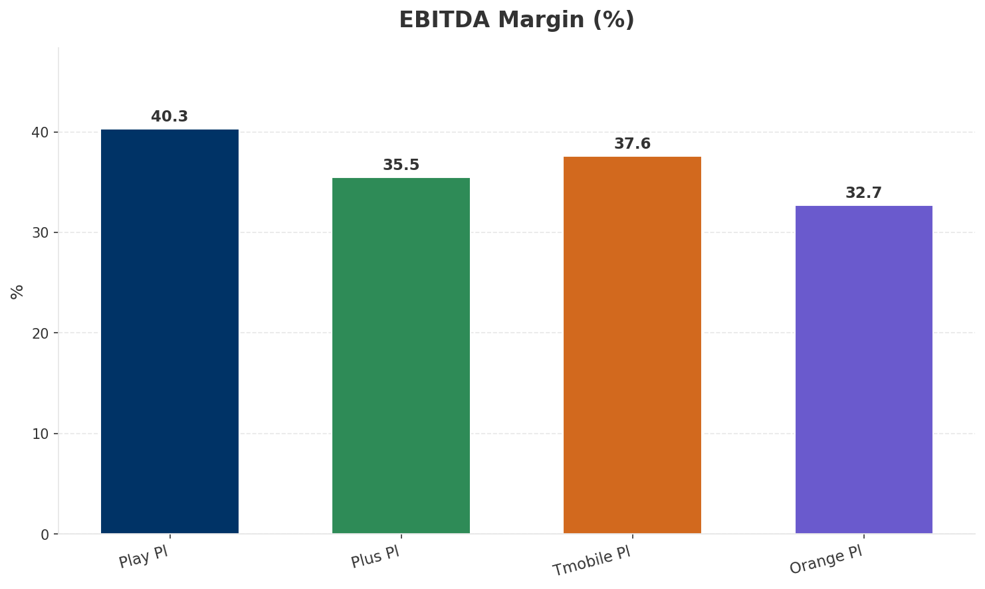
Revenue Comparison
COMPETITIVE BENCHMARKING
Key Message: Revenue and margin benchmarking across operators
29

Slide 30
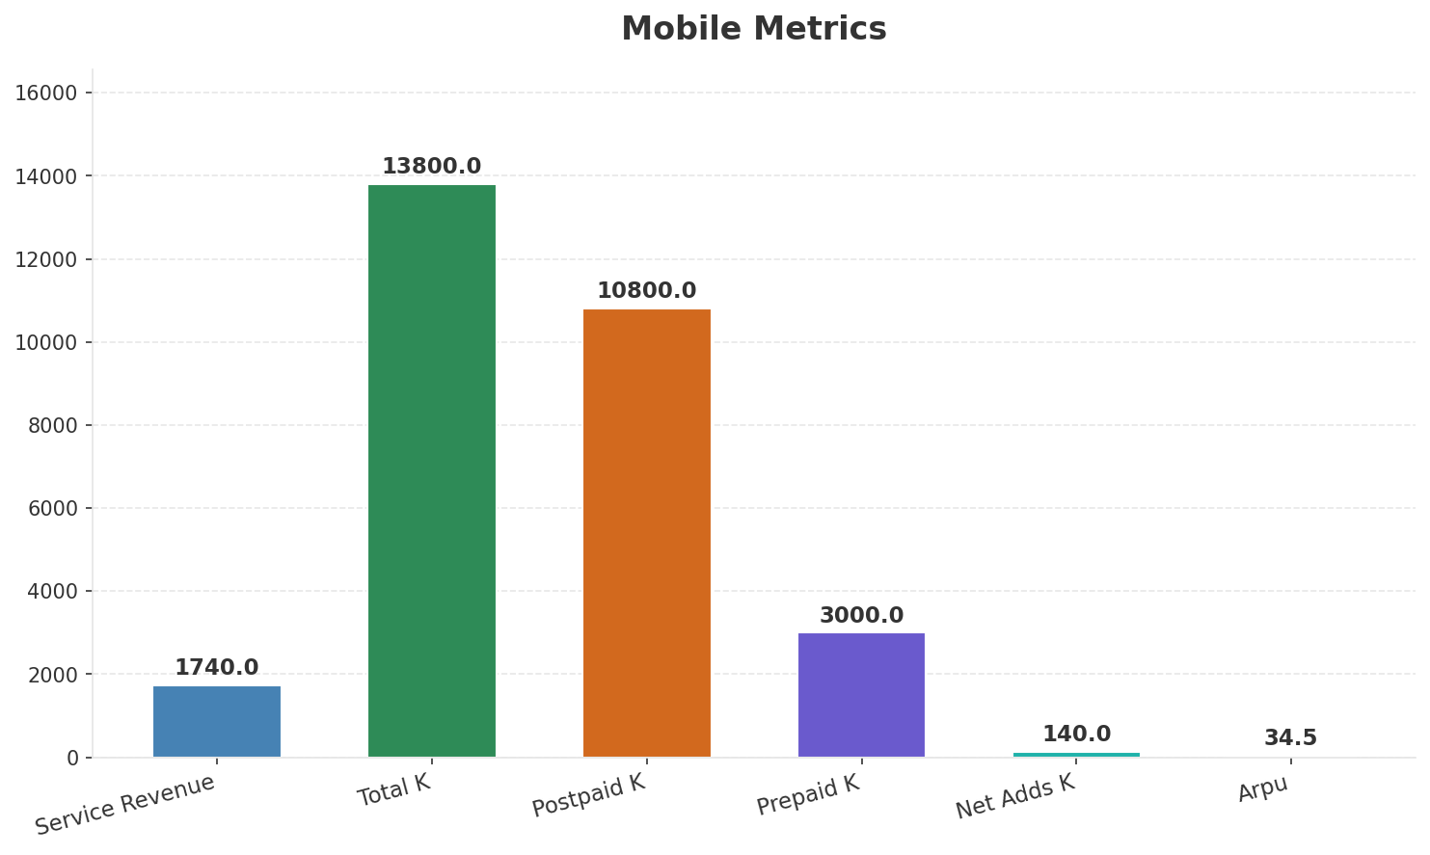
Segment Analysis: Mobile
SEGMENT PERFORMANCE
Service Revenue
Service Growth Pct
Total K
Postpaid K
€1,740M
3.0%
€13,800M
€10,800M
Health: STRONG
• revenue: improving
• subscribers: improving
• arpu: improving
• Poland's #1 mobile operator with highest net adds. 5G rollout accelerating. Iliad Group procurement synergies reducing equipment costs. Play Box launched using Freebox technology platform.
• FY2024: Revenue PLN 10,190M (~EUR 2,398M). Q4 growth 3.2%. 13.3M mobile + 2.1M fixed subscribers. UPC Poland integration complete. PSO open access fiber JV operational.
• revenue increased 4.2% QoQ
Key Message: Mobile service revenue at 1,740M; up 3.0% YoY; ARPU 34.5
30

Slide 31
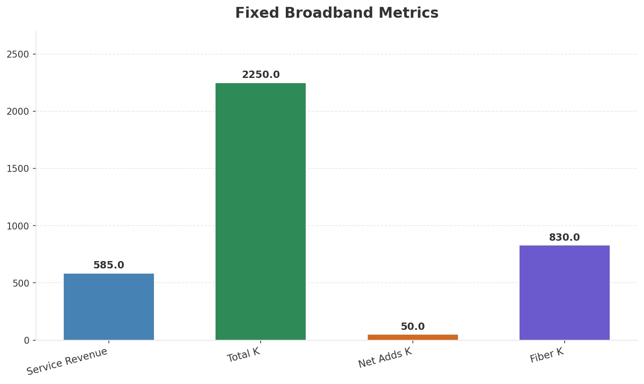
Segment Analysis: Fixed Broadband
SEGMENT PERFORMANCE
Service Revenue
Service Growth Pct
Total K
Net Adds K
€585M
5.4%
€2,250M
50
Health: STRONG
• revenue: improving
• subscribers: improving
• arpu: stable
• FY2024: Revenue PLN 10,190M (~EUR 2,398M). Q4 growth 3.2%. 13.3M mobile + 2.1M fixed subscribers. UPC Poland integration complete. PSO open access fiber JV operational.
• revenue increased 3.5% QoQ
• subscribers increased 2.3% QoQ
Key Message: Fixed service revenue 585.0M; growth +5.4% YoY; Fiber subs 830K
31

Slide 32
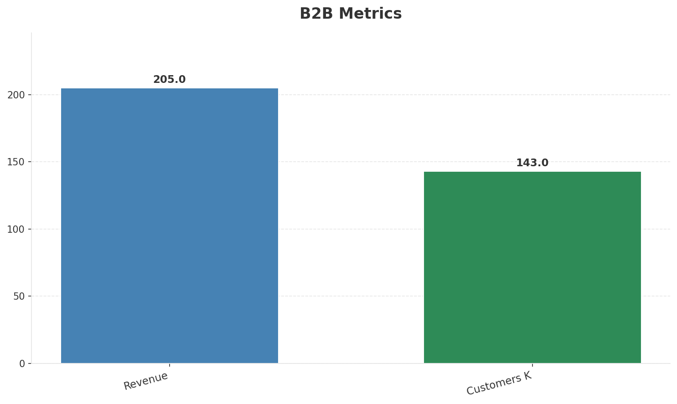
Segment Analysis: B2B
SEGMENT PERFORMANCE
Revenue
Growth Pct
Customers K
Share Of Revenue Pct
€205M
None
€143M
7.5%
Health: STRONG
• revenue: improving
• customers: improving
• revenue increased 10.8% QoQ
• customers increased 2.9% QoQ
Key Message: B2B revenue 205.0M; 7.5% of total revenue
32

Slide 33
Segment Analysis: TV/Convergence
SEGMENT PERFORMANCE
Revenue
Total K
Net Adds K
Fmc Total K
None
€1,170M
None
None
Health: STABLE
• revenue: stable
• subscribers: stable
• fmc_subscribers: stable
Key Message: TV subscribers 1170K
33

Slide 34
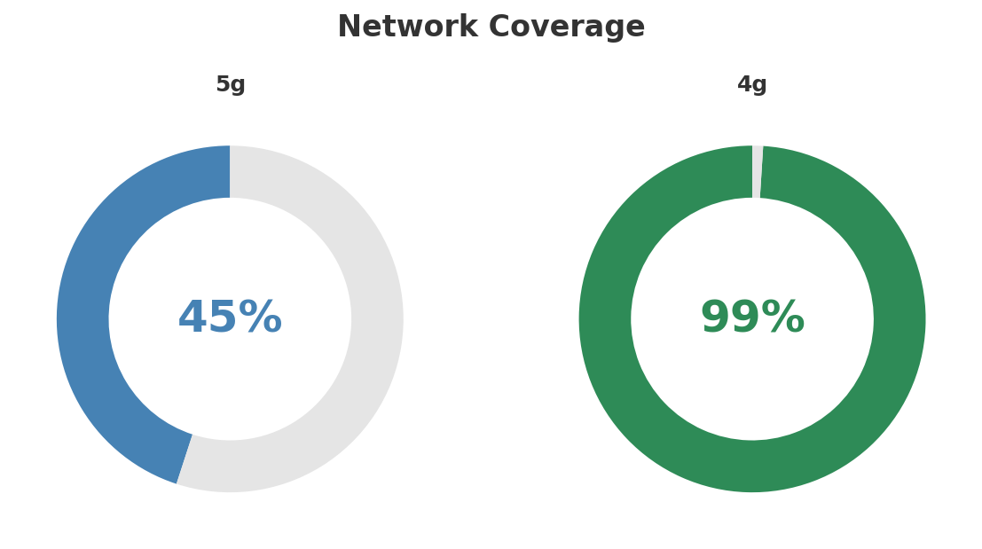
Network Analysis
INFRASTRUCTURE
Technology Mix:
Investment Direction: increasing
• Mobile Vendor: Nokia/Ericsson
• Spectrum Mhz: 310
• Core Vendor: Nokia
• Cable Docsis: 3.1
• Cable Homepass K: 3200
• Notes: UPC Poland cable integrated Aug 2023; PSO open fiber access JV
Key Message: Network infrastructure and coverage assessment
34

Slide 35

Business Model Canvas
BMC
Key Message: Business model canvas overview
35

Slide 36
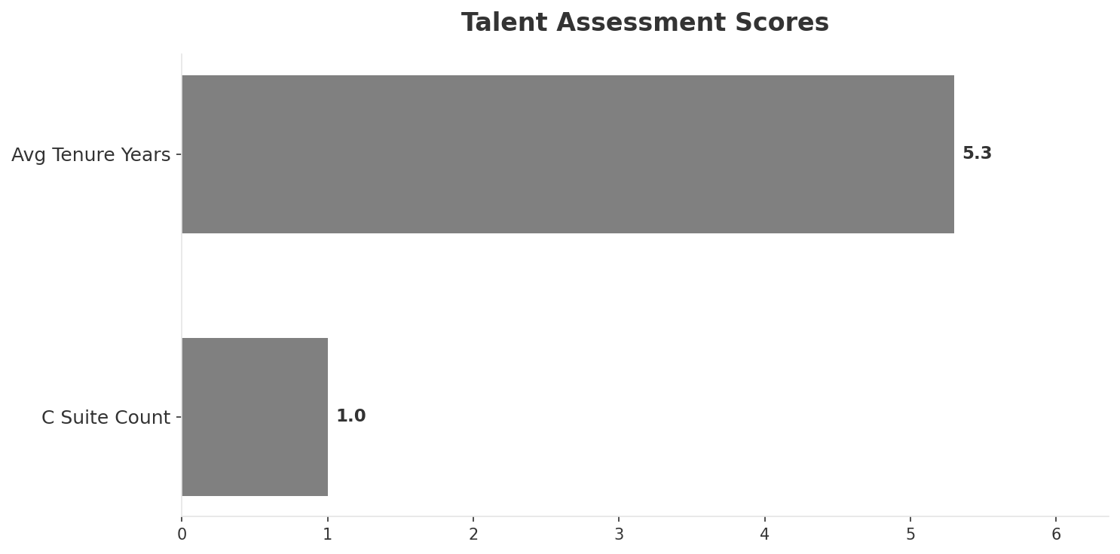
Organization & Talent
PEOPLE & CULTURE
Employees
C Suite Count
Avg Tenure Years
Key Leaders
6,200
1
5.3
['Jean-Marc Harion (CEO, Play (P4))']
Organization Culture:
Stable leadership team (avg tenure >3 years); Growth-oriented strategic posture; High-investment posture; Challenger culture reinforced by Iliad ownership. Dynamic and commercially aggressive. Engineering-focused. Digital-first operations.
Leadership Changes:
• Jean-Marc Harion: (
Key Message: Organization and talent assessment
36

Slide 37
Strengths, Weaknesses & Exposure Points
SELF ASSESSMENT
Strengths
Weaknesses
Exposure Points
• Digital Experience: score 85 (market avg 80
• Price Competitiveness: score 82 (market avg 72
• Strong EBITDA margin at 40.3%
• Revenue on growth trajectory
• Top 2 in revenue market ranking
• Distribution: score 78 (market avg 83
• Enterprise Solutions: score 50 (market avg 69
• 5G coverage gap at only 45.0%
• No owned fixed broadband infrastructure: Cannot offer true converged bundles without wholesale dependency
• Iliad Group managing 3 markets (France, Italy, Poland) with different dynamics: Capital allocation competition between markets
Key Message: Ranked #2 of 4 operators in market; revenue PLN 2,730M; EBITDA margin 40.3%; overall healthy operations; key strength: Digital Experience; key challenge: Distribution; Management outlook: FY2024: Revenue PLN 10,190M (~EUR 2,398M). Q4 growth 3.2%. 13.3M mobile + 2.1M fixed subscribers. UPC Poland integration complete. PSO open access fiber JV operational.
37

Slide 38
SWOT Synthesis
Strengths, Weaknesses, Opportunities & Threats

Slide 39
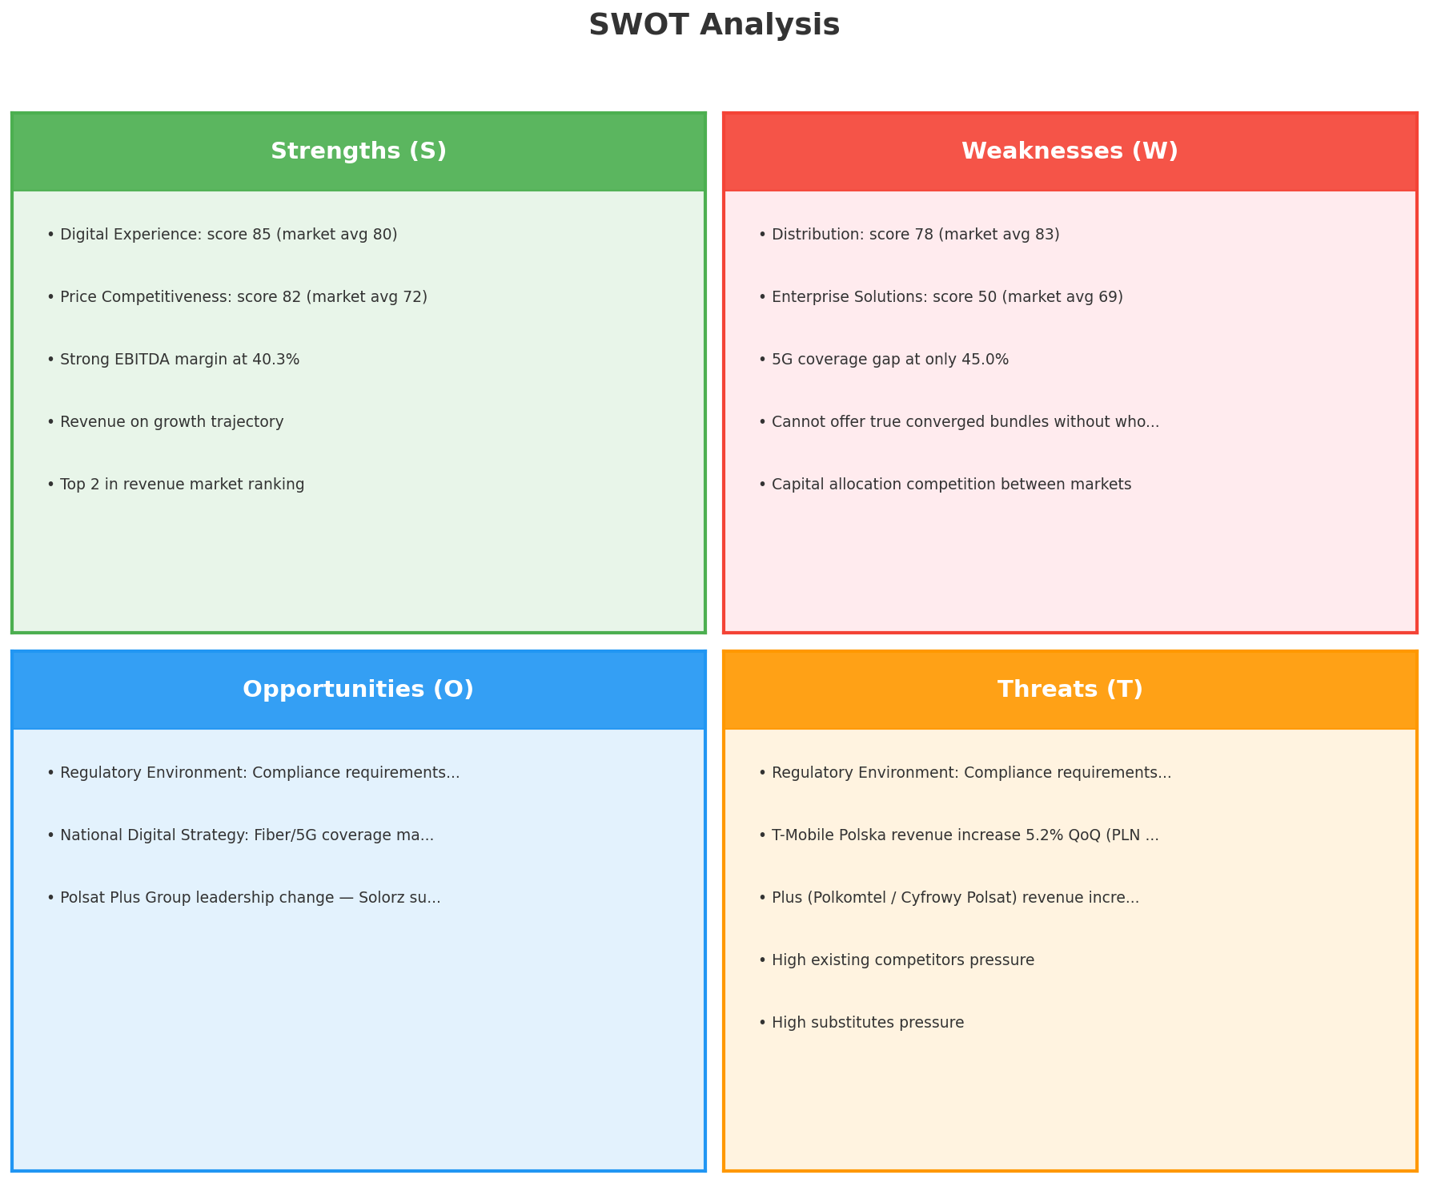
SWOT Analysis
STRATEGIC SYNTHESIS
SO:
Leverage 'Digital Experience: score 85 (market avg 80)' t...
WO:
Address weakness 'Distribution: score 78 (market avg 83)'...
ST:
Use strength 'Digital Experience: score 85 (market avg 80...
WT:
Mitigate weakness 'Distribution: score 78 (market avg 83)...
Key Message: SWOT analysis identifies 5 strengths, 5 weaknesses, 3 opportunities, and 5 threats. The recommended strategic posture is cautious (WT-dominant).
39

Slide 40
05 Look at Opportunities
SPAN Matrix — Opportunity Selection

Slide 41
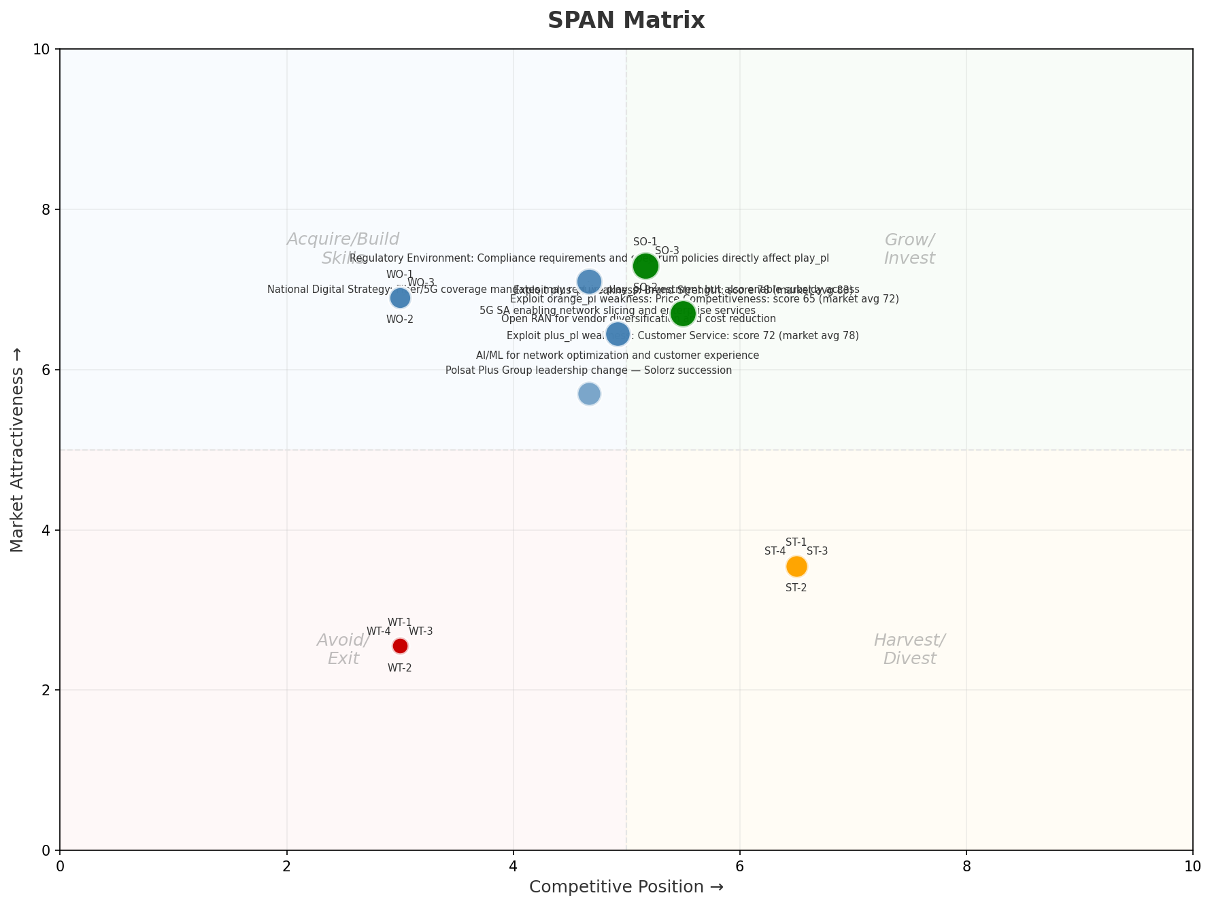
SPAN Matrix — Opportunity Positioning
OPPORTUNITY MAP
Key Message: SPAN matrix positions 23 opportunities: 6 grow/invest, 9 acquire skills, 4 harvest, 4 avoid/exit. Focus resources on the 6 grow/invest items for maximum strategic impact.
41

Slide 42
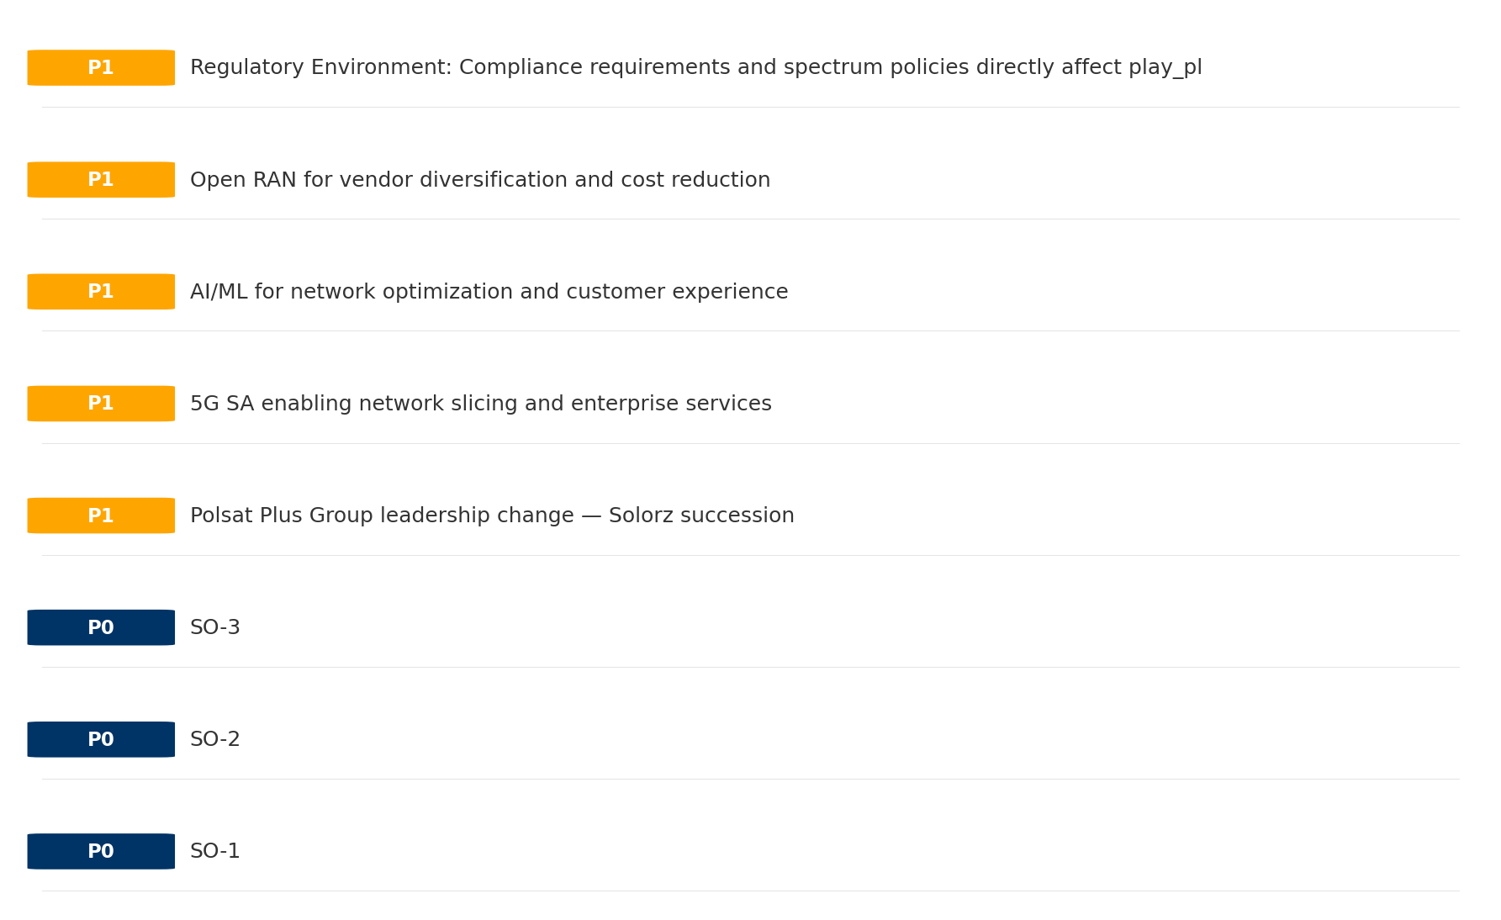
Opportunity Priority Ranking
PRIORITIES
Key Message: SPAN matrix positions 23 opportunities: 6 grow/invest, 9 acquire skills, 4 harvest, 4 avoid/exit. Focus resources on the 6 grow/invest items for maximum strategic impact.
42

Slide 43
Opportunity Details
DEEP DIVE
P0
SO-1
Market: N/A | Window:
Leverage 'Digital Experience: score 85 (market avg 80)' to capture the opportunity of 'Regulatory Environment: Compliance requirements and spectrum policies directly affect play_pl'.
P0
SO-2
Market: N/A | Window:
Leverage 'Price Competitiveness: score 82 (market avg 72)' to capture the opportunity of 'National Digital Strategy: Fiber/5G coverage mandates may require play_pl investment but also enable subsidy access'.
P0
SO-3
Market: N/A | Window:
Leverage 'Strong EBITDA margin at 40.3%' to capture the opportunity of 'Polsat Plus Group leadership change — Solorz succession'.
P1
Polsat Plus Group leadership change — Solorz succession
Market: N/A | Window:
Polsat Plus Group leadership change — Solorz succession
Key Message: SPAN matrix positions 23 opportunities: 6 grow/invest, 9 acquire skills, 4 harvest, 4 avoid/exit. Focus resources on the 6 grow/invest items for maximum strategic impact.
43

Slide 44
Three Decisions
Strategy — Key Tasks — Execution

Slide 45
Decision 1: Define Strategy
DEFENSIVE
As The Squeezed Middle: stabilize core business, then selectively invest for turnaround
P0
P0
P1
P1
Growth Strategy
Competitive Strategy
Transformation Strategy
Customer Strategy
Close the gap to market leader — accelerate Mobile, Fixed Broadband, B2B
Shore up competitive position — address: Distribution: score 78 (market avg 83
Accelerate fiber transition — converged network as competitive moat
Optimize value extraction in stable segments: TV/Convergence, Wholesale
- Gain 1-2pp revenue share
- Grow Mobile, Fixed Broadband, B2B double-digit
- Close Distribution: score 78 (market avg 83) gap within 12 months
- Reduce customer churn
- Fiber homepass coverage +20%
- FMC bundle attach rate 50%+
- Upsell rate +10% in TV/Convergence, Wholesale
- Cross-sell convergence bundles
Key Message: As The Squeezed Middle, the strategic posture is Defensive. As The Squeezed Middle: stabilize core business, then select
45

Slide 46
Decision 2: Define Key Tasks
3 P0 (IMMEDIATE), 3 P1 (1-2 YEARS), 1 P2 (3-5 YEARS
P0
Network
Accelerate Fixed Network Upgrade
Homepass coverage +15% | Speed tier upgrades
Drive DOCSIS/Fiber rollout to increase homepass and improve quality scores
P0
Business
Accelerate Mobile Growth
Mobile revenue +10% YoY | Market share gain
Mobile at €1,740M showing strong momentum — invest to scale
P0
Business
Accelerate Fixed Broadband Growth
Fixed Broadband revenue +10% YoY | Market share gain
Fixed Broadband at €585M showing strong momentum — invest to scale
P1
Network
5G Coverage Expansion
5G pop coverage target | 5G attach rate
Expand 5G population coverage to strengthen mobile competitive position
P1
Business
Opportunity Portfolio Execution
Launch 3+ priority initiatives | Pipeline contribution tracking
6 grow/invest opportunities identified — establish execution office
P1
Customer
Customer Experience Enhancement
NPS +5 points | First-call resolution rate 80%+
Improve digital touchpoints and service resolution to boost NPS
P2
Efficiency
Operational Efficiency & Automation
Process automation 30%+ | Cost-to-serve reduction
EBITDA margin 40.3% — maintain through smart automation and resource reallocatio
Key Message: 7 critical tasks: 3 P0 (immediate), 3 P1 (1-2 years), 1 P2 (3-5 years
46

Slide 47

Decision 3: Define Execution
QUARTERLY ROADMAP & GOVERNANCE
Governance
Strategic Traps to Avoid
- Monthly Progress Review (Monthly
x Enter a price war
- Quarterly Strategic Checkpoint (Quarterly
x Attempt premium repositioning
- Mid-Year Strategic Adjustment (Semi-annual
x Delay core transformation
Key Risks & Mitigation
! Resource constraints delay P0 initiatives -- Ring-fence P0 budgets; establish escalation path for blockers
Key Message: Execute with discipline: monthly reviews, quarterly checkpoints, annual refresh
! Macro-economic slowdown reduces consumer spending -- Prepare value-tier offerings; shift mix toward B2B resilience
47

Slide 48
Analysis Summary
KEY TAKEAWAYS
01 Trends
Macro environment: Favorable. Key opportunities: Regulatory Environment, National Digital Strategy. Key risks: Regulatory Environment, Fiber Broadband Penetration Industry is in late growth phase. (+5.9% YoY (CQ2_2025 -> CQ4_2025)
02 Market
Poland telecom market totals PLN 10.1B in quarterly revenue; competitive strengths in Availability, Performance; gaps in Assurances; Market presents a balanced mix of opportunities and challenges.
03 Competition
In a 4-player market with medium competition intensity, Orange Polska leads with 34% revenue share. Target operator holds 27% share. Strongest competitive force: Existing Competitors.
04 Self
Ranked #2 of 4 operators in market; revenue PLN 2,730M; EBITDA margin 40.3%; overall healthy operations; key strength: Digital Experience; key challenge: Distribution; Management outlook: FY2024: Revenue PLN 10,190M (~EUR 2,398M). Q4 growth 3.2%. 13.3M mobile + 2.1M fixed subscribers. UPC Poland integration complete. PSO open access fiber JV operational.
SWOT
SWOT analysis identifies 5 strengths, 5 weaknesses, 3 opportunities, and 5 threats. The recommended strategic posture is cautious (WT-dominant).
05 Opportunities
SPAN matrix positions 23 opportunities: 6 grow/invest, 9 acquire skills, 4 harvest, 4 avoid/exit. Focus resources on the 6 grow/invest items for maximum strategic impact.
Key Message: Complete Five Looks analysis — see opportunity priorities for next steps
48

Slide 49
Data Provenance
SOURCES & METHODOLOGY
No provenance data recorded for this analysis
Key Message: All data points are traceable to original sources
49

Slide 50
Thank You
BLM Five Looks Strategic Analysis

