Slide 1
Vodafone BLM Strategic Analysis
BLM (Business Leadership Model) Five Looks Analysis
Target Operator
Market
Analysis Period
Report Date
Vodafone Germany
Germany
CQ4_2025
2026-02-09
01 Trends (PEST) | 02 Market/Customer ($APPEALS) | 03 Competition (Porter) | 04 Self (BMC) | SWOT Synthesis | 05 Opportunities (SPAN)

Slide 2
Report Contents
目录
01
Executive Summary
Key findings and recommendations
02
看趋势 Trends
PEST Framework — macro environment
03
看市场 Market/Customer
$APPEALS — market changes & needs
04
看竞争 Competition
Porter's Five Forces — competitive landscape
05
看自己 Self
BMC + Capability — internal assessment
06
SWOT Synthesis
Strengths, Weaknesses, Opportunities, Threats
07
看机会 Opportunities
SPAN Matrix — opportunity selection
08
Summary & Provenance
Conclusions and data sources
2

Slide 3
Data Quality Overview
数据质量概览
Total Data Points
High Confidence
Medium Confidence
Low/Estimated
19
0
0
19
0%
Unique Sources: 0
Data Conflicts: 0
Coverage: Partial
Key Message: 19 data points tracked, 0 high-confidence (0%)
3

Slide 4
Executive Summary
执行摘要
Trends
Macro environment: Favorable. Key opportunities: Regulatory Environment, National Digital Strategy. Key risks: Regulatory Environment, Fiber Broadband Penetration.. Industry is mature. (+0.3% YoY (CQ2_2025 -> CQ4_2025))
Market/Customer
German telecom market totals EUR 12327.0M in quarterly revenue; vodafone_germany holds 25.1% market share; competitive strengths in Availability, Assurances; Market presents a balanced mix of opportunities and challenges.
Competition
In a 4-player market with medium competition intensity, Deutsche Telekom leads with 50% revenue share. Target operator holds 25% share. Strongest competitive force: Existing Competitors.
Self Assessment
Ranked #2 of 4 operators in market; revenue EUR 3092.0M; EBITDA margin 36.2%; stable but facing challenges; key strength: Brand Strength; key challenge: Customer Service
SWOT
SWOT analysis identifies 7 strengths, 3 weaknesses, 2 opportunities, and 3 threats. The recommended strategic posture is defensive (ST-dominant).
Opportunities
SPAN matrix positions 9 opportunities: 7 grow/invest, 2 acquire skills, 0 harvest, 0 avoid/exit. Focus resources on the 7 grow/invest items for maximum strategic impact.
Key Message: Five Looks analysis completed — see details in following sections
4

Slide 5
01 看趋势
Look at Trends — PEST Framework

Slide 6

PEST Analysis Dashboard
宏观环境分析
Key Message: Macro environment: Favorable. Key opportunities: Regulatory Environment, National Digital Strategy. Key risks: Regulatory Environment, Fiber Broadband Penetration.
6

Slide 7
Industry Environment
行业环境
• Market Size: EUR 12.3B (quarterly, CQ4_2025)
• Growth Rate: +0.3% YoY (CQ2_2025 -> CQ4_2025)
• Profit Trend: Stable (industry EBITDA margin ~36.6%)
• Concentration: CR4 = 100% (Deutsche Telekom: 50.3%, Vodafone Germany: 25.1%, Telefonica O2 Germany: 16.2%, 1&1 AG: 8.4%)
• Lifecycle Stage: mature
• New Business Models:
• FWA (Fixed Wireless Access) as fiber alternative
• Network-as-a-Service for enterprise verticals
• Wholesale/MVNO partnerships for coverage monetization
• Technology Revolution:
• 5G SA enabling network slicing and enterprise services
• AI/ML for network optimization and customer experience
• Open RAN for vendor diversification and cost reduction
Key Success Factors:
• Network quality and coverage breadth
• Convergent (FMC) bundling strategy
• B2B/ICT capabilities for enterprise growth
• Operational efficiency (OPEX/revenue ratio)
Key Message: Macro environment: Favorable. Key opportunities: Regulatory Environment, National Digital Strategy. Key risks: Regulatory Environment, Fiber Broadband Penetration.. Industry is mature. (+0.3% YoY (CQ2_2025 -> CQ4_2025))
7

Slide 8
Value Transfer Trends
价值转移趋势
• Value shifting from voice/SMS to data and digital services
• B2B/ICT growing faster than consumer segment
• Fiber displacing copper and cable broadband
Key Message: Macro environment: Favorable. Key opportunities: Regulatory Environment, National Digital Strategy. Key risks: Regulatory Environment, Fiber Broadband Penetration.. Industry is mature. (+0.3% YoY (CQ2_2025 -> CQ4_2025))
8

Slide 9
02 看市场/客户
Look at Market/Customer — $APPEALS

Slide 10
Market Change Panorama
市场变化全景
Total Revenue
12327.0
Key Message: German telecom market totals EUR 12327.0M in quarterly revenue; vodafone_germany holds 25.1% market share; competitive strengths in Availability, Assurances; Market presents a balanced mix of opportunities and challenges.
10

Slide 11
Customer Segments
客户细分
Consumer High-End
Size: ~13.9M subscribers | Trend: growing | Our Share: ~25% of postpaid
Unmet Needs: Premium 5G standalone experiences, Ultra-low latency gaming and VR
Consumer Mainstream
Size: ~51.2M subscribers | Trend: stable | Our Share: ~25% of postpaid
Unmet Needs: Better value convergent bundles, Transparent pricing without hidden fees
Consumer Price-Sensitive
Size: ~35.1M subscribers | Trend: shrinking | Our Share: ~19% of prepaid
Unmet Needs: Affordable unlimited data plans, No-contract flexibility
Consumer Youth
Size: ~17.2M subscribers | Trend: growing | Our Share: ~23% overall
Unmet Needs: Social media and streaming-optimized plans, eSIM and digital-first experience
Key Message: German telecom market totals EUR 12327.0M in quarterly revenue; vodafone_germany holds 25.1% market share; competitive strengths in Availability, Assurances; Market presents a balanced mix of opportunities and challenges.
11

Slide 12
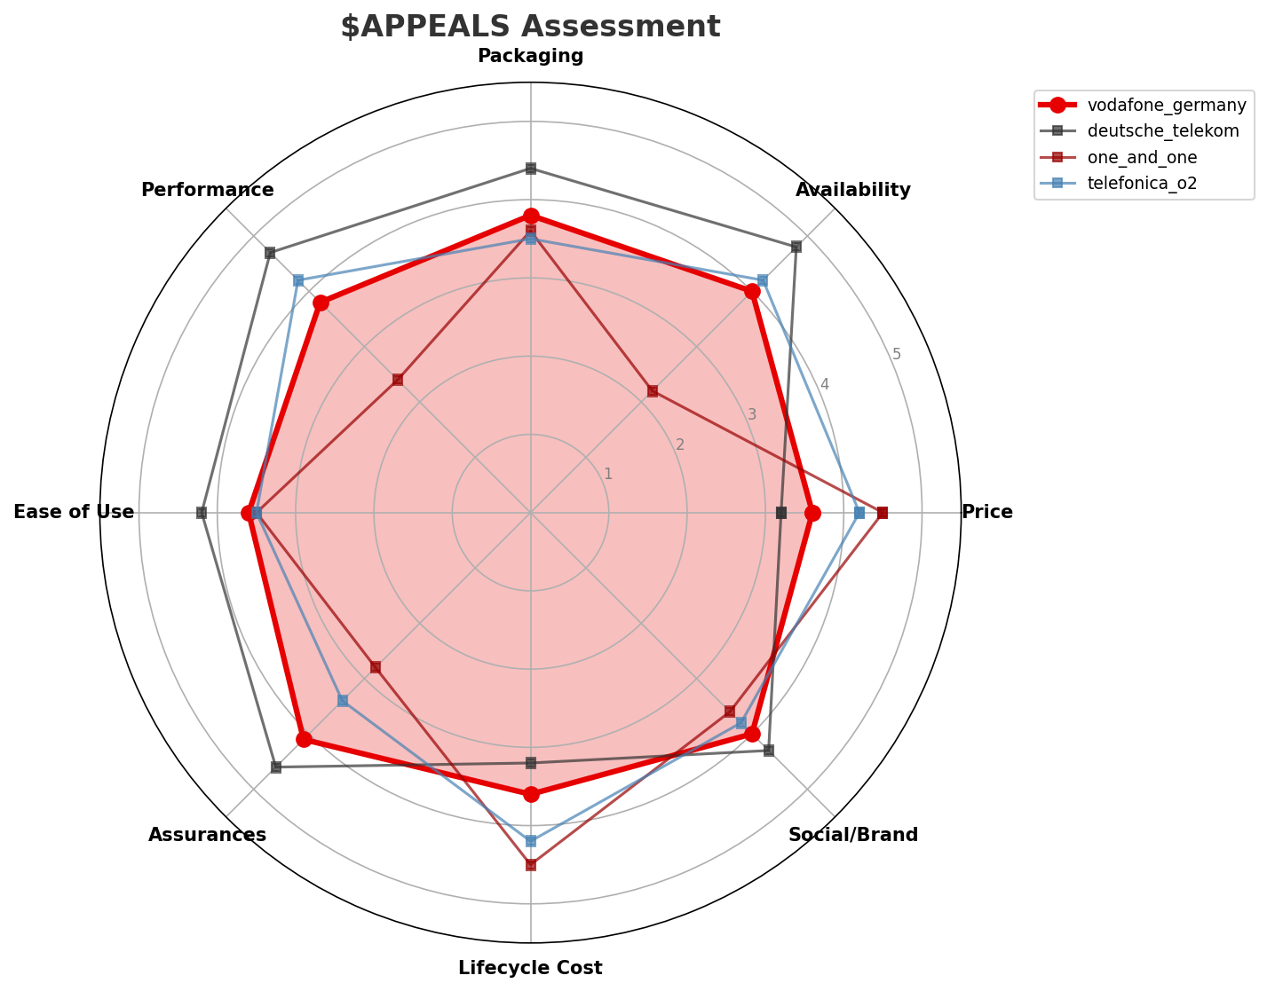
$APPEALS Assessment
客户需求评估
Key Message: German telecom market totals EUR 12327.0M in quarterly revenue; vodafone_germany holds 25.1% market share; competitive strengths in Availability, Assurances; Market presents a balanced mix of opportunities and challenges.
12

Slide 13
Customer Value Migration
客户价值迁移
Limited data to assess value migration trends
Key Message: German telecom market totals EUR 12327.0M in quarterly revenue; vodafone_germany holds 25.1% market share; competitive strengths in Availability, Assurances; Market presents a balanced mix of opportunities and challenges.
13

Slide 14
03 看竞争
Look at Competition — Porter's Five Forces

Slide 15

Porter's Five Forces
波特五力分析
Overall Intensity: MEDIUM
Key Message: In a 4-player market with medium competition intensity, Deutsche Telekom leads with 50% revenue share. Target operator holds 25% share. Strongest competitive force: Existing Competitors.
15

Slide 16
Competitor Analysis: Telefonica O2
竞争对手分析
Status
Latest Quarter
Revenue
Service Revenue
data_available
CQ4_2025
2000.0
1700.0
Strengths
Weaknesses
• 5G Deployment: 88.0/100
• Brand Strength: 75.0/100
• Customer Service: 72.0/100
• Network Coverage: 85.0/100
• Network Quality: 78.0/100
Key Message: Competitor analysis: telefonica_o2
16

Slide 17
Competitor Analysis: Deutsche Telekom
竞争对手分析
Status
Latest Quarter
Revenue
Service Revenue
data_available
CQ4_2025
6200.0
5460.0
Strengths
Weaknesses
• 5G Deployment: 95.0/100
• Brand Strength: 90.0/100
• Customer Service: 82.0/100
• Digital Services: 85.0/100
• Enterprise Solutions: 92.0/100
Key Message: Competitor analysis: deutsche_telekom
17

Slide 18
Competitor Analysis: One And One
竞争对手分析
Status
Latest Quarter
Revenue
Service Revenue
data_available
CQ4_2025
1035.0
915.0
Strengths
Weaknesses
• Pricing Competitiveness: 90.0/100
• Product Innovation: 72.0/100
• Sustainability: 80.0/100
Key Message: Competitor analysis: one_and_one
18

Slide 19
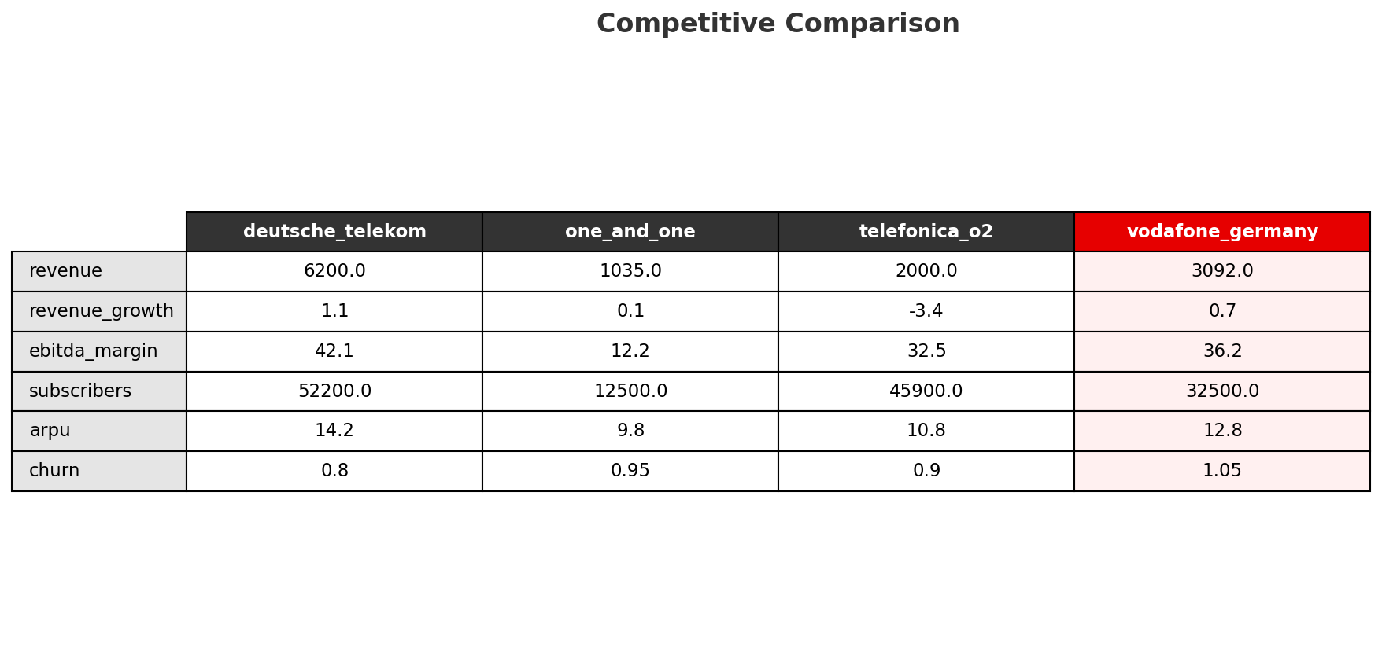
Competitive Landscape Summary
竞争格局总结
Key Message: In a 4-player market with medium competition intensity, Deutsche Telekom leads with 50% revenue share. Target operator holds 25% share. Strongest competitive force: Existing Competitors.
19

Slide 20
New Entrants Threat
新进入者威胁
• Active new entrant: 1&1 AG: 1&1 AG is currently building/expanding its network presence
• Entry barriers: High barriers: spectrum licensing, massive capex for network build, regulatory approvals, established brand loyalty
Key Message: New entrants threat level: medium
20

Slide 21
04 看自己
Look at Self — BMC + Capability

Slide 22
Operating Health Check
经营体检
Total Revenue
Service Revenue
Ebitda
Ebitda Margin Pct
3092.0
2726.0
1120.0
36.2
Health Rating: STABLE
Revenue Breakdown:
Market Positions:
• mobile_service_revenue: {'value': 1520.0, 'share_pct': 49.2}
• fixed_service_revenue: {'value': 795.0, 'share_pct': 25.7}
• b2b_revenue: {'value': 520.0, 'share_pct': 16.8}
• tv_revenue: {'value': 268.0, 'share_pct': 8.7}
• wholesale_revenue: {'value': 380.0, 'share_pct': 12.3}
• total_revenue: 3092.0
• calendar_quarter: CQ4_2025
• operators_count: 4
• revenue_rank: 2
• total_revenue: 3092.0
• revenue_market_share_pct: 25.1
• subscriber_rank: 3
Key Message: Ranked #2 of 4 operators in market; revenue EUR 3092.0M; EBITDA margin 36.2%; stable but facing challenges; key strength: Brand Strength; key challenge: Customer Service
22

Slide 23
Segment Analysis: Mobile
细分业务分析
Mobile Service Revenue
Mobile Service Growth Pct
Mobile Total K
Mobile Postpaid K
1520.0
2.8
32500.0
23200.0
Health: STABLE
• revenue: improving
• subscribers: stable
• arpu: improving
Key Message: Mobile service revenue at EUR 1520.0M; up 2.8% YoY; ARPU EUR 12.8
23

Slide 24
Segment Analysis: Fixed Broadband
细分业务分析
Fixed Service Revenue
Fixed Service Growth Pct
Broadband Total K
Broadband Net Adds K
795.0
-1.1
9940.0
-63.0
Health: STABLE
• revenue: stable
• subscribers: stable
• arpu: stable
Key Message: Fixed service revenue EUR 795.0M; growth -1.1% YoY; Fiber subs 1480K
24

Slide 25
Segment Analysis: B2B
细分业务分析
B2B Revenue
B2B Growth Pct
B2B Customers K
B2B Share Of Revenue Pct
520.0
8.5
215.0
16.8
Health: STRONG
• revenue: improving
• customers: improving
Key Message: B2B revenue EUR 520.0M; growth +8.5% YoY; 16.8% of total revenue
25

Slide 26
Segment Analysis: TV/Convergence
细分业务分析
Tv Revenue
Tv Total K
Tv Net Adds K
Fmc Total K
268.0
7740.0
-6.0
4900.0
Health: STABLE
• revenue: stable
• subscribers: stable
• fmc_subscribers: improving
Key Message: TV subscribers 7740K; FMC 4900K; FMC penetration 49.3%
26

Slide 27
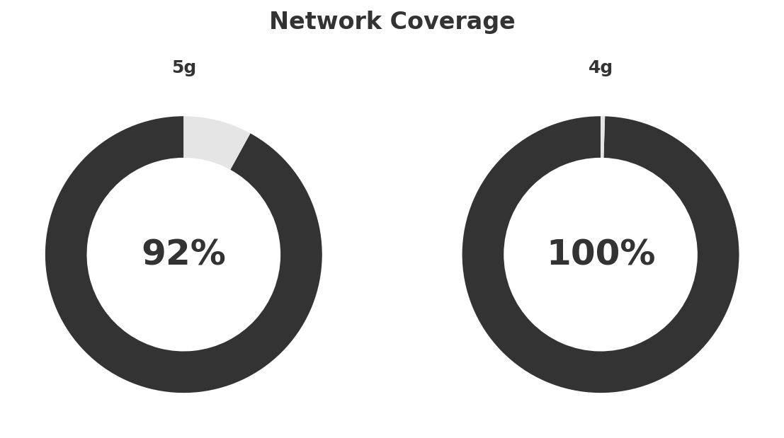
Network Analysis
网络分析
Technology Mix:
Investment Direction: stable
• mobile_vendor: Ericsson + Nokia (non-standalone 5G)%
• 5g_sa_status: Testing, planned 2026%
• spectrum_mhz: {'700': 20, '1800': 50, '2100': 40, '2600': 20, '3600': 90}%
• 5g_base_stations: 18500%
• core_vendor: Ericsson%
• virtualization_pct: 45%
• edge_nodes: 12%
Key Message: Network infrastructure and coverage assessment
27

Slide 28
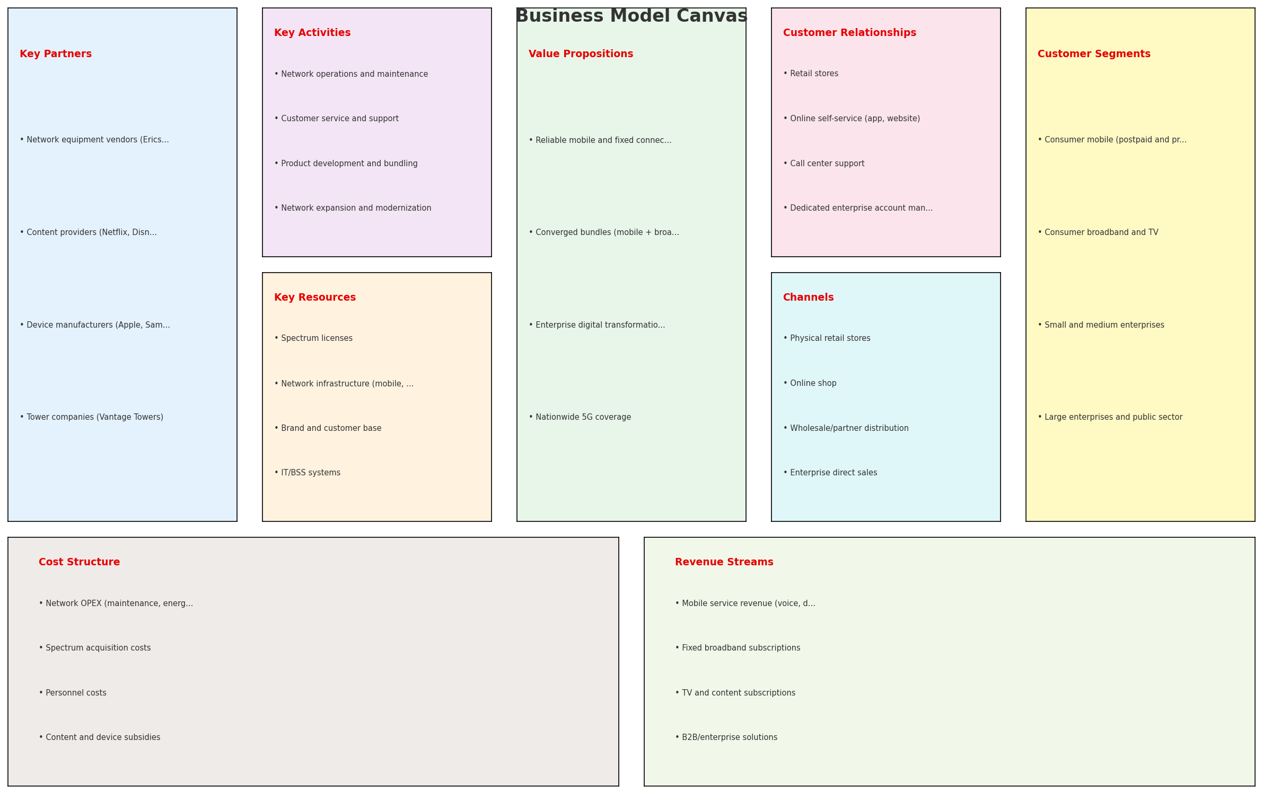
Business Model Canvas
商业模式画布
Key Message: Business model canvas overview
28

Slide 29
Organization & Talent
组织与人才
Key Message: Organization and talent assessment
29

Slide 30
Strengths, Weaknesses & Exposure Points
优势/劣势/风险暴露点
Strengths
Weaknesses
Exposure Points
• Brand Strength: score 82 (market avg 78)
• Enterprise Solutions: score 82 (market avg 74)
• Network Coverage: score 80 (market avg 76)
• Strong EBITDA margin at 36.2%
• Revenue on growth trajectory
• Top 2 in revenue market ranking
• Customer Service: score 70 (market avg 74)
• Pricing Competitiveness: score 72 (market avg 78)
• 1&1 building own mobile network and migrating users off Vodafone wholesale: Loss of wholesale revenue as 1&1 users migrate to own network
Key Message: Ranked #2 of 4 operators in market; revenue EUR 3092.0M; EBITDA margin 36.2%; stable but facing challenges; key strength: Brand Strength; key challenge: Customer Service
30

Slide 31
SWOT 综合分析
SWOT Synthesis

Slide 32
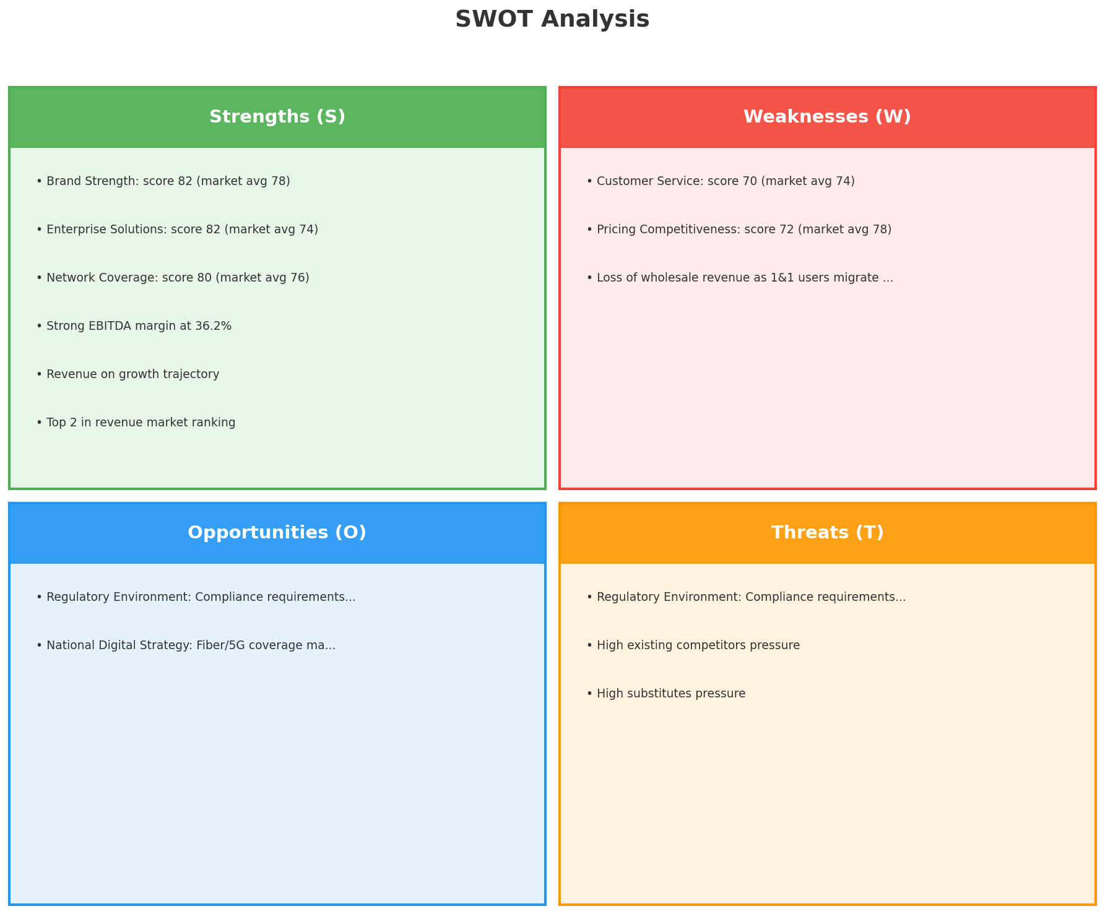
SWOT Analysis
SWOT 综合分析
SO:
Leverage 'Brand Strength: score 82 (market avg 78)' to ca...
WO:
Address weakness 'Customer Service: score 70 (market avg ...
ST:
Use strength 'Brand Strength: score 82 (market avg 78)' t...
WT:
Mitigate weakness 'Customer Service: score 70 (market avg...
Key Message: SWOT analysis identifies 7 strengths, 3 weaknesses, 2 opportunities, and 3 threats. The recommended strategic posture is defensive (ST-dominant).
32

Slide 33
05 看机会
Look at Opportunities — SPAN Matrix

Slide 34
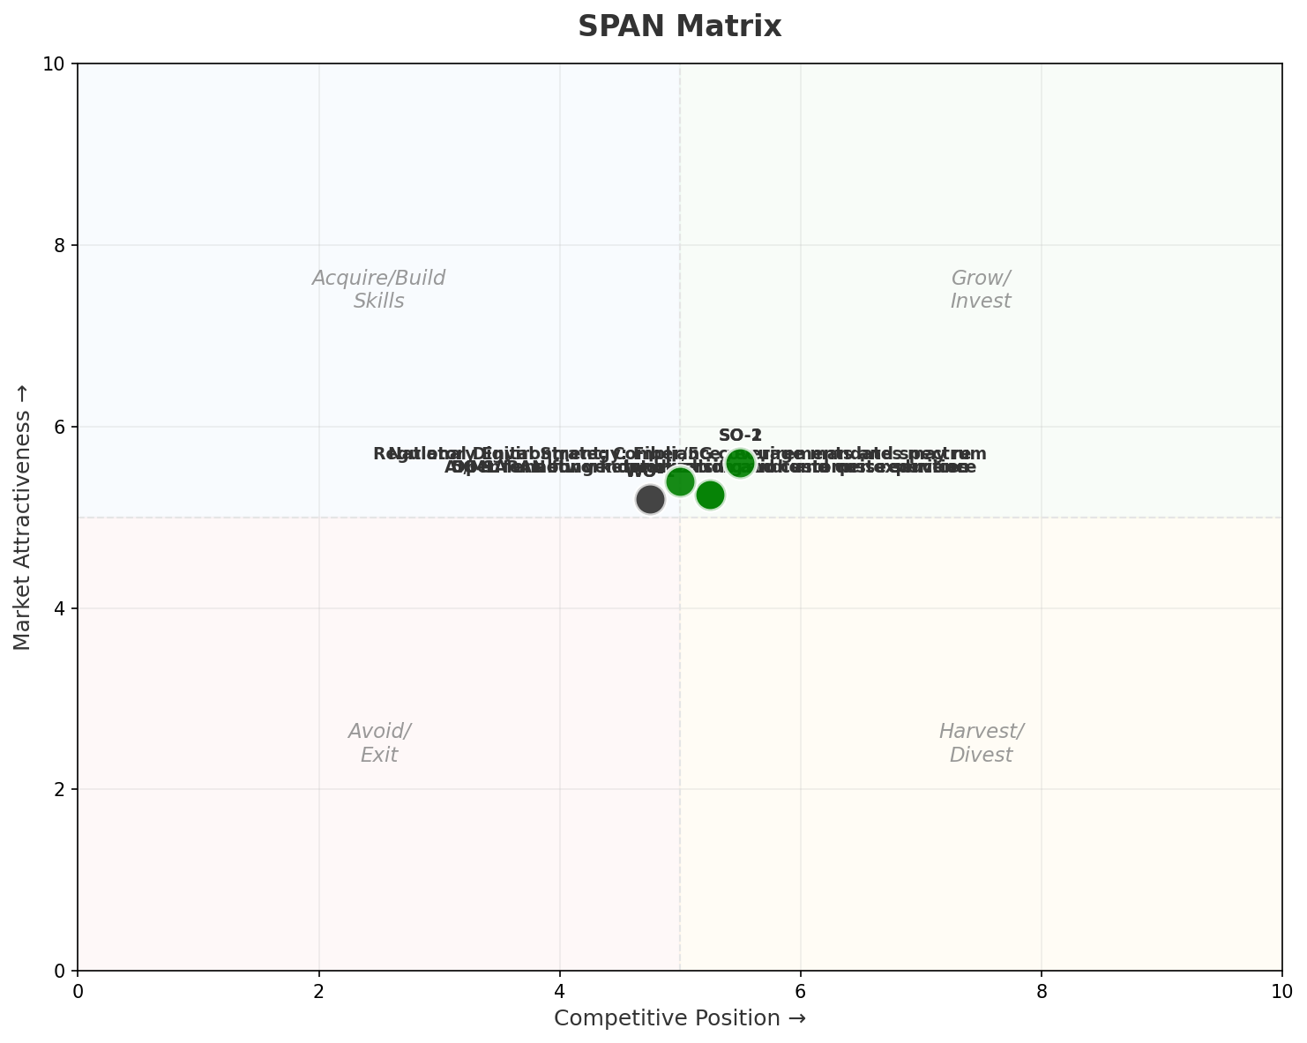
SPAN Matrix — Opportunity Positioning
机会定位矩阵
Key Message: SPAN matrix positions 9 opportunities: 7 grow/invest, 2 acquire skills, 0 harvest, 0 avoid/exit. Focus resources on the 7 grow/invest items for maximum strategic impact.
34

Slide 35
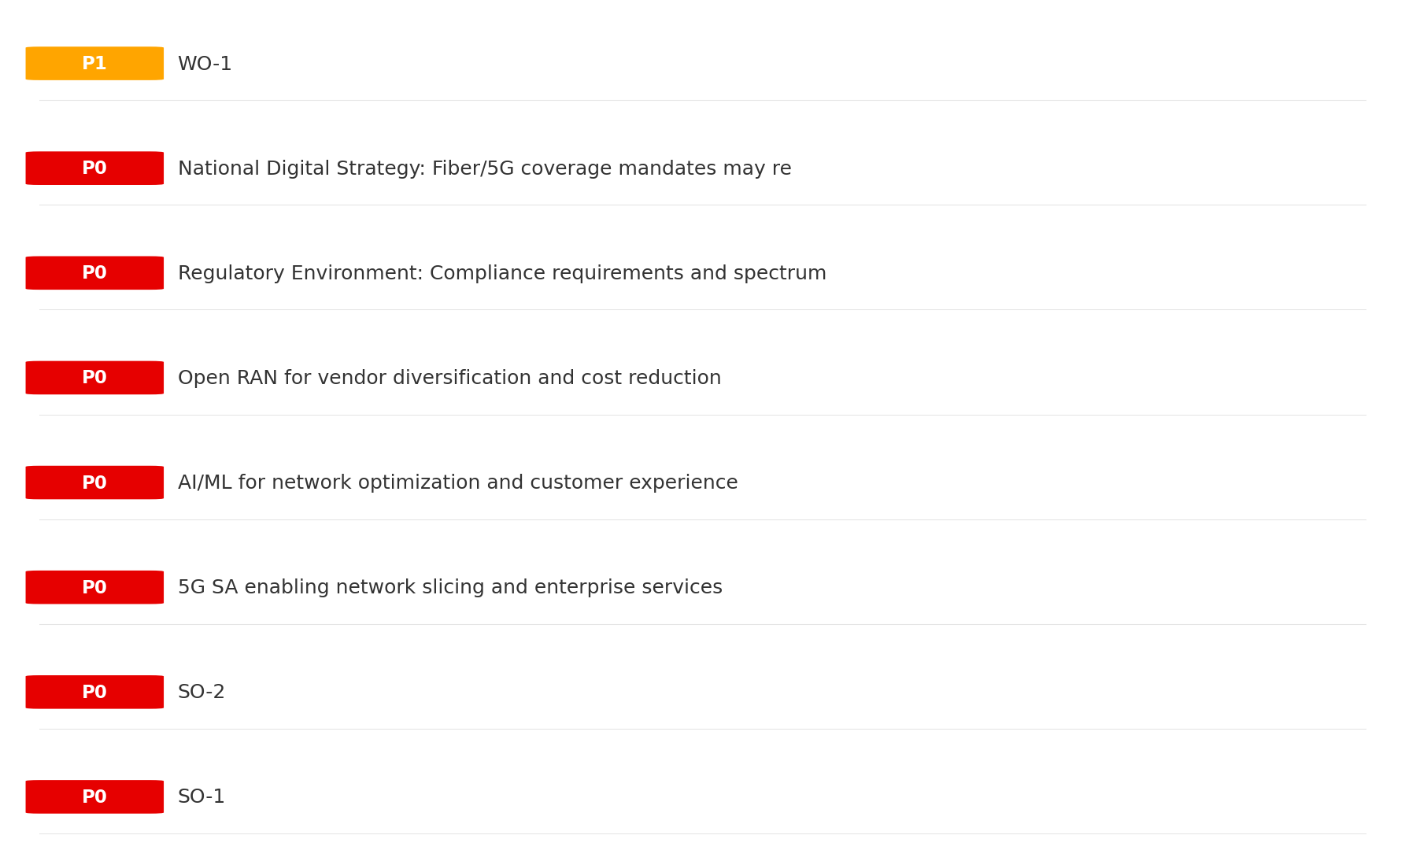
Opportunity Priority Ranking
机会优先级排序
Key Message: SPAN matrix positions 9 opportunities: 7 grow/invest, 2 acquire skills, 0 harvest, 0 avoid/exit. Focus resources on the 7 grow/invest items for maximum strategic impact.
35

Slide 36
Opportunity Details
机会详情
P0
SO-1
Market: N/A | Window:
Leverage 'Brand Strength: score 82 (market avg 78)' to capture the opportunity of 'Regulatory Environment: Compliance requirements and spectrum policies directly affect vodafone_germany'.
P0
SO-2
Market: N/A | Window:
Leverage 'Enterprise Solutions: score 82 (market avg 74)' to capture the opportunity of 'National Digital Strategy: Fiber/5G coverage mandates may require vodafone_germany investment but also enable subsidy access'.
P0
5G SA enabling network slicing and enterprise services
Market: N/A | Window:
Technology trend: 5G SA enabling network slicing and enterprise services
P0
AI/ML for network optimization and customer experience
Market: N/A | Window:
Technology trend: AI/ML for network optimization and customer experience
Key Message: SPAN matrix positions 9 opportunities: 7 grow/invest, 2 acquire skills, 0 harvest, 0 avoid/exit. Focus resources on the 7 grow/invest items for maximum strategic impact.
36

Slide 37
Analysis Summary
分析总结
01 Trends
Macro environment: Favorable. Key opportunities: Regulatory Environment, National Digital Strategy. Key risks: Regulatory Environment, Fiber Broadband Penetration.. Industry is mature. (+0.3% YoY (CQ2_2025 -> CQ4_2025))
02 Market
German telecom market totals EUR 12327.0M in quarterly revenue; vodafone_germany holds 25.1% market share; competitive strengths in Availability, Assurances; Market presents a balanced mix of opportunities and challenges.
03 Competition
In a 4-player market with medium competition intensity, Deutsche Telekom leads with 50% revenue share. Target operator holds 25% share. Strongest competitive force: Existing Competitors.
04 Self
Ranked #2 of 4 operators in market; revenue EUR 3092.0M; EBITDA margin 36.2%; stable but facing challenges; key strength: Brand Strength; key challenge: Customer Service
SWOT
SWOT analysis identifies 7 strengths, 3 weaknesses, 2 opportunities, and 3 threats. The recommended strategic posture is defensive (ST-dominant).
05 Opportunities
SPAN matrix positions 9 opportunities: 7 grow/invest, 2 acquire skills, 0 harvest, 0 avoid/exit. Focus resources on the 7 grow/invest items for maximum strategic impact.
Key Message: Complete Five Looks analysis — see opportunity priorities for next steps
37

Slide 38
Data Provenance
数据溯源
No provenance data recorded for this analysis
Key Message: All data points are traceable to original sources
38

Slide 39
Thank You
BLM Five Looks Strategic Analysis

