Slide 1
Vodafone Germany — BLM Strategic Assessment
Deep Analysis | Five Looks + SWOT + SPAN | CQ4 2025
Target Operator
Market
Period
Report Date
Vodafone Germany
German Telecom (4-Op Oligopoly
CQ4 2025 / Q3 FY26
2026-02-10
01 Trends (PEST) | 02 Market ($APPEALS) | Tariff | 03 Competition (Porter) | 04 Self (BMC) | SWOT | 05 Opportunities (SPAN

Slide 2
Report Contents
TABLE OF CONTENTS
ES
Executive Summary
Key findings, position, priorities (5 slides
01
Look at Trends
PEST macro environment analysis (5 slides
02
Look at Market
$APPEALS, segments, events (5 slides
T
Tariff Analysis
Mobile, fixed, FMC pricing (5 slides
03
Look at Competition
Porter, 3 competitor deep dives (6 slides
04
Look at Self
Health, revenue, network, BMC (6 slides
SW
SWOT Synthesis
Matrix, strategies, priorities (5 slides
05
Look at Opportunities
SPAN, priorities, financials (5 slides
S
Summary
Risk/reward, KPI dashboard (3 slides
2

Slide 3
Data Sources & Methodology
Data Points
Tariff Records
Analysis Documents
Time Span
~2,700 lines
466
8
8 Quarters
• CQ4_2025 Market Snapshot (4 operators, all KPIs
• 466 Tariff Records (H1_2023 - H1_2026, 7 snapshots
• 8-Quarter Financial Trend (CQ1 2024 – CQ4 2025 by segment
• 10 Market Events (ranked by strategic impact
• $APPEALS Assessment (8 dimensions x 4 operators
• Porter Five Forces + SWOT + SPAN Matrix
• Management Commentary (Q3 FY26 Earnings Call
Key Message: All data traceable to original sources; 8 deep analysis documents totaling ~2,700 lines
3

Slide 4
Executive Summary
Vodafone Germany BLM Strategic Assessment

Slide 5
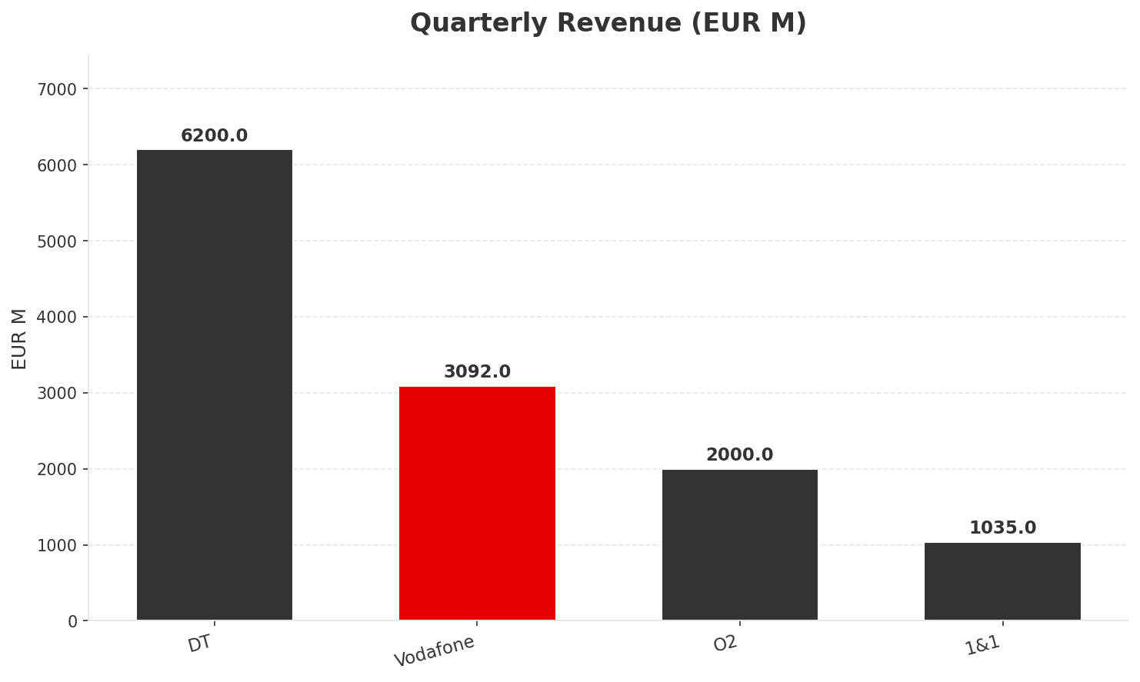
Situation at a Glance
EXECUTIVE SUMMARY
Market
Growth
HHI
Lifecycle
EUR 12.3B/q
+0.3% YoY
~3,500+
Mature
~EUR 49B ann.
Near-zero real
Highly concentrated
Zero-sum game
Revenue
EBITDA
Mobile
Churn
EUR 3,092M #2
36.2%
32,500K #3
1.05%
+0.7% YoY
+0.8pp over 8Q
+80K/q
Worst in market
• DT alone > other 3 combined (EUR 6,200M vs EUR 6,127M
• VF growing +0.7% vs DT +1.1% — gap widening
• O2 winning subs but losing revenue (-3.4%
• 1&1 at 8.4% share, still in MVNO-to-MNO build phase
Key Message: EUR 12.3B market growing at near-zero real — every euro must come from competitors
5

Slide 6
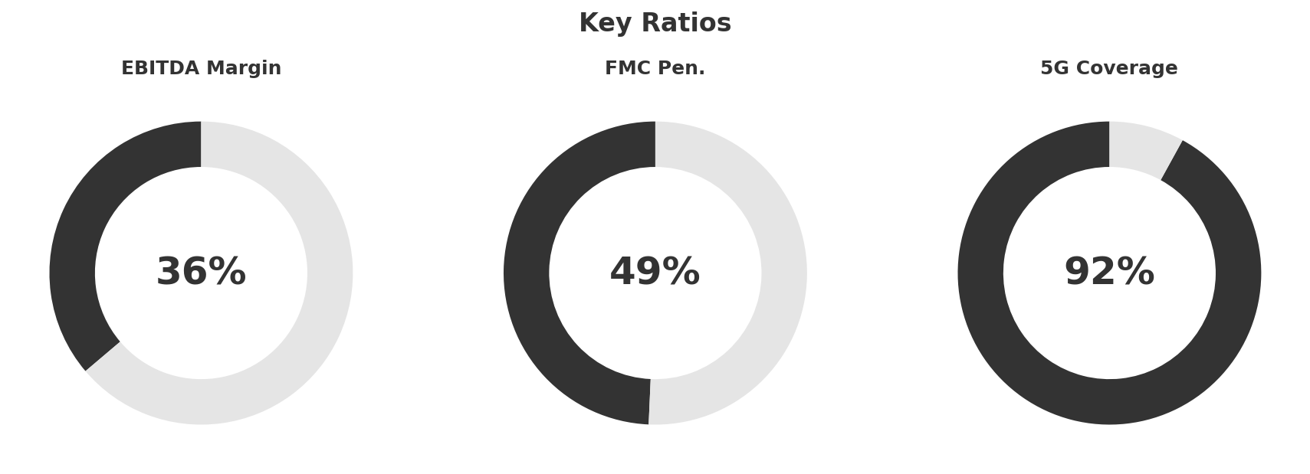
Vodafone Germany — Headline Numbers
EXECUTIVE SUMMARY
Revenue
EUR 3,092M/q (+0.7% YoY
Growing, barely
EBITDA
EUR 1,120M/q (36.2% margin
Healthy
Mobile
+80K/q net adds
Weakest in market (DT +340K
Broadband
-63K/q net loss
ONLY operator losing BB subs
B2B
EUR 520M/q (+8.5% YoY
Strongest growth engine
Wholesale
EUR 380M/q (+90% YoY
Temporary 1&1 windfall
FMC
4,900K subs (49.3% pen.
Key retention metric
Key Message: Stable #2 but growth engines (B2B, wholesale) mask flat consumer and declining broadband
6

Slide 7
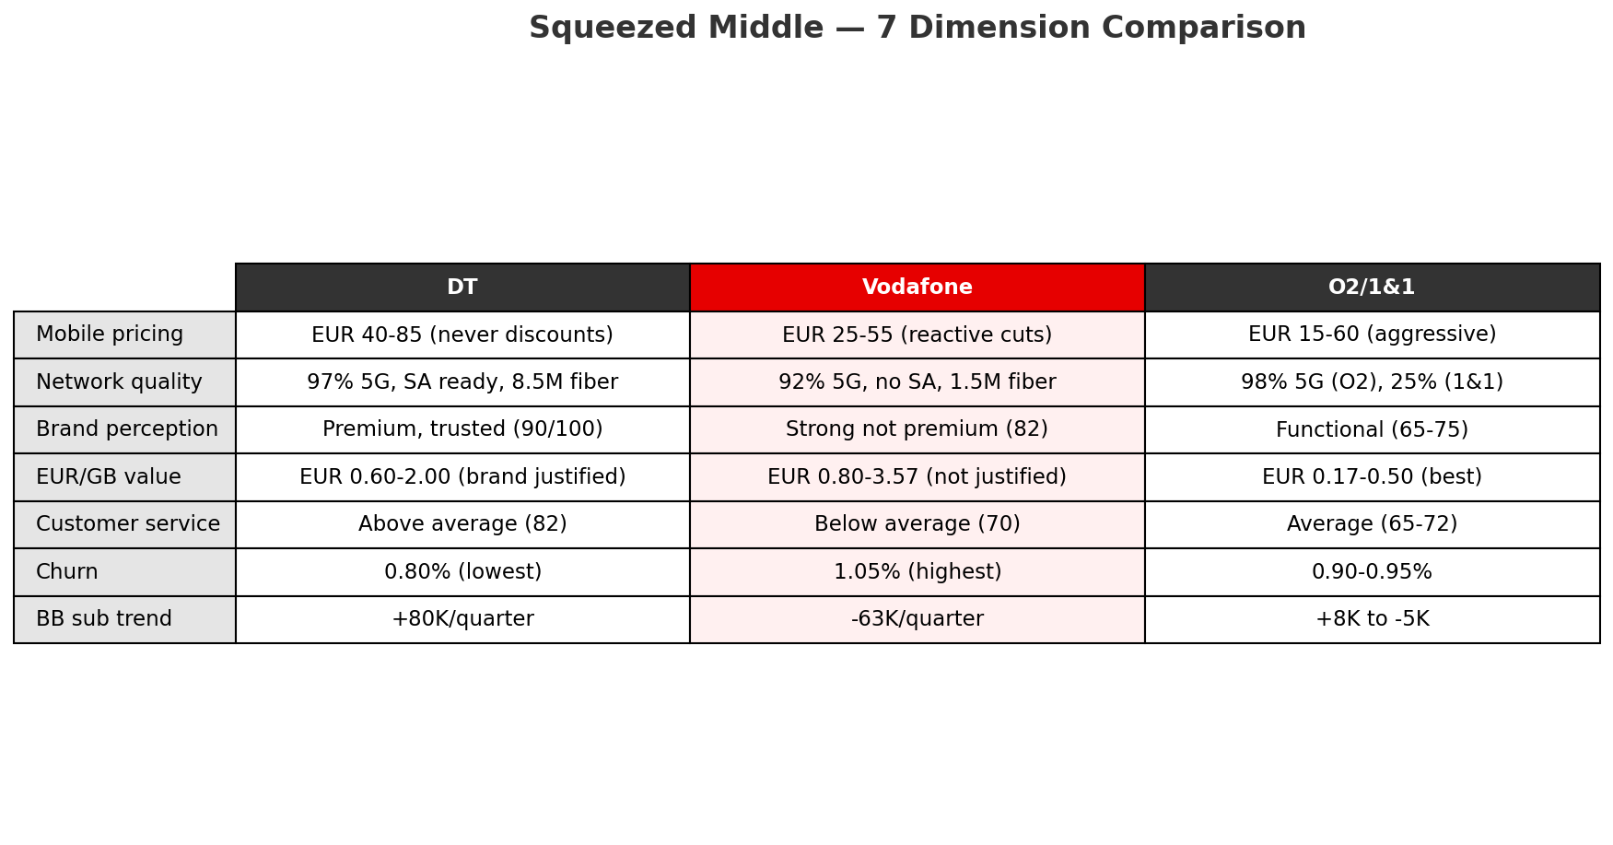
The "Squeezed Middle" — Central Diagnosis
EXECUTIVE SUMMARY
Escape Routes:
• Convergence moat: Cable+mobile FMC unique — neither O2 nor 1&1 can match
• B2B pivot: Enterprise less price-sensitive; Skaylink adds cloud/security
• Infrastructure: FibreCo JV + DOCSIS 4.0 to defend fixed broadband
Key Message: Customers wanting premium choose DT; wanting value choose O2/1&1 — VF must differentiate via FMC, B2B, infra
7

Slide 8
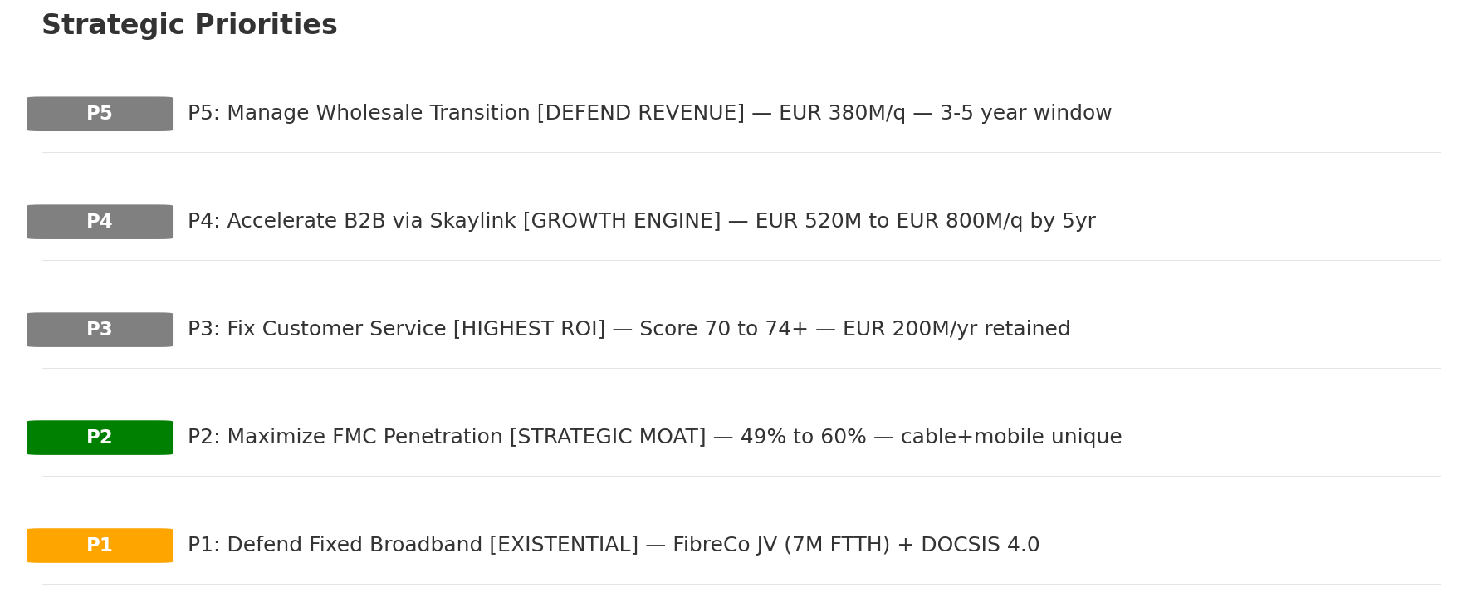
5 Strategic Priorities — Consolidated
EXECUTIVE SUMMARY
Key Message: Five priorities across all analyses — P1 (BB defense) is existential, P3 (service) is highest ROI
8

Slide 9
01 Look at Trends
PEST Framework — Macro Environment

Slide 10
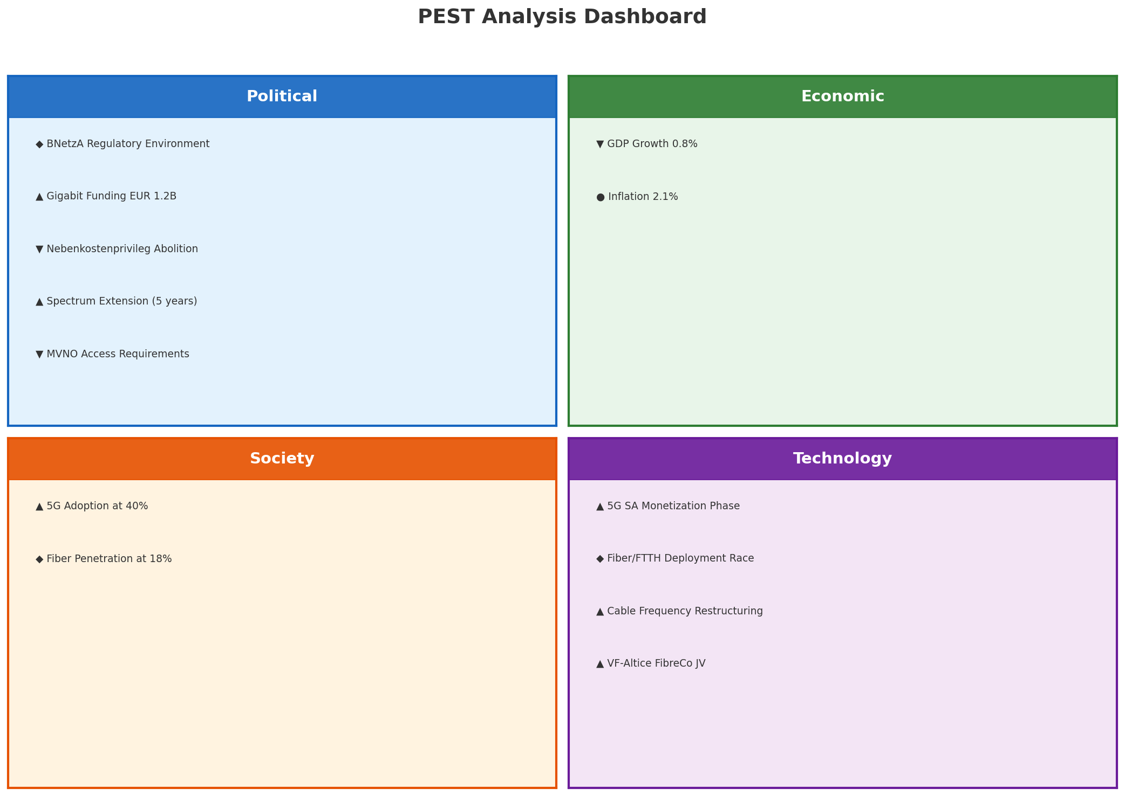
PEST Analysis Dashboard
MACRO ENVIRONMENT
Key Message: Net favorable (9 opps vs 3 threats) — but fiber displacement and 5G SA gap are existential risks
10

Slide 11
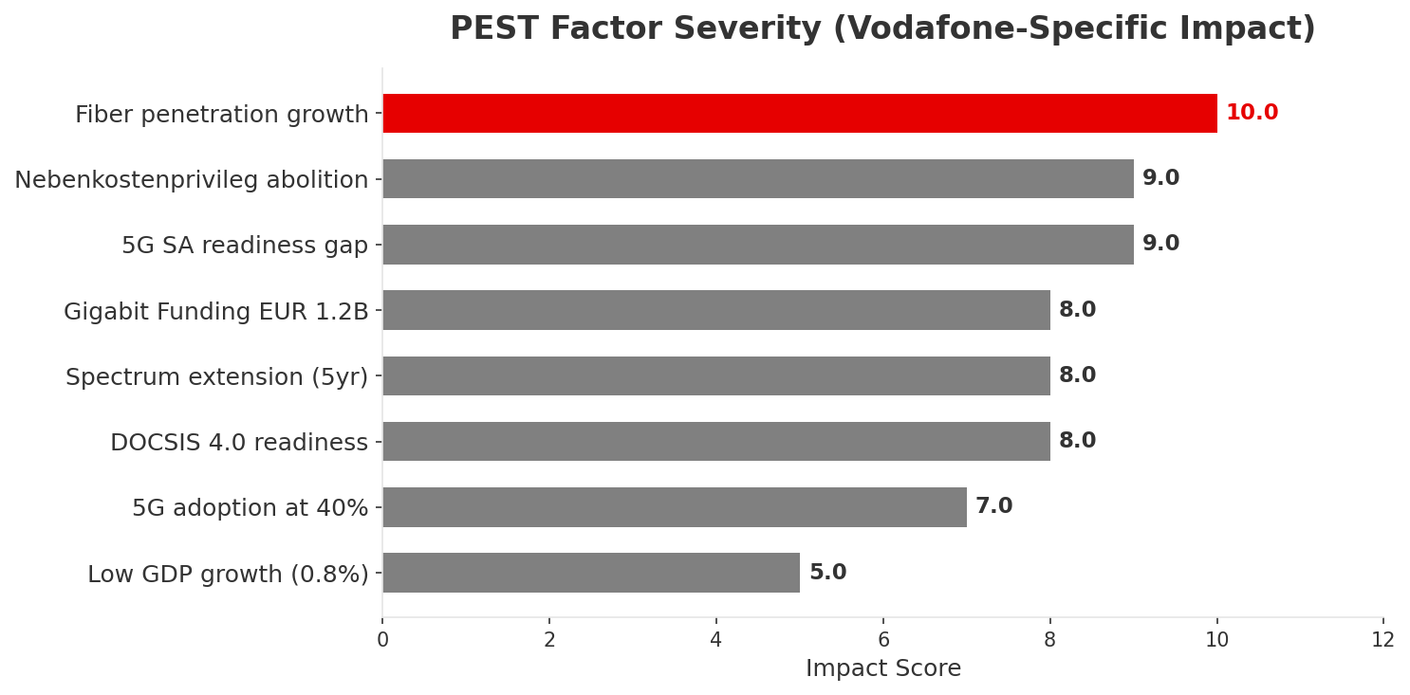
PEST Factor Priority Ranking — VF-Specific
MACRO IMPACT
Key Message: Fiber displacement is #1 threat; Gigabit Fund and spectrum extension are #1 opportunities
11

Slide 12
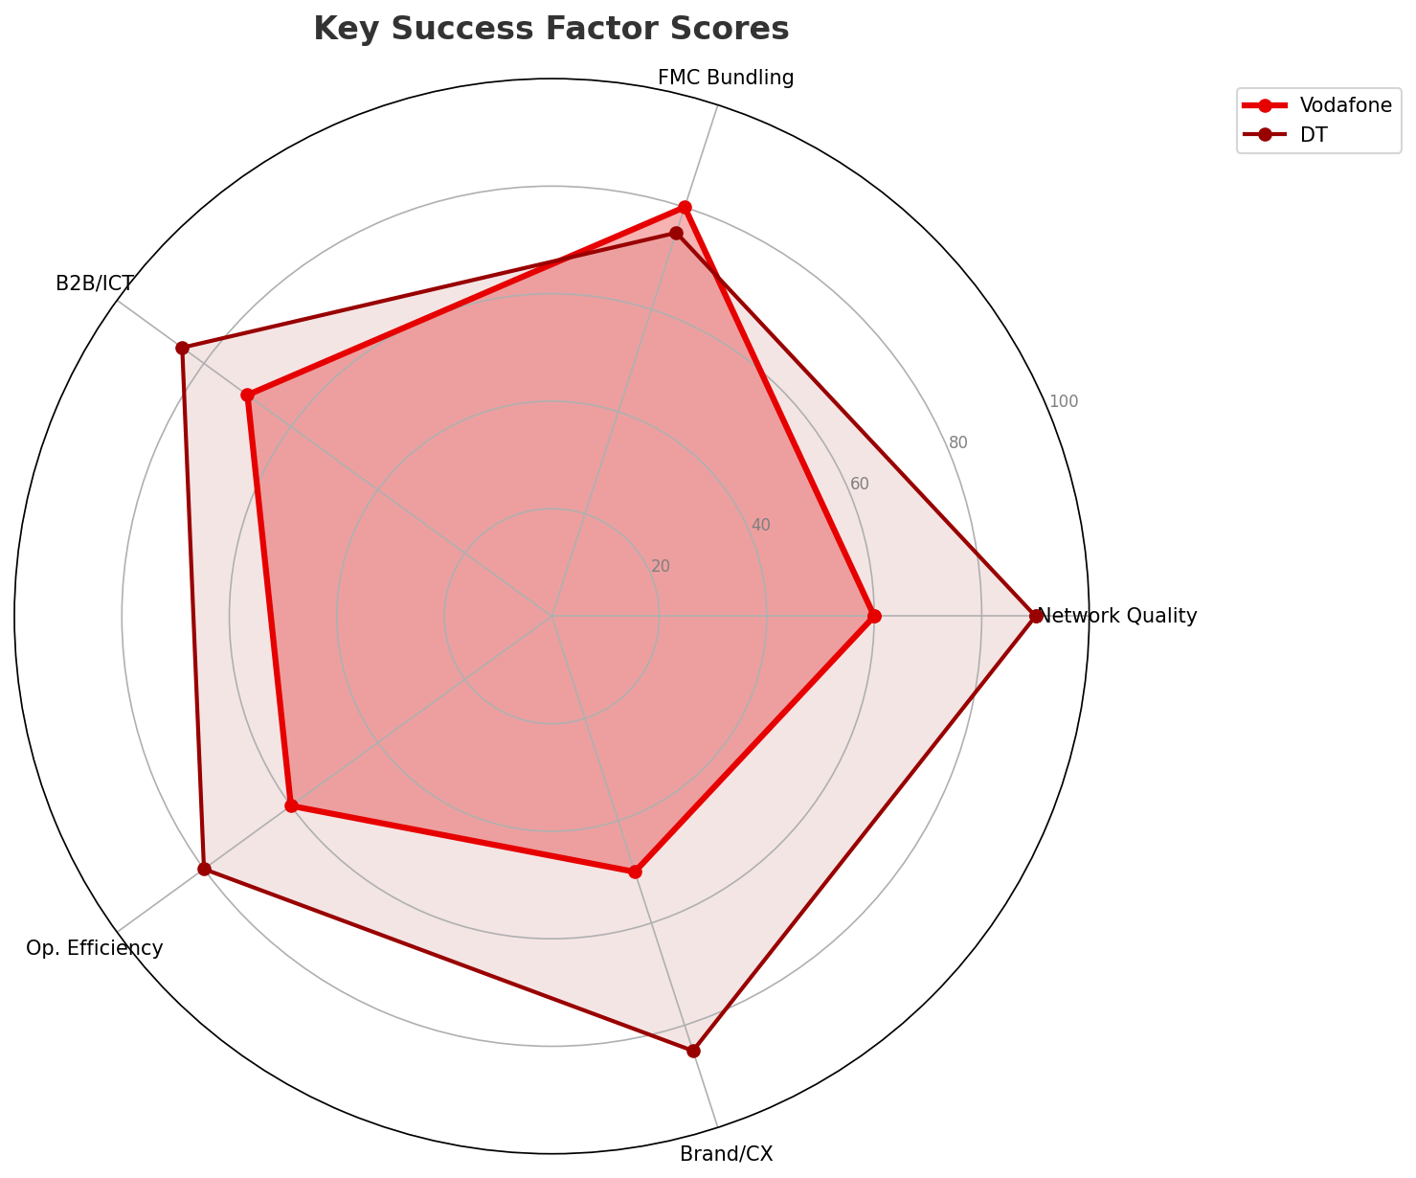
Industry Landscape & Key Success Factors
INDUSTRY ANALYSIS
Market Size
Penetration
CR4
Avg Margin
EUR 49B/yr
Mobile 170% / BB 37%
100%
~36.6%
4th globally
Pure oligopoly
Healthy
Mature Market Implications:
• Volume growth exhausted — mobile pen. >130%
• Competition shifts to retention and upsell
• ARPU defense > subscriber growth
• FMC and B2B are remaining growth pockets
• Regulatory and tech shifts are primary disruptors
Key Message: Mature market — growth only from stealing share; FMC and B2B are the growth pockets
12

Slide 13
Value Transfer & New Business Models
VALUE MIGRATION
Voice/SMS -> Data/OTT
Complete
Emerging Models:
• FWA (5G as BB substitute) — moderate for VF
• Network-as-a-Service (slicing) — high, needs 5G SA
• Wholesale/MVNO — EUR 380M/q, structural decline
• IoT platform — 3M connections, B2B synergy
Linear TV -> Streaming
Accelerating
Consumer -> B2B Enterprise
Growing
DSL/Copper -> Fiber
Accelerating
Cable BB -> Fiber
Beginning — VF main risk
Traditional capex -> NaaS
Emerging
Mobile-only -> FMC
Mature — proven retention
Key Message: Cable-to-fiber migration is VF's #1 value risk; FMC convergence is proven value creation
13

Slide 14
02 Look at Market
$APPEALS — Market Changes & Customer Needs

Slide 15
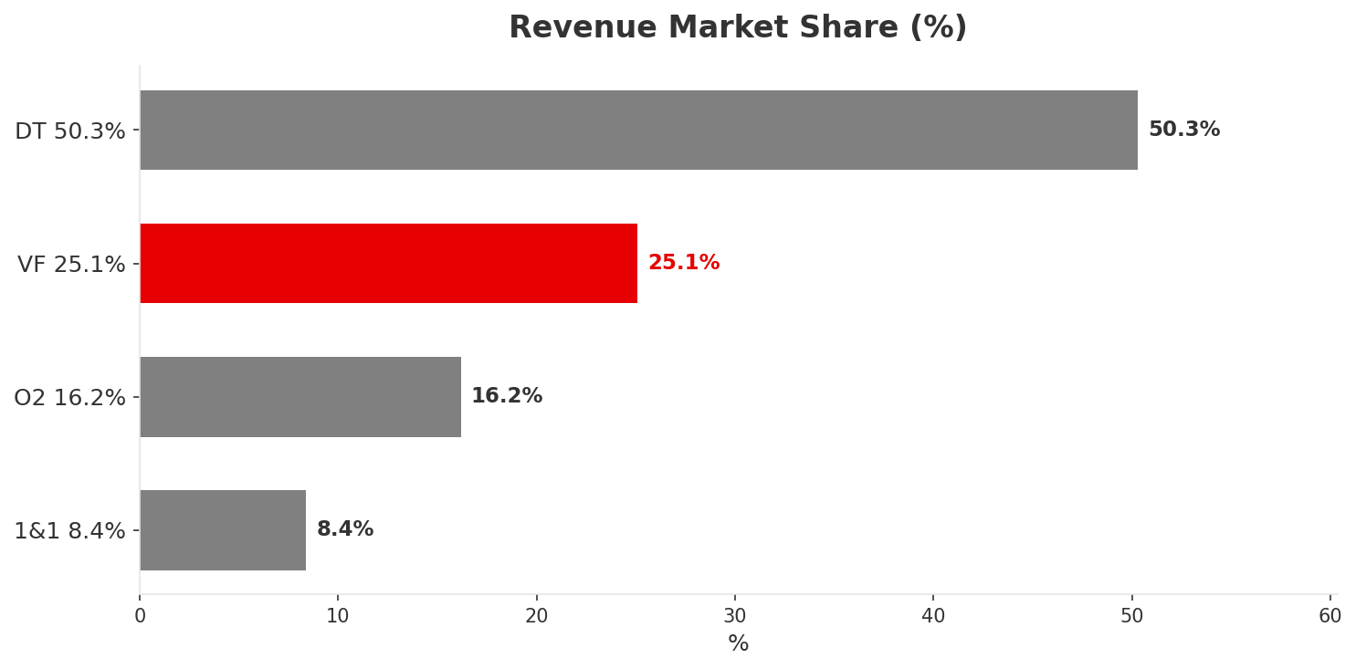
Market Snapshot — CQ4 2025
MARKET OVERVIEW
Revenue
Mobile Subs
BB Subs
Operators
EUR 12,327M/q
143,100K
31,420K
4
~EUR 49B/yr
170% pen.
37% pen.
CR4=100%
Monetization Insight:
• DT monetizes best: 36.5% mobile subs -> 50.3% revenue
• O2 monetizes worst: 32.1% subs -> 16.2% revenue
• VF in between: revenue share (25.1%) > mobile sub share (22.7%
• Revenue share tells the real competitive story
Key Message: EUR 12.3B market — DT captures more revenue than the other 3 combined
15

Slide 16
7 Customer Segments
SEGMENTATION
P1
Consumer High-End
~13.9M
Growing
P1
Consumer Mainstream
~51.2M
Stable
P3
Consumer Price-Sensitive
~35.1M
Shrinking
P2
Consumer Youth
~17.2M
Growing
P1
Enterprise Large
~47K
Growing
P2
Enterprise SME
~896K
Stable
P2
Wholesale/MVNO
~17.2M
Stable
Key Message: Focus on High-End + Mainstream + Enterprise; deprioritize price-sensitive (35M subs
16

Slide 17
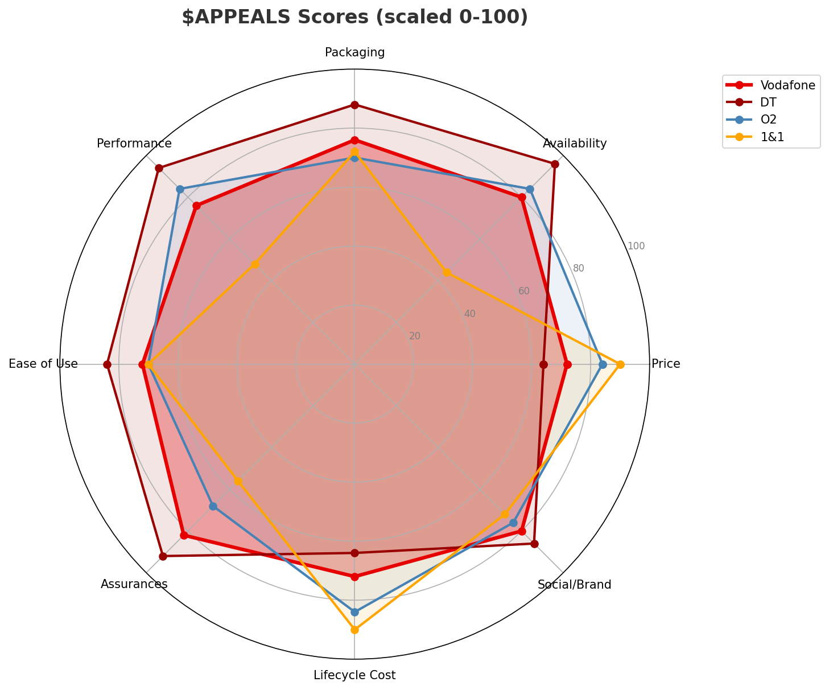
$APPEALS Assessment — Customer Needs
CUSTOMER PERCEPTION
Key Gaps:
• Performance: VF 3.8 vs DT 4.7 (gap -0.9pt) — CRITICAL
• Price: VF 3.6 vs 1&1 4.5 (gap -0.9pt) — CRITICAL
• Availability: VF 4.0 vs DT 4.8 (gap -0.8pt) — CRITICAL
• VF beats DT on: NOTHING
• VF best score: Assurances (4.1) — trust/reliability
• Triple weakness: Price, Ease of Use, Lifecycle Cost (all 3.6
Key Message: VF beats DT on nothing — squeezed middle confirmed in customer perception
17

Slide 18
Top Market Events — CQ4 2025
COMPETITIVE INTELLIGENCE
1
DT reboots fiber, targets VF cable footprint
High
2
VF completes 1&1 migration: 12M users on network
High
3
1&1 completes OpenRAN, reaches 25% coverage
High
4
VF-Altice FibreCo JV: 7M FTTH homes
High
5
VF acquires Skaylink for EUR 175M
High
6
BNetzA extends spectrum by 5 years
High
7
DT Q3: revenue +1.5%, profit +14.3%
Medium
8
VF restructures cable TV frequencies
Medium
Three Battles: 1) Fixed BB Infrastructure | 2) Wholesale Economics | 3) B2B Transformation
Key Message: 10 market events — DT fiber overbuild (#1) and 1&1 network build (#3) are the strategic threats
18

Slide 19
Tariff Analysis
Mobile, Fixed & Convergence Pricing Landscape

Slide 20
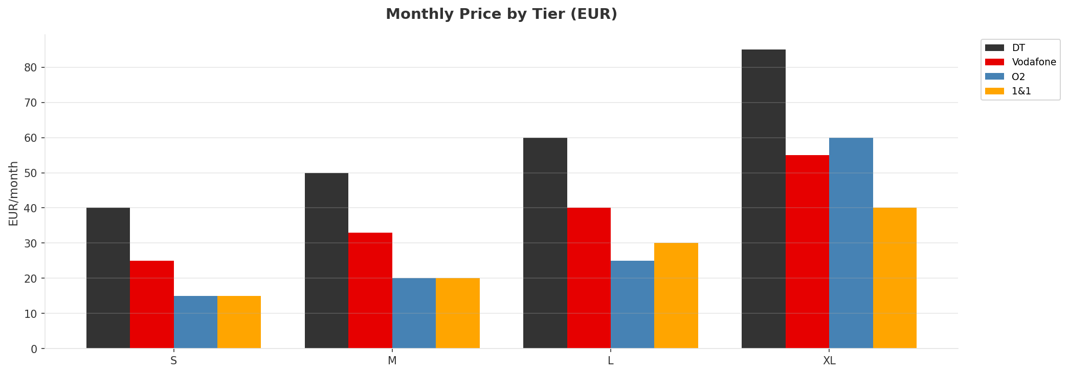
Mobile Postpaid Price Comparison — H1 2026
CROSS-OPERATOR BENCHMARKING
Price Gaps:
• Tier S: DT premium 167% vs O2/1&1
• Tier M: DT premium 150%
• Tier L: DT premium 140%
• Tier XL: DT premium 112%
• VF sits 65-75% above O2/1&1
• VF sits 20-35% below DT
• = Classic 'squeezed middle'
Key Message: DT commands 112-167% premium; VF caught in the middle — too expensive for value, not premium enough for DT
20

Slide 21
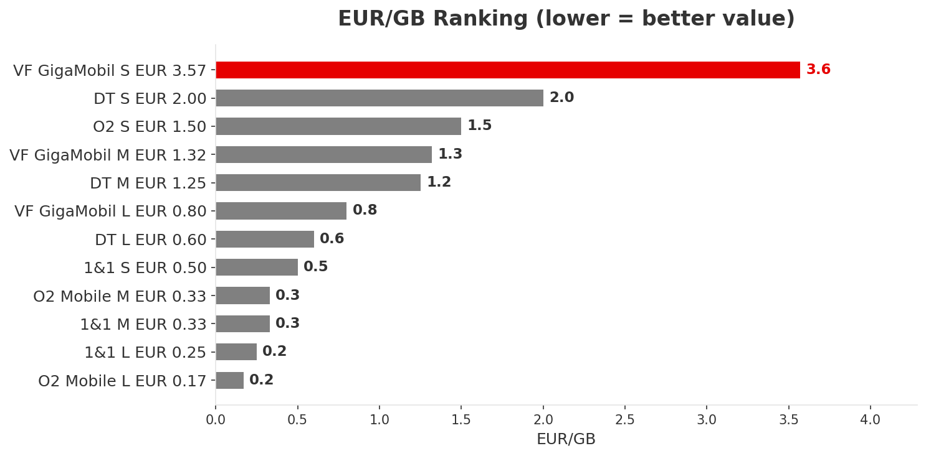
EUR/GB Value Analysis — Mobile Postpaid H1 2026
PRICING INTELLIGENCE
• VF GigaMobil S at EUR 3.57/GB is worst in market
• That's 21x worse than O2 Mobile L (EUR 0.17/GB
• O2 best value: 1/5 of VF at L tier
• 1&1 consistently 2nd-best value
• Options: increase data to 15-20GB at same price
• or cut price to EUR 20 to close O2/1&1 gap
Key Message: VF GigaMobil S worst value in market (EUR 3.57/GB) — 21x worse than O2; repricing or data rebalance needed
21

Slide 22
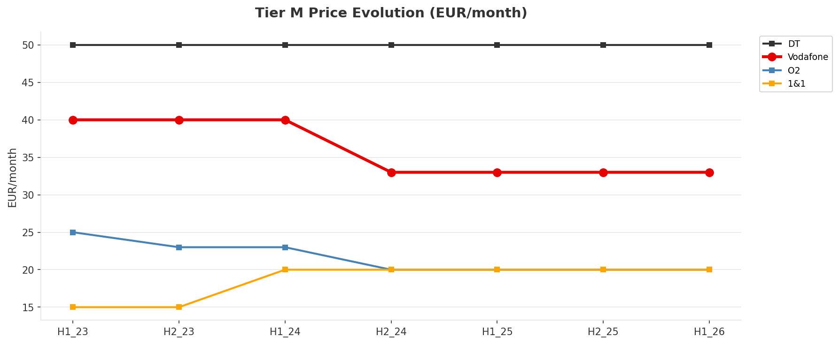
Mobile Postpaid Price Evolution — H1 2023 to H1 2026
3-YEAR PRICING TRENDS
• DT: Never discounts — doubled data instead
• VF: One major reset H2_2024 (-17-20%), then frozen
• O2: Most aggressive — two disruptions in 18mo
• 1&1: MVNO-to-MNO price increase justified by own network
• 5G premium eroded from +123% to 0% in 18 months
• Differentiation must come from FMC, SA, B2B
Key Message: DT never discounts; O2 most aggressive; VF reactive — 5G premium fully eroded to 0%
22

Slide 23
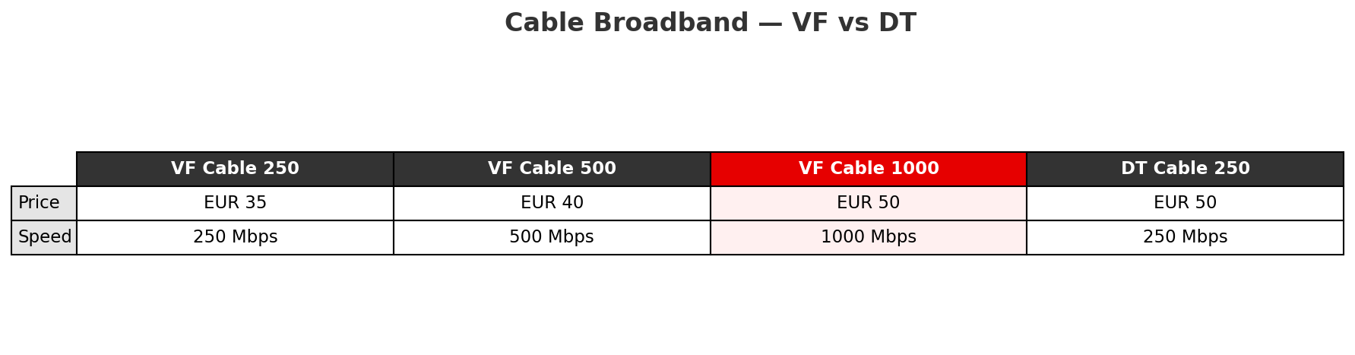
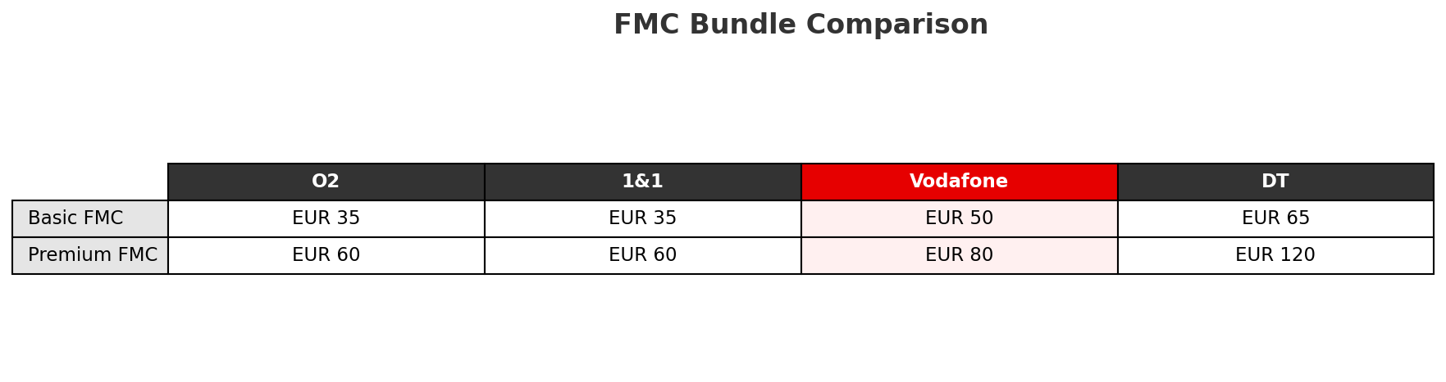
Fixed Broadband & FMC Bundle Pricing
CABLE, DSL, FIBER, FMC
• Cable is VF's crown jewel:
• 1000 Mbps at EUR 50 vs DT 250 Mbps at EUR 50
• = 4x speed at same price
• FMC narrows the price gap:
• VF Basic EUR 50 is 43% above O2/1&1
• (vs 65-167% gap in mobile alone
• FMC should be the lead product —
• cable speed advantage = sustainable moat
Key Message: Cable is VF's only clear pricing win (4x speed at same price); FMC narrows the competitive gap
23

Slide 24
03 Look at Competition
Porter's Five Forces — Competitive Landscape

Slide 25

Porter's Five Forces
COMPETITIVE FORCES
Overall: MEDIUM
• Price competition fierce at value end
• DT insulated in premium bubble
• 1&1 OpenRAN is structural change
• OTT substitution 90% complete
• VF has highest churn (1.05%
Key Message: Medium overall intensity — but masks fierce price competition at value end while DT operates in premium bubble
25

Slide 26
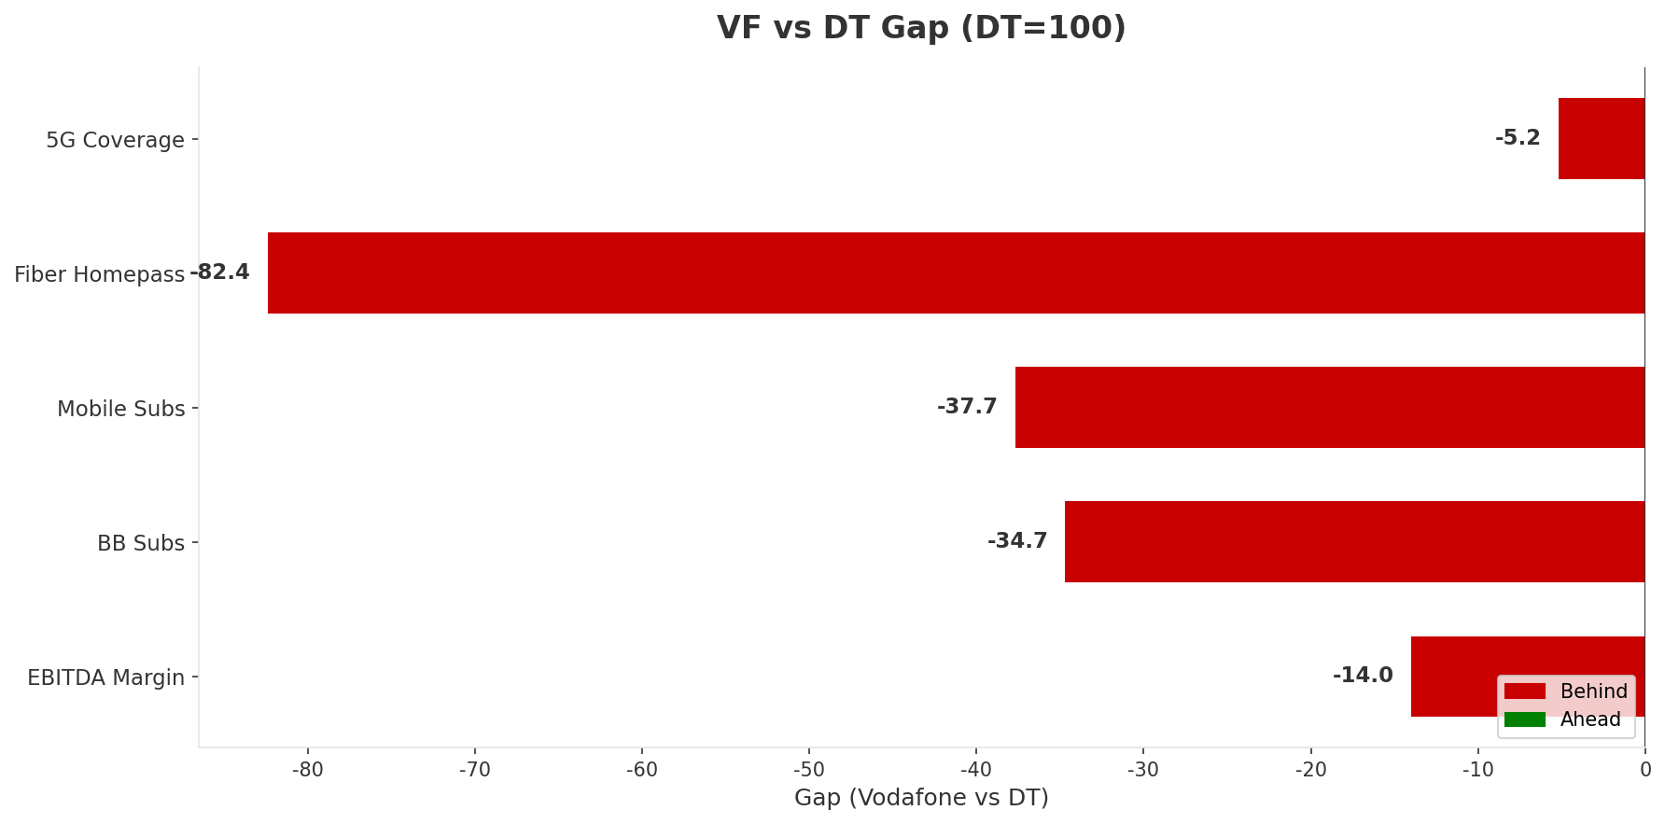
Deutsche Telekom — The Unassailable Incumbent
COMPETITOR DEEP DIVE
Revenue
EBITDA Margin
Capex/Rev
Mobile Subs
EUR 6,200M/q
42.1%
19.4%
52,200K
2.0x VF
+5.9pp vs VF
Most efficient
1.6x VF
Strategy: "Premium fortress with fiber moat"
• Never discount — doubles data instead
• Fiber-first: 8,500K homepass (4x VF
• Commands 112-167% premium across all tiers
• Only operator growing revenue + margin + subs
• Actively targeting VF cable footprint with fiber
Key Message: DT is 2x VF on revenue with 6pp higher margins — gap widening; fiber overbuild is existential threat
26

Slide 27
Telefonica O2 — The Value Disruptor
COMPETITOR DEEP DIVE
Revenue
EBITDA Margin
Revenue Growth
Mobile Subs
EUR 2,000M/q
32.5%
-3.4%
45,900K
0.65x VF
-3.7pp vs VF
Declining!
1.4x VF
Strategy: "More for less — volume at any cost"
Threat & Opportunity:
• Most aggressive pricing: two major restructures in 18mo
• 5G democratization — first to make 5G standard on all plans
• "Grow" innovation: auto-increasing data at same price
• 98% 5G but only 2,400K BB subs — no convergence play
• Revenue paradox: winning subs (+170K/q) but losing revenue
• THREAT: O2 EUR 20/60GB vs VF EUR 33/25GB — stark value gap
• O2 'Grow' feature is a retention innovation VF lacks
• OPPORTUNITY: O2 has no fixed BB (2,400K vs VF 9,940K
• FMC bundling is VF's counter to O2 price aggression
Key Message: O2 winning subs but destroying value (-3.4% revenue); FMC is VF's counter — O2 has no fixed broadband
27

Slide 28
1&1 AG — The Insurgent Network Builder
COMPETITOR DEEP DIVE
Revenue
EBITDA Margin
Capex/Rev
5G Coverage
EUR 1,035M/q
12.2%
38.6%
55%
0.33x VF
-24pp vs VF
Building network
vs VF 92%
Strategy: "From MVNO underdog to OpenRAN pioneer"
Wholesale Risk:
• MVNO to MNO transformation — Europe's first OpenRAN 5G
• Successfully raised prices 14-50% at network launch
• Cheapest unlimited in Germany: EUR 40 (VF EUR 55, DT EUR 85
• 12.2% EBITDA reflects 'invest now, monetize later'
• Coverage gap (55%) is critical weakness
• THREAT (short-term): competes on price at bottom tier
• THREAT (long-term): 12M hosted subs will migrate off VF network
• At 50% coverage (est. 2027), migration accelerates
• Wholesale revenue EUR 380M/q at risk over 3-5 years
• OPPORTUNITY: OpenRAN quality untested — may drive subs back
Key Message: 1&1 at 25% coverage with cheapest unlimited (EUR 40) — wholesale revenue (EUR 380M/q) is VF's main risk
28

Slide 29
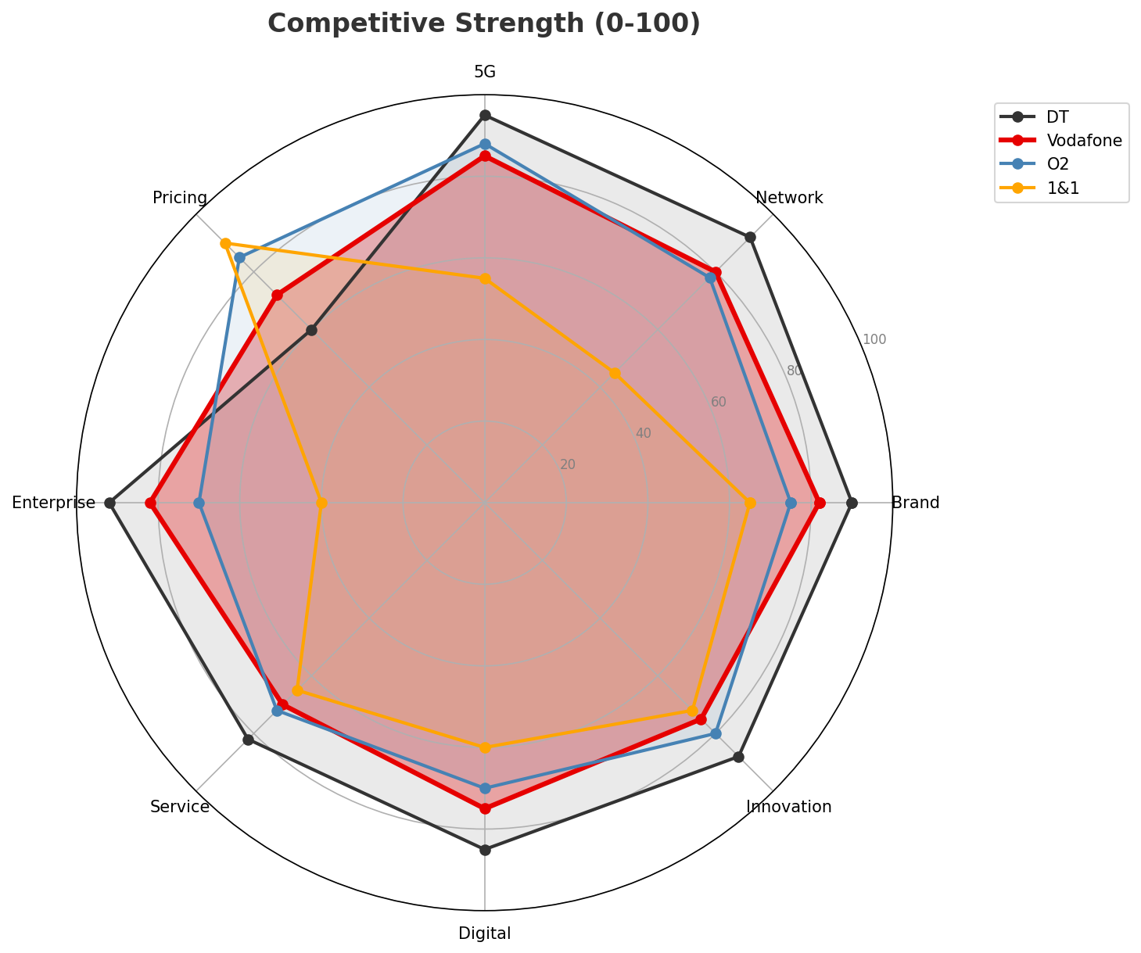
Competitive Strength Radar
CROSS-OPERATOR COMPARISON
• DT outscores VF on 8 of 9 dimensions
• VF's only relative advantage: Pricing (72 vs DT 60
• But O2 (85) and 1&1 (90) outscore VF on Pricing too
• = Squeezed middle quantified
• VF wins on:
• Cable broadband (~24M homepass
• Convergence/FMC (4,900K subs
• TV leadership (7,740K — 1.8x DT
Key Message: DT outscores VF on 8/9 dimensions; VF's advantages are cable, FMC, and TV — must defend and extend
29

Slide 30
04 Look at Self
BMC + Capability Assessment

Slide 31
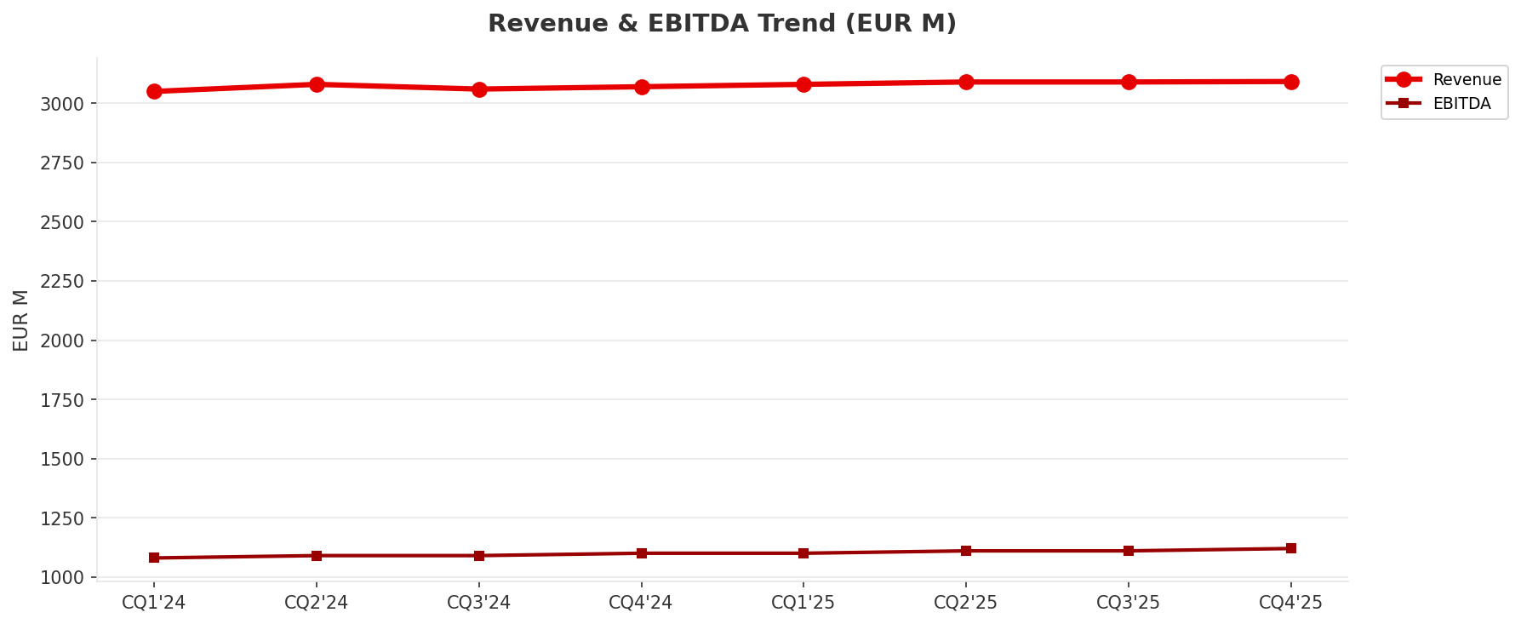
Operating Health Check
FINANCIAL HEALTH
Revenue
EBITDA
Capex
Employees
EUR 3,092M/q
EUR 1,120M/q
EUR 800M/q
14,500
+0.7% YoY
36.2% margin
25.9% intensity
• Revenue flat: EUR 3,050M -> EUR 3,092M over 8Q (+1.4%
• Margin expanding: 35.4% -> 36.2% (+0.8pp
• Cost optimization doing the heavy lifting, not growth
• Capex/Rev 25.9% vs DT 19.4% — less efficient
• "Managed optimization" playbook, not a growth story
Key Message: Slow growth mode — revenue +0.7% but margin improving; cost optimization doing heavy lifting
31

Slide 32
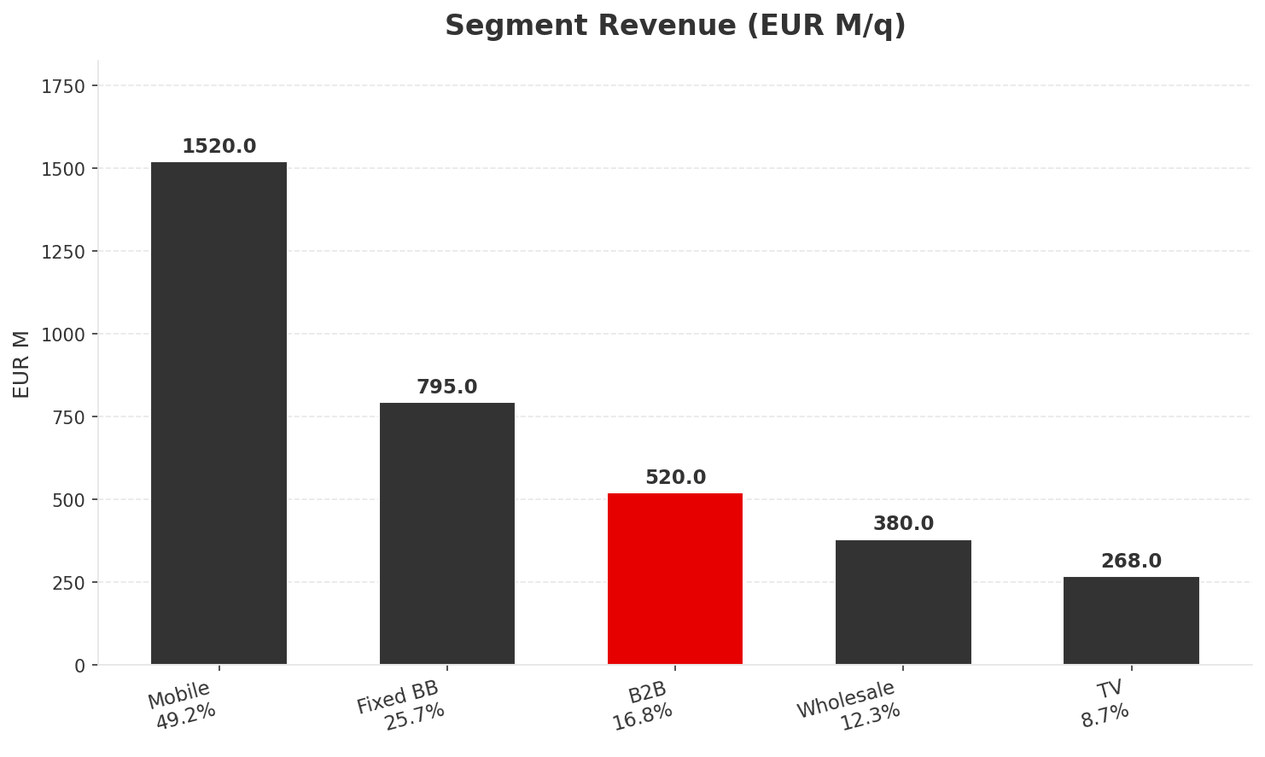
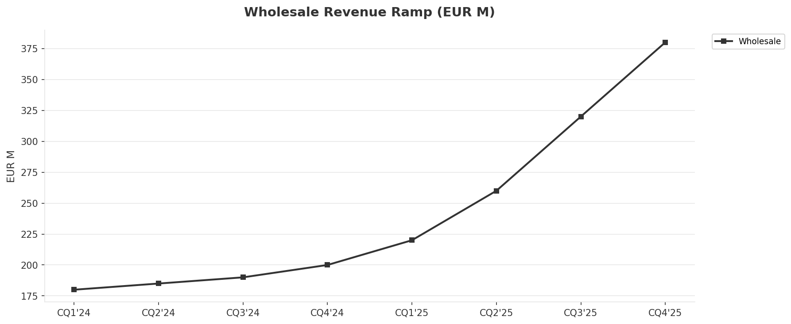
Revenue Breakdown & Segment Portfolio
REVENUE ANALYSIS
YoY Growth:
Mobile +2.8%
Fixed BB -1.1%
B2B +8.5%
Wholesale +90%
TV -3.6%
• Wholesale EUR 180M -> EUR 380M in 8Q (1&1 driven
• Peak reached — structural decline as 1&1 builds coverage
• EUR 100-200M/q at risk by 2028-29
Key Message: B2B (+8.5%) and Wholesale (+90%) mask flat consumer; wholesale is temporary windfall
32

Slide 33
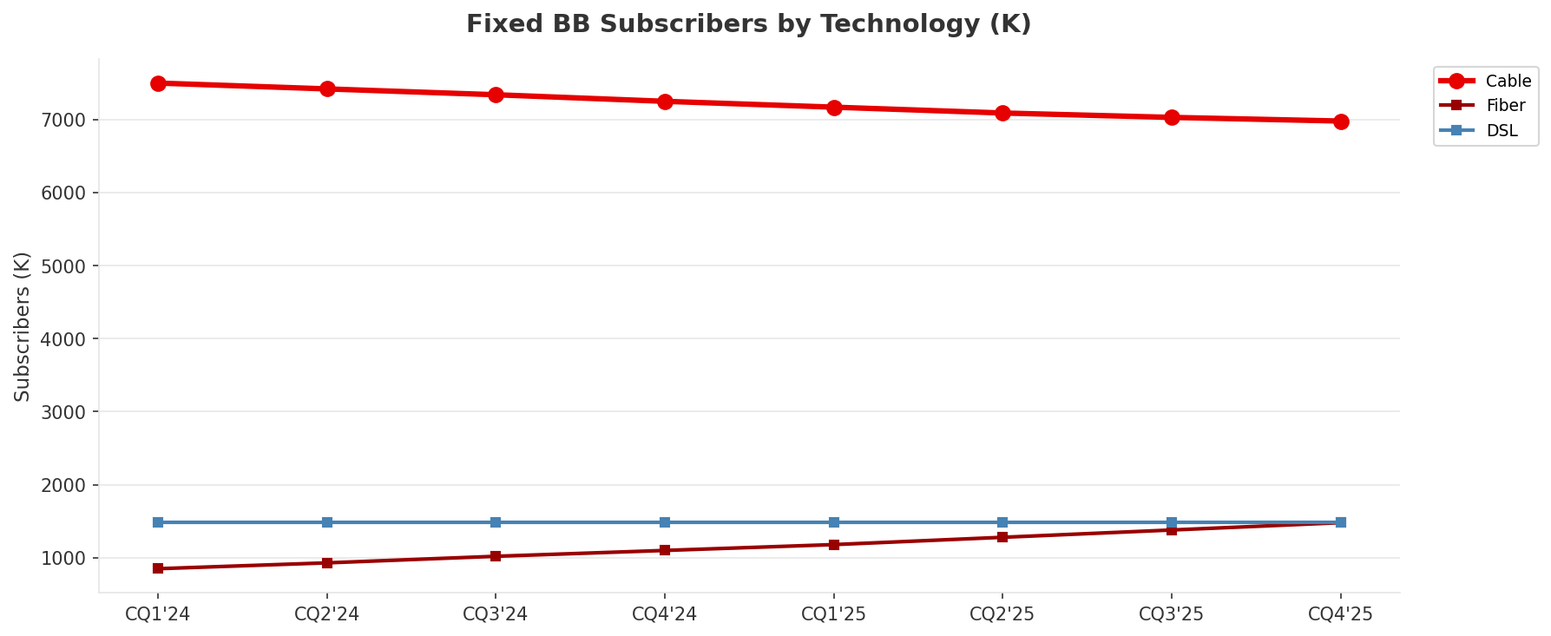
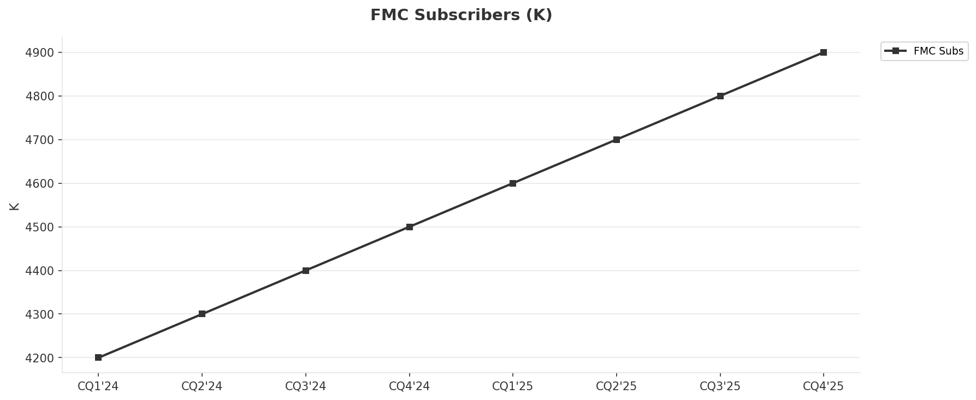
Fixed Broadband — The Critical Battleground
SEGMENT ANALYSIS
• Cable: 7,500K -> 6,980K (-6.9%) HEMORRHAGING
• Fiber: 850K -> 1,480K (+74.1%) BRIGHT SPOT
• DSL: 1,480K stable (legacy
• Net: -63K/q — ONLY operator losing BB subs
• At current pace, cable < 6,000K by end-2027
• FibreCo JV + DOCSIS 4.0 is the dual-track answer
• FMC: 4,200K -> 4,900K (+16.7%
• Penetration: 40.7% -> 49.3% (+8.6pp
• FMC customers churn 30-40% less
Key Message: Cable hemorrhaging (-6.9% over 8Q); fiber growing (+74%); FMC at 49% is the retention engine
33

Slide 34
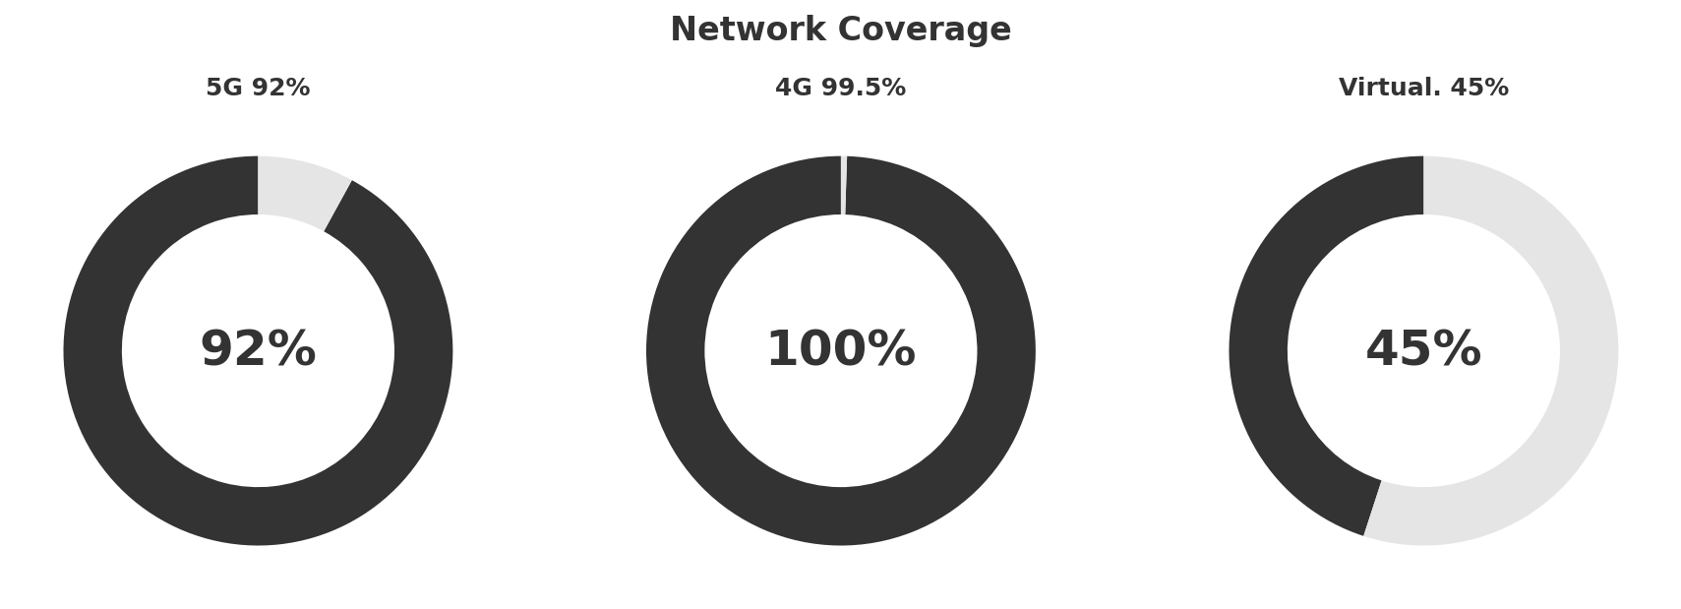
Network Infrastructure & Technology Gap
NETWORK
Three Critical Gaps:
Unique Advantage:
• 5G coverage: 92% vs DT 97%, O2 98% — now #3 network
• 5G SA: DT commercial since Sep 2024; VF still testing — 12-18mo behind
• Fiber homepass: 1,500K vs DT 8,500K (5.7x gap
• Cable network (~24M homepass) — unique differentiator
• 1000 Mbps cable at competitive prices
• DOCSIS 4.0 -> 10Gbps symmetric (matches fiber
Key Message: 5G #3, fiber 5.7x behind DT, SA 12-18mo late — but cable 24M homepass is unchallengeable moat
34

Slide 35
Strengths, Weaknesses & Exposure Points
SELF ASSESSMENT
Strengths
Weaknesses
Exposure Points
• Cable BB network (24M homes
• Brand strength (82/100
• Enterprise solutions (82/100
• EBITDA margin (36.2%
• TV leadership (7,740K
• Revenue growth trajectory
• Highest churn (1.05%
• Customer service (70/100
• Pricing competitiveness (72
• 5G coverage gap (92%
• Fiber homepass gap (1.5M
• BB subscriber losses (-63K/q
• 1&1 wholesale decline (EUR 100-200M/q
• DT fiber overbuild in cable footprint
• O2 further price disruption
• 5G SA delay beyond 2026
• Cable obsolescence perception
Key Message: Stable but diverging — B2B and wholesale masking declines in fixed and competitive slippage
35

Slide 36
SWOT Synthesis
Strengths, Weaknesses, Opportunities & Threats

Slide 37
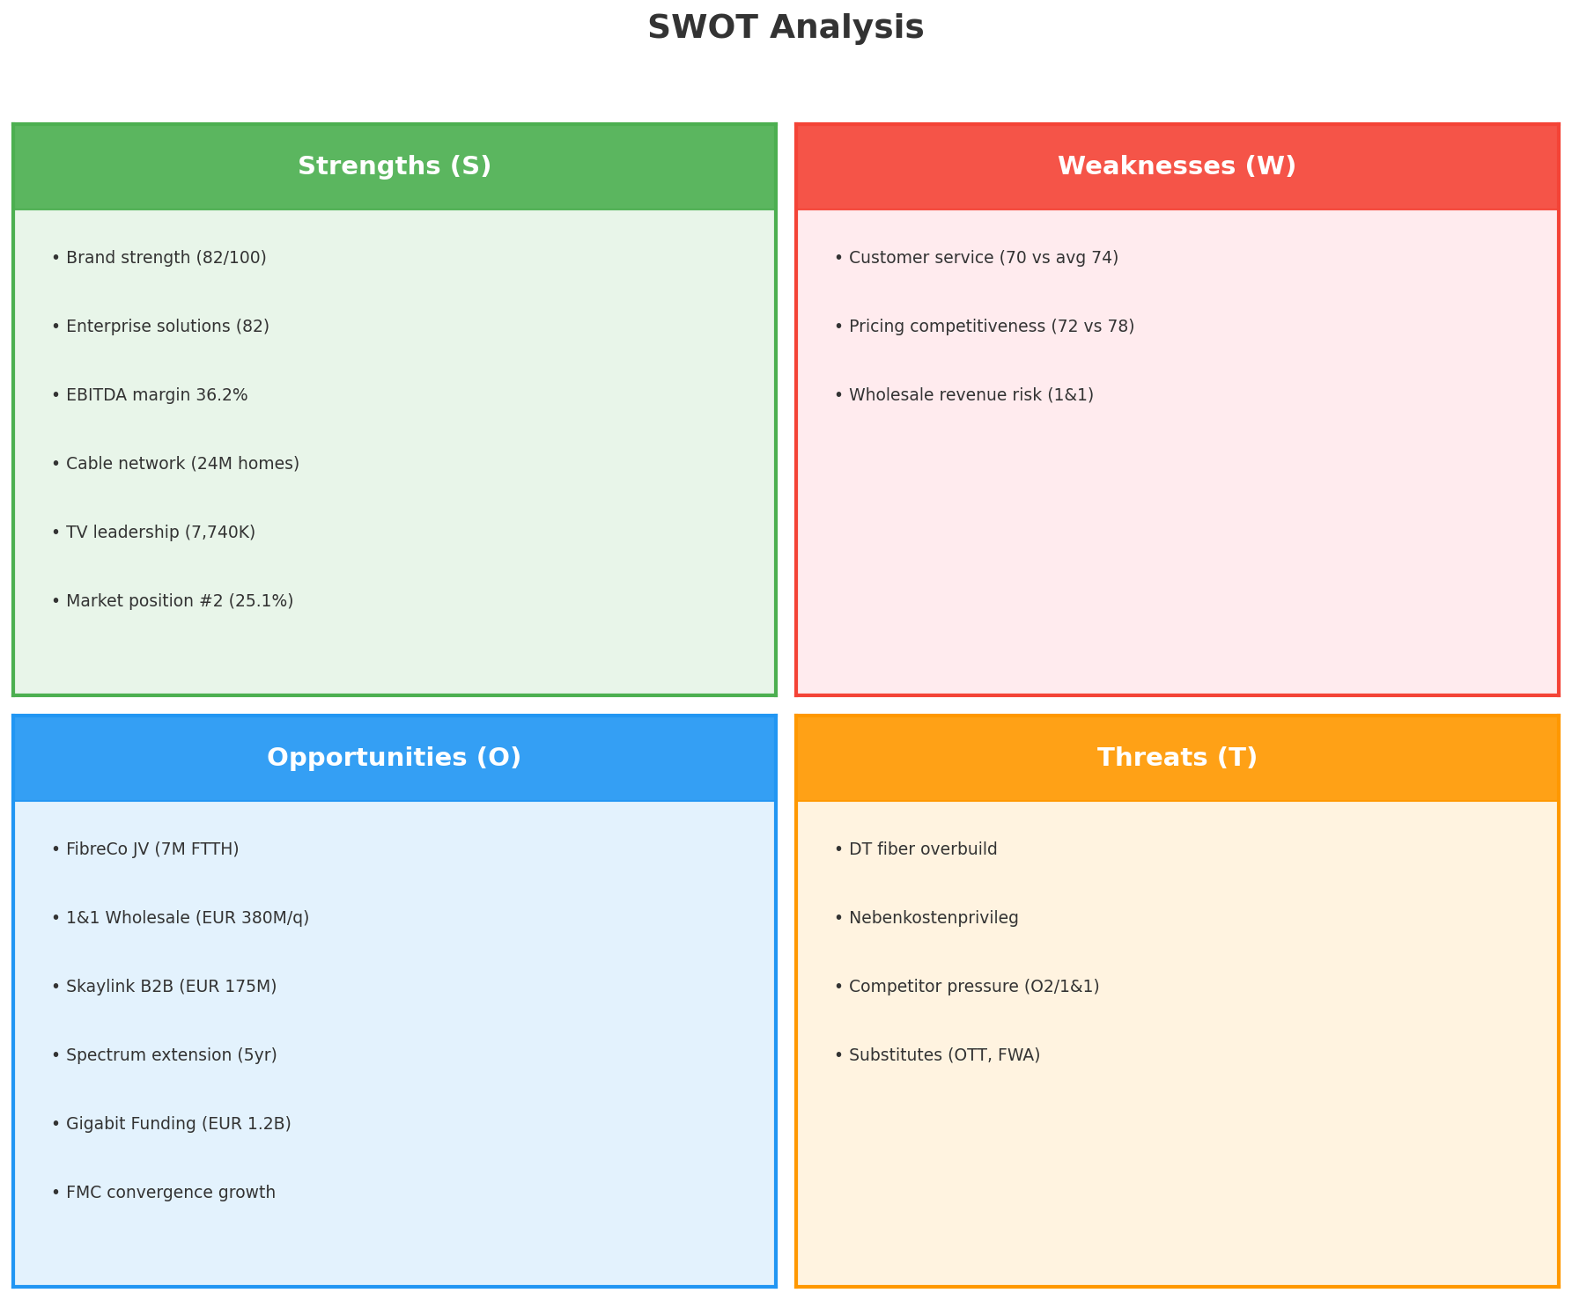
SWOT Analysis
STRATEGIC SYNTHESIS
Posture: OFFENSIVE
• S=7 > W=3
• O=11 > T=4 (ratio ~3:1
• SO-dominant strategy
• Aggressive exploitation,
• not defensive retrenchment
Key Message: Offensive posture — strengths > weaknesses, opportunities 3:1 vs threats; SO-dominant strategy
37

Slide 38
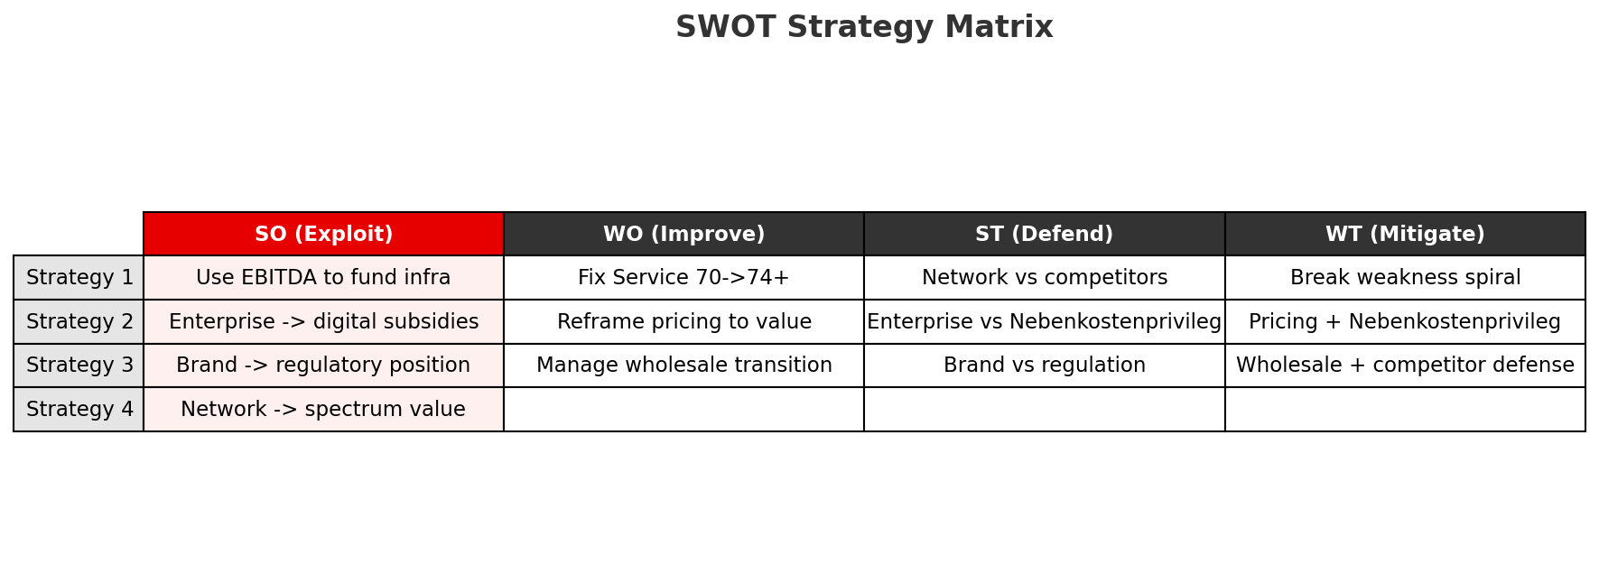
SWOT Strategy Matrix — Cross-Quadrant
STRATEGIC RESPONSES
SO Mega-Strategy: Use financial strength and enterprise capabilities to fund and capture the infrastructure transformation opportunity.
Key Message: SO-dominant: use EBITDA + enterprise to fund infra transformation; WO: fix service as highest ROI
38

Slide 39
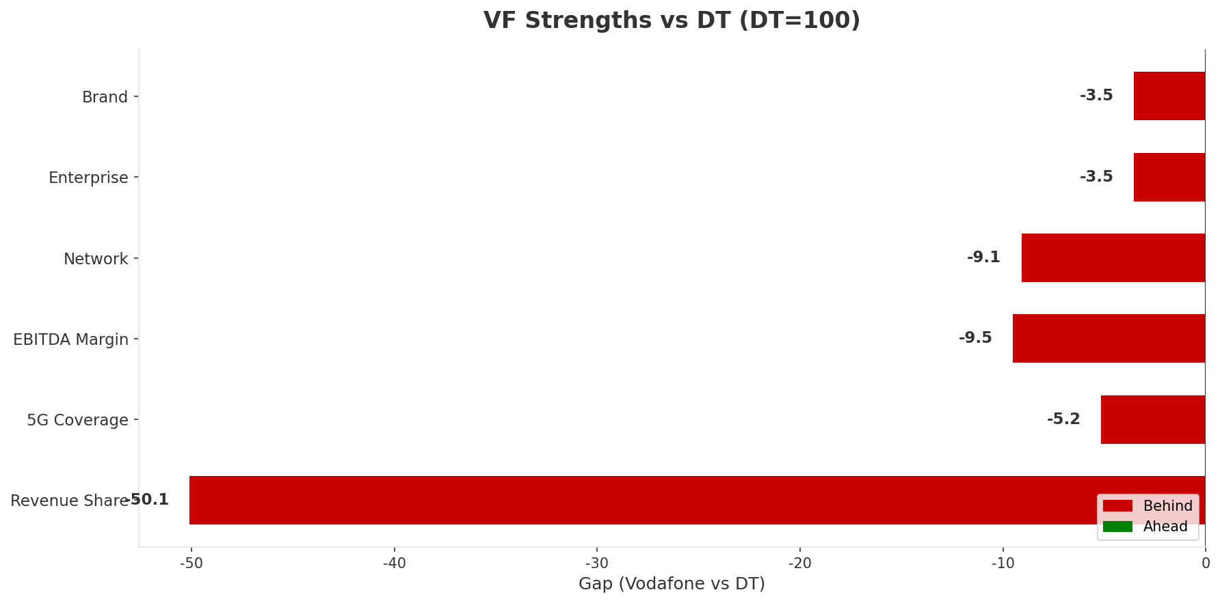
The "Squeezed Middle" — SWOT Evidence
STRATEGIC DIAGNOSIS
• VF strengths are above market average
• But BELOW DT on every single dimension
• This is the fundamental positioning problem:
• Not weakness — insufficiency of strength vs leader
• VF charges near-premium (closer to DT
• But delivers mid-range (closer to O2
Key Message: VF's strengths are above average but below DT on every dimension — not weak, but insufficient vs leader
39

Slide 40
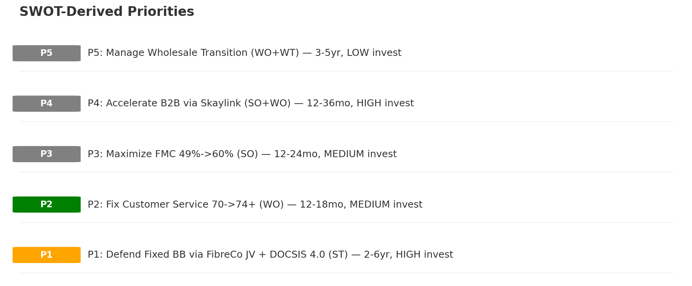
SWOT-Derived Strategic Priorities
PRIORITY RANKING
What NOT To Do:
• Price wars — destroys 36.2% margin without winning share
• Premium repositioning — behind DT on every dimension, 5+ years
• Standalone TV investment — declining; value is as FMC anchor
• Delay fiber — every quarter = ~63K BB subs lost to DT
Key Message: 5 priorities: defend BB (existential), fix service (highest ROI), grow FMC, accelerate B2B, manage wholesale
40

Slide 41
05 Look at Opportunities
SPAN Matrix — Opportunity Selection

Slide 42
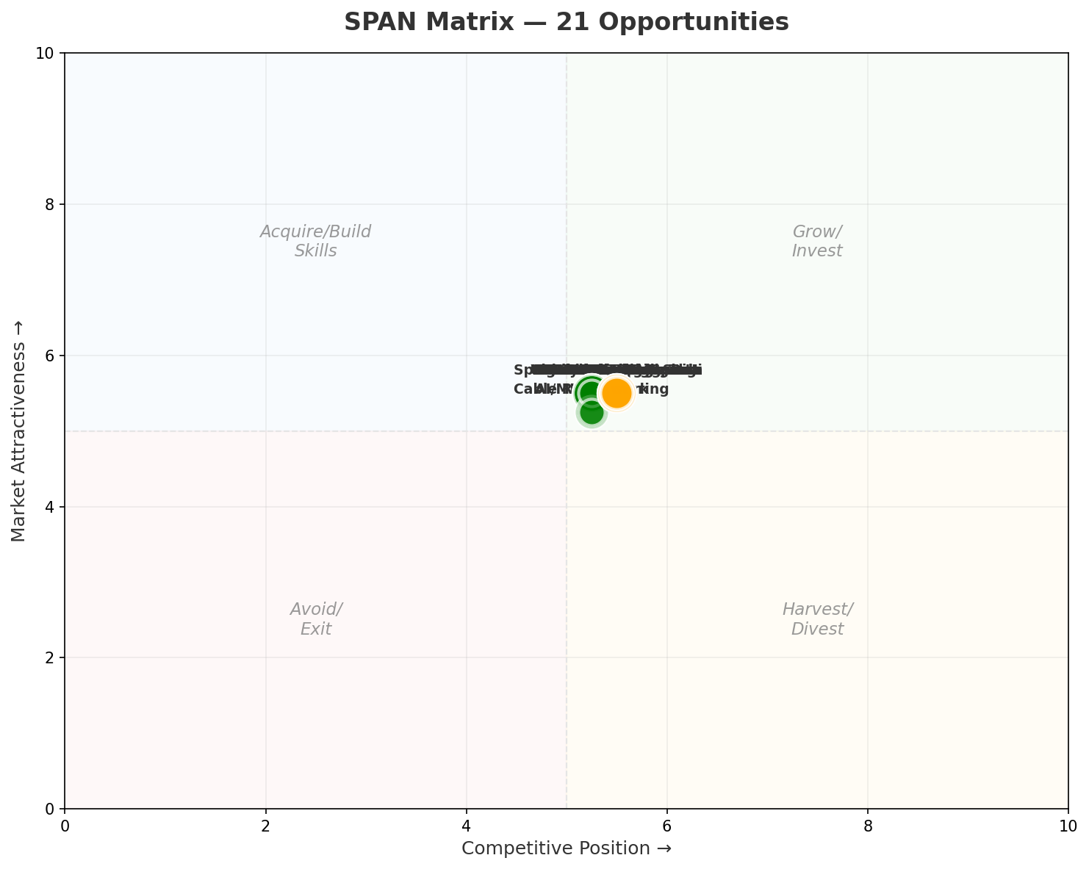
SPAN Matrix — 21 Opportunities
OPPORTUNITY POSITIONING
• Grow/Invest: 18 (86%
• Acquire Skills: 3 (14%
• Harvest: 0
• Avoid/Exit: 0
• 86% in Grow/Invest confirms
• offensive strategic posture
• Challenge is not finding opportunities
• but prioritizing and sequencing them
Key Message: 86% of opportunities in Grow/Invest — market offering favorable hand; challenge is execution speed
42

Slide 43
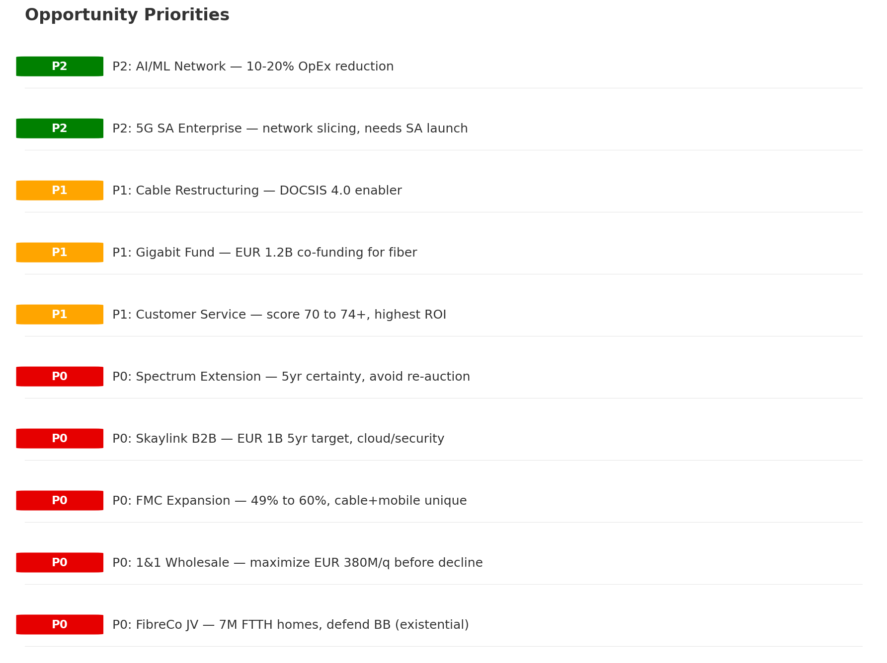
Opportunity Priority Ranking
RESOURCE ALLOCATION
Key Message: 5 P0 (must-do), 3 P1 (should-do), 2 P2 (explore) — 60/30/10% resource allocation
43

Slide 44
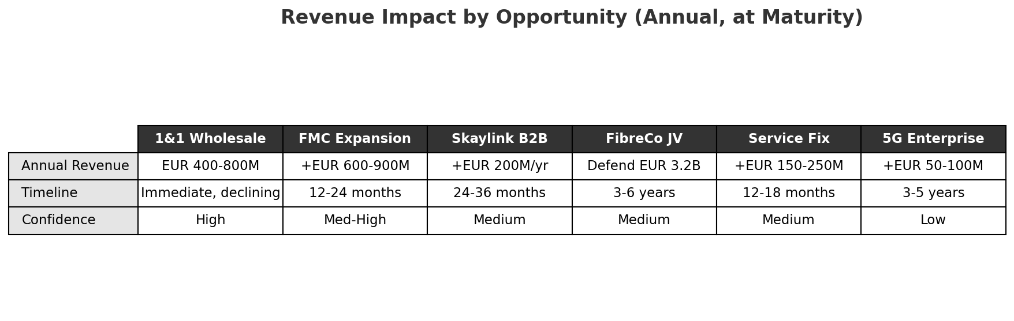
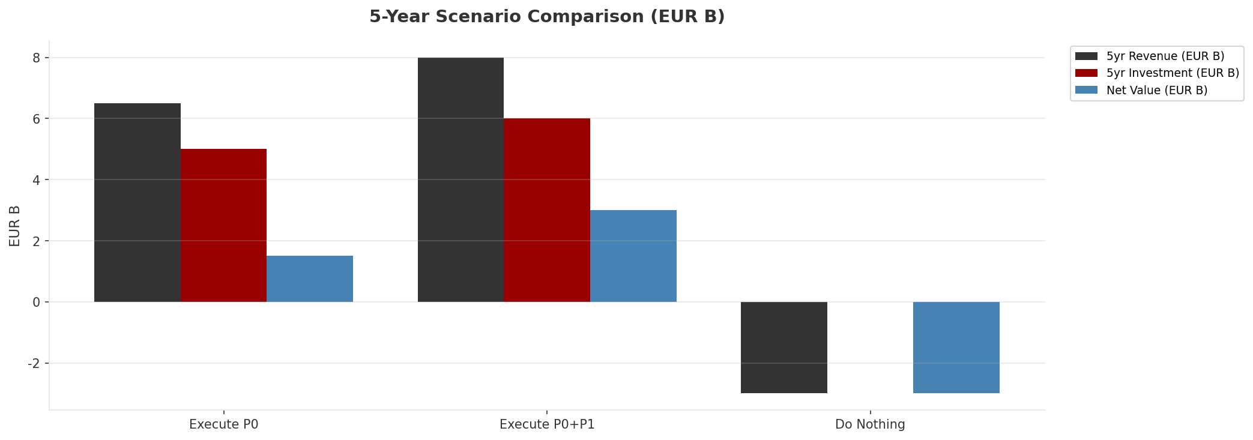
Financial Impact Assessment
REVENUE & INVESTMENT
• Cost of inaction: -EUR 2-4B
• Net value of full execution: +EUR 2-4B
• Asymmetry is clear: invest or decline
Key Message: Cost of inaction (EUR 2-4B loss) exceeds cost of action (EUR 1-3B net gain) — VF must invest
44

Slide 45
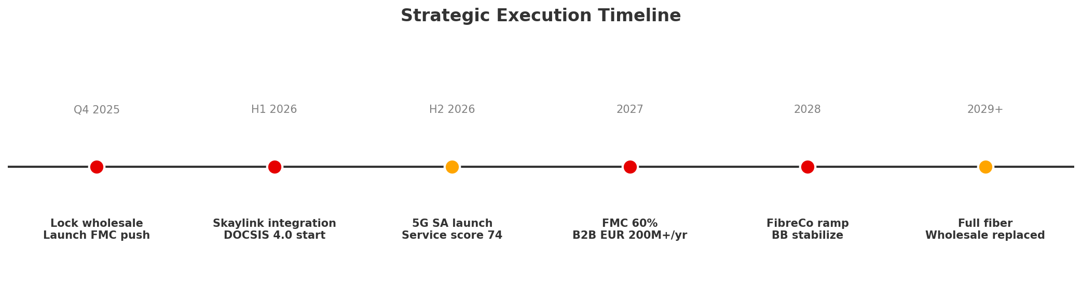
Opportunity Sequencing — 2025 to 2029+
EXECUTION PLAN
• P0 (Must Execute): 60% of strategic investment
• FibreCo JV, Wholesale Max, FMC, Skaylink, Spectrum
• P1 (Should Execute): 30% of strategic investment
• Customer Service, Gigabit Fund, Cable Restructuring
• P2 (Explore): 10% of strategic investment
• 5G SA/Enterprise, AI/ML, Open RAN
Key Message: 3-5 year window to execute — FibreCo JV and wholesale revenue fund the transformation
45

Slide 46
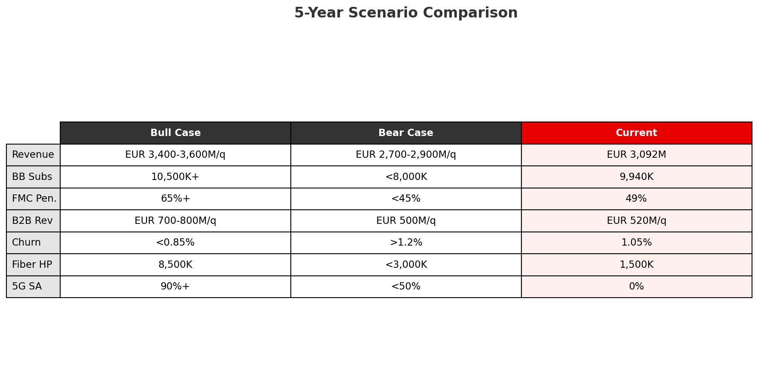
Risk / Reward Summary
STRATEGIC OUTLOOK
The asymmetry is clear: downside of inaction (EUR 2-4B value destruction) exceeds net cost of action (EUR 1-3B net value creation after investment). Vodafone must invest.
Key Message: Execute: +EUR 1-3B net value | Do nothing: -EUR 2-4B loss — the cost of inaction exceeds the cost of action
46

Slide 47
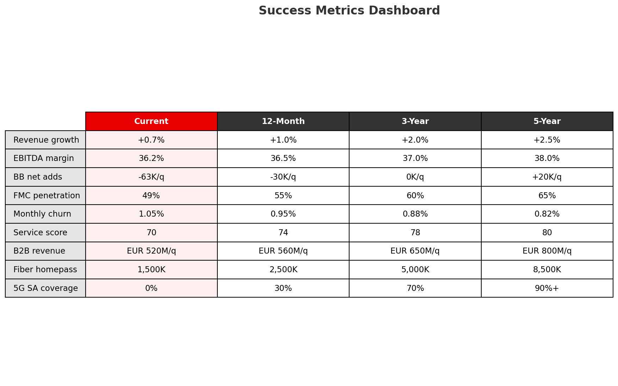
Success Metrics Dashboard
KPI TRACKING
Key Message: 9 KPIs tracked across 4 horizons — BB stabilization, churn reduction, and FMC growth are the leading indicators
47

Slide 48
Thank You
Vodafone Germany — BLM Strategic Assessment
Deep Analysis | CQ4 2025 | Five Looks + SWOT + SPAN
Generated: 2026-02-10

