Slide 1
Default BLM Strategic Analysis
BLM (Business Leadership Model) Five Looks Analysis
Target Operator
Market
Analysis Period
Report Date
Entel Chile
Chile
CQ4_2025
2026-02-15
01 Trends (PEST) | 02 Market/Customer ($APPEALS) | 03 Competition (Porter) | 04 Self (BMC) | SWOT Synthesis | 05 Opportunities (SPAN

Slide 2
Report Contents
TABLE OF CONTENTS
01
Executive Summary
Key findings and recommendations
02
Look at Trends
PEST Framework — macro environment
03
Look at Market
$APPEALS — market changes & customer needs
T
Tariff Analysis
Pricing comparison — mobile, fixed & convergence
04
Look at Competition
Porter's Five Forces — competitive landscape
05
Look at Self
BMC + Capability — internal assessment
06
SWOT Synthesis
Strengths, Weaknesses, Opportunities, Threats
07
Look at Opportunities
SPAN Matrix — opportunity selection
Summary & Provenance
2
08
Conclusions and data sources

Slide 3
Data Quality Overview
DATA QUALITY
Total Data Points
High Confidence
Medium Confidence
Low/Estimated
20
0
0
20
0%
Unique Sources: 0
Data Conflicts: 0
Coverage: Partial
Key Message: 20 data points tracked, 0 high-confidence (0%
3

Slide 4
Executive Summary
Trends
Macro environment: Favorable. Key opportunities: Regulatory Environment, National Digital Strategy. Key risks: Regulatory Environment, Fiber Broadband Penetration Industry is in late growth phase. (+7.2% YoY (CQ2_2025 -> CQ4_2025)
Market/Customer
Chile telecom market totals CLP 1.39T in quarterly revenue; Market faces significant competitive headwinds.
Competition
Strongest competitive force: Existing Competitors.
Self Assessment
stable but facing challenges; key strength: Established market presence; key challenge: No critical weaknesses identified from available data
SWOT
SWOT analysis identifies 1 strengths, 1 weaknesses, 2 opportunities, and 8 threats. The recommended strategic posture is cautious (WT-dominant).
Opportunities
SPAN matrix positions 20 opportunities: 14 grow/invest, 2 acquire skills, 2 harvest, 2 avoid/exit. Focus resources on the 14 grow/invest items for maximum strategic impact.
Key Message: Five Looks analysis completed — see details in following sections
4

Slide 5
01 Look at Trends
PEST Framework — Macro Environment

Slide 6
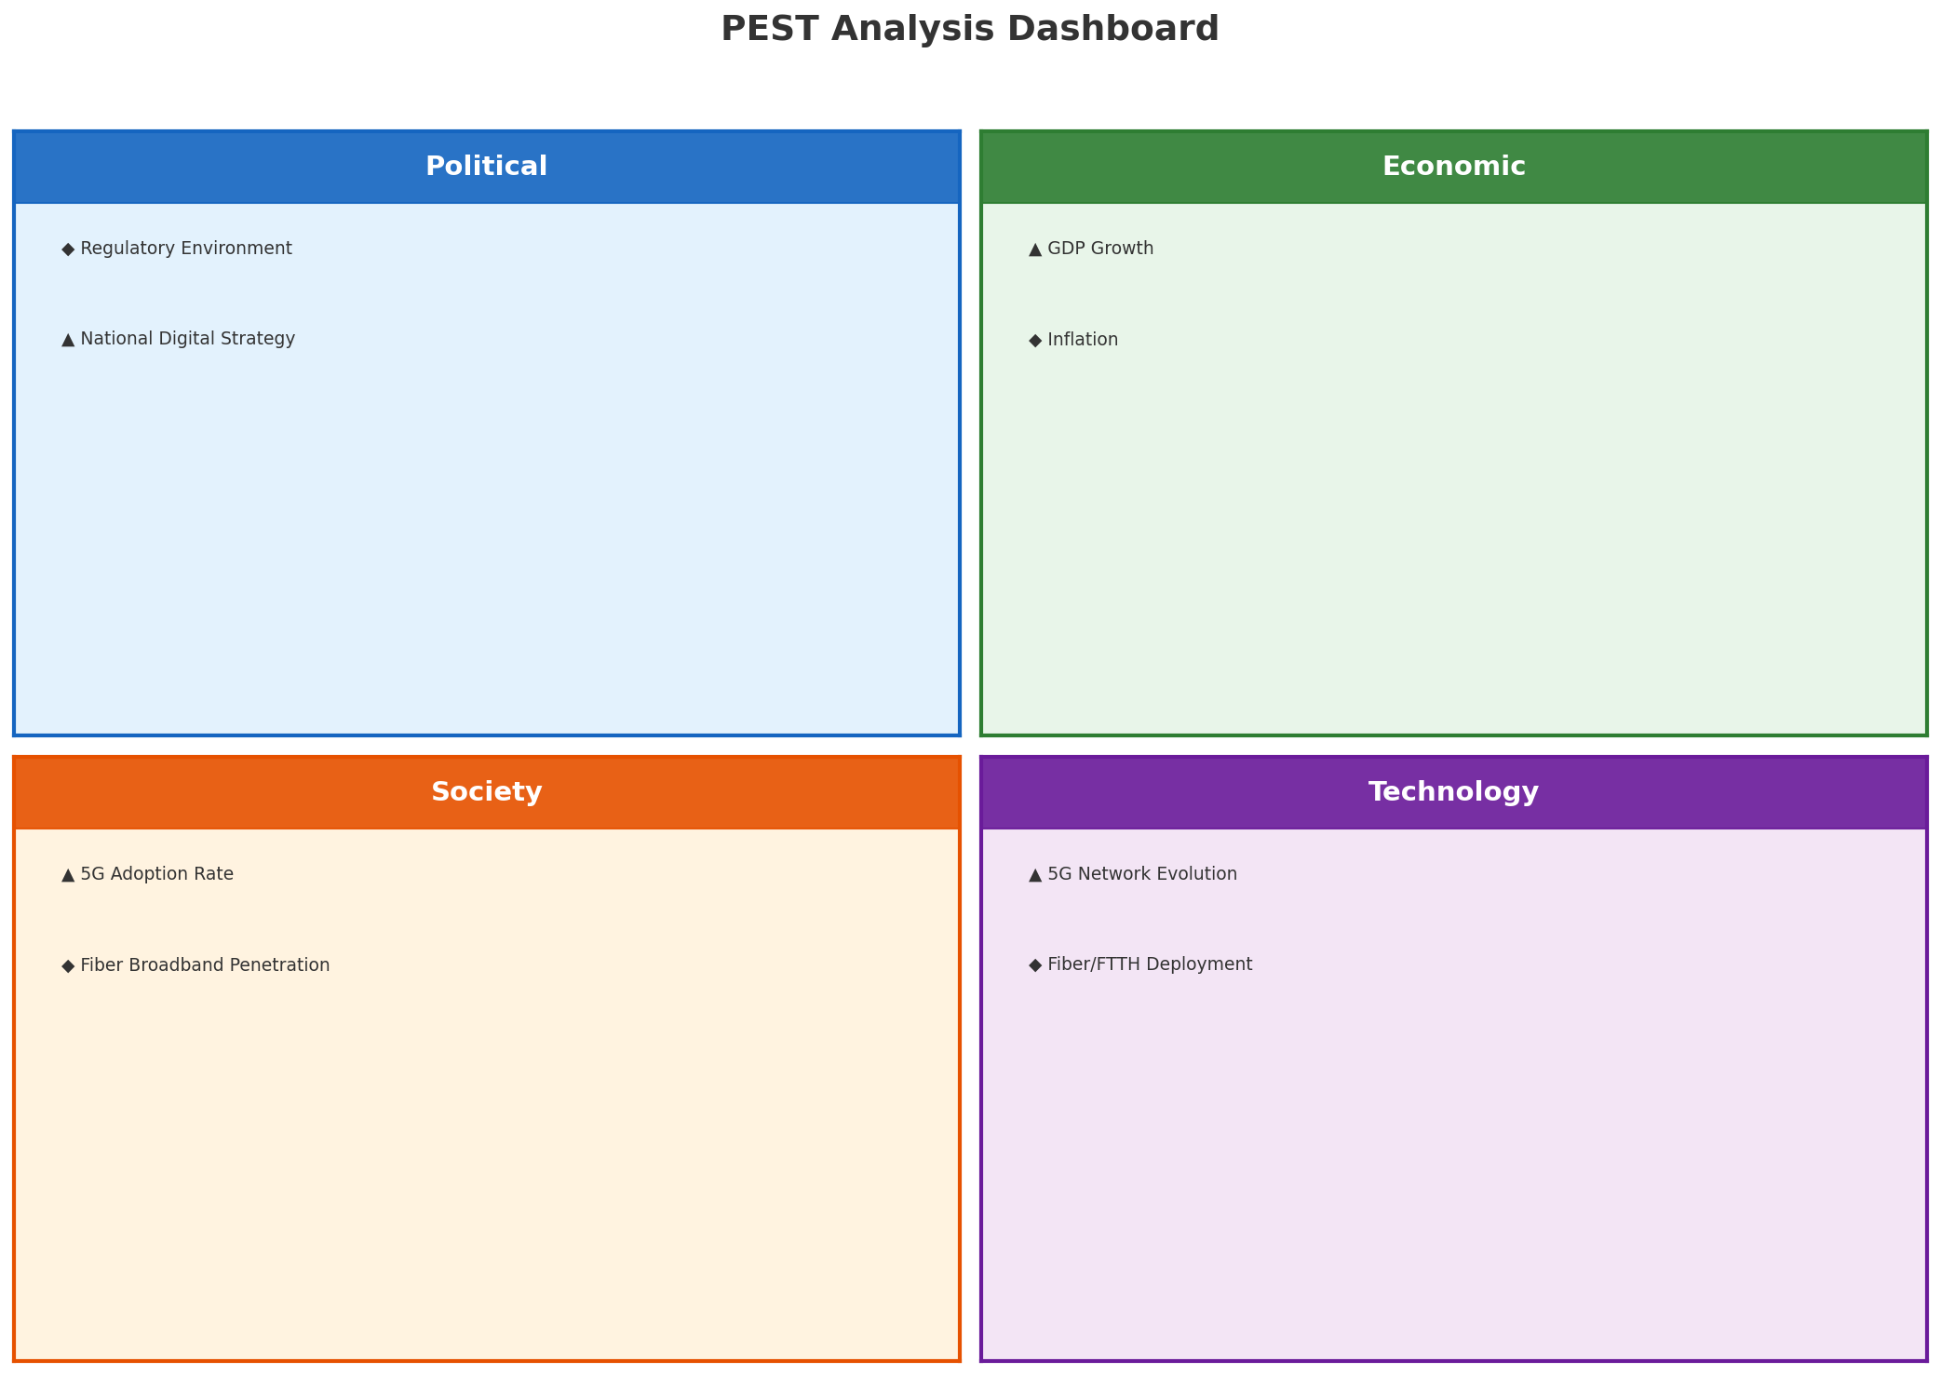
PEST Analysis Dashboard
MACRO ENVIRONMENT
Key Message: Macro environment: Favorable. Key opportunities: Regulatory Environment, National Digital Strategy. Key risks: Regulatory Environment, Fiber Broadband Penetration.
6

Slide 7
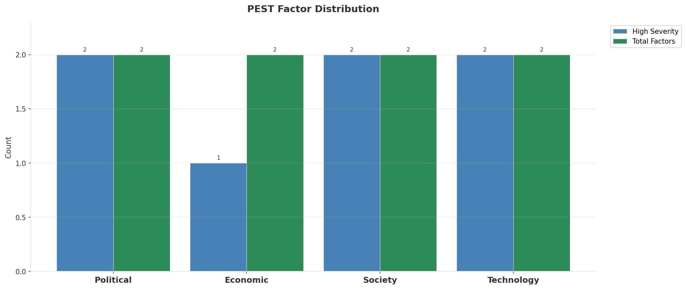
Industry Environment
INDUSTRY ANALYSIS
Market Size
Growth Rate
Concentration
Lifecycle
CLP 1.4T (quarterly, CQ4_2025
+7.2% YoY (CQ2_2025 -> CQ4_2025
CR4 = 100% (Entel Chile: 58.3%, Movistar Chile: 17.6%, WOM Chile: 13.3%, Claro Chile: 10.8%
late_growth
• New Business Models:
• FWA (Fixed Wireless Access) as fiber alternative
• Network-as-a-Service for enterprise verticals
• Wholesale/MVNO partnerships for coverage monetization
• Technology Revolution:
• 5G SA enabling network slicing and enterprise services
• AI/ML for network optimization and customer experience
• Open RAN for vendor diversification and cost reduction
Key Message: Macro environment: Favorable. Key opportunities: Regulatory Environment, National Digital Strategy. Key risks: Regulatory Environment, Fiber Broadband Penetration Industry is in late growth phase. (+7.2% YoY (CQ2_2025 -> CQ4_2025)
7

Slide 8
Value Transfer Trends
VALUE MIGRATION
• Value shifting from voice/SMS to data and digital services
• B2B/ICT growing faster than consumer segment
• Fiber displacing copper and cable broadband
Key Message: Macro environment: Favorable. Key opportunities: Regulatory Environment, National Digital Strategy. Key risks: Regulatory Environment, Fiber Broadband Penetration Industry is in late growth phase. (+7.2% YoY (CQ2_2025 -> CQ4_2025)
8

Slide 9
02 Look at Market
$APPEALS — Market Changes & Customer Needs

Slide 10
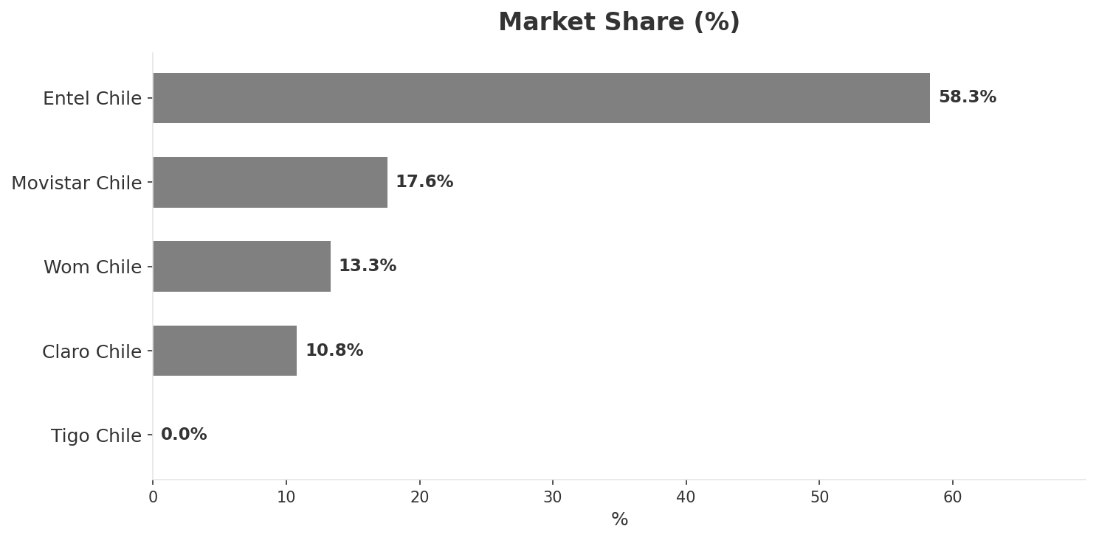
Market Change Panorama
MARKET OVERVIEW
Total Revenue (€M
Mobile Subs (K
Broadband Subs (K
Operators
1,391,000
30,500
4,180
5
Market Changes:
• Entel Chile revenue growth 15.9% YoY
• Movistar Chile revenue growth 8.9% YoY
• WOM Chile revenue growth 6.9% YoY
• Claro Chile revenue growth 8.7% YoY
Key Message: Chile telecom market totals CLP 1.39T in quarterly revenue; Market faces significant competitive headwinds.
10

Slide 11
Customer Segments
SEGMENTATION
Consumer Postpaid Premium
Size: ~2.8M subscribers | Trend: growing
Needs: 5G coverage and experiences, Premium convergent bundles (fiber+mobile+streaming
Consumer Mainstream
Size: ~10.2M subscribers | Trend: stable
Needs: Better value mobile plans, Reliable home broadband
Consumer Price-Sensitive
Size: ~8.3M subscribers | Trend: shrinking
Needs: Ultra-low-cost data plans, No-contract flexibility
Enterprise Large
Size: ~5K customers (top 5%) | Trend: growing
Needs: SD-WAN and multi-cloud solutions, Private 5G for mining and logistics
Key Message: Chile telecom market totals CLP 1.39T in quarterly revenue; Market faces significant competitive headwinds.
11

Slide 12
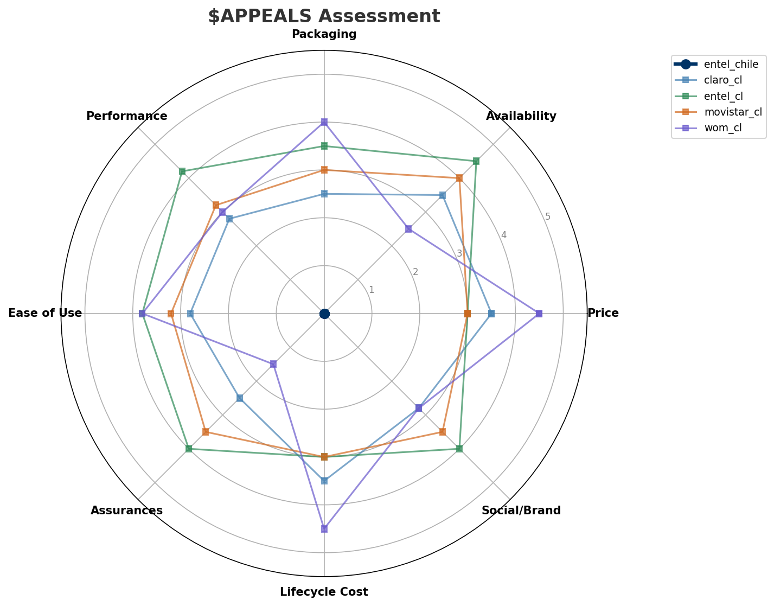
$APPEALS Assessment
CUSTOMER NEEDS
Key Message: Chile telecom market totals CLP 1.39T in quarterly revenue; Market faces significant competitive headwinds.
12

Slide 13
Customer Value Migration
VALUE MIGRATION
Value migration trending upward: customers willing to pay more for premium connectivity and convergent bundles. Focus on upselling and cross-selling opportunities.
Threats:
• Entel Chile revenue growth 15.9% YoY
• Movistar Chile revenue growth 8.9% YoY
• WOM Chile revenue growth 6.9% YoY
• Claro Chile revenue growth 8.7% YoY
Key Message: Chile telecom market totals CLP 1.39T in quarterly revenue; Market faces significant competitive headwinds.
13

Slide 14
Tariff Analysis
Mobile, Fixed & Convergence Pricing Landscape

Slide 15
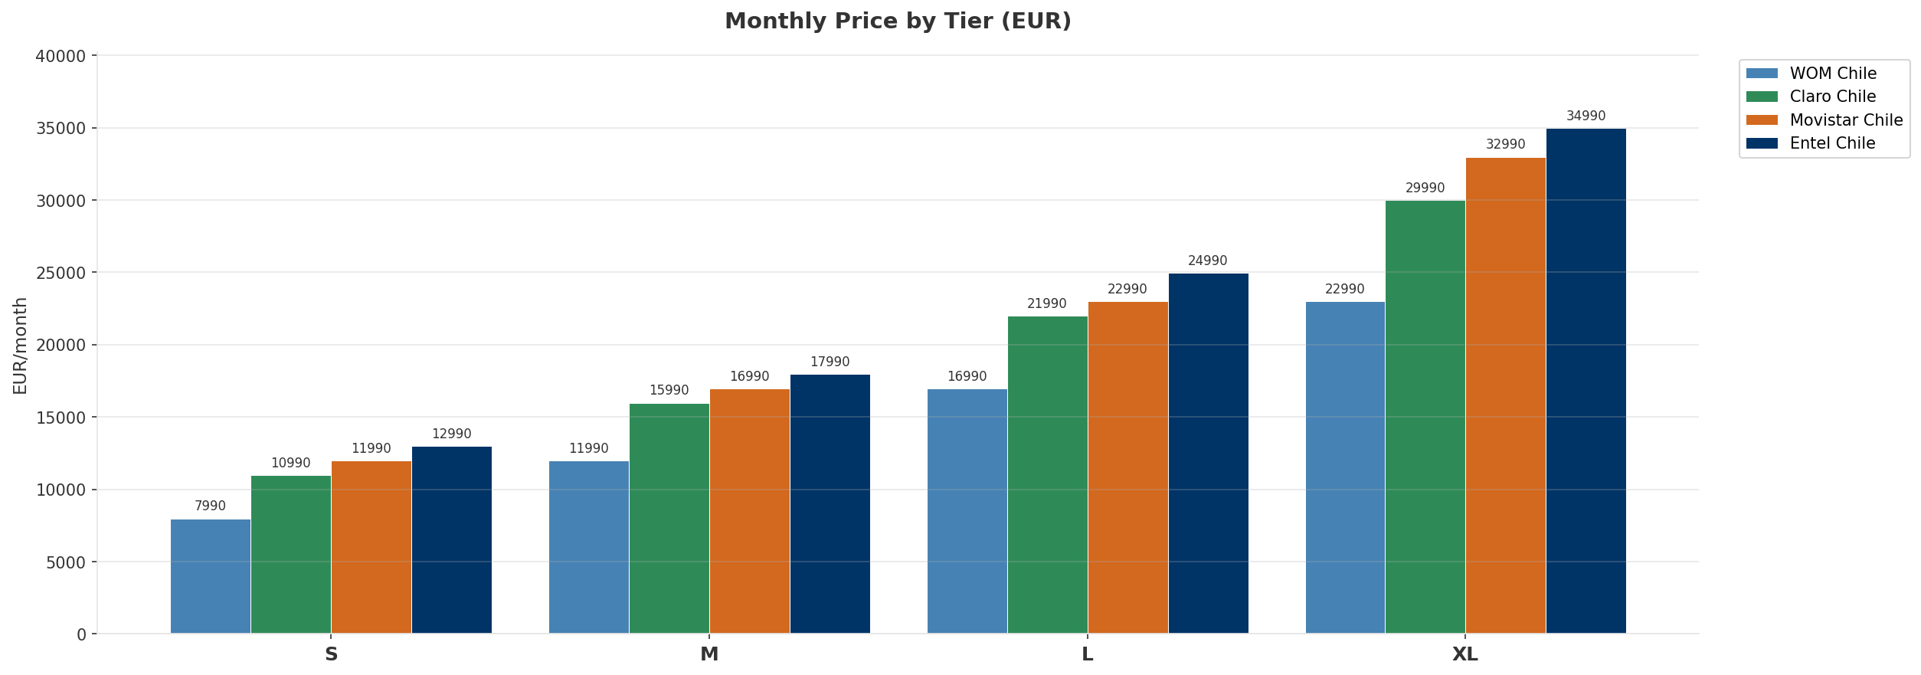
Mobile Postpaid Price Comparison
CROSS-OPERATOR TIER BENCHMARKING
Price Gaps:
• Tier S: EUR 5000 gap — cheapest WOM Chile, most expensive Entel Chile
• Tier M: EUR 6000 gap — cheapest WOM Chile, most expensive Entel Chile
• Tier L: EUR 8000 gap — cheapest WOM Chile, most expensive Entel Chile
• Tier XL: EUR 12000 gap — cheapest WOM Chile, most expensive Entel Chile
Key Message: Mobile postpaid tier comparison across all operators
15

Slide 16
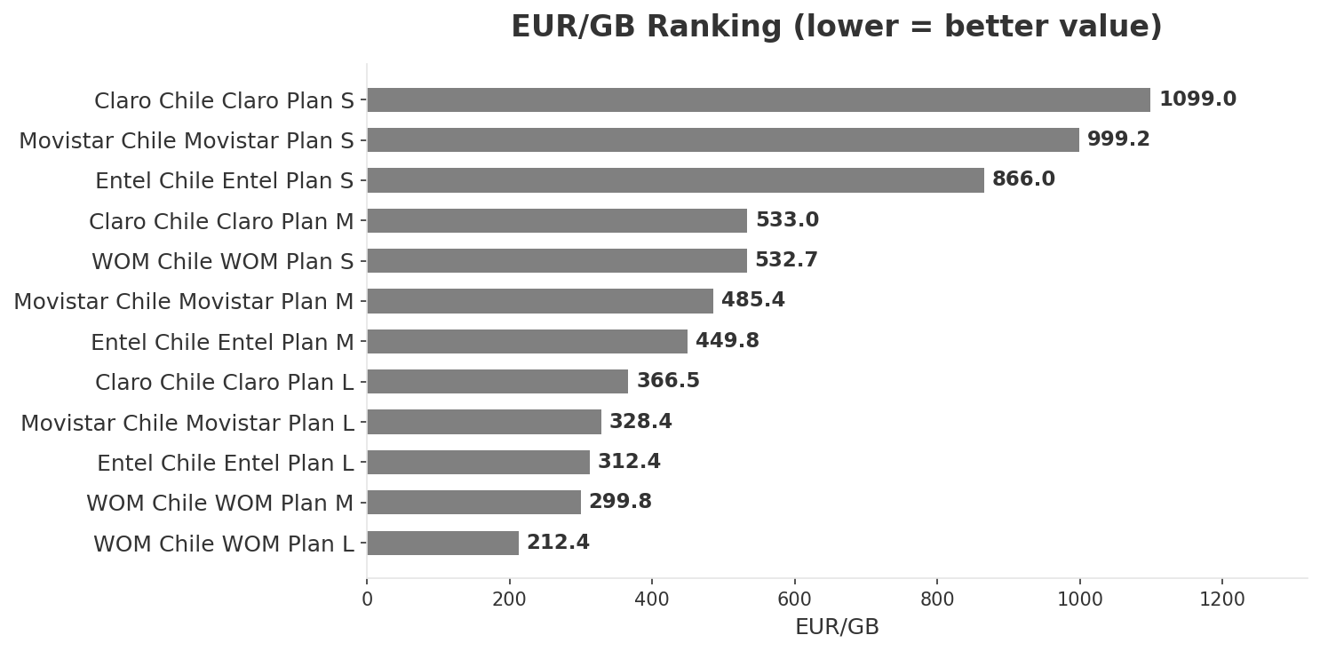
EUR/GB Value Analysis & 5G Premium Erosion
PRICING INTELLIGENCE
All mobile postpaid plans now include 5G — premium fully eroded
Key Message: Best value: WOM Chile at EUR 212.38/GB
16

Slide 17
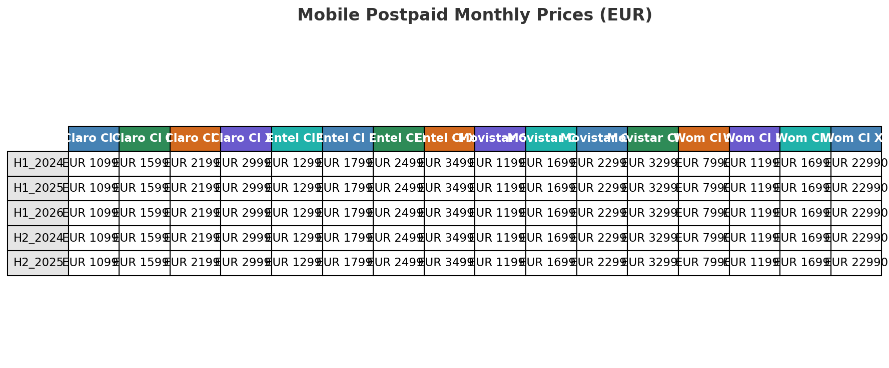
Price Evolution — Mobile Postpaid
H1_2023 TO H1_2026
Key Message: Price evolution across 7 snapshots — H1_2023 to H1_2026
17

Slide 18
Fixed & Convergence Pricing Landscape
DSL / CABLE / FIBER / FMC BUNDLES
Cable:
• Claro Chile ClaroVTR Cable 1000: EUR 24990/mo 1000.0Mbps
• Claro Chile ClaroVTR Cable 500: EUR 18990/mo 500.0Mbps
• Claro Chile ClaroVTR Cable 200: EUR 13990/mo 200.0Mbps
FMC Bundles:
• Entel Chile Entel Pack Premium: EUR 49990/mo
• Claro Chile ClaroVTR Pack Total: EUR 49990/mo
• Movistar Chile Movistar Pack Total: EUR 54990/mo
• Claro Chile ClaroVTR Pack Duo: EUR 22990/mo
• Movistar Chile Movistar Pack Duo: EUR 24990/mo
• Entel Chile Entel Pack Hogar: EUR 27990/mo
Fiber:
• Claro Chile ClaroVTR Fibra 1000: EUR 25990/mo 1000.0Mbps
• Movistar Chile Movistar Fibra 1000: EUR 27990/mo 1000.0Mbps
• Entel Chile Entel Fibra 1000: EUR 29990/mo 1000.0Mbps
• Claro Chile ClaroVTR Fibra 500: EUR 19990/mo 500.0Mbps
Key Message: Cheapest FMC bundle: Claro Chile ClaroVTR Pack Duo at EUR 22990/mo
18

Slide 19
03 Look at Competition
Porter's Five Forces — Competitive Landscape

Slide 20

Porter's Five Forces
COMPETITIVE FORCES
Overall Intensity: MEDIUM
Key Message: Strongest competitive force: Existing Competitors.
20

Slide 21
Competitor Analysis: Claro Cl
COMPETITOR DEEP DIVE
Revenue
EBITDA
Margin
Capex/Rev
€150,000M
€33,000M
22.0%
20.0%
+2.2% YoY
Strengths
Weaknesses
• 5G Deployment: score 50 (market avg 65
• Brand Strength: score 60 (market avg 72
• Customer Service: score 50 (market avg 65
• Digital Services: score 60 (market avg 70
Strategy: Revenue-led profitable growth; subscriber acquisition focus
Key Message: Competitor analysis: Claro Cl
21

Slide 22
Competitor Analysis: Tigo Chile
COMPETITOR DEEP DIVE
Strengths
Weaknesses
Key Message: Competitor analysis: Tigo Chile
22

Slide 23
Competitor Analysis: Wom Cl
COMPETITOR DEEP DIVE
Revenue
EBITDA
Margin
Capex/Rev
€185,000M
€37,000M
20.0%
15.1%
+6.8% YoY
Strengths
Weaknesses
• 5G Deployment: score 70 (market avg 65
• Customer Service: score 70 (market avg 65
• Digital Services: score 80 (market avg 70
• Pricing Competitiveness: score 90 (market avg 70
• Enterprise Solutions: score 30 (market avg 58
• Network Coverage: score 50 (market avg 72
• Network Quality: score 50 (market avg 68
• Sustainability: score 40 (market avg 58
Strategy: Revenue-led profitable growth; subscriber acquisition focus
Key Message: Competitor analysis: Wom Cl
23

Slide 24
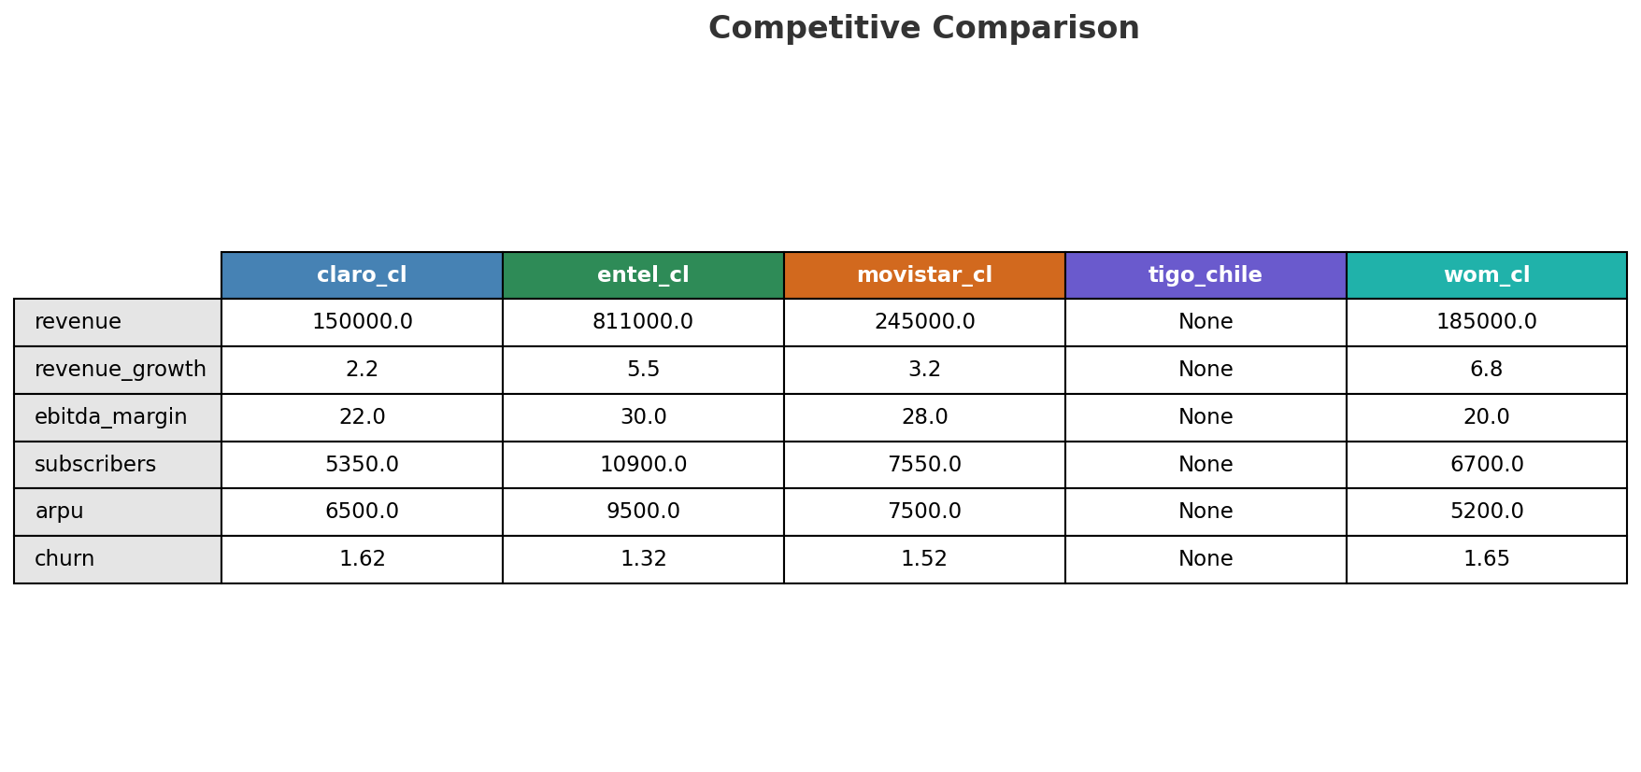
Competitive Landscape Summary
COMPETITION
Key Message: Strongest competitive force: Existing Competitors.
24

Slide 25
New Entrants Threat
MARKET ENTRY
• Entry barriers: High barriers: spectrum licensing, massive capex for network build, regulatory approvals, established brand loyalty
Key Message: New entrants threat level: low
25

Slide 26
04 Look at Self
BMC + Capability Assessment

Slide 27
Operating Health Check
FINANCIAL HEALTH
Key Message: stable but facing challenges; key strength: Established market presence; key challenge: No critical weaknesses identified from available data
27

Slide 28
Market Share Evolution
REVENUE SHARE TREND
Entel Chile
Movistar Chile
WOM Chile
Claro Chile
58.3% #1
17.6% #2
13.3% #3
10.8% #4
+2.2pp gaining
-0.7pp losing
-1.0pp losing
-0.5pp stable
Market Concentration: HHI 4,003 (Highly Concentrated) | CR3: 89.2% | Trend: Concentrating
Key Message: Revenue share data unavailable for the target operator.
28

Slide 29
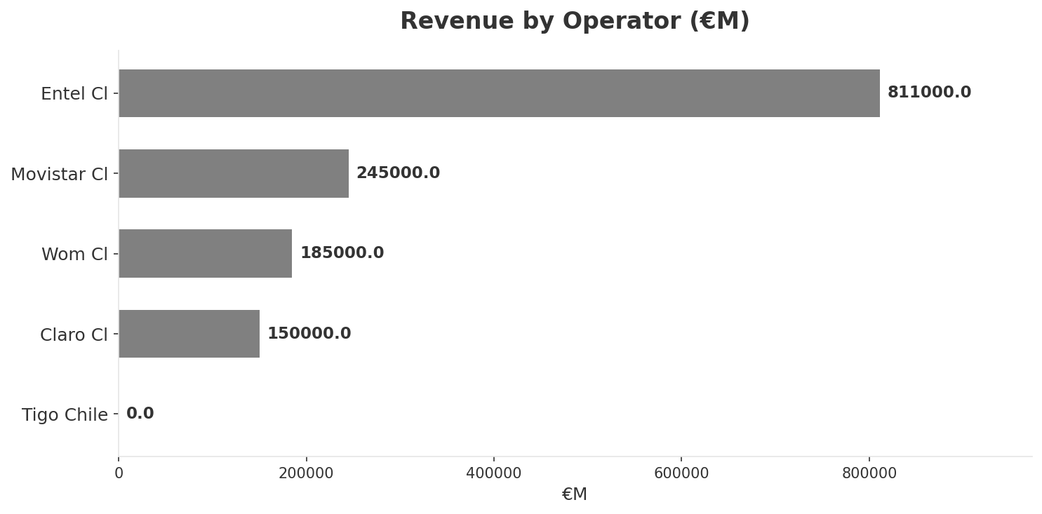
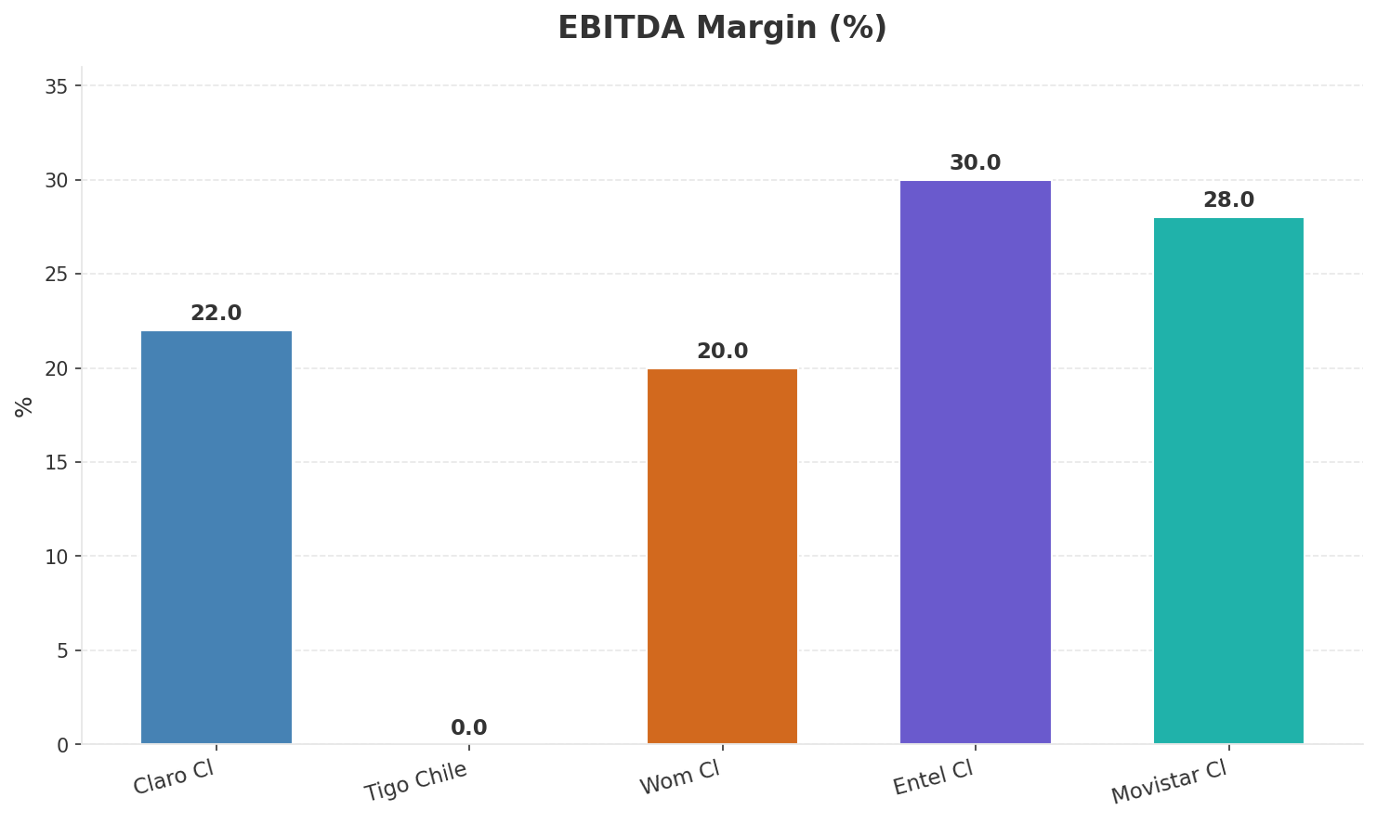
Revenue Comparison
COMPETITIVE BENCHMARKING
Key Message: Revenue and margin benchmarking across operators
29

Slide 30
Segment Analysis: Mobile
SEGMENT PERFORMANCE
Service Revenue
Service Growth Pct
Total K
Postpaid K
None
None
None
None
Health: STABLE
• revenue: stable
• subscribers: stable
• arpu: stable
Key Message: Insufficient data for mobile segment assessment
30

Slide 31
Segment Analysis: Fixed Broadband
SEGMENT PERFORMANCE
Service Revenue
Service Growth Pct
Total K
Net Adds K
None
None
None
None
Health: STABLE
• revenue: stable
• subscribers: stable
• arpu: stable
Key Message: Insufficient data for fixed broadband assessment
31

Slide 32
Segment Analysis: B2B
SEGMENT PERFORMANCE
Revenue
Growth Pct
Customers K
Share Of Revenue Pct
None
None
None
None
Health: STABLE
• revenue: stable
• customers: stable
Key Message: Insufficient data for B2B assessment
32

Slide 33
Segment Analysis: TV/Convergence
SEGMENT PERFORMANCE
Revenue
Total K
Net Adds K
Fmc Total K
None
None
None
None
Health: STABLE
• revenue: stable
• subscribers: stable
• fmc_subscribers: stable
Key Message: Insufficient data for TV/convergence assessment
33

Slide 34
Network Analysis
INFRASTRUCTURE
Key Message: Network infrastructure and coverage assessment
34

Slide 35

Business Model Canvas
BMC
Key Message: Business model canvas overview
35

Slide 36
Organization & Talent
PEOPLE & CULTURE
C Suite Count
Avg Tenure Years
Key Leaders
0
None
[]
Talent Assessment:
• c_suite_count: 0
• avg_tenure_years: None
• key_leaders: []
• capability_alignment: []
• assessment: Limited executive visibility from available data
Key Message: Organization and talent assessment
36

Slide 37
Strengths, Weaknesses & Exposure Points
SELF ASSESSMENT
Strengths
Weaknesses
Exposure Points
• Established market presence
• No critical weaknesses identified from available data
Key Message: stable but facing challenges; key strength: Established market presence; key challenge: No critical weaknesses identified from available data
37

Slide 38
SWOT Synthesis
Strengths, Weaknesses, Opportunities & Threats

Slide 39
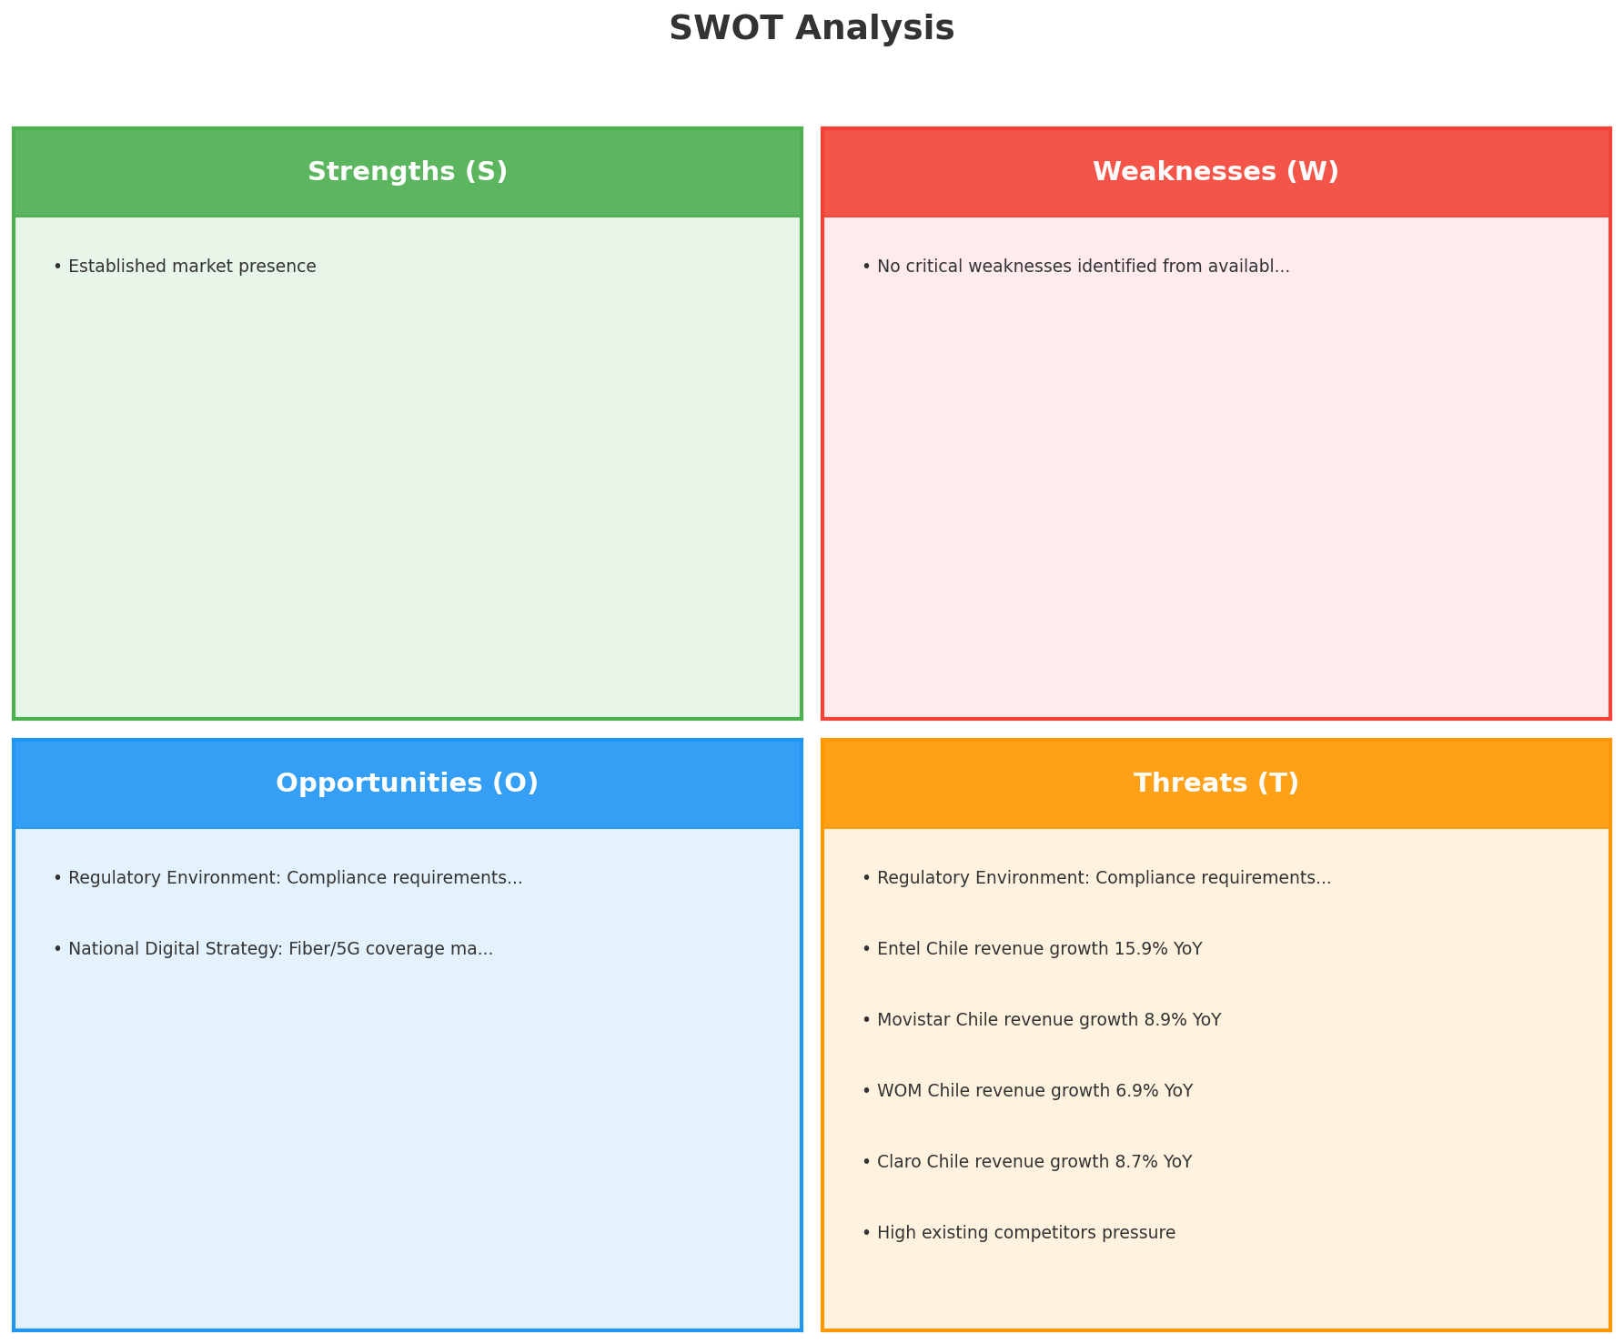
SWOT Analysis
STRATEGIC SYNTHESIS
SO:
Leverage 'Established market presence' to capture the opp...
WO:
Address weakness 'No critical weaknesses identified from ...
ST:
Use strength 'Established market presence' to counter the...
WT:
Mitigate weakness 'No critical weaknesses identified from...
Key Message: SWOT analysis identifies 1 strengths, 1 weaknesses, 2 opportunities, and 8 threats. The recommended strategic posture is cautious (WT-dominant).
39

Slide 40
05 Look at Opportunities
SPAN Matrix — Opportunity Selection

Slide 41
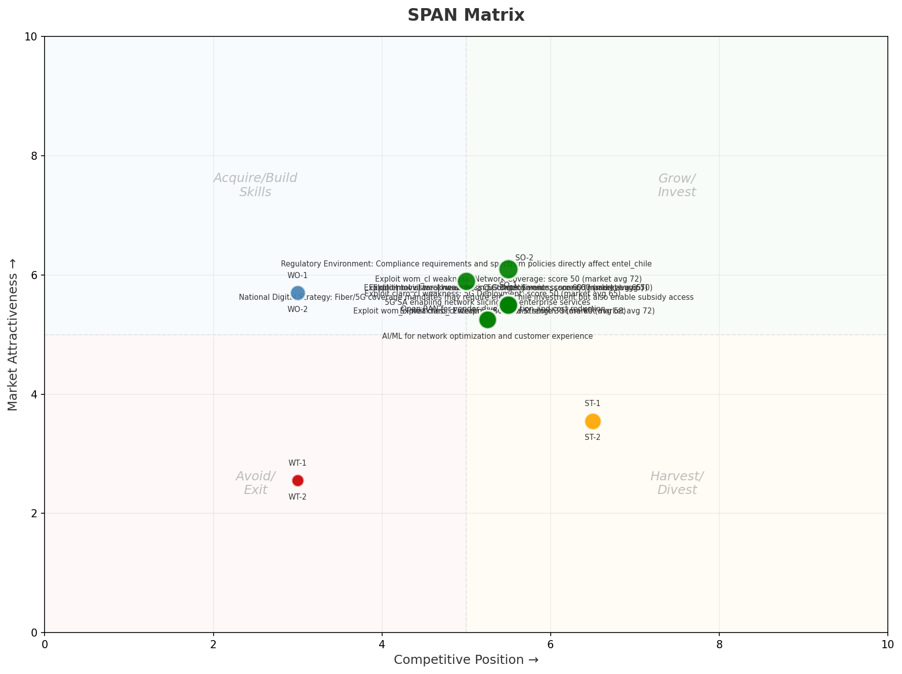
SPAN Matrix — Opportunity Positioning
OPPORTUNITY MAP
Key Message: SPAN matrix positions 20 opportunities: 14 grow/invest, 2 acquire skills, 2 harvest, 2 avoid/exit. Focus resources on the 14 grow/invest items for maximum strategic impact.
41

Slide 42
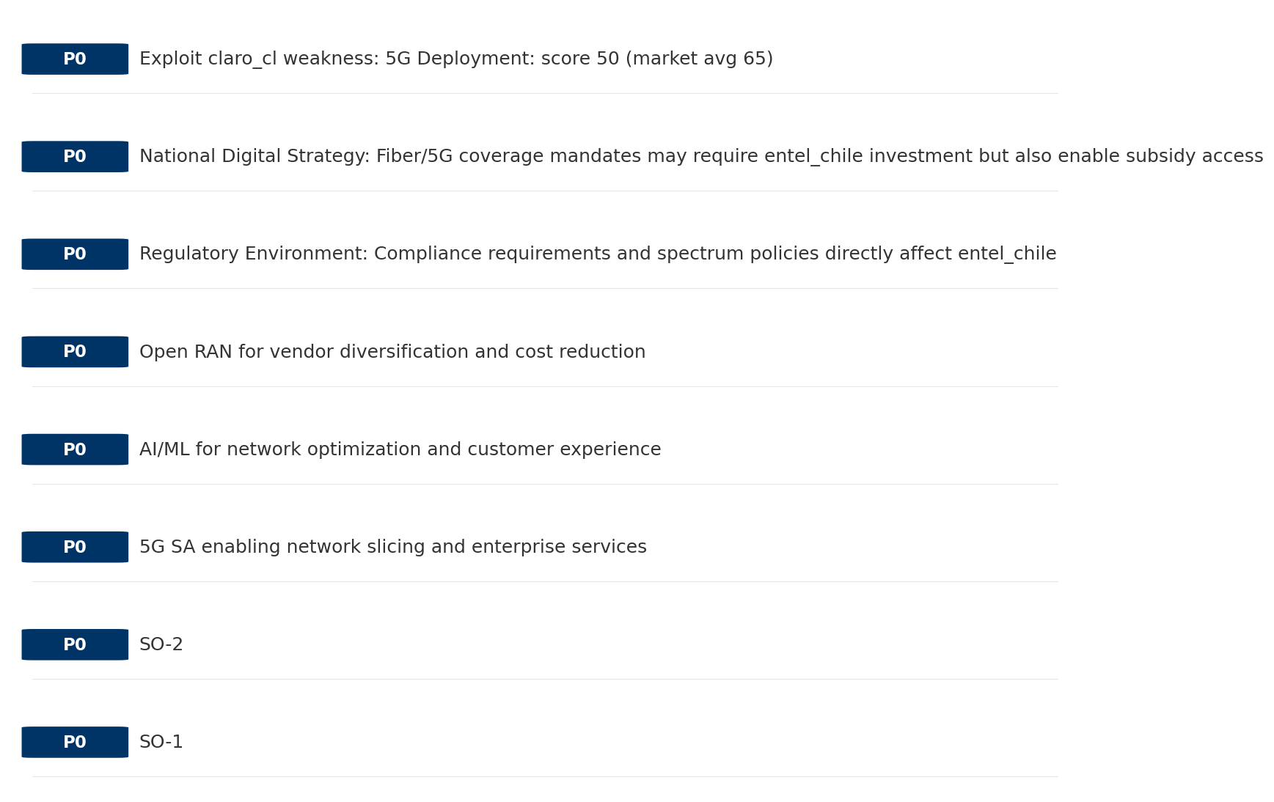
Opportunity Priority Ranking
PRIORITIES
Key Message: SPAN matrix positions 20 opportunities: 14 grow/invest, 2 acquire skills, 2 harvest, 2 avoid/exit. Focus resources on the 14 grow/invest items for maximum strategic impact.
42

Slide 43
Opportunity Details
DEEP DIVE
P0
SO-1
Market: N/A | Window:
Leverage 'Established market presence' to capture the opportunity of 'Regulatory Environment: Compliance requirements and spectrum policies directly affect entel_chile'.
P0
SO-2
Market: N/A | Window:
Leverage 'Established market presence' to capture the opportunity of 'National Digital Strategy: Fiber/5G coverage mandates may require entel_chile investment but also enable subsidy access'.
P0
5G SA enabling network slicing and enterprise services
Market: N/A | Window:
Technology trend: 5G SA enabling network slicing and enterprise services
P0
AI/ML for network optimization and customer experience
Market: N/A | Window:
Technology trend: AI/ML for network optimization and customer experience
Key Message: SPAN matrix positions 20 opportunities: 14 grow/invest, 2 acquire skills, 2 harvest, 2 avoid/exit. Focus resources on the 14 grow/invest items for maximum strategic impact.
43

Slide 44
Three Decisions
Strategy — Key Tasks — Execution

Slide 45
Decision 1: Define Strategy
DEFENSIVE
As The Dominant Leader: defend leadership through innovation and ecosystem lock-in
P0
P0
P1
P1
Growth Strategy
Competitive Strategy
Transformation Strategy
Customer Strategy
Defend leadership through ecosystem expansion in core segments
Shore up competitive position — address: No critical weaknesses identified from available data
Network modernization to close infrastructure gaps
Optimize value extraction in stable segments: Mobile, Fixed Broadband
- Maintain #1 revenue share
- Grow core segments by 5-8% YoY
- Close No critical weaknesses identified from available data gap within 12 months
- Reduce customer churn
- Capex efficiency improvement
- Network quality score top 2
- Upsell rate +10% in Mobile, Fixed Broadband
- Cross-sell convergence bundles
Key Message: As The Dominant Leader, the strategic posture is Defensive. As The Dominant Leader: defend leadership through innovation
45

Slide 46
Decision 2: Define Key Tasks
1 P0 (IMMEDIATE), 3 P1 (1-2 YEARS), 0 P2 (3-5 YEARS
P0
Efficiency
Margin Recovery Program
EBITDA margin +2pp | Opex reduction 5%
EBITDA margin at 0.0% — below industry average, drive cost optimization
P1
Network
Network Quality Optimization
Network quality index improvement
Improve network reliability and customer experience scores
P1
Business
Opportunity Portfolio Execution
Launch 3+ priority initiatives | Pipeline contribution tracking
14 grow/invest opportunities identified — establish execution office
P1
Customer
Customer Experience Enhancement
NPS +5 points | First-call resolution rate 80%+
Improve digital touchpoints and service resolution to boost NPS
Key Message: 4 critical tasks: 1 P0 (immediate), 3 P1 (1-2 years), 0 P2 (3-5 years
46

Slide 47
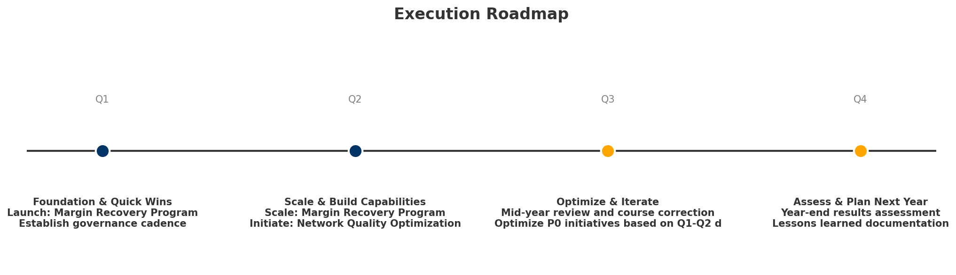
Decision 3: Define Execution
QUARTERLY ROADMAP & GOVERNANCE
Governance
Strategic Traps to Avoid
- Monthly Progress Review (Monthly
x Delay core transformation
- Quarterly Strategic Checkpoint (Quarterly
- Mid-Year Strategic Adjustment (Semi-annual
Key Risks & Mitigation
! Resource constraints delay P0 initiatives -- Ring-fence P0 budgets; establish escalation path for blockers
Key Message: Execute with discipline: monthly reviews, quarterly checkpoints, annual refresh
! Macro-economic slowdown reduces consumer spending -- Prepare value-tier offerings; shift mix toward B2B resilience
47

Slide 48
Analysis Summary
KEY TAKEAWAYS
01 Trends
Macro environment: Favorable. Key opportunities: Regulatory Environment, National Digital Strategy. Key risks: Regulatory Environment, Fiber Broadband Penetration Industry is in late growth phase. (+7.2% YoY (CQ2_2025 -> CQ4_2025)
02 Market
Chile telecom market totals CLP 1.39T in quarterly revenue; Market faces significant competitive headwinds.
03 Competition
Strongest competitive force: Existing Competitors.
04 Self
stable but facing challenges; key strength: Established market presence; key challenge: No critical weaknesses identified from available data
SWOT
SWOT analysis identifies 1 strengths, 1 weaknesses, 2 opportunities, and 8 threats. The recommended strategic posture is cautious (WT-dominant).
05 Opportunities
SPAN matrix positions 20 opportunities: 14 grow/invest, 2 acquire skills, 2 harvest, 2 avoid/exit. Focus resources on the 14 grow/invest items for maximum strategic impact.
Key Message: Complete Five Looks analysis — see opportunity priorities for next steps
48

Slide 49
Data Provenance
SOURCES & METHODOLOGY
No provenance data recorded for this analysis
Key Message: All data points are traceable to original sources
49

Slide 50
Thank You
BLM Five Looks Strategic Analysis

