Slide 1
Default BLM Strategic Analysis
BLM (Business Leadership Model) Five Looks Analysis
Target Operator
Market
Analysis Period
Report Date
Tigo Colombia
Colombia
CQ4_2025
2026-02-14
01 Trends (PEST) | 02 Market/Customer ($APPEALS) | 03 Competition (Porter) | 04 Self (BMC) | SWOT Synthesis | 05 Opportunities (SPAN

Slide 2
Report Contents
TABLE OF CONTENTS
01
Executive Summary
Key findings and recommendations
02
Look at Trends
PEST Framework — macro environment
03
Look at Market
$APPEALS — market changes & customer needs
T
Tariff Analysis
Pricing comparison — mobile, fixed & convergence
04
Look at Competition
Porter's Five Forces — competitive landscape
05
Look at Self
BMC + Capability — internal assessment
06
SWOT Synthesis
Strengths, Weaknesses, Opportunities, Threats
07
Look at Opportunities
SPAN Matrix — opportunity selection
Summary & Provenance
2
08
Conclusions and data sources

Slide 3
Data Quality Overview
DATA QUALITY
Total Data Points
High Confidence
Medium Confidence
Low/Estimated
20
0
0
20
0%
Unique Sources: 0
Data Conflicts: 0
Coverage: Partial
Key Message: 20 data points tracked, 0 high-confidence (0%
3

Slide 4
Executive Summary
Trends
Macro environment: Favorable. Key opportunities: Regulatory Environment, National Digital Strategy. Key risks: Regulatory Environment, Inflation Industry is in late growth phase. (+3.0% YoY (CQ2_2025 -> CQ4_2025)
Market/Customer
Colombia telecom market totals COP 9,340M in quarterly revenue; Market presents a balanced mix of opportunities and challenges.
Competition
In a 4-player market with high competition intensity, Claro Colombia leads with 49% revenue share. Target operator holds 26% share. Strongest competitive force: Existing Competitors.
Self Assessment
Ranked #2 of 4 operators in market; revenue COP 2,420M; EBITDA margin 35.1%; stable but facing challenges; key strength: Customer Service; key challenge: Price Competitiveness; Management outlook: Mobile service revenue growth accelerating with data monetization and postpaid migration
SWOT
SWOT analysis identifies 9 strengths, 5 weaknesses, 5 opportunities, and 7 threats. The recommended strategic posture is defensive (ST-dominant).
Opportunities
SPAN matrix positions 29 opportunities: 14 grow/invest, 7 acquire skills, 4 harvest, 4 avoid/exit. Focus resources on the 14 grow/invest items for maximum strategic impact.
Key Message: Five Looks analysis completed — see details in following sections
4

Slide 5
01 Look at Trends
PEST Framework — Macro Environment

Slide 6
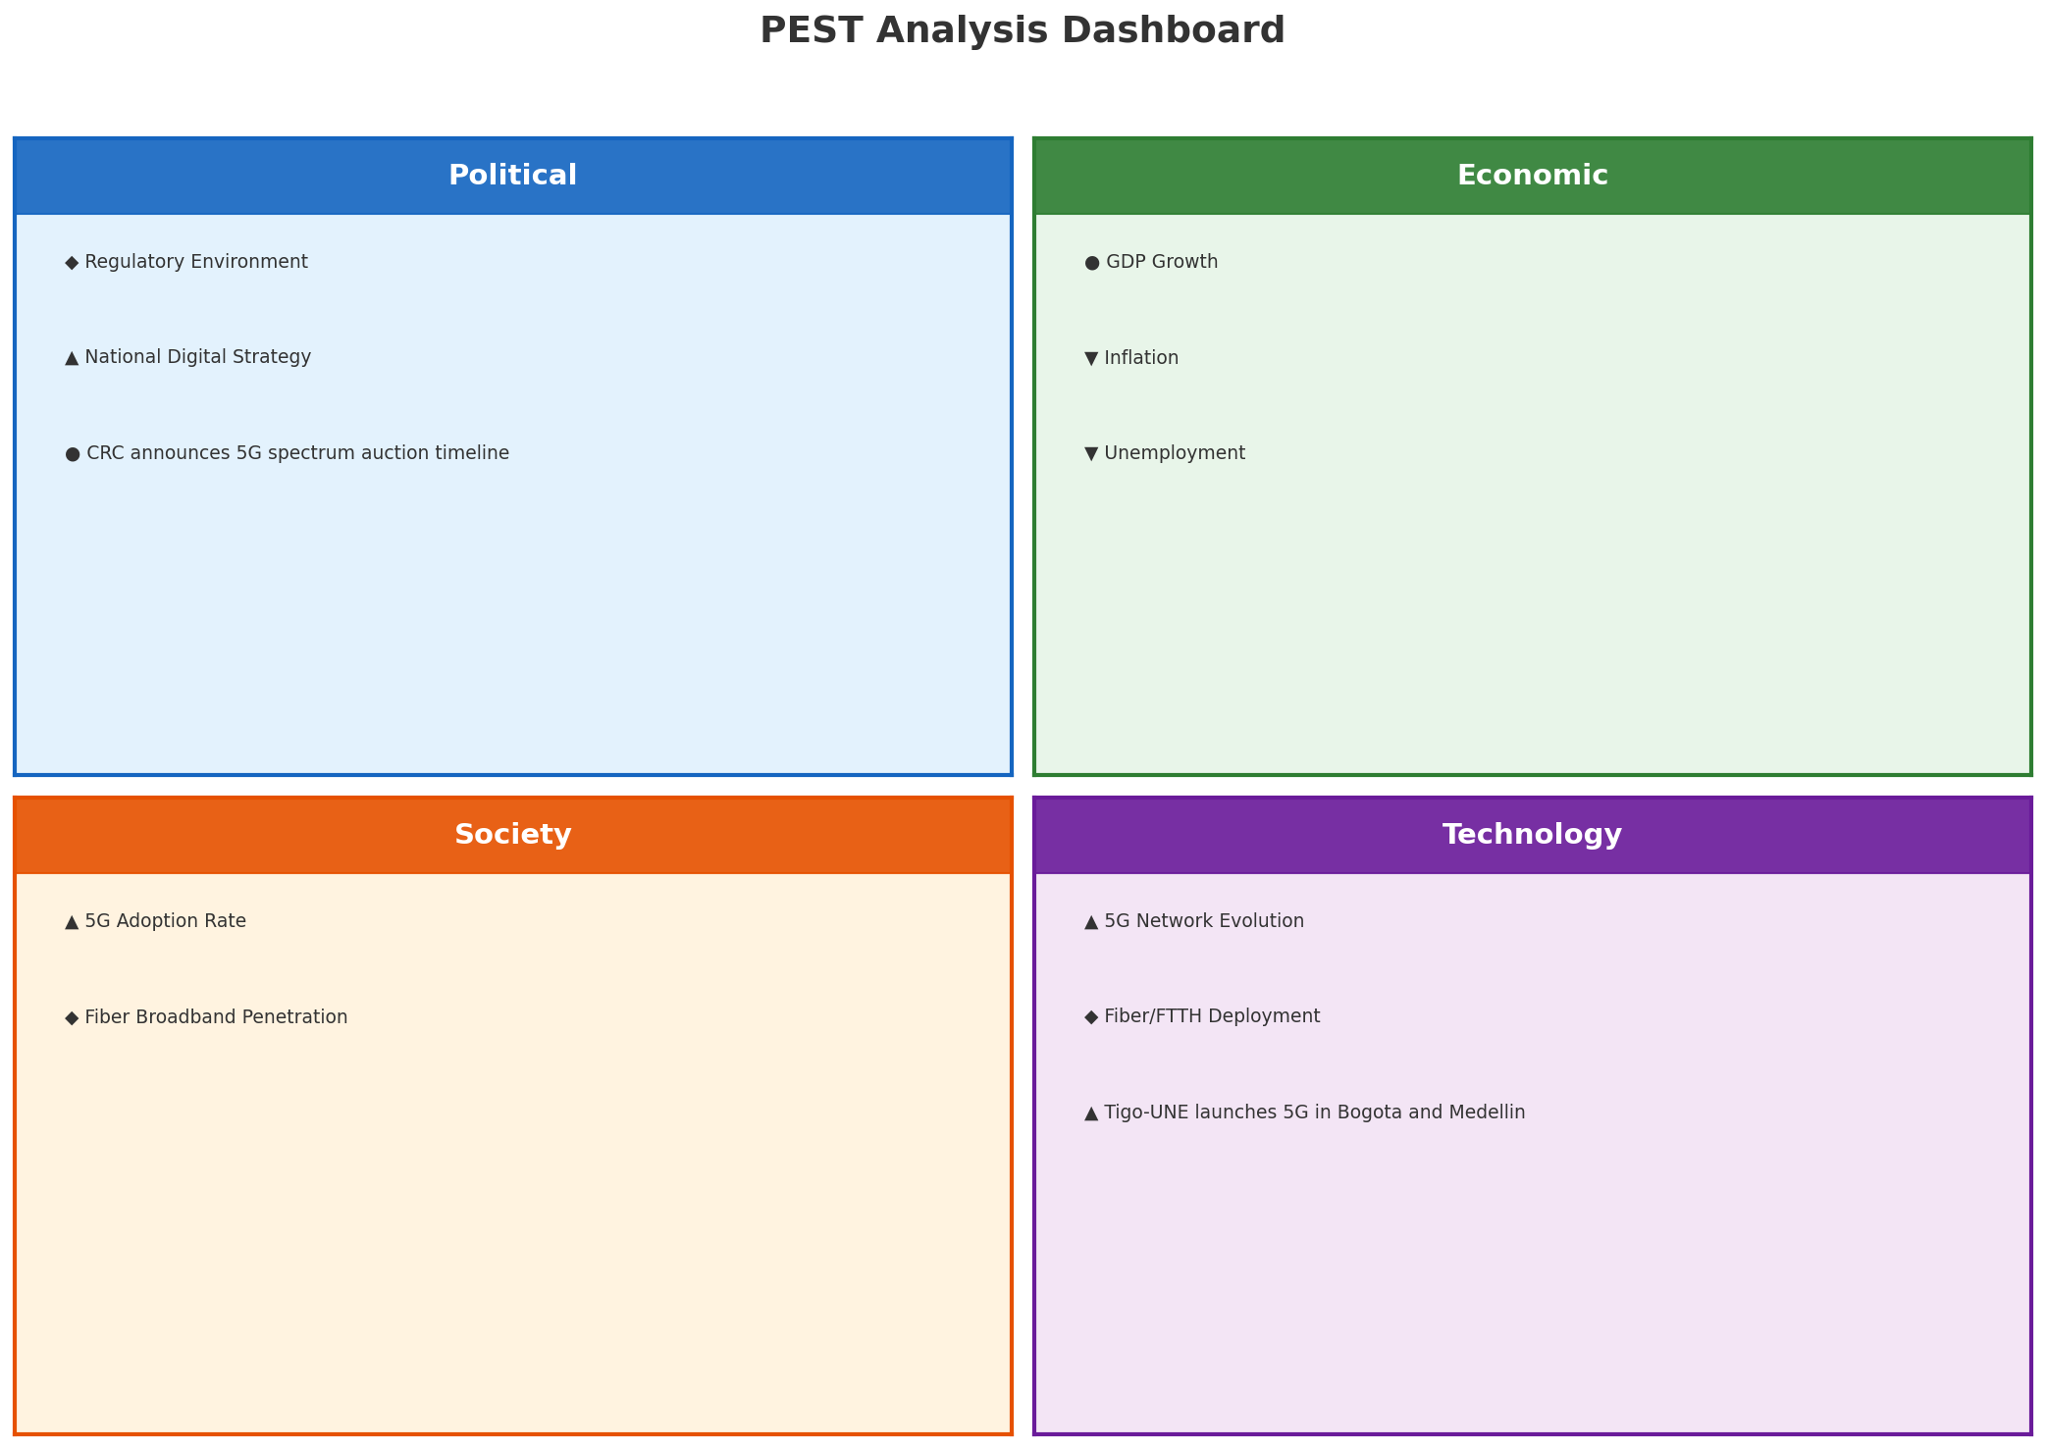
PEST Analysis Dashboard
MACRO ENVIRONMENT
Key Message: Macro environment: Favorable. Key opportunities: Regulatory Environment, National Digital Strategy. Key risks: Regulatory Environment, Inflation.
6

Slide 7
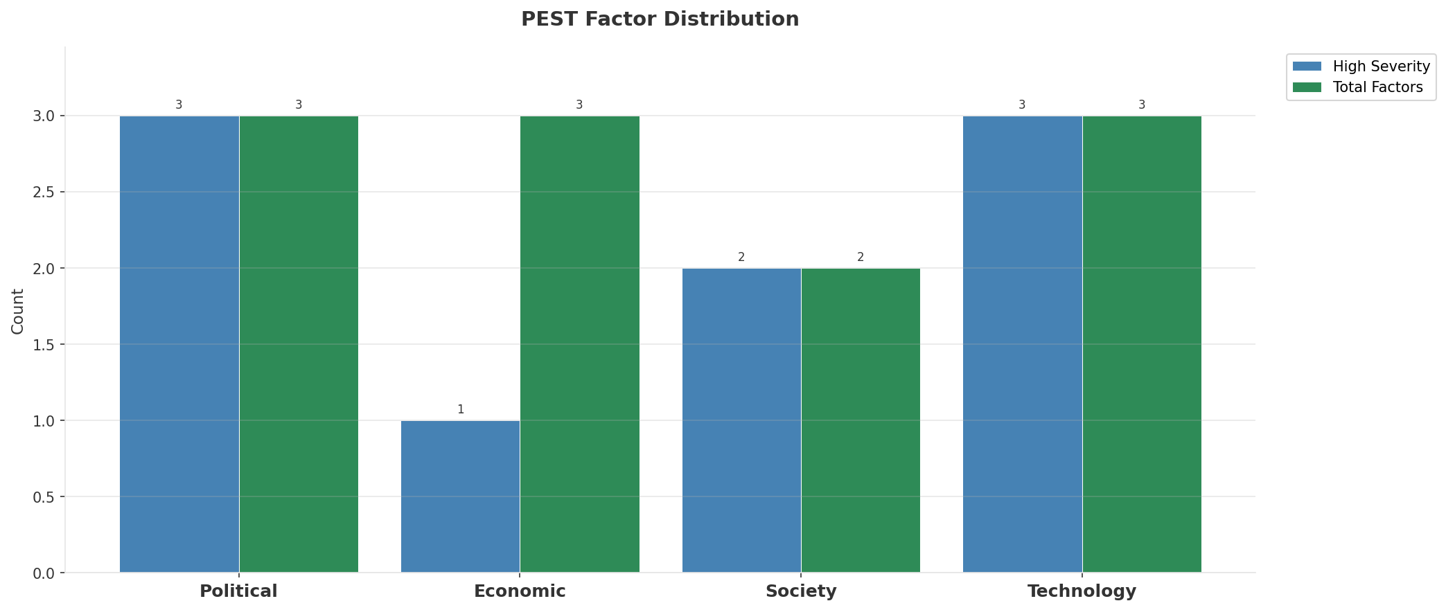
Industry Environment
INDUSTRY ANALYSIS
Market Size
Growth Rate
Concentration
Lifecycle
COP 9.3B (quarterly, CQ4_2025
+3.0% YoY (CQ2_2025 -> CQ4_2025
CR4 = 100% (Claro Colombia: 48.7%, Tigo Colombia: 25.9%, Movistar Colombia: 20.0%, WOM Colombia: 5.4%
late_growth
• New Business Models:
• FWA (Fixed Wireless Access) as fiber alternative
• Network-as-a-Service for enterprise verticals
• Wholesale/MVNO partnerships for coverage monetization
• Technology Revolution:
• 5G SA enabling network slicing and enterprise services
• AI/ML for network optimization and customer experience
• Open RAN for vendor diversification and cost reduction
Key Message: Macro environment: Favorable. Key opportunities: Regulatory Environment, National Digital Strategy. Key risks: Regulatory Environment, Inflation Industry is in late growth phase. (+3.0% YoY (CQ2_2025 -> CQ4_2025)
7

Slide 8
Value Transfer Trends
VALUE MIGRATION
• Value shifting from voice/SMS to data and digital services
• B2B/ICT growing faster than consumer segment
• Fiber displacing copper and cable broadband
Key Message: Macro environment: Favorable. Key opportunities: Regulatory Environment, National Digital Strategy. Key risks: Regulatory Environment, Inflation Industry is in late growth phase. (+3.0% YoY (CQ2_2025 -> CQ4_2025)
8

Slide 9
02 Look at Market
$APPEALS — Market Changes & Customer Needs

Slide 10
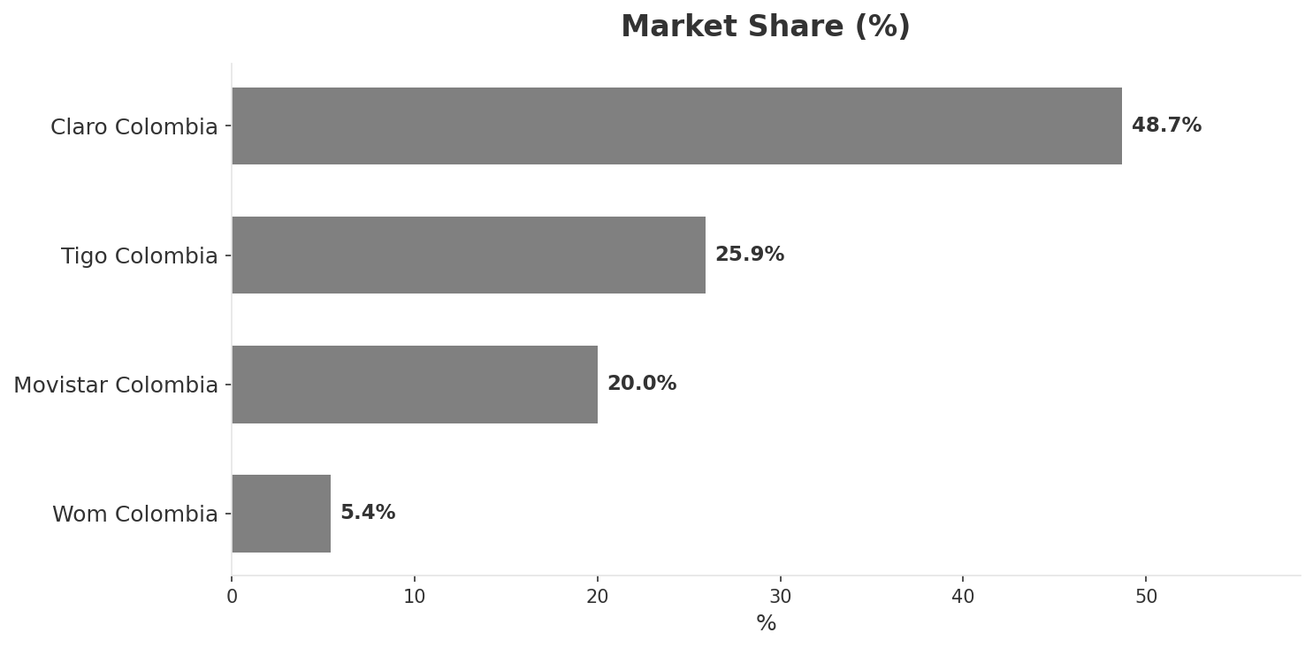
Market Change Panorama
MARKET OVERVIEW
Total Revenue (€M
Mobile Subs (K
Broadband Subs (K
Operators
9,340
68,250
6,060
4
Market Changes:
• Tigo Colombia revenue growth 7.1% YoY
• WOM Colombia revenue increase 8.7% QoQ (COP 500.0M vs COP 460.0M
• WOM Colombia revenue growth 35.1% YoY
• WOM Colombia mobile ARPU increase 8.7% QoQ (COP 10870.0
Key Message: Colombia telecom market totals COP 9,340M in quarterly revenue; Market presents a balanced mix of opportunities and challenges.
10

Slide 11
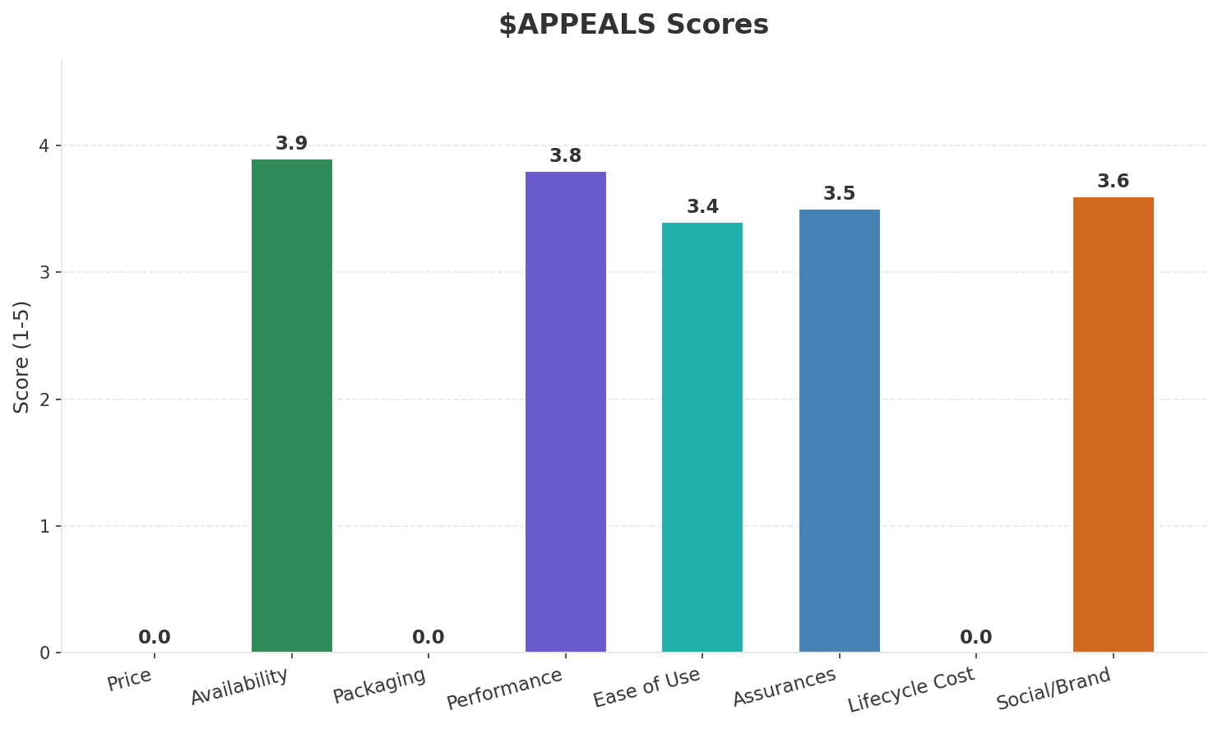
Customer Segments
SEGMENTATION
Consumer Prepaid Mass
Trend: stable
Needs: Affordable data plans for low-income users, Rural and semi-urban coverage
Consumer Postpaid & Convergent
Trend: stable
Needs: High-quality convergent bundles (mobile+fiber+TV), 5G-ready plans
Enterprise Large
Size: ~16K customers (top 5%) | Trend: growing | Our Share: ~30% of B2B base
Needs: SD-WAN and multi-cloud connectivity, IoT solutions for agriculture and logistics
Enterprise SME
Size: ~314K customers | Trend: stable | Our Share: ~30% of B2B base
Needs: Simple all-in-one business connectivity, Affordable cloud solutions
Key Message: Colombia telecom market totals COP 9,340M in quarterly revenue; Market presents a balanced mix of opportunities and challenges.
11

Slide 12
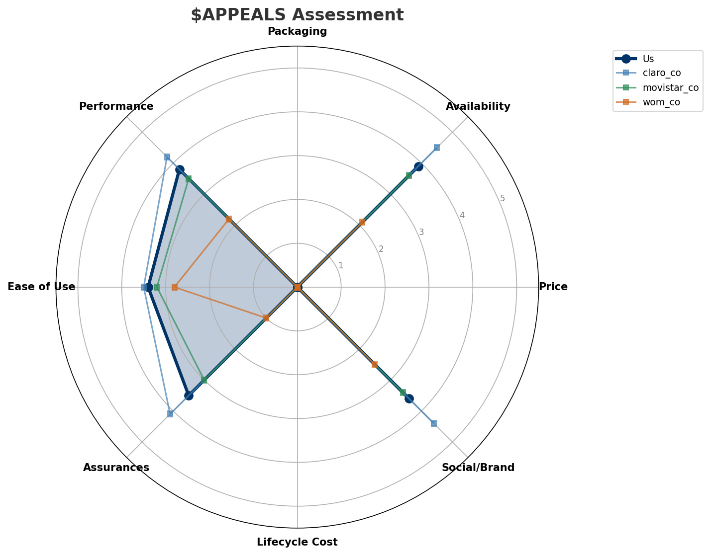
$APPEALS Assessment
CUSTOMER NEEDS
Key Message: Colombia telecom market totals COP 9,340M in quarterly revenue; Market presents a balanced mix of opportunities and challenges.
12

Slide 13
Customer Value Migration
VALUE MIGRATION
Value migration trending upward: customers willing to pay more for premium connectivity and convergent bundles. Focus on upselling and cross-selling opportunities.
Opportunities:
Threats:
• Tigo Colombia revenue growth 7.1% YoY
• Tigo-UNE launches 5G in Bogota and Medellin
• WOM reaches 4.6M subscribers in Colombia
• WOM Colombia revenue increase 8.7% QoQ (COP 500.0M vs COP 460.0M
• WOM Colombia revenue growth 35.1% YoY
• WOM Colombia EBITDA margin improvement: -2.0% vs -4.3% (+2.3pp
Key Message: Colombia telecom market totals COP 9,340M in quarterly revenue; Market presents a balanced mix of opportunities and challenges.
13

Slide 14
Tariff Analysis
Mobile, Fixed & Convergence Pricing Landscape

Slide 15
Fixed & Convergence Pricing Landscape
DSL / CABLE / FIBER / FMC BUNDLES
Key Message: Fixed and convergence pricing overview
15

Slide 16
03 Look at Competition
Porter's Five Forces — Competitive Landscape

Slide 17
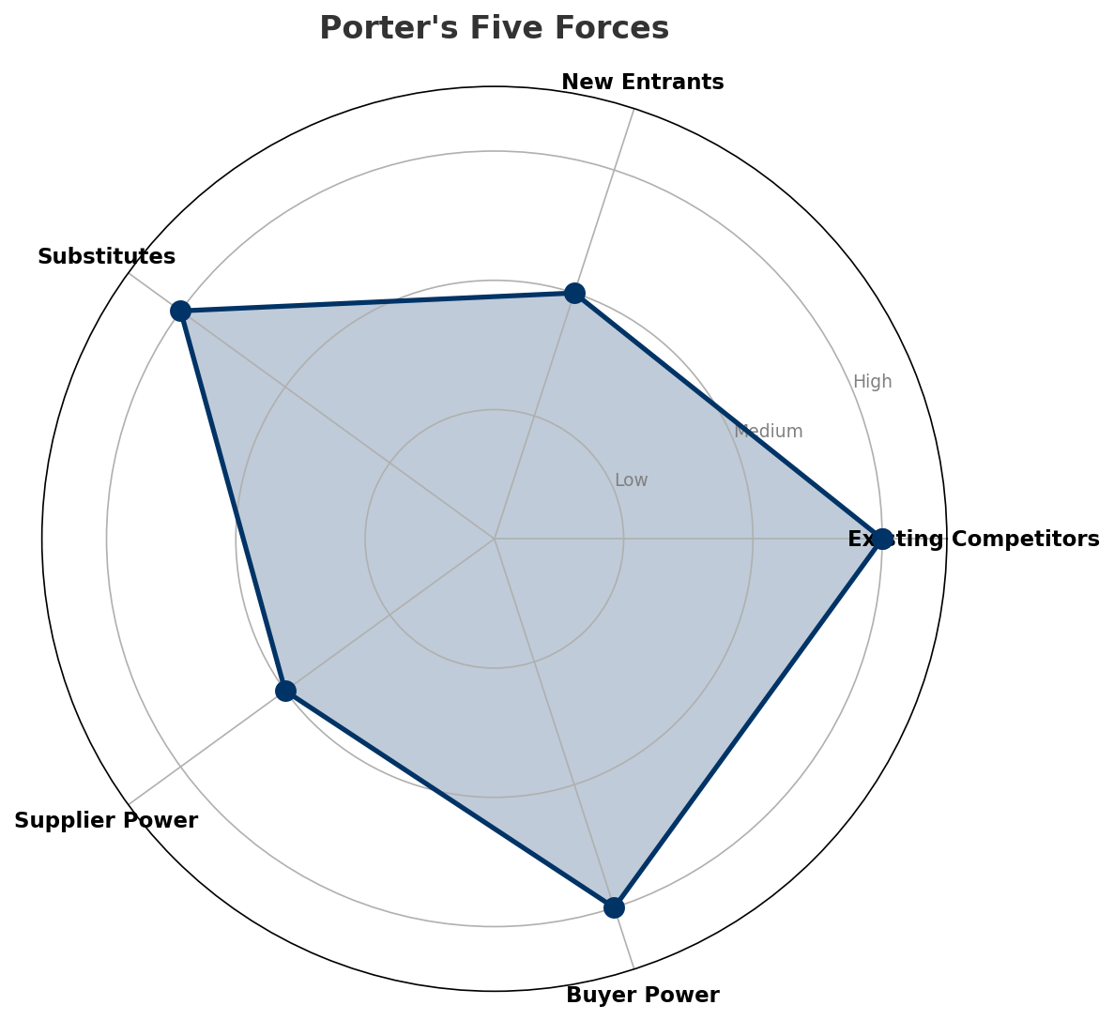
Porter's Five Forces
COMPETITIVE FORCES
Overall Intensity: HIGH
Key Message: In a 4-player market with high competition intensity, Claro Colombia leads with 49% revenue share. Target operator holds 26% share. Strongest competitive force: Existing Competitors.
17

Slide 18
Competitor Analysis: Movistar Co
COMPETITOR DEEP DIVE
Revenue
EBITDA
Margin
Capex/Rev
€1,870M
€555M
29.7%
17.9%
+2.3% YoY
Strengths
Weaknesses
• Digital Experience: score 62 (market avg 68
• Innovation: score 58 (market avg 67
• Price Competitiveness: score 68 (market avg 73
Strategy: Revenue-led profitable growth; subscriber acquisition focus
Key Message: Competitor analysis: Movistar Co
18

Slide 19
Competitor Analysis: Claro Co
COMPETITOR DEEP DIVE
Revenue
EBITDA
Margin
Capex/Rev
€4,550M
€1,820M
40.0%
17.6%
+4.2% YoY
Strengths
Weaknesses
• Brand Strength: score 88 (market avg 70
• Customer Service: score 70 (market avg 64
• Digital Experience: score 75 (market avg 68
• Distribution: score 90 (market avg 70
• Price Competitiveness: score 65 (market avg 73
Strategy: Steady growth trajectory; subscriber acquisition focus; strong B2B/enterprise push
Key Message: Competitor analysis: Claro Co
19

Slide 20
Competitor Analysis: Wom Co
COMPETITOR DEEP DIVE
Revenue
EBITDA
Margin
Capex/Rev
€500M
€-10M
-2.0%
34.0%
+35.3% YoY
Strengths
Weaknesses
• Price Competitiveness: score 90 (market avg 73
• Brand Strength: score 50 (market avg 70
• Customer Service: score 55 (market avg 64
• Distribution: score 45 (market avg 70
• Enterprise Solutions: score 20 (market avg 58
Strategy: Revenue-led profitable growth; subscriber acquisition focus
Key Message: Competitor analysis: Wom Co
20

Slide 21
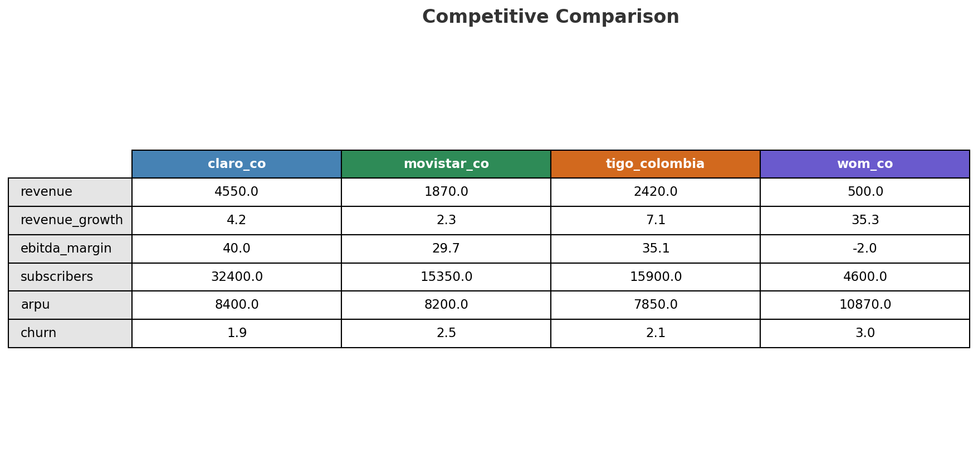
Competitive Landscape Summary
COMPETITION
Key Message: In a 4-player market with high competition intensity, Claro Colombia leads with 49% revenue share. Target operator holds 26% share. Strongest competitive force: Existing Competitors.
21

Slide 22
New Entrants Threat
MARKET ENTRY
• Active new entrant: WOM Colombia: WOM Colombia is currently building/expanding its network presence
• Entry barriers: High barriers: spectrum licensing, massive capex for network build, regulatory approvals, established brand loyalty
Key Message: New entrants threat level: medium
22

Slide 23
04 Look at Self
BMC + Capability Assessment

Slide 24
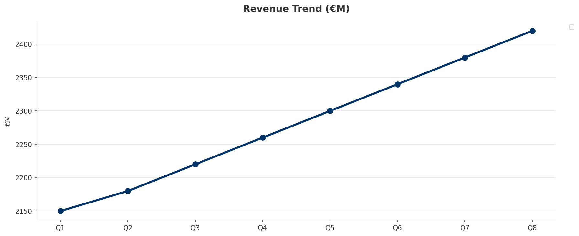
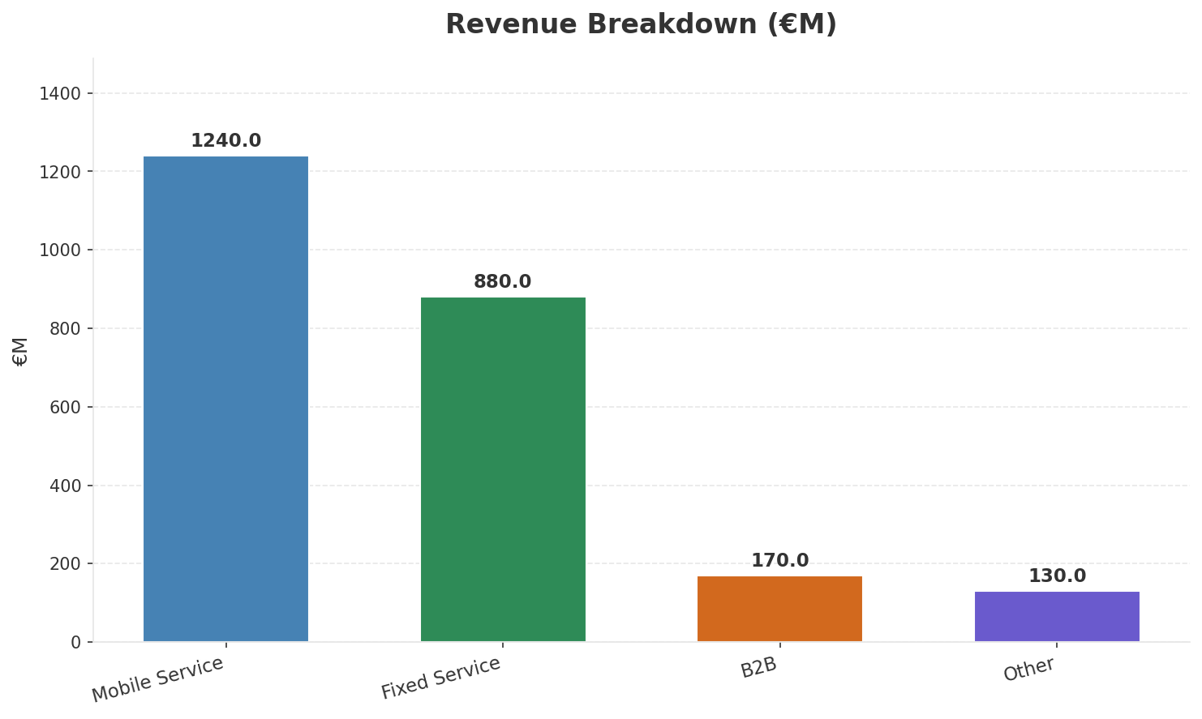
Operating Health Check
FINANCIAL HEALTH
Revenue
EBITDA
EBITDA Margin
Capex/Rev
€2,420M
€850M
35.1%
20.2%
+7.08% YoY
+7.6% YoY
Key Message: Ranked #2 of 4 operators in market; revenue COP 2,420M; EBITDA margin 35.1%; stable but facing challenges; key strength: Customer Service; key challenge: Price Competitiveness; Management outlook: Mobile service revenue growth accelerating with data monetization and postpaid migration
24

Slide 25
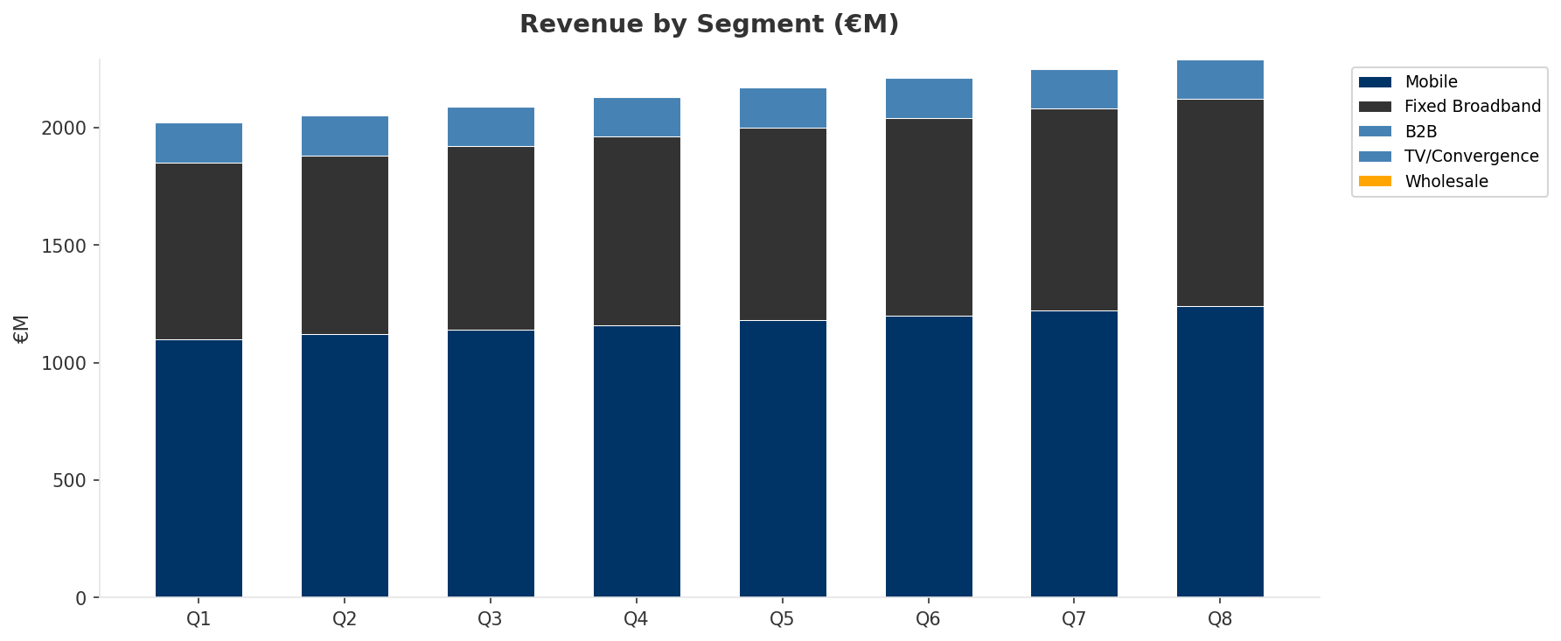
Revenue Composition Trend
SEGMENT REVENUE MIX OVER TIME
Key Message: Growing: Mobile, Fixed Broadband
25

Slide 26
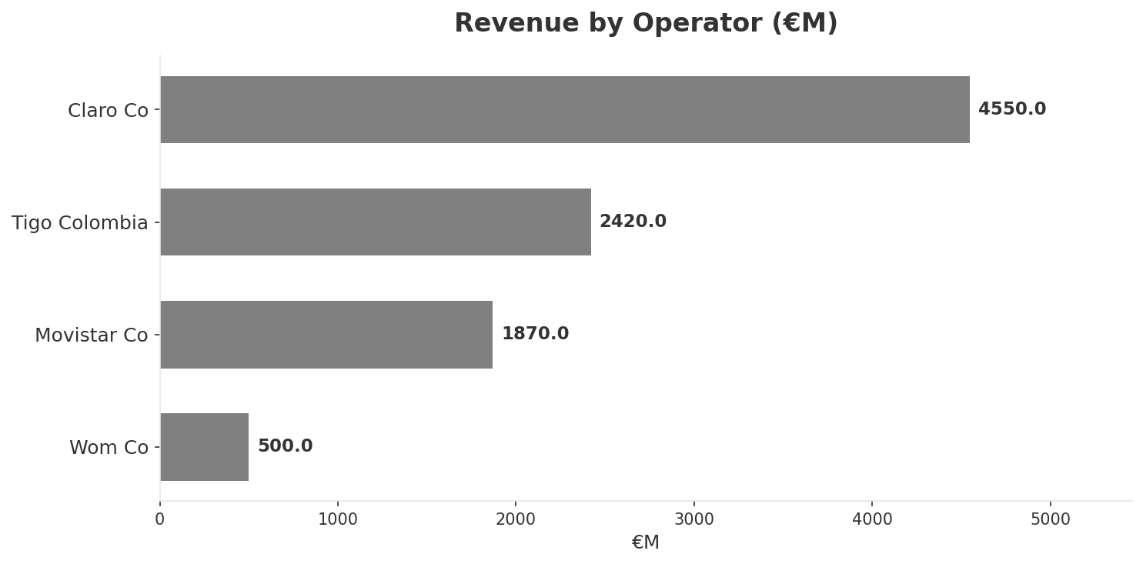
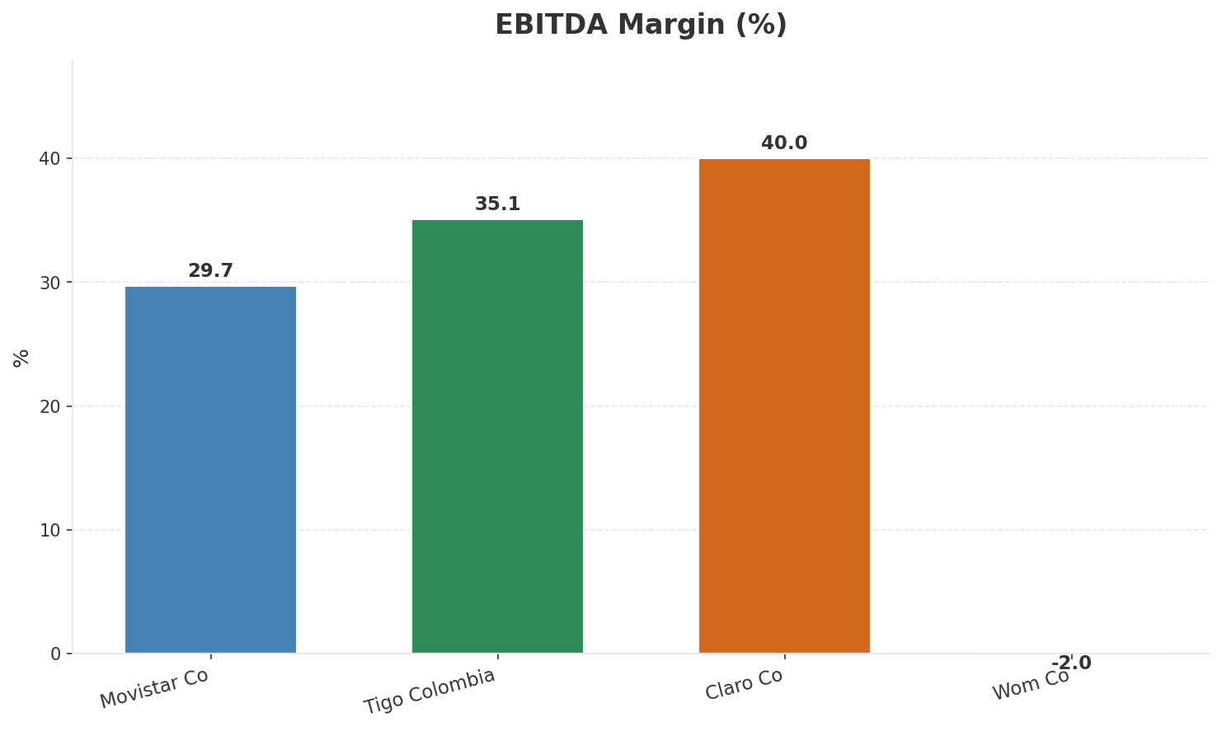
Revenue Comparison
COMPETITIVE BENCHMARKING
Key Message: Revenue and margin benchmarking across operators
26

Slide 27
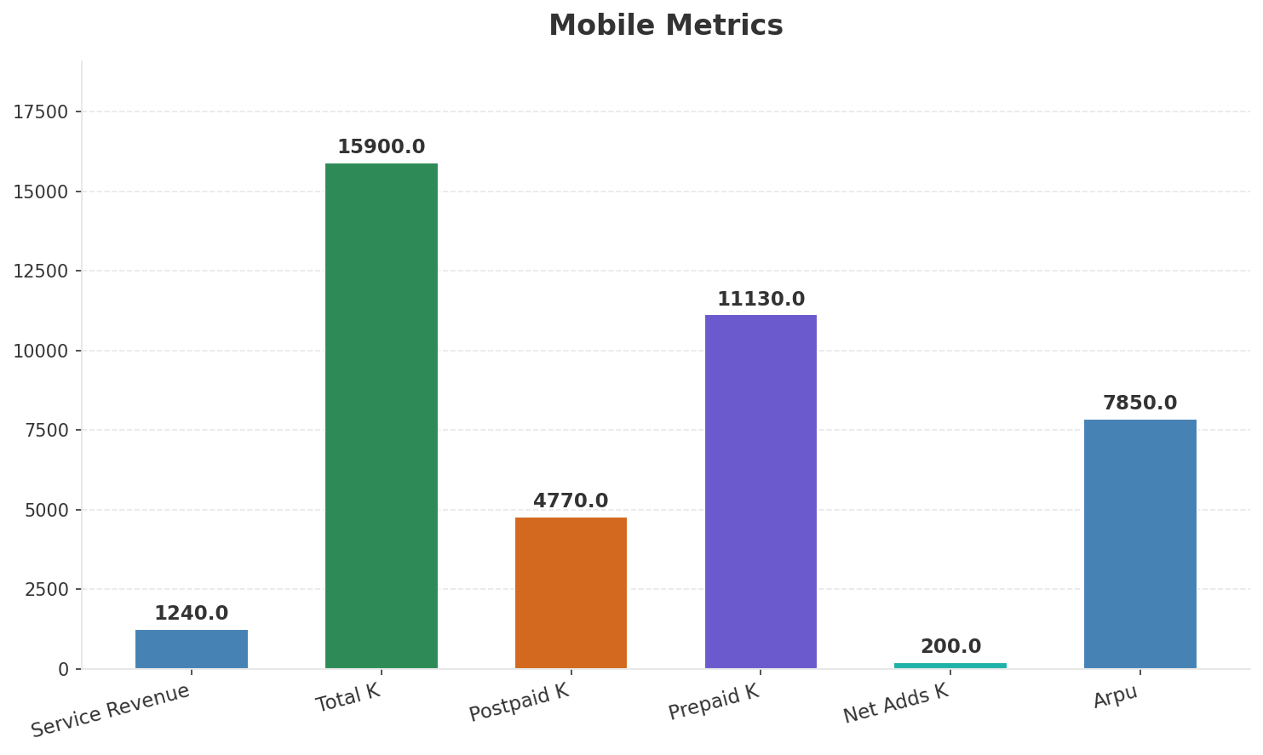
Segment Analysis: Mobile
SEGMENT PERFORMANCE
Service Revenue
Service Growth Pct
Total K
Postpaid K
€1,240M
6.9%
€15,900M
€4,770M
Health: STABLE
• revenue: improving
• subscribers: improving
• arpu: stable
• Mobile service revenue growth accelerating with data monetization and postpaid migration
Key Message: Mobile service revenue at 1,240M; up 6.9% YoY; ARPU 7850.0
27

Slide 28
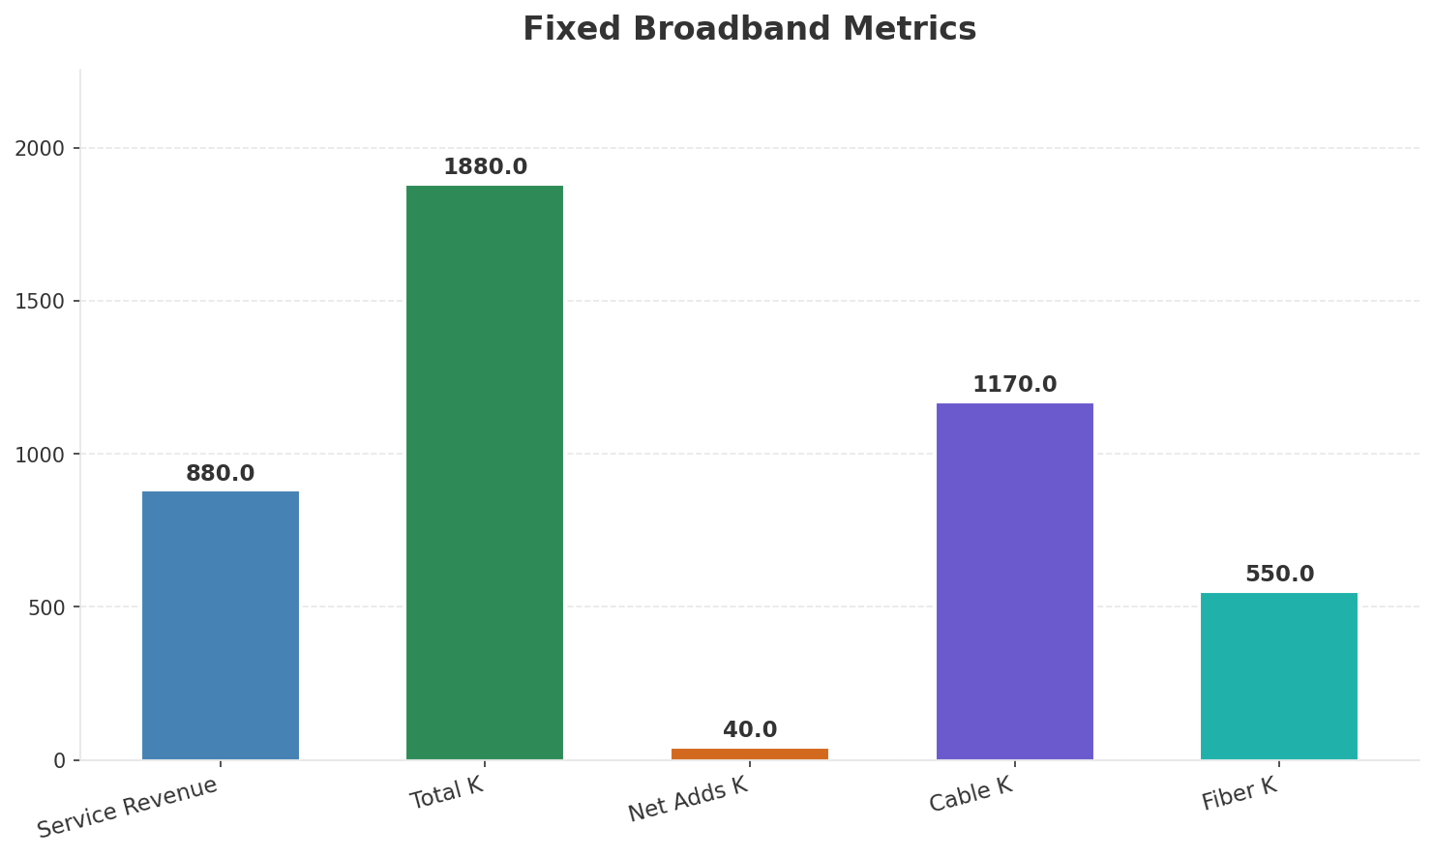
Segment Analysis: Fixed Broadband
SEGMENT PERFORMANCE
Service Revenue
Service Growth Pct
Total K
Net Adds K
€880M
7.5%
€1,880M
40
Health: STRONG
• revenue: improving
• subscribers: improving
• arpu: stable
• Fixed broadband growth driven by fiber expansion, targeting 550K fiber subs by end of 2025
• revenue increased 2.3% QoQ
• subscribers increased 2.2% QoQ
Key Message: Fixed service revenue 880.0M; growth +7.5% YoY; Fiber subs 550K
28

Slide 29
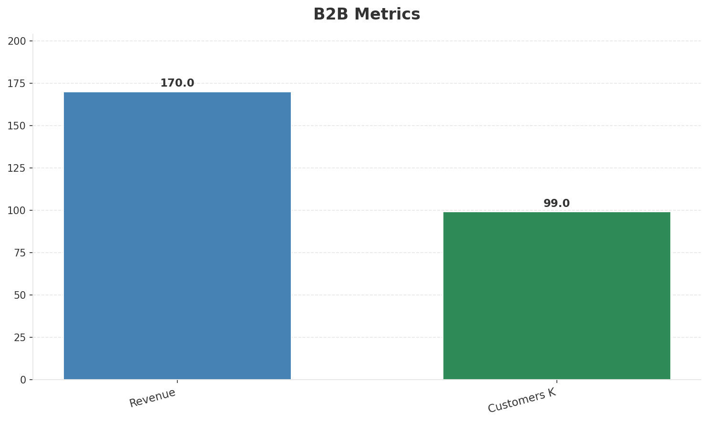
Segment Analysis: B2B
SEGMENT PERFORMANCE
Revenue
Growth Pct
Customers K
Share Of Revenue Pct
€170M
None
99
7.0%
Health: STABLE
• revenue: stable
• customers: improving
• Colombia B2B segment benefiting from enterprise cloud connectivity solutions
• customers increased 2.1% QoQ
Key Message: B2B revenue 170.0M; 7.0% of total revenue
29

Slide 30
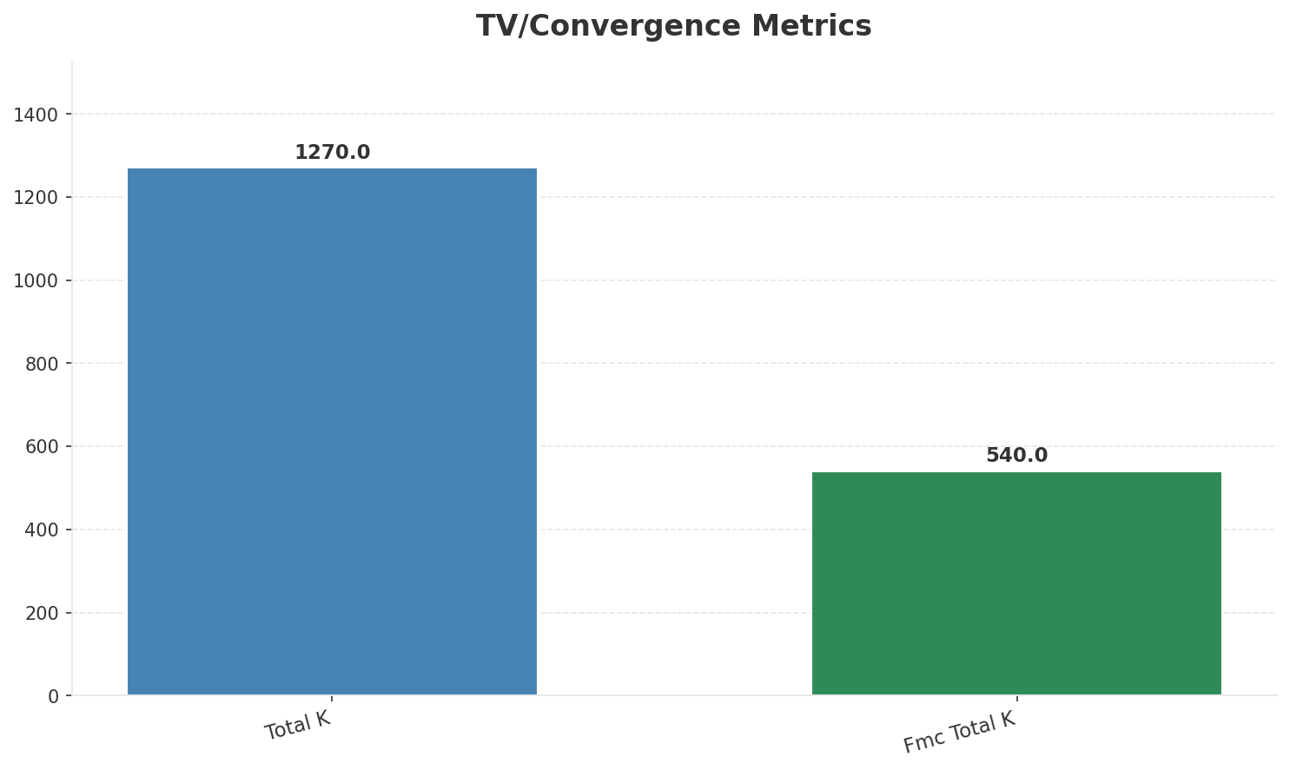
Segment Analysis: TV/Convergence
SEGMENT PERFORMANCE
Revenue
Total K
Net Adds K
Fmc Total K
None
€1,270M
None
€540M
Health: STABLE
• revenue: stable
• subscribers: stable
• fmc_subscribers: improving
• fmc_subscribers increased 3.9% QoQ
Key Message: TV subscribers 1270K; FMC 540K; FMC penetration 28.7%
30

Slide 31
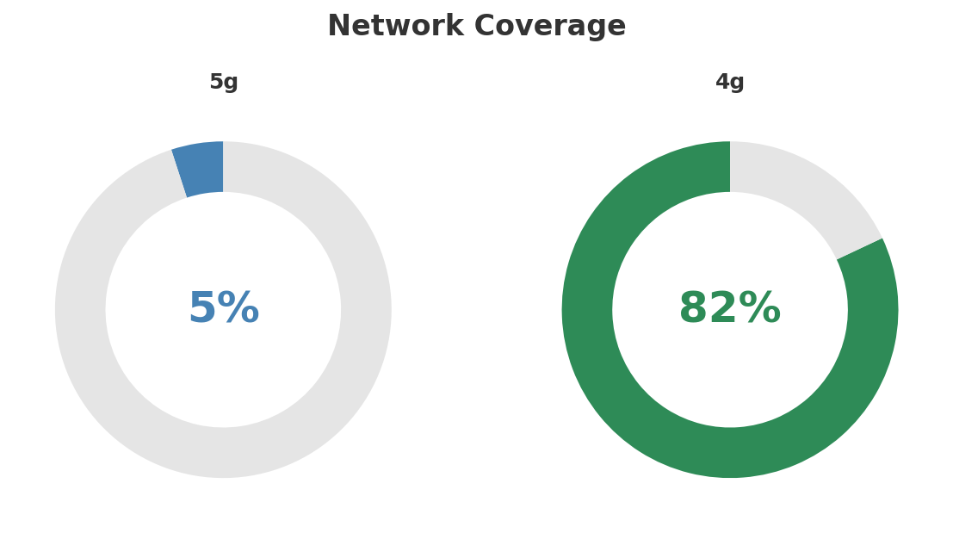
Network Analysis
INFRASTRUCTURE
Technology Mix:
Investment Direction: stable
• Mobile Vendor: Nokia/Ericsson
• Spectrum Mhz: 145
• Core Vendor: Nokia
Key Message: Network infrastructure and coverage assessment
31

Slide 32

Business Model Canvas
BMC
Key Message: Business model canvas overview
32

Slide 33
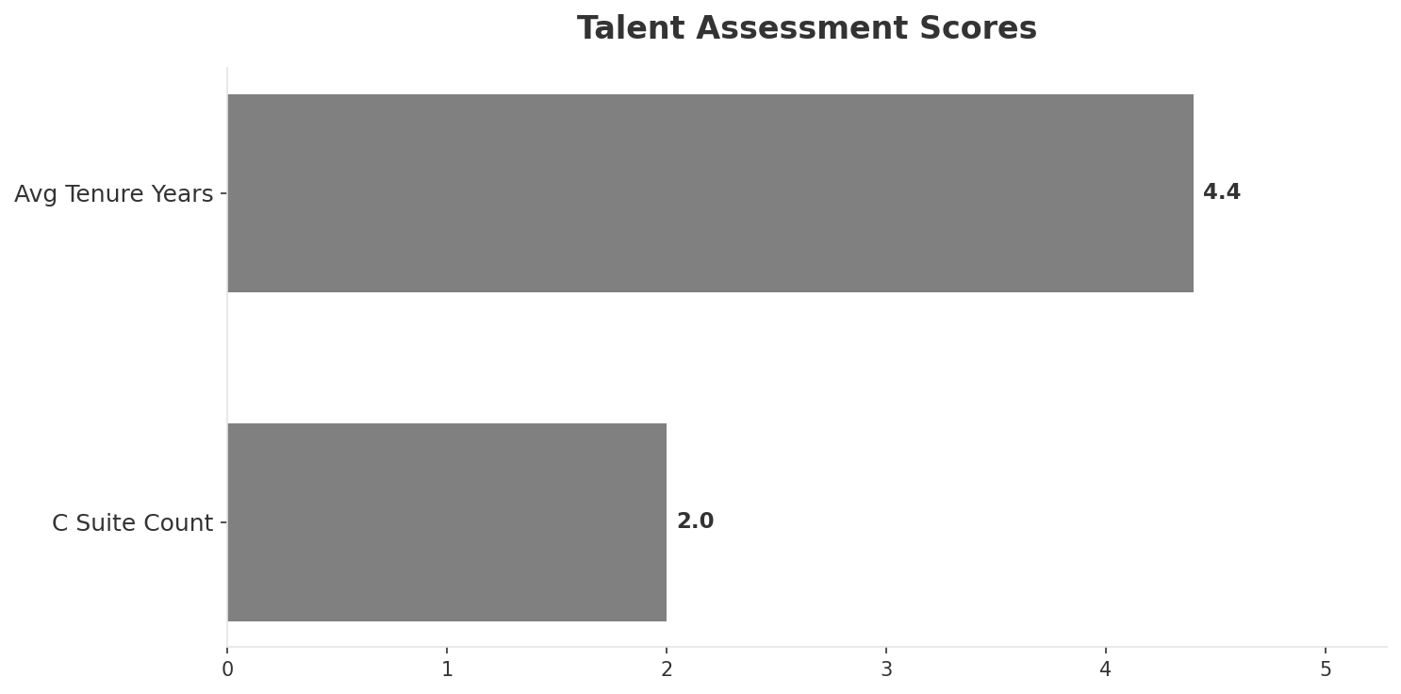
Organization & Talent
PEOPLE & CULTURE
Employees
C Suite Count
Avg Tenure Years
Key Leaders
6,800
2
4.4
['Marcelo Cataldo (CEO)', 'Diego Pardo (CFO)']
Organization Culture:
Stable leadership team (avg tenure >3 years); Growth-oriented strategic posture; High-investment posture; JV culture blending Millicom commercial agility with EPM public utility stability; innovation-oriented with digital transformation focus; strong local brand.
Leadership Changes:
• Marcelo Cataldo: (
• Diego Pardo: (
Key Message: Organization and talent assessment
33

Slide 34
Strengths, Weaknesses & Exposure Points
SELF ASSESSMENT
Strengths
Weaknesses
Exposure Points
• Customer Service: score 68 (market avg 64
• Digital Experience: score 72 (market avg 68
• Distribution: score 75 (market avg 70
• Enterprise Solutions: score 70 (market avg 58
• Network Coverage: score 78 (market avg 70
• Network Quality: score 75 (market avg 69
• Price Competitiveness: score 70 (market avg 73
• 5G coverage gap at only 5.0%
• WOM aggressive pricing disrupting postpaid economics: ARPU pressure as WOM grows from 2.5M to 4.6M subscribers
• 50% JV structure with EPM limits strategic flexibility: Slower decision-making and capex allocation vs fully-owned subsidiaries
• Cable network aging while competitors deploy fiber: Speed and perception gap vs Claro fiber offerings
Key Message: Ranked #2 of 4 operators in market; revenue COP 2,420M; EBITDA margin 35.1%; stable but facing challenges; key strength: Customer Service; key challenge: Price Competitiveness; Management outlook: Mobile service revenue growth accelerating with data monetization and postpaid migration
34

Slide 35
SWOT Synthesis
Strengths, Weaknesses, Opportunities & Threats

Slide 36

SWOT Analysis
STRATEGIC SYNTHESIS
SO:
Leverage 'Customer Service: score 68 (market avg 64)' to ...
WO:
Address weakness 'Price Competitiveness: score 70 (market...
ST:
Use strength 'Customer Service: score 68 (market avg 64)'...
WT:
Mitigate weakness 'Price Competitiveness: score 70 (marke...
Key Message: SWOT analysis identifies 9 strengths, 5 weaknesses, 5 opportunities, and 7 threats. The recommended strategic posture is defensive (ST-dominant).
36

Slide 37
05 Look at Opportunities
SPAN Matrix — Opportunity Selection

Slide 38
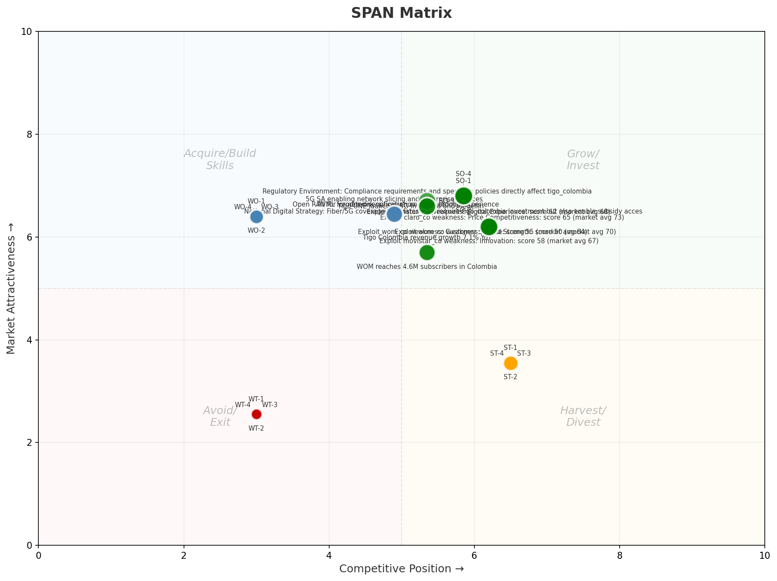
SPAN Matrix — Opportunity Positioning
OPPORTUNITY MAP
Key Message: SPAN matrix positions 29 opportunities: 14 grow/invest, 7 acquire skills, 4 harvest, 4 avoid/exit. Focus resources on the 14 grow/invest items for maximum strategic impact.
38

Slide 39
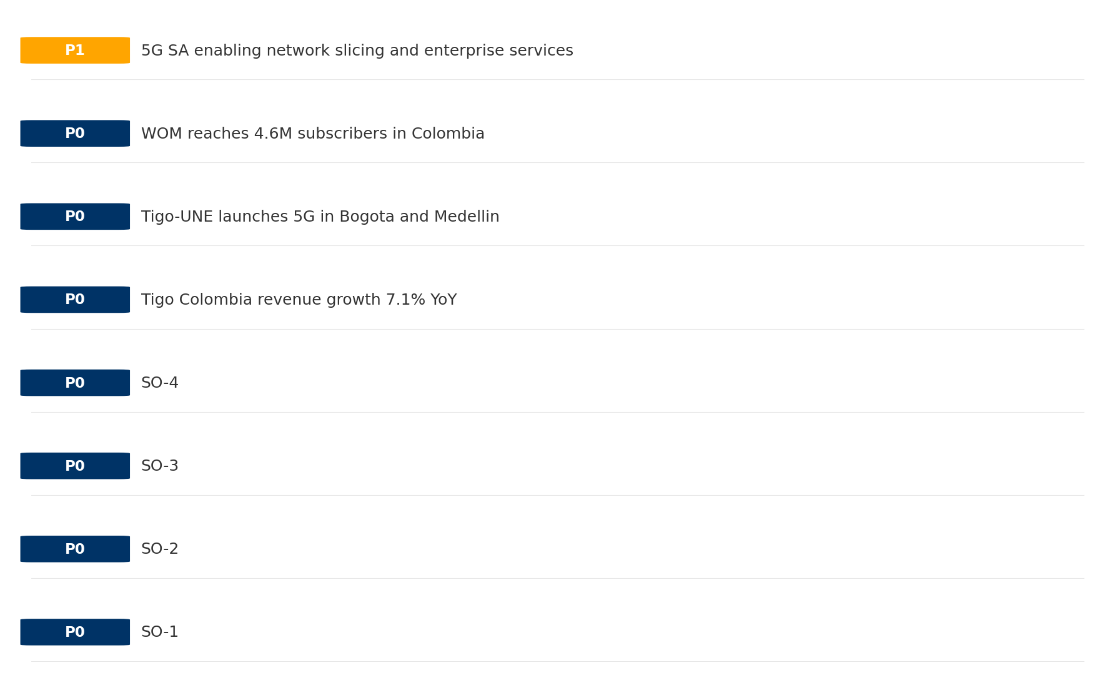
Opportunity Priority Ranking
PRIORITIES
Key Message: SPAN matrix positions 29 opportunities: 14 grow/invest, 7 acquire skills, 4 harvest, 4 avoid/exit. Focus resources on the 14 grow/invest items for maximum strategic impact.
39

Slide 40
Opportunity Details
DEEP DIVE
P0
SO-1
Market: N/A | Window:
Leverage 'Customer Service: score 68 (market avg 64)' to capture the opportunity of 'Regulatory Environment: Compliance requirements and spectrum policies directly affect tigo_colombia'.
P0
SO-2
Market: N/A | Window:
Leverage 'Digital Experience: score 72 (market avg 68)' to capture the opportunity of 'National Digital Strategy: Fiber/5G coverage mandates may require tigo_colombia investment but also enable subsidy access'.
P0
SO-3
Market: N/A | Window:
Leverage 'Distribution: score 75 (market avg 70)' to capture the opportunity of 'Tigo Colombia revenue growth 7.1% YoY'.
P0
SO-4
Market: N/A | Window:
Leverage 'Enterprise Solutions: score 70 (market avg 58)' to capture the opportunity of 'Tigo-UNE launches 5G in Bogota and Medellin'.
Key Message: SPAN matrix positions 29 opportunities: 14 grow/invest, 7 acquire skills, 4 harvest, 4 avoid/exit. Focus resources on the 14 grow/invest items for maximum strategic impact.
40

Slide 41
Three Decisions
Strategy — Key Tasks — Execution

Slide 42
Decision 1: Define Strategy
DEFENSIVE
As The Squeezed Middle: stabilize core business, then selectively invest for turnaround
P0
P0
P1
P1
Growth Strategy
Competitive Strategy
Transformation Strategy
Customer Strategy
Close the gap to market leader — accelerate Mobile, Fixed Broadband, B2B
Shore up competitive position — address: Price Competitiveness: score 70 (market avg 73
Accelerate fiber transition — converged network as competitive moat
Optimize value extraction in stable segments: Wholesale
- Gain 1-2pp revenue share
- Grow Mobile, Fixed Broadband, B2B double-digit
- Close Price Competitiveness: score 70 (market avg 73) gap within 12 months
- Reduce customer churn
- Fiber homepass coverage +20%
- FMC bundle attach rate 50%+
- Upsell rate +10% in Wholesale
- Cross-sell convergence bundles
Key Message: As The Squeezed Middle, the strategic posture is Defensive. As The Squeezed Middle: stabilize core business, then select
42

Slide 43
Decision 2: Define Key Tasks
3 P0 (IMMEDIATE), 3 P1 (1-2 YEARS), 1 P2 (3-5 YEARS
P0
Network
Accelerate Fixed Network Upgrade
Homepass coverage +15% | Speed tier upgrades
Drive DOCSIS/Fiber rollout to increase homepass and improve quality scores
P0
Business
Accelerate Mobile Growth
Mobile revenue +10% YoY | Market share gain
Mobile at €1,240M showing strong momentum — invest to scale
P0
Business
Accelerate Fixed Broadband Growth
Fixed Broadband revenue +10% YoY | Market share gain
Fixed Broadband at €880M showing strong momentum — invest to scale
P1
Network
5G Coverage Expansion
5G pop coverage target | 5G attach rate
Expand 5G population coverage to strengthen mobile competitive position
P1
Business
Opportunity Portfolio Execution
Launch 3+ priority initiatives | Pipeline contribution tracking
14 grow/invest opportunities identified — establish execution office
P1
Customer
Customer Experience Enhancement
NPS +5 points | First-call resolution rate 80%+
Improve digital touchpoints and service resolution to boost NPS
P2
Efficiency
Operational Efficiency & Automation
Process automation 30%+ | Cost-to-serve reduction
EBITDA margin 35.1% — maintain through smart automation and resource reallocatio
Key Message: 7 critical tasks: 3 P0 (immediate), 3 P1 (1-2 years), 1 P2 (3-5 years
43

Slide 44

Decision 3: Define Execution
QUARTERLY ROADMAP & GOVERNANCE
Governance
Strategic Traps to Avoid
- Monthly Progress Review (Monthly
x Enter a price war
- Quarterly Strategic Checkpoint (Quarterly
x Attempt premium repositioning
- Mid-Year Strategic Adjustment (Semi-annual
x Delay core transformation
Key Risks & Mitigation
! Resource constraints delay P0 initiatives -- Ring-fence P0 budgets; establish escalation path for blockers
Key Message: Execute with discipline: monthly reviews, quarterly checkpoints, annual refresh
! Macro-economic slowdown reduces consumer spending -- Prepare value-tier offerings; shift mix toward B2B resilience
44

Slide 45
Analysis Summary
KEY TAKEAWAYS
01 Trends
Macro environment: Favorable. Key opportunities: Regulatory Environment, National Digital Strategy. Key risks: Regulatory Environment, Inflation Industry is in late growth phase. (+3.0% YoY (CQ2_2025 -> CQ4_2025)
02 Market
Colombia telecom market totals COP 9,340M in quarterly revenue; Market presents a balanced mix of opportunities and challenges.
03 Competition
In a 4-player market with high competition intensity, Claro Colombia leads with 49% revenue share. Target operator holds 26% share. Strongest competitive force: Existing Competitors.
04 Self
Ranked #2 of 4 operators in market; revenue COP 2,420M; EBITDA margin 35.1%; stable but facing challenges; key strength: Customer Service; key challenge: Price Competitiveness; Management outlook: Mobile service revenue growth accelerating with data monetization and postpaid migration
SWOT
SWOT analysis identifies 9 strengths, 5 weaknesses, 5 opportunities, and 7 threats. The recommended strategic posture is defensive (ST-dominant).
05 Opportunities
SPAN matrix positions 29 opportunities: 14 grow/invest, 7 acquire skills, 4 harvest, 4 avoid/exit. Focus resources on the 14 grow/invest items for maximum strategic impact.
Key Message: Complete Five Looks analysis — see opportunity priorities for next steps
45

Slide 46
Data Provenance
SOURCES & METHODOLOGY
No provenance data recorded for this analysis
Key Message: All data points are traceable to original sources
46

Slide 47
Thank You
BLM Five Looks Strategic Analysis

