Slide 1
Default BLM Strategic Analysis
BLM (Business Leadership Model) Five Looks Analysis
Target Operator
Market
Analysis Period
Report Date
Tigo Ecuador
Ecuador
CQ4_2025
2026-02-14
01 Trends (PEST) | 02 Market/Customer ($APPEALS) | 03 Competition (Porter) | 04 Self (BMC) | SWOT Synthesis | 05 Opportunities (SPAN

Slide 2
Report Contents
TABLE OF CONTENTS
01
Executive Summary
Key findings and recommendations
02
Look at Trends
PEST Framework — macro environment
03
Look at Market
$APPEALS — market changes & customer needs
T
Tariff Analysis
Pricing comparison — mobile, fixed & convergence
04
Look at Competition
Porter's Five Forces — competitive landscape
05
Look at Self
BMC + Capability — internal assessment
06
SWOT Synthesis
Strengths, Weaknesses, Opportunities, Threats
07
Look at Opportunities
SPAN Matrix — opportunity selection
Summary & Provenance
2
08
Conclusions and data sources

Slide 3
Data Quality Overview
DATA QUALITY
Total Data Points
High Confidence
Medium Confidence
Low/Estimated
20
0
0
20
0%
Unique Sources: 0
Data Conflicts: 0
Coverage: Partial
Key Message: 20 data points tracked, 0 high-confidence (0%
3

Slide 4
Executive Summary
Trends
Macro environment: Favorable. Key opportunities: Regulatory Environment, National Digital Strategy. Key risks: Regulatory Environment, Fiber Broadband Penetration Industry is in late growth phase. (+2.5% YoY (CQ2_2025 -> CQ4_2025)
Market/Customer
Ecuador telecom market totals USD 1,225M in quarterly revenue; gaps in Assurances, Social/Brand; Market outlook is favorable with more opportunities than threats.
Competition
In a 3-player market with medium competition intensity, Claro Ecuador leads with 47% revenue share. Target operator holds 29% share. Strongest competitive force: Substitutes.
Self Assessment
Ranked #2 of 3 operators in market; revenue USD 355.0M; EBITDA margin 32.7%; stable but facing challenges; key strength: Innovation; key challenge: Brand Strength; Management outlook: Ecuador integration proceeding on schedule; synergies expected from Millicom LATAM platform
SWOT
SWOT analysis identifies 4 strengths, 6 weaknesses, 4 opportunities, and 4 threats. The recommended strategic posture is cautious (WT-dominant).
Opportunities
SPAN matrix positions 26 opportunities: 7 grow/invest, 11 acquire skills, 4 harvest, 4 avoid/exit. Focus resources on the 7 grow/invest items for maximum strategic impact.
Key Message: Five Looks analysis completed — see details in following sections
4

Slide 5
01 Look at Trends
PEST Framework — Macro Environment

Slide 6
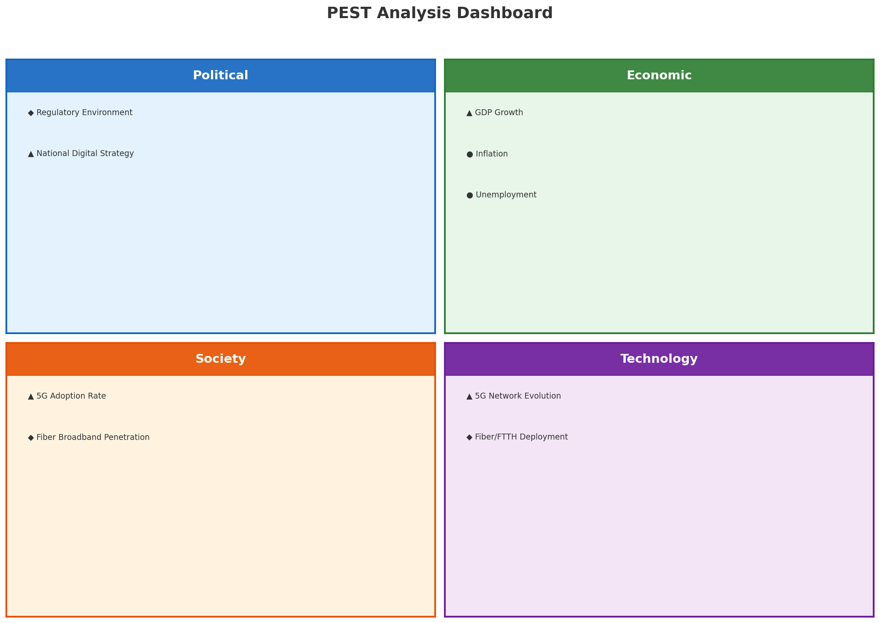
PEST Analysis Dashboard
MACRO ENVIRONMENT
Key Message: Macro environment: Favorable. Key opportunities: Regulatory Environment, National Digital Strategy. Key risks: Regulatory Environment, Fiber Broadband Penetration.
6

Slide 7
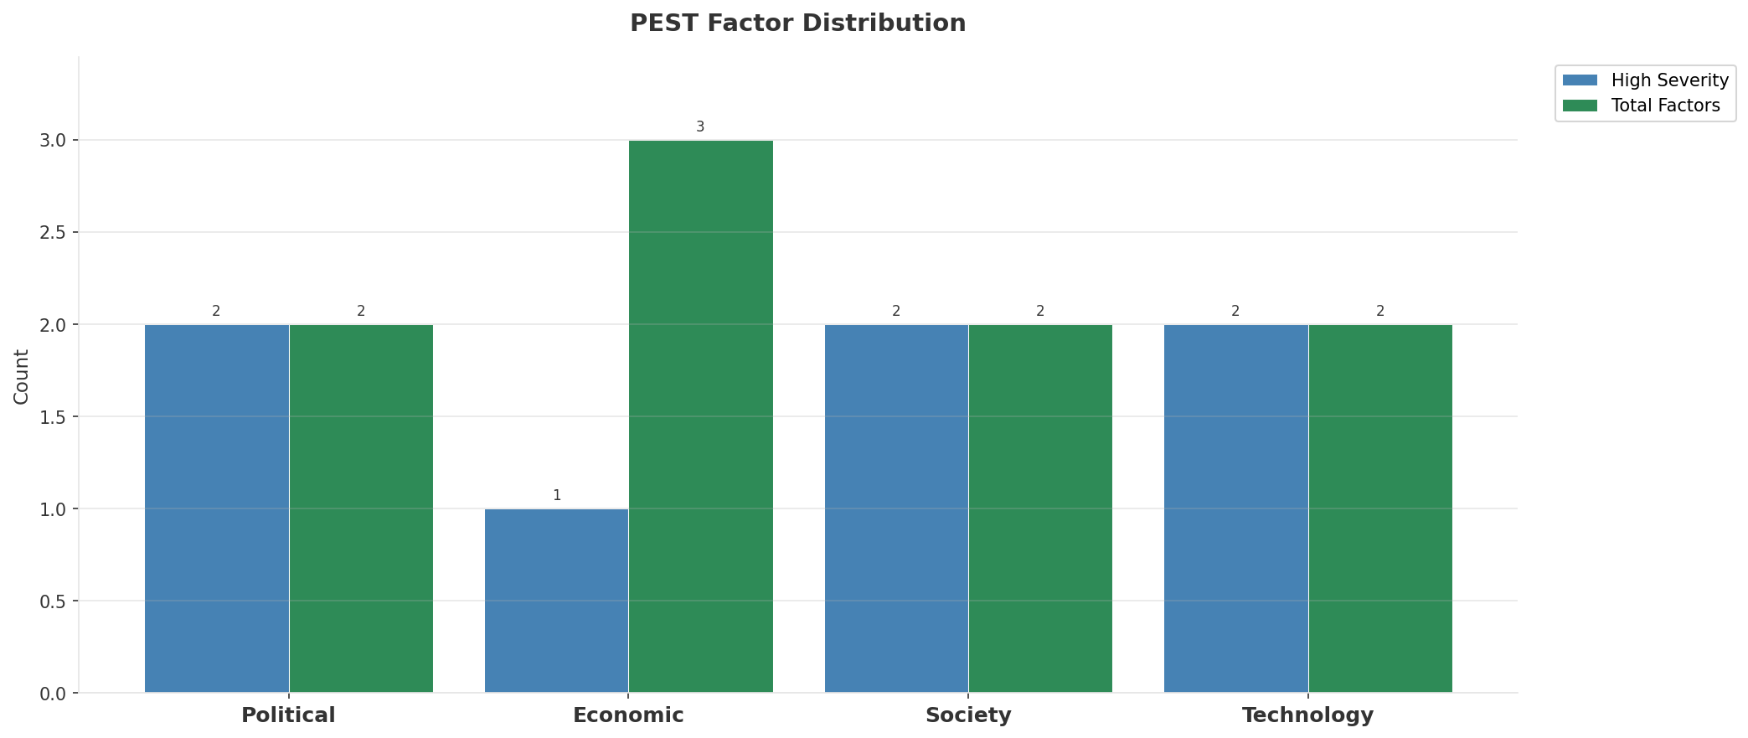
Industry Environment
INDUSTRY ANALYSIS
Market Size
Growth Rate
Concentration
Lifecycle
USD 1.2B (quarterly, CQ4_2025
+2.5% YoY (CQ2_2025 -> CQ4_2025
CR4 = 100% (Claro Ecuador: 47.0%, Tigo Ecuador: 29.0%, CNT Ecuador: 24.0%
late_growth
• New Business Models:
• FWA (Fixed Wireless Access) as fiber alternative
• Network-as-a-Service for enterprise verticals
• Wholesale/MVNO partnerships for coverage monetization
• Technology Revolution:
• 5G SA enabling network slicing and enterprise services
• AI/ML for network optimization and customer experience
• Open RAN for vendor diversification and cost reduction
Key Message: Macro environment: Favorable. Key opportunities: Regulatory Environment, National Digital Strategy. Key risks: Regulatory Environment, Fiber Broadband Penetration Industry is in late growth phase. (+2.5% YoY (CQ2_2025 -> CQ4_2025)
7

Slide 8
Value Transfer Trends
VALUE MIGRATION
• Value shifting from voice/SMS to data and digital services
• B2B/ICT growing faster than consumer segment
• Fiber displacing copper and cable broadband
Key Message: Macro environment: Favorable. Key opportunities: Regulatory Environment, National Digital Strategy. Key risks: Regulatory Environment, Fiber Broadband Penetration Industry is in late growth phase. (+2.5% YoY (CQ2_2025 -> CQ4_2025)
8

Slide 9
02 Look at Market
$APPEALS — Market Changes & Customer Needs

Slide 10
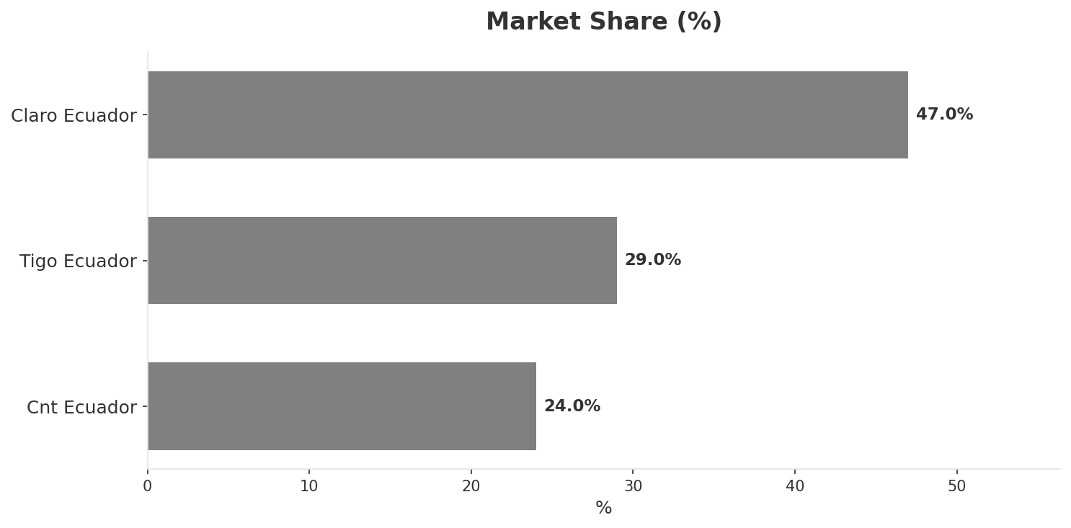
Market Change Panorama
MARKET OVERVIEW
Total Revenue (€M
Mobile Subs (K
Broadband Subs (K
Operators
1,225
17,700
1,895
3
Market Changes:
• Claro Ecuador revenue growth 5.9% YoY
• Tigo Ecuador revenue growth 6.0% YoY
• Millicom completes acquisition of Telefonica Ecuador
Key Message: Ecuador telecom market totals USD 1,225M in quarterly revenue; gaps in Assurances, Social/Brand; Market outlook is favorable with more opportunities than threats.
10

Slide 11
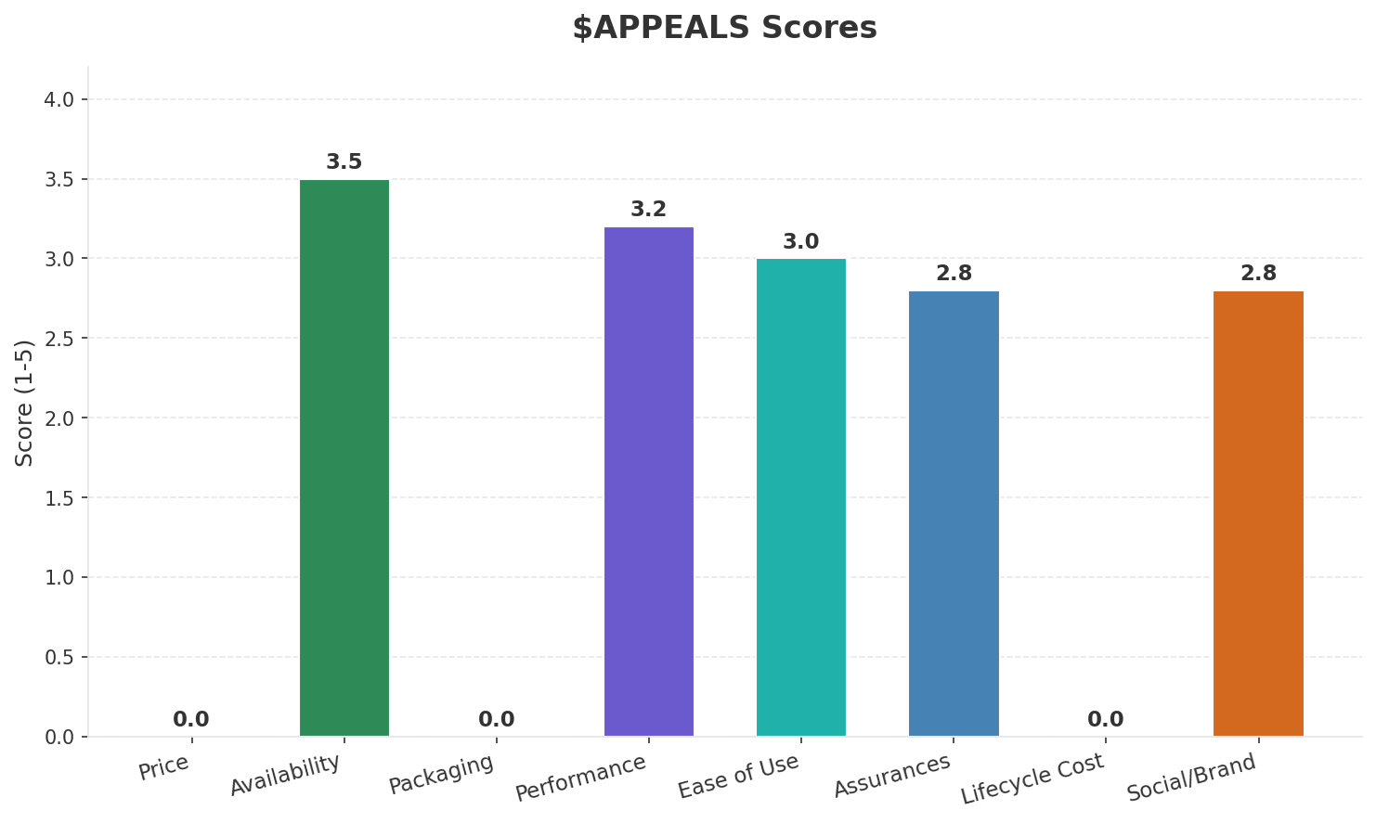
Customer Segments
SEGMENTATION
Consumer Prepaid Mass
Trend: stable
Needs: Affordable mobile data packages, Better rural connectivity
Consumer Postpaid Urban
Trend: stable
Needs: Higher speed 4G/LTE service, Convergent fixed-mobile bundles
Enterprise & Government
Trend: stable
Needs: Cloud connectivity and managed services, Reliable enterprise broadband
Key Message: Ecuador telecom market totals USD 1,225M in quarterly revenue; gaps in Assurances, Social/Brand; Market outlook is favorable with more opportunities than threats.
11

Slide 12
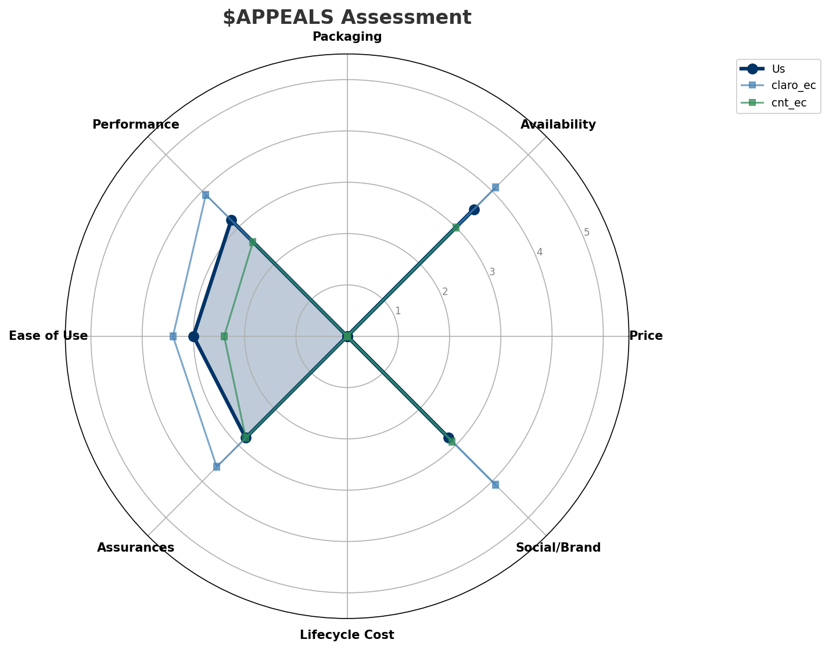
$APPEALS Assessment
CUSTOMER NEEDS
Key Message: Ecuador telecom market totals USD 1,225M in quarterly revenue; gaps in Assurances, Social/Brand; Market outlook is favorable with more opportunities than threats.
12

Slide 13
Customer Value Migration
VALUE MIGRATION
Value migration trending upward: customers willing to pay more for premium connectivity and convergent bundles. Focus on upselling and cross-selling opportunities.
Opportunities:
Threats:
• Tigo Ecuador revenue growth 6.0% YoY
• Millicom completes acquisition of Telefonica Ecuador
• Claro Ecuador revenue growth 5.9% YoY
Key Message: Ecuador telecom market totals USD 1,225M in quarterly revenue; gaps in Assurances, Social/Brand; Market outlook is favorable with more opportunities than threats.
13

Slide 14
Tariff Analysis
Mobile, Fixed & Convergence Pricing Landscape

Slide 15
Fixed & Convergence Pricing Landscape
DSL / CABLE / FIBER / FMC BUNDLES
Key Message: Fixed and convergence pricing overview
15

Slide 16
03 Look at Competition
Porter's Five Forces — Competitive Landscape

Slide 17
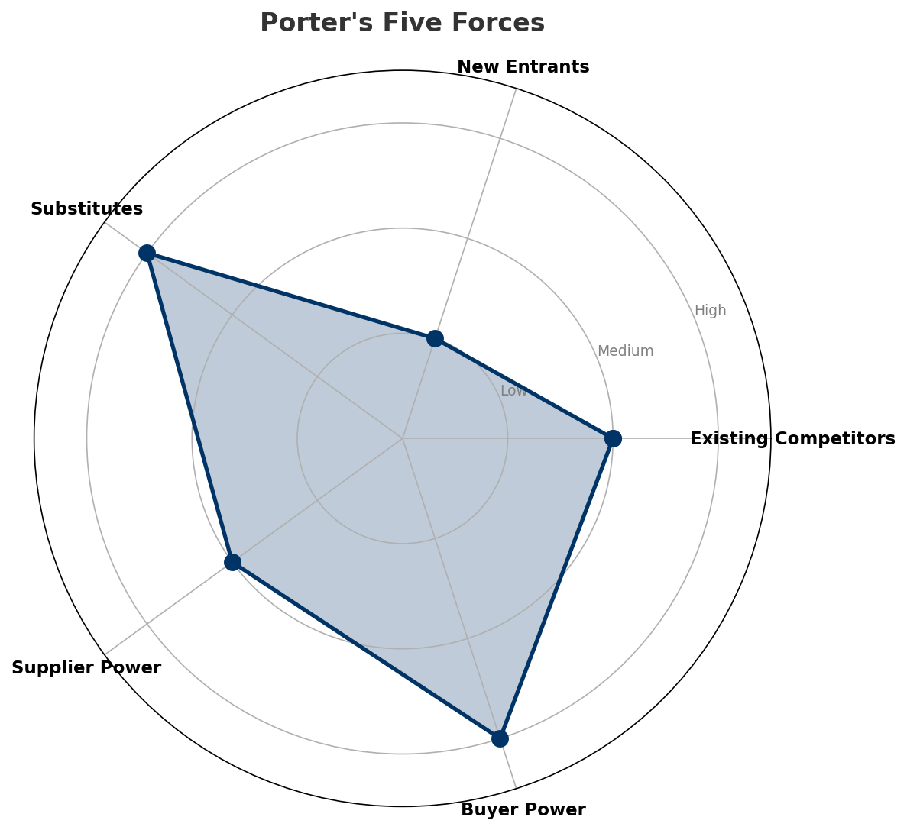
Porter's Five Forces
COMPETITIVE FORCES
Overall Intensity: MEDIUM
Key Message: In a 3-player market with medium competition intensity, Claro Ecuador leads with 47% revenue share. Target operator holds 29% share. Strongest competitive force: Substitutes.
17

Slide 18
Competitor Analysis: Cnt Ec
COMPETITOR DEEP DIVE
Revenue
EBITDA
Margin
Capex/Rev
€294M
€59M
20.1%
18.0%
+1.4% YoY
Strengths
Weaknesses
• Price Competitiveness: score 75 (market avg 68
• Brand Strength: score 58 (market avg 65
• Customer Service: score 48 (market avg 59
• Digital Experience: score 42 (market avg 57
• Enterprise Solutions: score 55 (market avg 61
Strategy: Revenue-led profitable growth
Key Message: Competitor analysis: Cnt Ec
18

Slide 19
Competitor Analysis: Claro Ec
COMPETITOR DEEP DIVE
Revenue
EBITDA
Margin
Capex/Rev
€576M
€213M
37.0%
17.5%
+6.0% YoY
Strengths
Weaknesses
• Brand Strength: score 82 (market avg 65
• Customer Service: score 68 (market avg 59
• Digital Experience: score 70 (market avg 57
• Distribution: score 85 (market avg 73
• Price Competitiveness: score 62 (market avg 68
Strategy: Revenue-led profitable growth; subscriber acquisition focus
Key Message: Competitor analysis: Claro Ec
19

Slide 20
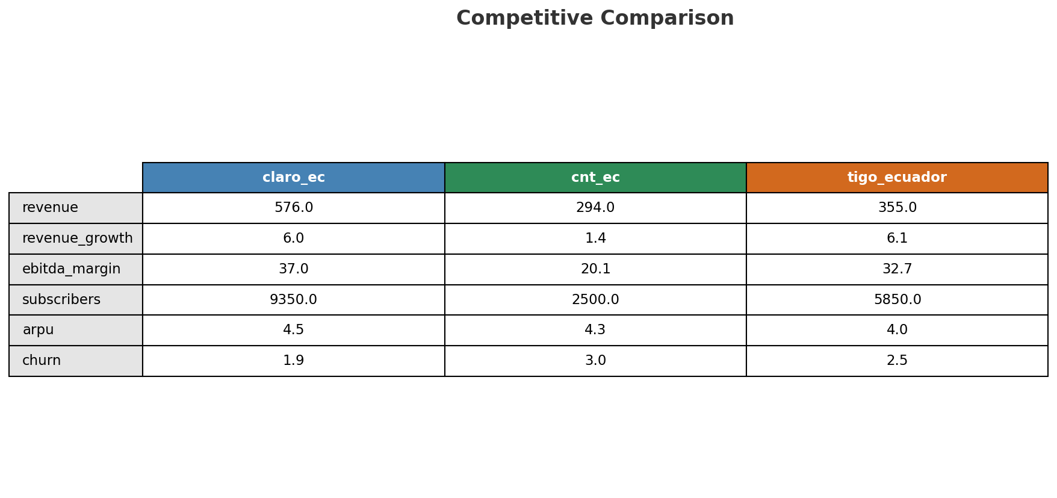
Competitive Landscape Summary
COMPETITION
Key Message: In a 3-player market with medium competition intensity, Claro Ecuador leads with 47% revenue share. Target operator holds 29% share. Strongest competitive force: Substitutes.
20

Slide 21
New Entrants Threat
MARKET ENTRY
• Entry barriers: High barriers: spectrum licensing, massive capex for network build, regulatory approvals, established brand loyalty
Key Message: New entrants threat level: low
21

Slide 22
04 Look at Self
BMC + Capability Assessment

Slide 23
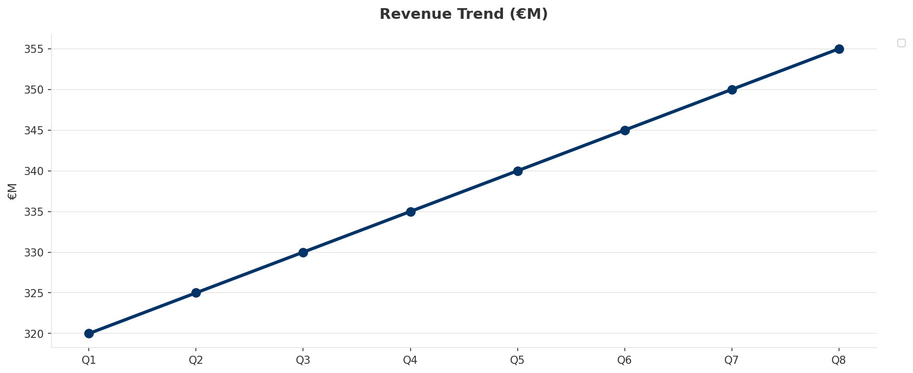
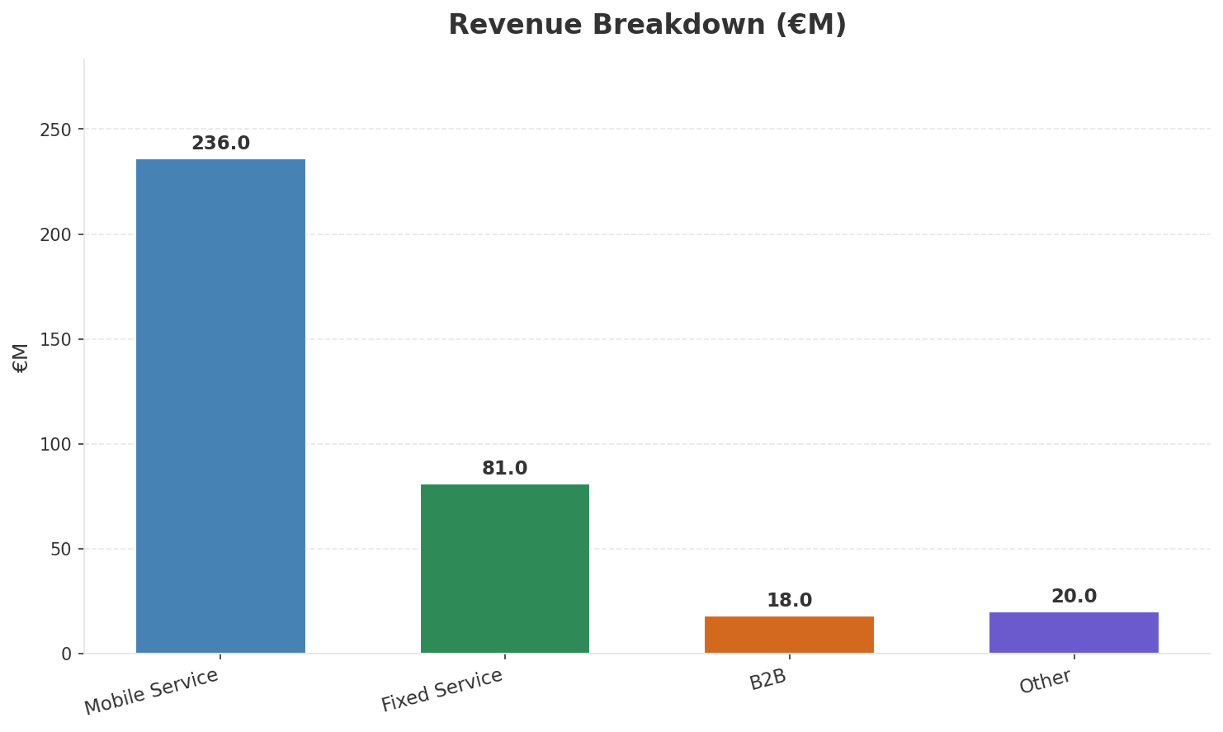
Operating Health Check
FINANCIAL HEALTH
Revenue
EBITDA
EBITDA Margin
Capex/Rev
€355M
€116M
32.7%
18.0%
+5.97% YoY
+7.4% YoY
Key Message: Ranked #2 of 3 operators in market; revenue USD 355.0M; EBITDA margin 32.7%; stable but facing challenges; key strength: Innovation; key challenge: Brand Strength; Management outlook: Ecuador integration proceeding on schedule; synergies expected from Millicom LATAM platform
23

Slide 24
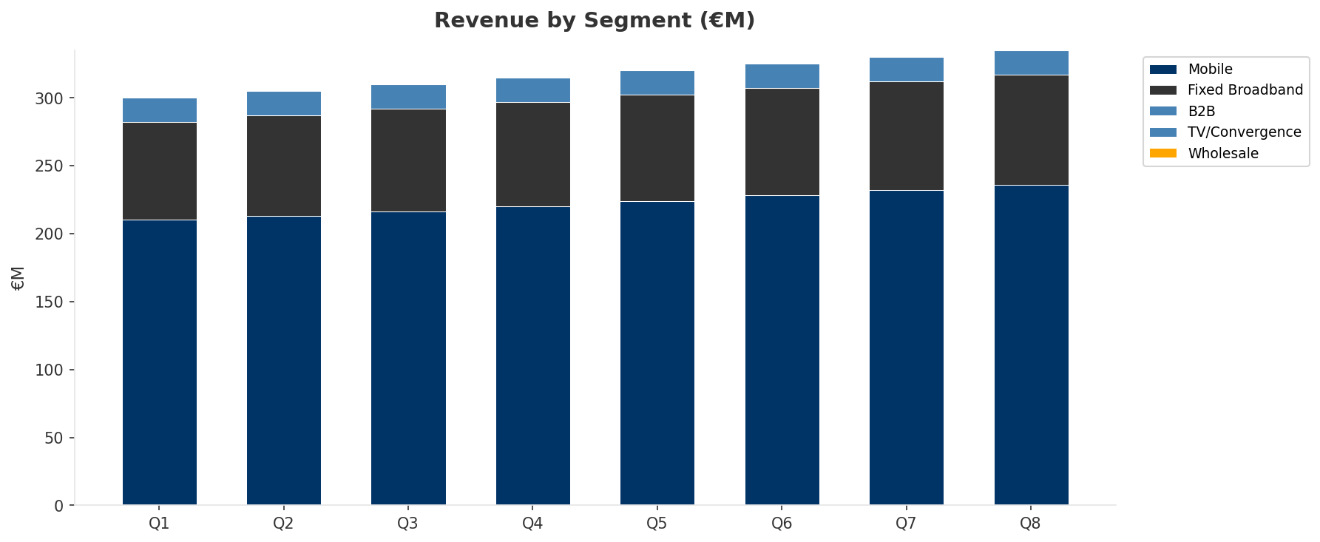
Revenue Composition Trend
SEGMENT REVENUE MIX OVER TIME
Key Message: Growing: Mobile, Fixed Broadband
24

Slide 25
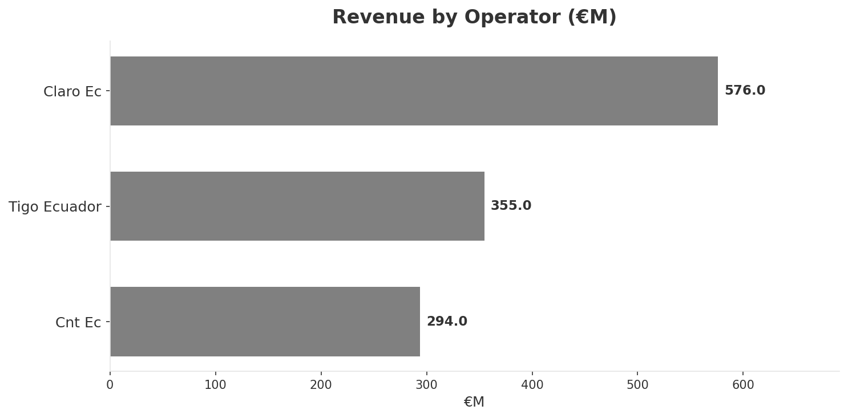
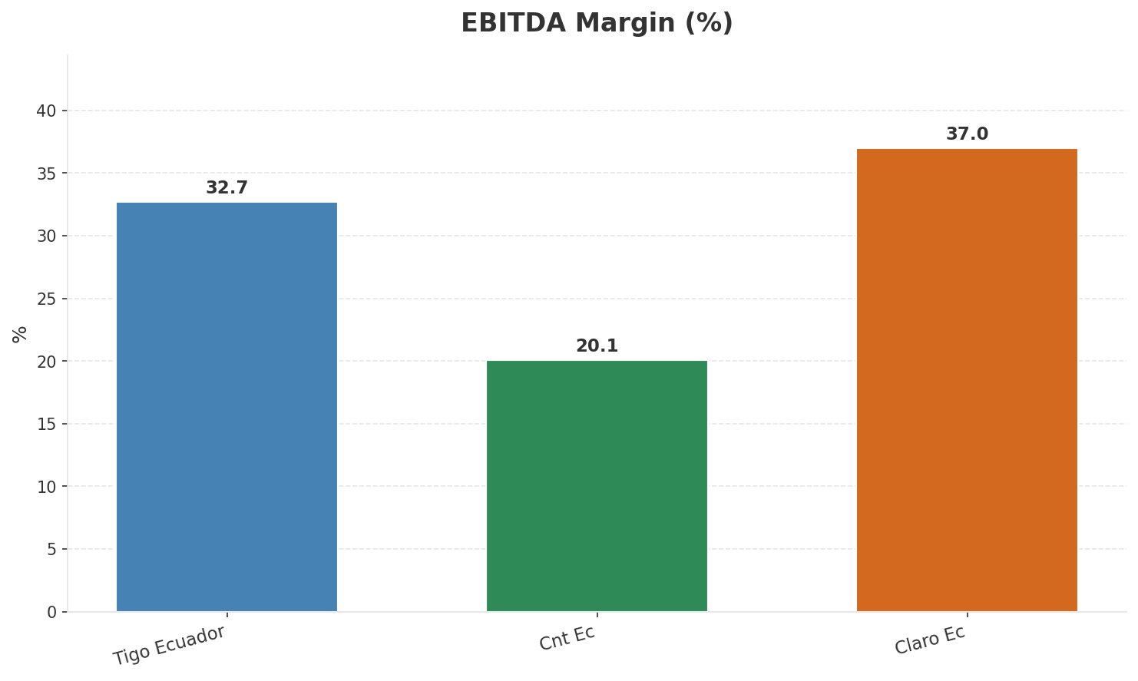
Revenue Comparison
COMPETITIVE BENCHMARKING
Key Message: Revenue and margin benchmarking across operators
25

Slide 26
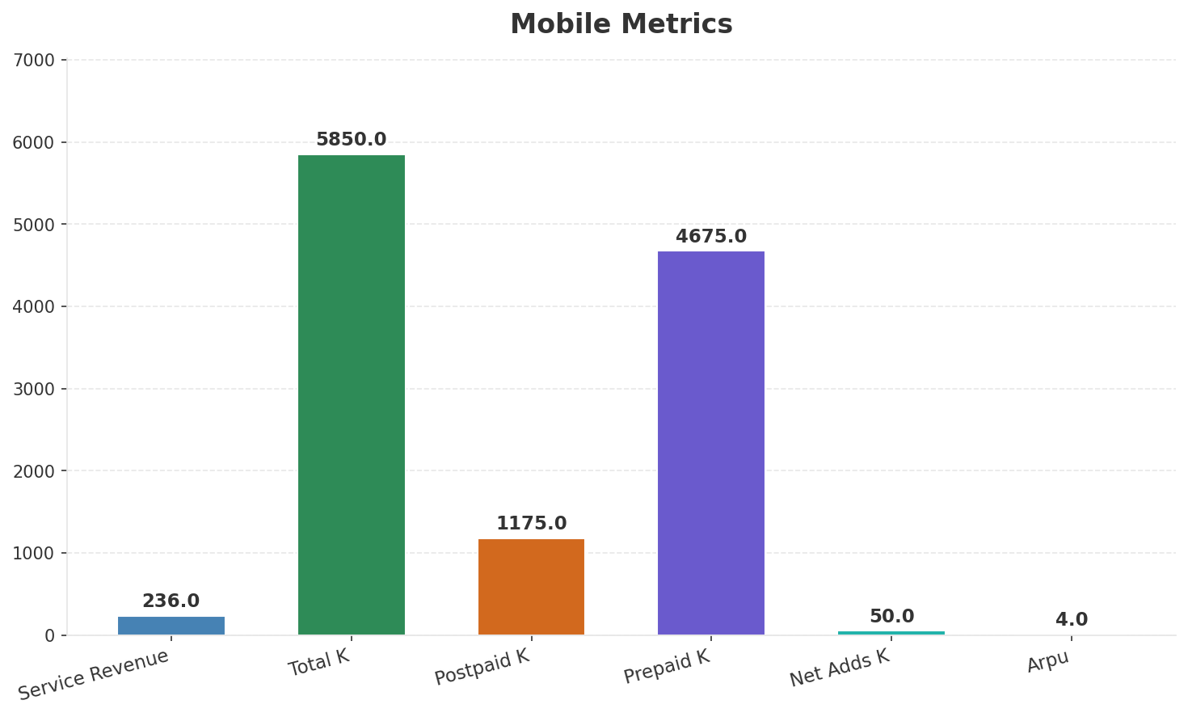
Segment Analysis: Mobile
SEGMENT PERFORMANCE
Service Revenue
Service Growth Pct
Total K
Postpaid K
€236M
7.3%
€5,850M
€1,175M
Health: STABLE
• revenue: improving
• subscribers: stable
• arpu: stable
Key Message: Mobile service revenue at 236.0M; up 7.3% YoY; ARPU 4.0
26

Slide 27
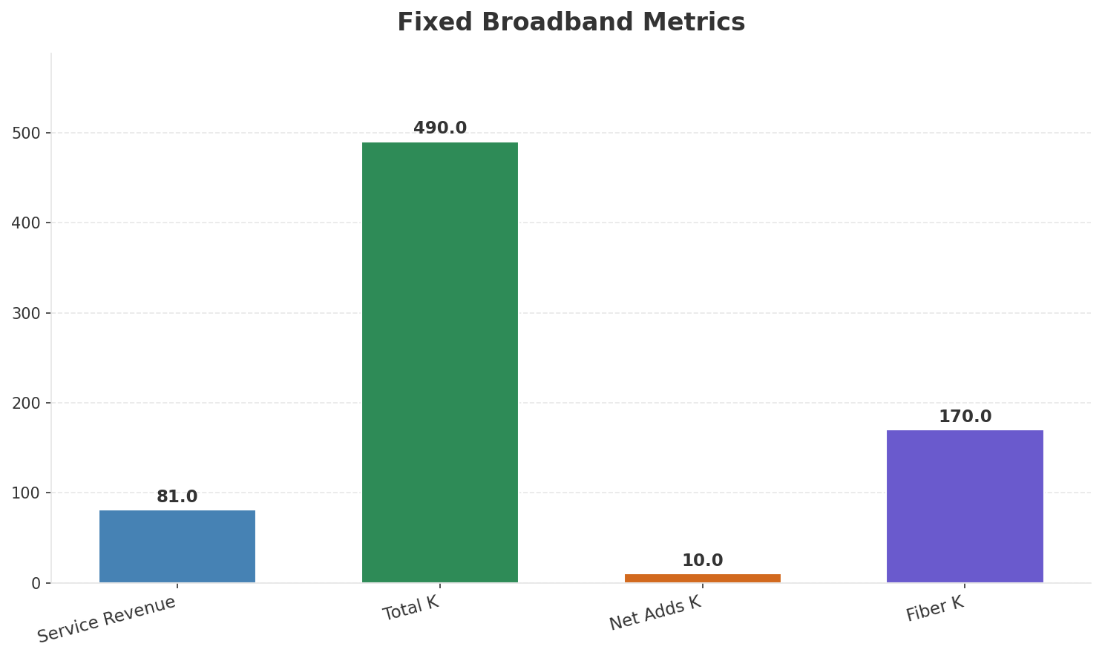
Segment Analysis: Fixed Broadband
SEGMENT PERFORMANCE
Service Revenue
Service Growth Pct
Total K
Net Adds K
€81M
5.1%
€490M
10
Health: STABLE
• revenue: improving
• subscribers: improving
• arpu: stable
• subscribers increased 2.1% QoQ
Key Message: Fixed service revenue 81.0M; growth +5.1% YoY; Fiber subs 170K
27

Slide 28
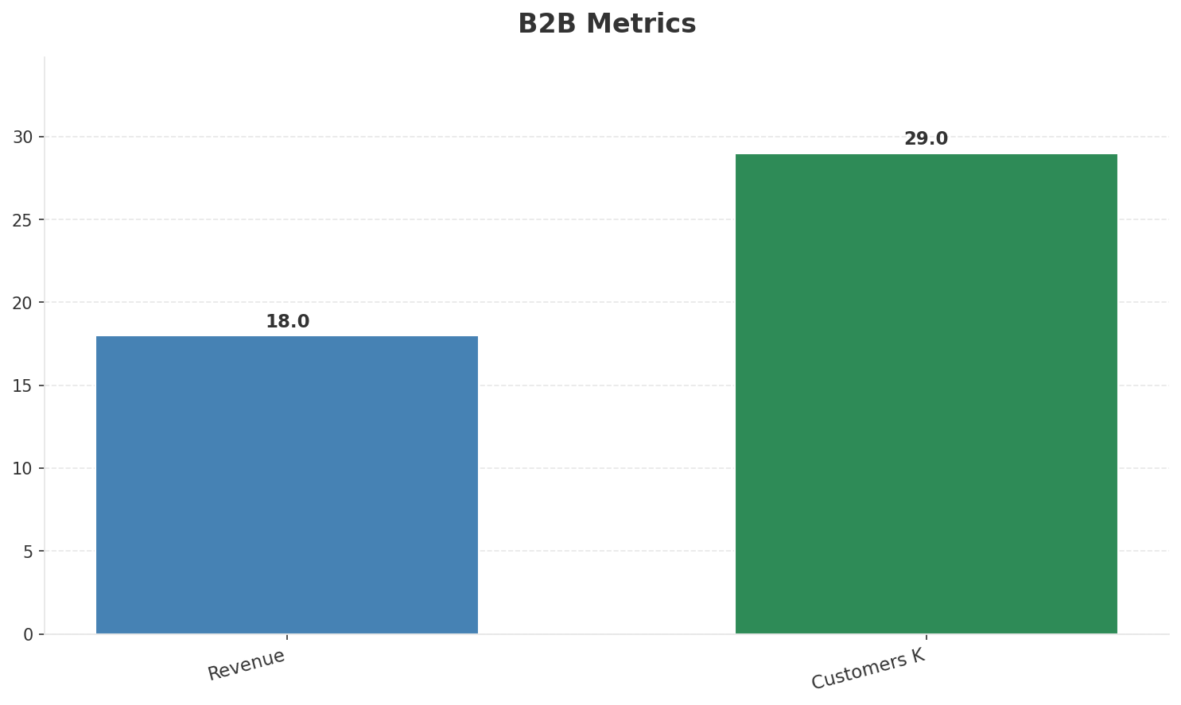
Segment Analysis: B2B
SEGMENT PERFORMANCE
Revenue
Growth Pct
Customers K
Share Of Revenue Pct
€18M
None
29
5.1%
Health: STABLE
• revenue: stable
• customers: improving
• customers increased 3.6% QoQ
Key Message: B2B revenue 18.0M; 5.1% of total revenue
28

Slide 29
Segment Analysis: TV/Convergence
SEGMENT PERFORMANCE
Revenue
Total K
Net Adds K
Fmc Total K
None
€235M
None
None
Health: STABLE
• revenue: stable
• subscribers: improving
• fmc_subscribers: stable
• subscribers increased 2.2% QoQ
Key Message: TV subscribers 235K
29

Slide 30
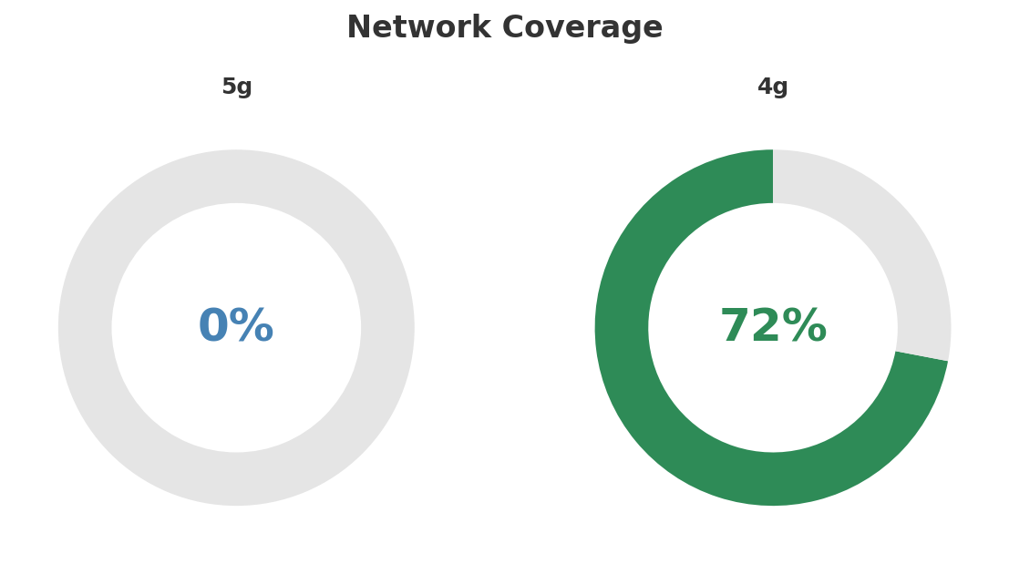
Network Analysis
INFRASTRUCTURE
Technology Mix:
Investment Direction: stable
• Mobile Vendor: Nokia/Ericsson
• Spectrum Mhz: 110
• Core Vendor: Nokia
Key Message: Network infrastructure and coverage assessment
30

Slide 31

Business Model Canvas
BMC
Key Message: Business model canvas overview
31

Slide 32
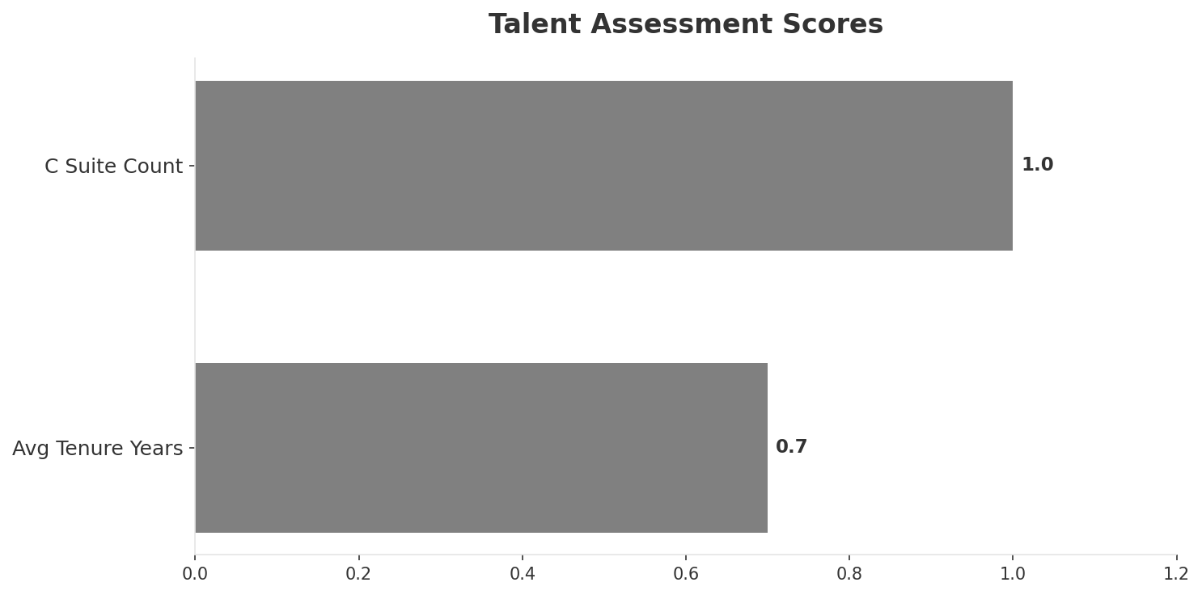
Organization & Talent
PEOPLE & CULTURE
Employees
C Suite Count
Avg Tenure Years
Key Leaders
2,600
1
0.7
['Carlos Villagomez (CEO)']
Organization Culture:
Leadership in transition (avg tenure <1.5 years); Transitioning from Telefonica culture to Millicom/Tigo operational model; integration-focused management team.
Leadership Changes:
• Carlos Villagomez: (
Key Message: Organization and talent assessment
32

Slide 33
Strengths, Weaknesses & Exposure Points
SELF ASSESSMENT
Strengths
Weaknesses
Exposure Points
• Innovation: score 58 (market avg 54
• Strong EBITDA margin at 32.7%
• Revenue on growth trajectory
• Top 2 in revenue market ranking
• Brand Strength: score 55 (market avg 65
• Distribution: score 65 (market avg 73
• Enterprise Solutions: score 55 (market avg 61
• 5G coverage gap at only 0.0%
• Post-acquisition integration complexity from Telefonica Ecuador: Customer churn during brand transition period
• Limited historical brand awareness as Tigo in Ecuador: Customer trust deficit vs established Claro and CNT brands
Key Message: Ranked #2 of 3 operators in market; revenue USD 355.0M; EBITDA margin 32.7%; stable but facing challenges; key strength: Innovation; key challenge: Brand Strength; Management outlook: Ecuador integration proceeding on schedule; synergies expected from Millicom LATAM platform
33

Slide 34
SWOT Synthesis
Strengths, Weaknesses, Opportunities & Threats

Slide 35
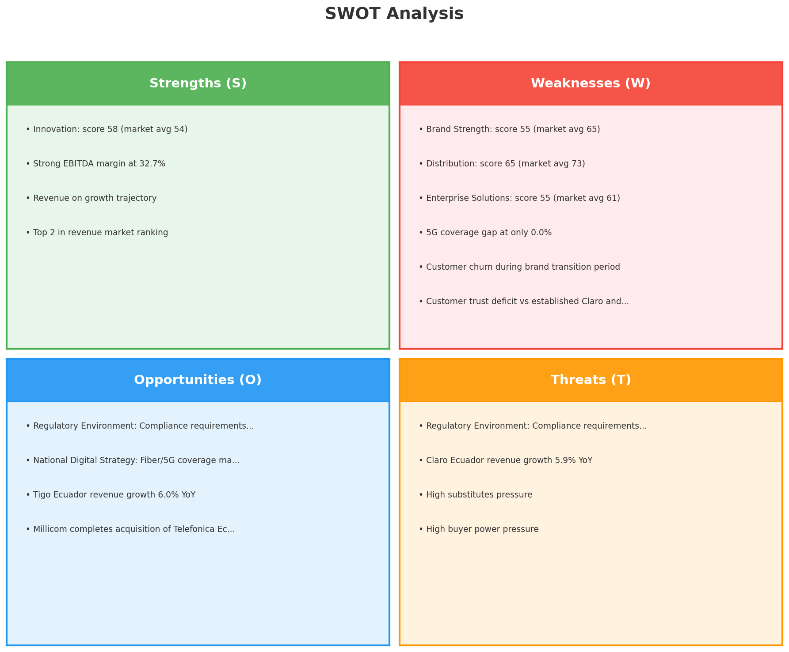
SWOT Analysis
STRATEGIC SYNTHESIS
SO:
Leverage 'Innovation: score 58 (market avg 54)' to captur...
WO:
Address weakness 'Brand Strength: score 55 (market avg 65...
ST:
Use strength 'Innovation: score 58 (market avg 54)' to co...
WT:
Mitigate weakness 'Brand Strength: score 55 (market avg 6...
Key Message: SWOT analysis identifies 4 strengths, 6 weaknesses, 4 opportunities, and 4 threats. The recommended strategic posture is cautious (WT-dominant).
35

Slide 36
05 Look at Opportunities
SPAN Matrix — Opportunity Selection

Slide 37
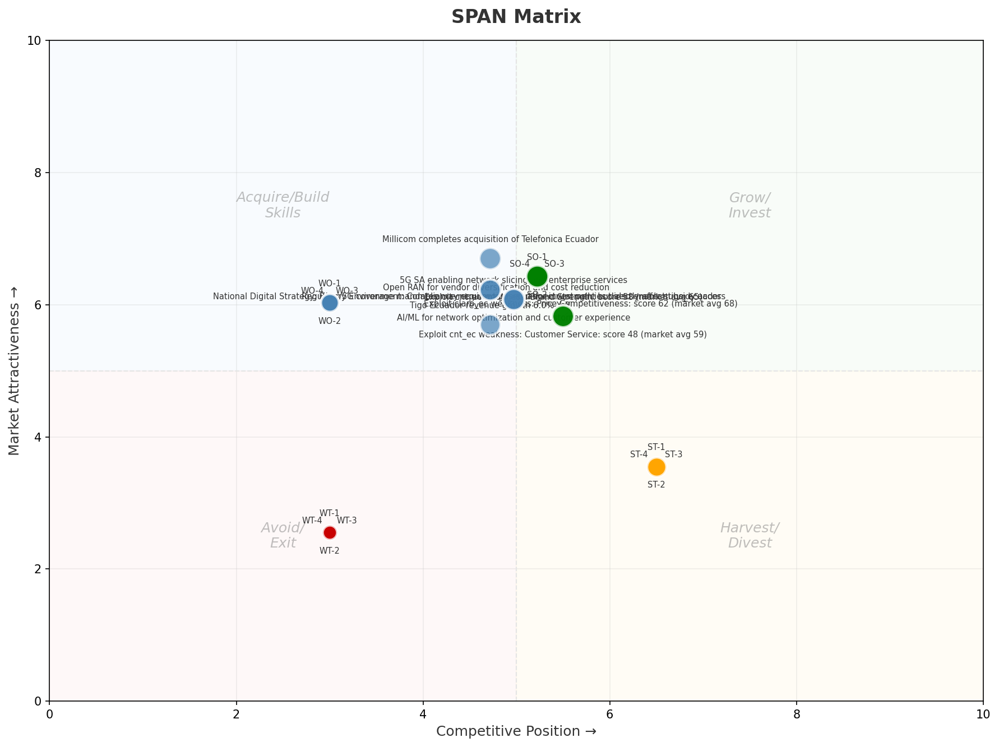
SPAN Matrix — Opportunity Positioning
OPPORTUNITY MAP
Key Message: SPAN matrix positions 26 opportunities: 7 grow/invest, 11 acquire skills, 4 harvest, 4 avoid/exit. Focus resources on the 7 grow/invest items for maximum strategic impact.
37

Slide 38
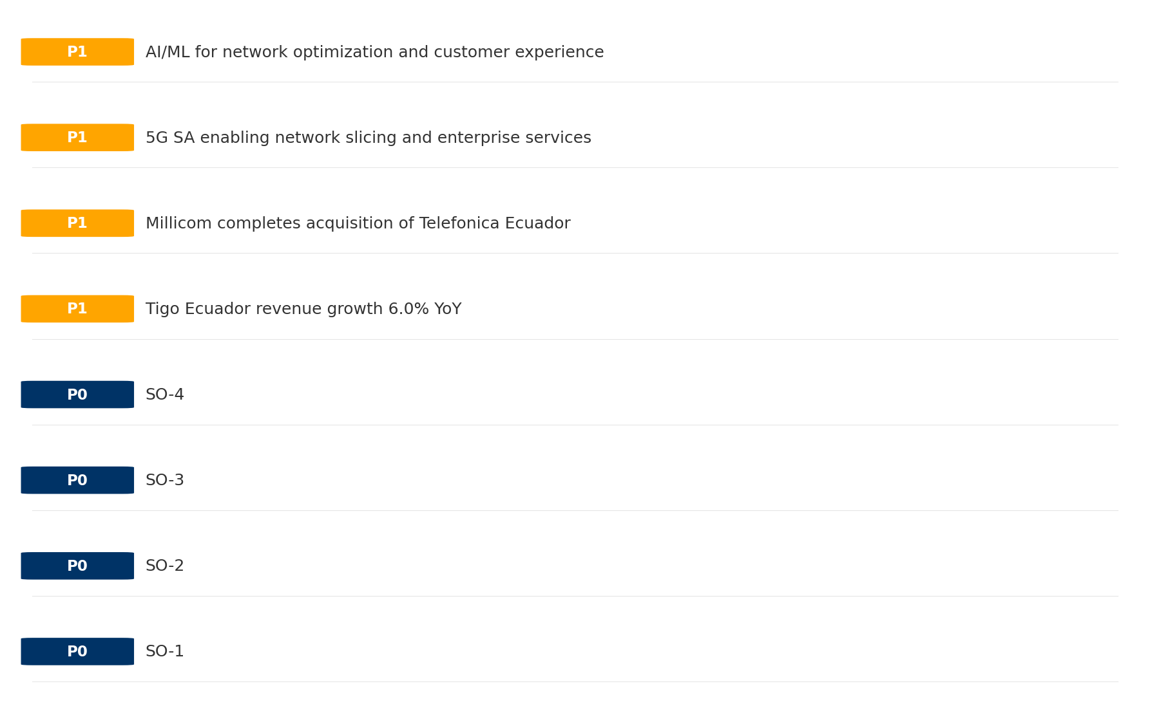
Opportunity Priority Ranking
PRIORITIES
Key Message: SPAN matrix positions 26 opportunities: 7 grow/invest, 11 acquire skills, 4 harvest, 4 avoid/exit. Focus resources on the 7 grow/invest items for maximum strategic impact.
38

Slide 39
Opportunity Details
DEEP DIVE
P0
SO-1
Market: N/A | Window:
Leverage 'Innovation: score 58 (market avg 54)' to capture the opportunity of 'Regulatory Environment: Compliance requirements and spectrum policies directly affect tigo_ecuador'.
P0
SO-2
Market: N/A | Window:
Leverage 'Strong EBITDA margin at 32.7%' to capture the opportunity of 'National Digital Strategy: Fiber/5G coverage mandates may require tigo_ecuador investment but also enable subsidy access'.
P0
SO-3
Market: N/A | Window:
Leverage 'Revenue on growth trajectory' to capture the opportunity of 'Tigo Ecuador revenue growth 6.0% YoY'.
P0
SO-4
Market: N/A | Window:
Leverage 'Top 2 in revenue market ranking' to capture the opportunity of 'Millicom completes acquisition of Telefonica Ecuador'.
Key Message: SPAN matrix positions 26 opportunities: 7 grow/invest, 11 acquire skills, 4 harvest, 4 avoid/exit. Focus resources on the 7 grow/invest items for maximum strategic impact.
39

Slide 40
Three Decisions
Strategy — Key Tasks — Execution

Slide 41
Decision 1: Define Strategy
TURNAROUND
As The Squeezed Middle: stabilize core business, then selectively invest for turnaround
P0
P0
P1
P1
Growth Strategy
Competitive Strategy
Transformation Strategy
Customer Strategy
Close the gap to market leader — accelerate Mobile, Fixed Broadband, B2B
Shore up competitive position — address: Brand Strength: score 55 (market avg 65
Accelerate fiber transition — converged network as competitive moat
Optimize value extraction in stable segments: Wholesale
- Gain 1-2pp revenue share
- Grow Mobile, Fixed Broadband, B2B double-digit
- Close Brand Strength: score 55 (market avg 65) gap within 12 months
- Reduce customer churn
- Fiber homepass coverage +20%
- FMC bundle attach rate 50%+
- Upsell rate +10% in Wholesale
- Cross-sell convergence bundles
Key Message: As The Squeezed Middle, the strategic posture is Turnaround. As The Squeezed Middle: stabilize core business, then selec
41

Slide 42
Decision 2: Define Key Tasks
3 P0 (IMMEDIATE), 2 P1 (1-2 YEARS), 1 P2 (3-5 YEARS
P0
Network
Accelerate Fixed Network Upgrade
Homepass coverage +15% | Speed tier upgrades
Drive DOCSIS/Fiber rollout to increase homepass and improve quality scores
P0
Business
Accelerate Mobile Growth
Mobile revenue +10% YoY | Market share gain
Mobile at €236M showing strong momentum — invest to scale
P0
Business
Accelerate Fixed Broadband Growth
Fixed Broadband revenue +10% YoY | Market share gain
Fixed Broadband at €81M showing strong momentum — invest to scale
P1
Business
Opportunity Portfolio Execution
Launch 3+ priority initiatives | Pipeline contribution tracking
7 grow/invest opportunities identified — establish execution office
P1
Customer
Customer Experience Enhancement
NPS +5 points | First-call resolution rate 80%+
Improve digital touchpoints and service resolution to boost NPS
P2
Efficiency
Operational Efficiency & Automation
Process automation 30%+ | Cost-to-serve reduction
EBITDA margin 32.7% — maintain through smart automation and resource reallocatio
Key Message: 6 critical tasks: 3 P0 (immediate), 2 P1 (1-2 years), 1 P2 (3-5 years
42

Slide 43

Decision 3: Define Execution
QUARTERLY ROADMAP & GOVERNANCE
Governance
Strategic Traps to Avoid
- Monthly Progress Review (Monthly
x Enter a price war
- Quarterly Strategic Checkpoint (Quarterly
x Attempt premium repositioning
- Mid-Year Strategic Adjustment (Semi-annual
x Delay core transformation
Key Risks & Mitigation
! Resource constraints delay P0 initiatives -- Ring-fence P0 budgets; establish escalation path for blockers
Key Message: Execute with discipline: monthly reviews, quarterly checkpoints, annual refresh
! Macro-economic slowdown reduces consumer spending -- Prepare value-tier offerings; shift mix toward B2B resilience
43

Slide 44
Analysis Summary
KEY TAKEAWAYS
01 Trends
Macro environment: Favorable. Key opportunities: Regulatory Environment, National Digital Strategy. Key risks: Regulatory Environment, Fiber Broadband Penetration Industry is in late growth phase. (+2.5% YoY (CQ2_2025 -> CQ4_2025)
02 Market
Ecuador telecom market totals USD 1,225M in quarterly revenue; gaps in Assurances, Social/Brand; Market outlook is favorable with more opportunities than threats.
03 Competition
In a 3-player market with medium competition intensity, Claro Ecuador leads with 47% revenue share. Target operator holds 29% share. Strongest competitive force: Substitutes.
04 Self
Ranked #2 of 3 operators in market; revenue USD 355.0M; EBITDA margin 32.7%; stable but facing challenges; key strength: Innovation; key challenge: Brand Strength; Management outlook: Ecuador integration proceeding on schedule; synergies expected from Millicom LATAM platform
SWOT
SWOT analysis identifies 4 strengths, 6 weaknesses, 4 opportunities, and 4 threats. The recommended strategic posture is cautious (WT-dominant).
05 Opportunities
SPAN matrix positions 26 opportunities: 7 grow/invest, 11 acquire skills, 4 harvest, 4 avoid/exit. Focus resources on the 7 grow/invest items for maximum strategic impact.
Key Message: Complete Five Looks analysis — see opportunity priorities for next steps
44

Slide 45
Data Provenance
SOURCES & METHODOLOGY
No provenance data recorded for this analysis
Key Message: All data points are traceable to original sources
45

Slide 46
Thank You
BLM Five Looks Strategic Analysis

