Slide 1
Default BLM Strategic Analysis
BLM (Business Leadership Model) Five Looks Analysis
Target Operator
Market
Analysis Period
Report Date
Tigo Guatemala
Guatemala
CQ4_2025
2026-02-14
01 Trends (PEST) | 02 Market/Customer ($APPEALS) | 03 Competition (Porter) | 04 Self (BMC) | SWOT Synthesis | 05 Opportunities (SPAN

Slide 2
Report Contents
TABLE OF CONTENTS
01
Executive Summary
Key findings and recommendations
02
Look at Trends
PEST Framework — macro environment
03
Look at Market
$APPEALS — market changes & customer needs
T
Tariff Analysis
Pricing comparison — mobile, fixed & convergence
04
Look at Competition
Porter's Five Forces — competitive landscape
05
Look at Self
BMC + Capability — internal assessment
06
SWOT Synthesis
Strengths, Weaknesses, Opportunities, Threats
07
Look at Opportunities
SPAN Matrix — opportunity selection
Summary & Provenance
2
08
Conclusions and data sources

Slide 3
Data Quality Overview
DATA QUALITY
Total Data Points
High Confidence
Medium Confidence
Low/Estimated
20
0
0
20
0%
Unique Sources: 0
Data Conflicts: 0
Coverage: Partial
Key Message: 20 data points tracked, 0 high-confidence (0%
3

Slide 4
Executive Summary
Trends
Macro environment: Favorable. Key opportunities: Regulatory Environment, National Digital Strategy. Key risks: Regulatory Environment, Inflation Industry is in late growth phase. (+2.4% YoY (CQ2_2025 -> CQ4_2025)
Market/Customer
Guatemala telecom market totals GTQ 8,530M in quarterly revenue; competitive strengths in Availability, Social/Brand; Market outlook is favorable with more opportunities than threats.
Competition
In a 3-player market with medium competition intensity, Tigo Guatemala leads with 51% revenue share. Target operator holds 51% share. Strongest competitive force: Existing Competitors.
Self Assessment
Ranked #1 of 3 operators in market; revenue GTQ 4,350M; EBITDA margin 45.1%; stable but facing challenges; key strength: Brand Strength; key challenge: 5G coverage gap at only 0.0%; Management outlook: Expect continued mid-single-digit mobile service revenue growth driven by data monetization
SWOT
SWOT analysis identifies 13 strengths, 3 weaknesses, 5 opportunities, and 5 threats. The recommended strategic posture is offensive (SO-dominant).
Opportunities
SPAN matrix positions 24 opportunities: 14 grow/invest, 3 acquire skills, 4 harvest, 3 avoid/exit. Focus resources on the 14 grow/invest items for maximum strategic impact.
Key Message: Five Looks analysis completed — see details in following sections
4

Slide 5
01 Look at Trends
PEST Framework — Macro Environment

Slide 6
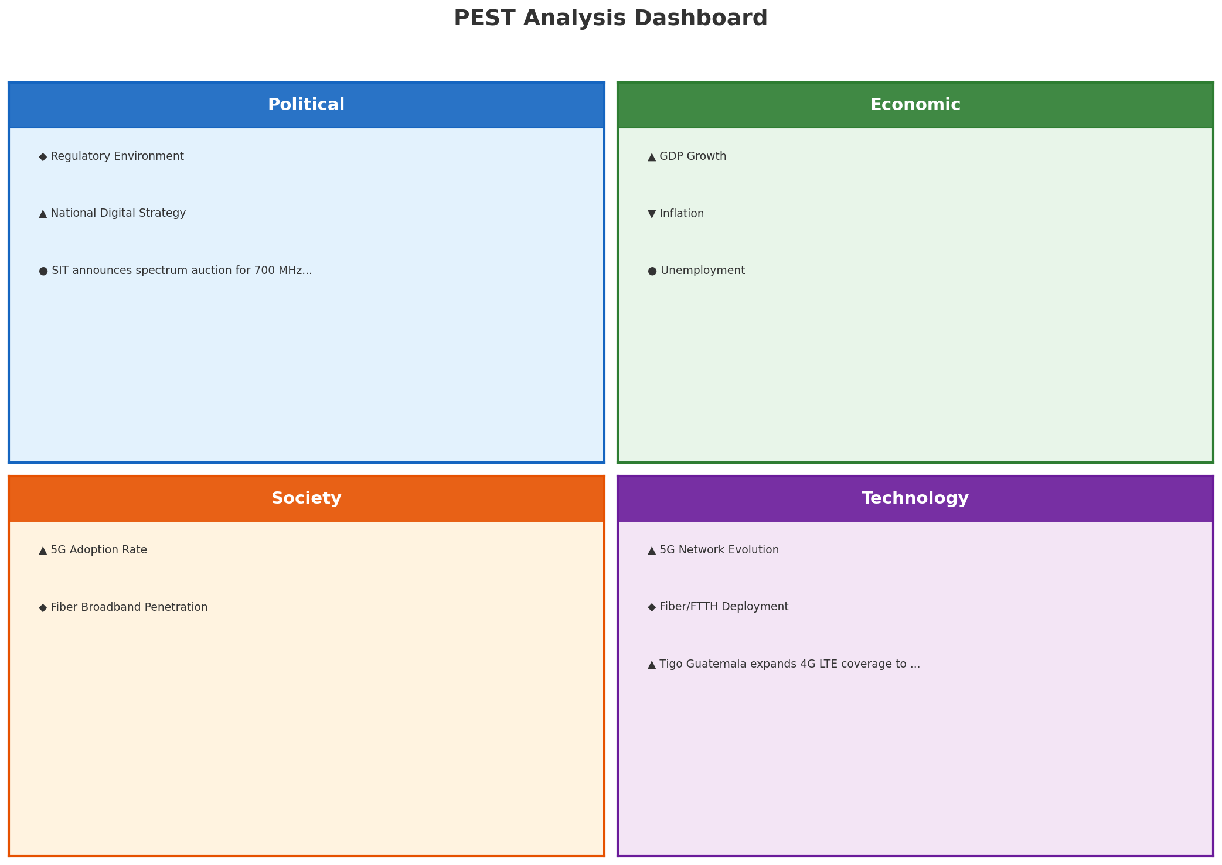
PEST Analysis Dashboard
MACRO ENVIRONMENT
Key Message: Macro environment: Favorable. Key opportunities: Regulatory Environment, National Digital Strategy. Key risks: Regulatory Environment, Inflation.
6

Slide 7
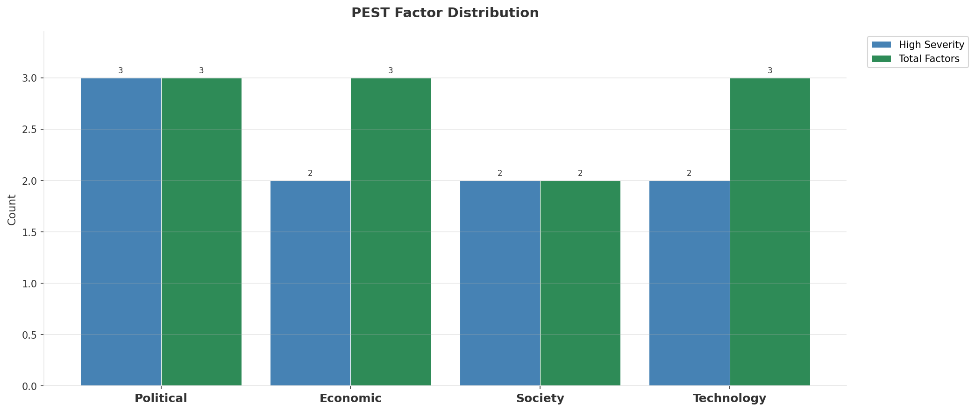
Industry Environment
INDUSTRY ANALYSIS
Market Size
Growth Rate
Concentration
Lifecycle
GTQ 8.5B (quarterly, CQ4_2025
+2.4% YoY (CQ2_2025 -> CQ4_2025
CR4 = 100% (Tigo Guatemala: 51.0%, Claro Guatemala: 35.8%, Movistar Guatemala: 13.2%
late_growth
• New Business Models:
• FWA (Fixed Wireless Access) as fiber alternative
• Network-as-a-Service for enterprise verticals
• Wholesale/MVNO partnerships for coverage monetization
• Technology Revolution:
• 5G SA enabling network slicing and enterprise services
• AI/ML for network optimization and customer experience
• Open RAN for vendor diversification and cost reduction
Key Message: Macro environment: Favorable. Key opportunities: Regulatory Environment, National Digital Strategy. Key risks: Regulatory Environment, Inflation Industry is in late growth phase. (+2.4% YoY (CQ2_2025 -> CQ4_2025)
7

Slide 8
Value Transfer Trends
VALUE MIGRATION
• Value shifting from voice/SMS to data and digital services
• B2B/ICT growing faster than consumer segment
• Fiber displacing copper and cable broadband
Key Message: Macro environment: Favorable. Key opportunities: Regulatory Environment, National Digital Strategy. Key risks: Regulatory Environment, Inflation Industry is in late growth phase. (+2.4% YoY (CQ2_2025 -> CQ4_2025)
8

Slide 9
02 Look at Market
$APPEALS — Market Changes & Customer Needs

Slide 10
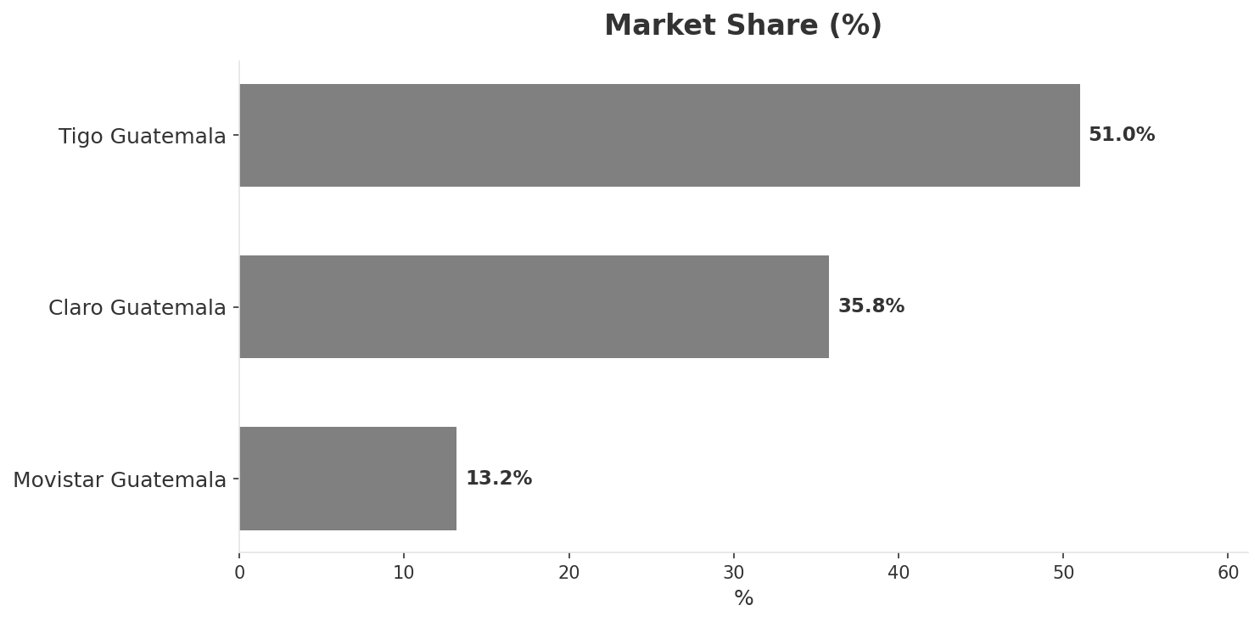
Market Change Panorama
MARKET OVERVIEW
Total Revenue (€M
Mobile Subs (K
Broadband Subs (K
Operators
8,530
22,700
1,058
3
Market Changes:
• Tigo Guatemala revenue growth 7.4% YoY
• Claro Guatemala revenue growth 5.2% YoY
• Tigo launches Tigo Money mobile wallet expansion
• Tigo Guatemala expands 4G LTE coverage to 5 new departments
Key Message: Guatemala telecom market totals GTQ 8,530M in quarterly revenue; competitive strengths in Availability, Social/Brand; Market outlook is favorable with more opportunities than threats.
10

Slide 11
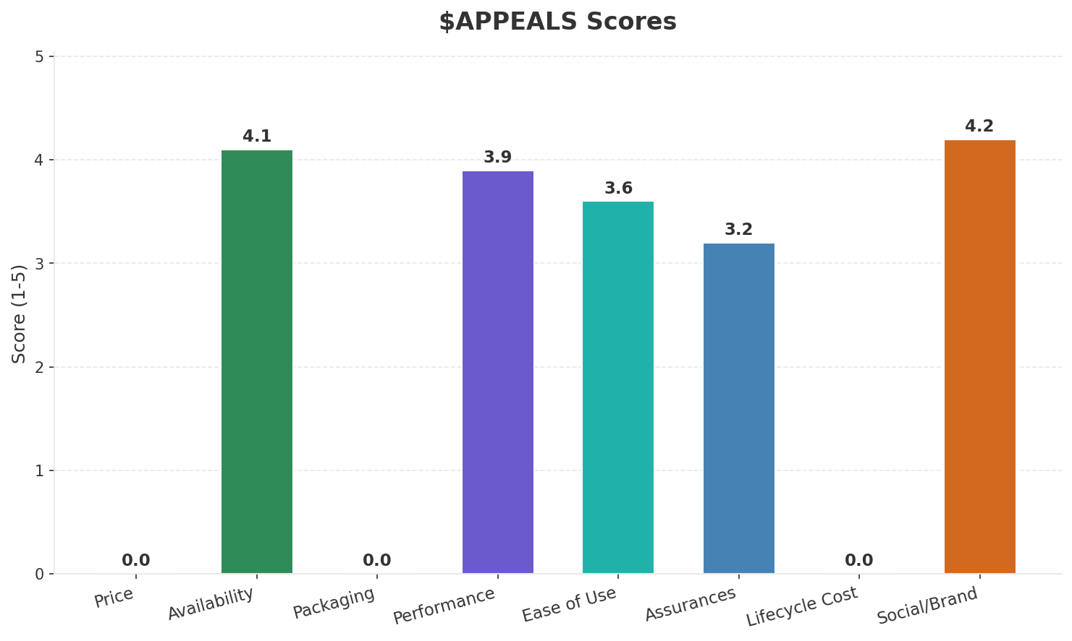
Customer Segments
SEGMENTATION
Consumer Prepaid Mass
Trend: stable
Needs: Affordable mobile data in rural areas, Spanish + indigenous language customer support
Consumer Postpaid Urban
Trend: stable
Needs: Faster 4G/LTE speeds, Convergent home+mobile bundles
Enterprise & SME
Trend: stable
Needs: Cloud connectivity solutions, Reliable business broadband
Key Message: Guatemala telecom market totals GTQ 8,530M in quarterly revenue; competitive strengths in Availability, Social/Brand; Market outlook is favorable with more opportunities than threats.
11

Slide 12
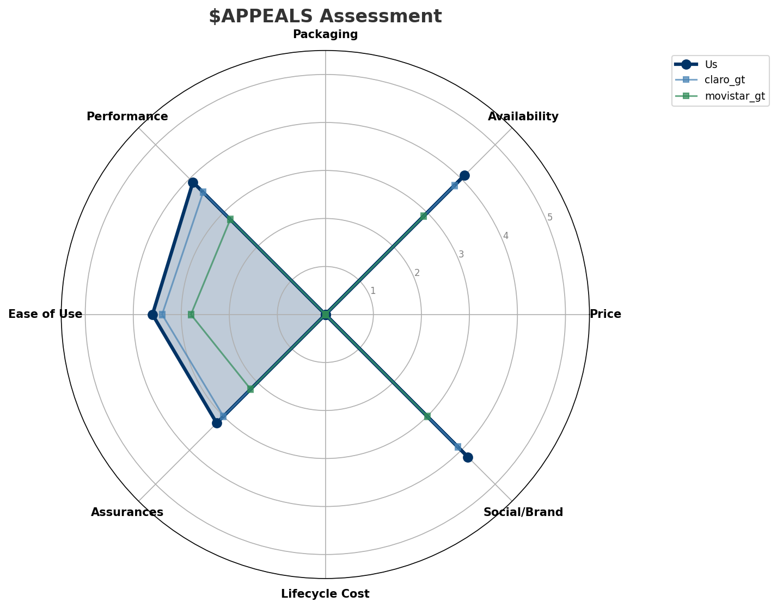
$APPEALS Assessment
CUSTOMER NEEDS
Key Message: Guatemala telecom market totals GTQ 8,530M in quarterly revenue; competitive strengths in Availability, Social/Brand; Market outlook is favorable with more opportunities than threats.
12

Slide 13
Customer Value Migration
VALUE MIGRATION
Value migration trending upward: customers willing to pay more for premium connectivity and convergent bundles. Focus on upselling and cross-selling opportunities.
Opportunities:
Threats:
• Tigo Guatemala revenue growth 7.4% YoY
• Tigo launches Tigo Money mobile wallet expansion
• Tigo Guatemala expands 4G LTE coverage to 5 new departments
• Claro Guatemala revenue growth 5.2% YoY
Key Message: Guatemala telecom market totals GTQ 8,530M in quarterly revenue; competitive strengths in Availability, Social/Brand; Market outlook is favorable with more opportunities than threats.
13

Slide 14
Tariff Analysis
Mobile, Fixed & Convergence Pricing Landscape

Slide 15
Fixed & Convergence Pricing Landscape
DSL / CABLE / FIBER / FMC BUNDLES
Key Message: Fixed and convergence pricing overview
15

Slide 16
03 Look at Competition
Porter's Five Forces — Competitive Landscape

Slide 17

Porter's Five Forces
COMPETITIVE FORCES
Overall Intensity: MEDIUM
Key Message: In a 3-player market with medium competition intensity, Tigo Guatemala leads with 51% revenue share. Target operator holds 51% share. Strongest competitive force: Existing Competitors.
17

Slide 18
Competitor Analysis: Claro Gt
COMPETITOR DEEP DIVE
Revenue
EBITDA
Margin
Capex/Rev
€3,050M
€1,070M
35.1%
16.1%
+5.5% YoY
Strengths
Weaknesses
Strategy: Revenue-led profitable growth; subscriber acquisition focus
Key Message: Competitor analysis: Claro Gt
18

Slide 19
Competitor Analysis: Movistar Gt
COMPETITOR DEEP DIVE
Revenue
EBITDA
Margin
Capex/Rev
€1,130M
€325M
28.8%
13.3%
-3.4% YoY
Strengths
Weaknesses
• Brand Strength: score 60 (market avg 74
• Customer Service: score 55 (market avg 65
• Digital Experience: score 50 (market avg 62
• Distribution: score 60 (market avg 76
Strategy: Defensive cost restructuring; ARPU-led value strategy
Key Message: Competitor analysis: Movistar Gt
19

Slide 20
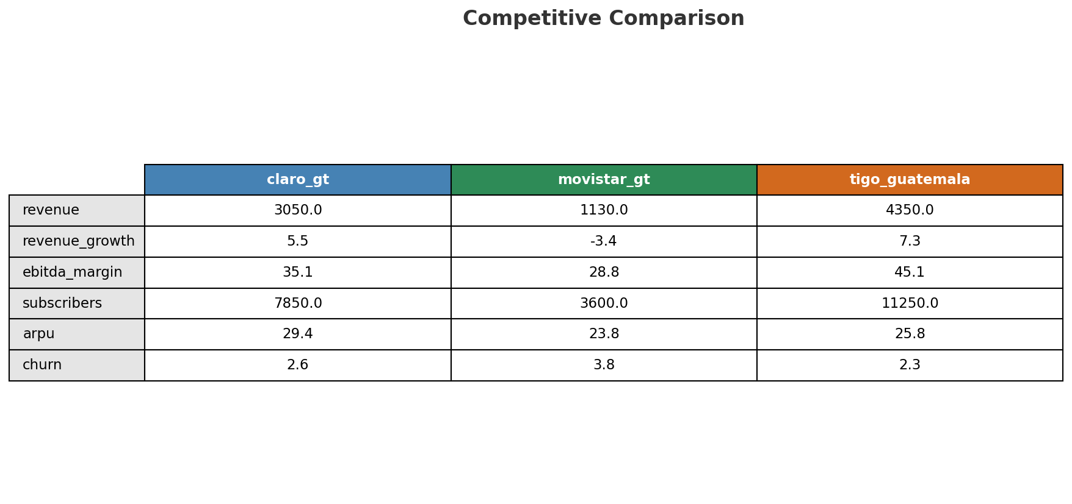
Competitive Landscape Summary
COMPETITION
Key Message: In a 3-player market with medium competition intensity, Tigo Guatemala leads with 51% revenue share. Target operator holds 51% share. Strongest competitive force: Existing Competitors.
20

Slide 21
New Entrants Threat
MARKET ENTRY
• Entry barriers: High barriers: spectrum licensing, massive capex for network build, regulatory approvals, established brand loyalty
Key Message: New entrants threat level: low
21

Slide 22
04 Look at Self
BMC + Capability Assessment

Slide 23
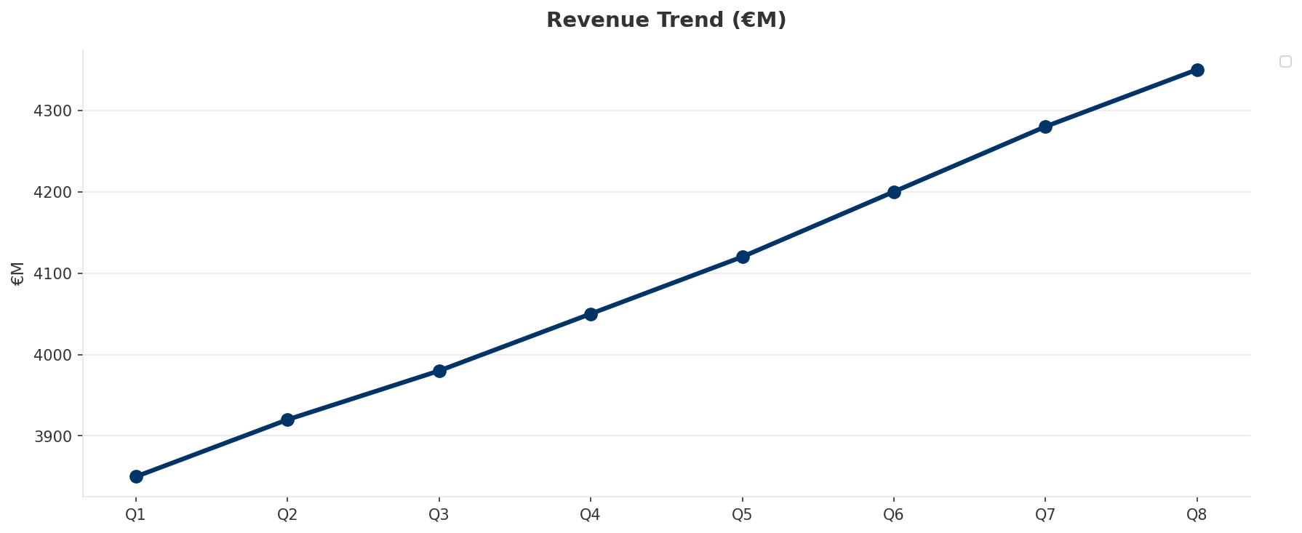
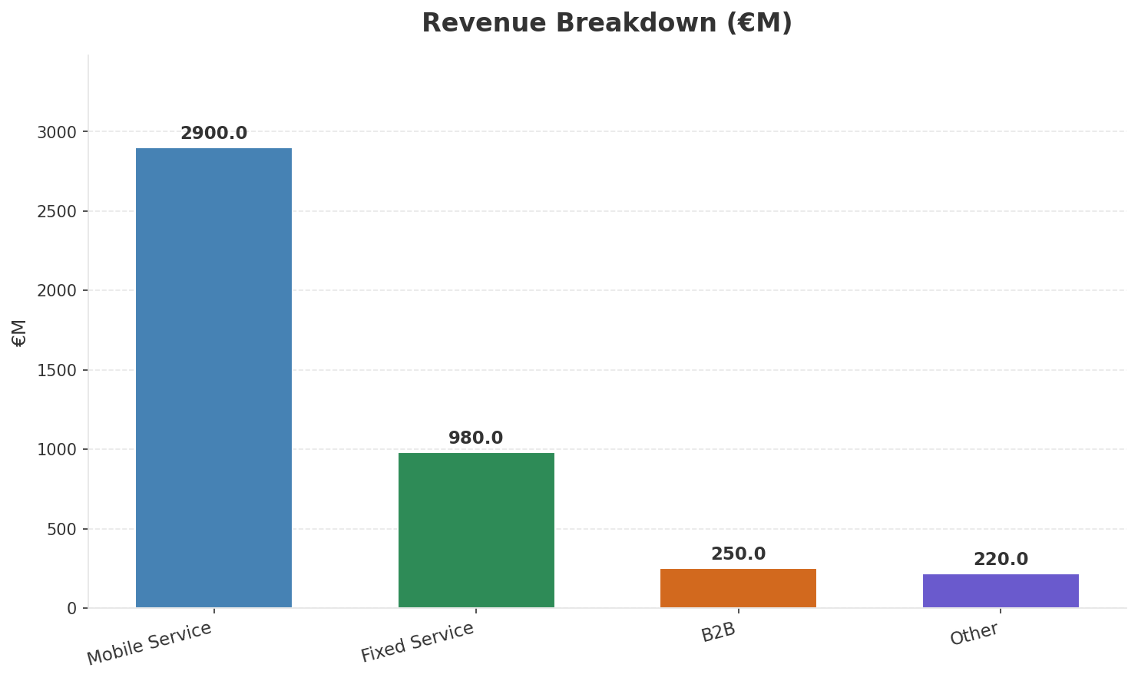
Operating Health Check
FINANCIAL HEALTH
Revenue
EBITDA
EBITDA Margin
Capex/Rev
€4,350M
€1,960M
45.1%
15.4%
+7.41% YoY
+7.7% YoY
Key Message: Ranked #1 of 3 operators in market; revenue GTQ 4,350M; EBITDA margin 45.1%; stable but facing challenges; key strength: Brand Strength; key challenge: 5G coverage gap at only 0.0%; Management outlook: Expect continued mid-single-digit mobile service revenue growth driven by data monetization
23

Slide 24
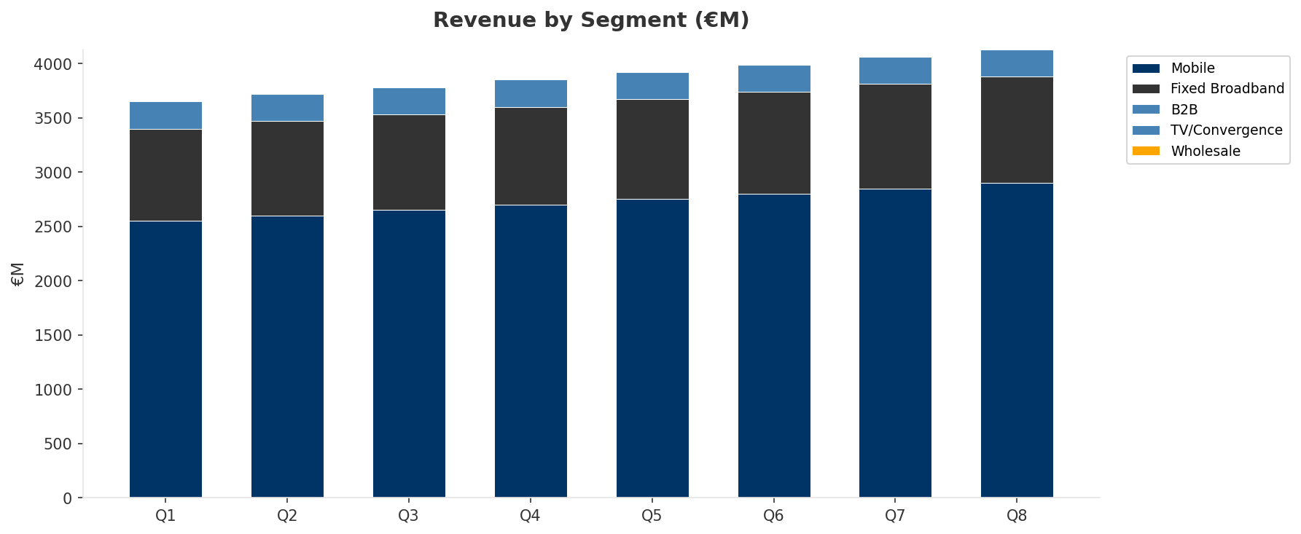
Revenue Composition Trend
SEGMENT REVENUE MIX OVER TIME
Key Message: Growing: Mobile, Fixed Broadband
24

Slide 25
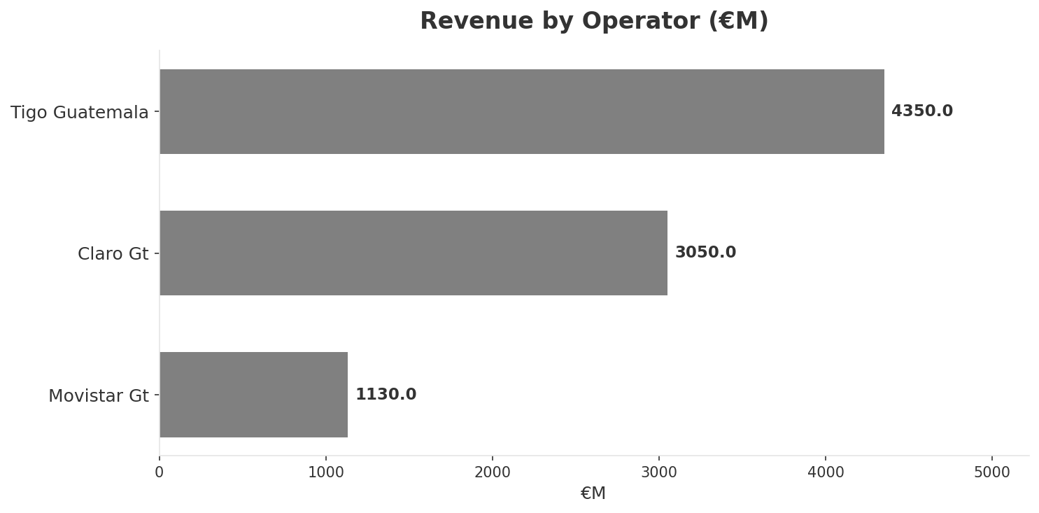
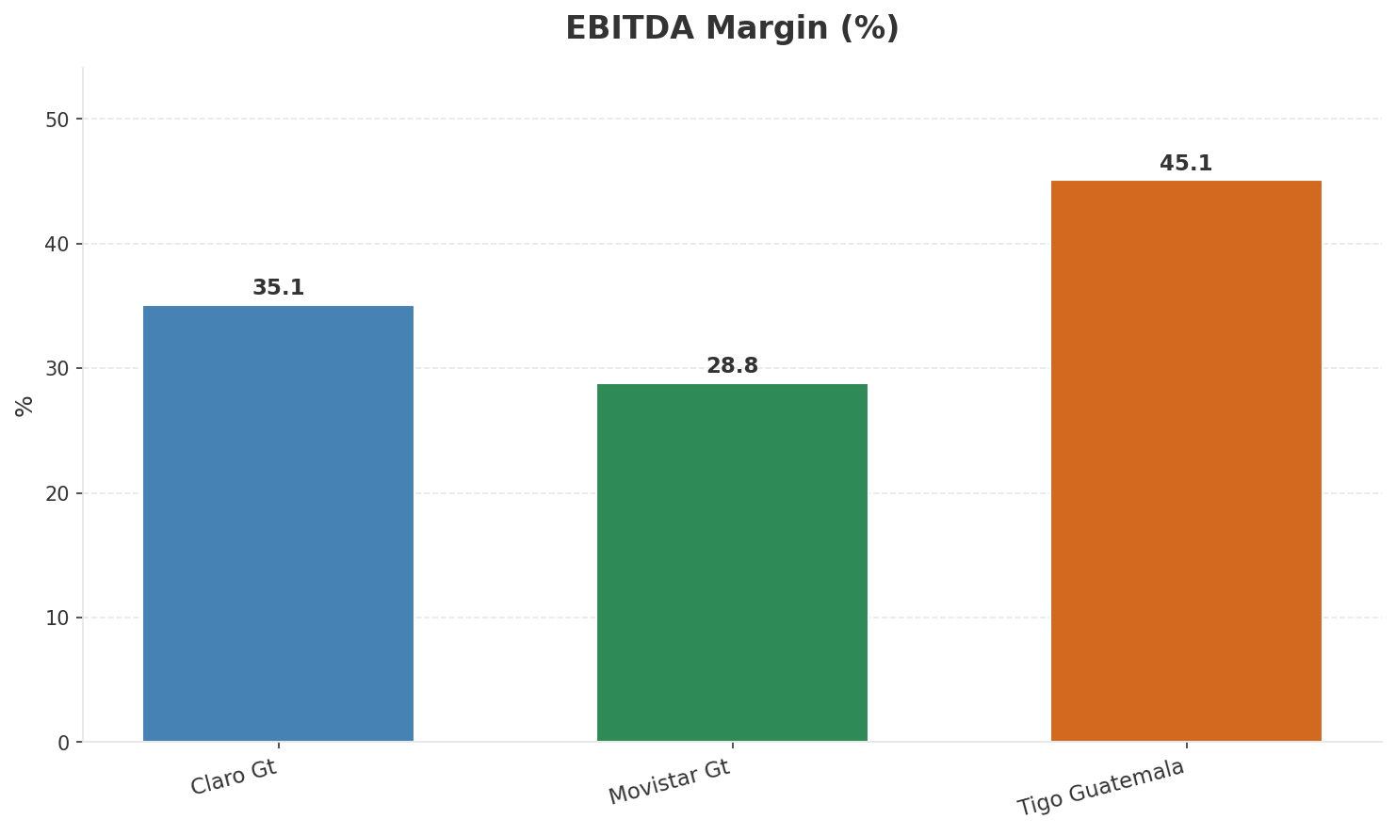
Revenue Comparison
COMPETITIVE BENCHMARKING
Key Message: Revenue and margin benchmarking across operators
25

Slide 26
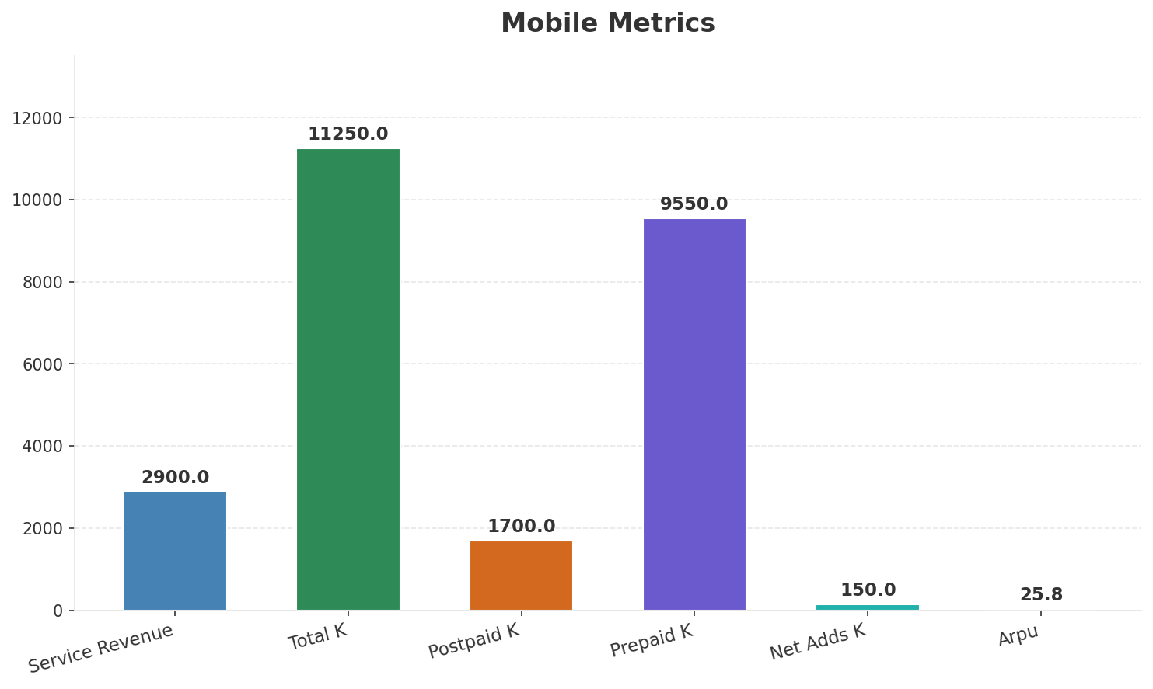
Segment Analysis: Mobile
SEGMENT PERFORMANCE
Service Revenue
Service Growth Pct
Total K
Postpaid K
€2,900M
7.4%
€11,250M
€1,700M
Health: STABLE
• revenue: improving
• subscribers: improving
• arpu: stable
• Expect continued mid-single-digit mobile service revenue growth driven by data monetization
• Tigo launches Tigo Money mobile wallet expansion
Key Message: Mobile service revenue at 2,900M; up 7.4% YoY; ARPU 25.8
26

Slide 27
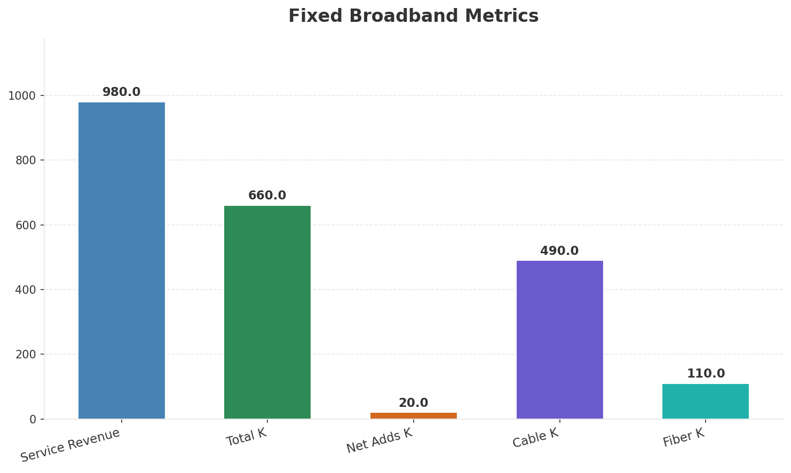
Segment Analysis: Fixed Broadband
SEGMENT PERFORMANCE
Service Revenue
Service Growth Pct
Total K
Net Adds K
€980M
8.9%
€660M
20
Health: STRONG
• revenue: improving
• subscribers: improving
• arpu: stable
• HFC expansion driving fixed broadband subscriber growth of 20K per quarter
• revenue increased 2.1% QoQ
• subscribers increased 3.1% QoQ
Key Message: Fixed service revenue 980.0M; growth +8.9% YoY; Fiber subs 110K
27

Slide 28
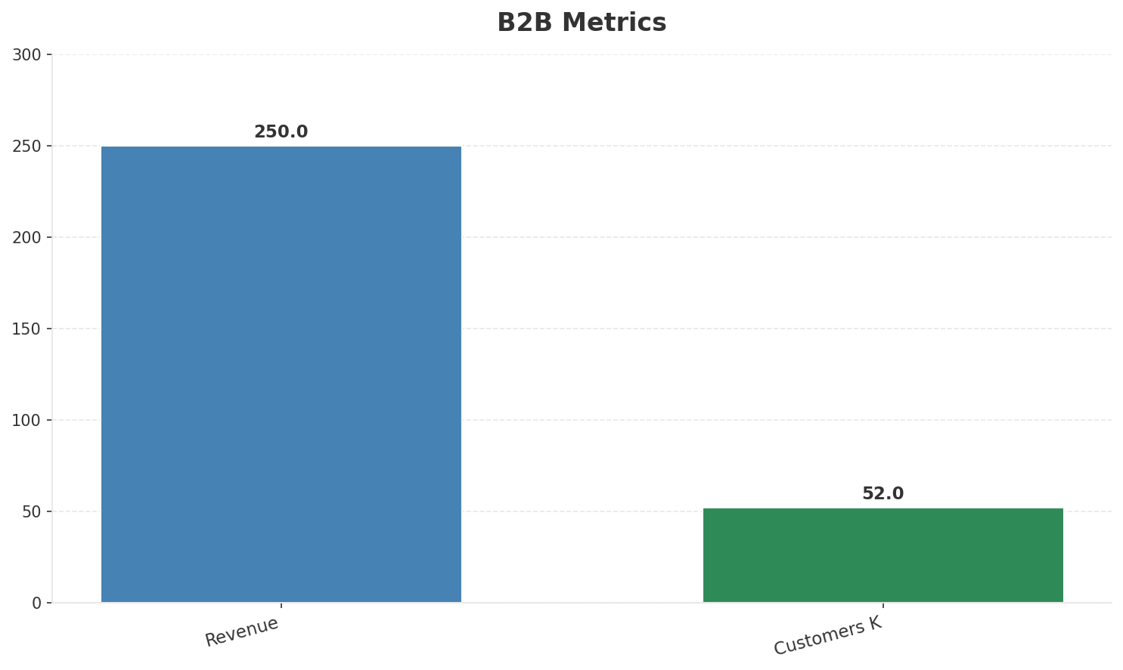
Segment Analysis: B2B
SEGMENT PERFORMANCE
Revenue
Growth Pct
Customers K
Share Of Revenue Pct
€250M
None
52
5.7%
Health: STABLE
• revenue: stable
• customers: improving
• Enterprise segment growing with cloud and connectivity solutions for SMEs
Key Message: B2B revenue 250.0M; 5.7% of total revenue
28

Slide 29
Segment Analysis: TV/Convergence
SEGMENT PERFORMANCE
Revenue
Total K
Net Adds K
Fmc Total K
None
€450M
None
None
Health: STABLE
• revenue: stable
• subscribers: improving
• fmc_subscribers: stable
• subscribers increased 2.3% QoQ
Key Message: TV subscribers 450K
29

Slide 30
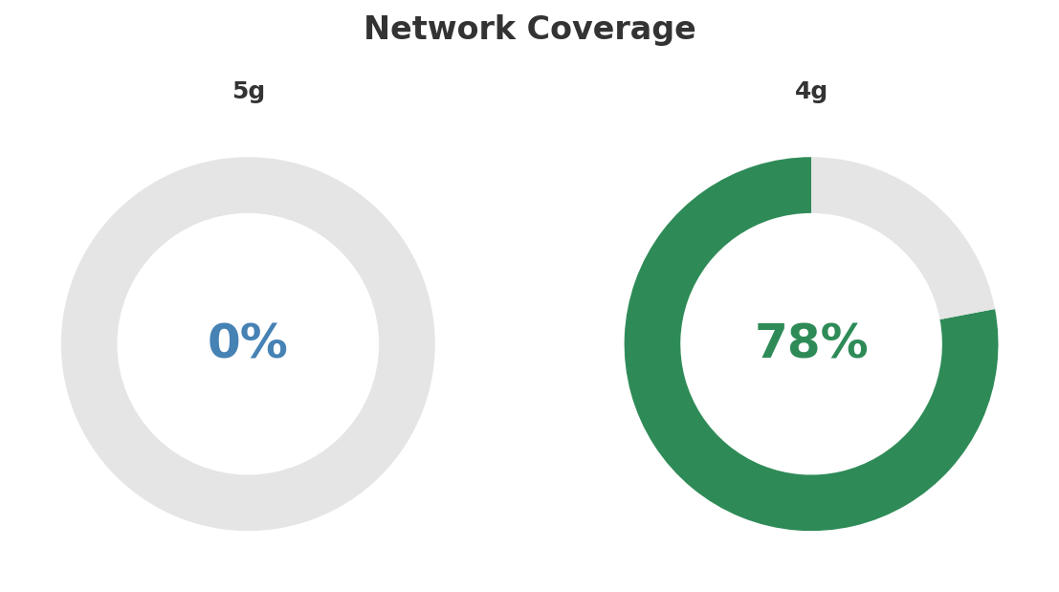
Network Analysis
INFRASTRUCTURE
Technology Mix:
Investment Direction: stable
• Mobile Vendor: Ericsson
• Spectrum Mhz: 130
• Core Vendor: Ericsson
Key Message: Network infrastructure and coverage assessment
30

Slide 31

Business Model Canvas
BMC
Key Message: Business model canvas overview
31

Slide 32
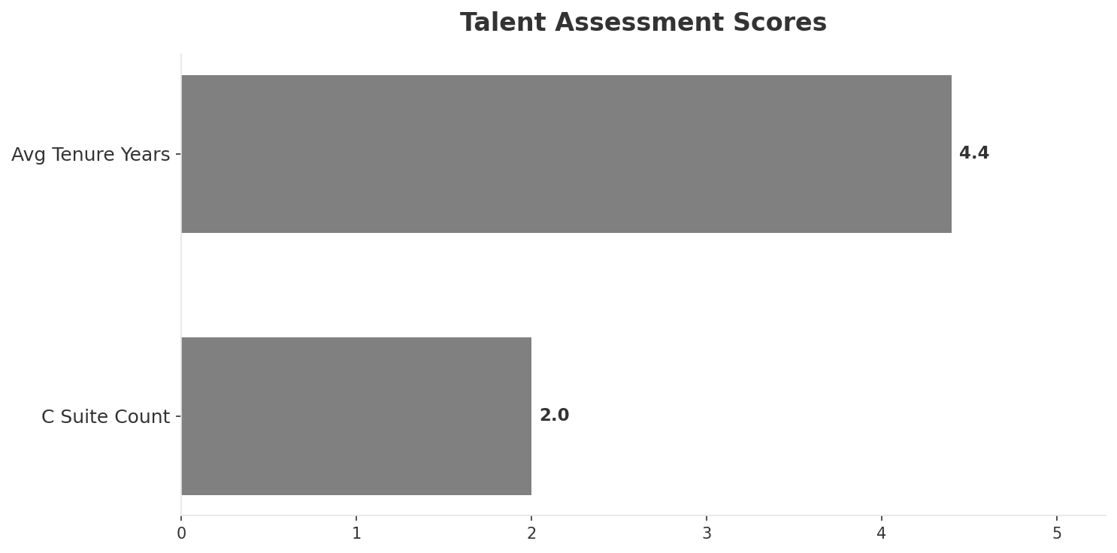
Organization & Talent
PEOPLE & CULTURE
Employees
C Suite Count
Avg Tenure Years
Key Leaders
3,350
2
4.4
['Rodrigo Aguilar (CEO)', 'Carlos Martinez (CFO)']
Organization Culture:
Stable leadership team (avg tenure >3 years); Growth-oriented strategic posture; Market-leading confidence; strong commercial execution; Millicom operational standards; focus on digital inclusion and financial services (Tigo Money).
Leadership Changes:
• Rodrigo Aguilar: (
• Carlos Martinez: (
Key Message: Organization and talent assessment
32

Slide 33
Strengths, Weaknesses & Exposure Points
SELF ASSESSMENT
Strengths
Weaknesses
Exposure Points
• Brand Strength: score 85 (market avg 74
• Customer Service: score 72 (market avg 65
• Digital Experience: score 70 (market avg 62
• Distribution: score 88 (market avg 76
• Enterprise Solutions: score 65 (market avg 57
• Innovation: score 68 (market avg 59
• 5G coverage gap at only 0.0%
• Dependence on prepaid revenue in price-sensitive market: Vulnerable to aggressive pricing from competitors
• Cable network aging requires DOCSIS upgrade investment: Capex pressure to maintain broadband competitiveness
Key Message: Ranked #1 of 3 operators in market; revenue GTQ 4,350M; EBITDA margin 45.1%; stable but facing challenges; key strength: Brand Strength; key challenge: 5G coverage gap at only 0.0%; Management outlook: Expect continued mid-single-digit mobile service revenue growth driven by data monetization
33

Slide 34
SWOT Synthesis
Strengths, Weaknesses, Opportunities & Threats

Slide 35
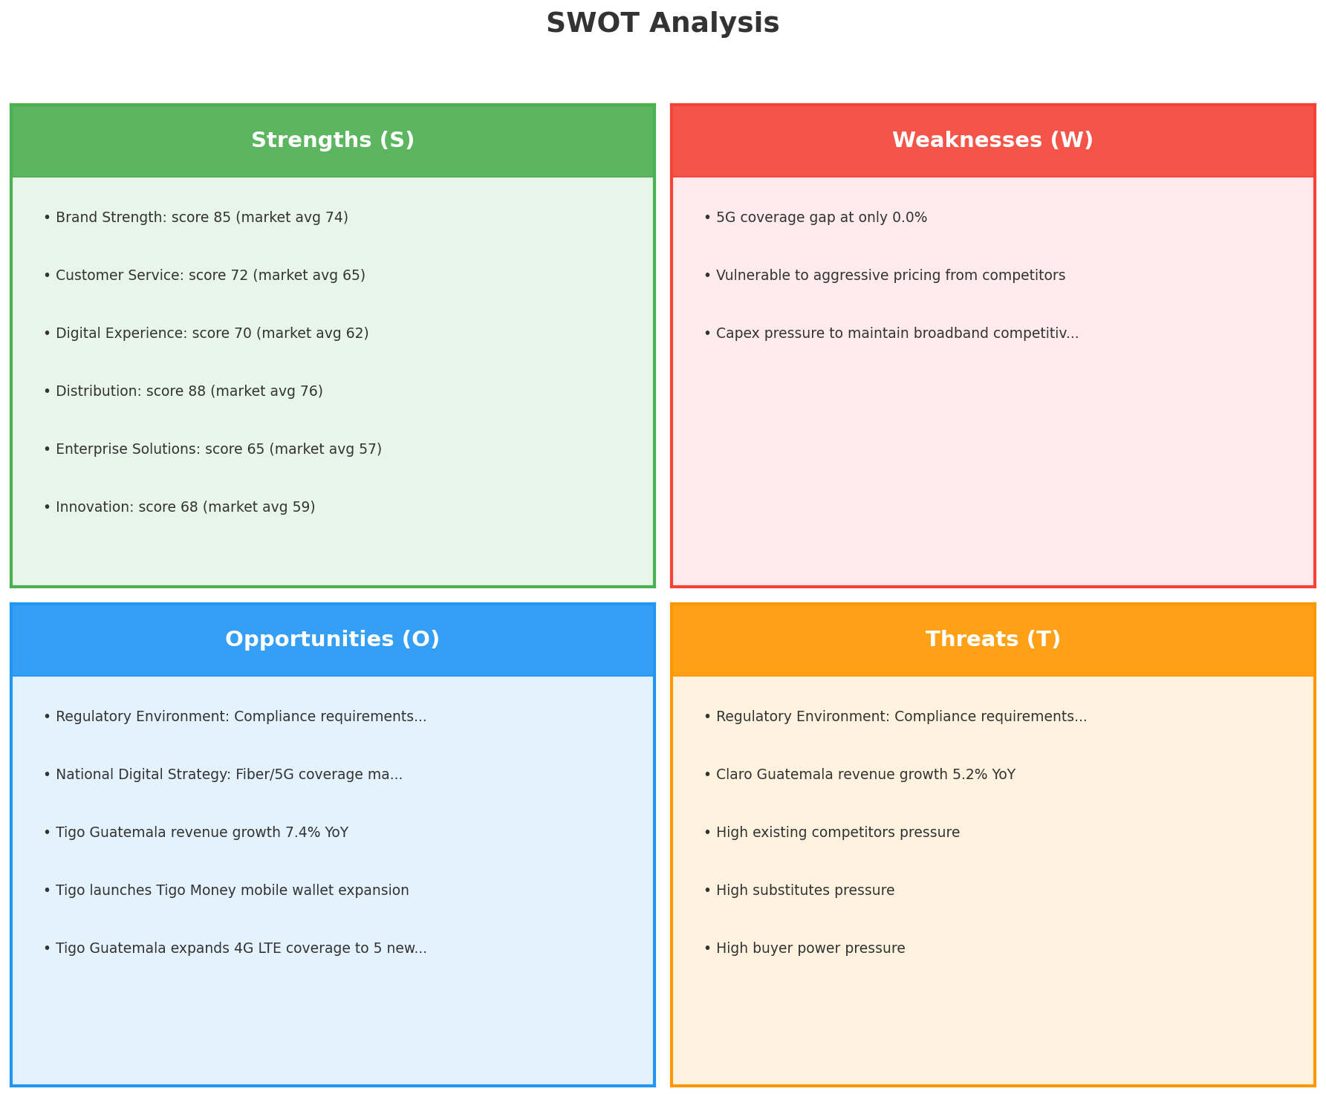
SWOT Analysis
STRATEGIC SYNTHESIS
SO:
Leverage 'Brand Strength: score 85 (market avg 74)' to ca...
WO:
Address weakness '5G coverage gap at only 0.0%' to unlock...
ST:
Use strength 'Brand Strength: score 85 (market avg 74)' t...
WT:
Mitigate weakness '5G coverage gap at only 0.0%' and defe...
Key Message: SWOT analysis identifies 13 strengths, 3 weaknesses, 5 opportunities, and 5 threats. The recommended strategic posture is offensive (SO-dominant).
35

Slide 36
05 Look at Opportunities
SPAN Matrix — Opportunity Selection

Slide 37
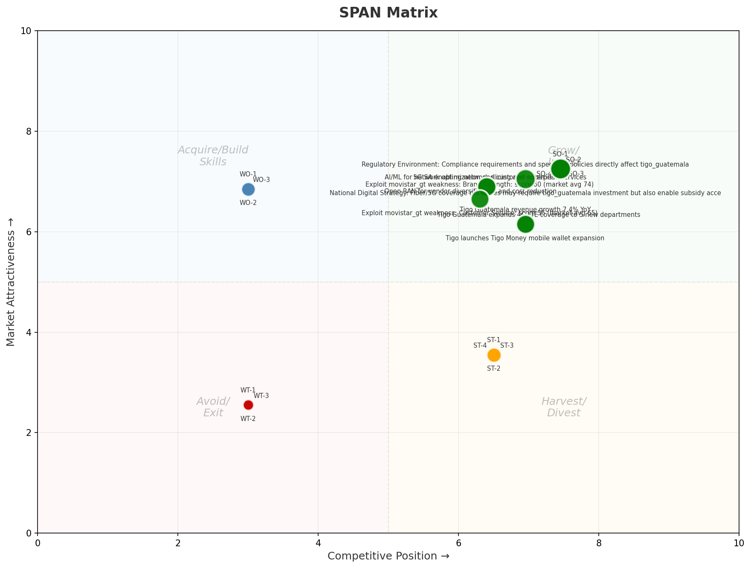
SPAN Matrix — Opportunity Positioning
OPPORTUNITY MAP
Key Message: SPAN matrix positions 24 opportunities: 14 grow/invest, 3 acquire skills, 4 harvest, 3 avoid/exit. Focus resources on the 14 grow/invest items for maximum strategic impact.
37

Slide 38
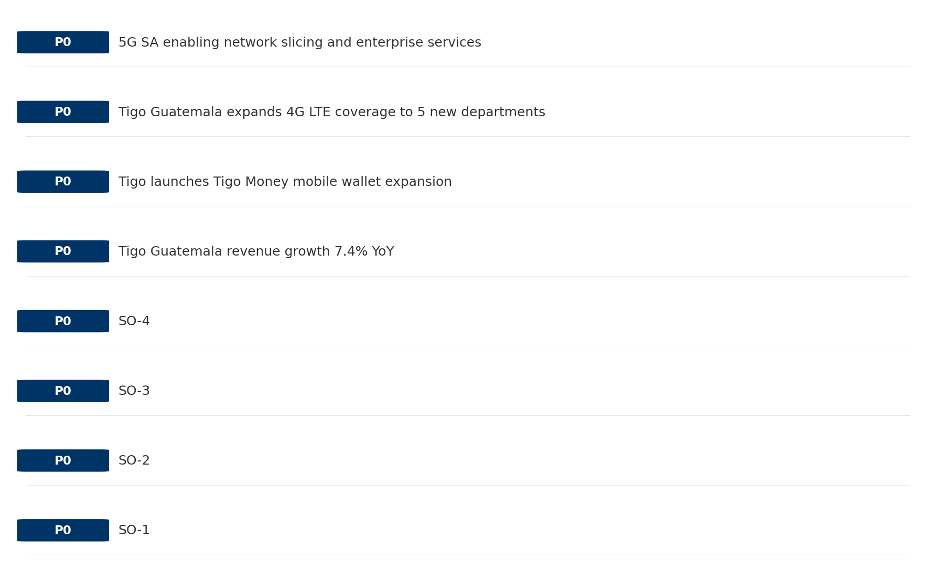
Opportunity Priority Ranking
PRIORITIES
Key Message: SPAN matrix positions 24 opportunities: 14 grow/invest, 3 acquire skills, 4 harvest, 3 avoid/exit. Focus resources on the 14 grow/invest items for maximum strategic impact.
38

Slide 39
Opportunity Details
DEEP DIVE
P0
SO-1
Market: N/A | Window:
Leverage 'Brand Strength: score 85 (market avg 74)' to capture the opportunity of 'Regulatory Environment: Compliance requirements and spectrum policies directly affect tigo_guatemala'.
P0
SO-2
Market: N/A | Window:
Leverage 'Customer Service: score 72 (market avg 65)' to capture the opportunity of 'National Digital Strategy: Fiber/5G coverage mandates may require tigo_guatemala investment but also enable subsidy access'.
P0
SO-3
Market: N/A | Window:
Leverage 'Digital Experience: score 70 (market avg 62)' to capture the opportunity of 'Tigo Guatemala revenue growth 7.4% YoY'.
P0
SO-4
Market: N/A | Window:
Leverage 'Distribution: score 88 (market avg 76)' to capture the opportunity of 'Tigo launches Tigo Money mobile wallet expansion'.
Key Message: SPAN matrix positions 24 opportunities: 14 grow/invest, 3 acquire skills, 4 harvest, 3 avoid/exit. Focus resources on the 14 grow/invest items for maximum strategic impact.
39

Slide 40
Three Decisions
Strategy — Key Tasks — Execution

Slide 41
Decision 1: Define Strategy
OFFENSIVE
As The Dominant Leader: defend leadership through innovation and ecosystem lock-in
P0
P0
P1
P1
Growth Strategy
Competitive Strategy
Transformation Strategy
Customer Strategy
Defend leadership through ecosystem expansion in Mobile, Fixed Broadband, B2B
Capitalize on competitive strengths to gain market share
Accelerate fiber transition — converged network as competitive moat
Optimize value extraction in stable segments: Wholesale
- Maintain #1 revenue share
- Grow Mobile, Fixed Broadband, B2B by 5-8% YoY
- Outgrow competitors in key segments
- Increase service differentiation
- Fiber homepass coverage +20%
- FMC bundle attach rate 50%+
- Upsell rate +10% in Wholesale
- Cross-sell convergence bundles
Key Message: As The Dominant Leader, the strategic posture is Offensive. As The Dominant Leader: defend leadership through innovation
41

Slide 42
Decision 2: Define Key Tasks
2 P0 (IMMEDIATE), 3 P1 (1-2 YEARS), 1 P2 (3-5 YEARS
P0
Business
Accelerate Mobile Growth
Mobile revenue +10% YoY | Market share gain
Mobile at €2,900M showing strong momentum — invest to scale
P0
Business
Accelerate Fixed Broadband Growth
Fixed Broadband revenue +10% YoY | Market share gain
Fixed Broadband at €980M showing strong momentum — invest to scale
P1
Network
Network Quality Optimization
Network quality index improvement
Improve network reliability and customer experience scores
P1
Business
Opportunity Portfolio Execution
Launch 3+ priority initiatives | Pipeline contribution tracking
14 grow/invest opportunities identified — establish execution office
P1
Customer
Customer Experience Enhancement
NPS +5 points | First-call resolution rate 80%+
Improve digital touchpoints and service resolution to boost NPS
P2
Efficiency
Operational Efficiency & Automation
Process automation 30%+ | Cost-to-serve reduction
EBITDA margin 45.1% — maintain through smart automation and resource reallocatio
Key Message: 6 critical tasks: 2 P0 (immediate), 3 P1 (1-2 years), 1 P2 (3-5 years
42

Slide 43
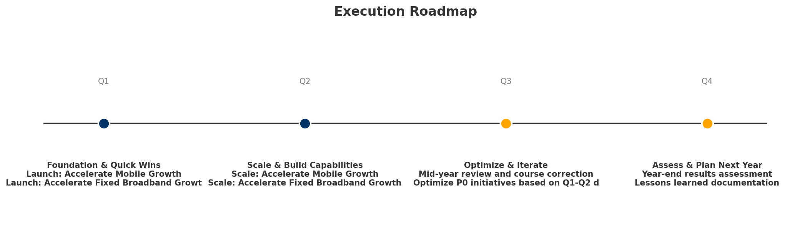
Decision 3: Define Execution
QUARTERLY ROADMAP & GOVERNANCE
Governance
Strategic Traps to Avoid
- Monthly Progress Review (Monthly
x Delay core transformation
- Quarterly Strategic Checkpoint (Quarterly
- Mid-Year Strategic Adjustment (Semi-annual
Key Risks & Mitigation
! Resource constraints delay P0 initiatives -- Ring-fence P0 budgets; establish escalation path for blockers
Key Message: Execute with discipline: monthly reviews, quarterly checkpoints, annual refresh
! Macro-economic slowdown reduces consumer spending -- Prepare value-tier offerings; shift mix toward B2B resilience
43

Slide 44
Analysis Summary
KEY TAKEAWAYS
01 Trends
Macro environment: Favorable. Key opportunities: Regulatory Environment, National Digital Strategy. Key risks: Regulatory Environment, Inflation Industry is in late growth phase. (+2.4% YoY (CQ2_2025 -> CQ4_2025)
02 Market
Guatemala telecom market totals GTQ 8,530M in quarterly revenue; competitive strengths in Availability, Social/Brand; Market outlook is favorable with more opportunities than threats.
03 Competition
In a 3-player market with medium competition intensity, Tigo Guatemala leads with 51% revenue share. Target operator holds 51% share. Strongest competitive force: Existing Competitors.
04 Self
Ranked #1 of 3 operators in market; revenue GTQ 4,350M; EBITDA margin 45.1%; stable but facing challenges; key strength: Brand Strength; key challenge: 5G coverage gap at only 0.0%; Management outlook: Expect continued mid-single-digit mobile service revenue growth driven by data monetization
SWOT
SWOT analysis identifies 13 strengths, 3 weaknesses, 5 opportunities, and 5 threats. The recommended strategic posture is offensive (SO-dominant).
05 Opportunities
SPAN matrix positions 24 opportunities: 14 grow/invest, 3 acquire skills, 4 harvest, 3 avoid/exit. Focus resources on the 14 grow/invest items for maximum strategic impact.
Key Message: Complete Five Looks analysis — see opportunity priorities for next steps
44

Slide 45
Data Provenance
SOURCES & METHODOLOGY
No provenance data recorded for this analysis
Key Message: All data points are traceable to original sources
45

Slide 46
Thank You
BLM Five Looks Strategic Analysis

