Slide 1
Default BLM Strategic Analysis
BLM (Business Leadership Model) Five Looks Analysis
Target Operator
Market
Analysis Period
Report Date
Tigo Nicaragua
Nicaragua
CQ4_2025
2026-02-14
01 Trends (PEST) | 02 Market/Customer ($APPEALS) | 03 Competition (Porter) | 04 Self (BMC) | SWOT Synthesis | 05 Opportunities (SPAN

Slide 2
Report Contents
TABLE OF CONTENTS
01
Executive Summary
Key findings and recommendations
02
Look at Trends
PEST Framework — macro environment
03
Look at Market
$APPEALS — market changes & customer needs
T
Tariff Analysis
Pricing comparison — mobile, fixed & convergence
04
Look at Competition
Porter's Five Forces — competitive landscape
05
Look at Self
BMC + Capability — internal assessment
06
SWOT Synthesis
Strengths, Weaknesses, Opportunities, Threats
07
Look at Opportunities
SPAN Matrix — opportunity selection
Summary & Provenance
2
08
Conclusions and data sources

Slide 3
Data Quality Overview
DATA QUALITY
Total Data Points
High Confidence
Medium Confidence
Low/Estimated
20
0
0
20
0%
Unique Sources: 0
Data Conflicts: 0
Coverage: Partial
Key Message: 20 data points tracked, 0 high-confidence (0%
3

Slide 4
Executive Summary
Trends
Macro environment: Favorable. Key opportunities: Regulatory Environment, National Digital Strategy. Key risks: Regulatory Environment, Inflation Industry is mature. (+2.0% YoY (CQ2_2025 -> CQ4_2025)
Market/Customer
Nicaragua telecom market totals NIO 4,130M in quarterly revenue; gaps in Assurances; Market outlook is favorable with more opportunities than threats.
Competition
In a 2-player market with medium competition intensity, Tigo Nicaragua leads with 58% revenue share. Target operator holds 58% share. Strongest competitive force: Substitutes.
Self Assessment
Ranked #1 of 2 operators in market; revenue NIO 2,410M; EBITDA margin 45.0%; stable but facing challenges; key strength: Brand Strength; key challenge: 5G coverage gap at only 0.0%; Management outlook: Nicaragua remains stable with steady mobile growth despite political challenges
SWOT
SWOT analysis identifies 11 strengths, 3 weaknesses, 4 opportunities, and 3 threats. The recommended strategic posture is offensive (SO-dominant).
Opportunities
SPAN matrix positions 22 opportunities: 13 grow/invest, 3 acquire skills, 3 harvest, 3 avoid/exit. Focus resources on the 13 grow/invest items for maximum strategic impact.
Key Message: Five Looks analysis completed — see details in following sections
4

Slide 5
01 Look at Trends
PEST Framework — Macro Environment

Slide 6

PEST Analysis Dashboard
MACRO ENVIRONMENT
Key Message: Macro environment: Favorable. Key opportunities: Regulatory Environment, National Digital Strategy. Key risks: Regulatory Environment, Inflation.
6

Slide 7
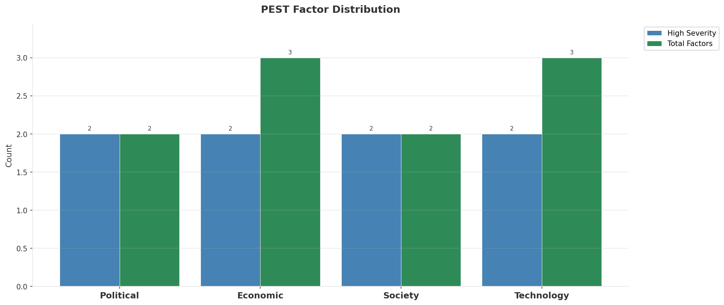
Industry Environment
INDUSTRY ANALYSIS
Market Size
Growth Rate
Concentration
Lifecycle
NIO 4.1B (quarterly, CQ4_2025
+2.0% YoY (CQ2_2025 -> CQ4_2025
CR4 = 100% (Tigo Nicaragua: 58.4%, Claro Nicaragua: 41.6%
mature
• New Business Models:
• FWA (Fixed Wireless Access) as fiber alternative
• Network-as-a-Service for enterprise verticals
• Wholesale/MVNO partnerships for coverage monetization
• Technology Revolution:
• 5G SA enabling network slicing and enterprise services
• AI/ML for network optimization and customer experience
• Open RAN for vendor diversification and cost reduction
Key Message: Macro environment: Favorable. Key opportunities: Regulatory Environment, National Digital Strategy. Key risks: Regulatory Environment, Inflation Industry is mature. (+2.0% YoY (CQ2_2025 -> CQ4_2025)
7

Slide 8
Value Transfer Trends
VALUE MIGRATION
• Value shifting from voice/SMS to data and digital services
• B2B/ICT growing faster than consumer segment
• Fiber displacing copper and cable broadband
Key Message: Macro environment: Favorable. Key opportunities: Regulatory Environment, National Digital Strategy. Key risks: Regulatory Environment, Inflation Industry is mature. (+2.0% YoY (CQ2_2025 -> CQ4_2025)
8

Slide 9
02 Look at Market
$APPEALS — Market Changes & Customer Needs

Slide 10
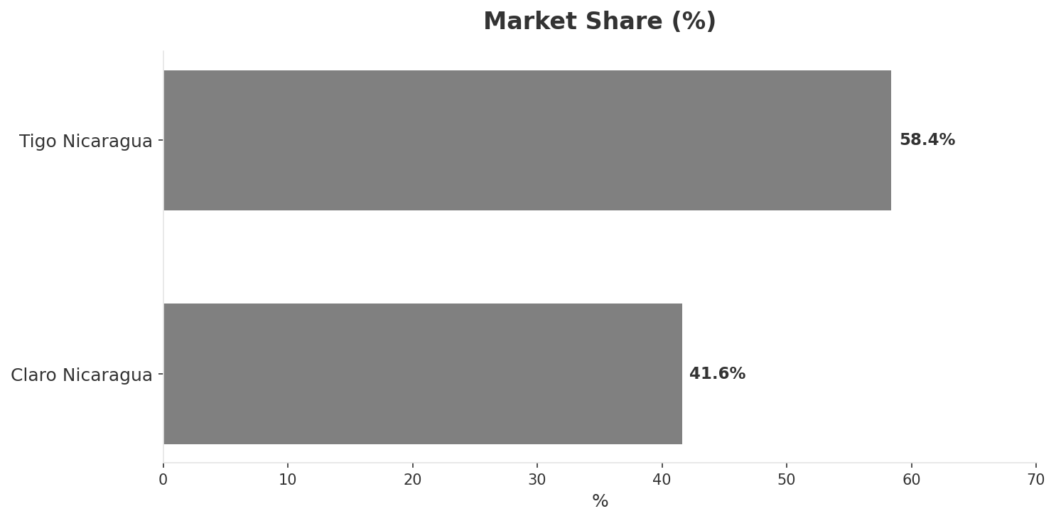
Market Change Panorama
MARKET OVERVIEW
Total Revenue (€M
Mobile Subs (K
Broadband Subs (K
Operators
4,130
7,020
239.0
2
Market Changes:
• Tigo Nicaragua revenue growth 5.2% YoY
• Tigo Nicaragua expands 4G to Pacific coast cities
Key Message: Nicaragua telecom market totals NIO 4,130M in quarterly revenue; gaps in Assurances; Market outlook is favorable with more opportunities than threats.
10

Slide 11
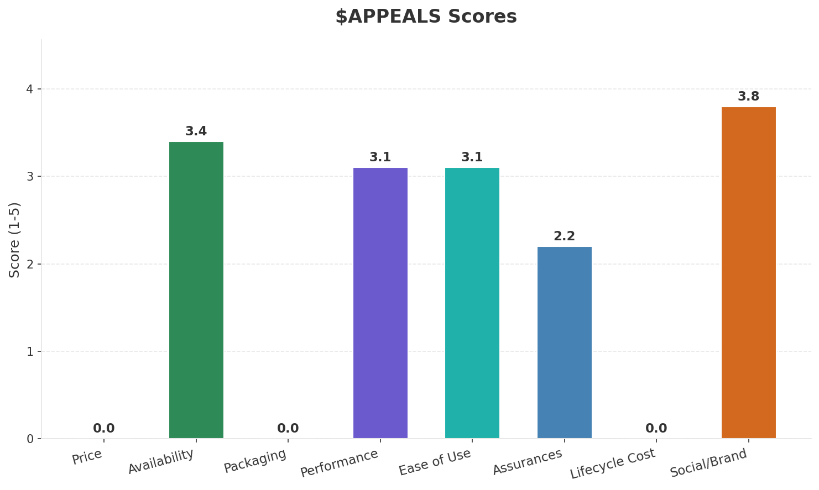
Customer Segments
SEGMENTATION
Consumer Prepaid Mass
Trend: stable
Needs: Affordable data access, Coverage beyond Managua
Consumer Urban
Trend: stable
Needs: Reliable home broadband, Better mobile speeds
Enterprise
Trend: stable
Needs: Business-grade connectivity, Basic cloud services
Key Message: Nicaragua telecom market totals NIO 4,130M in quarterly revenue; gaps in Assurances; Market outlook is favorable with more opportunities than threats.
11

Slide 12
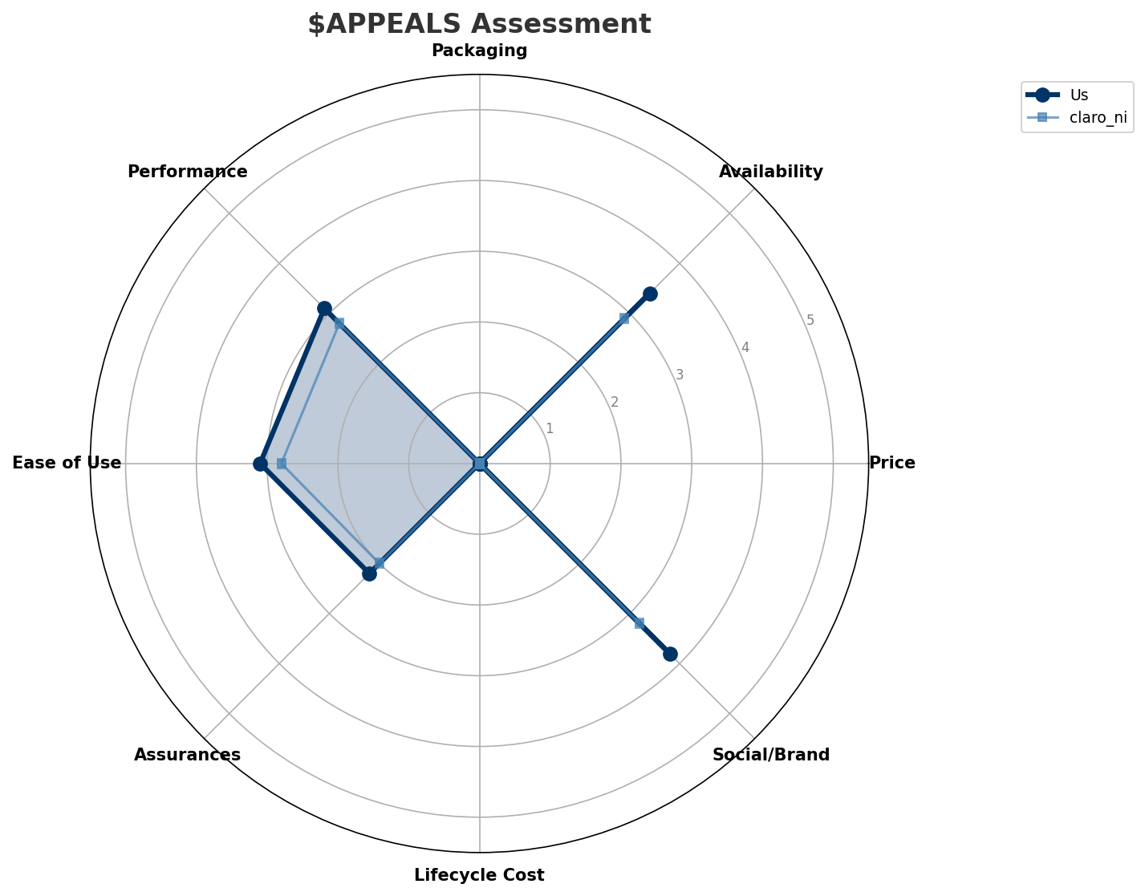
$APPEALS Assessment
CUSTOMER NEEDS
Key Message: Nicaragua telecom market totals NIO 4,130M in quarterly revenue; gaps in Assurances; Market outlook is favorable with more opportunities than threats.
12

Slide 13
Customer Value Migration
VALUE MIGRATION
Value migration trending upward: customers willing to pay more for premium connectivity and convergent bundles. Focus on upselling and cross-selling opportunities.
Opportunities:
• Tigo Nicaragua revenue growth 5.2% YoY
• Tigo Nicaragua expands 4G to Pacific coast cities
Key Message: Nicaragua telecom market totals NIO 4,130M in quarterly revenue; gaps in Assurances; Market outlook is favorable with more opportunities than threats.
13

Slide 14
Tariff Analysis
Mobile, Fixed & Convergence Pricing Landscape

Slide 15
Fixed & Convergence Pricing Landscape
DSL / CABLE / FIBER / FMC BUNDLES
Key Message: Fixed and convergence pricing overview
15

Slide 16
03 Look at Competition
Porter's Five Forces — Competitive Landscape

Slide 17
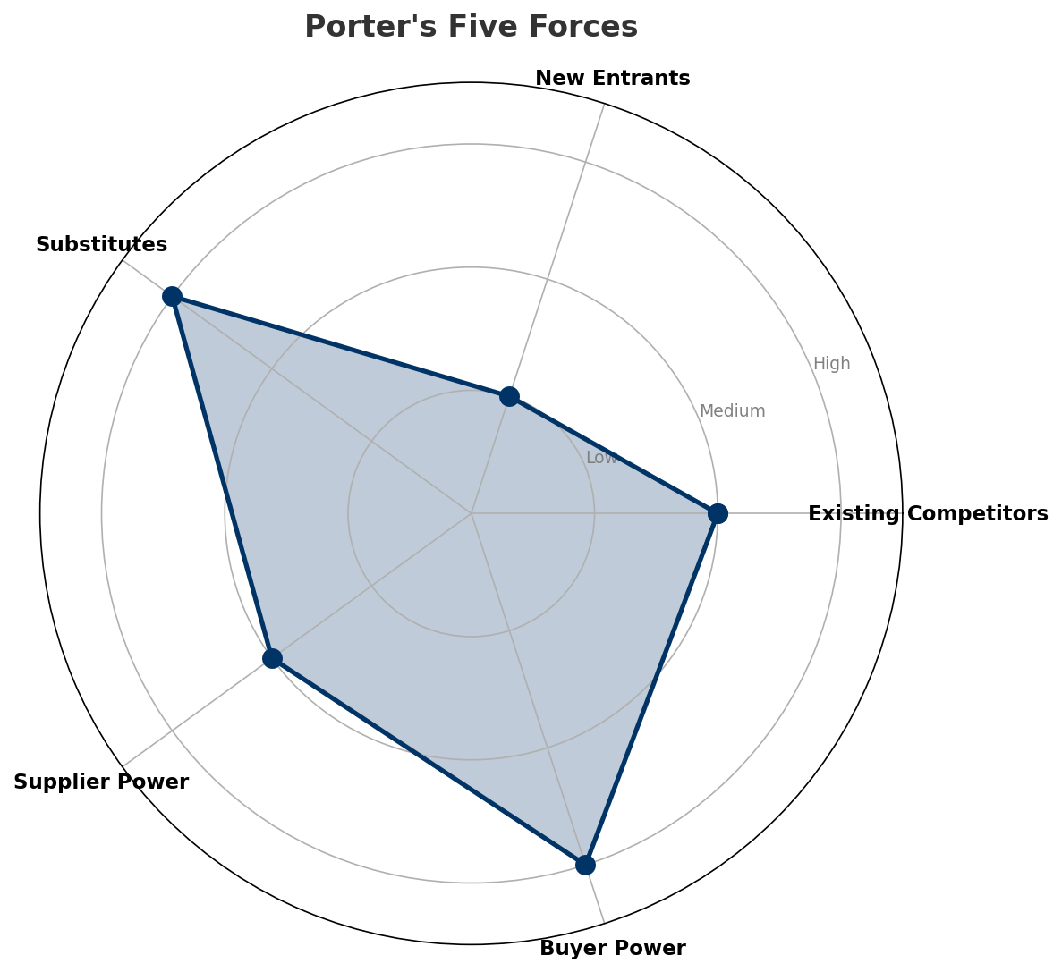
Porter's Five Forces
COMPETITIVE FORCES
Overall Intensity: MEDIUM
Key Message: In a 2-player market with medium competition intensity, Tigo Nicaragua leads with 58% revenue share. Target operator holds 58% share. Strongest competitive force: Substitutes.
17

Slide 18
Competitor Analysis: Claro Ni
COMPETITOR DEEP DIVE
Revenue
EBITDA
Margin
Capex/Rev
€1,720M
€533M
31.0%
16.2%
+2.5% YoY
Strengths
Weaknesses
• Brand Strength: score 65 (market avg 70
• Distribution: score 68 (market avg 73
• Innovation: score 45 (market avg 50
• Network Coverage: score 58 (market avg 63
Strategy: Revenue-led profitable growth; subscriber acquisition focus
Key Message: Competitor analysis: Claro Ni
18

Slide 19
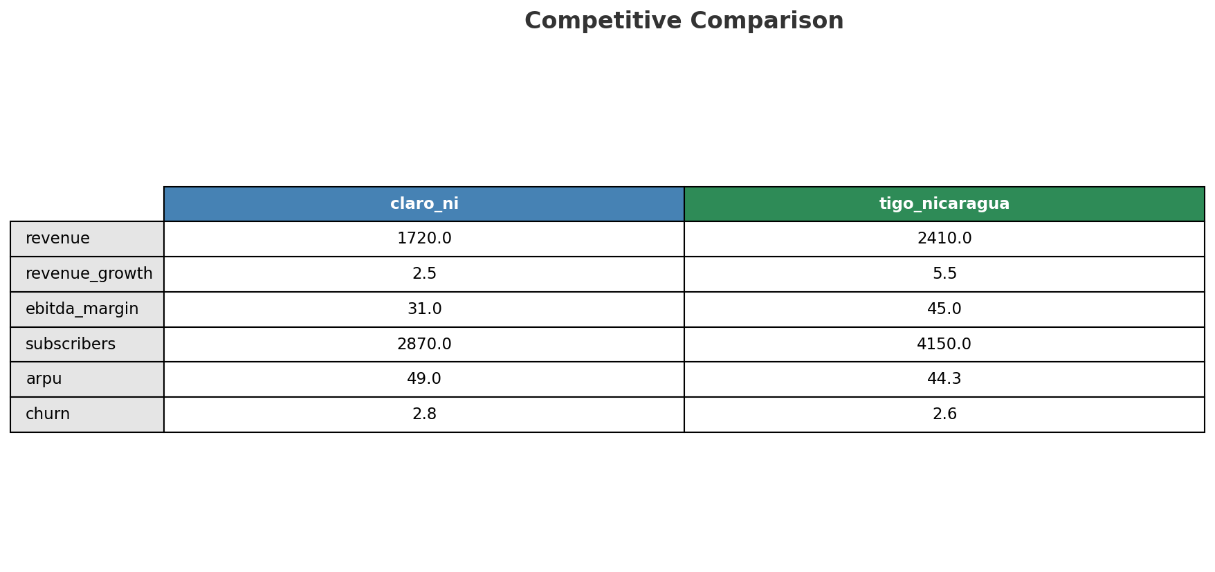
Competitive Landscape Summary
COMPETITION
Key Message: In a 2-player market with medium competition intensity, Tigo Nicaragua leads with 58% revenue share. Target operator holds 58% share. Strongest competitive force: Substitutes.
19

Slide 20
New Entrants Threat
MARKET ENTRY
• Entry barriers: High barriers: spectrum licensing, massive capex for network build, regulatory approvals, established brand loyalty
Key Message: New entrants threat level: low
20

Slide 21
04 Look at Self
BMC + Capability Assessment

Slide 22
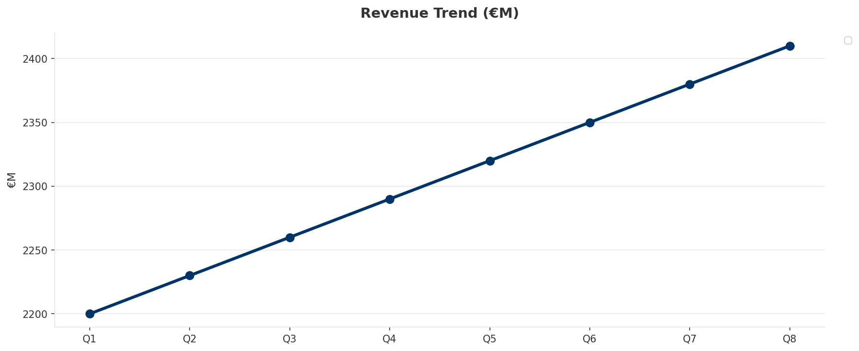
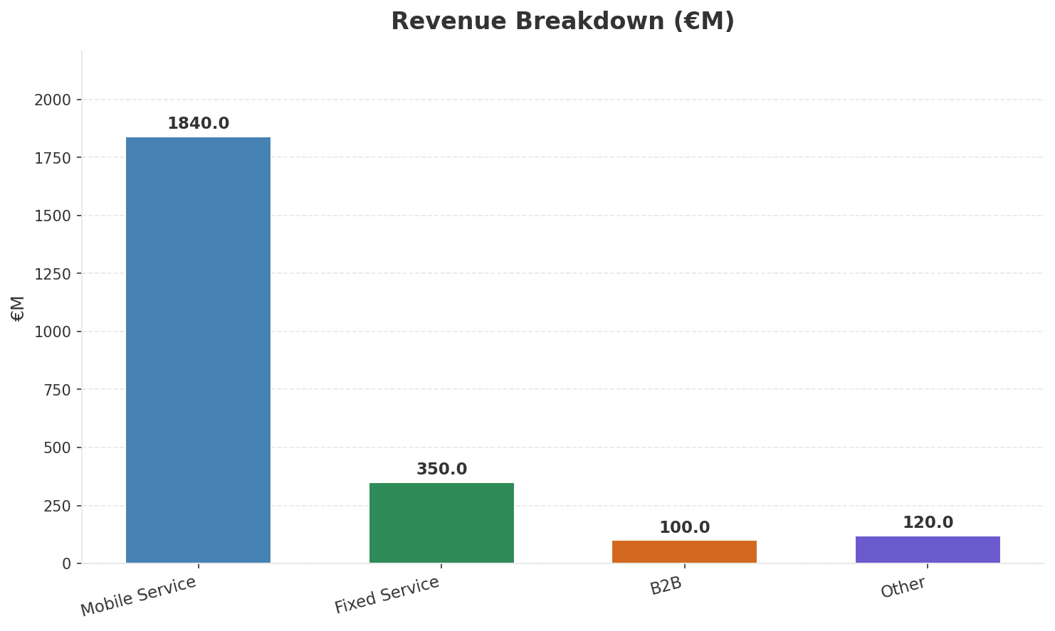
Operating Health Check
FINANCIAL HEALTH
Revenue
EBITDA
EBITDA Margin
Capex/Rev
€2,410M
€1,085M
45.0%
15.1%
+5.24% YoY
+5.3% YoY
Key Message: Ranked #1 of 2 operators in market; revenue NIO 2,410M; EBITDA margin 45.0%; stable but facing challenges; key strength: Brand Strength; key challenge: 5G coverage gap at only 0.0%; Management outlook: Nicaragua remains stable with steady mobile growth despite political challenges
22

Slide 23
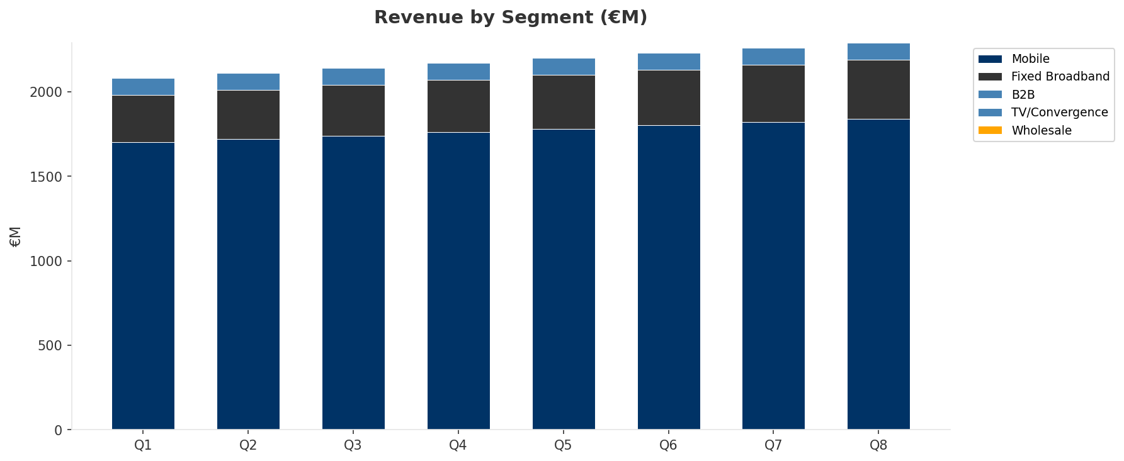
Revenue Composition Trend
SEGMENT REVENUE MIX OVER TIME
Key Message: Growing: Mobile, Fixed Broadband
23

Slide 24
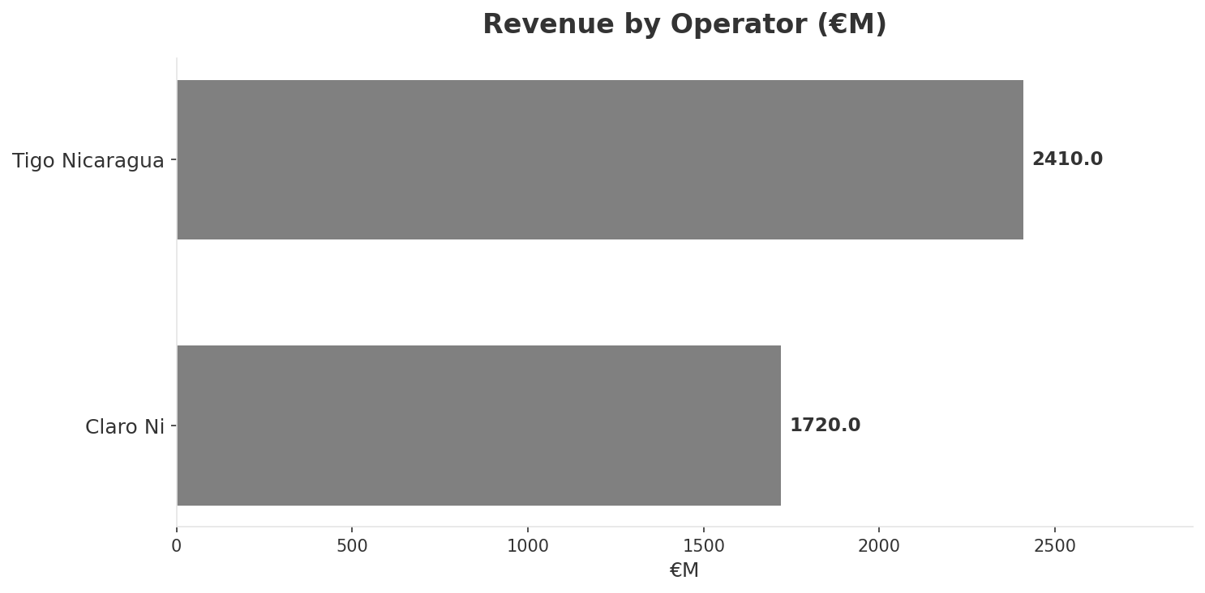
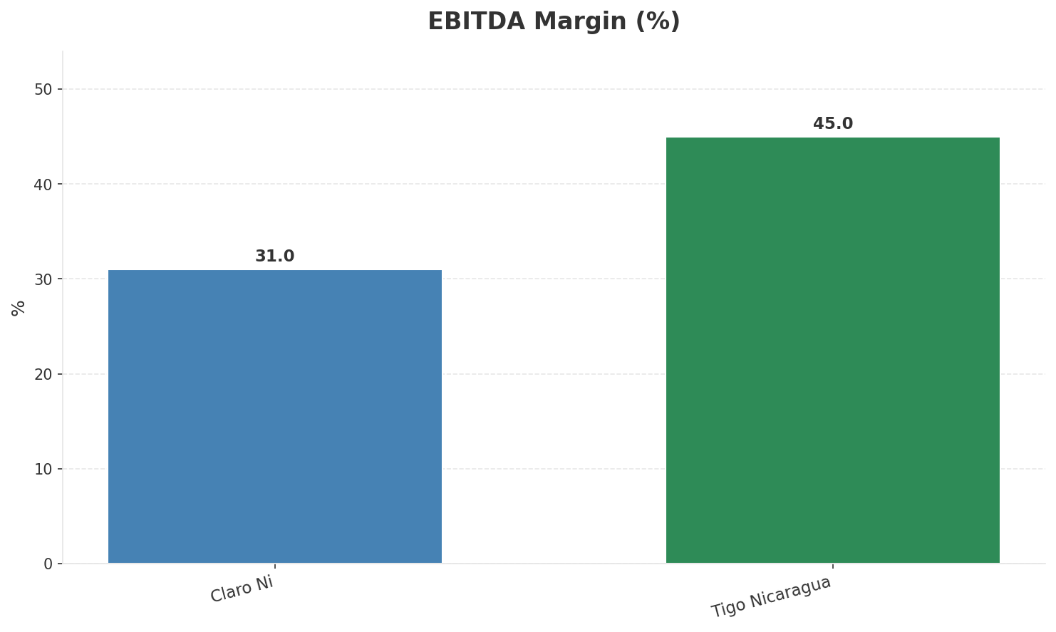
Revenue Comparison
COMPETITIVE BENCHMARKING
Key Message: Revenue and margin benchmarking across operators
24

Slide 25
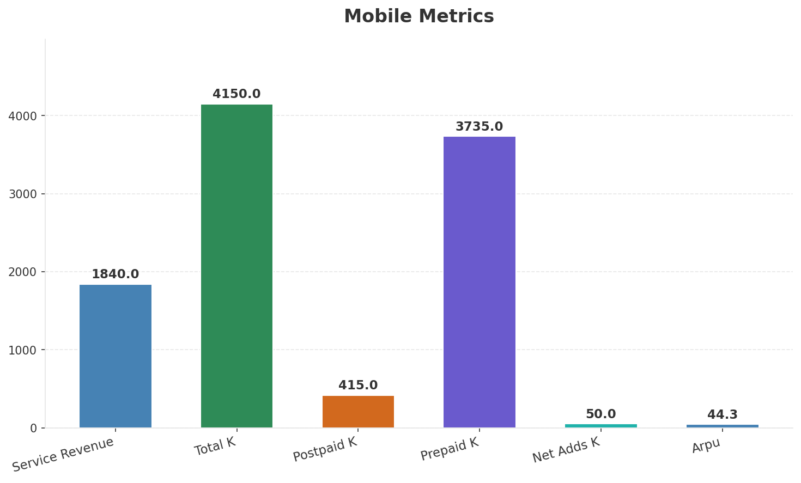
Segment Analysis: Mobile
SEGMENT PERFORMANCE
Service Revenue
Service Growth Pct
Total K
Postpaid K
€1,840M
4.4%
€4,150M
€415M
Health: STABLE
• revenue: improving
• subscribers: improving
• arpu: stable
• Nicaragua remains stable with steady mobile growth despite political challenges
Key Message: Mobile service revenue at 1,840M; up 4.4% YoY; ARPU 44.3
25

Slide 26
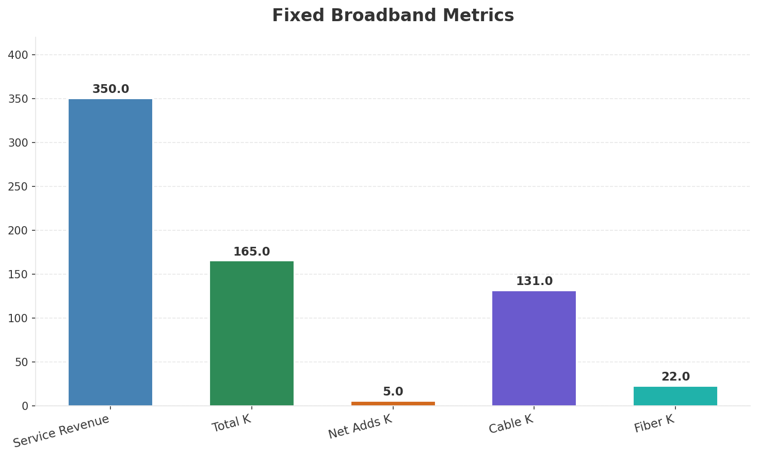
Segment Analysis: Fixed Broadband
SEGMENT PERFORMANCE
Service Revenue
Service Growth Pct
Total K
Net Adds K
€350M
12.9%
€165M
5
Health: STRONG
• revenue: improving
• subscribers: improving
• arpu: stable
• revenue increased 2.9% QoQ
• subscribers increased 3.1% QoQ
Key Message: Fixed service revenue 350.0M; growth +12.9% YoY; Fiber subs 22K
26

Slide 27
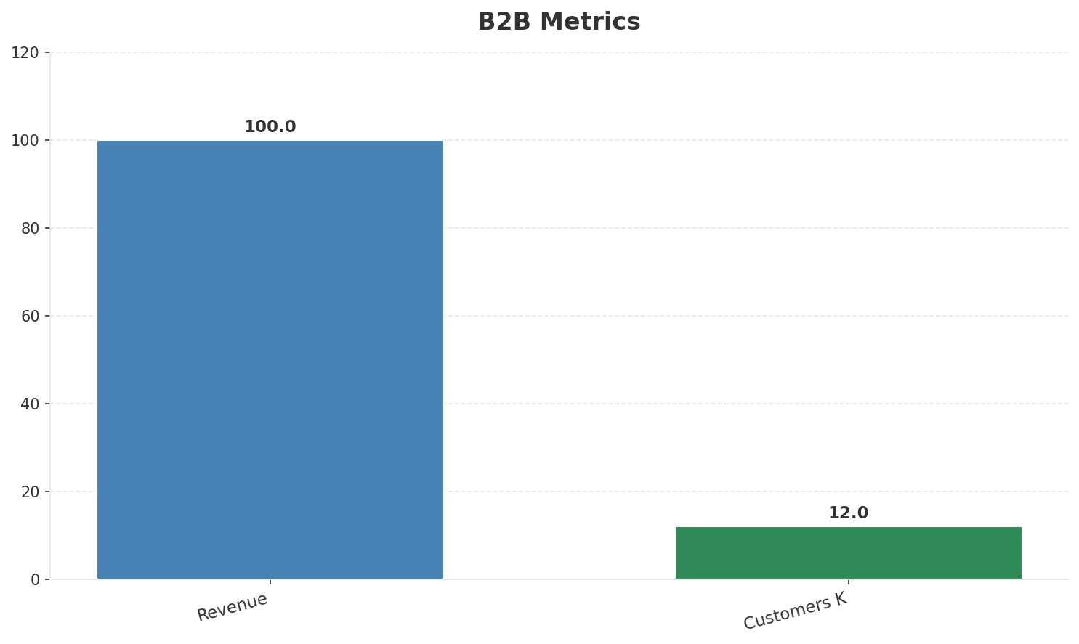
Segment Analysis: B2B
SEGMENT PERFORMANCE
Revenue
Growth Pct
Customers K
Share Of Revenue Pct
€100M
None
12
4.1%
Health: STABLE
• revenue: stable
• customers: stable
Key Message: B2B revenue 100.0M; 4.1% of total revenue
27

Slide 28
Segment Analysis: TV/Convergence
SEGMENT PERFORMANCE
Revenue
Total K
Net Adds K
Fmc Total K
None
€111M
None
None
Health: STABLE
• revenue: stable
• subscribers: improving
• fmc_subscribers: stable
• subscribers increased 2.8% QoQ
Key Message: TV subscribers 111K
28

Slide 29
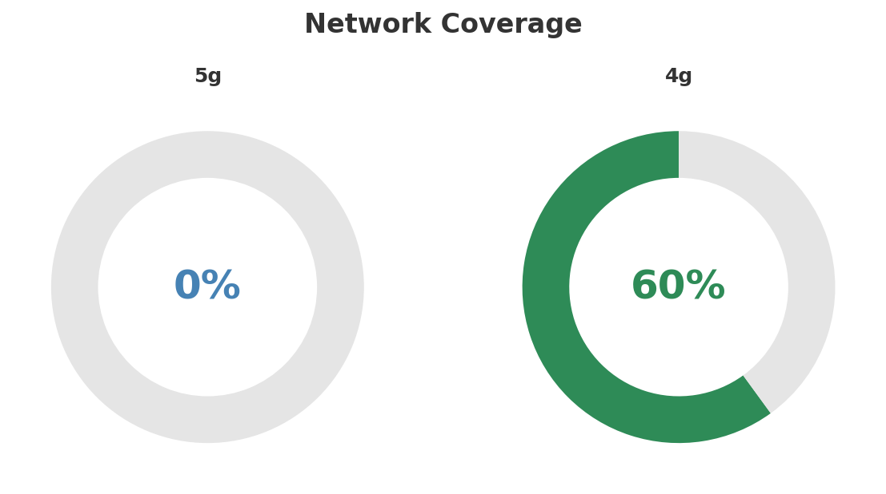
Network Analysis
INFRASTRUCTURE
Technology Mix:
Investment Direction: stable
• Mobile Vendor: Ericsson
• Spectrum Mhz: 90
• Core Vendor: Ericsson
Key Message: Network infrastructure and coverage assessment
29

Slide 30

Business Model Canvas
BMC
Key Message: Business model canvas overview
30

Slide 31
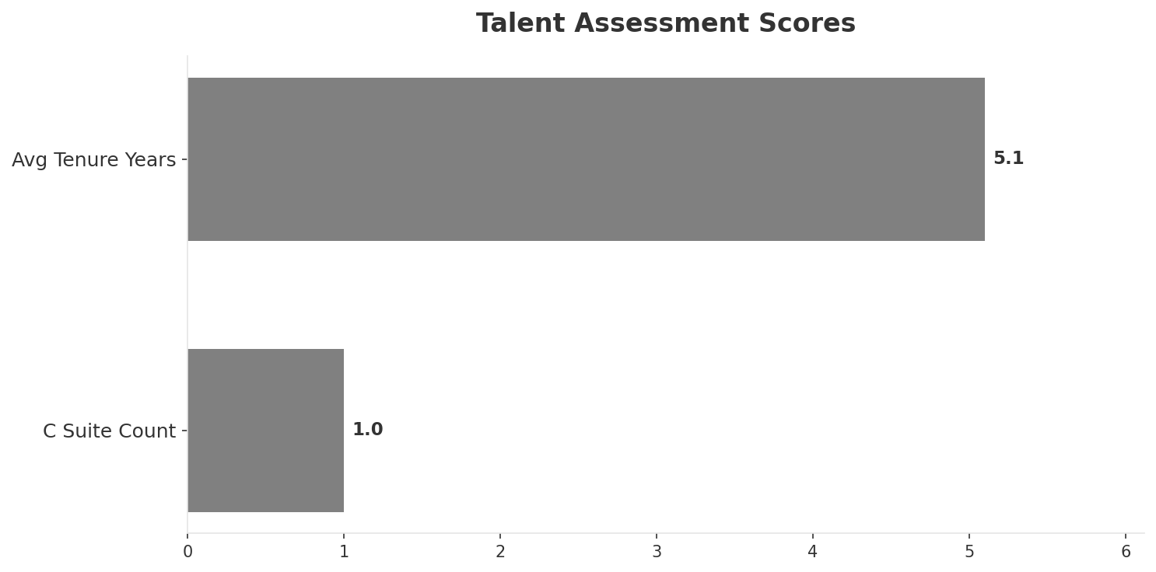
Organization & Talent
PEOPLE & CULTURE
Employees
C Suite Count
Avg Tenure Years
Key Leaders
1,560
1
5.1
['Ernesto Chamorro (CEO)']
Organization Culture:
Stable leadership team (avg tenure >3 years); Growth-oriented strategic posture; Resilient operations in challenging environment; Millicom standards; community engagement.
Leadership Changes:
• Ernesto Chamorro: (
Key Message: Organization and talent assessment
31

Slide 32
Strengths, Weaknesses & Exposure Points
SELF ASSESSMENT
Strengths
Weaknesses
Exposure Points
• Brand Strength: score 75 (market avg 70
• Customer Service: score 62 (market avg 58
• Digital Experience: score 55 (market avg 52
• Distribution: score 78 (market avg 73
• Innovation: score 55 (market avg 50
• Network Coverage: score 68 (market avg 63
• 5G coverage gap at only 0.0%
• Political instability and sanctions environment: Investment risk and potential operational restrictions
• Smallest market in Millicom portfolio limits strategic priority: Lower investment priority relative to Guatemala, Colombia
Key Message: Ranked #1 of 2 operators in market; revenue NIO 2,410M; EBITDA margin 45.0%; stable but facing challenges; key strength: Brand Strength; key challenge: 5G coverage gap at only 0.0%; Management outlook: Nicaragua remains stable with steady mobile growth despite political challenges
32

Slide 33
SWOT Synthesis
Strengths, Weaknesses, Opportunities & Threats

Slide 34
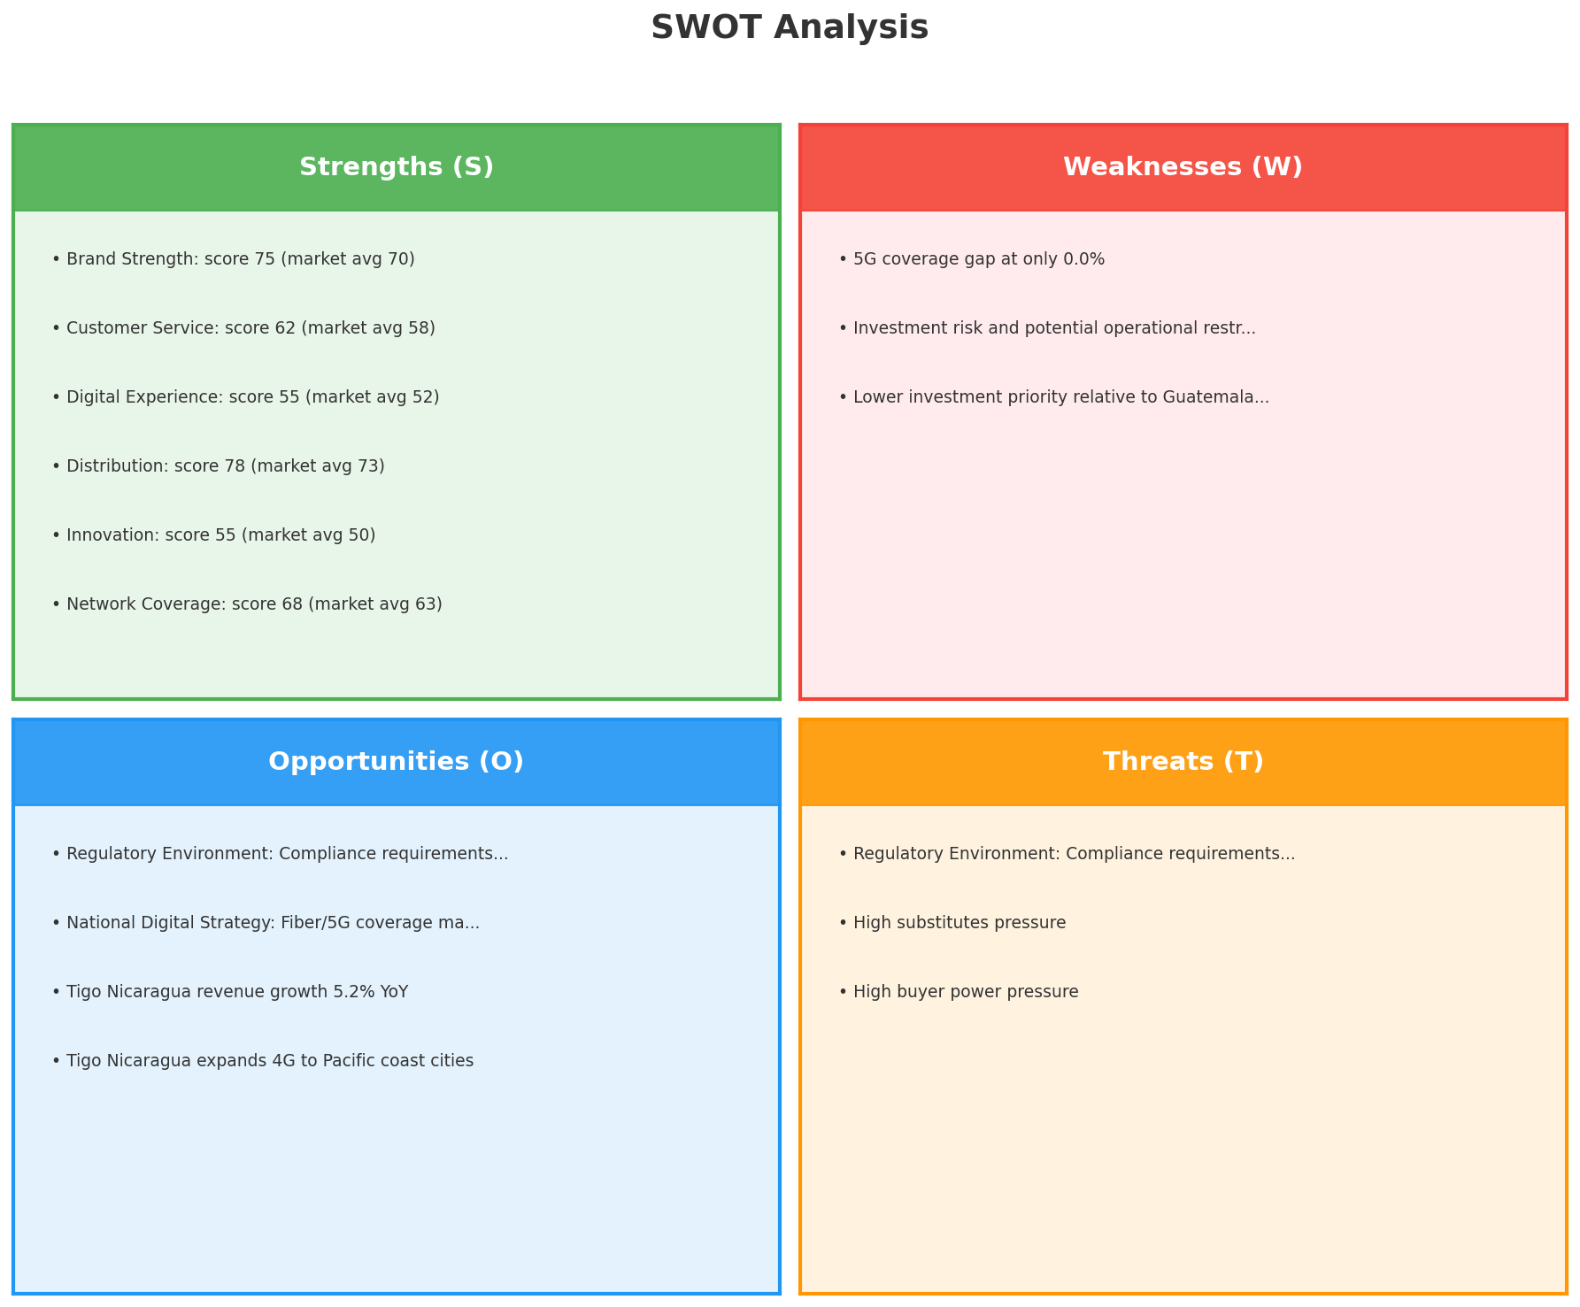
SWOT Analysis
STRATEGIC SYNTHESIS
SO:
Leverage 'Brand Strength: score 75 (market avg 70)' to ca...
WO:
Address weakness '5G coverage gap at only 0.0%' to unlock...
ST:
Use strength 'Brand Strength: score 75 (market avg 70)' t...
WT:
Mitigate weakness '5G coverage gap at only 0.0%' and defe...
Key Message: SWOT analysis identifies 11 strengths, 3 weaknesses, 4 opportunities, and 3 threats. The recommended strategic posture is offensive (SO-dominant).
34

Slide 35
05 Look at Opportunities
SPAN Matrix — Opportunity Selection

Slide 36
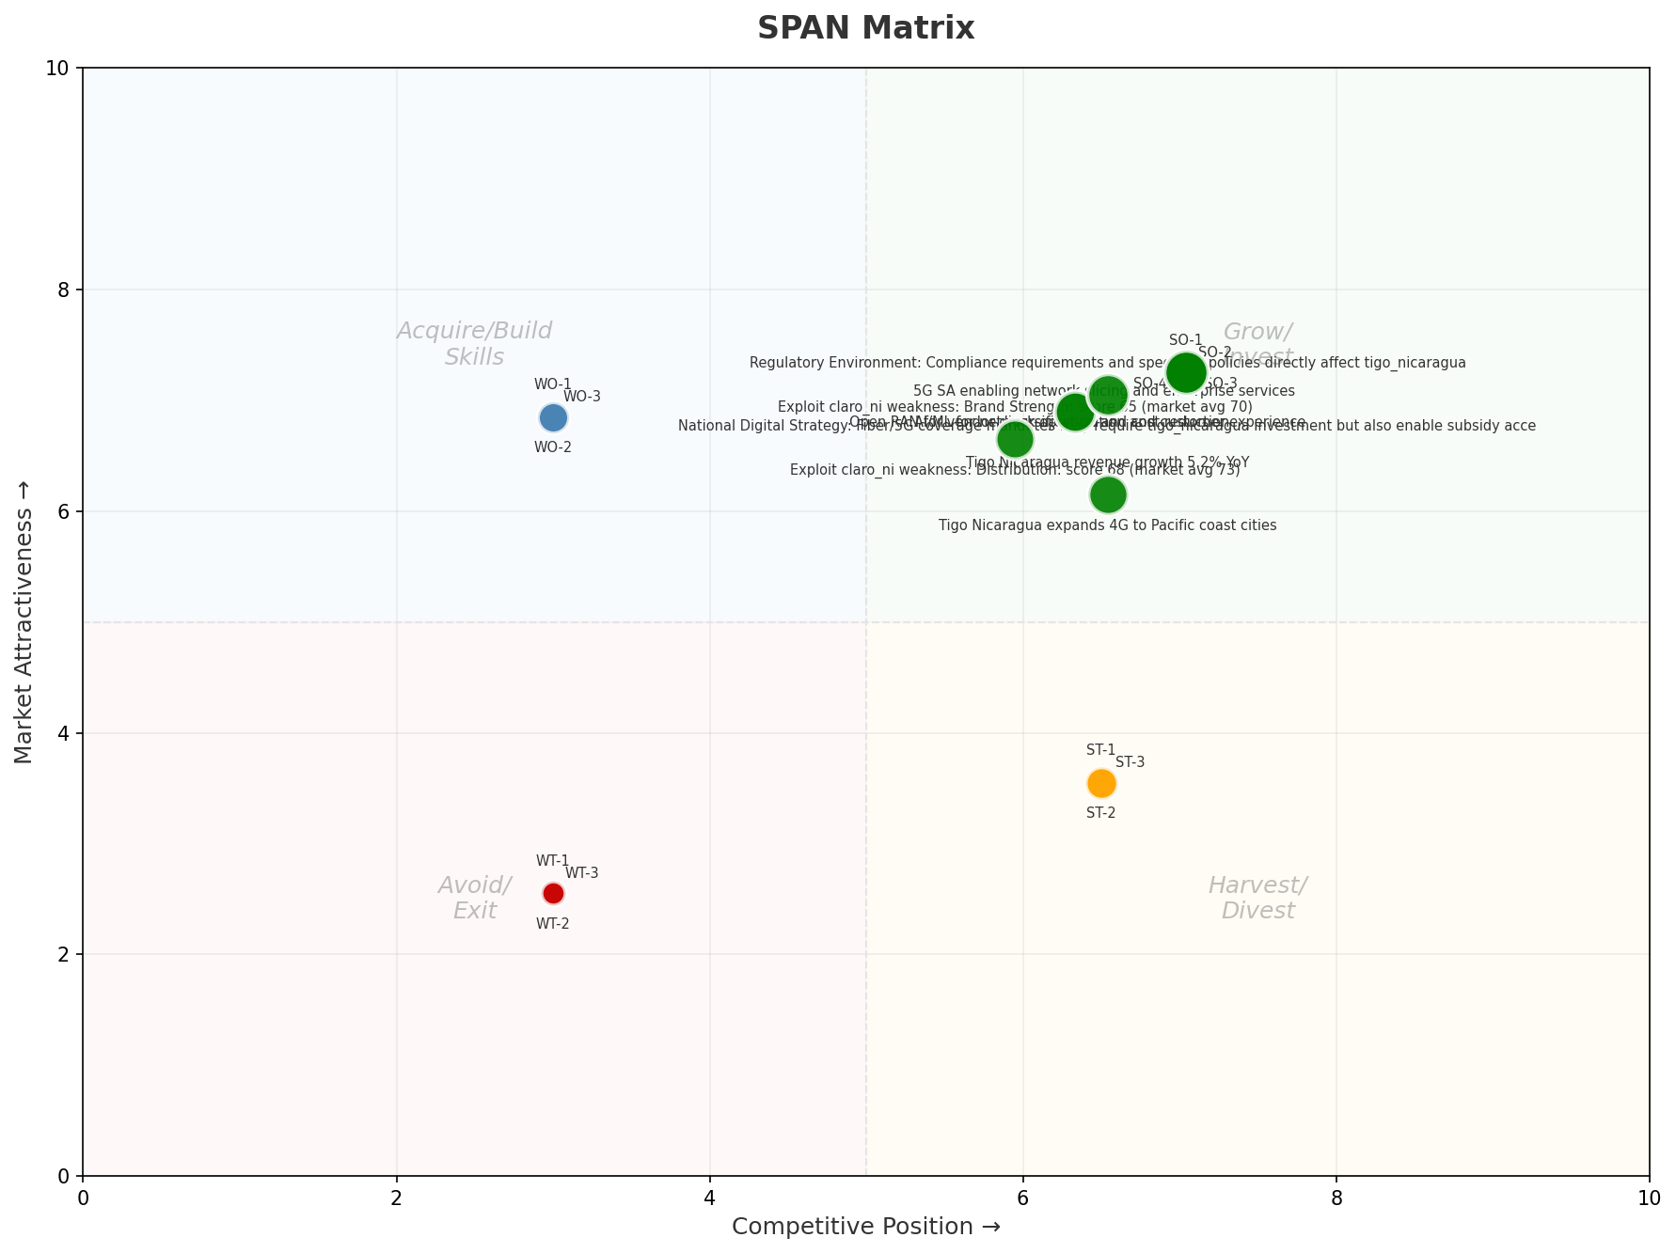
SPAN Matrix — Opportunity Positioning
OPPORTUNITY MAP
Key Message: SPAN matrix positions 22 opportunities: 13 grow/invest, 3 acquire skills, 3 harvest, 3 avoid/exit. Focus resources on the 13 grow/invest items for maximum strategic impact.
36

Slide 37
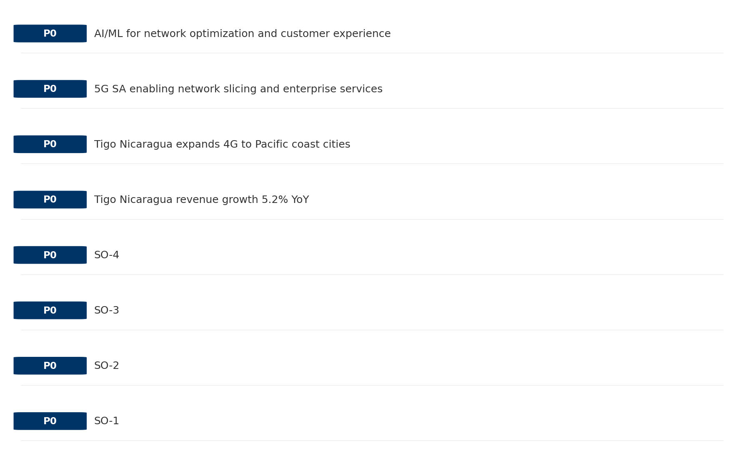
Opportunity Priority Ranking
PRIORITIES
Key Message: SPAN matrix positions 22 opportunities: 13 grow/invest, 3 acquire skills, 3 harvest, 3 avoid/exit. Focus resources on the 13 grow/invest items for maximum strategic impact.
37

Slide 38
Opportunity Details
DEEP DIVE
P0
SO-1
Market: N/A | Window:
Leverage 'Brand Strength: score 75 (market avg 70)' to capture the opportunity of 'Regulatory Environment: Compliance requirements and spectrum policies directly affect tigo_nicaragua'.
P0
SO-2
Market: N/A | Window:
Leverage 'Customer Service: score 62 (market avg 58)' to capture the opportunity of 'National Digital Strategy: Fiber/5G coverage mandates may require tigo_nicaragua investment but also enable subsidy access'.
P0
SO-3
Market: N/A | Window:
Leverage 'Digital Experience: score 55 (market avg 52)' to capture the opportunity of 'Tigo Nicaragua revenue growth 5.2% YoY'.
P0
SO-4
Market: N/A | Window:
Leverage 'Distribution: score 78 (market avg 73)' to capture the opportunity of 'Tigo Nicaragua expands 4G to Pacific coast cities'.
Key Message: SPAN matrix positions 22 opportunities: 13 grow/invest, 3 acquire skills, 3 harvest, 3 avoid/exit. Focus resources on the 13 grow/invest items for maximum strategic impact.
38

Slide 39
Three Decisions
Strategy — Key Tasks — Execution

Slide 40
Decision 1: Define Strategy
OFFENSIVE
As The Dominant Leader: defend leadership through innovation and ecosystem lock-in
P0
P0
P1
P1
Growth Strategy
Competitive Strategy
Transformation Strategy
Customer Strategy
Defend leadership through ecosystem expansion in Mobile, Fixed Broadband, TV/Convergence
Capitalize on competitive strengths to gain market share
Accelerate fiber transition — converged network as competitive moat
Optimize value extraction in stable segments: B2B, Wholesale
- Maintain #1 revenue share
- Grow Mobile, Fixed Broadband, TV/Convergence by 5-8% YoY
- Outgrow competitors in key segments
- Increase service differentiation
- Fiber homepass coverage +20%
- FMC bundle attach rate 50%+
- Upsell rate +10% in B2B, Wholesale
- Cross-sell convergence bundles
Key Message: As The Dominant Leader, the strategic posture is Offensive. As The Dominant Leader: defend leadership through innovation
40

Slide 41
Decision 2: Define Key Tasks
3 P0 (IMMEDIATE), 2 P1 (1-2 YEARS), 1 P2 (3-5 YEARS
P0
Network
Accelerate Fixed Network Upgrade
Homepass coverage +15% | Speed tier upgrades
Drive DOCSIS/Fiber rollout to increase homepass and improve quality scores
P0
Business
Accelerate Mobile Growth
Mobile revenue +10% YoY | Market share gain
Mobile at €1,840M showing strong momentum — invest to scale
P0
Business
Accelerate Fixed Broadband Growth
Fixed Broadband revenue +10% YoY | Market share gain
Fixed Broadband at €350M showing strong momentum — invest to scale
P1
Business
Opportunity Portfolio Execution
Launch 3+ priority initiatives | Pipeline contribution tracking
13 grow/invest opportunities identified — establish execution office
P1
Customer
Customer Experience Enhancement
NPS +5 points | First-call resolution rate 80%+
Improve digital touchpoints and service resolution to boost NPS
P2
Efficiency
Operational Efficiency & Automation
Process automation 30%+ | Cost-to-serve reduction
EBITDA margin 45.0% — maintain through smart automation and resource reallocatio
Key Message: 6 critical tasks: 3 P0 (immediate), 2 P1 (1-2 years), 1 P2 (3-5 years
41

Slide 42

Decision 3: Define Execution
QUARTERLY ROADMAP & GOVERNANCE
Governance
Strategic Traps to Avoid
- Monthly Progress Review (Monthly
x Delay core transformation
- Quarterly Strategic Checkpoint (Quarterly
- Mid-Year Strategic Adjustment (Semi-annual
Key Risks & Mitigation
! Resource constraints delay P0 initiatives -- Ring-fence P0 budgets; establish escalation path for blockers
Key Message: Execute with discipline: monthly reviews, quarterly checkpoints, annual refresh
! Macro-economic slowdown reduces consumer spending -- Prepare value-tier offerings; shift mix toward B2B resilience
42

Slide 43
Analysis Summary
KEY TAKEAWAYS
01 Trends
Macro environment: Favorable. Key opportunities: Regulatory Environment, National Digital Strategy. Key risks: Regulatory Environment, Inflation Industry is mature. (+2.0% YoY (CQ2_2025 -> CQ4_2025)
02 Market
Nicaragua telecom market totals NIO 4,130M in quarterly revenue; gaps in Assurances; Market outlook is favorable with more opportunities than threats.
03 Competition
In a 2-player market with medium competition intensity, Tigo Nicaragua leads with 58% revenue share. Target operator holds 58% share. Strongest competitive force: Substitutes.
04 Self
Ranked #1 of 2 operators in market; revenue NIO 2,410M; EBITDA margin 45.0%; stable but facing challenges; key strength: Brand Strength; key challenge: 5G coverage gap at only 0.0%; Management outlook: Nicaragua remains stable with steady mobile growth despite political challenges
SWOT
SWOT analysis identifies 11 strengths, 3 weaknesses, 4 opportunities, and 3 threats. The recommended strategic posture is offensive (SO-dominant).
05 Opportunities
SPAN matrix positions 22 opportunities: 13 grow/invest, 3 acquire skills, 3 harvest, 3 avoid/exit. Focus resources on the 13 grow/invest items for maximum strategic impact.
Key Message: Complete Five Looks analysis — see opportunity priorities for next steps
43

Slide 44
Data Provenance
SOURCES & METHODOLOGY
No provenance data recorded for this analysis
Key Message: All data points are traceable to original sources
44

Slide 45
Thank You
BLM Five Looks Strategic Analysis

