Slide 1
Default BLM Strategic Analysis
BLM (Business Leadership Model) Five Looks Analysis
Target Operator
Market
Analysis Period
Report Date
Tigo Uruguay
Uruguay
CQ4_2025
2026-02-14
01 Trends (PEST) | 02 Market/Customer ($APPEALS) | 03 Competition (Porter) | 04 Self (BMC) | SWOT Synthesis | 05 Opportunities (SPAN

Slide 2
Report Contents
TABLE OF CONTENTS
01
Executive Summary
Key findings and recommendations
02
Look at Trends
PEST Framework — macro environment
03
Look at Market
$APPEALS — market changes & customer needs
T
Tariff Analysis
Pricing comparison — mobile, fixed & convergence
04
Look at Competition
Porter's Five Forces — competitive landscape
05
Look at Self
BMC + Capability — internal assessment
06
SWOT Synthesis
Strengths, Weaknesses, Opportunities, Threats
07
Look at Opportunities
SPAN Matrix — opportunity selection
Summary & Provenance
2
08
Conclusions and data sources

Slide 3
Data Quality Overview
DATA QUALITY
Total Data Points
High Confidence
Medium Confidence
Low/Estimated
20
0
0
20
0%
Unique Sources: 0
Data Conflicts: 0
Coverage: Partial
Key Message: 20 data points tracked, 0 high-confidence (0%
3

Slide 4
Executive Summary
Trends
Macro environment: Favorable. Key opportunities: Regulatory Environment, National Digital Strategy. Key risks: Regulatory Environment, Inflation Industry is in late growth phase. (+2.0% YoY (CQ2_2025 -> CQ4_2025)
Market/Customer
Uruguay telecom market totals UYU 14.1B in quarterly revenue; gaps in Performance, Ease of Use; Market outlook is favorable with more opportunities than threats.
Competition
In a 3-player market with medium competition intensity, Antel Uruguay leads with 64% revenue share. Target operator holds 14% share. Strongest competitive force: Substitutes.
Self Assessment
Ranked #3 of 3 operators in market; revenue UYU 2,010M; EBITDA margin 30.0%; stable but facing challenges; key strength: Price Competitiveness; key challenge: Brand Strength; Management outlook: Uruguay entry progressing; mobile subscriber acquisition ahead of plan despite Antel dominance
SWOT
SWOT analysis identifies 3 strengths, 11 weaknesses, 4 opportunities, and 4 threats. The recommended strategic posture is cautious (WT-dominant).
Opportunities
SPAN matrix positions 23 opportunities: 0 grow/invest, 13 acquire skills, 5 harvest, 5 avoid/exit. Focus resources on the 0 grow/invest items for maximum strategic impact.
Key Message: Five Looks analysis completed — see details in following sections
4

Slide 5
01 Look at Trends
PEST Framework — Macro Environment

Slide 6

PEST Analysis Dashboard
MACRO ENVIRONMENT
Key Message: Macro environment: Favorable. Key opportunities: Regulatory Environment, National Digital Strategy. Key risks: Regulatory Environment, Inflation.
6

Slide 7
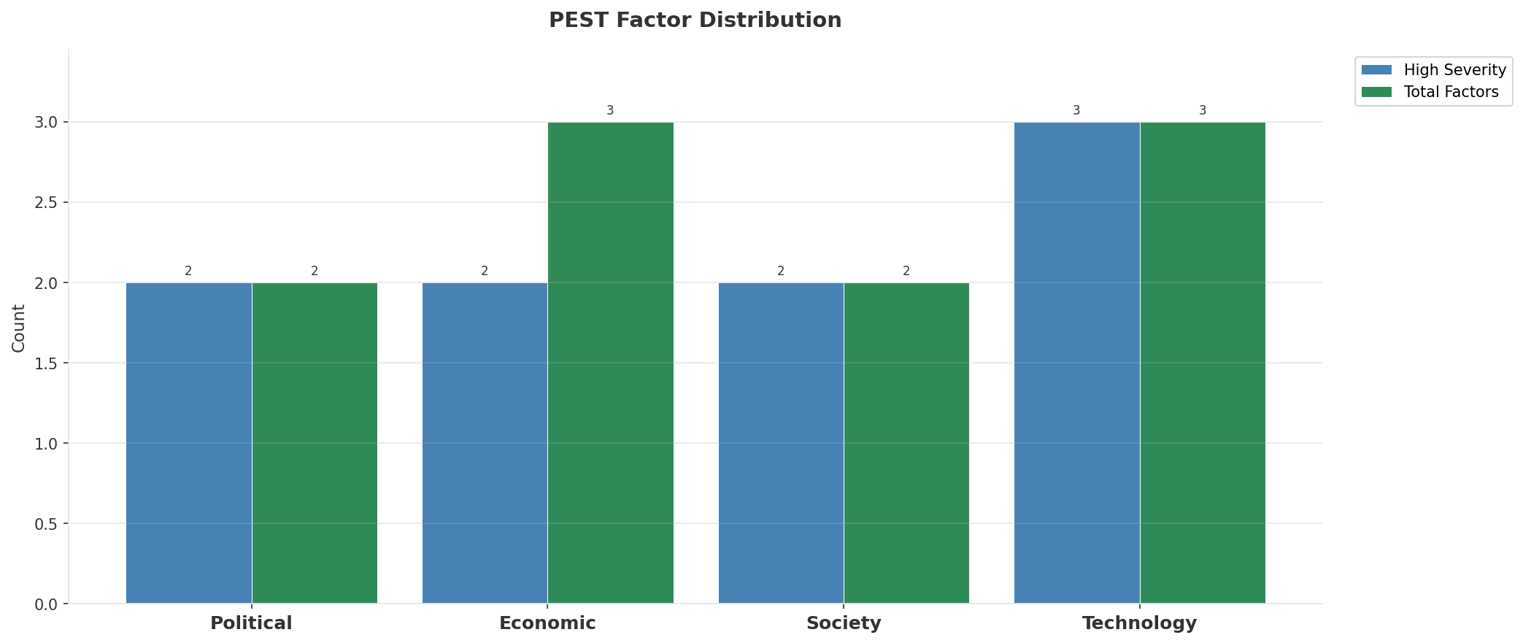
Industry Environment
INDUSTRY ANALYSIS
Market Size
Growth Rate
Concentration
Lifecycle
UYU 14.1B (quarterly, CQ4_2025
+2.0% YoY (CQ2_2025 -> CQ4_2025
CR4 = 100% (Antel Uruguay: 64.4%, Claro Uruguay: 21.3%, Tigo Uruguay: 14.3%
late_growth
• New Business Models:
• FWA (Fixed Wireless Access) as fiber alternative
• Network-as-a-Service for enterprise verticals
• Wholesale/MVNO partnerships for coverage monetization
• Technology Revolution:
• 5G SA enabling network slicing and enterprise services
• AI/ML for network optimization and customer experience
• Open RAN for vendor diversification and cost reduction
Key Message: Macro environment: Favorable. Key opportunities: Regulatory Environment, National Digital Strategy. Key risks: Regulatory Environment, Inflation Industry is in late growth phase. (+2.0% YoY (CQ2_2025 -> CQ4_2025)
7

Slide 8
Value Transfer Trends
VALUE MIGRATION
• Value shifting from voice/SMS to data and digital services
• B2B/ICT growing faster than consumer segment
• Fiber displacing copper and cable broadband
Key Message: Macro environment: Favorable. Key opportunities: Regulatory Environment, National Digital Strategy. Key risks: Regulatory Environment, Inflation Industry is in late growth phase. (+2.0% YoY (CQ2_2025 -> CQ4_2025)
8

Slide 9
02 Look at Market
$APPEALS — Market Changes & Customer Needs

Slide 10
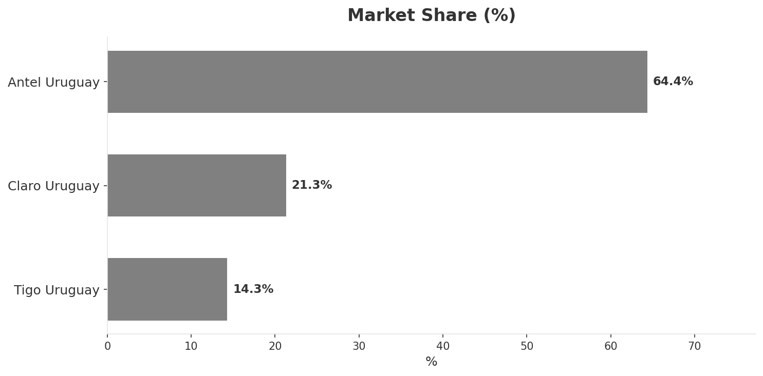
Market Change Panorama
MARKET OVERVIEW
Total Revenue (€M
Mobile Subs (K
Broadband Subs (K
Operators
14,066
5,380
935.0
3
Market Changes:
• Tigo Uruguay revenue growth 6.3% YoY
• Antel deploys 5G in Montevideo and coastal cities
• Millicom enters Uruguay market via acquisition
Key Message: Uruguay telecom market totals UYU 14.1B in quarterly revenue; gaps in Performance, Ease of Use; Market outlook is favorable with more opportunities than threats.
10

Slide 11
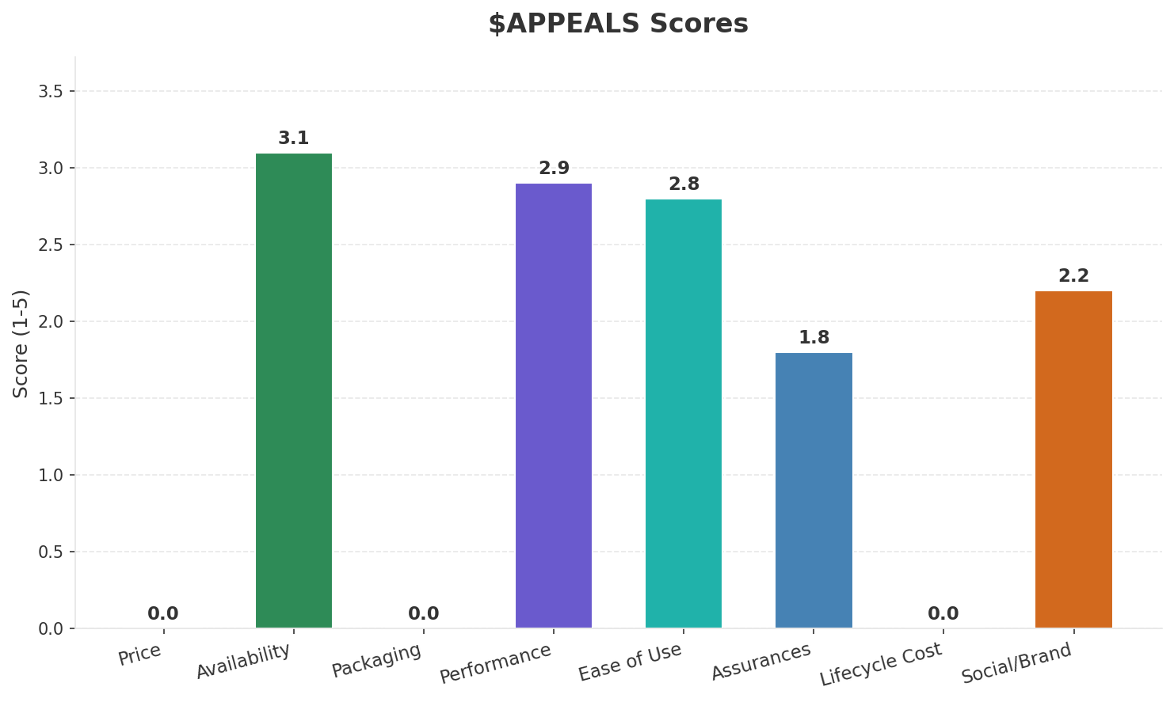
Customer Segments
SEGMENTATION
Consumer Postpaid
Trend: stable
Needs: Higher mobile data speeds and allowances, Better convergent fixed-mobile bundles
Consumer Prepaid
Trend: stable
Needs: More affordable data packages, Flexible top-up options
Enterprise & SME
Trend: stable
Needs: Cloud-integrated connectivity, Managed IT services for SMEs
Key Message: Uruguay telecom market totals UYU 14.1B in quarterly revenue; gaps in Performance, Ease of Use; Market outlook is favorable with more opportunities than threats.
11

Slide 12
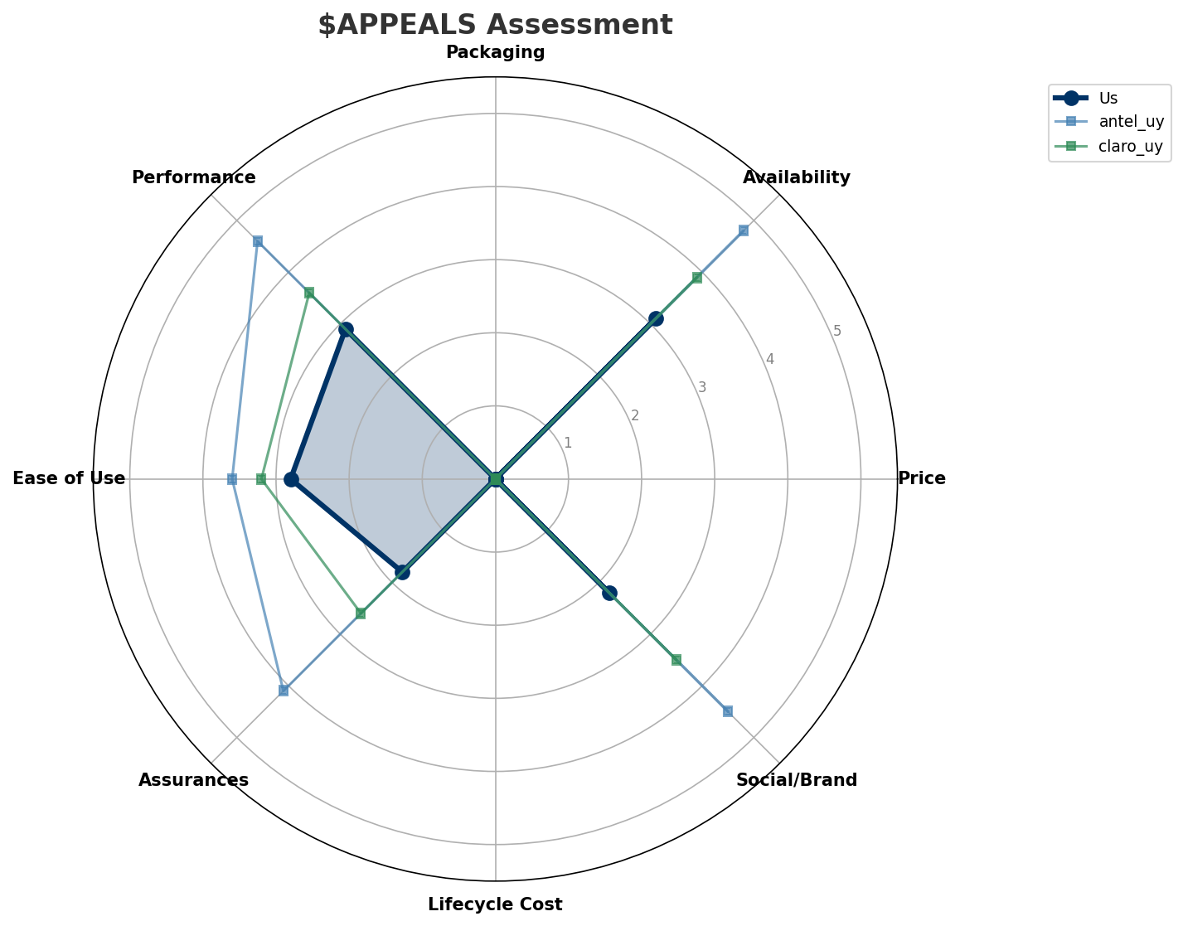
$APPEALS Assessment
CUSTOMER NEEDS
Key Message: Uruguay telecom market totals UYU 14.1B in quarterly revenue; gaps in Performance, Ease of Use; Market outlook is favorable with more opportunities than threats.
12

Slide 13
Customer Value Migration
VALUE MIGRATION
Value migration trending upward: customers willing to pay more for premium connectivity and convergent bundles. Focus on upselling and cross-selling opportunities.
Opportunities:
Threats:
• Tigo Uruguay revenue growth 6.3% YoY
• Millicom enters Uruguay market via acquisition
• Antel deploys 5G in Montevideo and coastal cities
Key Message: Uruguay telecom market totals UYU 14.1B in quarterly revenue; gaps in Performance, Ease of Use; Market outlook is favorable with more opportunities than threats.
13

Slide 14
Tariff Analysis
Mobile, Fixed & Convergence Pricing Landscape

Slide 15
Fixed & Convergence Pricing Landscape
DSL / CABLE / FIBER / FMC BUNDLES
Key Message: Fixed and convergence pricing overview
15

Slide 16
03 Look at Competition
Porter's Five Forces — Competitive Landscape

Slide 17
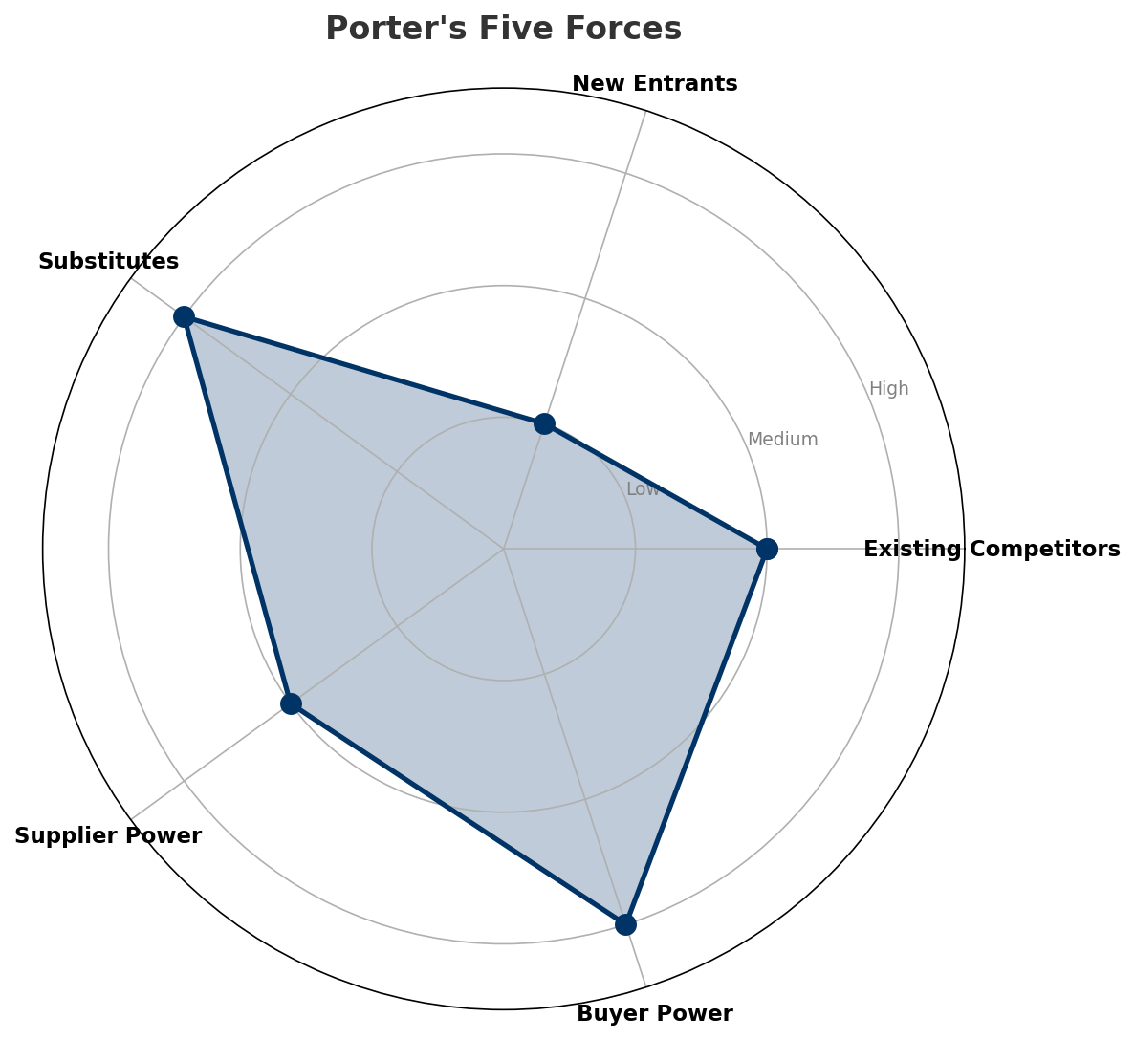
Porter's Five Forces
COMPETITIVE FORCES
Overall Intensity: MEDIUM
Key Message: In a 3-player market with medium competition intensity, Antel Uruguay leads with 64% revenue share. Target operator holds 14% share. Strongest competitive force: Substitutes.
17

Slide 18
Competitor Analysis: Claro Uy
COMPETITOR DEEP DIVE
Revenue
EBITDA
Margin
Capex/Rev
€2,996M
€899M
30.0%
15.4%
+4.0% YoY
Strengths
Weaknesses
• Innovation: score 55 (market avg 61
Strategy: Steady growth trajectory; subscriber acquisition focus
Key Message: Competitor analysis: Claro Uy
18

Slide 19
Competitor Analysis: Antel Uy
COMPETITOR DEEP DIVE
Revenue
EBITDA
Margin
Capex/Rev
€9,060M
€3,624M
40.0%
17.2%
+3.8% YoY
Strengths
Weaknesses
• Brand Strength: score 90 (market avg 68
• Customer Service: score 72 (market avg 64
• Digital Experience: score 75 (market avg 64
• Distribution: score 90 (market avg 72
• Price Competitiveness: score 60 (market avg 67
Strategy: Steady growth trajectory; subscriber acquisition focus; strong B2B/enterprise push
Key Message: Competitor analysis: Antel Uy
19

Slide 20
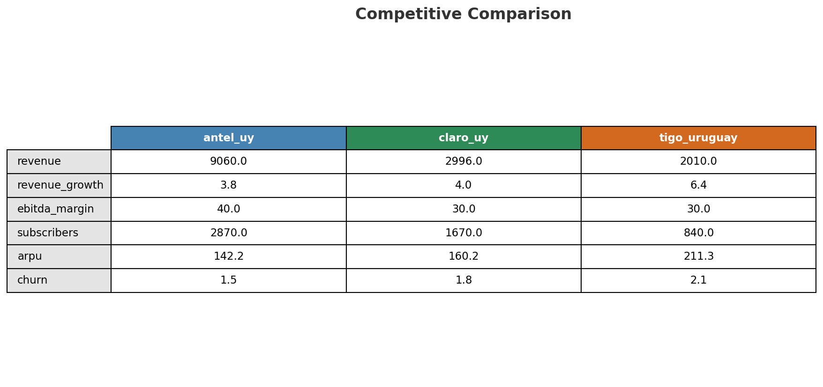
Competitive Landscape Summary
COMPETITION
Key Message: In a 3-player market with medium competition intensity, Antel Uruguay leads with 64% revenue share. Target operator holds 14% share. Strongest competitive force: Substitutes.
20

Slide 21
New Entrants Threat
MARKET ENTRY
• Entry barriers: High barriers: spectrum licensing, massive capex for network build, regulatory approvals, established brand loyalty
Key Message: New entrants threat level: low
21

Slide 22
04 Look at Self
BMC + Capability Assessment

Slide 23
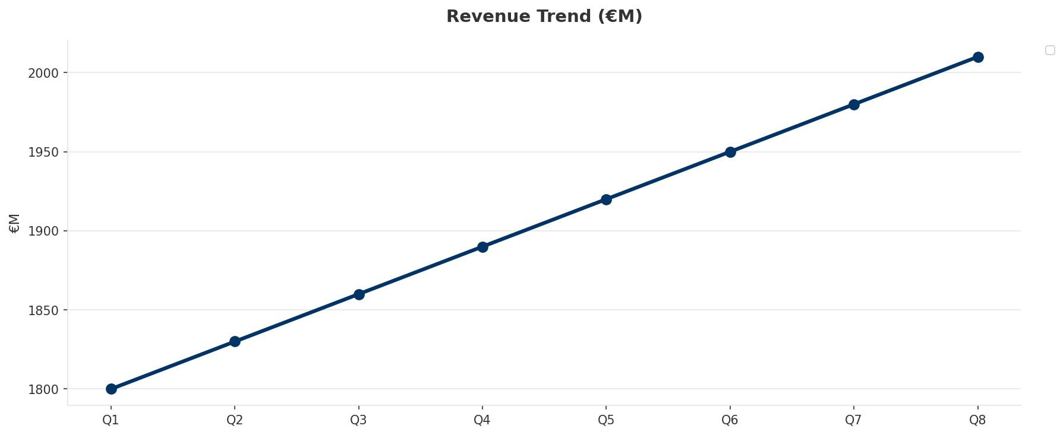
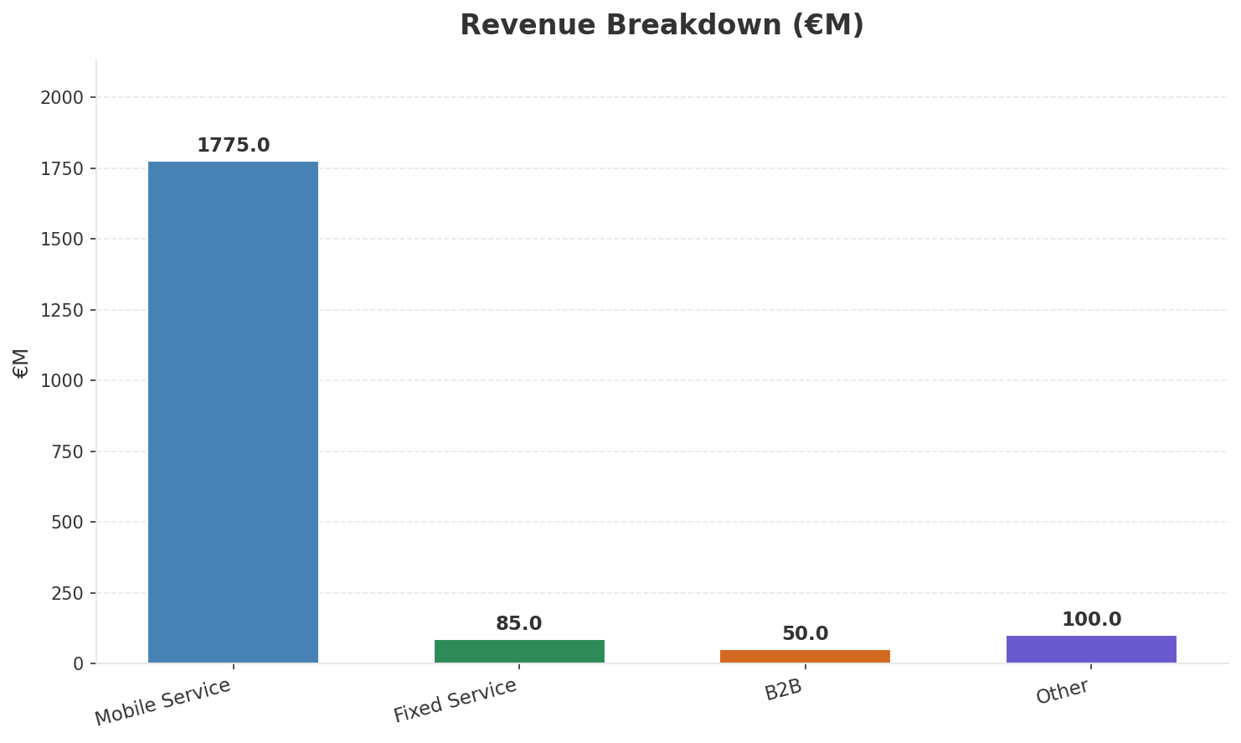
Operating Health Check
FINANCIAL HEALTH
Revenue
EBITDA
EBITDA Margin
Capex/Rev
€2,010M
€603M
30.0%
19.2%
+6.35% YoY
+6.1% YoY
Key Message: Ranked #3 of 3 operators in market; revenue UYU 2,010M; EBITDA margin 30.0%; stable but facing challenges; key strength: Price Competitiveness; key challenge: Brand Strength; Management outlook: Uruguay entry progressing; mobile subscriber acquisition ahead of plan despite Antel dominance
23

Slide 24
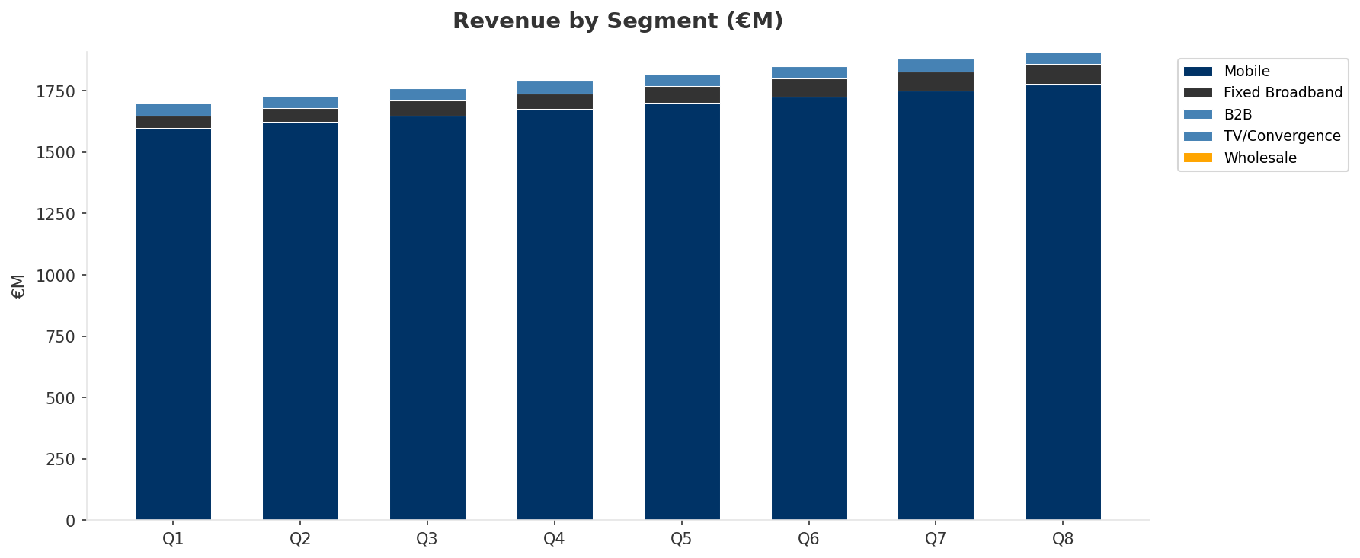
Revenue Composition Trend
SEGMENT REVENUE MIX OVER TIME
Key Message: Growing: Mobile, Fixed Broadband
24

Slide 25
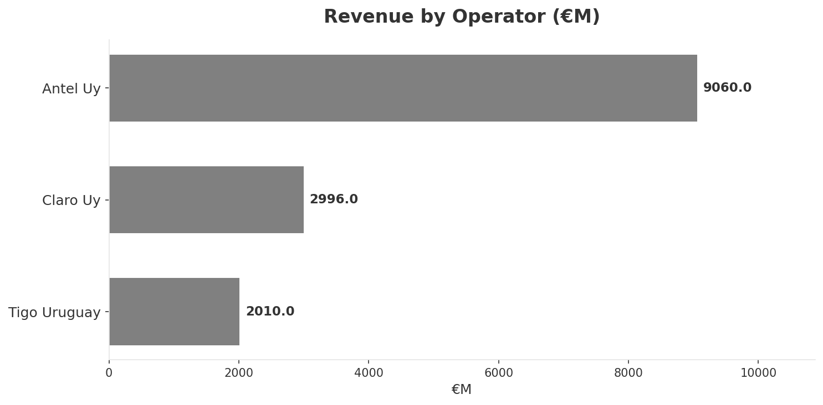
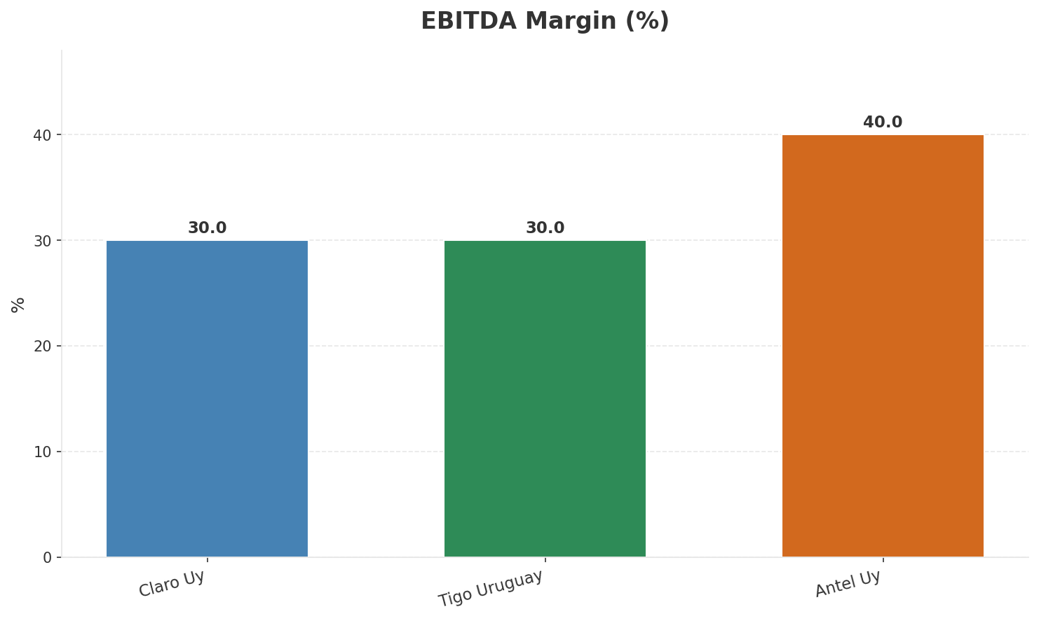
Revenue Comparison
COMPETITIVE BENCHMARKING
Key Message: Revenue and margin benchmarking across operators
25

Slide 26
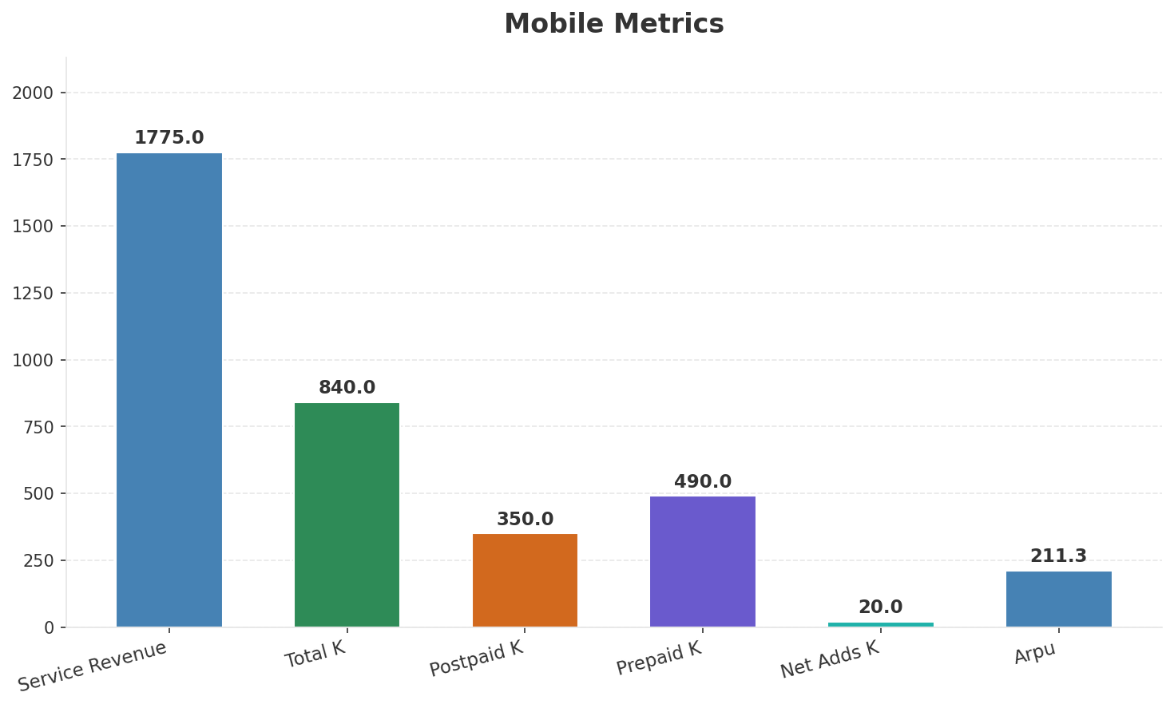
Segment Analysis: Mobile
SEGMENT PERFORMANCE
Service Revenue
Service Growth Pct
Total K
Postpaid K
€1,775M
6.0%
€840M
€350M
Health: STABLE
• revenue: improving
• subscribers: improving
• arpu: stable
• Uruguay entry progressing; mobile subscriber acquisition ahead of plan despite Antel dominance
• subscribers increased 2.4% QoQ
Key Message: Mobile service revenue at 1,775M; up 6.0% YoY; ARPU 211.3
26

Slide 27
Segment Analysis: Fixed Broadband
SEGMENT PERFORMANCE
Service Revenue
Service Growth Pct
Total K
Net Adds K
€85M
30.8%
None
None
Health: STRONG
• revenue: improving
• subscribers: stable
• arpu: stable
• revenue increased 6.2% QoQ
Key Message: Fixed service revenue 85.0M; growth +30.8% YoY
27

Slide 28
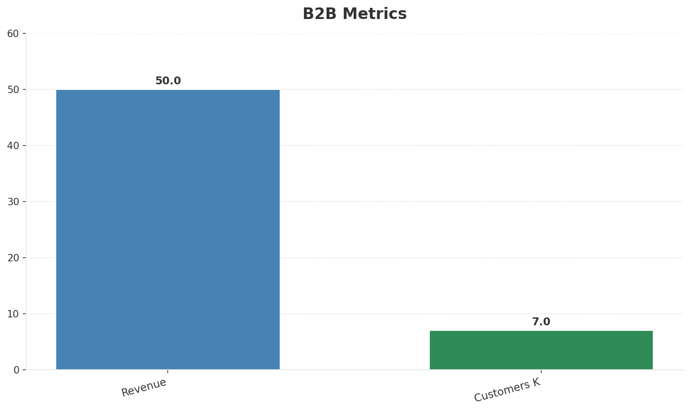
Segment Analysis: B2B
SEGMENT PERFORMANCE
Revenue
Growth Pct
Customers K
Share Of Revenue Pct
€50M
None
7
2.5%
Health: STABLE
• revenue: stable
• customers: stable
Key Message: B2B revenue 50.0M; 2.5% of total revenue
28

Slide 29
Segment Analysis: TV/Convergence
SEGMENT PERFORMANCE
Revenue
Total K
Net Adds K
Fmc Total K
None
None
None
None
Health: STABLE
• revenue: stable
• subscribers: stable
• fmc_subscribers: stable
Key Message: Insufficient data for TV/convergence assessment
29

Slide 30
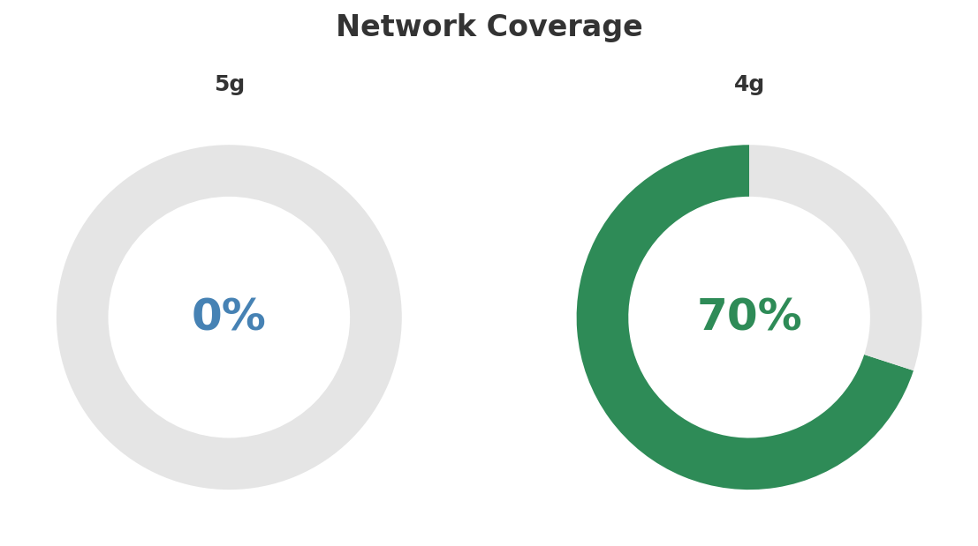
Network Analysis
INFRASTRUCTURE
Technology Mix:
Investment Direction: stable
• Mobile Vendor: Nokia
• Spectrum Mhz: 80
• Core Vendor: Nokia
Key Message: Network infrastructure and coverage assessment
30

Slide 31

Business Model Canvas
BMC
Key Message: Business model canvas overview
31

Slide 32
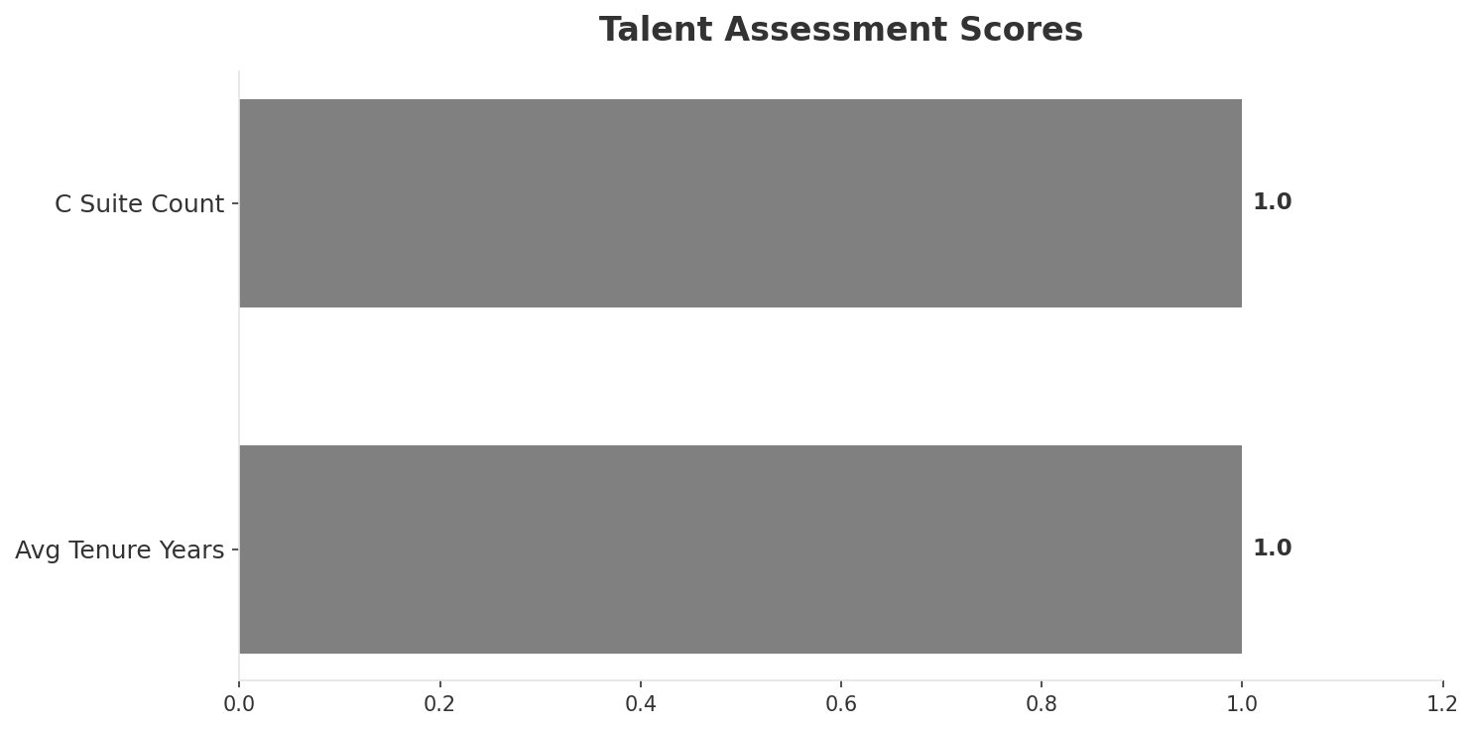
Organization & Talent
PEOPLE & CULTURE
Employees
C Suite Count
Avg Tenure Years
Key Leaders
880
1
1.0
['Martin Gonzalez (CEO)']
Organization Culture:
Leadership in transition (avg tenure <1.5 years); Startup/challenger mentality within Millicom framework; aggressive commercial posture; lean operations.
Leadership Changes:
• Martin Gonzalez: (
Key Message: Organization and talent assessment
32

Slide 33
Strengths, Weaknesses & Exposure Points
SELF ASSESSMENT
Strengths
Weaknesses
Exposure Points
• Price Competitiveness: score 72 (market avg 67
• Strong EBITDA margin at 30.0%
• Revenue on growth trajectory
• Brand Strength: score 45 (market avg 68
• Customer Service: score 55 (market avg 64
• Digital Experience: score 55 (market avg 64
• Distribution: score 55 (market avg 72
• Enterprise Solutions: score 35 (market avg 56
• Innovation: score 50 (market avg 61
• New market entry competing against Antel state monopoly: Limited fixed-line access constrains convergent offerings
• Small market size limits revenue potential: Difficulty achieving scale economies in 3.5M population market
Key Message: Ranked #3 of 3 operators in market; revenue UYU 2,010M; EBITDA margin 30.0%; stable but facing challenges; key strength: Price Competitiveness; key challenge: Brand Strength; Management outlook: Uruguay entry progressing; mobile subscriber acquisition ahead of plan despite Antel dominance
33

Slide 34
SWOT Synthesis
Strengths, Weaknesses, Opportunities & Threats

Slide 35
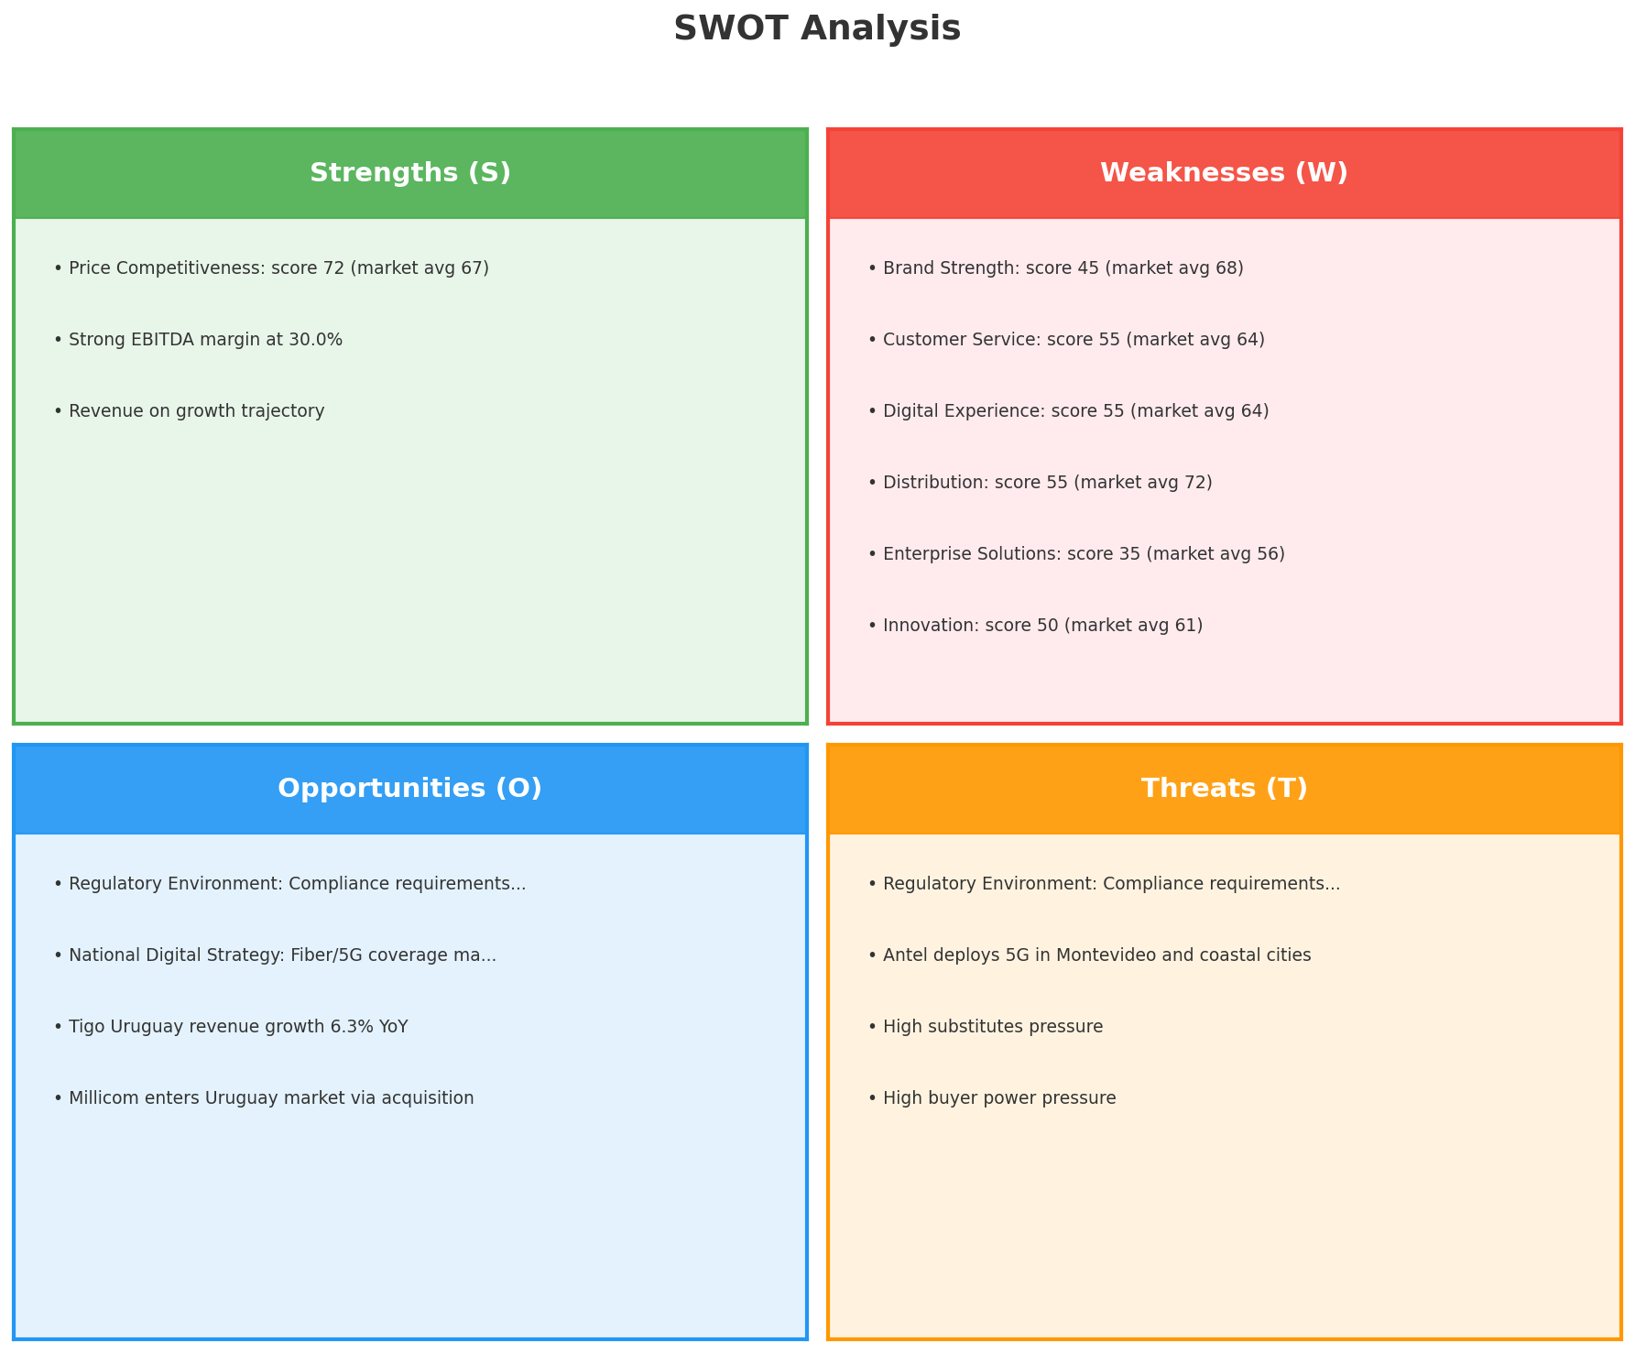
SWOT Analysis
STRATEGIC SYNTHESIS
SO:
Leverage 'Price Competitiveness: score 72 (market avg 67)...
WO:
Address weakness 'Brand Strength: score 45 (market avg 68...
ST:
Use strength 'Price Competitiveness: score 72 (market avg...
WT:
Mitigate weakness 'Brand Strength: score 45 (market avg 6...
Key Message: SWOT analysis identifies 3 strengths, 11 weaknesses, 4 opportunities, and 4 threats. The recommended strategic posture is cautious (WT-dominant).
35

Slide 36
05 Look at Opportunities
SPAN Matrix — Opportunity Selection

Slide 37
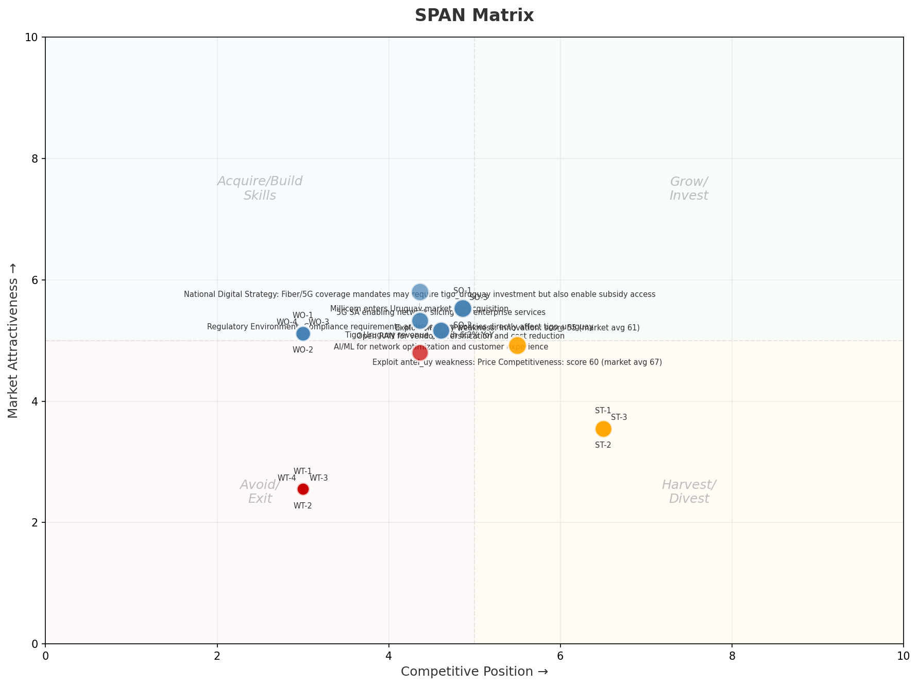
SPAN Matrix — Opportunity Positioning
OPPORTUNITY MAP
Key Message: SPAN matrix positions 23 opportunities: 0 grow/invest, 13 acquire skills, 5 harvest, 5 avoid/exit. Focus resources on the 0 grow/invest items for maximum strategic impact.
37

Slide 38
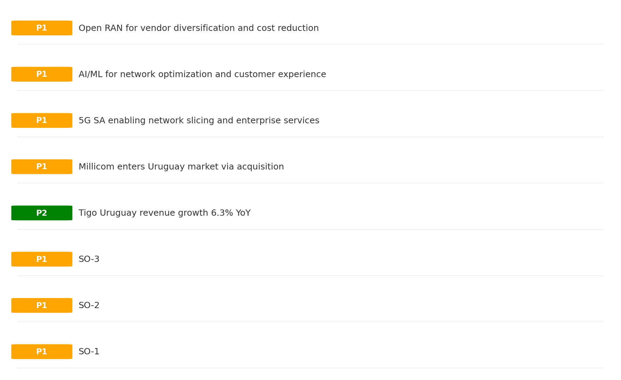
Opportunity Priority Ranking
PRIORITIES
Key Message: SPAN matrix positions 23 opportunities: 0 grow/invest, 13 acquire skills, 5 harvest, 5 avoid/exit. Focus resources on the 0 grow/invest items for maximum strategic impact.
38

Slide 39
Opportunity Details
DEEP DIVE
P1
SO-1
Market: N/A | Window:
Leverage 'Price Competitiveness: score 72 (market avg 67)' to capture the opportunity of 'Regulatory Environment: Compliance requirements and spectrum policies directly affect tigo_uruguay'.
P1
SO-2
Market: N/A | Window:
Leverage 'Strong EBITDA margin at 30.0%' to capture the opportunity of 'National Digital Strategy: Fiber/5G coverage mandates may require tigo_uruguay investment but also enable subsidy access'.
P1
SO-3
Market: N/A | Window:
Leverage 'Revenue on growth trajectory' to capture the opportunity of 'Tigo Uruguay revenue growth 6.3% YoY'.
P2
Tigo Uruguay revenue growth 6.3% YoY
Market: N/A | Window:
Tigo Uruguay revenue growth 6.3% YoY
Key Message: SPAN matrix positions 23 opportunities: 0 grow/invest, 13 acquire skills, 5 harvest, 5 avoid/exit. Focus resources on the 0 grow/invest items for maximum strategic impact.
39

Slide 40
Three Decisions
Strategy — Key Tasks — Execution

Slide 41
Decision 1: Define Strategy
TURNAROUND
As The Distant Third: stabilize core business, then selectively invest for turnaround
P0
P0
P1
P1
Growth Strategy
Competitive Strategy
Transformation Strategy
Customer Strategy
Focused growth in high-momentum segments: Mobile, Fixed Broadband
Shore up competitive position — address: Brand Strength: score 45 (market avg 68
5G-first network modernization — quality leadership
Optimize value extraction in stable segments: B2B, TV/Convergence
- Grow Mobile, Fixed Broadband above market rate
- Improve segment profitability
- Close Brand Strength: score 45 (market avg 68) gap within 12 months
- Reduce customer churn
- 5G population coverage 80%+
- 5G revenue contribution 15%+
- Upsell rate +10% in B2B, TV/Convergence
- Cross-sell convergence bundles
Key Message: As The Distant Third, the strategic posture is Turnaround. As The Distant Third: stabilize core business, then selective
41

Slide 42
Decision 2: Define Key Tasks
2 P0 (IMMEDIATE), 2 P1 (1-2 YEARS), 1 P2 (3-5 YEARS
P0
Business
Accelerate Mobile Growth
Mobile revenue +10% YoY | Market share gain
Mobile at €1,775M showing strong momentum — invest to scale
P0
Business
Accelerate Fixed Broadband Growth
Fixed Broadband revenue +10% YoY | Market share gain
Fixed Broadband at €85M showing strong momentum — invest to scale
P1
Network
5G Coverage Expansion
5G pop coverage target | 5G attach rate
Expand 5G population coverage to strengthen mobile competitive position
P1
Customer
Customer Experience Enhancement
NPS +5 points | First-call resolution rate 80%+
Improve digital touchpoints and service resolution to boost NPS
P2
Efficiency
Operational Efficiency & Automation
Process automation 30%+ | Cost-to-serve reduction
EBITDA margin 30.0% — maintain through smart automation and resource reallocatio
Key Message: 5 critical tasks: 2 P0 (immediate), 2 P1 (1-2 years), 1 P2 (3-5 years
42

Slide 43
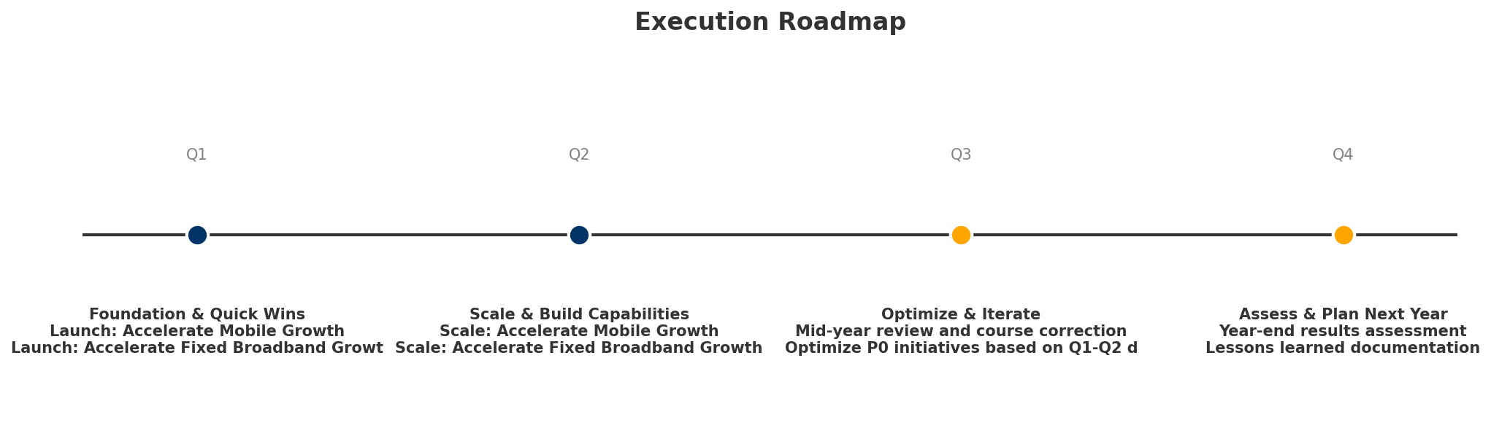
Decision 3: Define Execution
QUARTERLY ROADMAP & GOVERNANCE
Governance
Strategic Traps to Avoid
- Monthly Progress Review (Monthly
x Enter a price war
- Quarterly Strategic Checkpoint (Quarterly
x Attempt premium repositioning
- Mid-Year Strategic Adjustment (Semi-annual
x Delay core transformation
Key Risks & Mitigation
! Resource constraints delay P0 initiatives -- Ring-fence P0 budgets; establish escalation path for blockers
Key Message: Execute with discipline: monthly reviews, quarterly checkpoints, annual refresh
! Macro-economic slowdown reduces consumer spending -- Prepare value-tier offerings; shift mix toward B2B resilience
43

Slide 44
Analysis Summary
KEY TAKEAWAYS
01 Trends
Macro environment: Favorable. Key opportunities: Regulatory Environment, National Digital Strategy. Key risks: Regulatory Environment, Inflation Industry is in late growth phase. (+2.0% YoY (CQ2_2025 -> CQ4_2025)
02 Market
Uruguay telecom market totals UYU 14.1B in quarterly revenue; gaps in Performance, Ease of Use; Market outlook is favorable with more opportunities than threats.
03 Competition
In a 3-player market with medium competition intensity, Antel Uruguay leads with 64% revenue share. Target operator holds 14% share. Strongest competitive force: Substitutes.
04 Self
Ranked #3 of 3 operators in market; revenue UYU 2,010M; EBITDA margin 30.0%; stable but facing challenges; key strength: Price Competitiveness; key challenge: Brand Strength; Management outlook: Uruguay entry progressing; mobile subscriber acquisition ahead of plan despite Antel dominance
SWOT
SWOT analysis identifies 3 strengths, 11 weaknesses, 4 opportunities, and 4 threats. The recommended strategic posture is cautious (WT-dominant).
05 Opportunities
SPAN matrix positions 23 opportunities: 0 grow/invest, 13 acquire skills, 5 harvest, 5 avoid/exit. Focus resources on the 0 grow/invest items for maximum strategic impact.
Key Message: Complete Five Looks analysis — see opportunity priorities for next steps
44

Slide 45
Data Provenance
SOURCES & METHODOLOGY
No provenance data recorded for this analysis
Key Message: All data points are traceable to original sources
45

Slide 46
Thank You
BLM Five Looks Strategic Analysis

