Slide 1
Default BLM Strategic Analysis
BLM (Business Leadership Model) Five Looks Analysis
Target Operator
Market
Analysis Period
Report Date
Entel Cl
Chile
CQ4_2025
2026-02-12
01 Trends (PEST) | 02 Market/Customer ($APPEALS) | 03 Competition (Porter) | 04 Self (BMC) | SWOT Synthesis | 05 Opportunities (SPAN

Slide 2
Report Contents
TABLE OF CONTENTS
01
Executive Summary
Key findings and recommendations
02
Look at Trends
PEST Framework — macro environment
03
Look at Market
$APPEALS — market changes & customer needs
T
Tariff Analysis
Pricing comparison — mobile, fixed & convergence
04
Look at Competition
Porter's Five Forces — competitive landscape
05
Look at Self
BMC + Capability — internal assessment
06
SWOT Synthesis
Strengths, Weaknesses, Opportunities, Threats
07
Look at Opportunities
SPAN Matrix — opportunity selection
Summary & Provenance
2
08
Conclusions and data sources

Slide 3
Data Quality Overview
DATA QUALITY
Total Data Points
High Confidence
Medium Confidence
Low/Estimated
20
0
19
1
0%
Unique Sources: 36
Data Conflicts: 0
Coverage: Partial
Key Message: 20 data points tracked, 0 high-confidence (0%
3

Slide 4
Executive Summary
Trends
Macro environment: Favorable. Key opportunities: Regulatory Environment, National Digital Strategy. Key risks: Regulatory Environment, Fiber Broadband Penetration Industry is in late growth phase. (+7.2% YoY (CQ2_2025 -> CQ4_2025)
Market/Customer
Chile telecom market totals CLP 1.39T in quarterly revenue; competitive strengths in Availability, Performance; Market presents a balanced mix of opportunities and challenges.
Competition
In a 5-player market with medium competition intensity, Entel Chile leads with 58% revenue share. Target operator holds 58% share. Strongest competitive force: Existing Competitors.
Self Assessment
Ranked #1 of 5 operators in market; revenue CLP 811.0B; EBITDA margin 30.0%; overall healthy operations; key strength: 5G Deployment; key challenge: Pricing Competitiveness; Management outlook: FY2025 total revenue CLP 2.1T (+4.2% YoY). EBITDA margin improved to 32.8% (+0.7pp). Management reaffirms FY2026 guidance: revenue growth 4-5%, EBITDA margin 33-34%. Capex/revenue expected at 16-18% as 5G build-out phase peaks.
SWOT
SWOT analysis identifies 17 strengths, 5 weaknesses, 18 opportunities, and 16 threats. The recommended strategic posture is offensive (SO-dominant).
Opportunities
SPAN matrix positions 48 opportunities: 36 grow/invest, 4 acquire skills, 4 harvest, 4 avoid/exit. Focus resources on the 36 grow/invest items for maximum strategic impact.
Key Message: Five Looks analysis completed — see details in following sections
4

Slide 5
01 Look at Trends
PEST Framework — Macro Environment

Slide 6

PEST Analysis Dashboard
MACRO ENVIRONMENT
Key Message: Macro environment: Favorable. Key opportunities: Regulatory Environment, National Digital Strategy. Key risks: Regulatory Environment, Fiber Broadband Penetration.
6

Slide 7
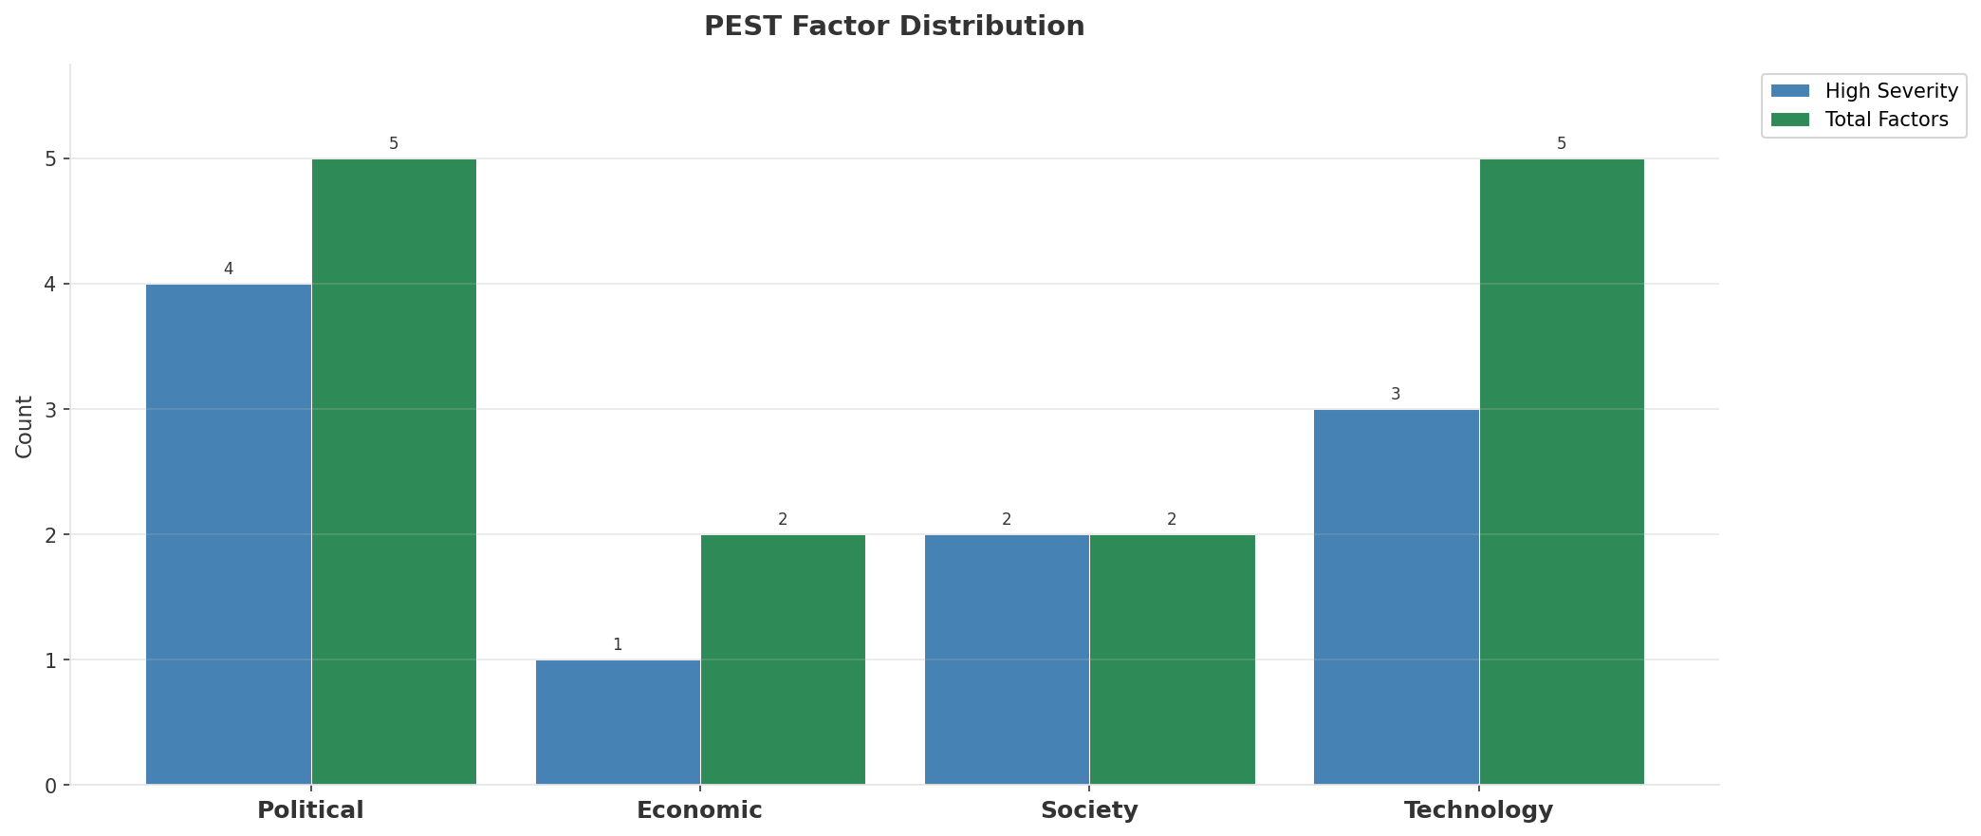
Industry Environment
INDUSTRY ANALYSIS
Market Size
Growth Rate
Concentration
Lifecycle
CLP 1.4T (quarterly, CQ4_2025
+7.2% YoY (CQ2_2025 -> CQ4_2025
CR4 = 100% (Entel Chile: 58.3%, Movistar Chile: 17.6%, WOM Chile: 13.3%, Claro Chile: 10.8%
late_growth
• New Business Models:
• FWA (Fixed Wireless Access) as fiber alternative
• Network-as-a-Service for enterprise verticals
• Wholesale/MVNO partnerships for coverage monetization
• Technology Revolution:
• 5G SA enabling network slicing and enterprise services
• AI/ML for network optimization and customer experience
• Open RAN for vendor diversification and cost reduction
Key Message: Macro environment: Favorable. Key opportunities: Regulatory Environment, National Digital Strategy. Key risks: Regulatory Environment, Fiber Broadband Penetration Industry is in late growth phase. (+7.2% YoY (CQ2_2025 -> CQ4_2025)
7

Slide 8
Value Transfer Trends
VALUE MIGRATION
• Value shifting from voice/SMS to data and digital services
• B2B/ICT growing faster than consumer segment
• Fiber displacing copper and cable broadband
Key Message: Macro environment: Favorable. Key opportunities: Regulatory Environment, National Digital Strategy. Key risks: Regulatory Environment, Fiber Broadband Penetration Industry is in late growth phase. (+7.2% YoY (CQ2_2025 -> CQ4_2025)
8

Slide 9
02 Look at Market
$APPEALS — Market Changes & Customer Needs

Slide 10
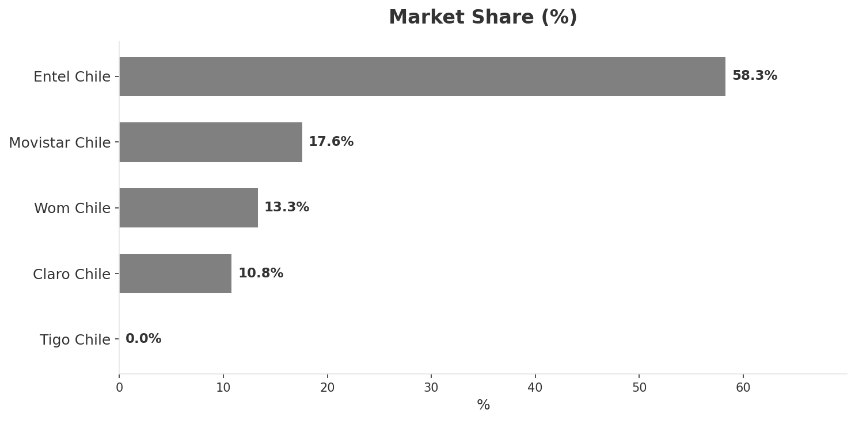
Market Change Panorama
MARKET OVERVIEW
Total Revenue (€M
Mobile Subs (K
Broadband Subs (K
Operators
1,391,000
30,500
4,180
5
Market Changes:
• Entel Chile revenue growth 15.9% YoY
• Movistar Chile revenue growth 8.9% YoY
• WOM Chile revenue growth 6.9% YoY
• Claro Chile revenue growth 8.7% YoY
Key Message: Chile telecom market totals CLP 1.39T in quarterly revenue; competitive strengths in Availability, Performance; Market presents a balanced mix of opportunities and challenges.
10

Slide 11
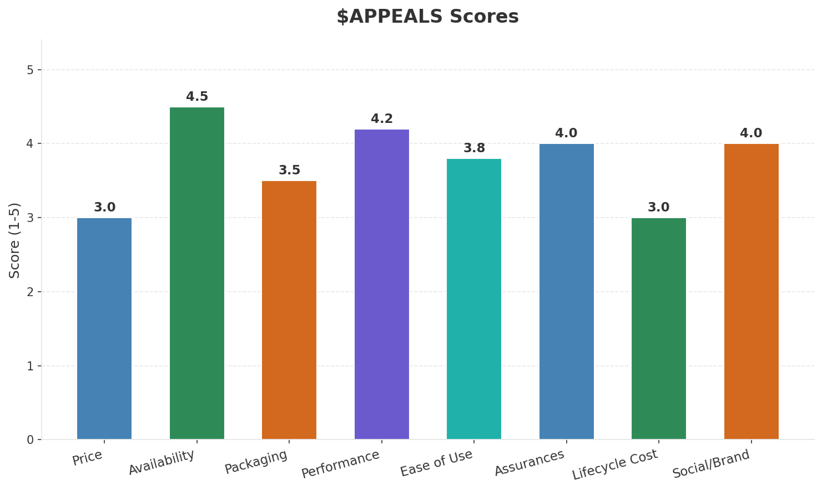
Customer Segments
SEGMENTATION
Consumer Postpaid Premium
Size: ~2.8M subscribers | Trend: growing | Our Share: ~39% of postpaid
Needs: 5G coverage and experiences, Premium convergent bundles (fiber+mobile+streaming
Consumer Mainstream
Size: ~10.2M subscribers | Trend: stable | Our Share: ~39% of postpaid
Needs: Better value mobile plans, Reliable home broadband
Consumer Price-Sensitive
Size: ~8.3M subscribers | Trend: shrinking | Our Share: ~31% of prepaid
Needs: Ultra-low-cost data plans, No-contract flexibility
Enterprise Large
Size: ~5K customers (top 5%) | Trend: growing | Our Share: ~39% of B2B base
Needs: SD-WAN and multi-cloud solutions, Private 5G for mining and logistics
Key Message: Chile telecom market totals CLP 1.39T in quarterly revenue; competitive strengths in Availability, Performance; Market presents a balanced mix of opportunities and challenges.
11

Slide 12
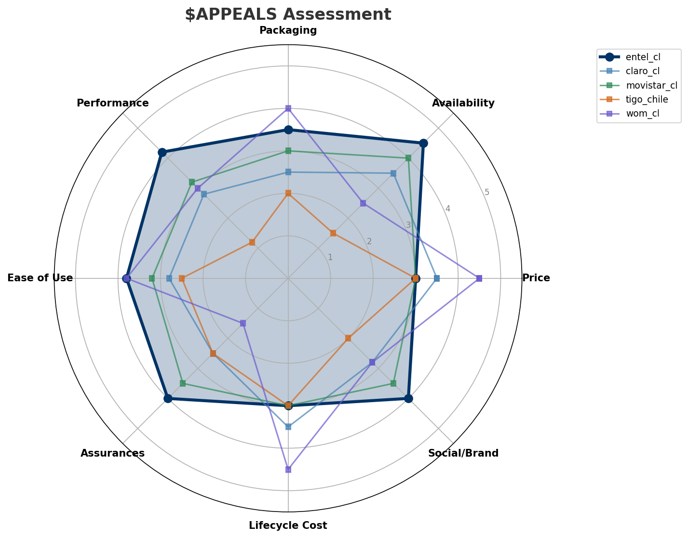
$APPEALS Assessment
CUSTOMER NEEDS
Key Message: Chile telecom market totals CLP 1.39T in quarterly revenue; competitive strengths in Availability, Performance; Market presents a balanced mix of opportunities and challenges.
12

Slide 13
Customer Value Migration
VALUE MIGRATION
Value migration trending upward: customers willing to pay more for premium connectivity and convergent bundles. Focus on upselling and cross-selling opportunities.
Opportunities:
Threats:
• Entel Chile revenue growth 15.9% YoY
• Entel FY2025: total revenue +4.2% to CLP 2.1T, mobile ARPU stable
• Chile telecom sector capex reaches $1.8B in 2025, highest ever
• Chile GDP growth 2.8% in 2025, consumer spending up 3.5%
• Movistar Chile revenue growth 8.9% YoY
• WOM Chile revenue growth 6.9% YoY
• Claro Chile revenue growth 8.7% YoY
• WOM Chile post-restructuring: aggressive pricing returns to market
Key Message: Chile telecom market totals CLP 1.39T in quarterly revenue; competitive strengths in Availability, Performance; Market presents a balanced mix of opportunities and challenges.
13

Slide 14
Tariff Analysis
Mobile, Fixed & Convergence Pricing Landscape

Slide 15
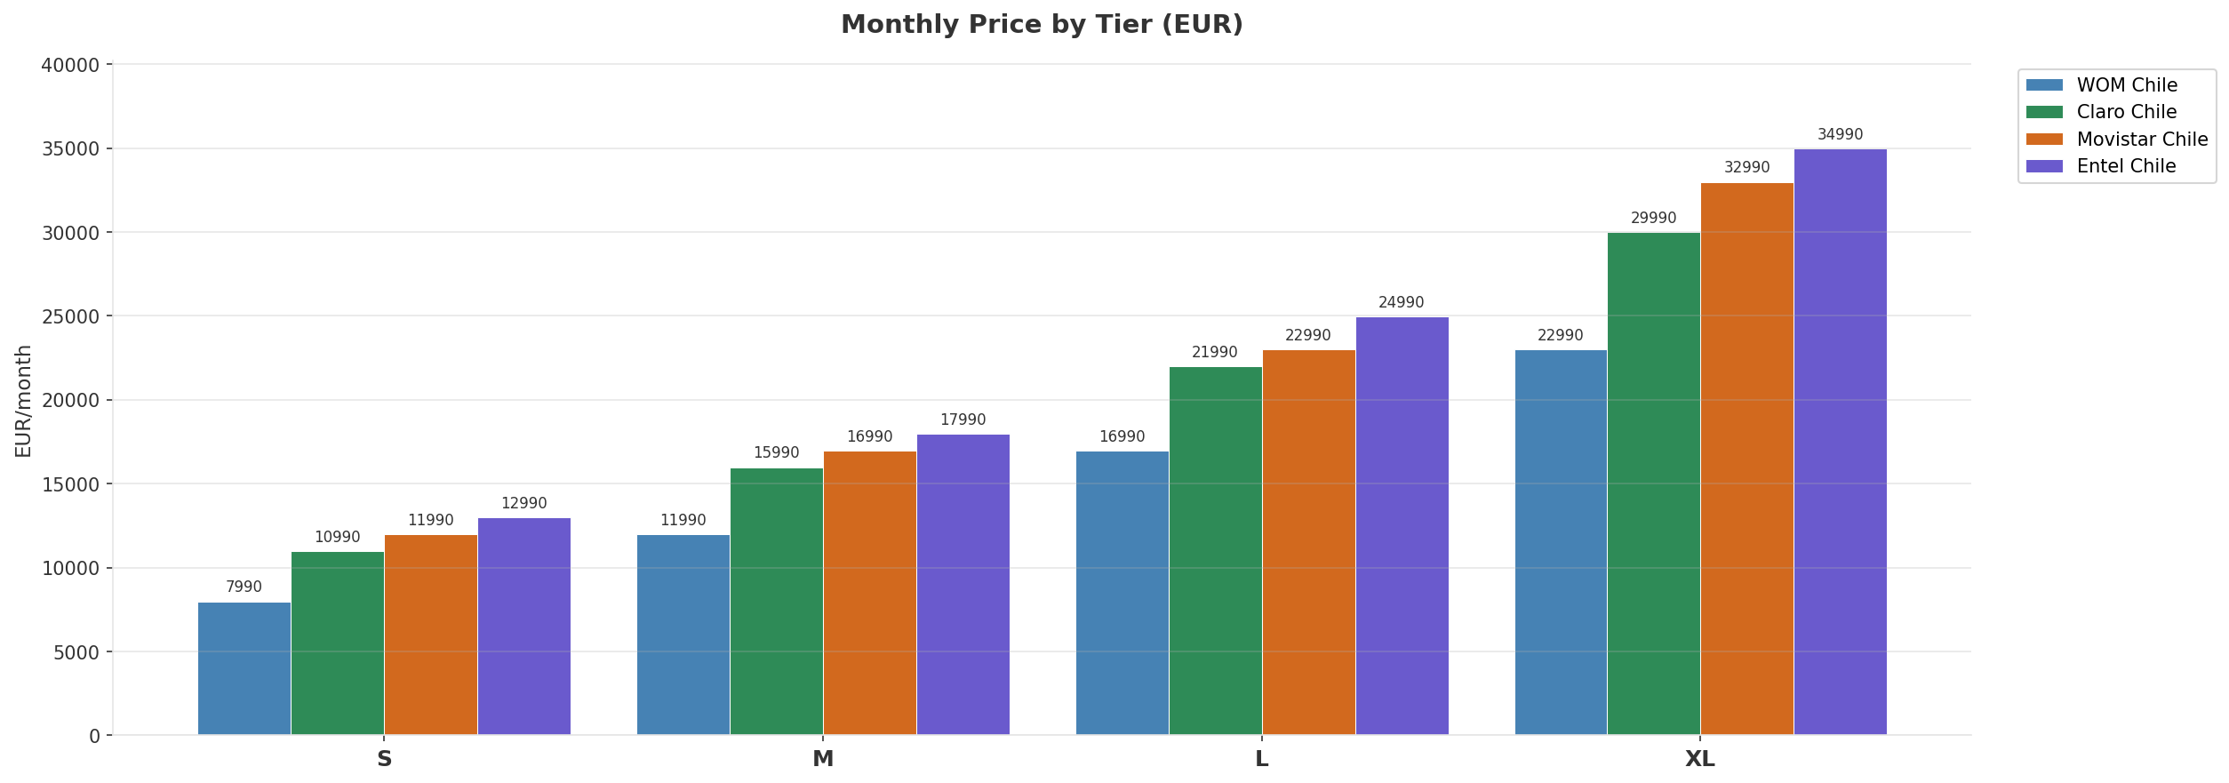
Mobile Postpaid Price Comparison
CROSS-OPERATOR TIER BENCHMARKING
Price Gaps:
• Tier S: EUR 5000 gap — cheapest WOM Chile, most expensive Entel Chile
• Tier M: EUR 6000 gap — cheapest WOM Chile, most expensive Entel Chile
• Tier L: EUR 8000 gap — cheapest WOM Chile, most expensive Entel Chile
• Tier XL: EUR 12000 gap — cheapest WOM Chile, most expensive Entel Chile
Key Message: Mobile postpaid tier comparison across all operators
15

Slide 16
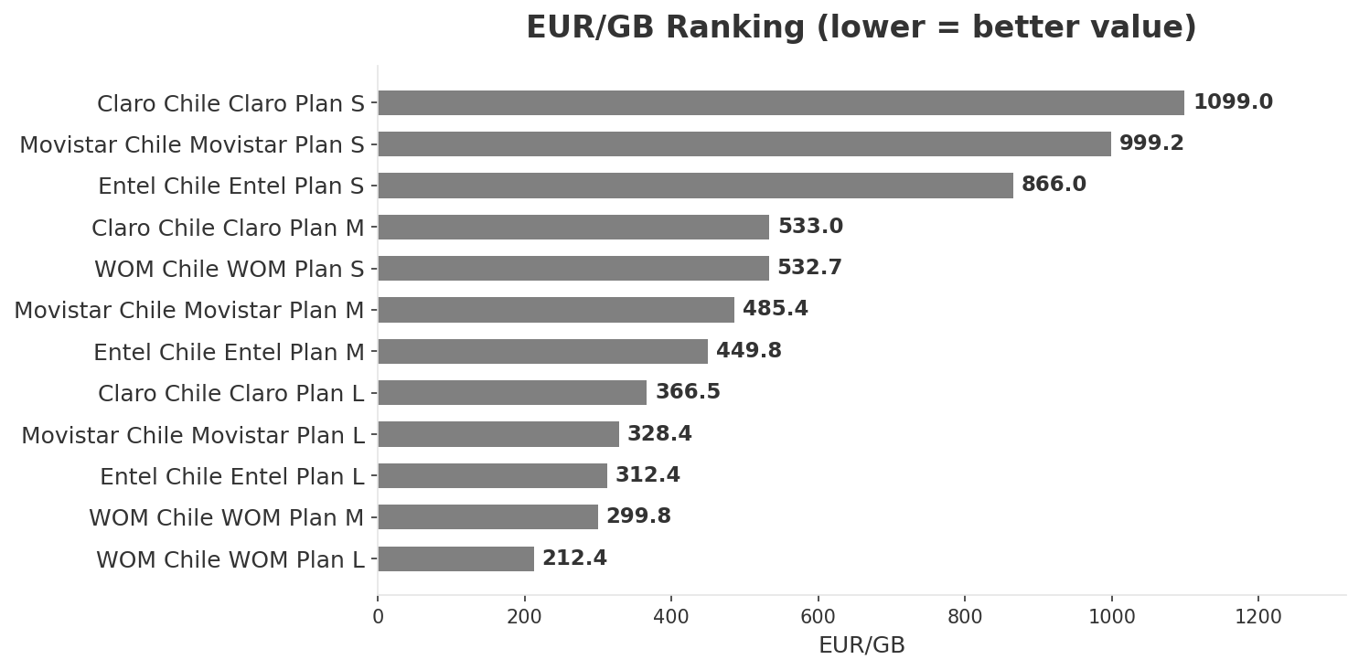
EUR/GB Value Analysis & 5G Premium Erosion
PRICING INTELLIGENCE
All mobile postpaid plans now include 5G — premium fully eroded
Key Message: Best value: WOM Chile at EUR 212.38/GB
16

Slide 17
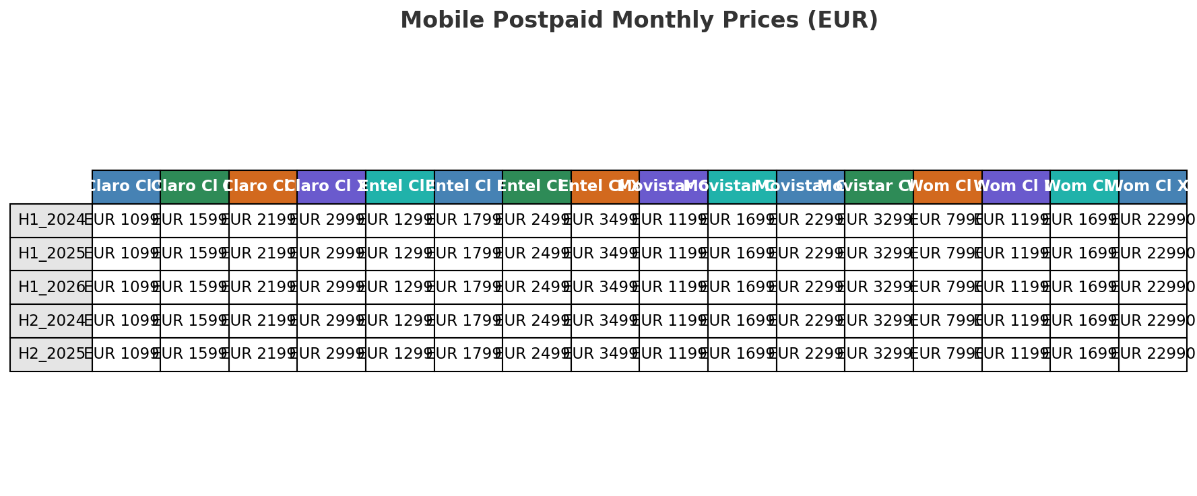
Price Evolution — Mobile Postpaid
H1_2023 TO H1_2026
Key Message: Price evolution across 7 snapshots — H1_2023 to H1_2026
17

Slide 18
Fixed & Convergence Pricing Landscape
DSL / CABLE / FIBER / FMC BUNDLES
Cable:
• Claro Chile ClaroVTR Cable 1000: EUR 24990/mo 1000.0Mbps
• Claro Chile ClaroVTR Cable 500: EUR 18990/mo 500.0Mbps
• Claro Chile ClaroVTR Cable 200: EUR 13990/mo 200.0Mbps
FMC Bundles:
• Entel Chile Entel Pack Premium: EUR 49990/mo
• Claro Chile ClaroVTR Pack Total: EUR 49990/mo
• Movistar Chile Movistar Pack Total: EUR 54990/mo
• Claro Chile ClaroVTR Pack Duo: EUR 22990/mo
• Movistar Chile Movistar Pack Duo: EUR 24990/mo
• Entel Chile Entel Pack Hogar: EUR 27990/mo
Fiber:
• Claro Chile ClaroVTR Fibra 1000: EUR 25990/mo 1000.0Mbps
• Movistar Chile Movistar Fibra 1000: EUR 27990/mo 1000.0Mbps
• Entel Chile Entel Fibra 1000: EUR 29990/mo 1000.0Mbps
• Claro Chile ClaroVTR Fibra 500: EUR 19990/mo 500.0Mbps
Key Message: Cheapest FMC bundle: Claro Chile ClaroVTR Pack Duo at EUR 22990/mo
18

Slide 19
03 Look at Competition
Porter's Five Forces — Competitive Landscape

Slide 20

Porter's Five Forces
COMPETITIVE FORCES
Overall Intensity: MEDIUM
Key Message: In a 5-player market with medium competition intensity, Entel Chile leads with 58% revenue share. Target operator holds 58% share. Strongest competitive force: Existing Competitors.
20

Slide 21
Competitor Analysis: Claro Cl
COMPETITOR DEEP DIVE
Revenue
EBITDA
Margin
Capex/Rev
€150,000M
€33,000M
22.0%
20.0%
+2.2% YoY
Strengths
Weaknesses
• Network Coverage: score 70 (market avg 64
• 5G Deployment: score 50 (market avg 56
• Brand Strength: score 60 (market avg 66
• Customer Experience: score 50 (market avg 65
• Customer Service: score 50 (market avg 62
Strategy: Revenue-led profitable growth; subscriber acquisition focus
Key Message: Competitor analysis: Claro Cl
21

Slide 22
Competitor Analysis: Tigo Chile
COMPETITOR DEEP DIVE
Revenue
EBITDA
Margin
Capex/Rev
€12M
€2M
16.0%
6.4%
-18.0% YoY
Strengths
Weaknesses
• 5G Deployment: score 20 (market avg 56
• Brand Strength: score 40 (market avg 66
• Customer Service: score 50 (market avg 62
• Digital Services: score 50 (market avg 66
Strategy: Defensive cost restructuring; ARPU-led value strategy
Key Message: Competitor analysis: Tigo Chile
22

Slide 23
Competitor Analysis: Wom Cl
COMPETITOR DEEP DIVE
Revenue
EBITDA
Margin
Capex/Rev
€185,000M
€37,000M
20.0%
15.1%
+6.8% YoY
Strengths
Weaknesses
• 5G Deployment: score 70 (market avg 56
• Customer Experience: score 70 (market avg 65
• Customer Service: score 70 (market avg 62
• Digital Capabilities: score 80 (market avg 70
• Enterprise Solutions: score 30 (market avg 56
• Financial Strength: score 40 (market avg 65
• Market Share: score 60 (market avg 68
• Network Coverage: score 50 (market avg 64
Strategy: Revenue-led profitable growth; subscriber acquisition focus
Key Message: Competitor analysis: Wom Cl
23

Slide 24
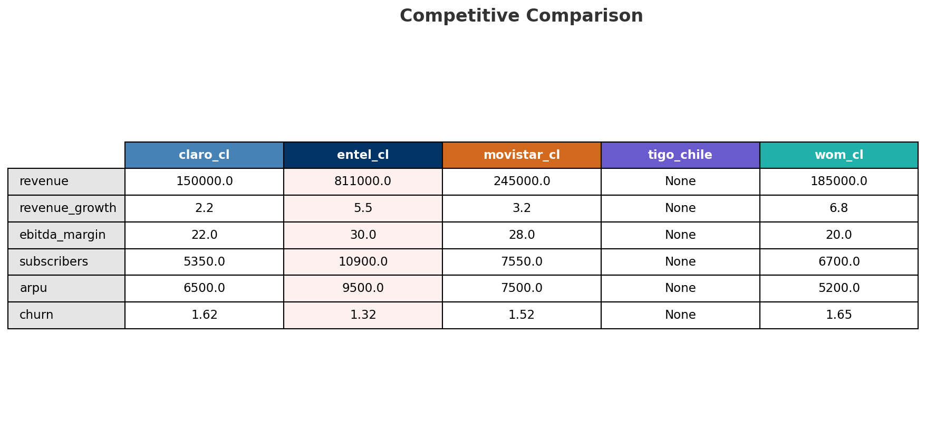
Competitive Landscape Summary
COMPETITION
Key Message: In a 5-player market with medium competition intensity, Entel Chile leads with 58% revenue share. Target operator holds 58% share. Strongest competitive force: Existing Competitors.
24

Slide 25
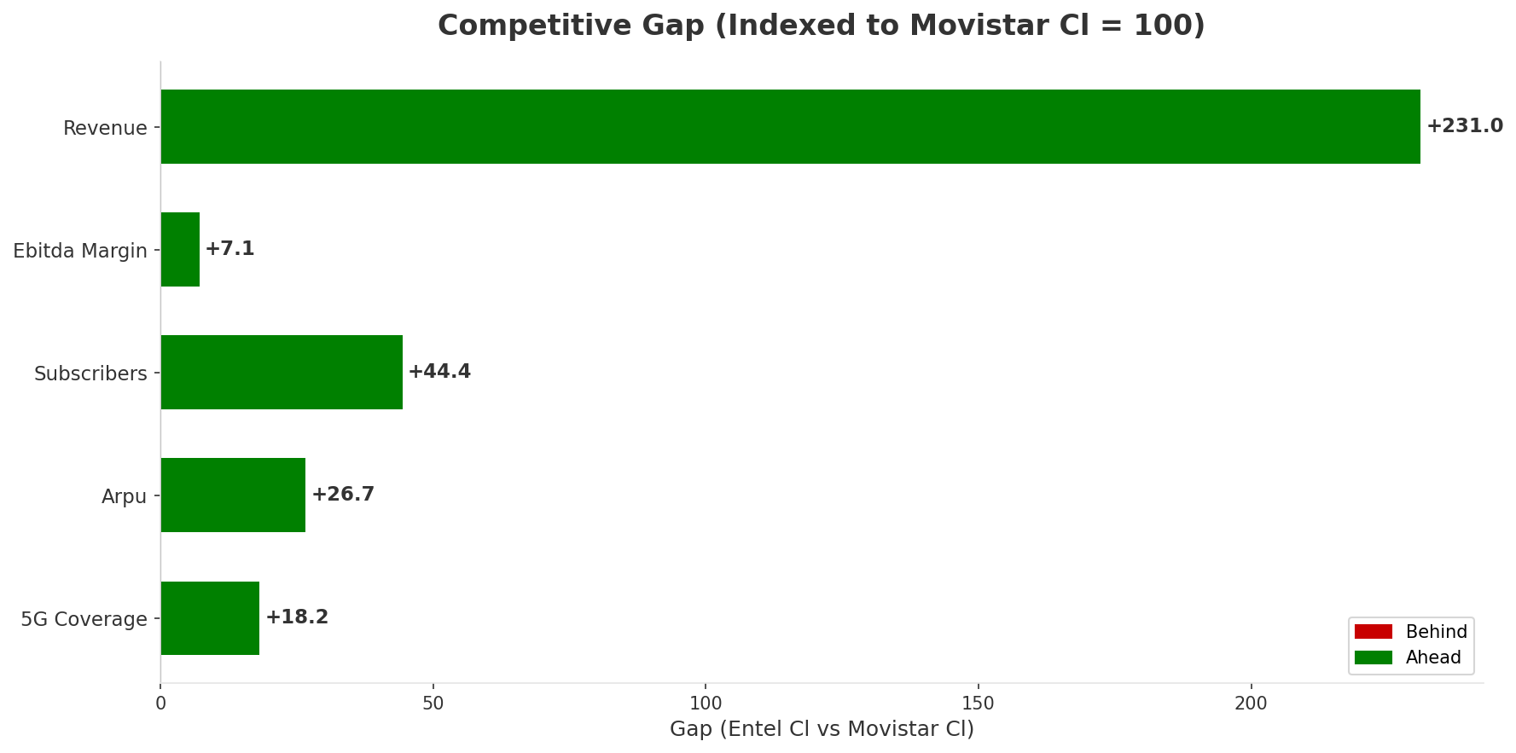
Gap Analysis: Entel Cl vs Movistar Cl
COMPETITIVE GAP
Key Message: Gap analysis vs market leader Movistar Cl
25

Slide 26
New Entrants Threat
MARKET ENTRY
• Entry barriers: High barriers: spectrum licensing, massive capex for network build, regulatory approvals, established brand loyalty
Key Message: New entrants threat level: low
26

Slide 27
04 Look at Self
BMC + Capability Assessment

Slide 28
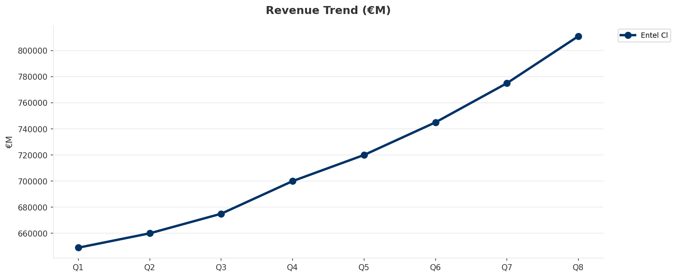
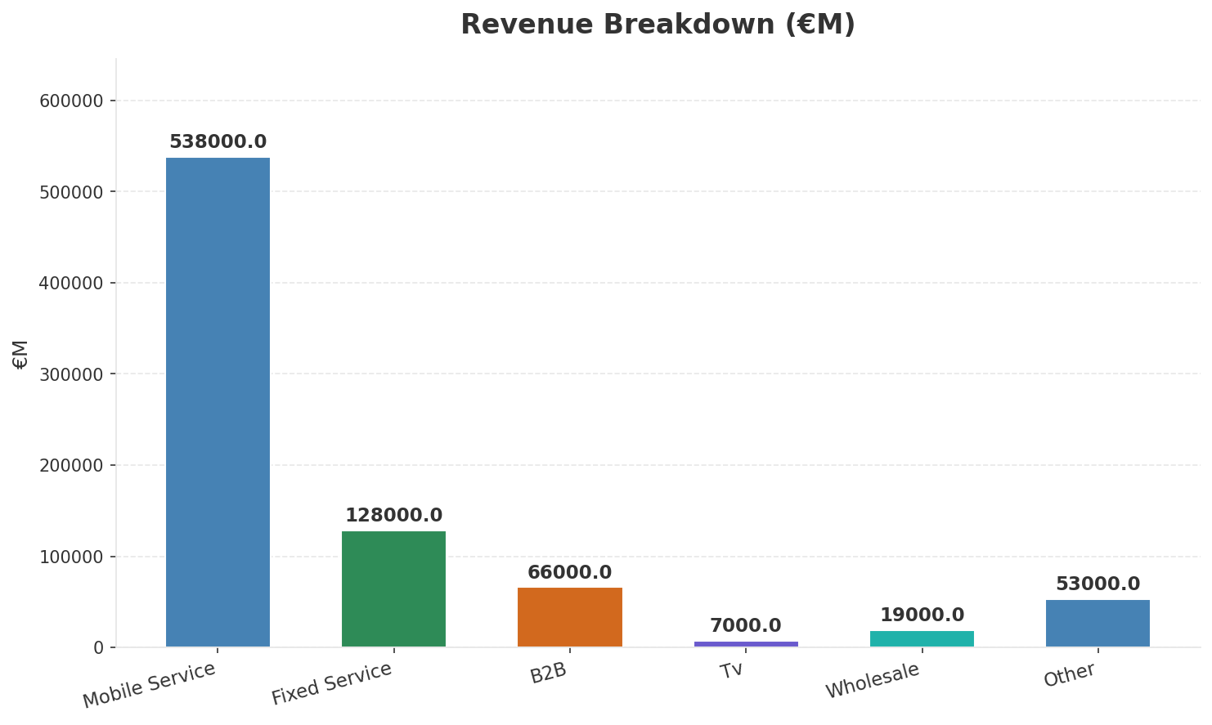
Operating Health Check
FINANCIAL HEALTH
Revenue
EBITDA
EBITDA Margin
Capex/Rev
€811,000M
€243,000M
30.0%
15.4%
+15.86% YoY
+6.5% YoY
Key Message: Ranked #1 of 5 operators in market; revenue CLP 811.0B; EBITDA margin 30.0%; overall healthy operations; key strength: 5G Deployment; key challenge: Pricing Competitiveness; Management outlook: FY2025 total revenue CLP 2.1T (+4.2% YoY). EBITDA margin improved to 32.8% (+0.7pp). Management reaffirms FY2026 guidance: revenue growth 4-5%, EBITDA margin 33-34%. Capex/revenue expected at 16-18% as 5G build-out phase peaks.
28

Slide 29
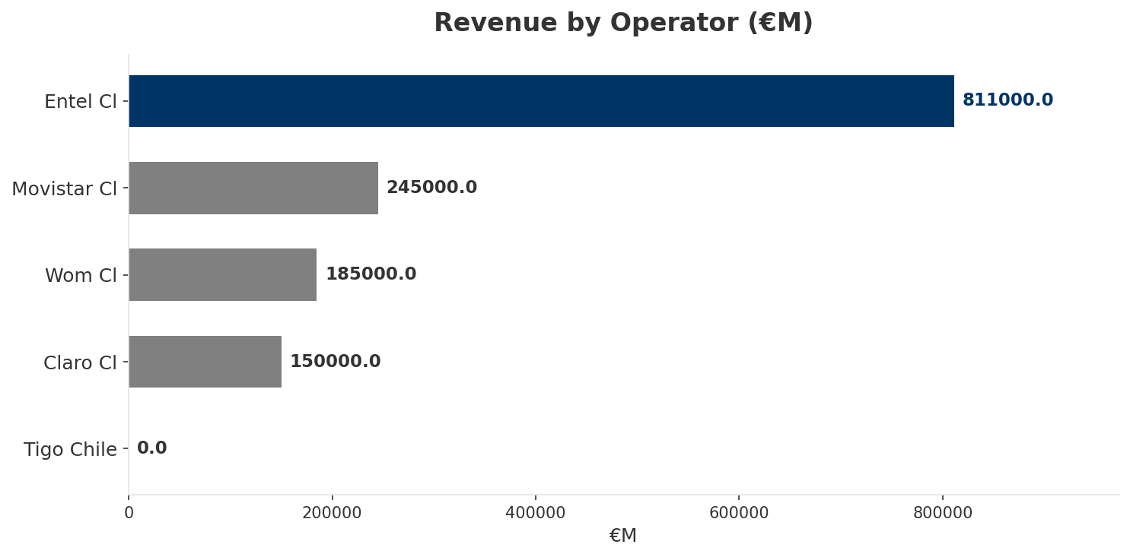
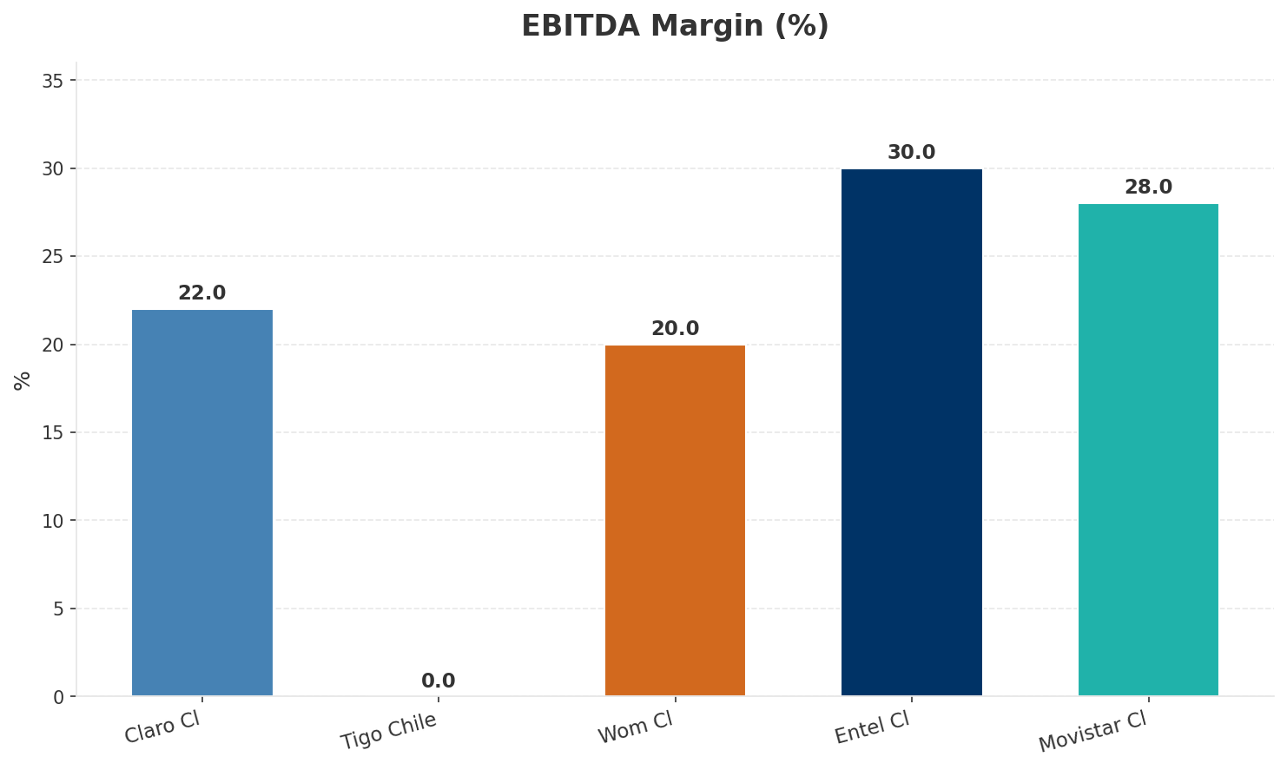
Revenue Comparison
COMPETITIVE BENCHMARKING
Key Message: Revenue and margin benchmarking across operators
29

Slide 30
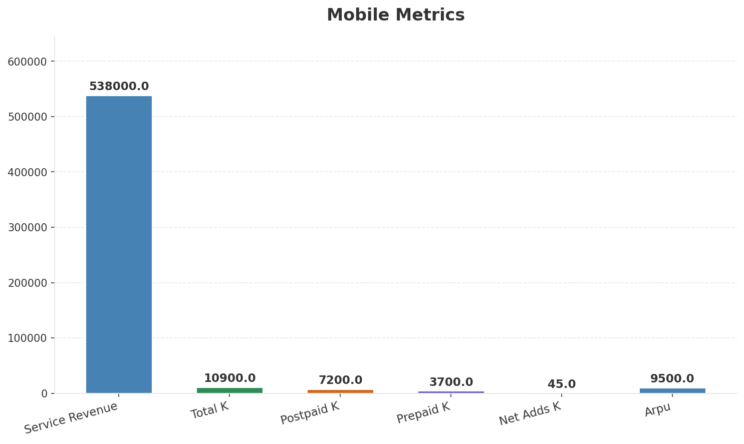
Segment Analysis: Mobile
SEGMENT PERFORMANCE
Service Revenue
Service Growth Pct
Total K
Postpaid K
€538,000M
6.2%
€10,900M
€7,200M
Health: STRONG
• revenue: improving
• subscribers: stable
• arpu: improving
• EBITDA margin expanded 70bps to 32.8%. Opex-to-revenue improved to 67.2%. Operational efficiency program delivered CLP 45B savings. Energy costs down 8% via renewable energy contracts. Capex/revenue a
• Enterprise revenue grew 8.5% YoY driven by cloud (+22%), cybersecurity (+35%), and private 5G contracts with BHP and Codelco. B2B now 28% of total revenue. Won 3 new private 5G network contracts worth
• Postpaid subscriber base grew 5.8% YoY to 5.1M. Blended mobile ARPU stable at CLP 8,200 despite WOM competition. Premium tier (>CLP 25K) grew 12%, now 22% of postpaid base. 5G users reached 1.2M with
Key Message: Mobile service revenue at 538.0B; up 6.2% YoY; ARPU 9500.0
30

Slide 31
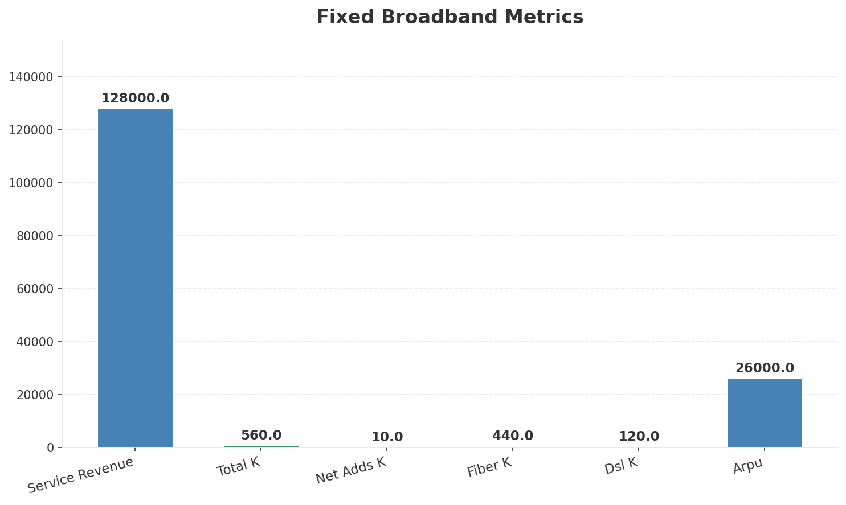
Segment Analysis: Fixed Broadband
SEGMENT PERFORMANCE
Service Revenue
Service Growth Pct
Total K
Net Adds K
€128,000M
3.2%
€560M
10
Health: STRONG
• revenue: improving
• subscribers: improving
• arpu: improving
• FTTH subscriber base reached 820K (+28% YoY). Copper-to-fiber migration 65% complete, full sunset targeted end-2027. Fiber ARPU 15% higher than legacy copper. Homes passed reached 2.8M. FMC penetratio
• revenue increased 3.2% QoQ
• subscribers increased 3.7% QoQ
Key Message: Fixed service revenue 128.0B; growth +3.2% YoY; Fiber subs 440K
31

Slide 32
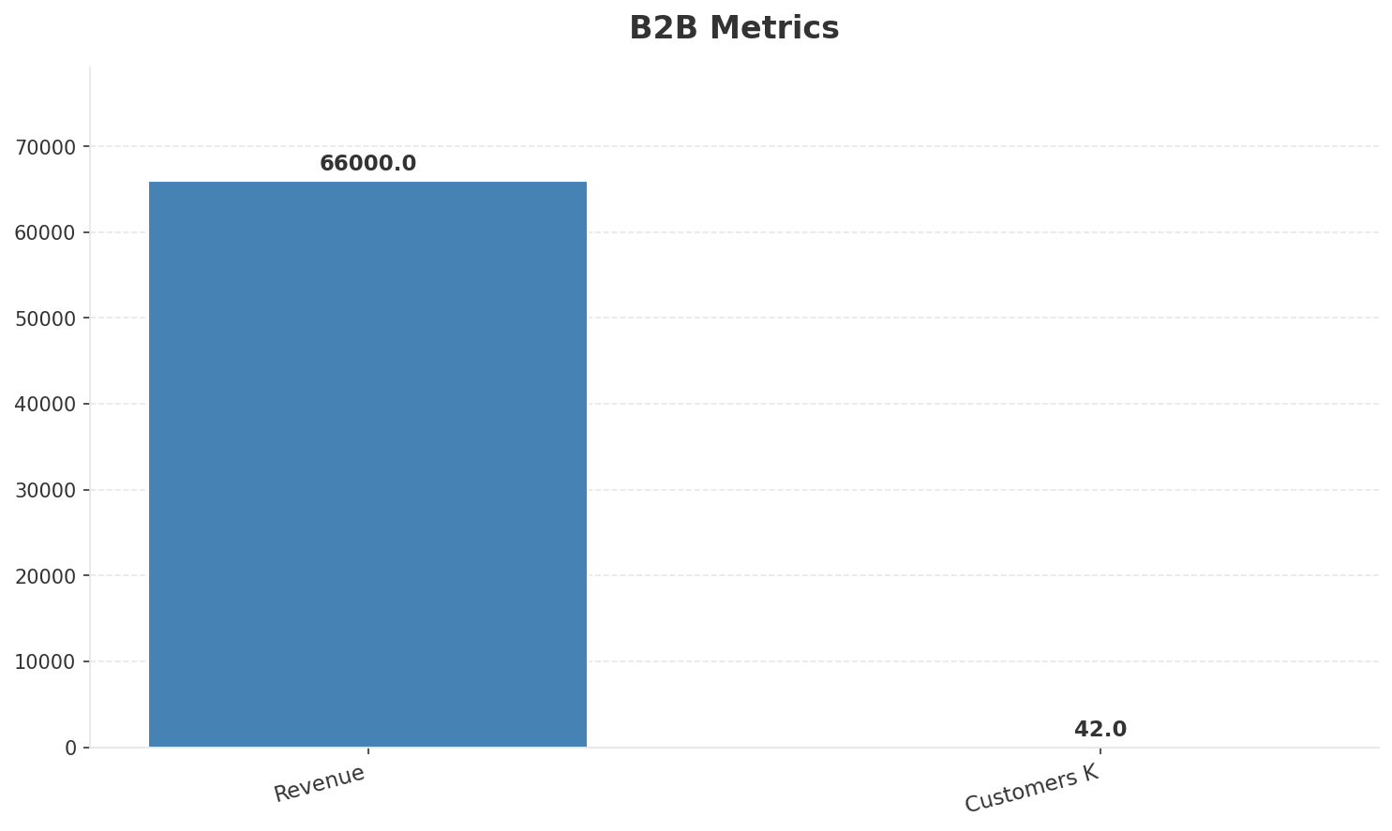
Segment Analysis: B2B
SEGMENT PERFORMANCE
Revenue
Growth Pct
Customers K
Share Of Revenue Pct
€66,000M
5.0%
42
8.1%
Health: STRONG
• revenue: improving
• customers: improving
• Enterprise revenue grew 8.5% YoY driven by cloud (+22%), cybersecurity (+35%), and private 5G contracts with BHP and Codelco. B2B now 28% of total revenue. Won 3 new private 5G network contracts worth
• 5G SA network launched covering 45% population. Network slicing tested with 3 mining enterprise customers. 5G FWA serves 50K rural households. SUBTEL infrastructure sharing regulation is net positive
• revenue increased 3.1% QoQ
Key Message: B2B revenue 66.0B; growth +5.0% YoY; 8.1% of total revenue
32

Slide 33
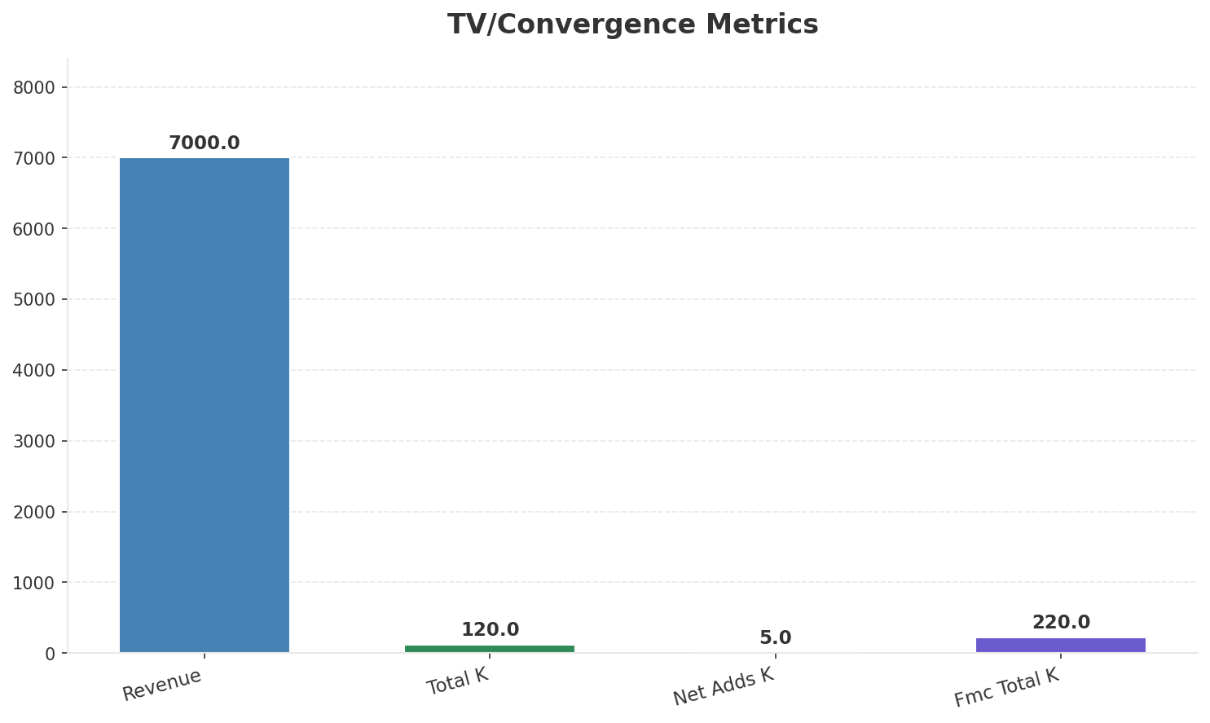
Segment Analysis: TV/Convergence
SEGMENT PERFORMANCE
Revenue
Total K
Net Adds K
Fmc Total K
€7,000M
€120M
5
€220M
Health: STRONG
• revenue: improving
• subscribers: improving
• fmc_subscribers: improving
• revenue increased 7.7% QoQ
• subscribers increased 9.1% QoQ
• fmc_subscribers increased 4.8% QoQ
Key Message: TV subscribers 120K; FMC 220K; FMC penetration 39.3%
33

Slide 34
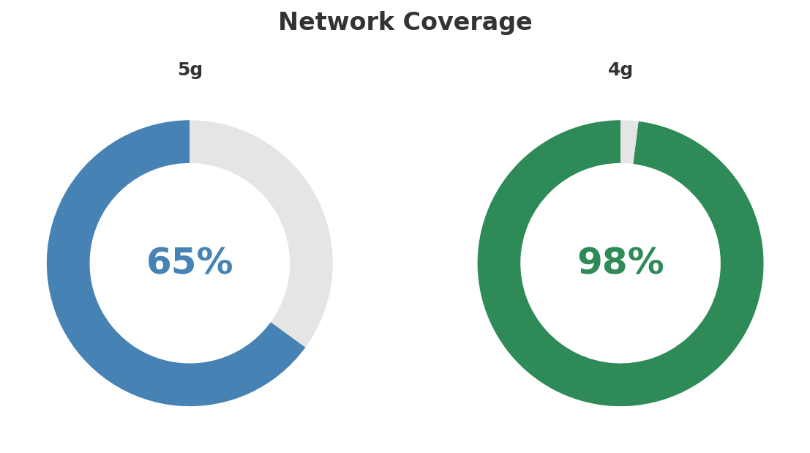
Network Analysis
INFRASTRUCTURE
Technology Mix:
Investment Direction: increasing
• Edge Nodes: 5
• Core Vendor: Ericsson
• 5G Sa Status: SA trial in Santiago, NSA commercial
• Spectrum Mhz: 700: 20, 1900: 30, 2100: 20, 2600: 40, 3500: 80
• Mobile Vendor: Ericsson (5G NSA + SA trial
• 5G Base Stations: 4200
• Virtualization Pct: 40%
Key Message: Network infrastructure and coverage assessment
34

Slide 35

Business Model Canvas
BMC
Key Message: Business model canvas overview
35

Slide 36
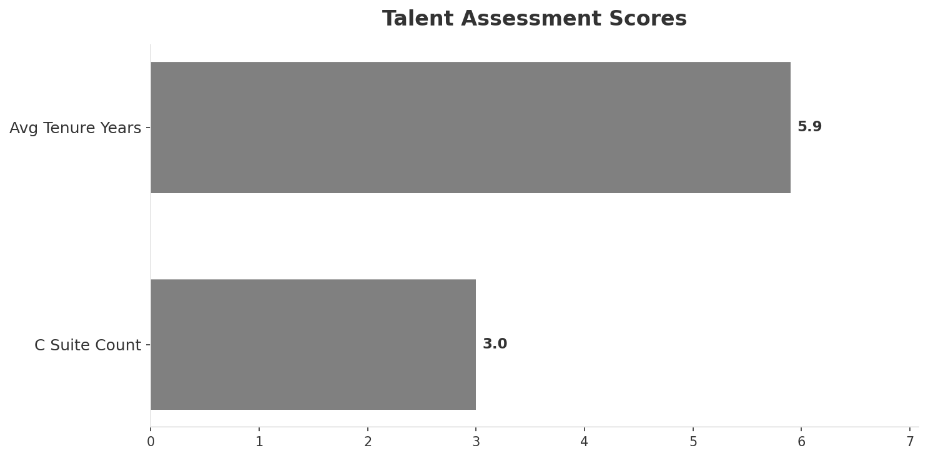
Organization & Talent
PEOPLE & CULTURE
Employees
C Suite Count
Avg Tenure Years
Key Leaders
5,400
3
5.9
['Antonio Büchi (CEO)', 'Emilio Novoa (CFO)', 'Carlos Zenteno (CTO)']
Organization Culture:
Stable leadership team (avg tenure >3 years); Growth-oriented strategic posture; Innovation-led culture; strong engineering focus; premium brand DNA; long-tenured leadership team; Chilean market champion identity.
Leadership Changes:
• Antonio Büchi: (
• Emilio Novoa: (
• Carlos Zenteno: (
Key Message: Organization and talent assessment
36

Slide 37
Strengths, Weaknesses & Exposure Points
SELF ASSESSMENT
Strengths
Weaknesses
Exposure Points
• 5G Deployment: score 80 (market avg 56
• Brand Strength: score 90 (market avg 69
• Customer Service: score 80 (market avg 62
• Digital Services: score 70 (market avg 66
• Enterprise Solutions: score 80 (market avg 56
• Network Coverage: score 90 (market avg 64
• Pricing Competitiveness: score 60 (market avg 69
• 5G coverage gap at only 65.0%
• 5G SA investment competing with established players: Capex pressure during 5G build-out phase (17-19% capex/revenue
• WOM's post-restructuring competitive aggression: ARPU pressure in price-sensitive segments
• Mining sector cyclicality affecting enterprise revenue: Enterprise segment (28% of revenue) exposed to commodity cycles
Key Message: Ranked #1 of 5 operators in market; revenue CLP 811.0B; EBITDA margin 30.0%; overall healthy operations; key strength: 5G Deployment; key challenge: Pricing Competitiveness; Management outlook: FY2025 total revenue CLP 2.1T (+4.2% YoY). EBITDA margin improved to 32.8% (+0.7pp). Management reaffirms FY2026 guidance: revenue growth 4-5%, EBITDA margin 33-34%. Capex/revenue expected at 16-18% as 5G build-out phase peaks.
37

Slide 38
SWOT Synthesis
Strengths, Weaknesses, Opportunities & Threats

Slide 39

SWOT Analysis
STRATEGIC SYNTHESIS
SO:
Leverage '5G Deployment: score 80 (market avg 56)' to cap...
WO:
Address weakness 'Pricing Competitiveness: score 60 (mark...
ST:
Use strength '5G Deployment: score 80 (market avg 56)' to...
WT:
Mitigate weakness 'Pricing Competitiveness: score 60 (mar...
Key Message: SWOT analysis identifies 17 strengths, 5 weaknesses, 18 opportunities, and 16 threats. The recommended strategic posture is offensive (SO-dominant).
39

Slide 40
05 Look at Opportunities
SPAN Matrix — Opportunity Selection

Slide 41
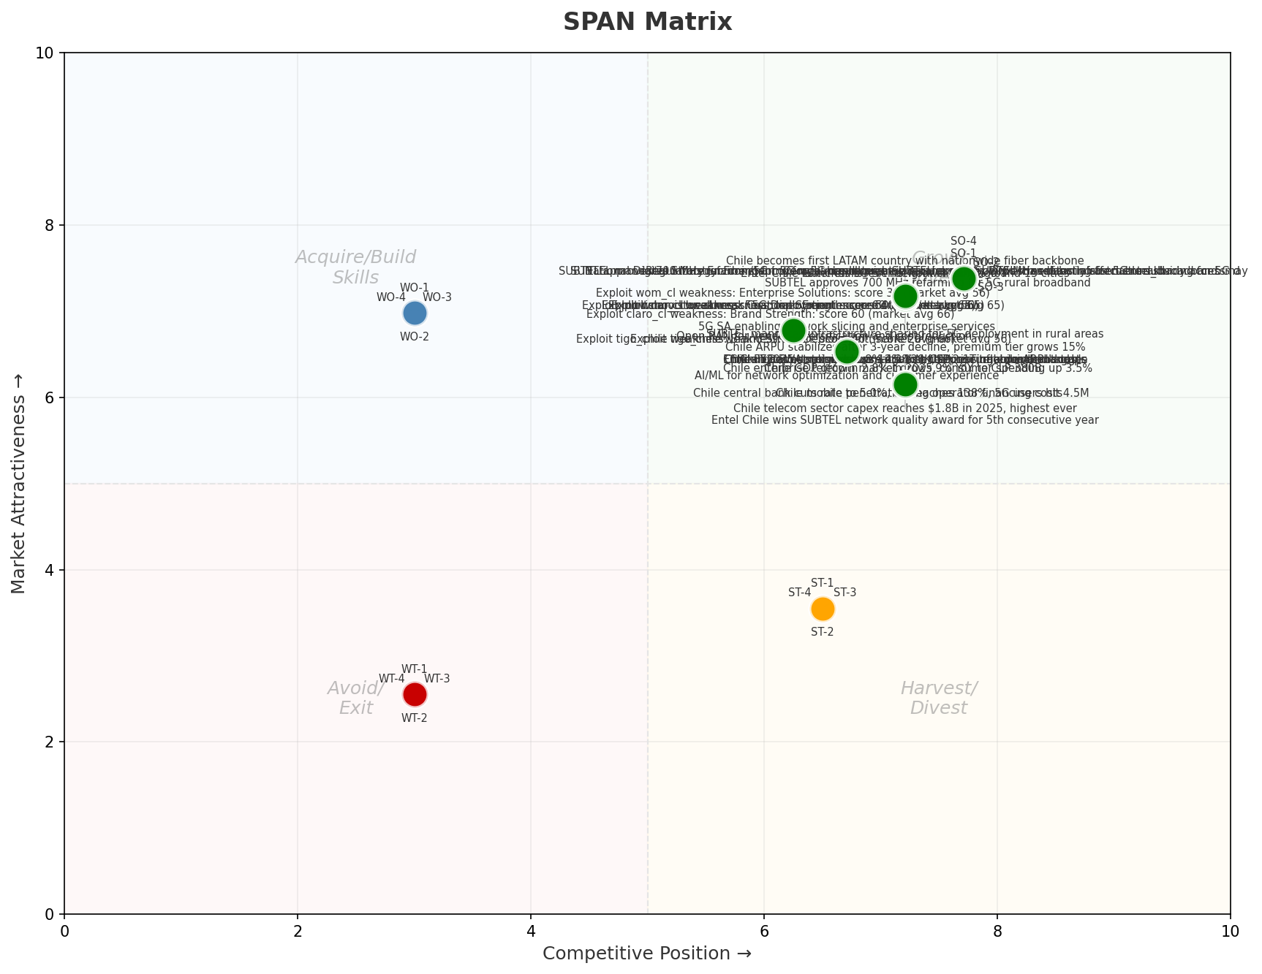
SPAN Matrix — Opportunity Positioning
OPPORTUNITY MAP
Key Message: SPAN matrix positions 48 opportunities: 36 grow/invest, 4 acquire skills, 4 harvest, 4 avoid/exit. Focus resources on the 36 grow/invest items for maximum strategic impact.
41

Slide 42
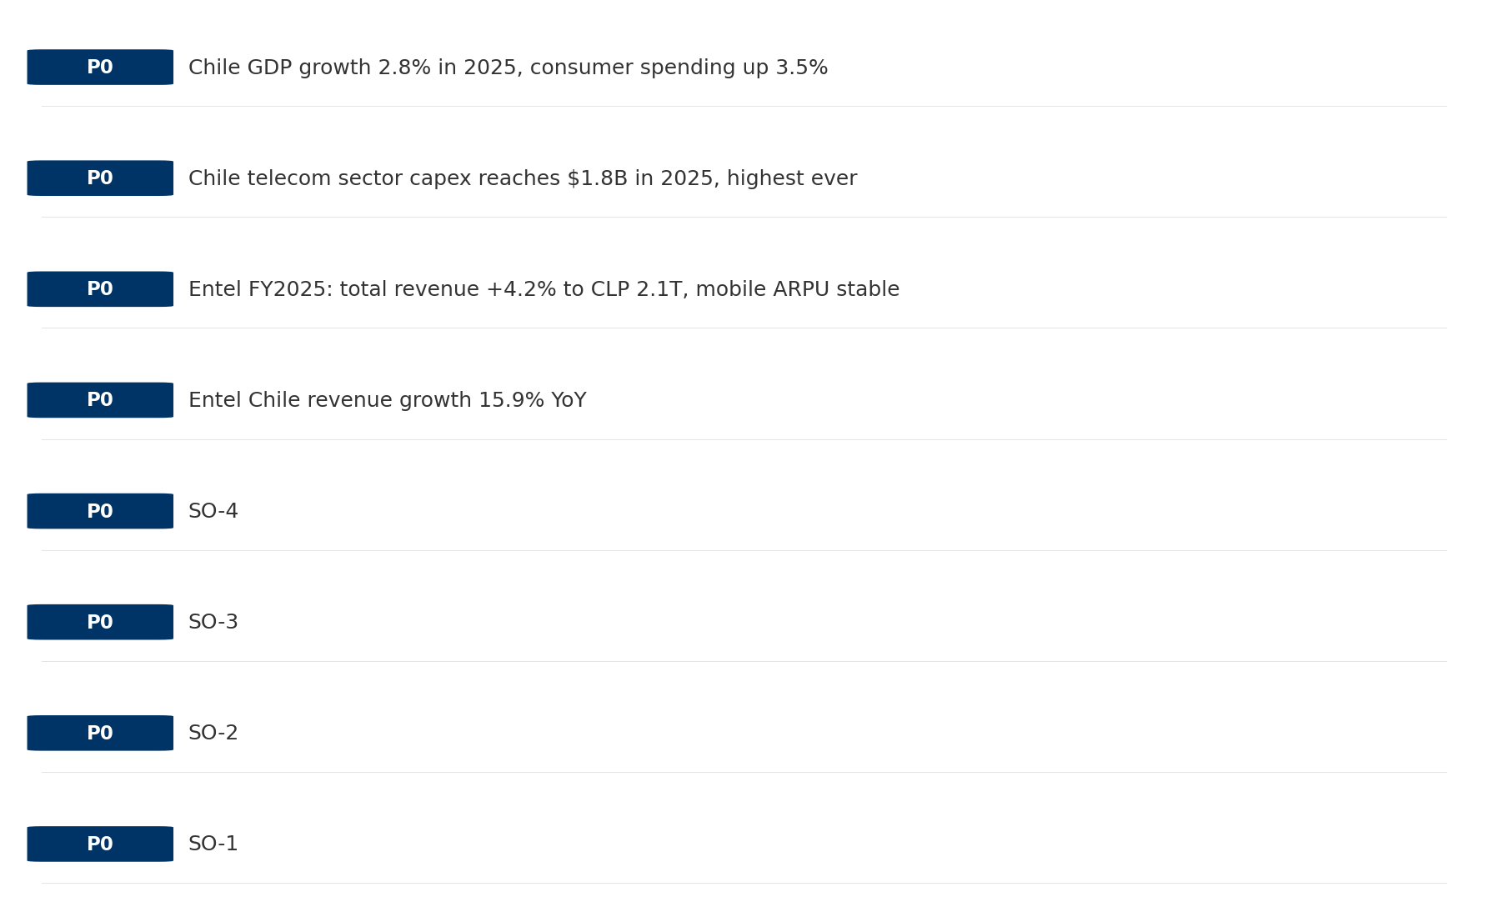
Opportunity Priority Ranking
PRIORITIES
Key Message: SPAN matrix positions 48 opportunities: 36 grow/invest, 4 acquire skills, 4 harvest, 4 avoid/exit. Focus resources on the 36 grow/invest items for maximum strategic impact.
42

Slide 43
Opportunity Details
DEEP DIVE
P0
SO-1
Market: N/A | Window:
Leverage '5G Deployment: score 80 (market avg 56)' to capture the opportunity of 'Regulatory Environment: Compliance requirements and spectrum policies directly affect entel_cl'.
P0
SO-2
Market: N/A | Window:
Leverage 'Brand Strength: score 90 (market avg 69)' to capture the opportunity of 'National Digital Strategy: Fiber/5G coverage mandates may require entel_cl investment but also enable subsidy access'.
P0
SO-3
Market: N/A | Window:
Leverage 'Customer Service: score 80 (market avg 62)' to capture the opportunity of 'SUBTEL approves 700 MHz refarming for 5G rural broadband: SUBTEL approves 700 MHz refarming for 5G rural broadband: may create new market access or subsidy opportunities for entel_cl'.
P0
SO-4
Market: N/A | Window:
Leverage 'Digital Services: score 70 (market avg 66)' to capture the opportunity of 'SUBTEL mandates infrastructure sharing for 5G deployment in rural areas: SUBTEL mandates infrastructure sharing for 5G deployment in rural areas: may create new market access or subsidy opportunities for entel_cl'.
Key Message: SPAN matrix positions 48 opportunities: 36 grow/invest, 4 acquire skills, 4 harvest, 4 avoid/exit. Focus resources on the 36 grow/invest items for maximum strategic impact.
43

Slide 44
Analysis Summary
KEY TAKEAWAYS
01 Trends
Macro environment: Favorable. Key opportunities: Regulatory Environment, National Digital Strategy. Key risks: Regulatory Environment, Fiber Broadband Penetration Industry is in late growth phase. (+7.2% YoY (CQ2_2025 -> CQ4_2025)
02 Market
Chile telecom market totals CLP 1.39T in quarterly revenue; competitive strengths in Availability, Performance; Market presents a balanced mix of opportunities and challenges.
03 Competition
In a 5-player market with medium competition intensity, Entel Chile leads with 58% revenue share. Target operator holds 58% share. Strongest competitive force: Existing Competitors.
04 Self
Ranked #1 of 5 operators in market; revenue CLP 811.0B; EBITDA margin 30.0%; overall healthy operations; key strength: 5G Deployment; key challenge: Pricing Competitiveness; Management outlook: FY2025 total revenue CLP 2.1T (+4.2% YoY). EBITDA margin improved to 32.8% (+0.7pp). Management reaffirms FY2026 guidance: revenue growth 4-5%, EBITDA margin 33-34%. Capex/revenue expected at 16-18% as 5G build-out phase peaks.
SWOT
SWOT analysis identifies 17 strengths, 5 weaknesses, 18 opportunities, and 16 threats. The recommended strategic posture is offensive (SO-dominant).
05 Opportunities
SPAN matrix positions 48 opportunities: 36 grow/invest, 4 acquire skills, 4 harvest, 4 avoid/exit. Focus resources on the 36 grow/invest items for maximum strategic impact.
Key Message: Complete Five Looks analysis — see opportunity priorities for next steps
44

Slide 45
Data Provenance
SOURCES & METHODOLOGY
• telecom.db
• telecom.db
• telecom.db
• telecom.db
• telecom.db
• telecom.db
• telecom.db
• telecom.db
Key Message: All data points are traceable to original sources
45

Slide 46
Thank You
BLM Five Looks Strategic Analysis

