Slide 1
Default BLM Strategic Analysis
BLM (Business Leadership Model) Five Looks Analysis
Target Operator
Market
Analysis Period
Report Date
Epic Cy
Cyprus
CQ4_2025
2026-02-15
01 Trends (PEST) | 02 Market/Customer ($APPEALS) | 03 Competition (Porter) | 04 Self (BMC) | SWOT Synthesis | 05 Opportunities (SPAN

Slide 2
Report Contents
TABLE OF CONTENTS
01
Executive Summary
Key findings and recommendations
02
Look at Trends
PEST Framework — macro environment
03
Look at Market
$APPEALS — market changes & customer needs
T
Tariff Analysis
Pricing comparison — mobile, fixed & convergence
04
Look at Competition
Porter's Five Forces — competitive landscape
05
Look at Self
BMC + Capability — internal assessment
06
SWOT Synthesis
Strengths, Weaknesses, Opportunities, Threats
07
Look at Opportunities
SPAN Matrix — opportunity selection
Summary & Provenance
2
08
Conclusions and data sources

Slide 3
Data Quality Overview
DATA QUALITY
Total Data Points
High Confidence
Medium Confidence
Low/Estimated
20
0
0
20
0%
Unique Sources: 0
Data Conflicts: 0
Coverage: Partial
Key Message: 20 data points tracked, 0 high-confidence (0%
3

Slide 4
Executive Summary
Trends
Macro environment: Favorable. Key opportunities: Regulatory Environment, National Digital Strategy. Key risks: Regulatory Environment, Fiber Broadband Penetration Industry is in late growth phase. (+4.8% YoY (CQ2_2025 -> CQ4_2025)
Market/Customer
Cyprus telecom market totals EUR 153.0M in quarterly revenue; competitive strengths in Performance; gaps in Assurances; Market presents a balanced mix of opportunities and challenges.
Competition
In a 3-player market with medium competition intensity, Cyta leads with 69% revenue share. Target operator holds 22% share. Strongest competitive force: Existing Competitors.
Self Assessment
Ranked #2 of 3 operators in market; revenue EUR 33.0M; EBITDA margin 39.4%; stable but facing challenges; key strength: Digital Experience; key challenge: Distribution; Management outlook: Epic is #1 mobile network in speed tests (Ookla). 5G pioneer since Jul 2021. Growing subscriber base challenging Cyta's dominance. NJJ/Monaco Telecom ownership providing investment commitment.
SWOT
SWOT analysis identifies 7 strengths, 6 weaknesses, 3 opportunities, and 4 threats. The recommended strategic posture is defensive (ST-dominant).
Opportunities
SPAN matrix positions 24 opportunities: 10 grow/invest, 6 acquire skills, 4 harvest, 4 avoid/exit. Focus resources on the 10 grow/invest items for maximum strategic impact.
Key Message: Five Looks analysis completed — see details in following sections
4

Slide 5
01 Look at Trends
PEST Framework — Macro Environment

Slide 6
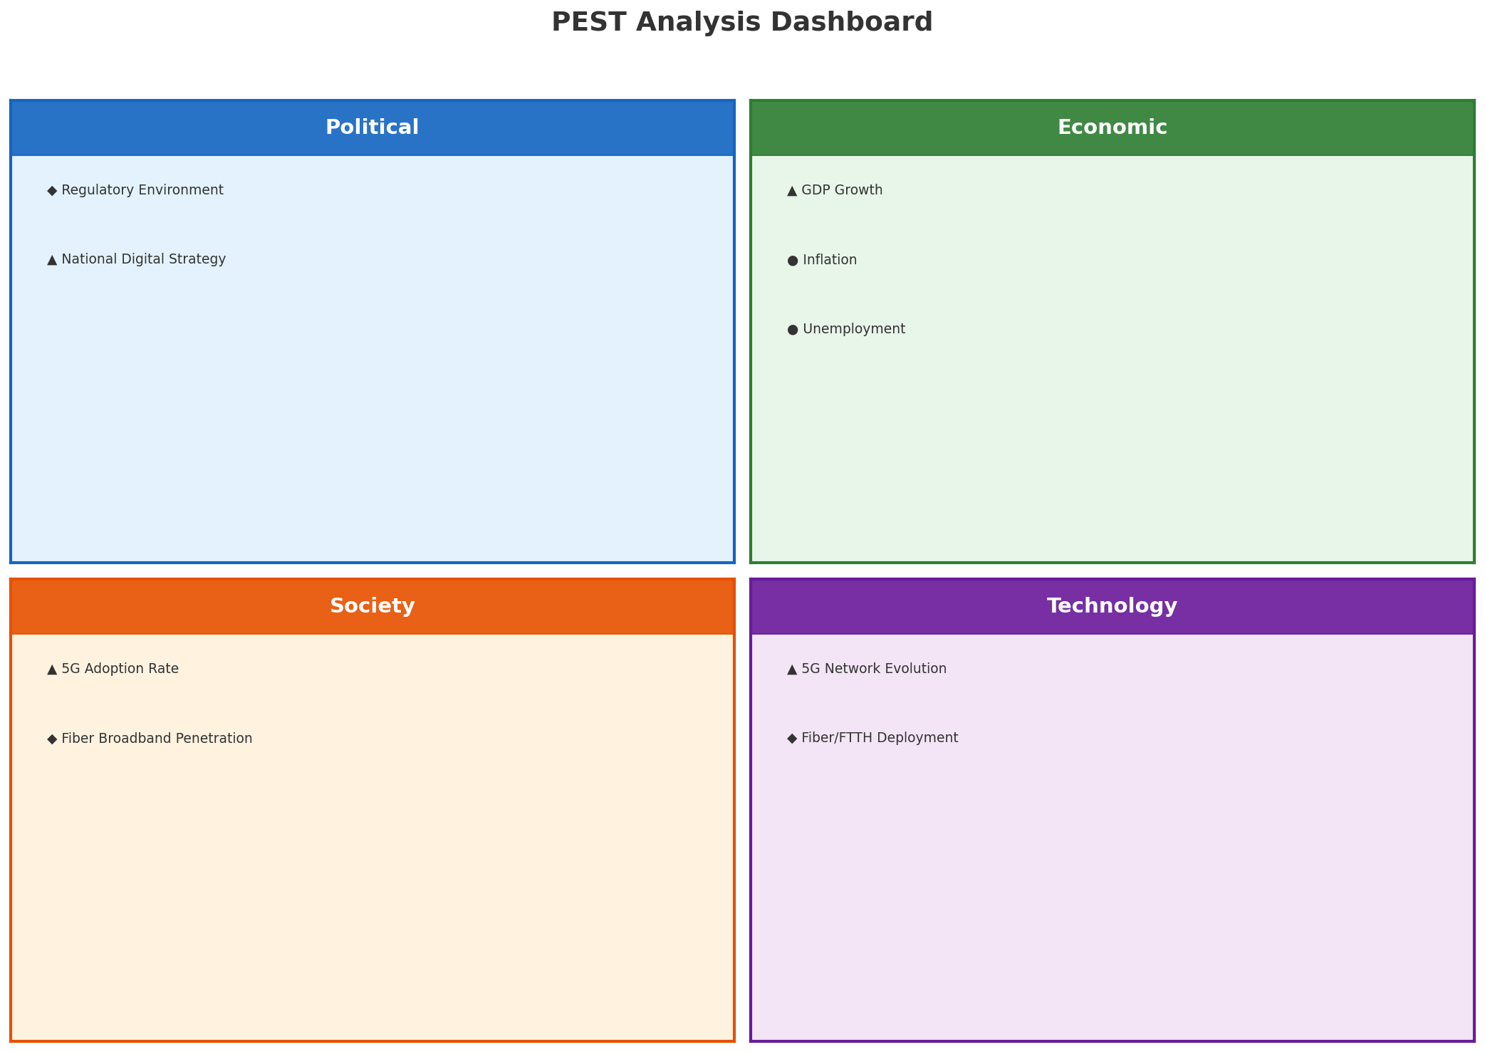
PEST Analysis Dashboard
MACRO ENVIRONMENT
Key Message: Macro environment: Favorable. Key opportunities: Regulatory Environment, National Digital Strategy. Key risks: Regulatory Environment, Fiber Broadband Penetration.
6

Slide 7
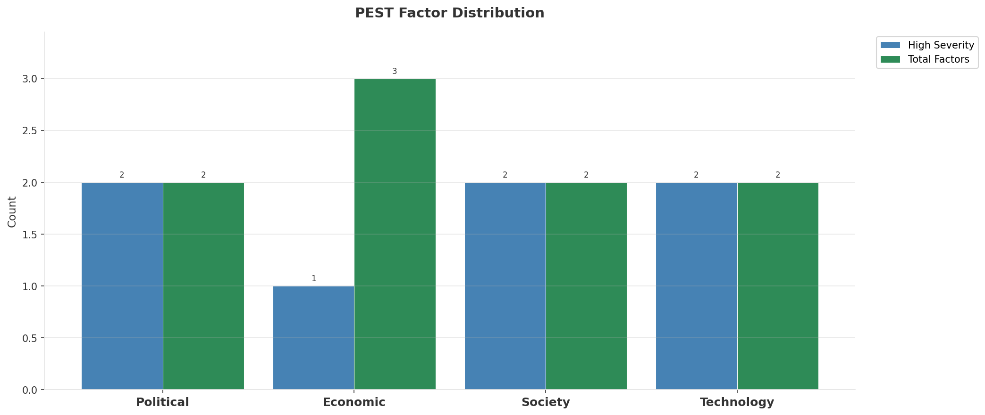
Industry Environment
INDUSTRY ANALYSIS
Market Size
Growth Rate
Concentration
Lifecycle
EUR 0.2B (quarterly, CQ4_2025
+4.8% YoY (CQ2_2025 -> CQ4_2025
CR4 = 100% (Cyta: 69.3%, Epic Cyprus: 21.6%, PrimeTel: 9.2%
late_growth
• New Business Models:
• FWA (Fixed Wireless Access) as fiber alternative
• Network-as-a-Service for enterprise verticals
• Wholesale/MVNO partnerships for coverage monetization
• Technology Revolution:
• 5G SA enabling network slicing and enterprise services
• AI/ML for network optimization and customer experience
• Open RAN for vendor diversification and cost reduction
Key Message: Macro environment: Favorable. Key opportunities: Regulatory Environment, National Digital Strategy. Key risks: Regulatory Environment, Fiber Broadband Penetration Industry is in late growth phase. (+4.8% YoY (CQ2_2025 -> CQ4_2025)
7

Slide 8
Value Transfer Trends
VALUE MIGRATION
• Value shifting from voice/SMS to data and digital services
• B2B/ICT growing faster than consumer segment
• Fiber displacing copper and cable broadband
Key Message: Macro environment: Favorable. Key opportunities: Regulatory Environment, National Digital Strategy. Key risks: Regulatory Environment, Fiber Broadband Penetration Industry is in late growth phase. (+4.8% YoY (CQ2_2025 -> CQ4_2025)
8

Slide 9
02 Look at Market
$APPEALS — Market Changes & Customer Needs

Slide 10
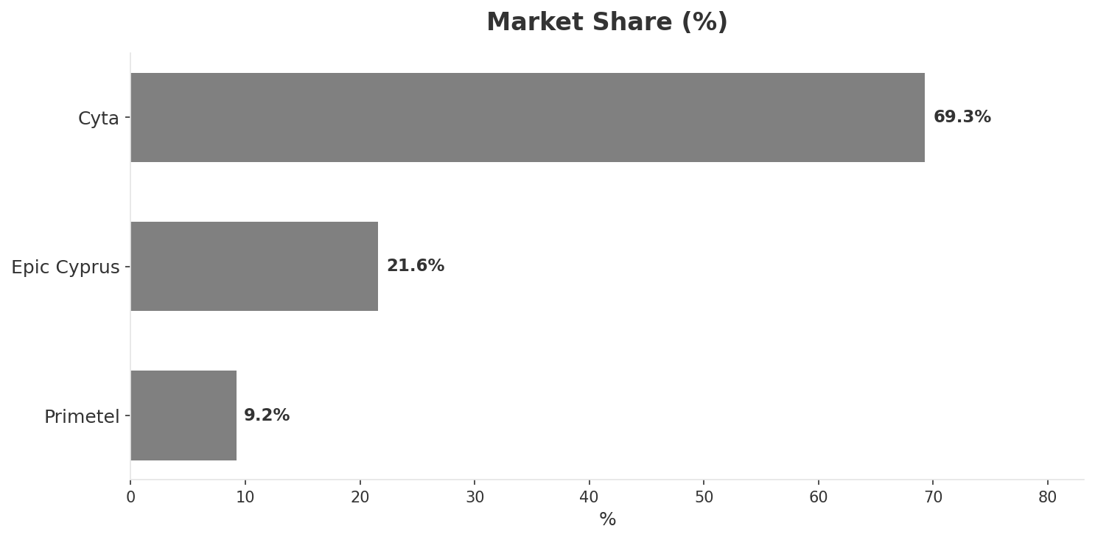
Market Change Panorama
MARKET OVERVIEW
Total Revenue (€M
Mobile Subs (K
Broadband Subs (K
Operators
153.0
1,442
302.0
3
Market Changes:
• Epic Cyprus revenue growth 10.0% YoY
• PrimeTel revenue growth 7.7% YoY
Key Message: Cyprus telecom market totals EUR 153.0M in quarterly revenue; competitive strengths in Performance; gaps in Assurances; Market presents a balanced mix of opportunities and challenges.
10

Slide 11
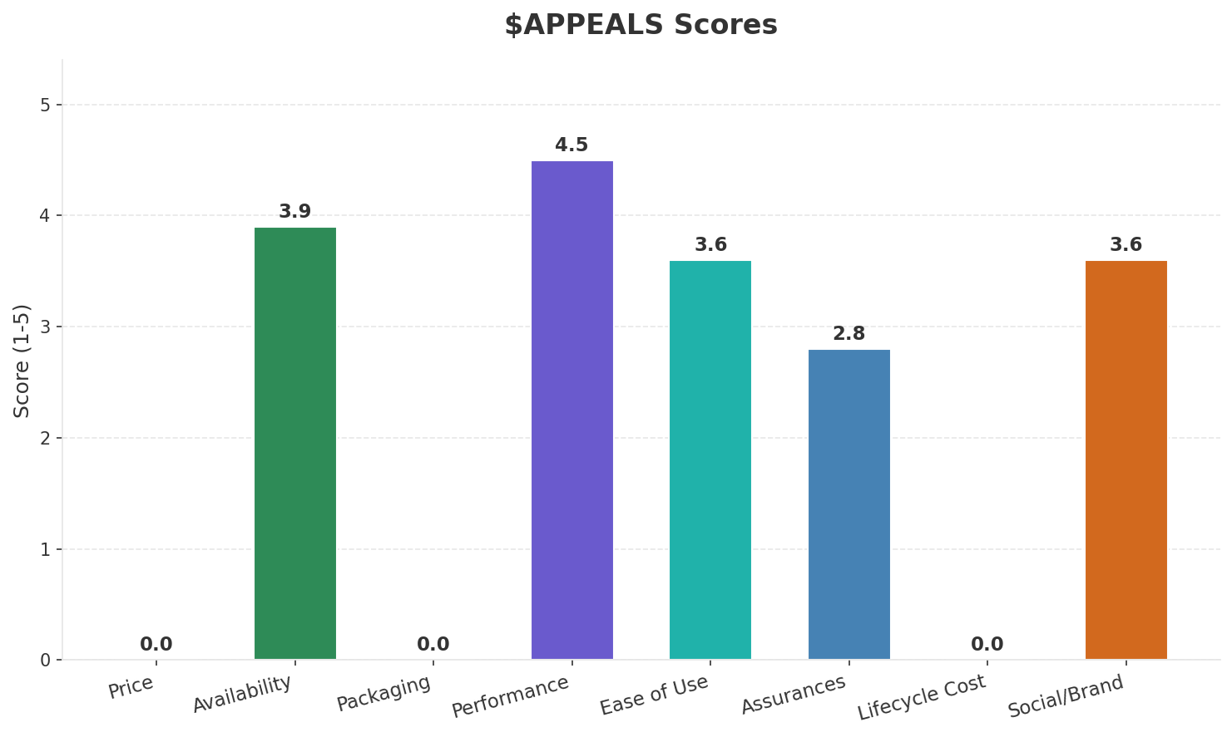
Customer Segments
SEGMENTATION
Consumer Urban Connected
Trend: stable
Needs: Faster and more affordable fiber broadband, Seamless converged fixed-mobile bundles
Consumer Price-Sensitive
Size: ~0.4M subscribers | Trend: shrinking | Our Share: ~33% of prepaid
Needs: More affordable unlimited mobile data plans, Transparent pricing without hidden fees
Tourist / Seasonal
Trend: stable
Needs: Easy tourist SIM activation and eSIM support, Short-term data-heavy plans for visitors
Enterprise & Government
Trend: stable
Needs: Managed ICT services for growing Cyprus business sector, Cloud and cybersecurity solutions
Key Message: Cyprus telecom market totals EUR 153.0M in quarterly revenue; competitive strengths in Performance; gaps in Assurances; Market presents a balanced mix of opportunities and challenges.
11

Slide 12
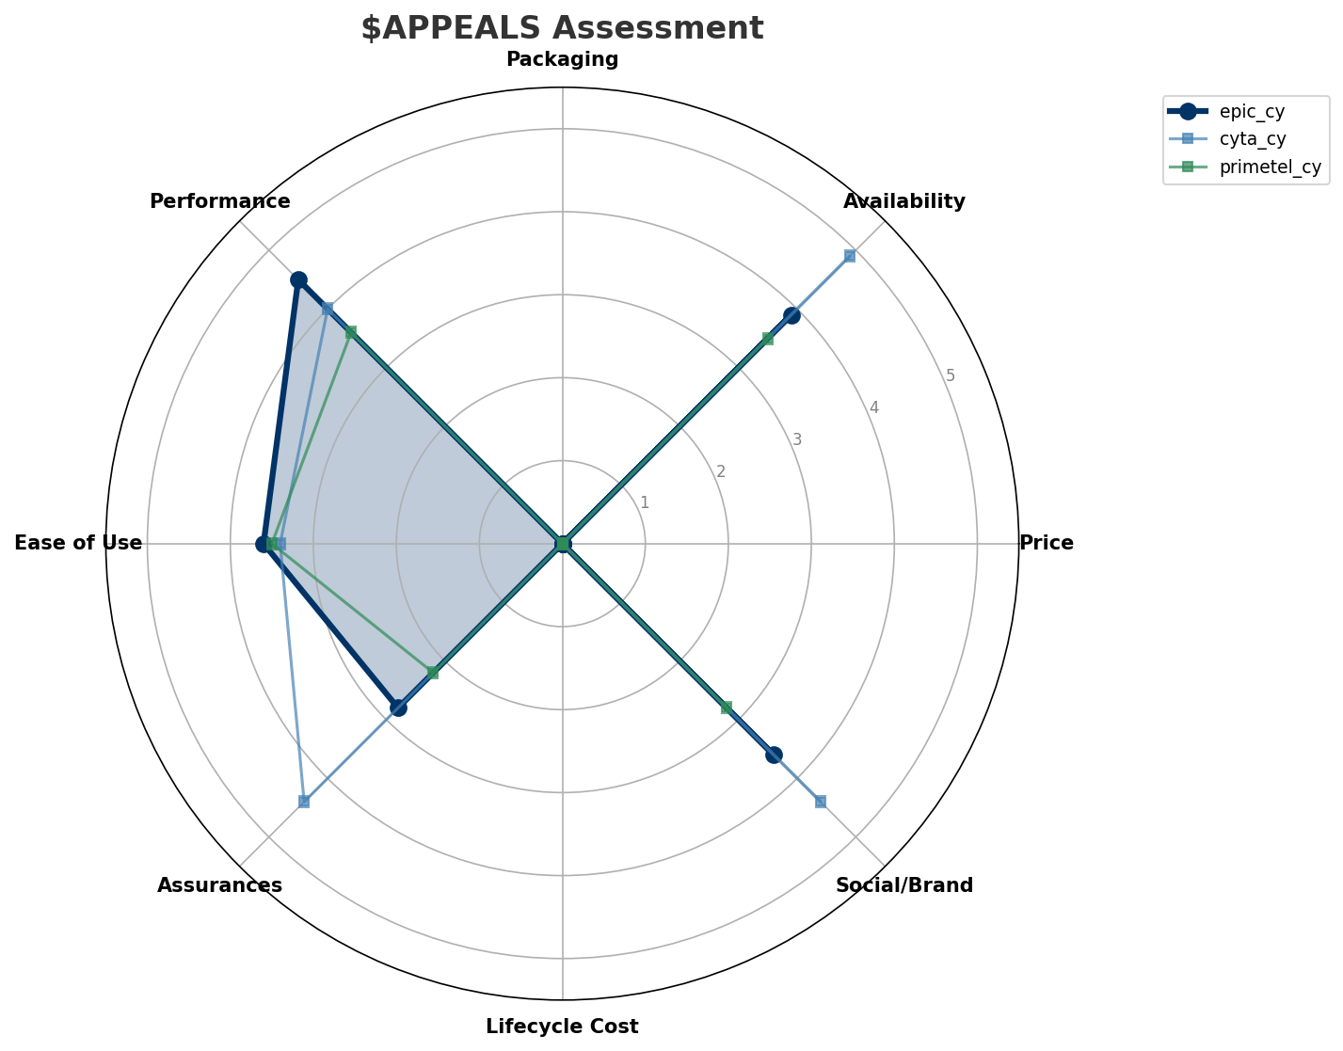
$APPEALS Assessment
CUSTOMER NEEDS
Key Message: Cyprus telecom market totals EUR 153.0M in quarterly revenue; competitive strengths in Performance; gaps in Assurances; Market presents a balanced mix of opportunities and challenges.
12

Slide 13
Customer Value Migration
VALUE MIGRATION
Value migration trending upward: customers willing to pay more for premium connectivity and convergent bundles. Focus on upselling and cross-selling opportunities.
Opportunities:
Threats:
• Epic Cyprus revenue growth 10.0% YoY
• PrimeTel revenue growth 7.7% YoY
Key Message: Cyprus telecom market totals EUR 153.0M in quarterly revenue; competitive strengths in Performance; gaps in Assurances; Market presents a balanced mix of opportunities and challenges.
13

Slide 14
Tariff Analysis
Mobile, Fixed & Convergence Pricing Landscape

Slide 15
Fixed & Convergence Pricing Landscape
DSL / CABLE / FIBER / FMC BUNDLES
Key Message: Fixed and convergence pricing overview
15

Slide 16
03 Look at Competition
Porter's Five Forces — Competitive Landscape

Slide 17
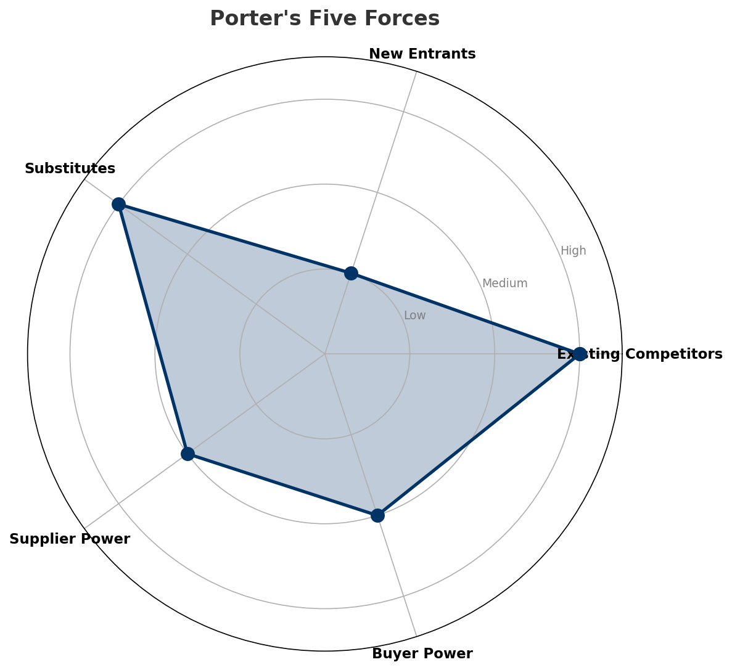
Porter's Five Forces
COMPETITIVE FORCES
Overall Intensity: MEDIUM
Key Message: In a 3-player market with medium competition intensity, Cyta leads with 69% revenue share. Target operator holds 22% share. Strongest competitive force: Existing Competitors.
17

Slide 18
Competitor Analysis: Primetel Cy
COMPETITOR DEEP DIVE
Revenue
EBITDA
Margin
Capex/Rev
€14M
€4M
28.6%
21.4%
+8.3% YoY
Strengths
Weaknesses
• Price Competitiveness: score 78 (market avg 72
• Brand Strength: score 55 (market avg 72
• Distribution: score 55 (market avg 72
• Enterprise Solutions: score 45 (market avg 63
• Innovation: score 60 (market avg 70
Strategy: Revenue-led profitable growth; subscriber acquisition focus
Key Message: Competitor analysis: Primetel Cy
18

Slide 19
Competitor Analysis: Cyta Cy
COMPETITOR DEEP DIVE
Revenue
EBITDA
Margin
Capex/Rev
€106M
€22M
20.8%
25.5%
+4.2% YoY
Strengths
Weaknesses
• Brand Strength: score 88 (market avg 72
• Distribution: score 92 (market avg 72
• Enterprise Solutions: score 88 (market avg 63
• Network Coverage: score 98 (market avg 82
• Digital Experience: score 65 (market avg 73
• Innovation: score 62 (market avg 70
• Price Competitiveness: score 55 (market avg 72
Strategy: Revenue-led profitable growth; subscriber acquisition focus; strong B2B/enterprise push
Key Message: Competitor analysis: Cyta Cy
19

Slide 20
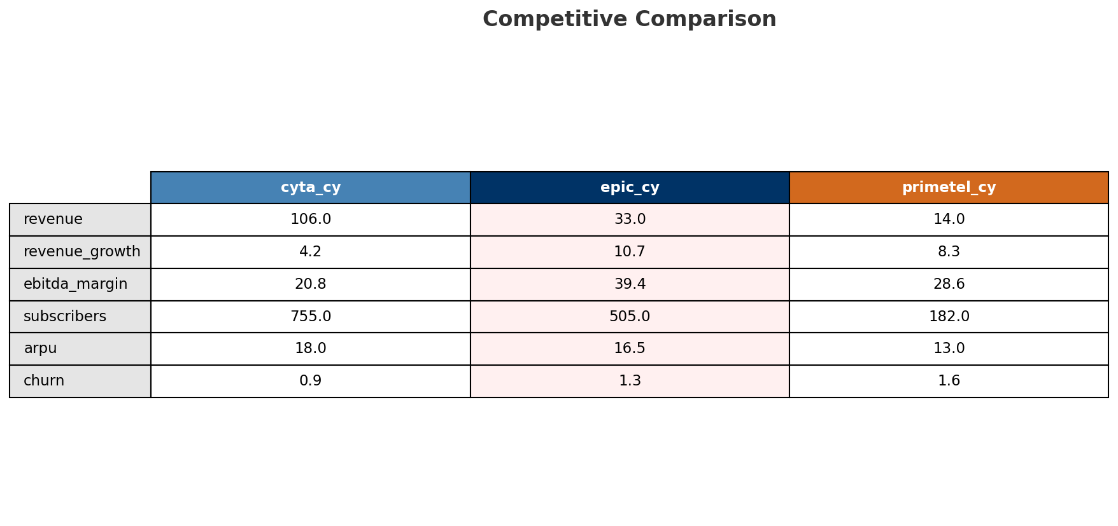
Competitive Landscape Summary
COMPETITION
Key Message: In a 3-player market with medium competition intensity, Cyta leads with 69% revenue share. Target operator holds 22% share. Strongest competitive force: Existing Competitors.
20

Slide 21
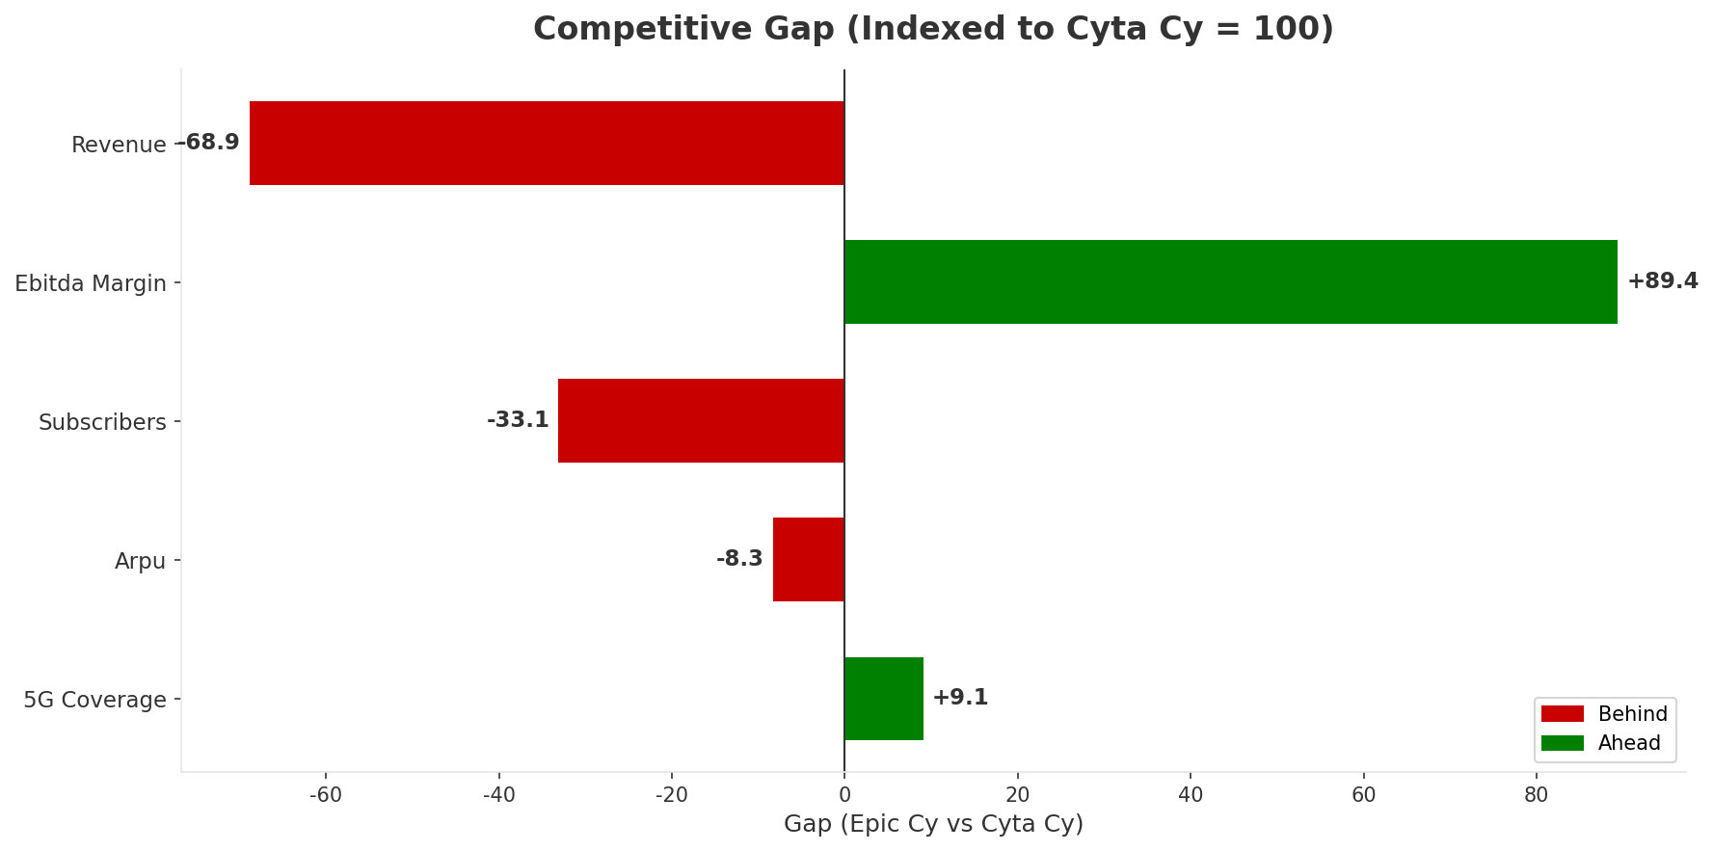
Gap Analysis: Epic Cy vs Cyta Cy
COMPETITIVE GAP
Key Message: Gap analysis vs market leader Cyta Cy
21

Slide 22
New Entrants Threat
MARKET ENTRY
• Entry barriers: High barriers: spectrum licensing, massive capex for network build, regulatory approvals, established brand loyalty
Key Message: New entrants threat level: low
22

Slide 23
04 Look at Self
BMC + Capability Assessment

Slide 24
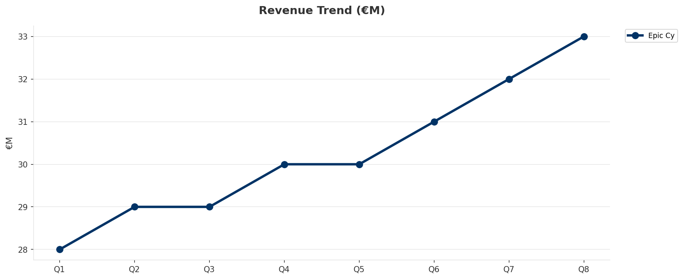
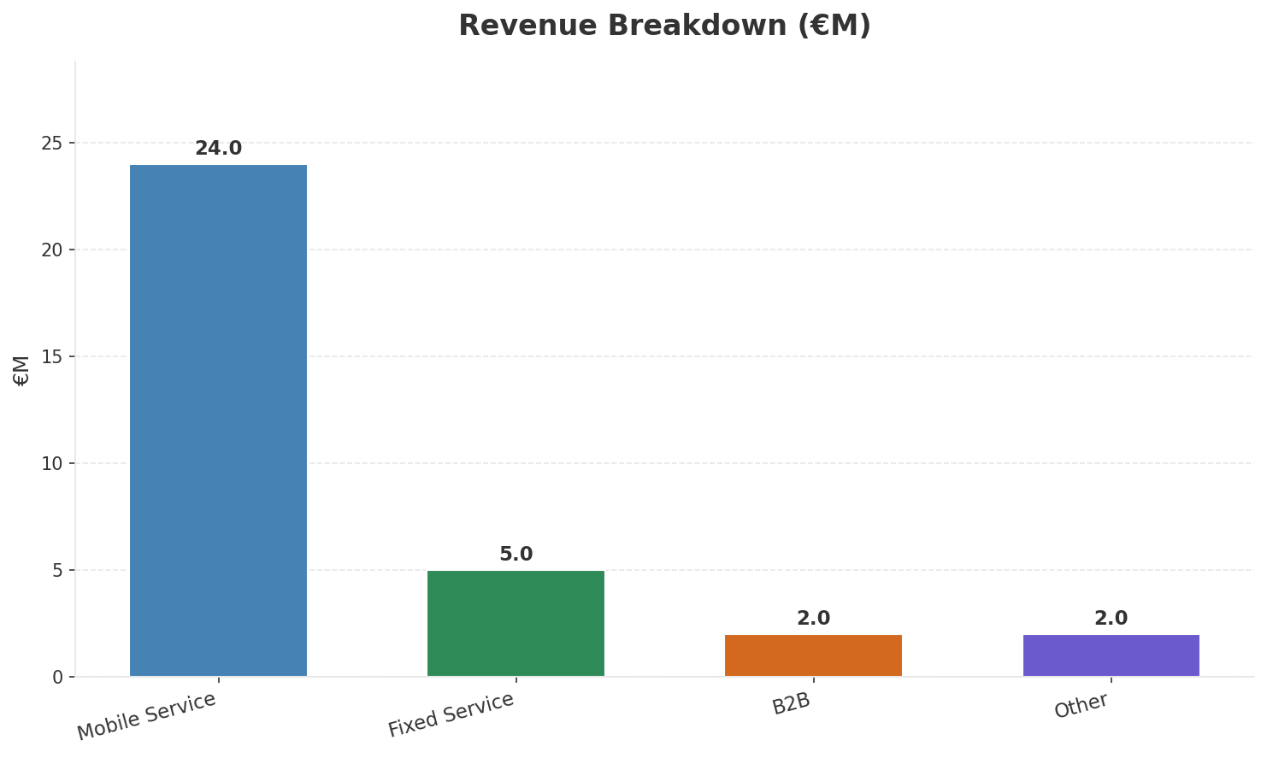
Operating Health Check
FINANCIAL HEALTH
Revenue
EBITDA
EBITDA Margin
Capex/Rev
€33M
€13M
39.4%
24.2%
+10.0% YoY
+8.3% YoY
CAGR: +9.8% | Accelerating Growth
Key Message: Ranked #2 of 3 operators in market; revenue EUR 33.0M; EBITDA margin 39.4%; stable but facing challenges; key strength: Digital Experience; key challenge: Distribution; Management outlook: Epic is #1 mobile network in speed tests (Ookla). 5G pioneer since Jul 2021. Growing subscriber base challenging Cyta's dominance. NJJ/Monaco Telecom ownership providing investment commitment.
24

Slide 25
Market Share Evolution
REVENUE SHARE TREND
Cyta
Epic Cyprus
PrimeTel
69.3% #1
21.6% #2
9.2% #3
-1.3pp losing
+1.0pp gaining
+0.3pp stable
Market Concentration: HHI 5,349 (Highly Concentrated) | CR3: 100.0% | Trend: Fragmenting
Subscriber share: Mobile: 35.0% (+0.6pp) | Broadband: 18.2% (+3.1pp
Key Message: Revenue share: 21.6% (#2); gaining (+1.0pp); market is highly concentrated (HHI 5,349); fragmenting.
25

Slide 26
Momentum Dashboard
MULTI-QUARTER TREND ANALYSIS
Revenue
EBITDA
Margin
+9.8% CAGR
+16.2% CAGR
+5.8% CAGR
Accelerating Growth (59/100
Stabilizing (15/100
Decelerating Growth (9/100
Key Message: Dominant momentum: Accelerating Growth — based on 3 KPI trend analyses
26

Slide 27
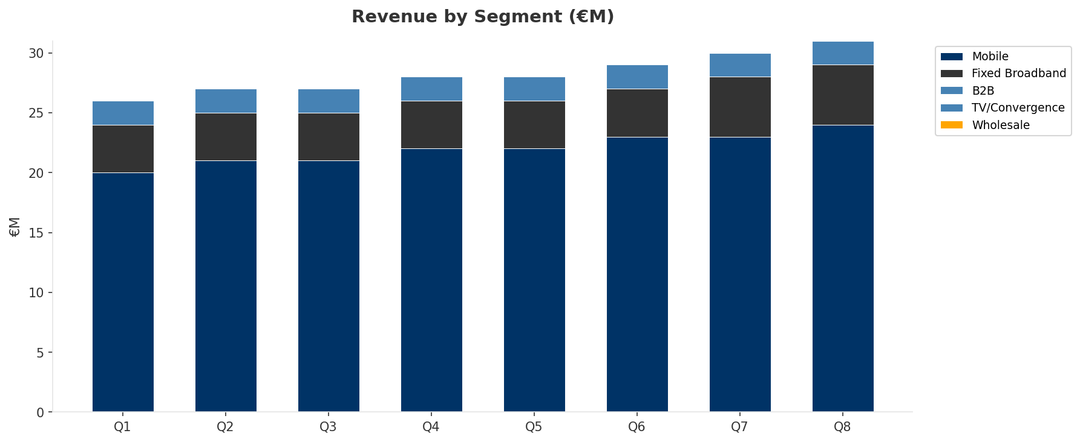
Revenue Composition Trend
SEGMENT REVENUE MIX OVER TIME
Key Message: Growing: Mobile, Fixed Broadband
27

Slide 28
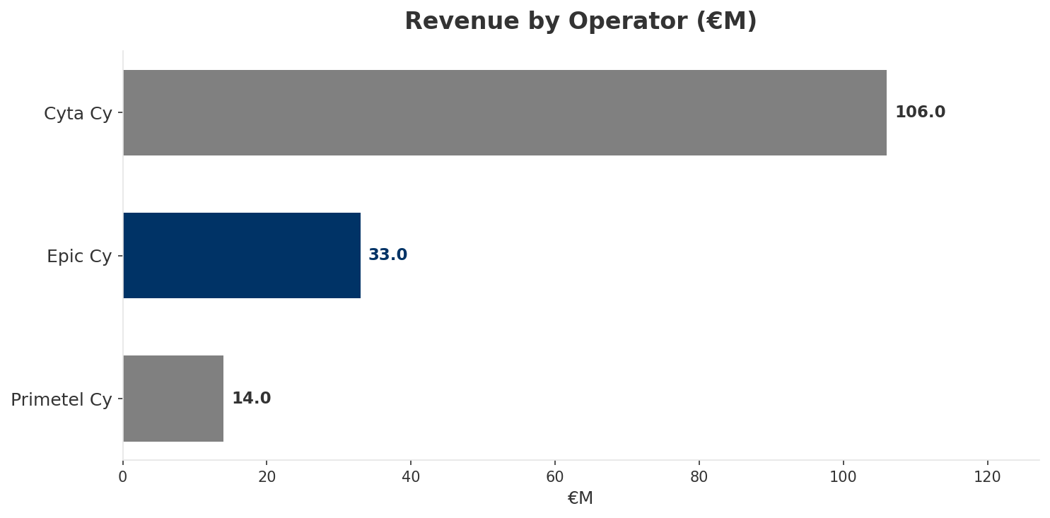
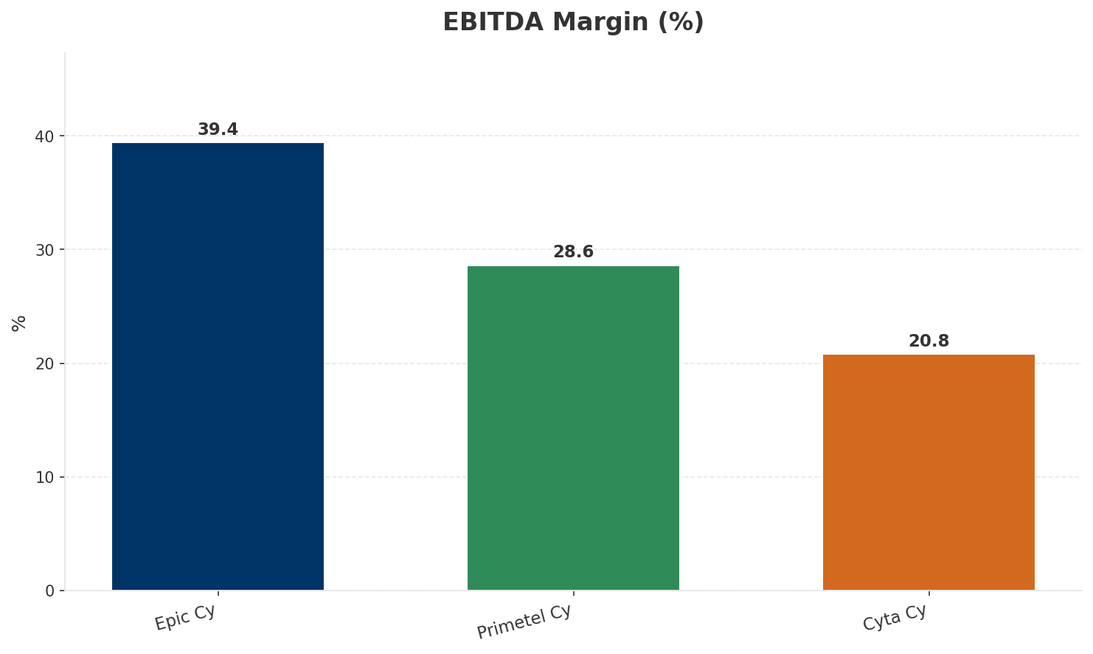
Revenue Comparison
COMPETITIVE BENCHMARKING
Key Message: Revenue and margin benchmarking across operators
28

Slide 29
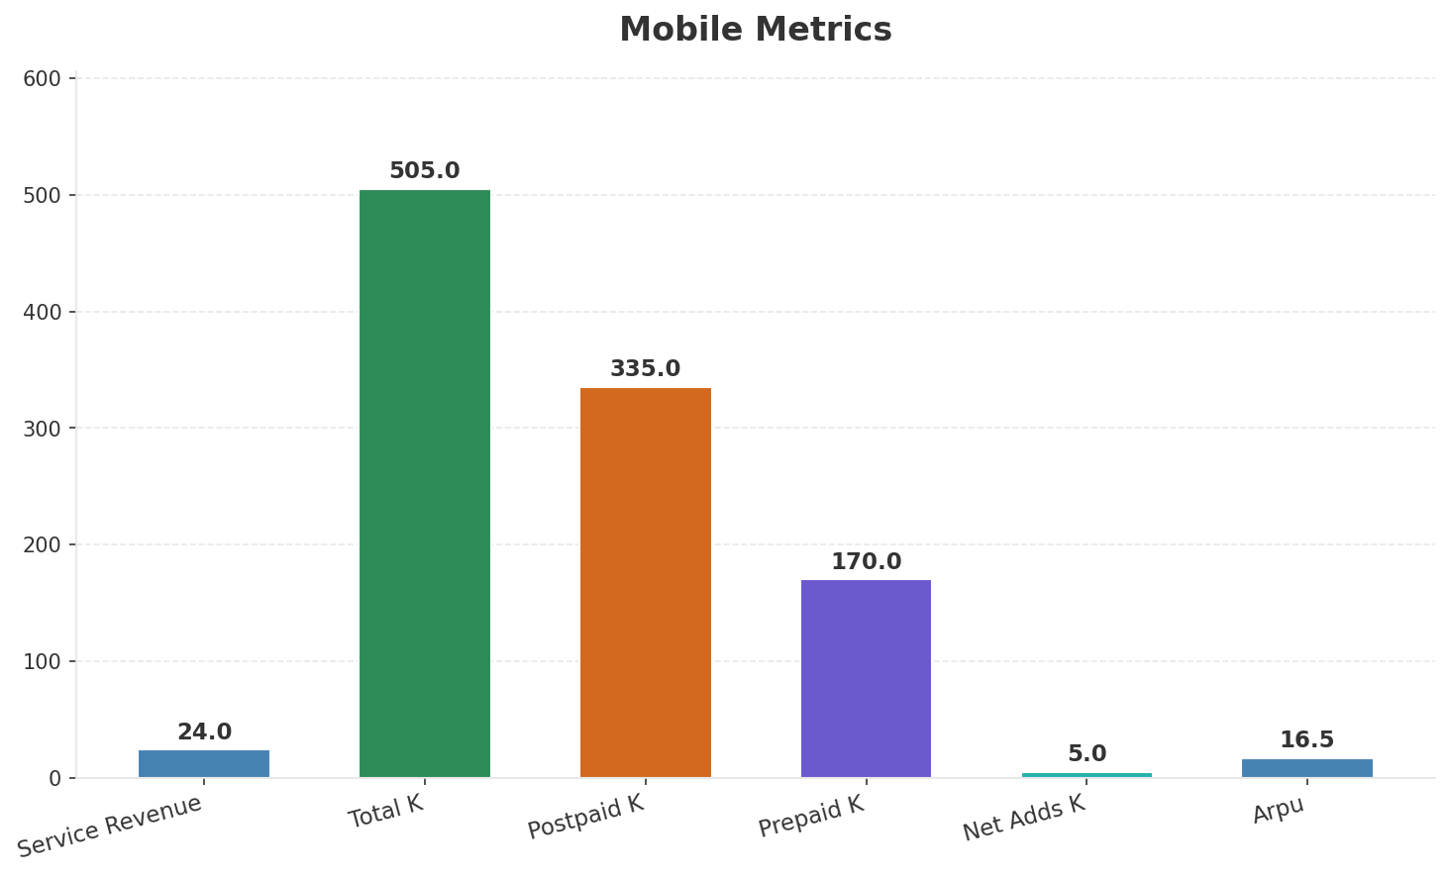
Segment Analysis: Mobile
SEGMENT PERFORMANCE
Service Revenue
Service Growth Pct
Total K
Postpaid K
€24M
9.1%
€505M
€335M
Health: STRONG
• revenue: improving
• subscribers: stable
• arpu: improving
• Epic is #1 mobile network in speed tests (Ookla). 5G pioneer since Jul 2021. Growing subscriber base challenging Cyta's dominance. NJJ/Monaco Telecom ownership providing investment commitment.
• FTTH rollout funded by EIB EUR 19M. Growing broadband subscriber base. Mobile-first evolving toward convergence to compete with Cyta's fixed-mobile bundles.
• revenue increased 4.3% QoQ
Key Message: Mobile service revenue at 24.0M; up 9.1% YoY; ARPU 16.5
29

Slide 30
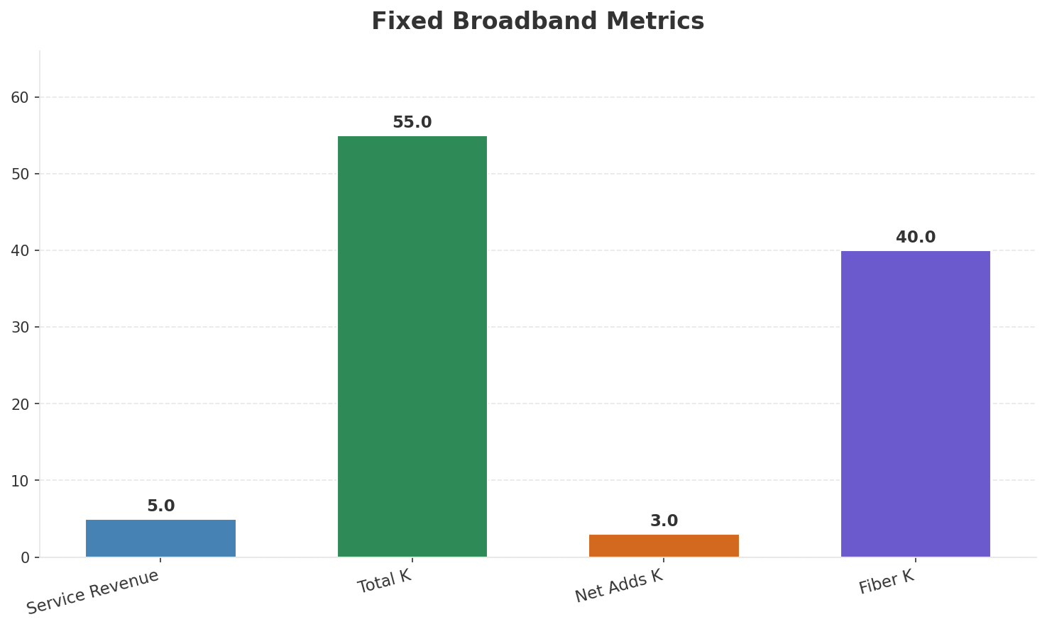
Segment Analysis: Fixed Broadband
SEGMENT PERFORMANCE
Service Revenue
Service Growth Pct
Total K
Net Adds K
€5M
25.0%
55
3
Health: STABLE
• revenue: stable
• subscribers: improving
• arpu: stable
• FTTH rollout funded by EIB EUR 19M. Growing broadband subscriber base. Mobile-first evolving toward convergence to compete with Cyta's fixed-mobile bundles.
• subscribers increased 5.8% QoQ
Key Message: Fixed service revenue 5.0M; growth +25.0% YoY; Fiber subs 40K
30

Slide 31
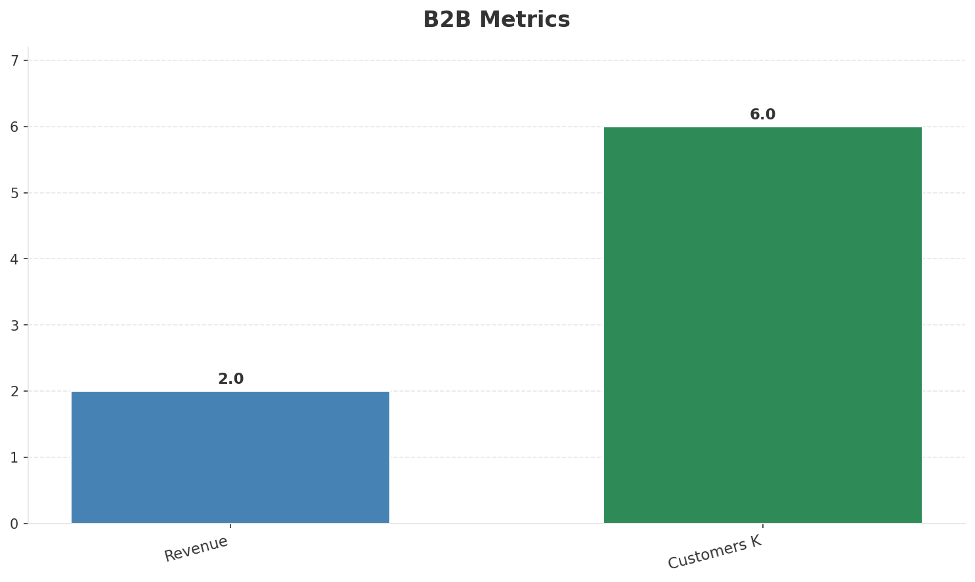
Segment Analysis: B2B
SEGMENT PERFORMANCE
Revenue
Growth Pct
Customers K
Share Of Revenue Pct
€2M
None
6
6.1%
Health: STABLE
• revenue: stable
• customers: stable
Key Message: B2B revenue 2.0M; 6.1% of total revenue
31

Slide 32
Segment Analysis: TV/Convergence
SEGMENT PERFORMANCE
Revenue
Total K
Net Adds K
Fmc Total K
None
0
None
None
Health: STABLE
• revenue: stable
• subscribers: stable
• fmc_subscribers: stable
• FTTH rollout funded by EIB EUR 19M. Growing broadband subscriber base. Mobile-first evolving toward convergence to compete with Cyta's fixed-mobile bundles.
Key Message: TV subscribers 0K
32

Slide 33
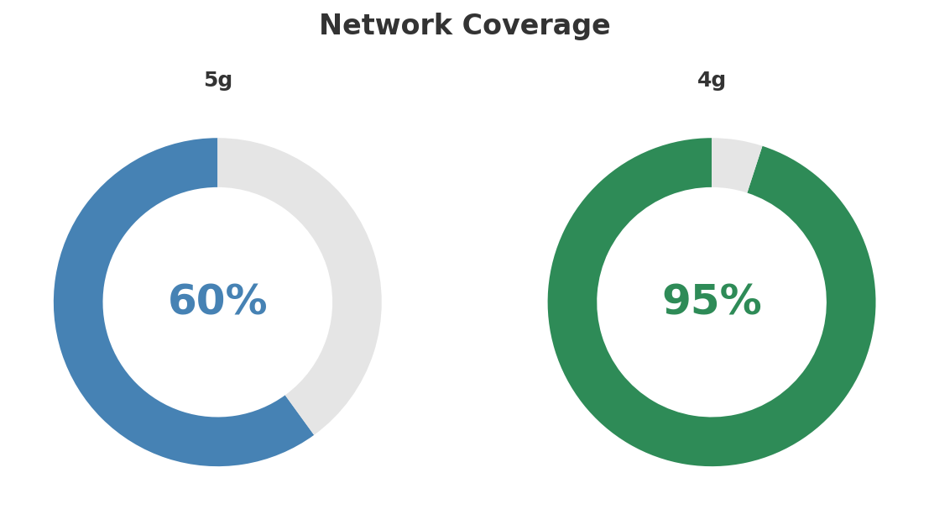
Network Analysis
INFRASTRUCTURE
Technology Mix:
Investment Direction: stable
• Mobile Vendor: Huawei
• Spectrum Mhz: 200
• 5G Launched: Jul 2021
• Fiber Status: EIB EUR 19M FTTH financing
Key Message: Network infrastructure and coverage assessment
33

Slide 34

Business Model Canvas
BMC
Key Message: Business model canvas overview
34

Slide 35
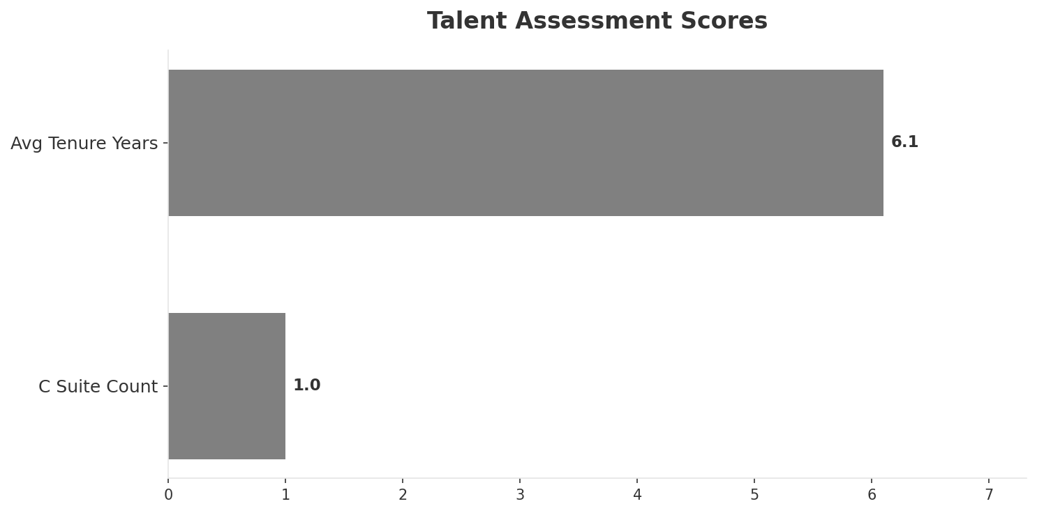
Organization & Talent
PEOPLE & CULTURE
Employees
C Suite Count
Avg Tenure Years
Key Leaders
585
1
6.1
['Marios Kalochoritis (CEO)']
Organization Culture:
Stable leadership team (avg tenure >3 years); Growth-oriented strategic posture; High-investment posture; Private-sector agility. Monaco Telecom management. Innovation-focused. Digital-first approach.
Leadership Changes:
• Marios Kalochoritis: (
Key Message: Organization and talent assessment
35

Slide 36
Strengths, Weaknesses & Exposure Points
SELF ASSESSMENT
Strengths
Weaknesses
Exposure Points
• Digital Experience: score 85 (market avg 73
• Innovation: score 88 (market avg 70
• Network Quality: score 90 (market avg 81
• Price Competitiveness: score 82 (market avg 72
• Strong EBITDA margin at 39.4%
• Revenue on growth trajectory
• Distribution: score 68 (market avg 72
• Enterprise Solutions: score 55 (market avg 63
• Network Coverage: score 78 (market avg 82
• 5G coverage gap at only 60.0%
• Limited fixed broadband infrastructure vs Cyta's national network: Cannot offer full convergent bundles across Cyprus
• Second-largest mobile operator competing against state-backed Cyta: Scale disadvantage in a small market
Key Message: Ranked #2 of 3 operators in market; revenue EUR 33.0M; EBITDA margin 39.4%; stable but facing challenges; key strength: Digital Experience; key challenge: Distribution; Management outlook: Epic is #1 mobile network in speed tests (Ookla). 5G pioneer since Jul 2021. Growing subscriber base challenging Cyta's dominance. NJJ/Monaco Telecom ownership providing investment commitment.
36

Slide 37
SWOT Synthesis
Strengths, Weaknesses, Opportunities & Threats

Slide 38
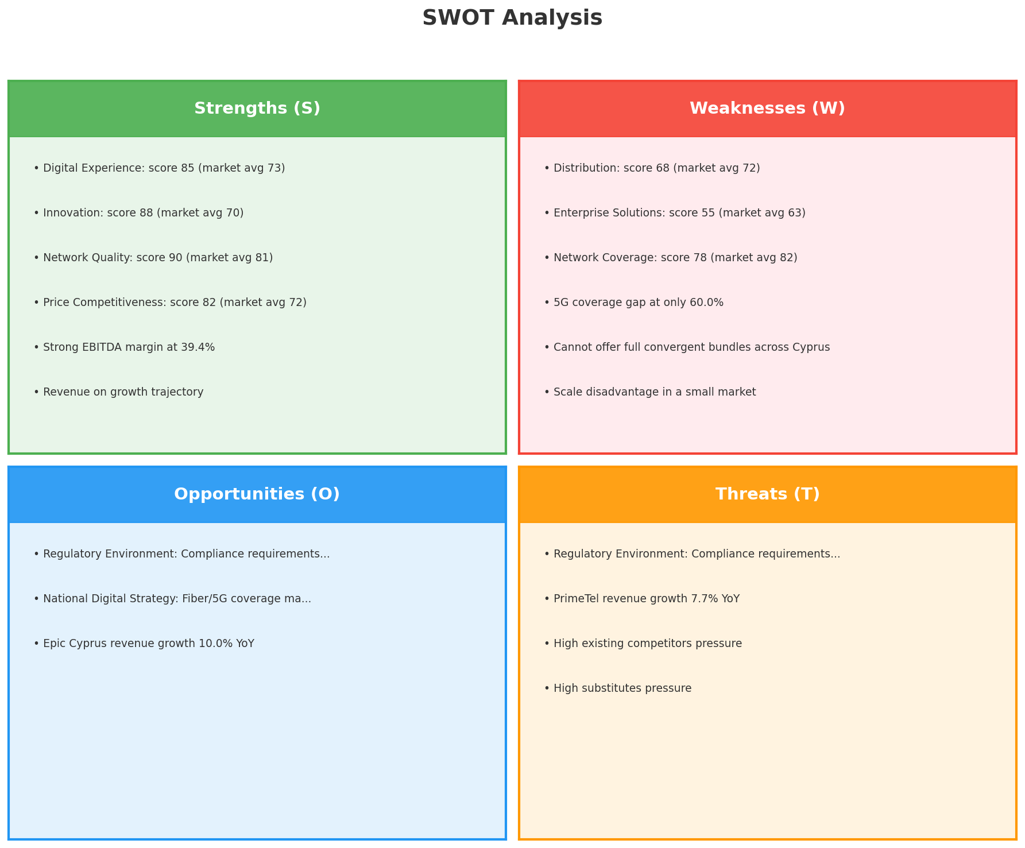
SWOT Analysis
STRATEGIC SYNTHESIS
SO:
Leverage 'Digital Experience: score 85 (market avg 73)' t...
WO:
Address weakness 'Distribution: score 68 (market avg 72)'...
ST:
Use strength 'Digital Experience: score 85 (market avg 73...
WT:
Mitigate weakness 'Distribution: score 68 (market avg 72)...
Key Message: SWOT analysis identifies 7 strengths, 6 weaknesses, 3 opportunities, and 4 threats. The recommended strategic posture is defensive (ST-dominant).
38

Slide 39
05 Look at Opportunities
SPAN Matrix — Opportunity Selection

Slide 40
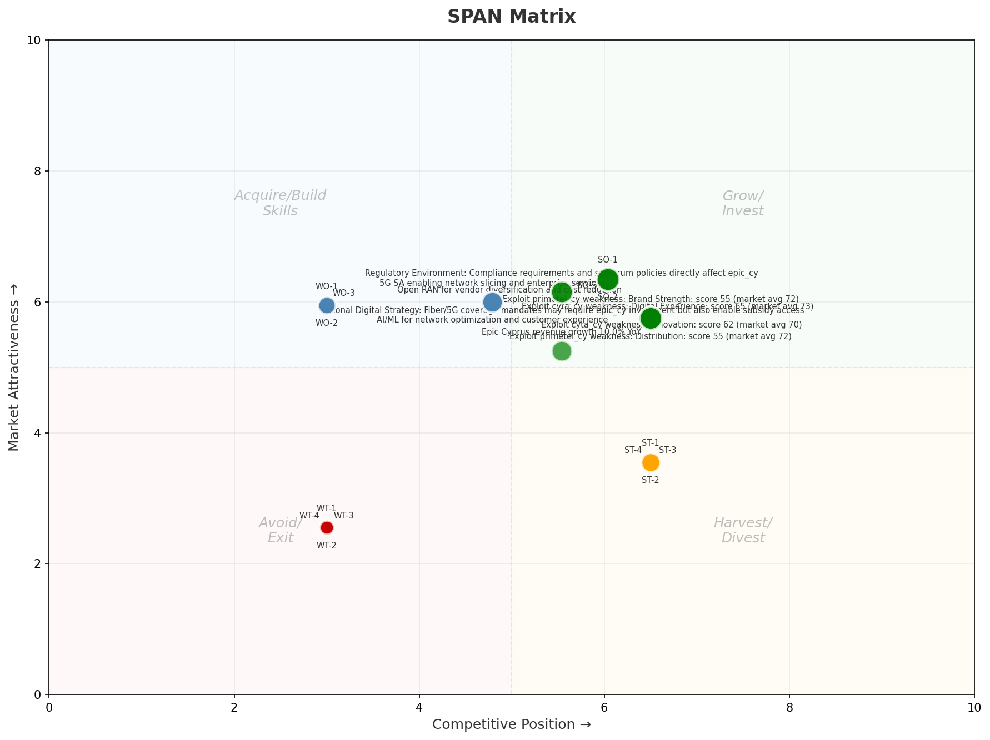
SPAN Matrix — Opportunity Positioning
OPPORTUNITY MAP
Key Message: SPAN matrix positions 24 opportunities: 10 grow/invest, 6 acquire skills, 4 harvest, 4 avoid/exit. Focus resources on the 10 grow/invest items for maximum strategic impact.
40

Slide 41
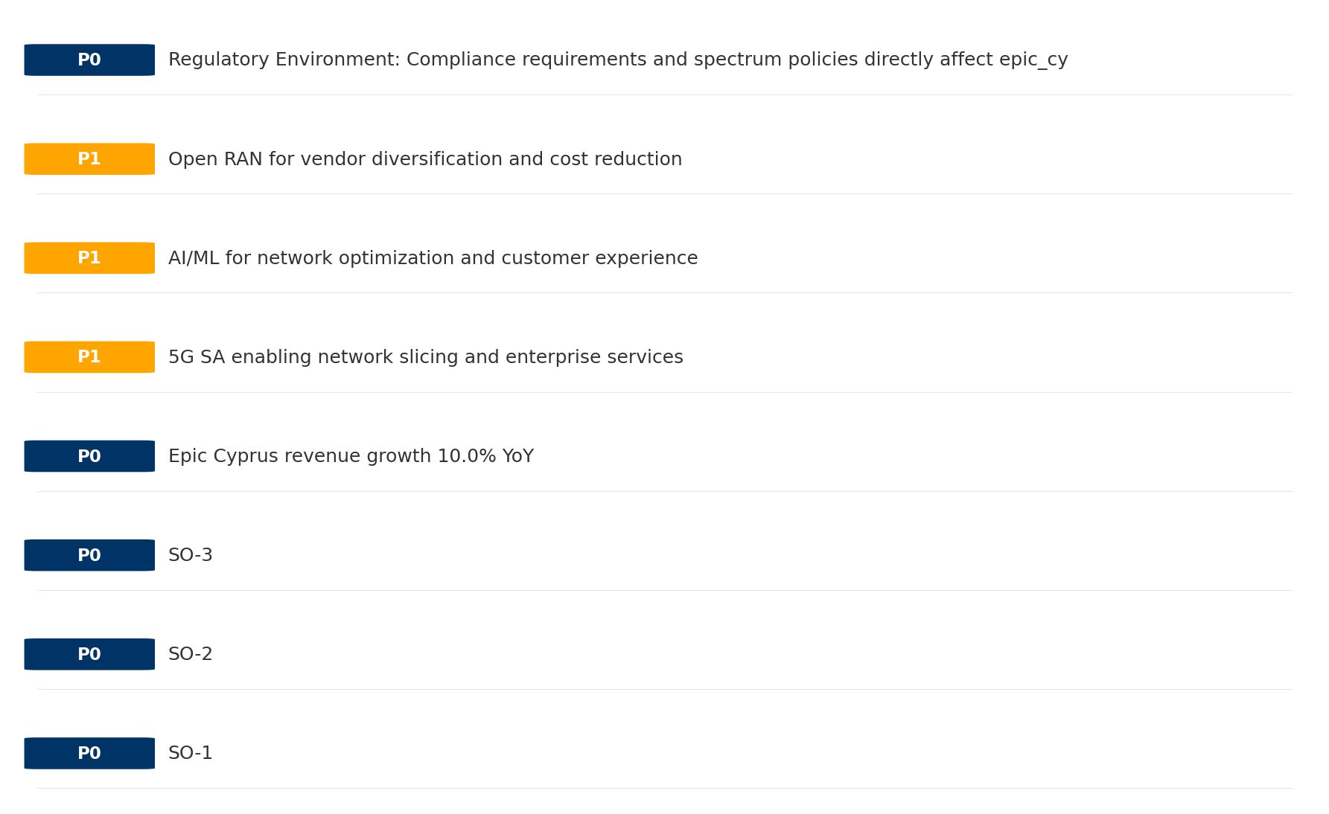
Opportunity Priority Ranking
PRIORITIES
Key Message: SPAN matrix positions 24 opportunities: 10 grow/invest, 6 acquire skills, 4 harvest, 4 avoid/exit. Focus resources on the 10 grow/invest items for maximum strategic impact.
41

Slide 42
Opportunity Details
DEEP DIVE
P0
SO-1
Market: N/A | Window:
Leverage 'Digital Experience: score 85 (market avg 73)' to capture the opportunity of 'Regulatory Environment: Compliance requirements and spectrum policies directly affect epic_cy'.
P0
SO-2
Market: N/A | Window:
Leverage 'Innovation: score 88 (market avg 70)' to capture the opportunity of 'National Digital Strategy: Fiber/5G coverage mandates may require epic_cy investment but also enable subsidy access'.
P0
SO-3
Market: N/A | Window:
Leverage 'Network Quality: score 90 (market avg 81)' to capture the opportunity of 'Epic Cyprus revenue growth 10.0% YoY'.
P0
Epic Cyprus revenue growth 10.0% YoY
Market: N/A | Window:
Epic Cyprus revenue growth 10.0% YoY
Key Message: SPAN matrix positions 24 opportunities: 10 grow/invest, 6 acquire skills, 4 harvest, 4 avoid/exit. Focus resources on the 10 grow/invest items for maximum strategic impact.
42

Slide 43
Three Decisions
Strategy — Key Tasks — Execution

Slide 44
Decision 1: Define Strategy
DEFENSIVE
As The Squeezed Middle: stabilize core business, then selectively invest for turnaround
P0
P0
P1
P1
Growth Strategy
Competitive Strategy
Transformation Strategy
Customer Strategy
Close the gap to market leader — accelerate Mobile, Fixed Broadband
Shore up competitive position — address: Distribution: score 68 (market avg 72
Accelerate fiber transition — converged network as competitive moat
Optimize value extraction in stable segments: B2B, TV/Convergence
- Gain 1-2pp revenue share
- Grow Mobile, Fixed Broadband double-digit
- Close Distribution: score 68 (market avg 72) gap within 12 months
- Reduce customer churn
- Fiber homepass coverage +20%
- FMC bundle attach rate 50%+
- Upsell rate +10% in B2B, TV/Convergence
- Cross-sell convergence bundles
Key Message: As The Squeezed Middle, the strategic posture is Defensive. As The Squeezed Middle: stabilize core business, then select
44

Slide 45
Decision 2: Define Key Tasks
3 P0 (IMMEDIATE), 3 P1 (1-2 YEARS), 1 P2 (3-5 YEARS
P0
Network
Accelerate Fixed Network Upgrade
Homepass coverage +15% | Speed tier upgrades
Drive DOCSIS/Fiber rollout to increase homepass and improve quality scores
P0
Business
Accelerate Mobile Growth
Mobile revenue +10% YoY | Market share gain
Mobile at €24M showing strong momentum — invest to scale
P0
Business
Accelerate Fixed Broadband Growth
Fixed Broadband revenue +10% YoY | Market share gain
Fixed Broadband at €5M showing strong momentum — invest to scale
P1
Network
5G Coverage Expansion
5G pop coverage target | 5G attach rate
Expand 5G population coverage to strengthen mobile competitive position
P1
Business
Opportunity Portfolio Execution
Launch 3+ priority initiatives | Pipeline contribution tracking
10 grow/invest opportunities identified — establish execution office
P1
Customer
Customer Experience Enhancement
NPS +5 points | First-call resolution rate 80%+
Improve digital touchpoints and service resolution to boost NPS
P2
Efficiency
Operational Efficiency & Automation
Process automation 30%+ | Cost-to-serve reduction
EBITDA margin 39.4% — maintain through smart automation and resource reallocatio
Key Message: 7 critical tasks: 3 P0 (immediate), 3 P1 (1-2 years), 1 P2 (3-5 years
45

Slide 46

Decision 3: Define Execution
QUARTERLY ROADMAP & GOVERNANCE
Governance
Strategic Traps to Avoid
- Monthly Progress Review (Monthly
x Enter a price war
- Quarterly Strategic Checkpoint (Quarterly
x Attempt premium repositioning
- Mid-Year Strategic Adjustment (Semi-annual
x Delay core transformation
Key Risks & Mitigation
! Resource constraints delay P0 initiatives -- Ring-fence P0 budgets; establish escalation path for blockers
Key Message: Execute with discipline: monthly reviews, quarterly checkpoints, annual refresh
! Macro-economic slowdown reduces consumer spending -- Prepare value-tier offerings; shift mix toward B2B resilience
46

Slide 47
Analysis Summary
KEY TAKEAWAYS
01 Trends
Macro environment: Favorable. Key opportunities: Regulatory Environment, National Digital Strategy. Key risks: Regulatory Environment, Fiber Broadband Penetration Industry is in late growth phase. (+4.8% YoY (CQ2_2025 -> CQ4_2025)
02 Market
Cyprus telecom market totals EUR 153.0M in quarterly revenue; competitive strengths in Performance; gaps in Assurances; Market presents a balanced mix of opportunities and challenges.
03 Competition
In a 3-player market with medium competition intensity, Cyta leads with 69% revenue share. Target operator holds 22% share. Strongest competitive force: Existing Competitors.
04 Self
Ranked #2 of 3 operators in market; revenue EUR 33.0M; EBITDA margin 39.4%; stable but facing challenges; key strength: Digital Experience; key challenge: Distribution; Management outlook: Epic is #1 mobile network in speed tests (Ookla). 5G pioneer since Jul 2021. Growing subscriber base challenging Cyta's dominance. NJJ/Monaco Telecom ownership providing investment commitment.
SWOT
SWOT analysis identifies 7 strengths, 6 weaknesses, 3 opportunities, and 4 threats. The recommended strategic posture is defensive (ST-dominant).
05 Opportunities
SPAN matrix positions 24 opportunities: 10 grow/invest, 6 acquire skills, 4 harvest, 4 avoid/exit. Focus resources on the 10 grow/invest items for maximum strategic impact.
Key Message: Complete Five Looks analysis — see opportunity priorities for next steps
47

Slide 48
Data Provenance
SOURCES & METHODOLOGY
No provenance data recorded for this analysis
Key Message: All data points are traceable to original sources
48

Slide 49
Thank You
BLM Five Looks Strategic Analysis

