Slide 1
Default BLM Strategic Analysis
BLM (Business Leadership Model) Five Looks Analysis
Target Operator
Market
Analysis Period
Report Date
Eir Ie
Ireland
CQ4_2025
2026-02-15
01 Trends (PEST) | 02 Market/Customer ($APPEALS) | 03 Competition (Porter) | 04 Self (BMC) | SWOT Synthesis | 05 Opportunities (SPAN

Slide 2
Report Contents
TABLE OF CONTENTS
01
Executive Summary
Key findings and recommendations
02
Look at Trends
PEST Framework — macro environment
03
Look at Market
$APPEALS — market changes & customer needs
T
Tariff Analysis
Pricing comparison — mobile, fixed & convergence
04
Look at Competition
Porter's Five Forces — competitive landscape
05
Look at Self
BMC + Capability — internal assessment
06
SWOT Synthesis
Strengths, Weaknesses, Opportunities, Threats
07
Look at Opportunities
SPAN Matrix — opportunity selection
Summary & Provenance
2
08
Conclusions and data sources

Slide 3
Data Quality Overview
DATA QUALITY
Total Data Points
High Confidence
Medium Confidence
Low/Estimated
20
0
0
20
0%
Unique Sources: 0
Data Conflicts: 0
Coverage: Partial
Key Message: 20 data points tracked, 0 high-confidence (0%
3

Slide 4
Executive Summary
Trends
Macro environment: Favorable. Key opportunities: Regulatory Environment, National Digital Strategy. Key risks: Regulatory Environment, Fiber Broadband Penetration Industry is in late growth phase. (+3.4% YoY (CQ2_2025 -> CQ4_2025)
Market/Customer
Ireland telecom market totals EUR 764.0M in quarterly revenue; competitive strengths in Availability, Performance; Market presents a balanced mix of opportunities and challenges.
Competition
In a 3-player market with medium competition intensity, eir leads with 45% revenue share. Target operator holds 45% share. Strongest competitive force: Substitutes.
Self Assessment
Ranked #1 of 3 operators in market; revenue EUR 345.0M; EBITDA margin 46.1%; stable but facing challenges; key strength: Distribution; key challenge: Price Competitiveness; Management outlook: FY2024 revenue EUR 1,326M (+2%), EBITDA EUR 614M (+4%), margin 46.3%. Mobile subs 1,509K (+6% YoY). Fiber BB connections 886K (94% on fiber). NJJ ownership consolidated to >70%.
SWOT
SWOT analysis identifies 7 strengths, 3 weaknesses, 2 opportunities, and 2 threats. The recommended strategic posture is offensive (SO-dominant).
Opportunities
SPAN matrix positions 17 opportunities: 11 grow/invest, 2 acquire skills, 2 harvest, 2 avoid/exit. Focus resources on the 11 grow/invest items for maximum strategic impact.
Key Message: Five Looks analysis completed — see details in following sections
4

Slide 5
01 Look at Trends
PEST Framework — Macro Environment

Slide 6
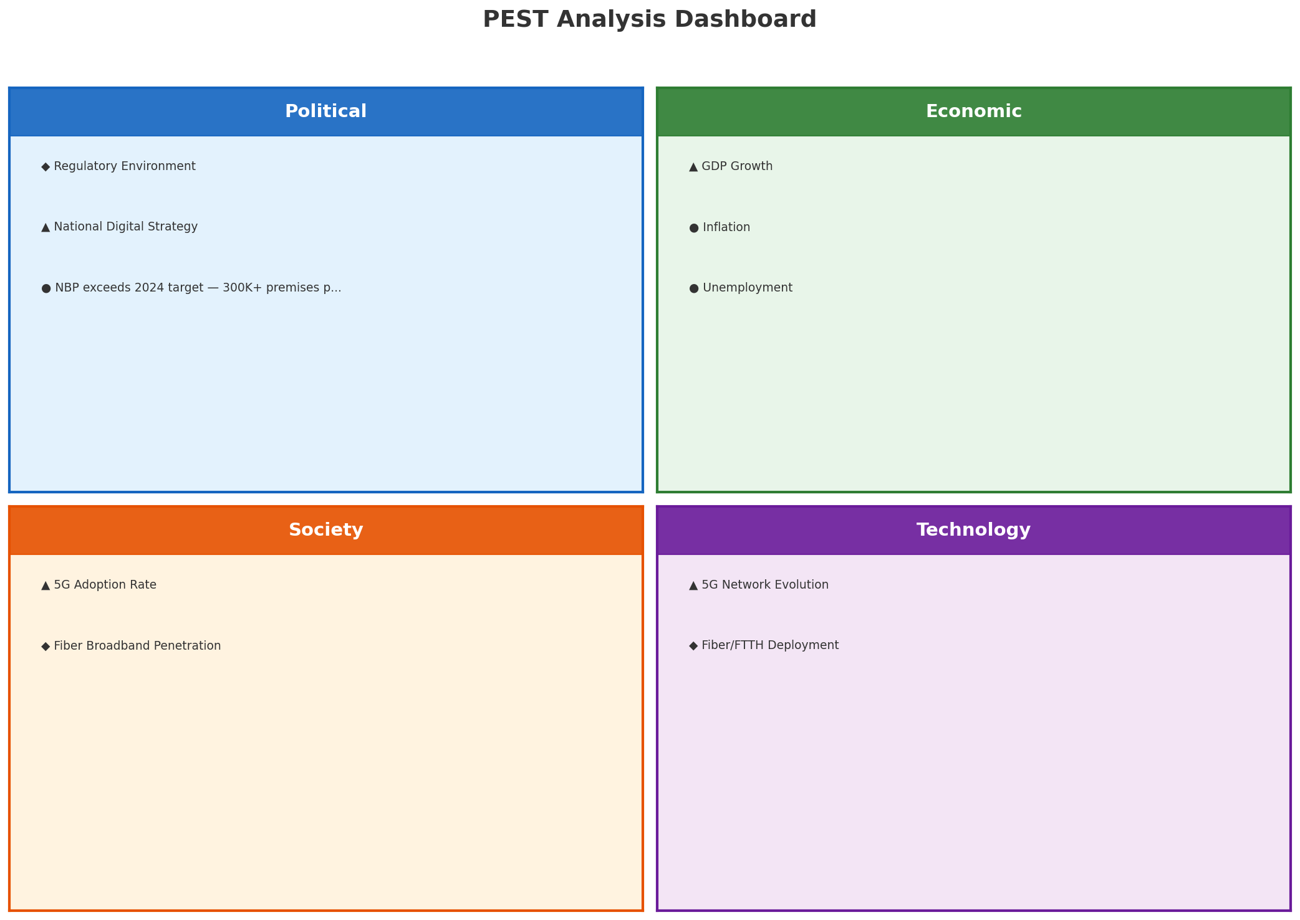
PEST Analysis Dashboard
MACRO ENVIRONMENT
Key Message: Macro environment: Favorable. Key opportunities: Regulatory Environment, National Digital Strategy. Key risks: Regulatory Environment, Fiber Broadband Penetration.
6

Slide 7
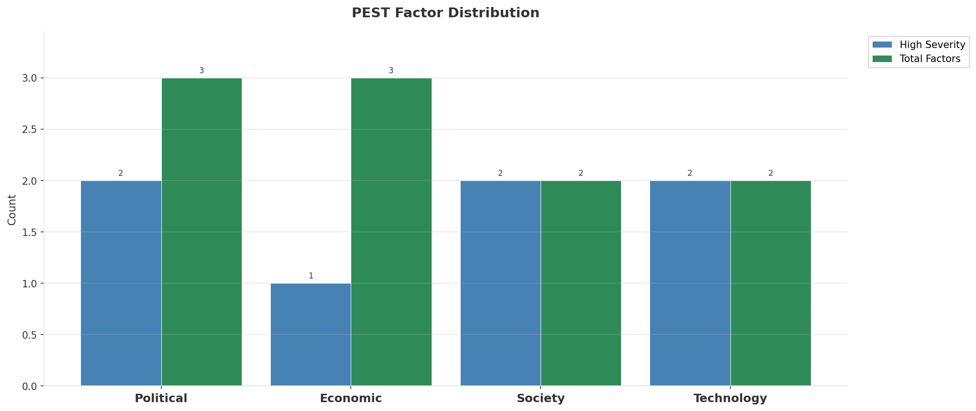
Industry Environment
INDUSTRY ANALYSIS
Market Size
Growth Rate
Concentration
Lifecycle
EUR 0.8B (quarterly, CQ4_2025
+3.4% YoY (CQ2_2025 -> CQ4_2025
CR4 = 100% (eir: 45.2%, Vodafone Ireland: 34.0%, Three Ireland: 20.8%
late_growth
• New Business Models:
• FWA (Fixed Wireless Access) as fiber alternative
• Network-as-a-Service for enterprise verticals
• Wholesale/MVNO partnerships for coverage monetization
• Technology Revolution:
• 5G SA enabling network slicing and enterprise services
• AI/ML for network optimization and customer experience
• Open RAN for vendor diversification and cost reduction
Key Message: Macro environment: Favorable. Key opportunities: Regulatory Environment, National Digital Strategy. Key risks: Regulatory Environment, Fiber Broadband Penetration Industry is in late growth phase. (+3.4% YoY (CQ2_2025 -> CQ4_2025)
7

Slide 8
Value Transfer Trends
VALUE MIGRATION
• Value shifting from voice/SMS to data and digital services
• B2B/ICT growing faster than consumer segment
• Fiber displacing copper and cable broadband
Key Message: Macro environment: Favorable. Key opportunities: Regulatory Environment, National Digital Strategy. Key risks: Regulatory Environment, Fiber Broadband Penetration Industry is in late growth phase. (+3.4% YoY (CQ2_2025 -> CQ4_2025)
8

Slide 9
02 Look at Market
$APPEALS — Market Changes & Customer Needs

Slide 10
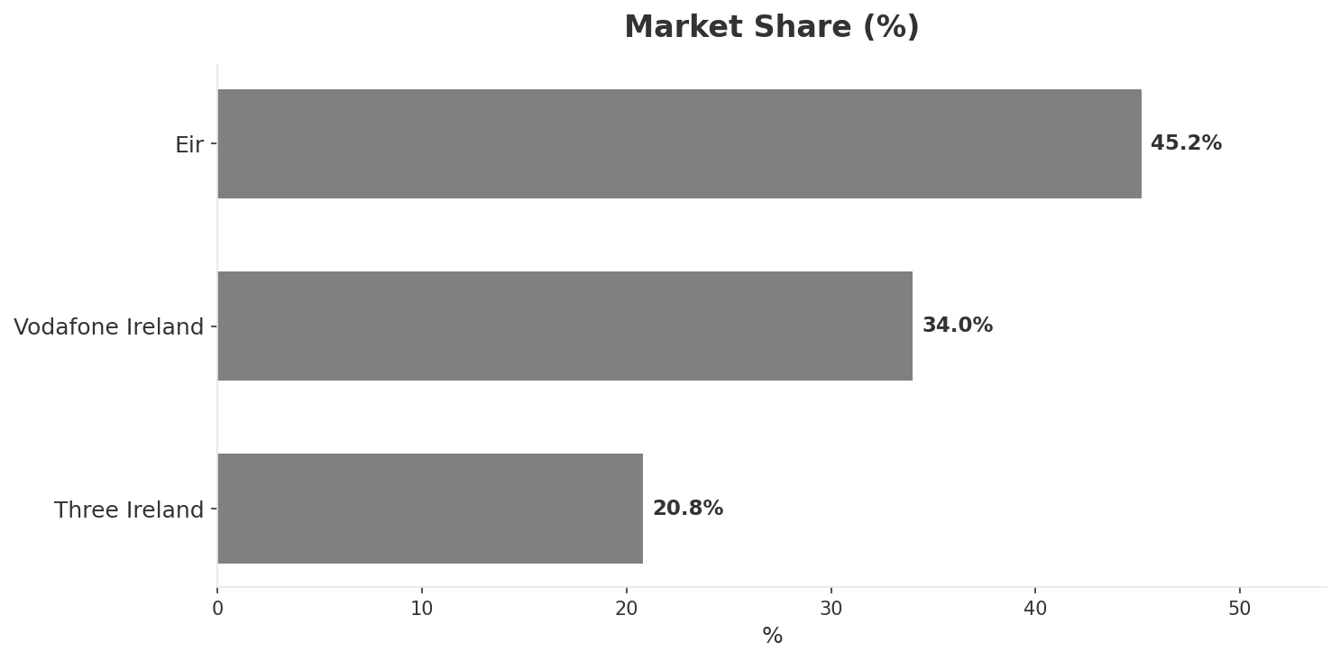
Market Change Panorama
MARKET OVERVIEW
Total Revenue (€M
Mobile Subs (K
Broadband Subs (K
Operators
764.0
6,039
887.0
3
Market Changes:
• Liberty Global in talks to acquire Three Ireland for EUR 1.5B
Key Message: Ireland telecom market totals EUR 764.0M in quarterly revenue; competitive strengths in Availability, Performance; Market presents a balanced mix of opportunities and challenges.
10

Slide 11
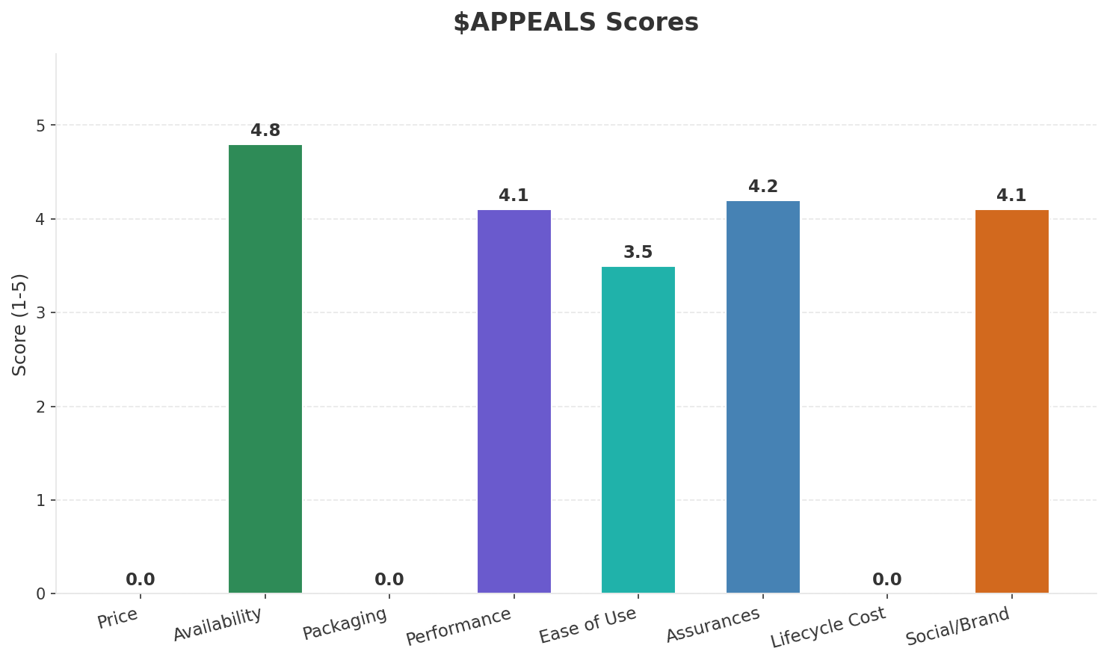
Customer Segments
SEGMENTATION
Consumer Premium Convergent
Trend: stable
Needs: Reliable high-speed fiber across all of Ireland (rural gap), Seamless fixed-mobile convergent bundles
Consumer Value-Seeking
Trend: stable
Needs: Affordable unlimited mobile data plans, Transparent pricing without bill shock
Consumer Digital-First / Young
Trend: stable
Needs: eSIM and digital-first onboarding, Flexible SIM-only plans
Enterprise & Public Sector
Trend: stable
Needs: Reliable connectivity for multinational HQs (Ireland is EU tech hub), Private 5G for pharmaceutical manufacturing
Key Message: Ireland telecom market totals EUR 764.0M in quarterly revenue; competitive strengths in Availability, Performance; Market presents a balanced mix of opportunities and challenges.
11

Slide 12
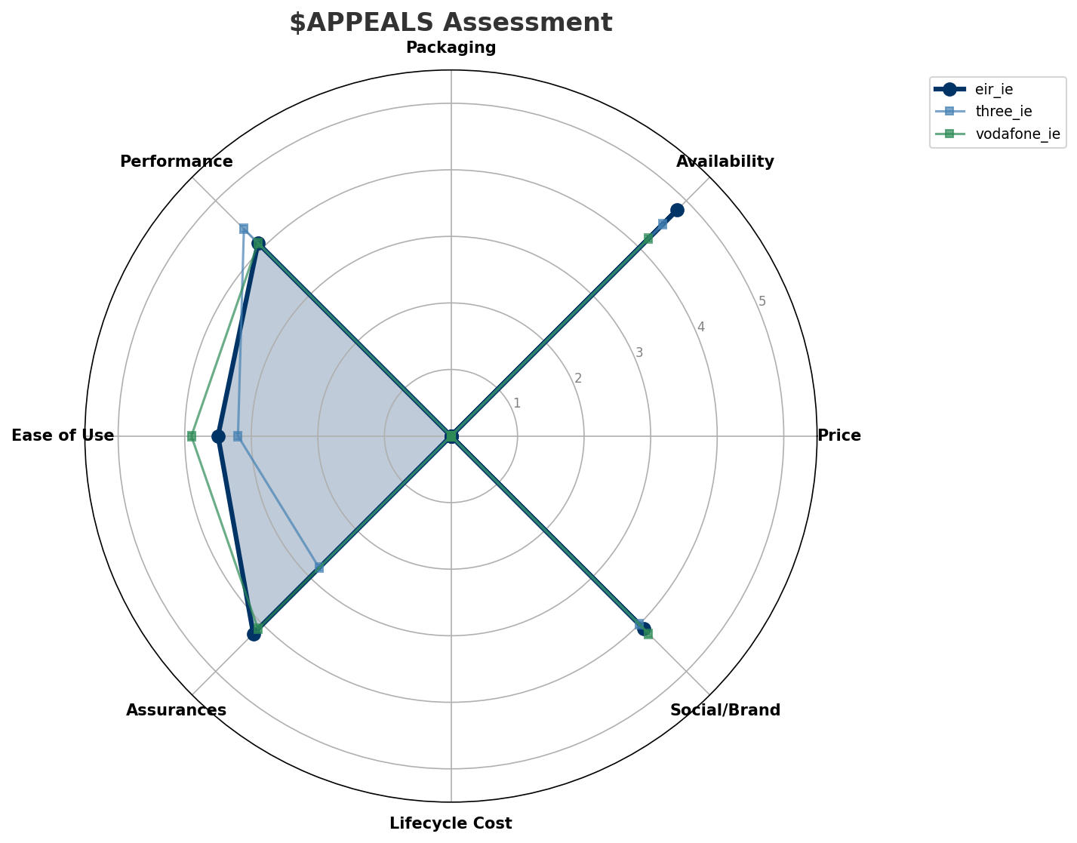
$APPEALS Assessment
CUSTOMER NEEDS
Key Message: Ireland telecom market totals EUR 764.0M in quarterly revenue; competitive strengths in Availability, Performance; Market presents a balanced mix of opportunities and challenges.
12

Slide 13
Customer Value Migration
VALUE MIGRATION
Limited data to assess value migration trends
Key Message: Ireland telecom market totals EUR 764.0M in quarterly revenue; competitive strengths in Availability, Performance; Market presents a balanced mix of opportunities and challenges.
13

Slide 14
Tariff Analysis
Mobile, Fixed & Convergence Pricing Landscape

Slide 15
Fixed & Convergence Pricing Landscape
DSL / CABLE / FIBER / FMC BUNDLES
Key Message: Fixed and convergence pricing overview
15

Slide 16
03 Look at Competition
Porter's Five Forces — Competitive Landscape

Slide 17
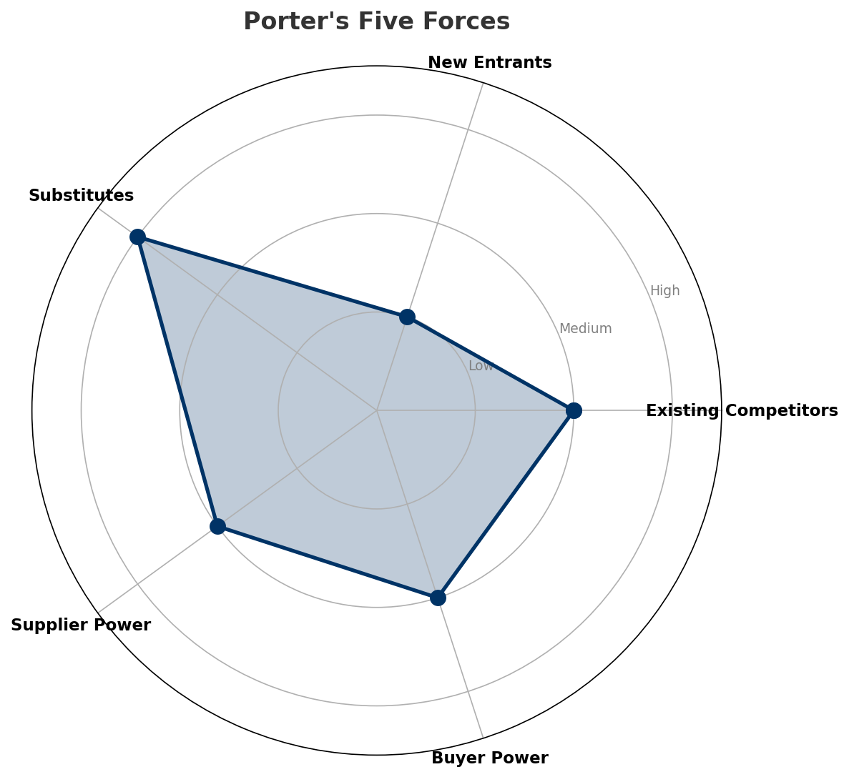
Porter's Five Forces
COMPETITIVE FORCES
Overall Intensity: MEDIUM
Key Message: In a 3-player market with medium competition intensity, eir leads with 45% revenue share. Target operator holds 45% share. Strongest competitive force: Substitutes.
17

Slide 18
Competitor Analysis: Vodafone Ie
COMPETITOR DEEP DIVE
Revenue
EBITDA
Margin
Capex/Rev
€260M
€45M
17.3%
13.1%
+3.6% YoY
Strengths
Weaknesses
• Customer Service: score 78 (market avg 71
• Enterprise Solutions: score 82 (market avg 74
• Network Coverage: score 85 (market avg 90
• Price Competitiveness: score 68 (market avg 74
Strategy: Revenue-led profitable growth; subscriber acquisition focus; strong B2B/enterprise push
Key Message: Competitor analysis: Vodafone Ie
18

Slide 19
Competitor Analysis: Three Ie
COMPETITOR DEEP DIVE
Revenue
EBITDA
Margin
Capex/Rev
€159M
€42M
26.4%
17.6%
+2.1% YoY
Strengths
Weaknesses
• Price Competitiveness: score 85 (market avg 74
• Customer Service: score 65 (market avg 71
• Enterprise Solutions: score 55 (market avg 74
Strategy: Revenue-led profitable growth; subscriber acquisition focus
Key Message: Competitor analysis: Three Ie
19

Slide 20
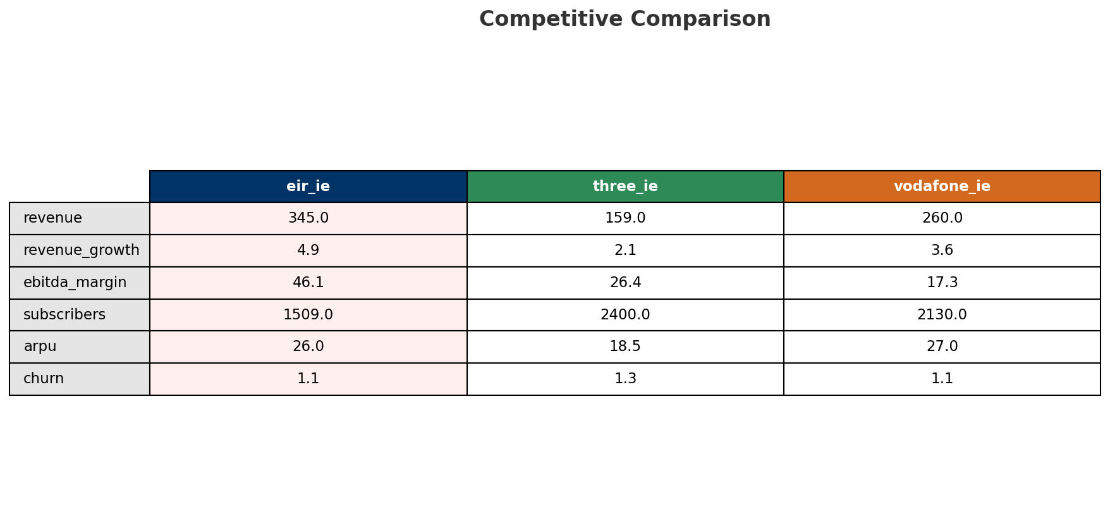
Competitive Landscape Summary
COMPETITION
Key Message: In a 3-player market with medium competition intensity, eir leads with 45% revenue share. Target operator holds 45% share. Strongest competitive force: Substitutes.
20

Slide 21
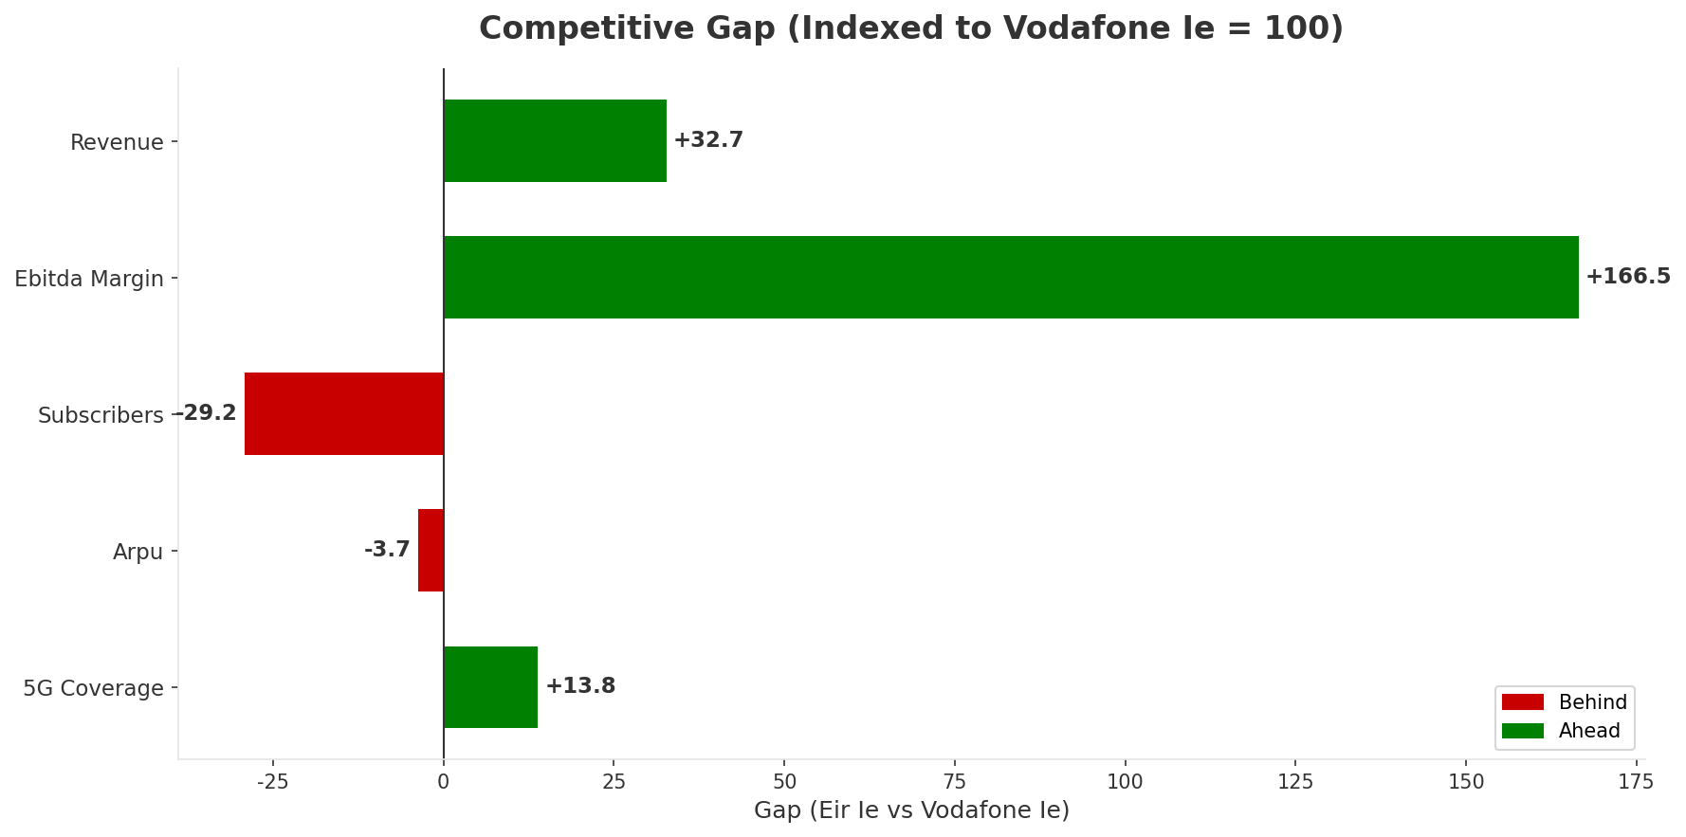
Gap Analysis: Eir Ie vs Vodafone Ie
COMPETITIVE GAP
Key Message: Gap analysis vs market leader Vodafone Ie
21

Slide 22
New Entrants Threat
MARKET ENTRY
• Entry barriers: High barriers: spectrum licensing, massive capex for network build, regulatory approvals, established brand loyalty
Key Message: New entrants threat level: low
22

Slide 23
04 Look at Self
BMC + Capability Assessment

Slide 24
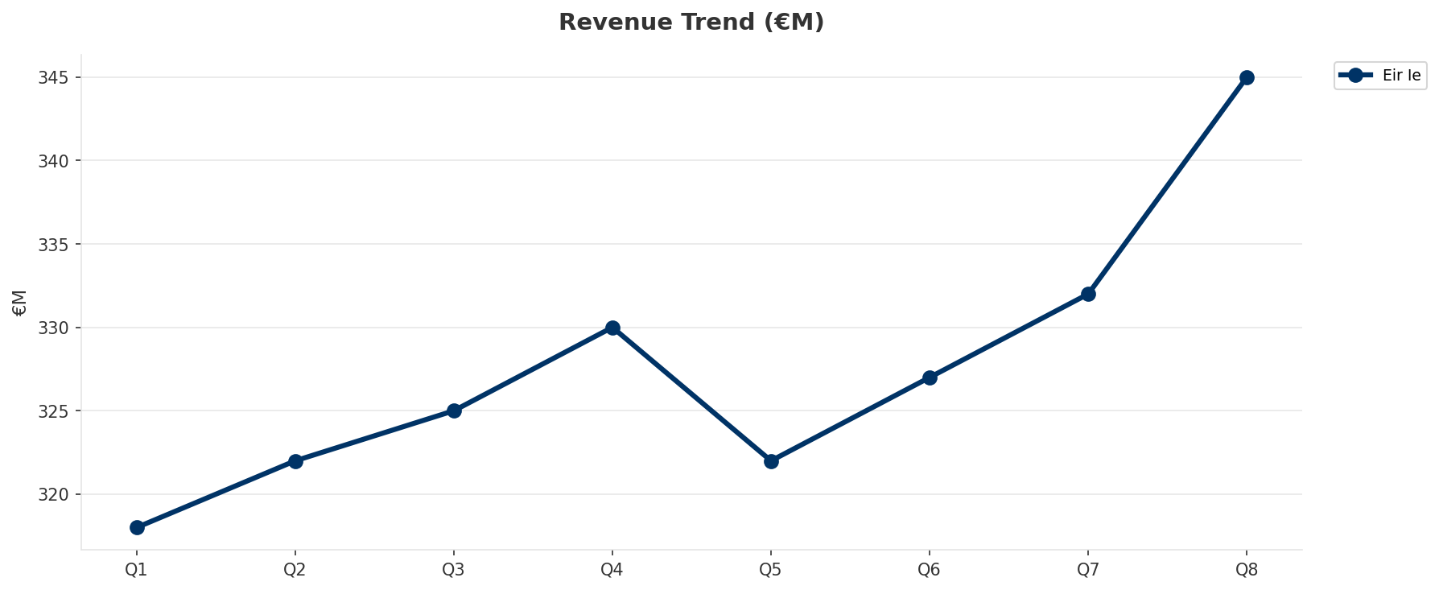
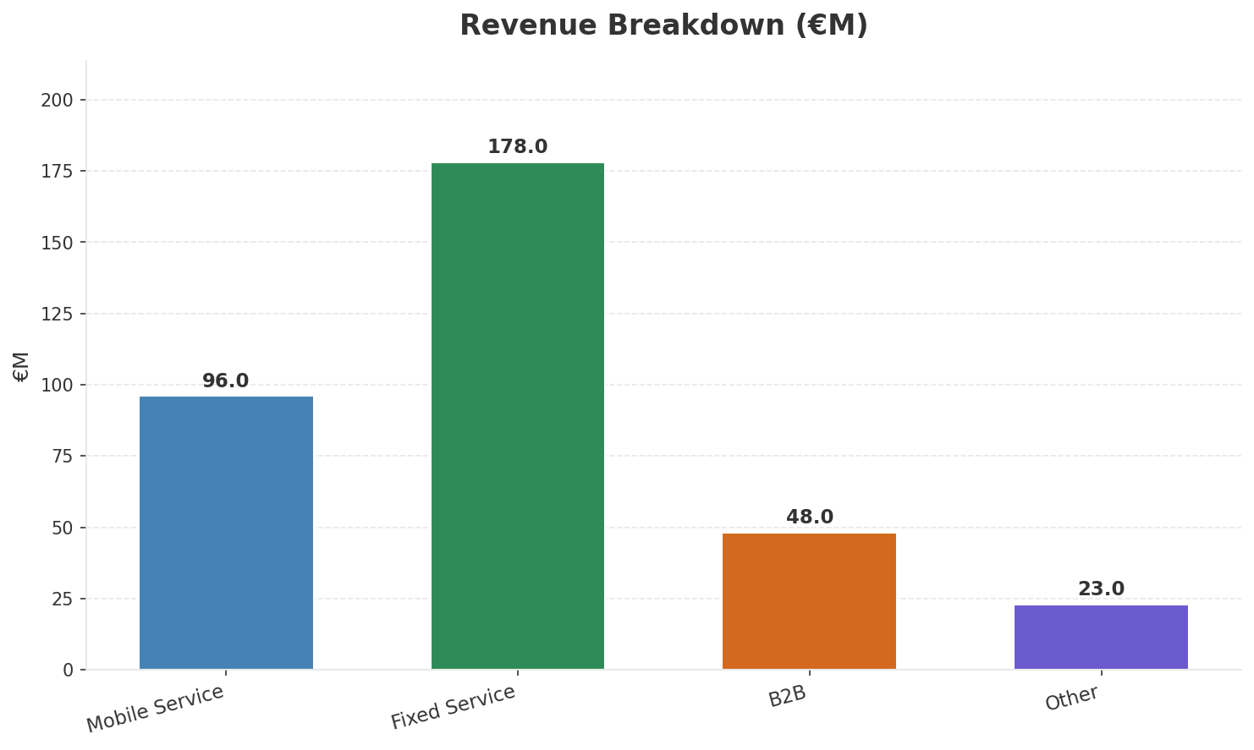
Operating Health Check
FINANCIAL HEALTH
Revenue
EBITDA
EBITDA Margin
Capex/Rev
€345M
€159M
46.1%
22.0%
+4.55% YoY
+4.6% YoY
CAGR: +4.8% | Accelerating Growth
Key Message: Ranked #1 of 3 operators in market; revenue EUR 345.0M; EBITDA margin 46.1%; stable but facing challenges; key strength: Distribution; key challenge: Price Competitiveness; Management outlook: FY2024 revenue EUR 1,326M (+2%), EBITDA EUR 614M (+4%), margin 46.3%. Mobile subs 1,509K (+6% YoY). Fiber BB connections 886K (94% on fiber). NJJ ownership consolidated to >70%.
24

Slide 25
Market Share Evolution
REVENUE SHARE TREND
eir
Vodafone Ireland
Three Ireland
45.2% #1
34.0% #2
20.8% #3
+0.7pp gaining
-0.2pp stable
-0.6pp losing
Market Concentration: HHI 3,630 (Highly Concentrated) | CR3: 100.0% | Trend: Stable
Subscriber share: Mobile: 25.0% (+0.9pp) | Broadband: 53.3% (-1.4pp
Key Message: Revenue share: 45.2% (#1); gaining (+0.7pp); market is highly concentrated (HHI 3,630).
25

Slide 26
Momentum Dashboard
MULTI-QUARTER TREND ANALYSIS
Revenue
EBITDA
Margin
+4.8% CAGR
+5.4% CAGR
+0.6% CAGR
Accelerating Growth (60/100
Accelerating Growth (58/100
Stabilizing (47/100
Key Message: Dominant momentum: Accelerating Growth — based on 3 KPI trend analyses
26

Slide 27
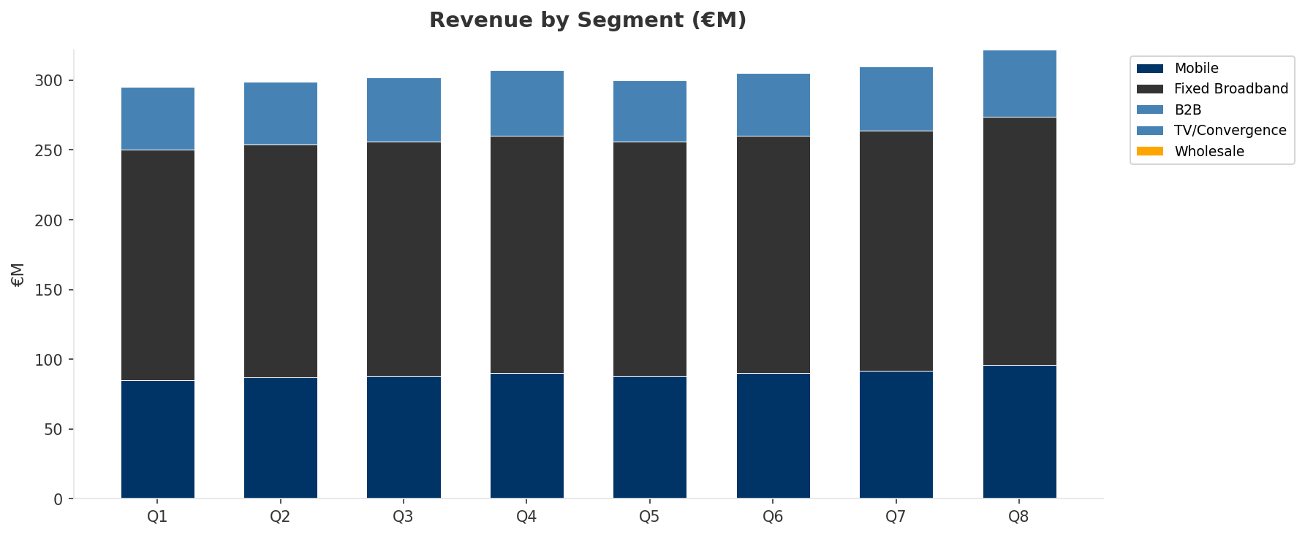
Revenue Composition Trend
SEGMENT REVENUE MIX OVER TIME
Key Message: Growing: Mobile, Fixed Broadband, B2B
27

Slide 28
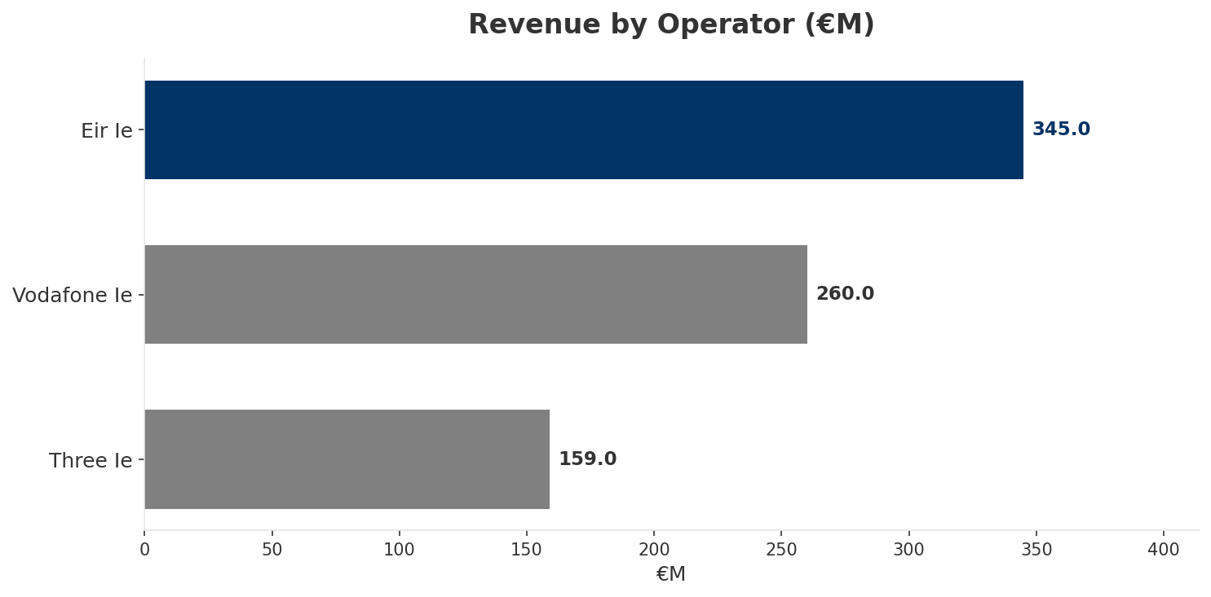
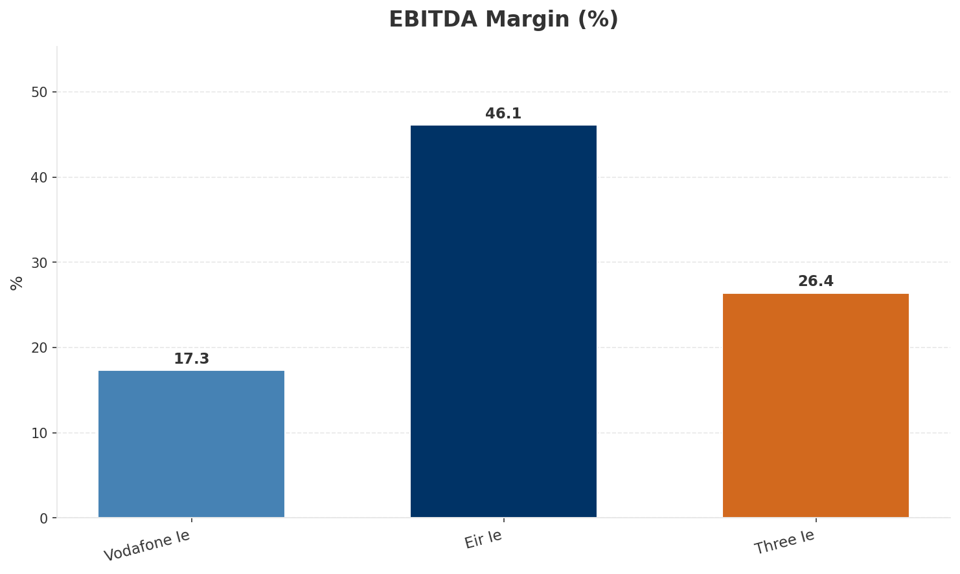
Revenue Comparison
COMPETITIVE BENCHMARKING
Key Message: Revenue and margin benchmarking across operators
28

Slide 29
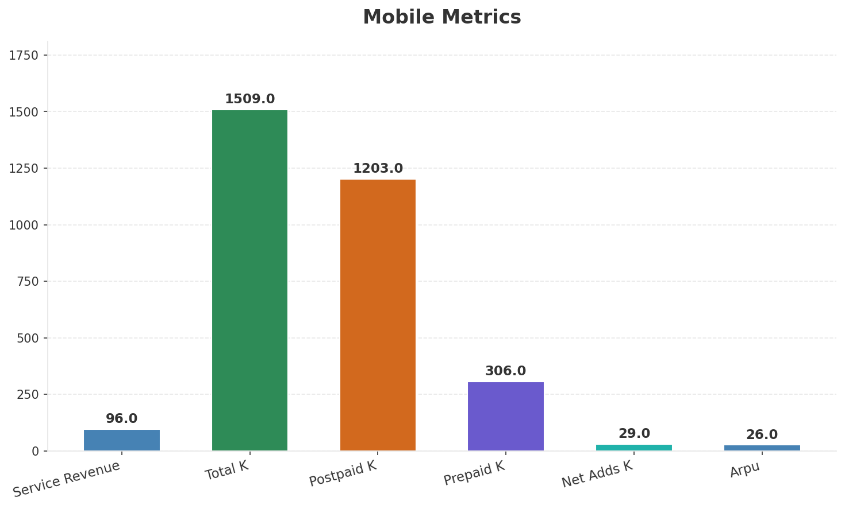
Segment Analysis: Mobile
SEGMENT PERFORMANCE
Service Revenue
Service Growth Pct
Total K
Postpaid K
€96M
6.7%
€1,509M
€1,203M
Health: STRONG
• revenue: improving
• subscribers: improving
• arpu: improving
• FY2024 revenue EUR 1,326M (+2%), EBITDA EUR 614M (+4%), margin 46.3%. Mobile subs 1,509K (+6% YoY). Fiber BB connections 886K (94% on fiber). NJJ ownership consolidated to >70%.
• revenue increased 4.3% QoQ
Key Message: Mobile service revenue at 96.0M; up 6.7% YoY; ARPU 26.0
29

Slide 30
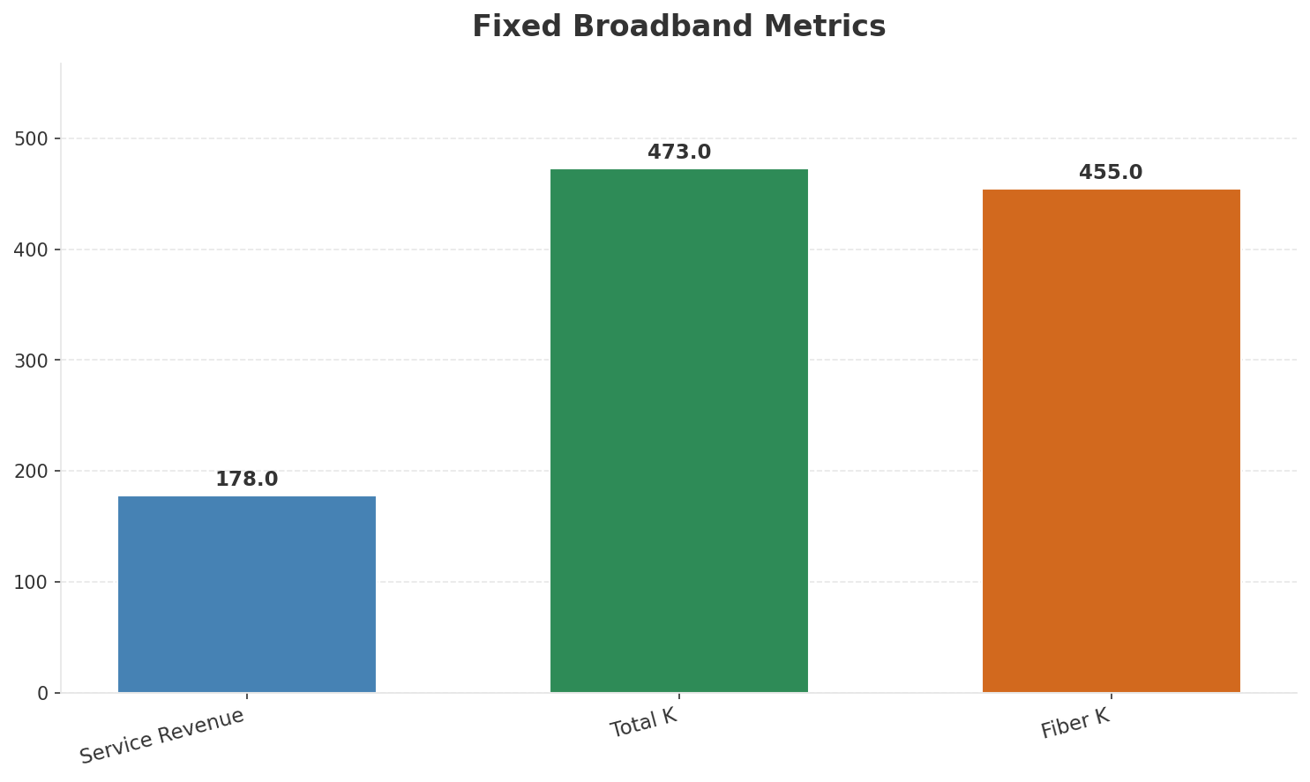
Segment Analysis: Fixed Broadband
SEGMENT PERFORMANCE
Service Revenue
Service Growth Pct
Total K
Net Adds K
€178M
4.7%
€473M
-2
Health: STABLE
• revenue: improving
• subscribers: stable
• arpu: stable
• FY2024 revenue EUR 1,326M (+2%), EBITDA EUR 614M (+4%), margin 46.3%. Mobile subs 1,509K (+6% YoY). Fiber BB connections 886K (94% on fiber). NJJ ownership consolidated to >70%.
• EUR 1.7B invested since 2018. FTTH passing 1.3M premises (+17% YoY), targeting 1.9M by 2026 via InfraVia JV. Combined FTTH/FTTC 2.2M premises (95% of Ireland). TV +11% to 112K.
• revenue increased 3.5% QoQ
Key Message: Fixed service revenue 178.0M; growth +4.7% YoY; Fiber subs 455K
30

Slide 31
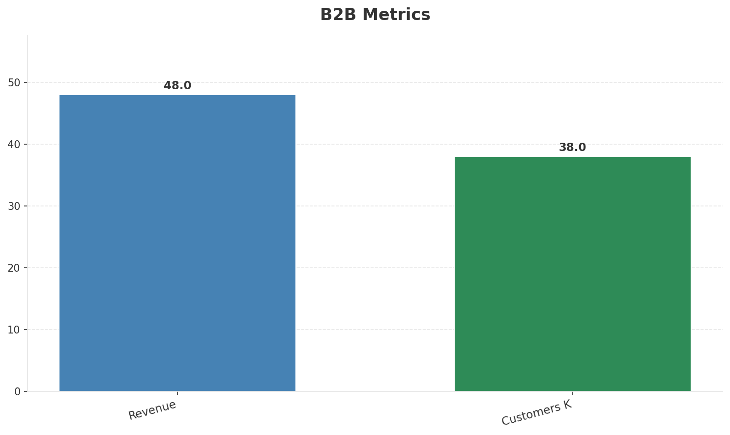
Segment Analysis: B2B
SEGMENT PERFORMANCE
Revenue
Growth Pct
Customers K
Share Of Revenue Pct
€48M
None
38
13.9%
Health: STRONG
• revenue: improving
• customers: stable
• revenue increased 4.3% QoQ
Key Message: B2B revenue 48.0M; 13.9% of total revenue
31

Slide 32
Segment Analysis: TV/Convergence
SEGMENT PERFORMANCE
Revenue
Total K
Net Adds K
Fmc Total K
None
€112M
None
None
Health: STABLE
• revenue: stable
• subscribers: improving
• fmc_subscribers: stable
• EUR 1.7B invested since 2018. FTTH passing 1.3M premises (+17% YoY), targeting 1.9M by 2026 via InfraVia JV. Combined FTTH/FTTC 2.2M premises (95% of Ireland). TV +11% to 112K.
Key Message: TV subscribers 112K
32

Slide 33
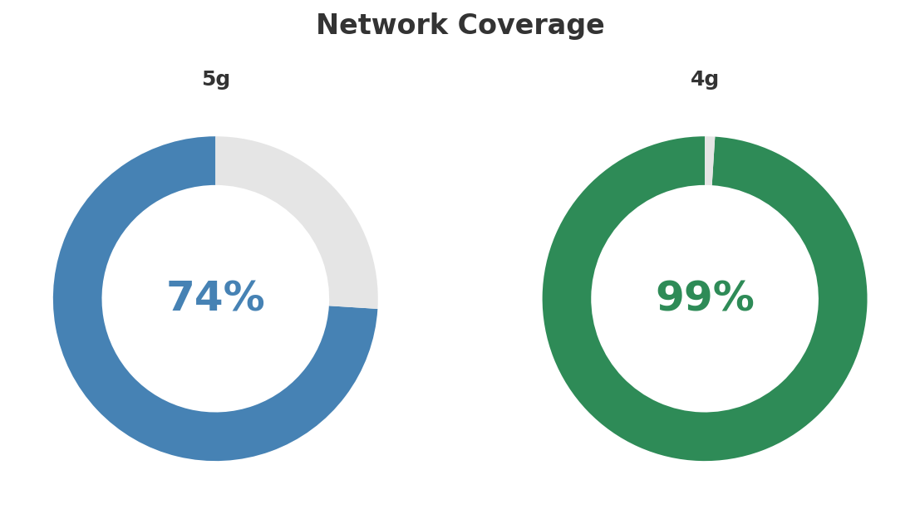
Network Analysis
INFRASTRUCTURE
Technology Mix:
Investment Direction: stable
• Mobile Vendor: Nokia
• Spectrum Mhz: 350
• Fiber Technology: GPON/XGS-PON
• Ftth Premises K: 1300
Key Message: Network infrastructure and coverage assessment
33

Slide 34

Business Model Canvas
BMC
Key Message: Business model canvas overview
34

Slide 35
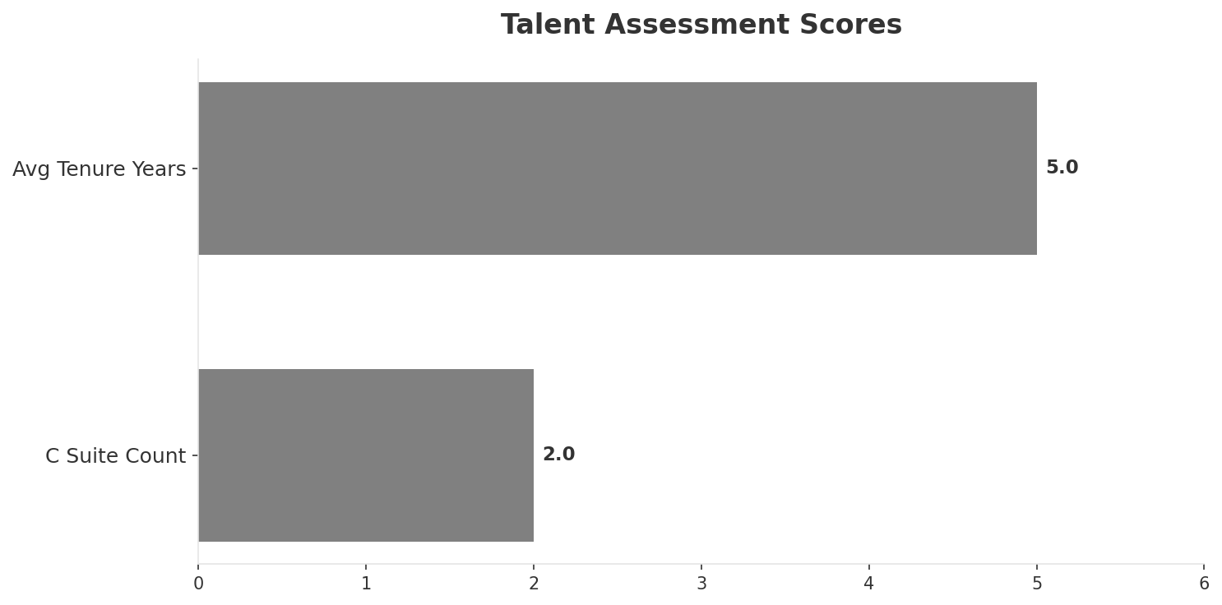
Organization & Talent
PEOPLE & CULTURE
Employees
C Suite Count
Avg Tenure Years
Key Leaders
3,170
2
5.0
['Oliver Loomes (CEO)', 'Stephen Tighe (CFO)']
Organization Culture:
Stable leadership team (avg tenure >3 years); High-investment posture; Incumbent transforming under NJJ ownership. More agile since Niel took control. Investment-focused. Customer satisfaction improving.
Leadership Changes:
• Oliver Loomes: (
• Stephen Tighe: (
Key Message: Organization and talent assessment
35

Slide 36
Strengths, Weaknesses & Exposure Points
SELF ASSESSMENT
Strengths
Weaknesses
Exposure Points
• Distribution: score 88 (market avg 83
• Enterprise Solutions: score 85 (market avg 74
• Network Coverage: score 95 (market avg 90
• Strong EBITDA margin at 46.1%
• Revenue on growth trajectory
• Dominant market share at 45.2%
• Price Competitiveness: score 68 (market avg 74
• Heavy capex burden from FTTH network rollout: Elevated investment constraining free cash flow
• Wholesale obligation means competitors benefit from eir's fiber investment: eir builds the network but competitors can resell at regulated prices
Key Message: Ranked #1 of 3 operators in market; revenue EUR 345.0M; EBITDA margin 46.1%; stable but facing challenges; key strength: Distribution; key challenge: Price Competitiveness; Management outlook: FY2024 revenue EUR 1,326M (+2%), EBITDA EUR 614M (+4%), margin 46.3%. Mobile subs 1,509K (+6% YoY). Fiber BB connections 886K (94% on fiber). NJJ ownership consolidated to >70%.
36

Slide 37
SWOT Synthesis
Strengths, Weaknesses, Opportunities & Threats

Slide 38
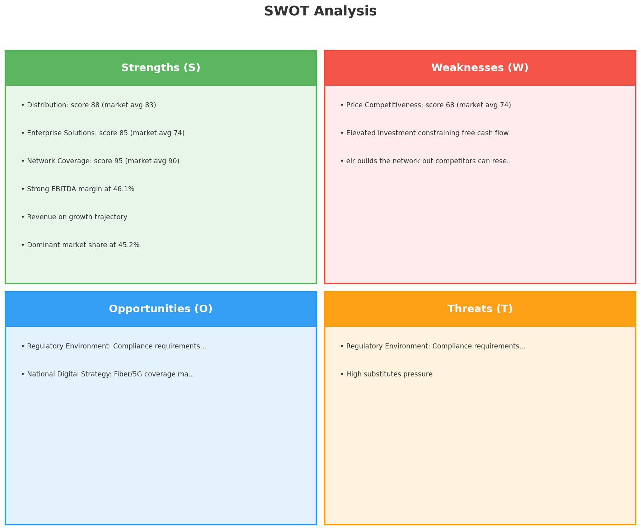
SWOT Analysis
STRATEGIC SYNTHESIS
SO:
Leverage 'Distribution: score 88 (market avg 83)' to capt...
WO:
Address weakness 'Price Competitiveness: score 68 (market...
ST:
Use strength 'Distribution: score 88 (market avg 83)' to ...
WT:
Mitigate weakness 'Price Competitiveness: score 68 (marke...
Key Message: SWOT analysis identifies 7 strengths, 3 weaknesses, 2 opportunities, and 2 threats. The recommended strategic posture is offensive (SO-dominant).
38

Slide 39
05 Look at Opportunities
SPAN Matrix — Opportunity Selection

Slide 40
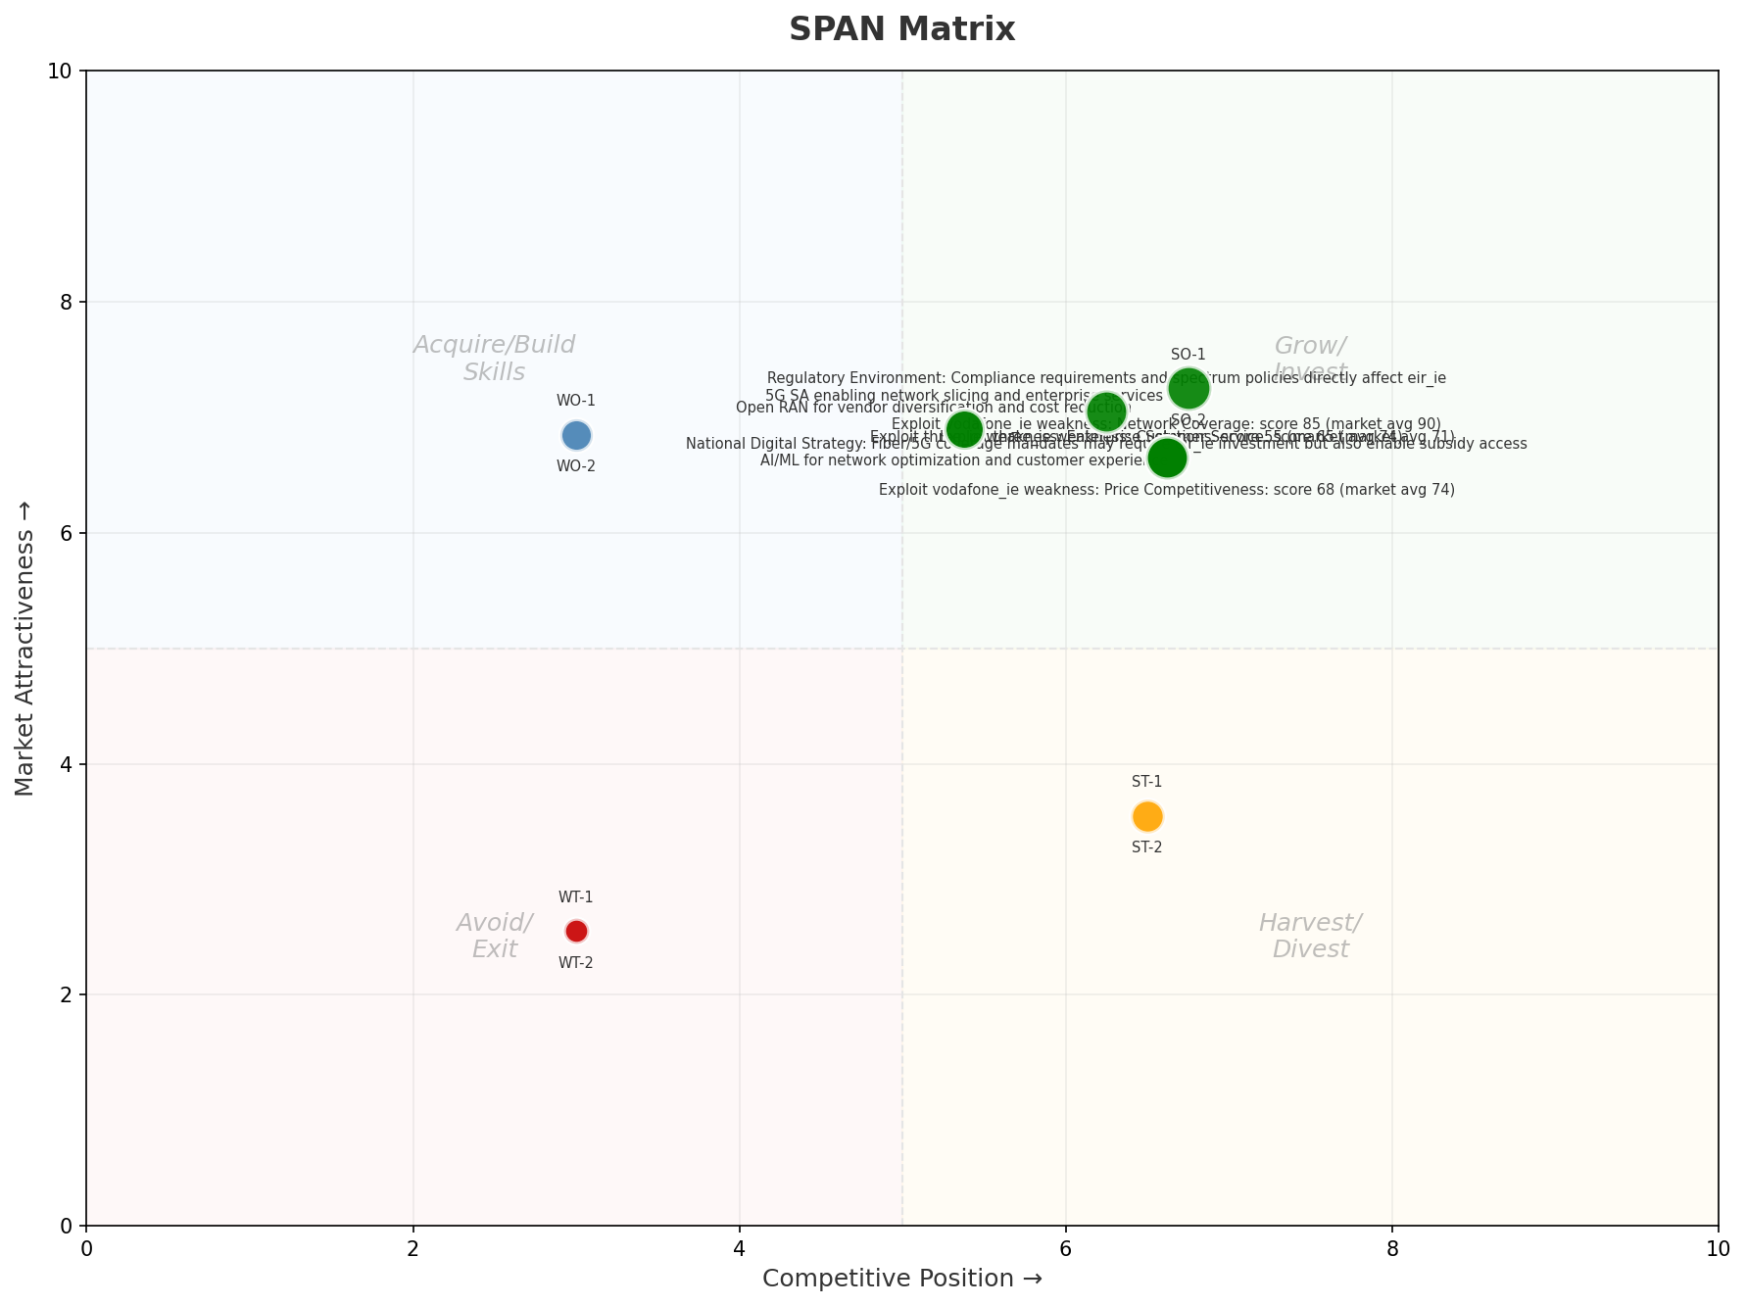
SPAN Matrix — Opportunity Positioning
OPPORTUNITY MAP
Key Message: SPAN matrix positions 17 opportunities: 11 grow/invest, 2 acquire skills, 2 harvest, 2 avoid/exit. Focus resources on the 11 grow/invest items for maximum strategic impact.
40

Slide 41
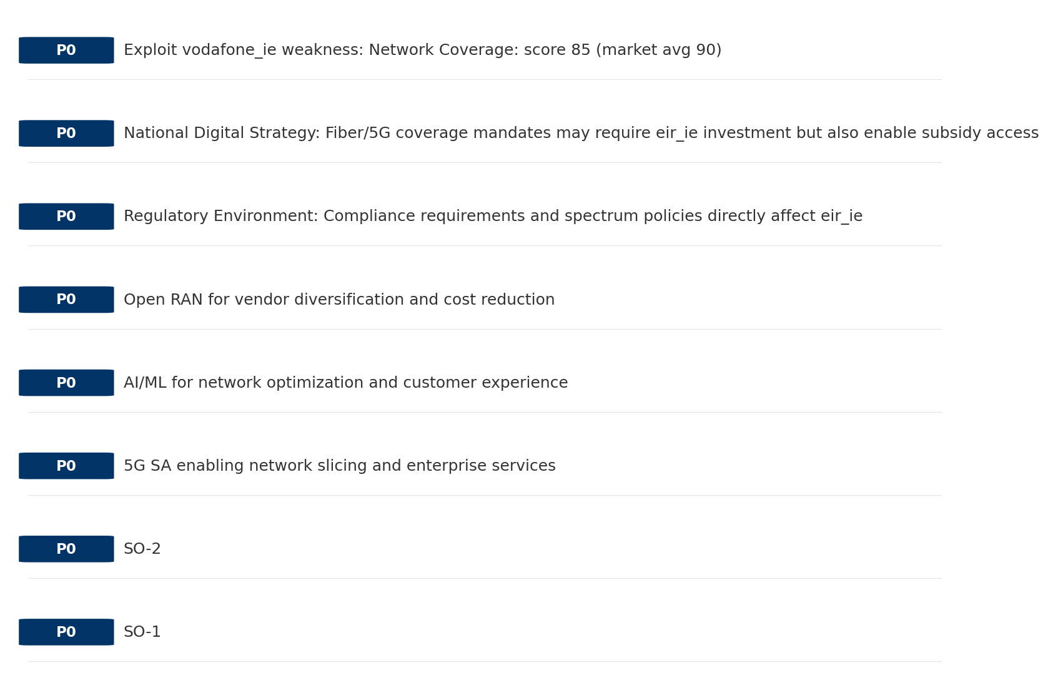
Opportunity Priority Ranking
PRIORITIES
Key Message: SPAN matrix positions 17 opportunities: 11 grow/invest, 2 acquire skills, 2 harvest, 2 avoid/exit. Focus resources on the 11 grow/invest items for maximum strategic impact.
41

Slide 42
Opportunity Details
DEEP DIVE
P0
SO-1
Market: N/A | Window:
Leverage 'Distribution: score 88 (market avg 83)' to capture the opportunity of 'Regulatory Environment: Compliance requirements and spectrum policies directly affect eir_ie'.
P0
SO-2
Market: N/A | Window:
Leverage 'Enterprise Solutions: score 85 (market avg 74)' to capture the opportunity of 'National Digital Strategy: Fiber/5G coverage mandates may require eir_ie investment but also enable subsidy access'.
P0
5G SA enabling network slicing and enterprise services
Market: N/A | Window:
Technology trend: 5G SA enabling network slicing and enterprise services
P0
AI/ML for network optimization and customer experience
Market: N/A | Window:
Technology trend: AI/ML for network optimization and customer experience
Key Message: SPAN matrix positions 17 opportunities: 11 grow/invest, 2 acquire skills, 2 harvest, 2 avoid/exit. Focus resources on the 11 grow/invest items for maximum strategic impact.
42

Slide 43
Three Decisions
Strategy — Key Tasks — Execution

Slide 44
Decision 1: Define Strategy
OFFENSIVE
As The Dominant Leader: defend leadership through innovation and ecosystem lock-in
P0
P0
P1
P1
Growth Strategy
Competitive Strategy
Transformation Strategy
Customer Strategy
Defend leadership through ecosystem expansion in Mobile, Fixed Broadband, B2B
Capitalize on competitive strengths to gain market share
Accelerate fiber transition — converged network as competitive moat
Optimize value extraction in stable segments: Wholesale
- Maintain #1 revenue share
- Grow Mobile, Fixed Broadband, B2B by 5-8% YoY
- Outgrow competitors in key segments
- Increase service differentiation
- Fiber homepass coverage +20%
- FMC bundle attach rate 50%+
- Upsell rate +10% in Wholesale
- Cross-sell convergence bundles
Key Message: As The Dominant Leader, the strategic posture is Offensive. As The Dominant Leader: defend leadership through innovation
44

Slide 45
Decision 2: Define Key Tasks
2 P0 (IMMEDIATE), 3 P1 (1-2 YEARS), 1 P2 (3-5 YEARS
P0
Business
Accelerate Mobile Growth
Mobile revenue +10% YoY | Market share gain
Mobile at €96M showing strong momentum — invest to scale
P0
Business
Accelerate Fixed Broadband Growth
Fixed Broadband revenue +10% YoY | Market share gain
Fixed Broadband at €178M showing strong momentum — invest to scale
P1
Network
5G Coverage Expansion
5G pop coverage target | 5G attach rate
Expand 5G population coverage to strengthen mobile competitive position
P1
Business
Opportunity Portfolio Execution
Launch 3+ priority initiatives | Pipeline contribution tracking
11 grow/invest opportunities identified — establish execution office
P1
Customer
Customer Experience Enhancement
NPS +5 points | First-call resolution rate 80%+
Improve digital touchpoints and service resolution to boost NPS
P2
Efficiency
Operational Efficiency & Automation
Process automation 30%+ | Cost-to-serve reduction
EBITDA margin 46.1% — maintain through smart automation and resource reallocatio
Key Message: 6 critical tasks: 2 P0 (immediate), 3 P1 (1-2 years), 1 P2 (3-5 years
45

Slide 46
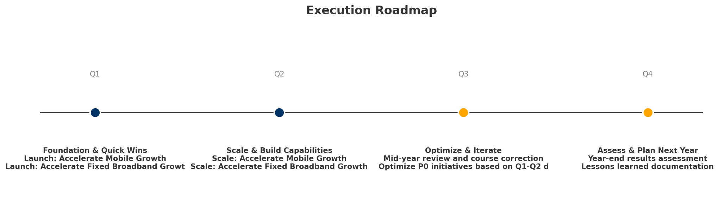
Decision 3: Define Execution
QUARTERLY ROADMAP & GOVERNANCE
Governance
Strategic Traps to Avoid
- Monthly Progress Review (Monthly
x Delay core transformation
- Quarterly Strategic Checkpoint (Quarterly
- Mid-Year Strategic Adjustment (Semi-annual
Key Risks & Mitigation
! Resource constraints delay P0 initiatives -- Ring-fence P0 budgets; establish escalation path for blockers
Key Message: Execute with discipline: monthly reviews, quarterly checkpoints, annual refresh
! Macro-economic slowdown reduces consumer spending -- Prepare value-tier offerings; shift mix toward B2B resilience
46

Slide 47
Analysis Summary
KEY TAKEAWAYS
01 Trends
Macro environment: Favorable. Key opportunities: Regulatory Environment, National Digital Strategy. Key risks: Regulatory Environment, Fiber Broadband Penetration Industry is in late growth phase. (+3.4% YoY (CQ2_2025 -> CQ4_2025)
02 Market
Ireland telecom market totals EUR 764.0M in quarterly revenue; competitive strengths in Availability, Performance; Market presents a balanced mix of opportunities and challenges.
03 Competition
In a 3-player market with medium competition intensity, eir leads with 45% revenue share. Target operator holds 45% share. Strongest competitive force: Substitutes.
04 Self
Ranked #1 of 3 operators in market; revenue EUR 345.0M; EBITDA margin 46.1%; stable but facing challenges; key strength: Distribution; key challenge: Price Competitiveness; Management outlook: FY2024 revenue EUR 1,326M (+2%), EBITDA EUR 614M (+4%), margin 46.3%. Mobile subs 1,509K (+6% YoY). Fiber BB connections 886K (94% on fiber). NJJ ownership consolidated to >70%.
SWOT
SWOT analysis identifies 7 strengths, 3 weaknesses, 2 opportunities, and 2 threats. The recommended strategic posture is offensive (SO-dominant).
05 Opportunities
SPAN matrix positions 17 opportunities: 11 grow/invest, 2 acquire skills, 2 harvest, 2 avoid/exit. Focus resources on the 11 grow/invest items for maximum strategic impact.
Key Message: Complete Five Looks analysis — see opportunity priorities for next steps
47

Slide 48
Data Provenance
SOURCES & METHODOLOGY
No provenance data recorded for this analysis
Key Message: All data points are traceable to original sources
48

Slide 49
Thank You
BLM Five Looks Strategic Analysis

