Slide 1
Default BLM Strategic Analysis
BLM (Business Leadership Model) Five Looks Analysis
Target Operator
Market
Analysis Period
Report Date
Epic Mt
Malta
CQ4_2025
2026-02-15
01 Trends (PEST) | 02 Market/Customer ($APPEALS) | 03 Competition (Porter) | 04 Self (BMC) | SWOT Synthesis | 05 Opportunities (SPAN

Slide 2
Report Contents
TABLE OF CONTENTS
01
Executive Summary
Key findings and recommendations
02
Look at Trends
PEST Framework — macro environment
03
Look at Market
$APPEALS — market changes & customer needs
T
Tariff Analysis
Pricing comparison — mobile, fixed & convergence
04
Look at Competition
Porter's Five Forces — competitive landscape
05
Look at Self
BMC + Capability — internal assessment
06
SWOT Synthesis
Strengths, Weaknesses, Opportunities, Threats
07
Look at Opportunities
SPAN Matrix — opportunity selection
Summary & Provenance
2
08
Conclusions and data sources

Slide 3
Data Quality Overview
DATA QUALITY
Total Data Points
High Confidence
Medium Confidence
Low/Estimated
20
0
0
20
0%
Unique Sources: 0
Data Conflicts: 0
Coverage: Partial
Key Message: 20 data points tracked, 0 high-confidence (0%
3

Slide 4
Executive Summary
Trends
Macro environment: Favorable. Key opportunities: Regulatory Environment, National Digital Strategy. Key risks: Regulatory Environment, Fiber Broadband Penetration Industry is in late growth phase. (+6.3% YoY (CQ2_2025 -> CQ4_2025)
Market/Customer
Malta telecom market totals EUR 101.0M in quarterly revenue; gaps in Assurances, Social/Brand; Market faces significant competitive headwinds.
Competition
In a 3-player market with medium competition intensity, GO plc leads with 63% revenue share. Target operator holds 10% share. Strongest competitive force: Existing Competitors.
Self Assessment
Ranked #3 of 3 operators in market; revenue EUR 10.0M; EBITDA margin 30.0%; stable but facing challenges; key strength: Digital Experience; key challenge: Brand Strength; Management outlook: Epic Malta growing mobile subscriber base as third operator. NJJ/Monaco Telecom investment commitment. 5G network expanding. Competitive pricing challenging GO and Melita.
SWOT
SWOT analysis identifies 4 strengths, 9 weaknesses, 3 opportunities, and 6 threats. The recommended strategic posture is cautious (WT-dominant).
Opportunities
SPAN matrix positions 21 opportunities: 1 grow/invest, 12 acquire skills, 4 harvest, 4 avoid/exit. Focus resources on the 1 grow/invest items for maximum strategic impact.
Key Message: Five Looks analysis completed — see details in following sections
4

Slide 5
01 Look at Trends
PEST Framework — Macro Environment

Slide 6
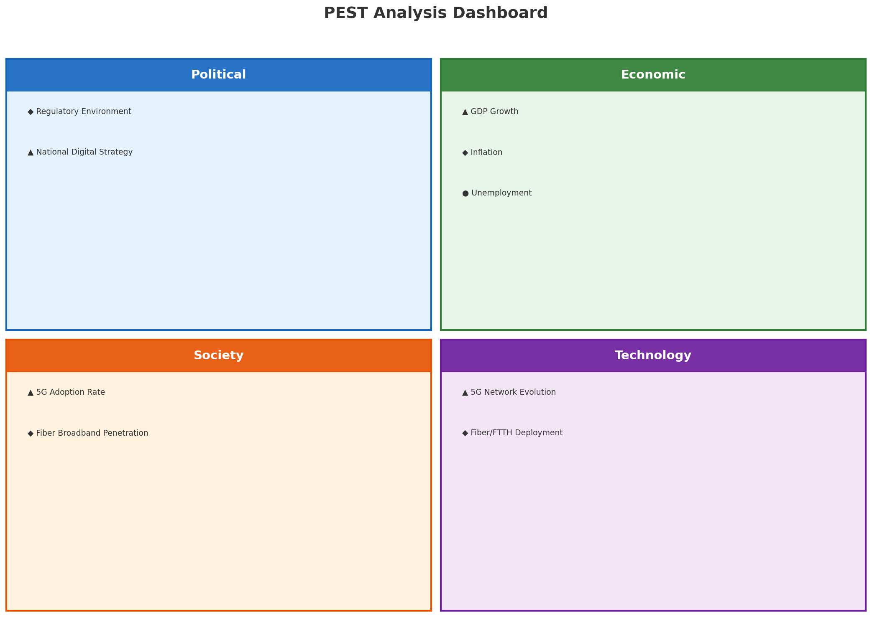
PEST Analysis Dashboard
MACRO ENVIRONMENT
Key Message: Macro environment: Favorable. Key opportunities: Regulatory Environment, National Digital Strategy. Key risks: Regulatory Environment, Fiber Broadband Penetration.
6

Slide 7
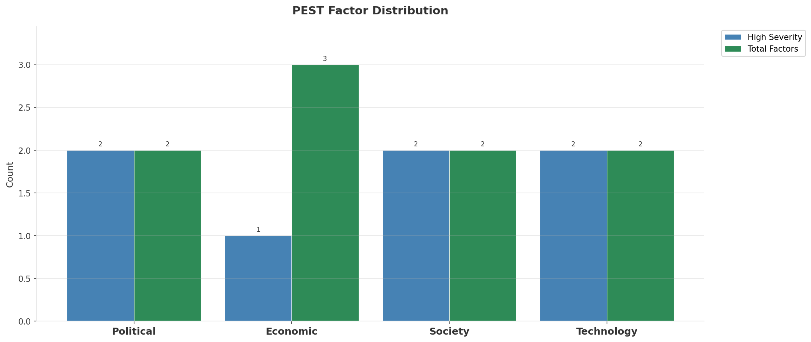
Industry Environment
INDUSTRY ANALYSIS
Market Size
Growth Rate
Concentration
Lifecycle
EUR 0.1B (quarterly, CQ4_2025
+6.3% YoY (CQ2_2025 -> CQ4_2025
CR4 = 100% (GO plc: 63.4%, Melita: 26.7%, Epic Malta: 9.9%
late_growth
• New Business Models:
• FWA (Fixed Wireless Access) as fiber alternative
• Network-as-a-Service for enterprise verticals
• Wholesale/MVNO partnerships for coverage monetization
• Technology Revolution:
• 5G SA enabling network slicing and enterprise services
• AI/ML for network optimization and customer experience
• Open RAN for vendor diversification and cost reduction
Key Message: Macro environment: Favorable. Key opportunities: Regulatory Environment, National Digital Strategy. Key risks: Regulatory Environment, Fiber Broadband Penetration Industry is in late growth phase. (+6.3% YoY (CQ2_2025 -> CQ4_2025)
7

Slide 8
Value Transfer Trends
VALUE MIGRATION
• Value shifting from voice/SMS to data and digital services
• B2B/ICT growing faster than consumer segment
• Fiber displacing copper and cable broadband
Key Message: Macro environment: Favorable. Key opportunities: Regulatory Environment, National Digital Strategy. Key risks: Regulatory Environment, Fiber Broadband Penetration Industry is in late growth phase. (+6.3% YoY (CQ2_2025 -> CQ4_2025)
8

Slide 9
02 Look at Market
$APPEALS — Market Changes & Customer Needs

Slide 10
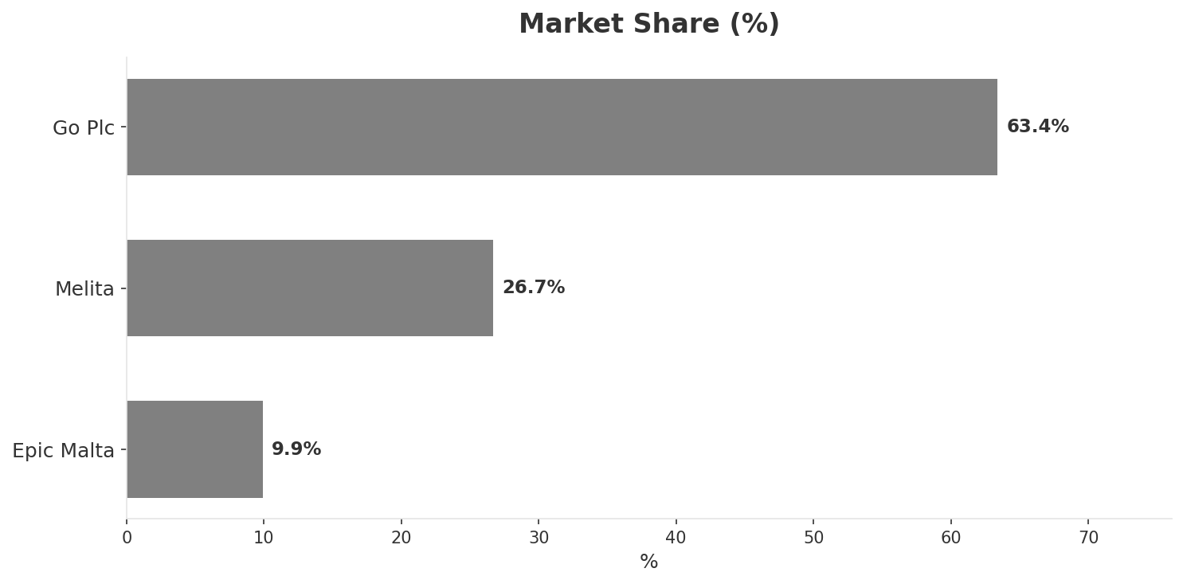
Market Change Panorama
MARKET OVERVIEW
Total Revenue (€M
Mobile Subs (K
Broadband Subs (K
Operators
101.0
408.0
172.0
3
Market Changes:
• GO plc revenue growth 6.7% YoY
• Melita EBITDA margin improvement: 40.7% vs 38.5% (+2.2pp
• Epic Malta revenue growth 11.1% YoY
• GO plc FTTH fiber rollout accelerating across Malta
Key Message: Malta telecom market totals EUR 101.0M in quarterly revenue; gaps in Assurances, Social/Brand; Market faces significant competitive headwinds.
10

Slide 11
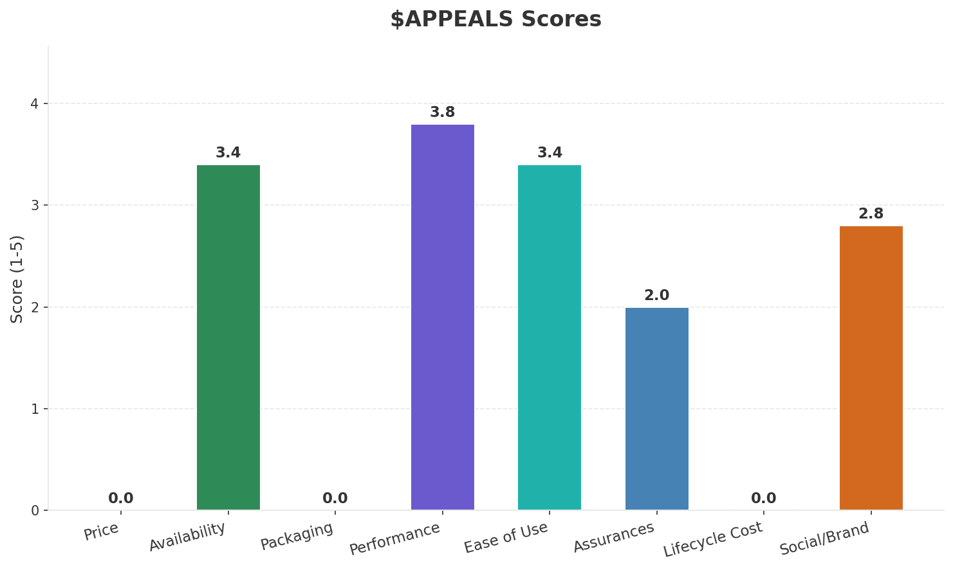
Customer Segments
SEGMENTATION
Consumer Urban Connected
Trend: stable
Needs: Faster and more reliable broadband speeds, Seamless converged fixed-mobile bundles
Consumer Digital-First / Young
Trend: stable
Needs: Affordable unlimited mobile data plans, eSIM and digital-first onboarding
Tourist / Seasonal
Trend: stable
Needs: Easy tourist SIM and eSIM access, Short-term data plans for visitors
Enterprise & iGaming
Trend: stable
Needs: Low-latency connectivity for iGaming industry (Malta is EU iGaming hub), Cloud and cybersecurity managed services
Key Message: Malta telecom market totals EUR 101.0M in quarterly revenue; gaps in Assurances, Social/Brand; Market faces significant competitive headwinds.
11

Slide 12
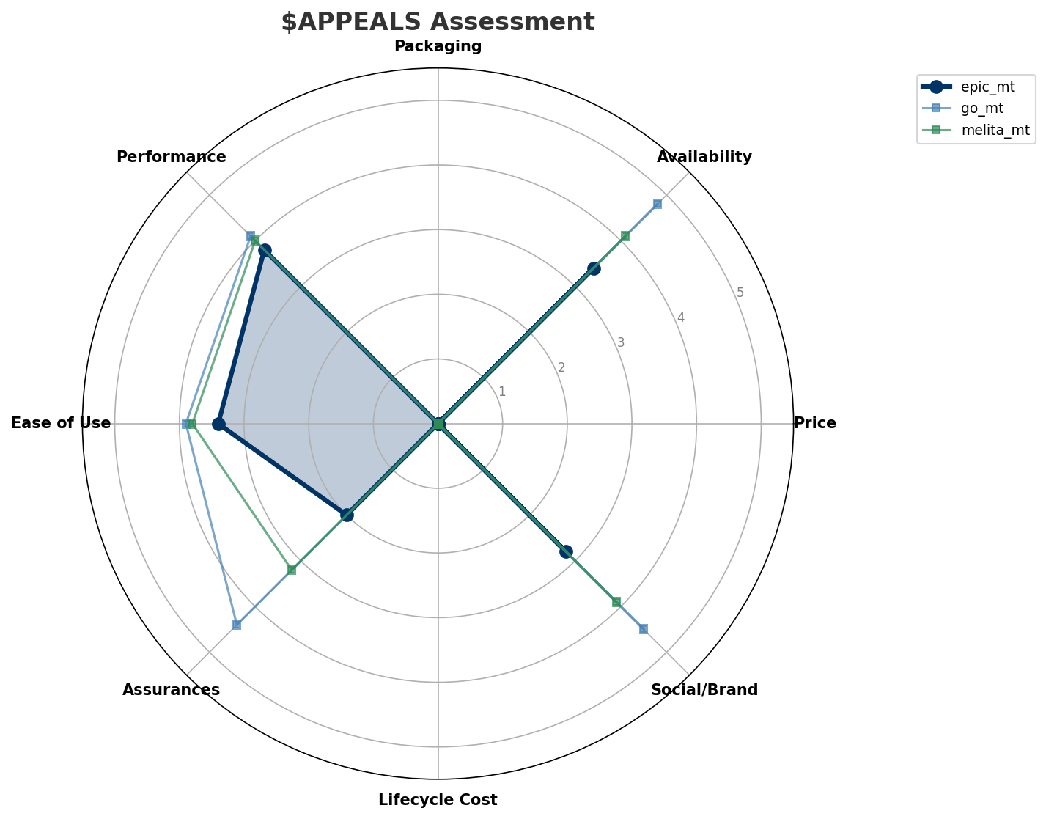
$APPEALS Assessment
CUSTOMER NEEDS
Key Message: Malta telecom market totals EUR 101.0M in quarterly revenue; gaps in Assurances, Social/Brand; Market faces significant competitive headwinds.
12

Slide 13
Customer Value Migration
VALUE MIGRATION
Value migration trending upward: customers willing to pay more for premium connectivity and convergent bundles. Focus on upselling and cross-selling opportunities.
Opportunities:
Threats:
• Epic Malta revenue growth 11.1% YoY
• GO plc revenue growth 6.7% YoY
• Melita EBITDA margin improvement: 40.7% vs 38.5% (+2.2pp
• GO plc FTTH fiber rollout accelerating across Malta
Key Message: Malta telecom market totals EUR 101.0M in quarterly revenue; gaps in Assurances, Social/Brand; Market faces significant competitive headwinds.
13

Slide 14
Tariff Analysis
Mobile, Fixed & Convergence Pricing Landscape

Slide 15
Fixed & Convergence Pricing Landscape
DSL / CABLE / FIBER / FMC BUNDLES
Key Message: Fixed and convergence pricing overview
15

Slide 16
03 Look at Competition
Porter's Five Forces — Competitive Landscape

Slide 17
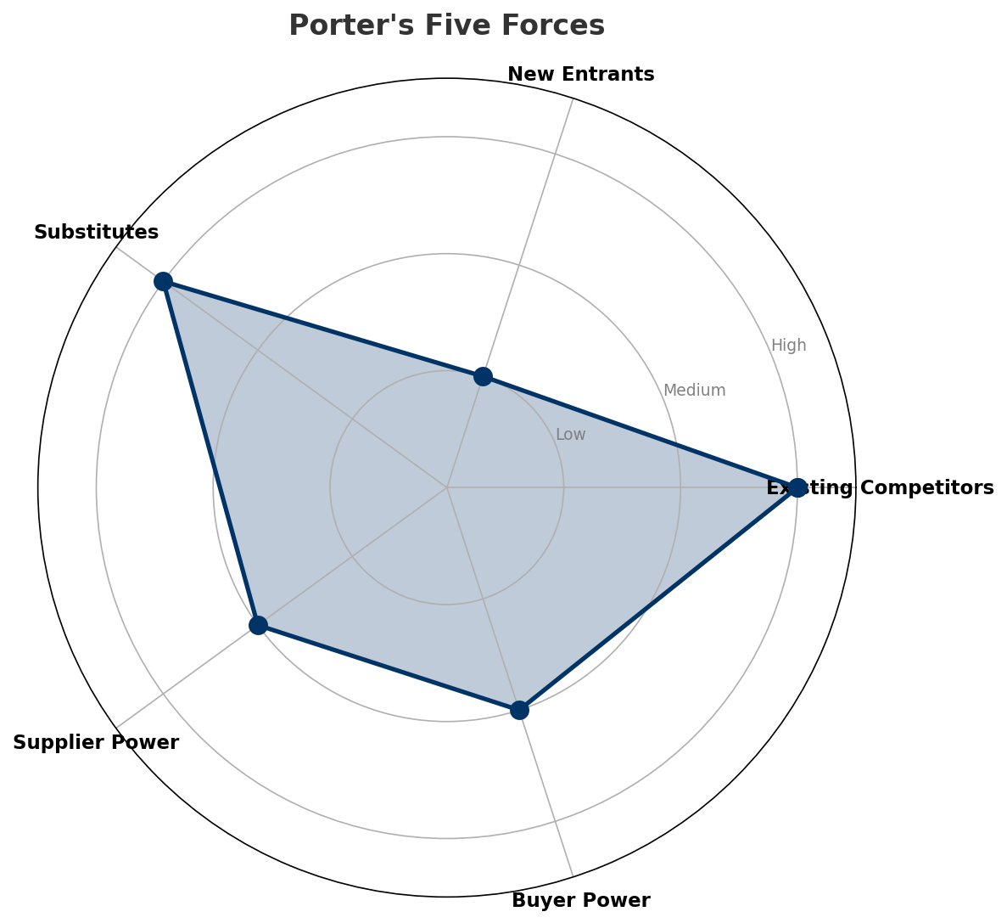
Porter's Five Forces
COMPETITIVE FORCES
Overall Intensity: MEDIUM
Key Message: In a 3-player market with medium competition intensity, GO plc leads with 63% revenue share. Target operator holds 10% share. Strongest competitive force: Existing Competitors.
17

Slide 18
Competitor Analysis: Melita Mt
COMPETITOR DEEP DIVE
Revenue
EBITDA
Margin
Capex/Rev
€27M
€11M
40.7%
22.2%
+4.2% YoY
Strengths
Weaknesses
Strategy: Revenue-led profitable growth; subscriber acquisition focus
Key Message: Competitor analysis: Melita Mt
18

Slide 19
Competitor Analysis: Go Mt
COMPETITOR DEEP DIVE
Revenue
EBITDA
Margin
Capex/Rev
€64M
€15M
23.4%
20.3%
+7.3% YoY
Strengths
Weaknesses
• Brand Strength: score 90 (market avg 74
• Distribution: score 90 (market avg 74
• Enterprise Solutions: score 88 (market avg 64
• Network Coverage: score 95 (market avg 82
• Price Competitiveness: score 60 (market avg 71
Strategy: Market share expansion (investing for growth); subscriber acquisition focus; strong B2B/enterprise push
Key Message: Competitor analysis: Go Mt
19

Slide 20
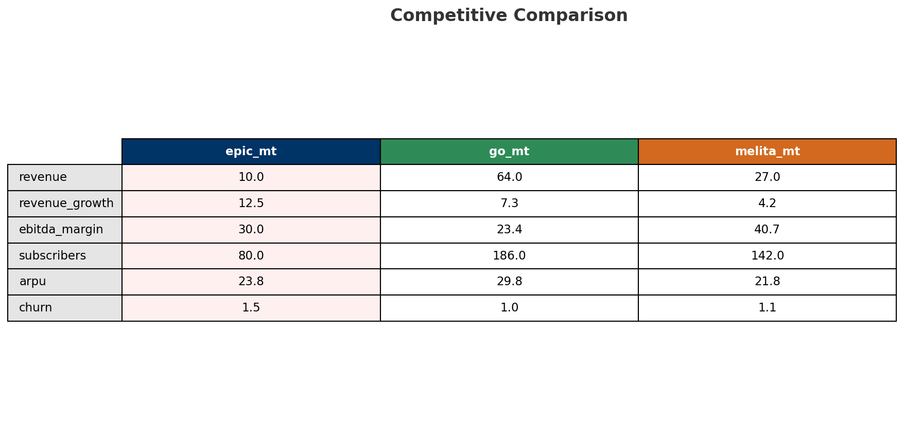
Competitive Landscape Summary
COMPETITION
Key Message: In a 3-player market with medium competition intensity, GO plc leads with 63% revenue share. Target operator holds 10% share. Strongest competitive force: Existing Competitors.
20

Slide 21
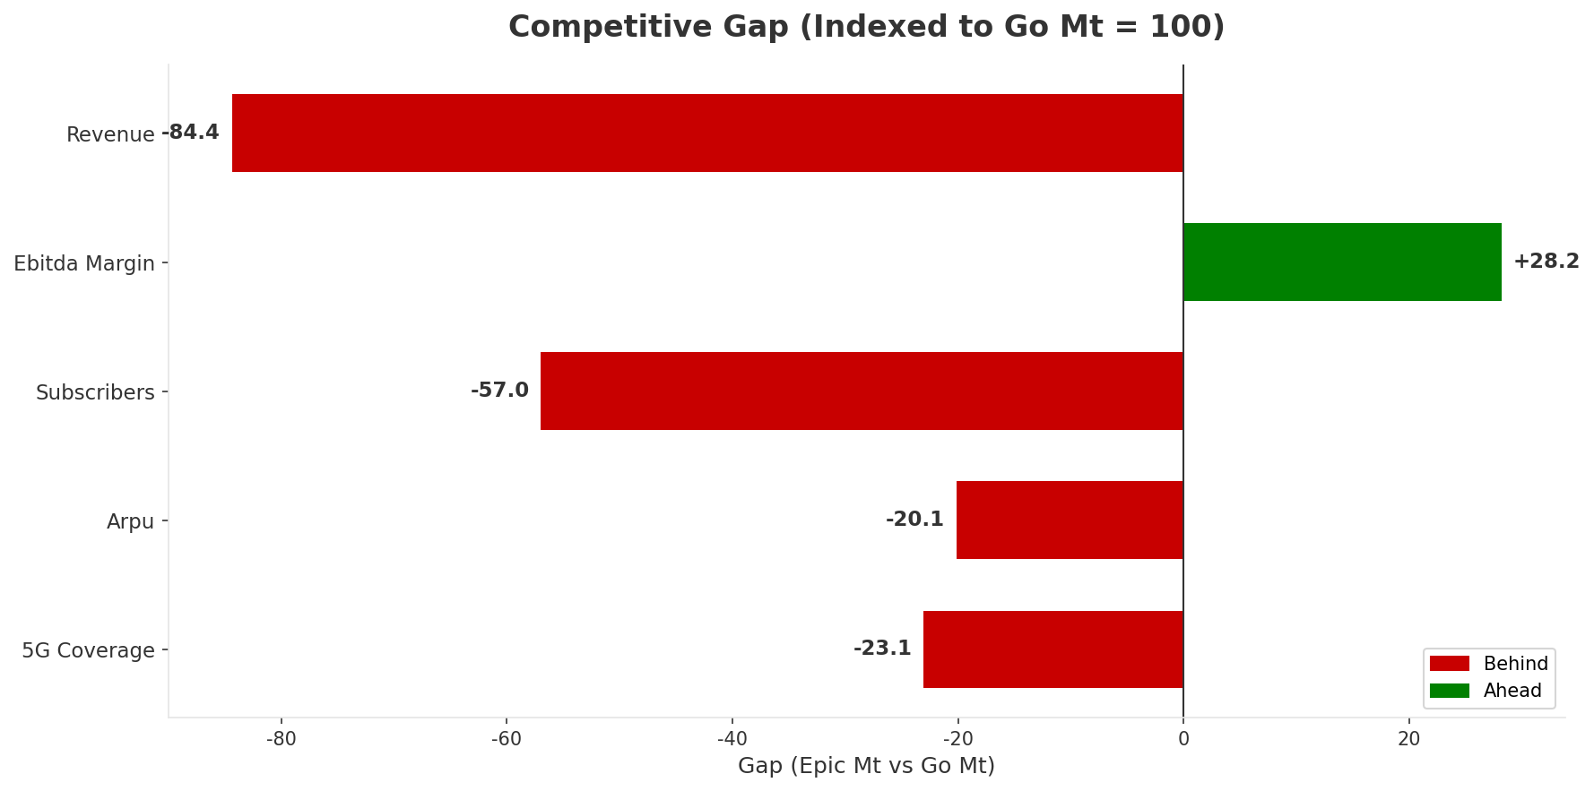
Gap Analysis: Epic Mt vs Go Mt
COMPETITIVE GAP
Key Message: Gap analysis vs market leader Go Mt
21

Slide 22
New Entrants Threat
MARKET ENTRY
• Entry barriers: High barriers: spectrum licensing, massive capex for network build, regulatory approvals, established brand loyalty
Key Message: New entrants threat level: low
22

Slide 23
04 Look at Self
BMC + Capability Assessment

Slide 24
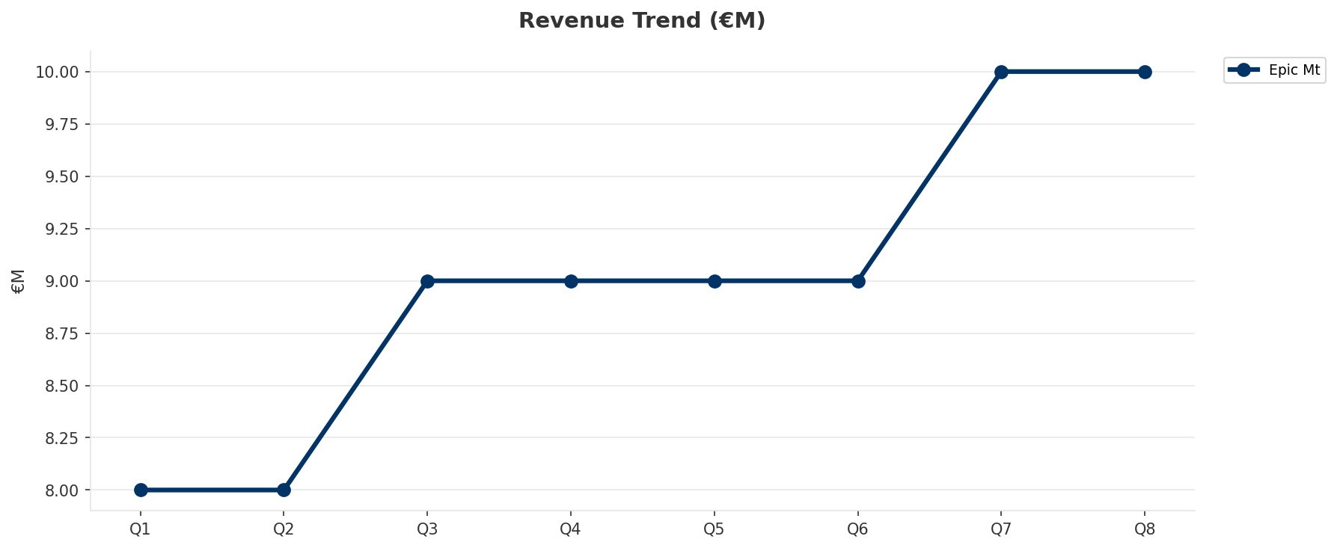
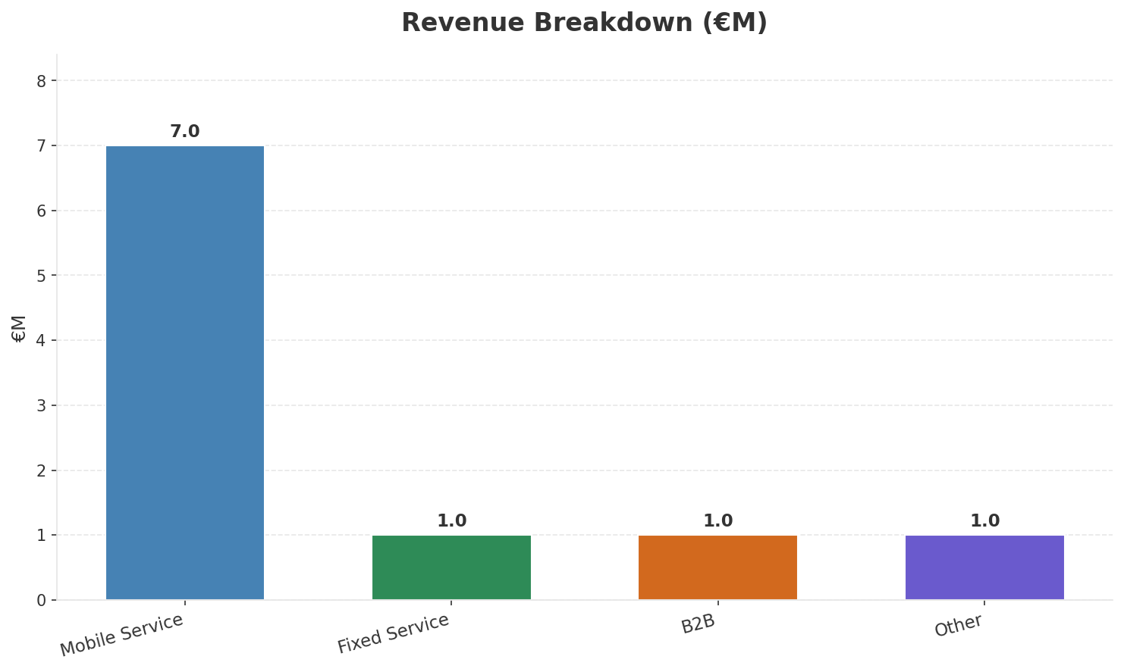
Operating Health Check
FINANCIAL HEALTH
Revenue
EBITDA
EBITDA Margin
Capex/Rev
€10M
€3M
30.0%
30.0%
+11.11% YoY
+0.0% YoY
CAGR: +13.6% | Stabilizing
Key Message: Ranked #3 of 3 operators in market; revenue EUR 10.0M; EBITDA margin 30.0%; stable but facing challenges; key strength: Digital Experience; key challenge: Brand Strength; Management outlook: Epic Malta growing mobile subscriber base as third operator. NJJ/Monaco Telecom investment commitment. 5G network expanding. Competitive pricing challenging GO and Melita.
24

Slide 25
Market Share Evolution
REVENUE SHARE TREND
GO plc
Melita
Epic Malta
63.4% #1
26.7% #2
9.9% #3
-0.7pp losing
-0.2pp stable
+0.9pp gaining
Market Concentration: HHI 4,828 (Highly Concentrated) | CR3: 100.0% | Trend: Fragmenting
Subscriber share: Mobile: 19.6% (+0.5pp) | Broadband: 6.4% (+1.3pp
Key Message: Revenue share: 9.9% (#3); gaining (+0.9pp); market is highly concentrated (HHI 4,828); fragmenting.
25

Slide 26
Momentum Dashboard
MULTI-QUARTER TREND ANALYSIS
Revenue
EBITDA
Margin
+13.6% CAGR
+26.1% CAGR
+11.0% CAGR
Stabilizing (46/100
Decelerating Growth (0/100
Decelerating Growth (0/100
Key Message: Dominant momentum: Stabilizing — based on 3 KPI trend analyses
26

Slide 27
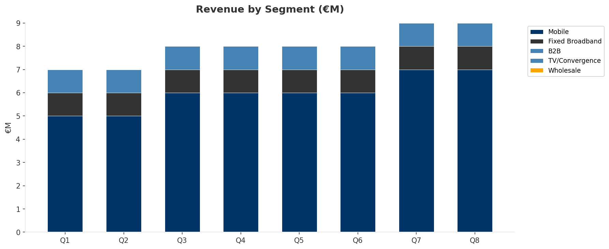
Revenue Composition Trend
SEGMENT REVENUE MIX OVER TIME
Key Message: Growing: Mobile
27

Slide 28
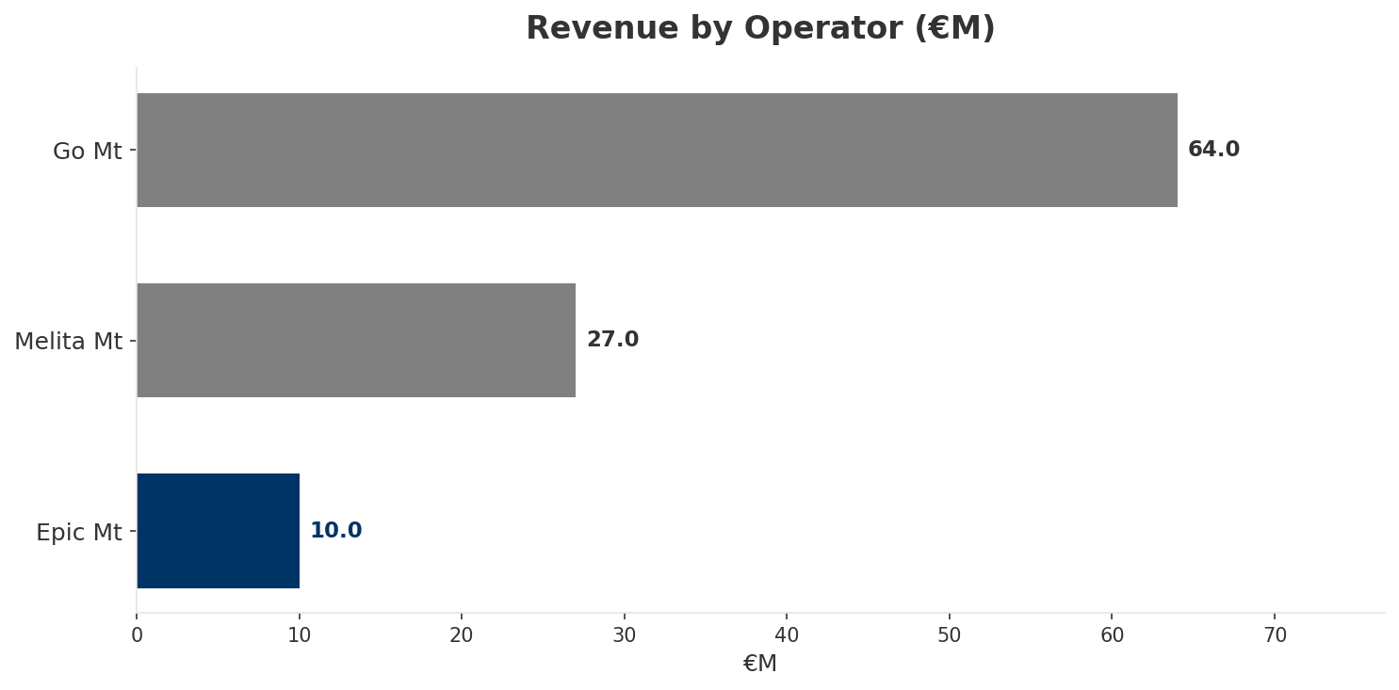
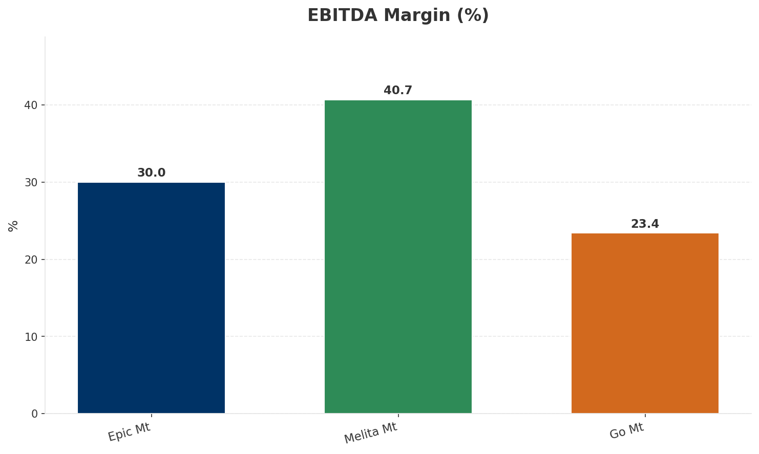
Revenue Comparison
COMPETITIVE BENCHMARKING
Key Message: Revenue and margin benchmarking across operators
28

Slide 29
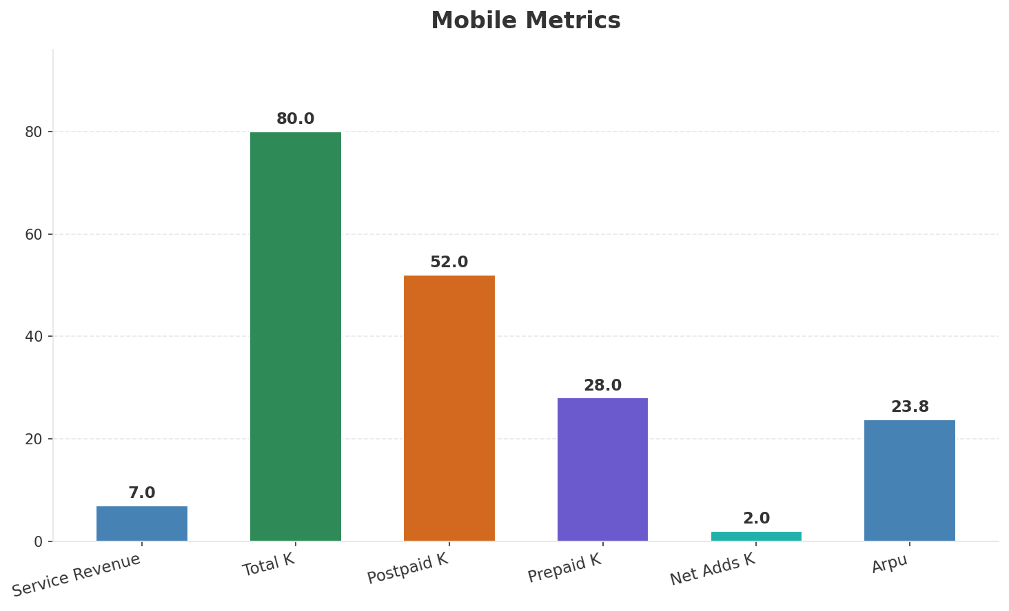
Segment Analysis: Mobile
SEGMENT PERFORMANCE
Service Revenue
Service Growth Pct
Total K
Postpaid K
€7M
16.7%
80
52
Health: STABLE
• revenue: stable
• subscribers: improving
• arpu: improving
• Epic Malta growing mobile subscriber base as third operator. NJJ/Monaco Telecom investment commitment. 5G network expanding. Competitive pricing challenging GO and Melita.
• subscribers increased 2.6% QoQ
Key Message: Mobile service revenue at 7.0M; up 16.7% YoY; ARPU 23.8
29

Slide 30
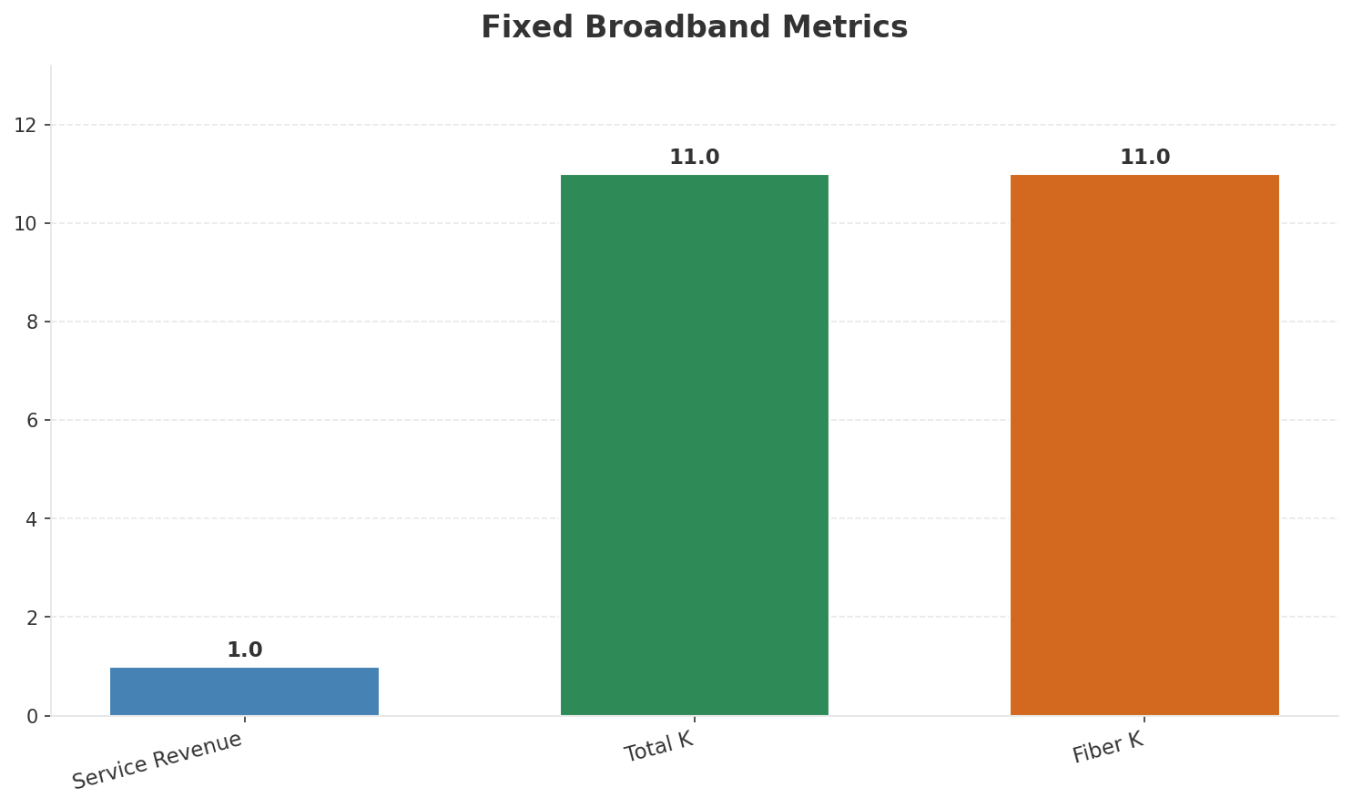
Segment Analysis: Fixed Broadband
SEGMENT PERFORMANCE
Service Revenue
Service Growth Pct
Total K
Net Adds K
€1M
0.0%
11
0
Health: STABLE
• revenue: stable
• subscribers: stable
• arpu: stable
Key Message: Fixed service revenue 1.0M; growth +0.0% YoY; Fiber subs 11K
30

Slide 31
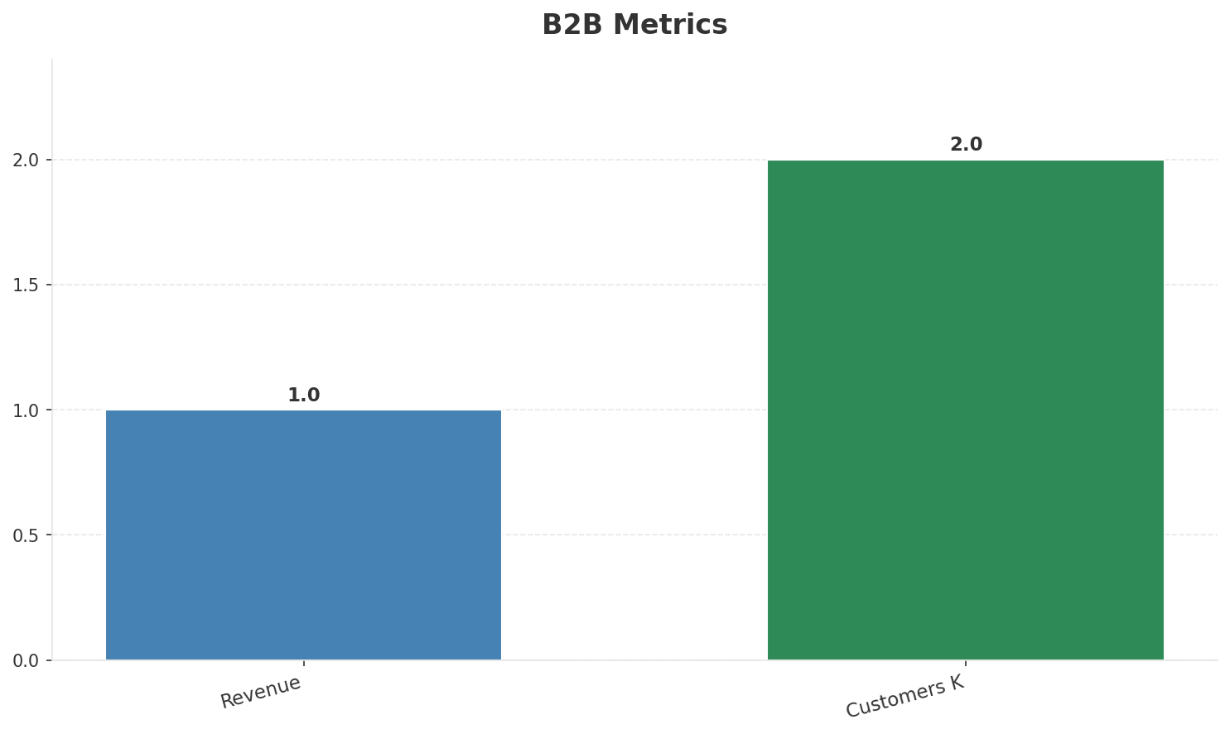
Segment Analysis: B2B
SEGMENT PERFORMANCE
Revenue
Growth Pct
Customers K
Share Of Revenue Pct
€1M
None
2
10.0%
Health: STABLE
• revenue: stable
• customers: stable
Key Message: B2B revenue 1.0M; 10.0% of total revenue
31

Slide 32
Segment Analysis: TV/Convergence
SEGMENT PERFORMANCE
Revenue
Total K
Net Adds K
Fmc Total K
None
0
None
None
Health: STABLE
• revenue: stable
• subscribers: stable
• fmc_subscribers: stable
Key Message: TV subscribers 0K
32

Slide 33
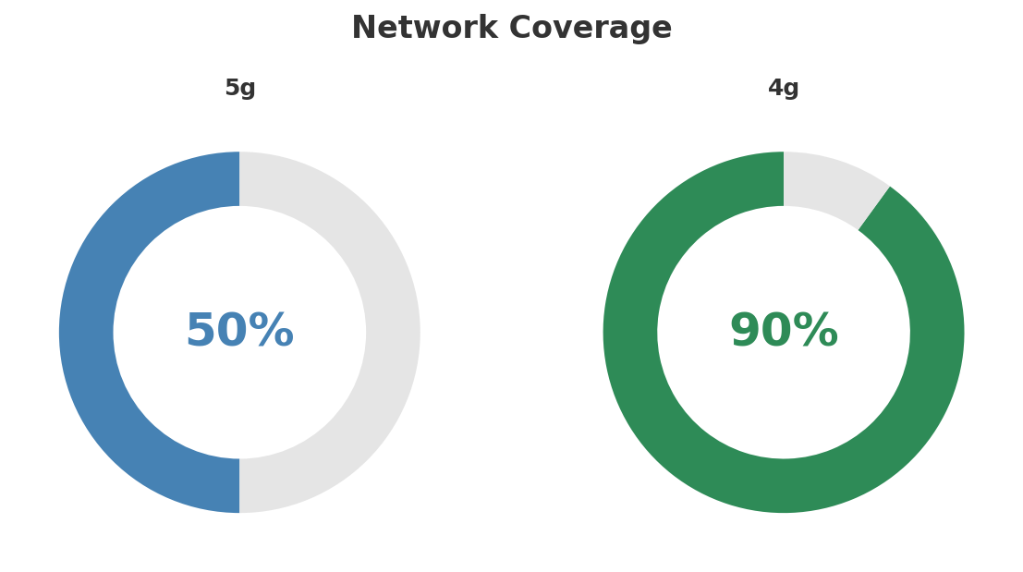
Network Analysis
INFRASTRUCTURE
Technology Mix:
Investment Direction: stable
• Mobile Vendor: Huawei
• Spectrum Mhz: 120
• Fixed Access: GO wholesale
Key Message: Network infrastructure and coverage assessment
33

Slide 34

Business Model Canvas
BMC
Key Message: Business model canvas overview
34

Slide 35
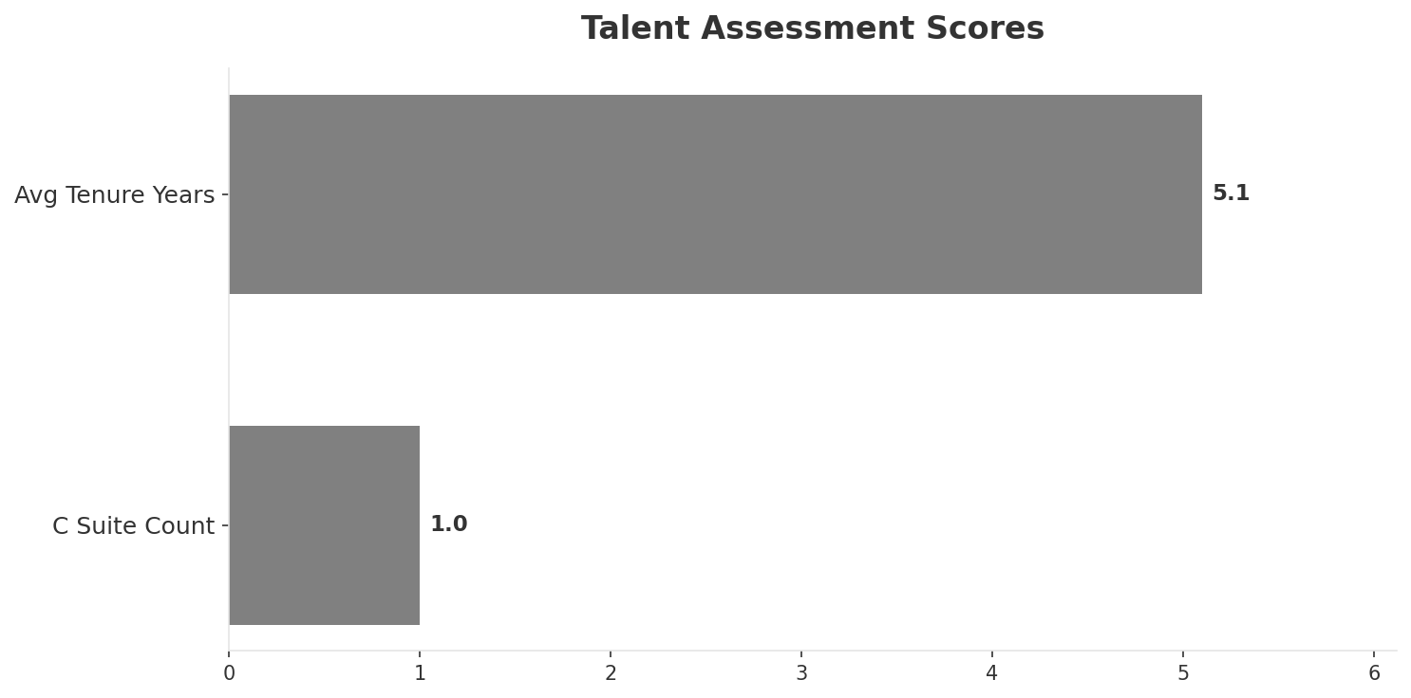
Organization & Talent
PEOPLE & CULTURE
Employees
C Suite Count
Avg Tenure Years
Key Leaders
195
1
5.1
['Paul Fenech (CEO)']
Organization Culture:
Stable leadership team (avg tenure >3 years); Growth-oriented strategic posture; High-investment posture; Monaco Telecom management. Private-sector agility. Challenger mindset.
Leadership Changes:
• Paul Fenech: (
Key Message: Organization and talent assessment
35

Slide 36
Strengths, Weaknesses & Exposure Points
SELF ASSESSMENT
Strengths
Weaknesses
Exposure Points
• Digital Experience: score 78 (market avg 73
• Price Competitiveness: score 80 (market avg 71
• Strong EBITDA margin at 30.0%
• Revenue on growth trajectory
• Brand Strength: score 55 (market avg 74
• Customer Service: score 68 (market avg 74
• Distribution: score 55 (market avg 74
• Enterprise Solutions: score 40 (market avg 64
• Network Coverage: score 68 (market avg 82
• Network Quality: score 75 (market avg 79
• Smallest operator in Malta's 3-player market: Scale disadvantage in a tiny market (540K population
• No owned fixed broadband infrastructure: Cannot offer competitive converged bundles independently
Key Message: Ranked #3 of 3 operators in market; revenue EUR 10.0M; EBITDA margin 30.0%; stable but facing challenges; key strength: Digital Experience; key challenge: Brand Strength; Management outlook: Epic Malta growing mobile subscriber base as third operator. NJJ/Monaco Telecom investment commitment. 5G network expanding. Competitive pricing challenging GO and Melita.
36

Slide 37
SWOT Synthesis
Strengths, Weaknesses, Opportunities & Threats

Slide 38
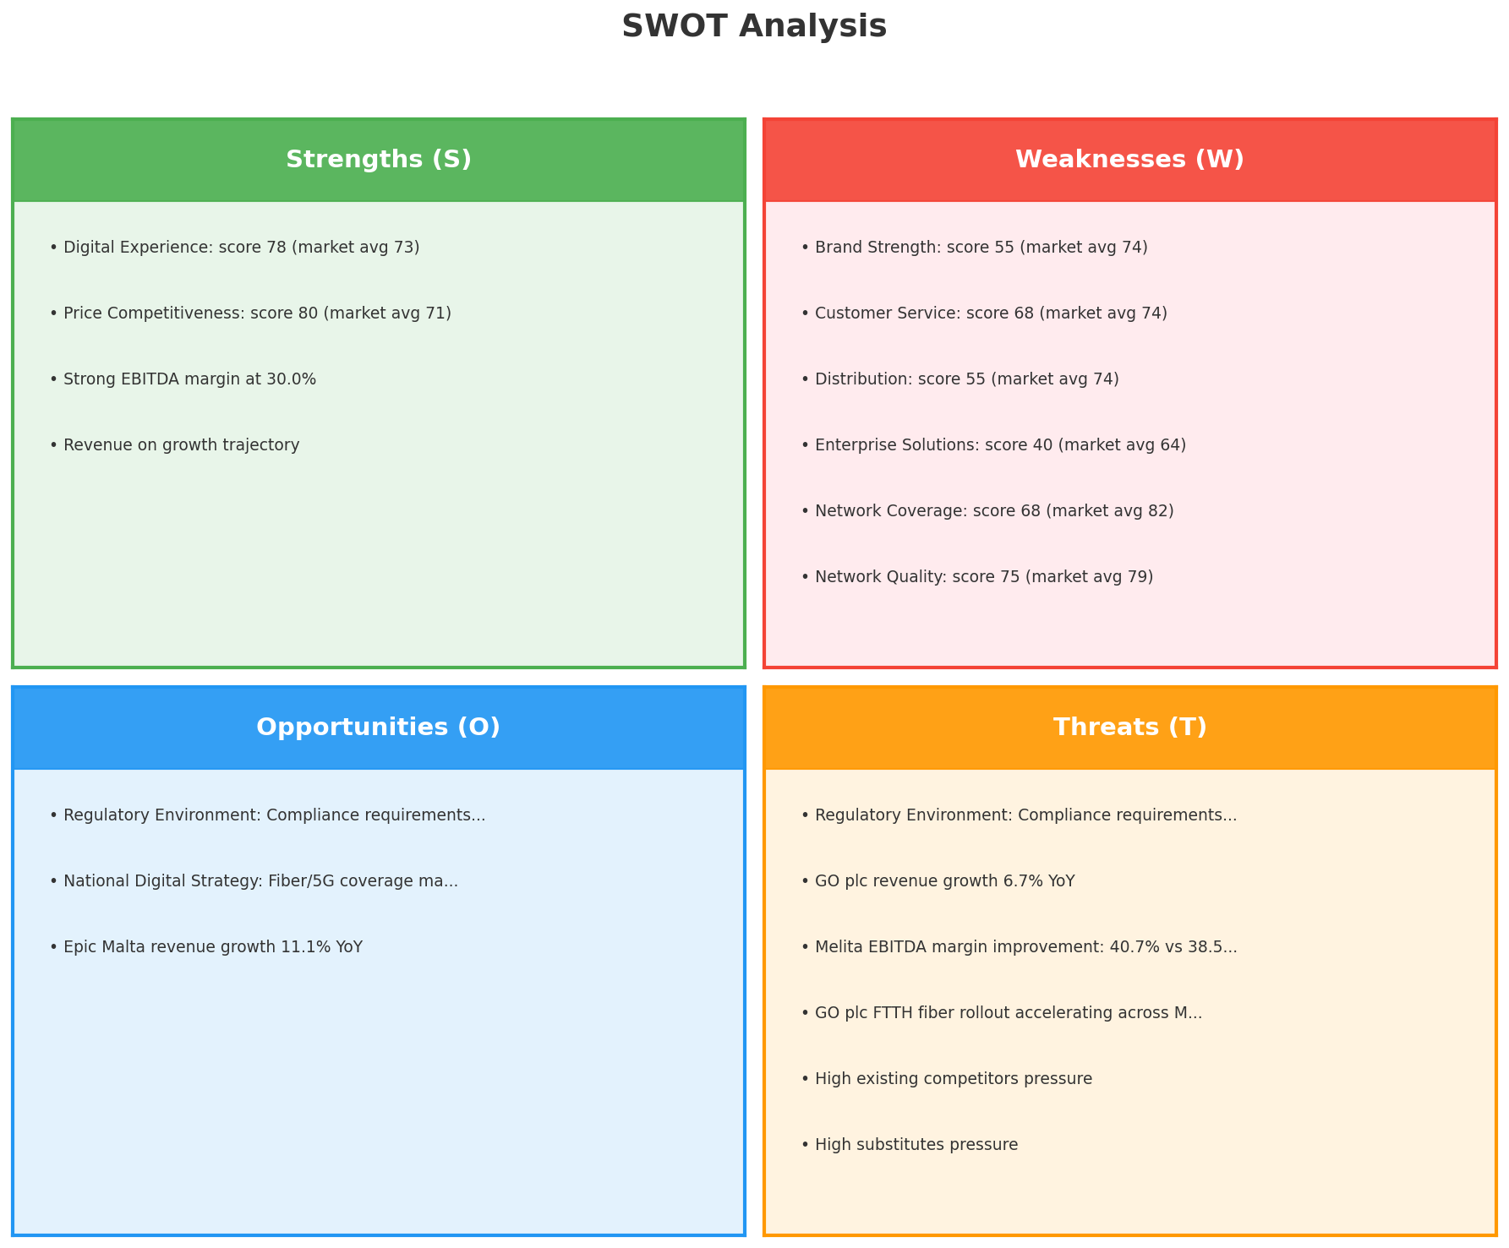
SWOT Analysis
STRATEGIC SYNTHESIS
SO:
Leverage 'Digital Experience: score 78 (market avg 73)' t...
WO:
Address weakness 'Brand Strength: score 55 (market avg 74...
ST:
Use strength 'Digital Experience: score 78 (market avg 73...
WT:
Mitigate weakness 'Brand Strength: score 55 (market avg 7...
Key Message: SWOT analysis identifies 4 strengths, 9 weaknesses, 3 opportunities, and 6 threats. The recommended strategic posture is cautious (WT-dominant).
38

Slide 39
05 Look at Opportunities
SPAN Matrix — Opportunity Selection

Slide 40
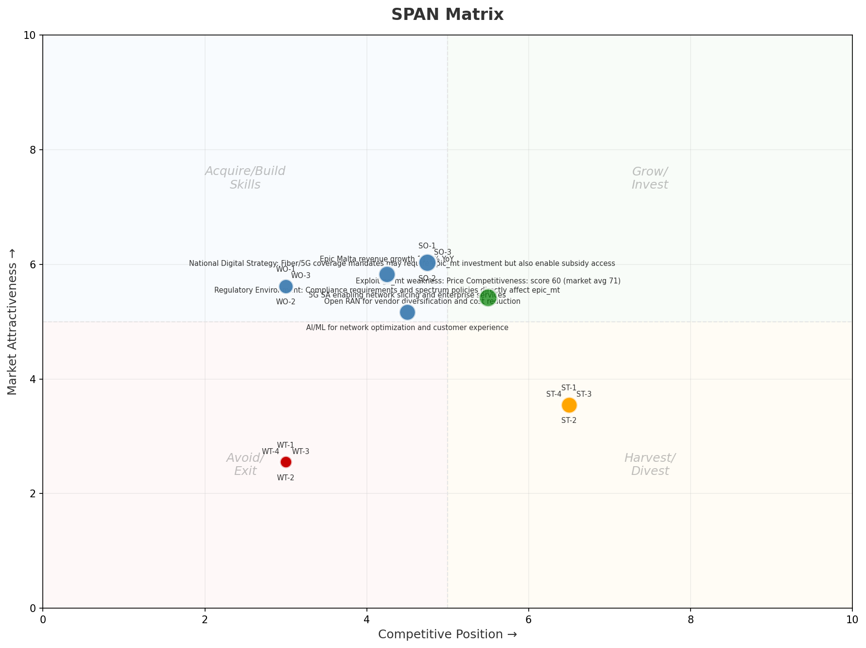
SPAN Matrix — Opportunity Positioning
OPPORTUNITY MAP
Key Message: SPAN matrix positions 21 opportunities: 1 grow/invest, 12 acquire skills, 4 harvest, 4 avoid/exit. Focus resources on the 1 grow/invest items for maximum strategic impact.
40

Slide 41
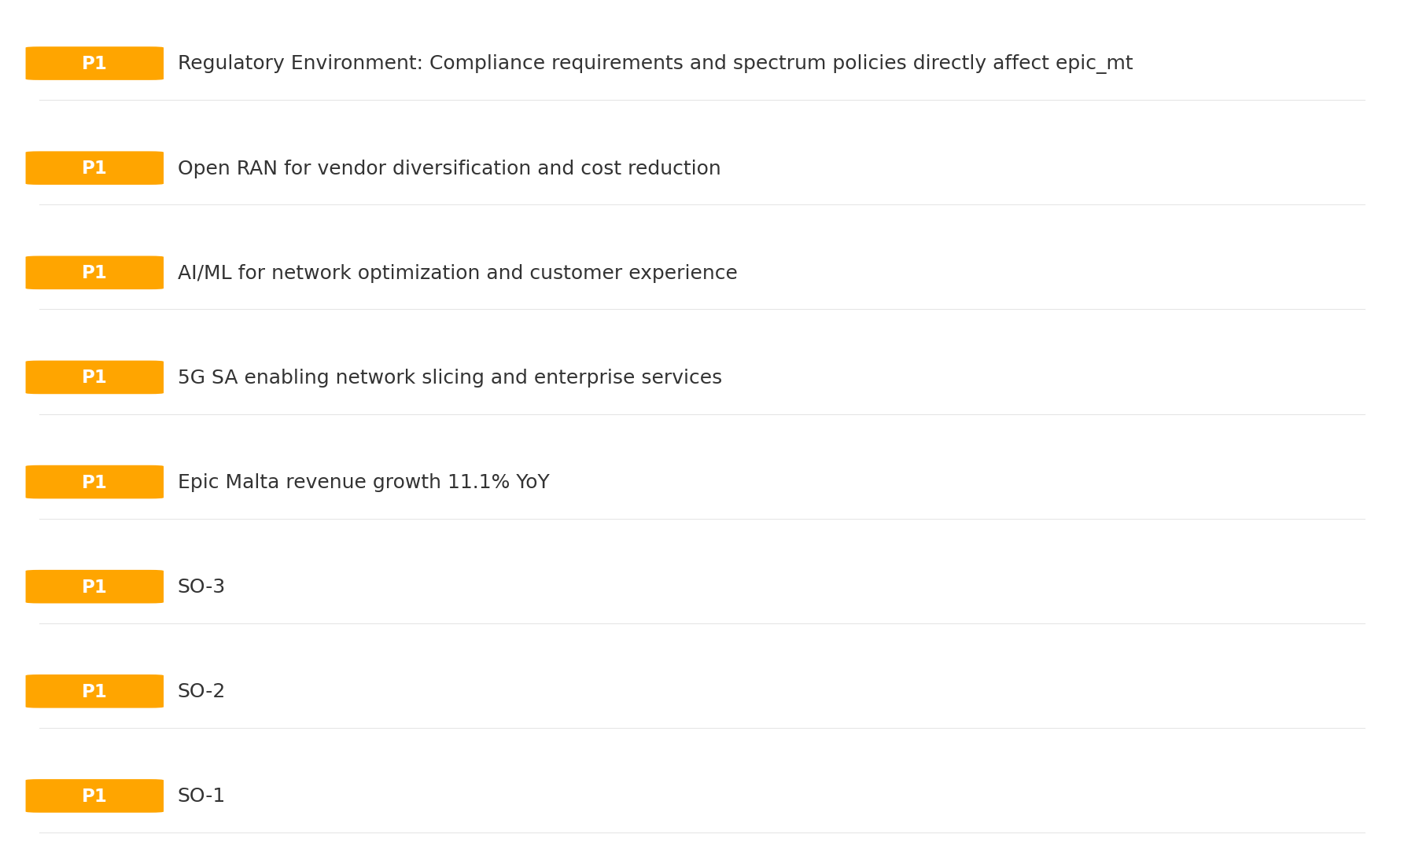
Opportunity Priority Ranking
PRIORITIES
Key Message: SPAN matrix positions 21 opportunities: 1 grow/invest, 12 acquire skills, 4 harvest, 4 avoid/exit. Focus resources on the 1 grow/invest items for maximum strategic impact.
41

Slide 42
Opportunity Details
DEEP DIVE
P1
SO-1
Market: N/A | Window:
Leverage 'Digital Experience: score 78 (market avg 73)' to capture the opportunity of 'Regulatory Environment: Compliance requirements and spectrum policies directly affect epic_mt'.
P1
SO-2
Market: N/A | Window:
Leverage 'Price Competitiveness: score 80 (market avg 71)' to capture the opportunity of 'National Digital Strategy: Fiber/5G coverage mandates may require epic_mt investment but also enable subsidy access'.
P1
SO-3
Market: N/A | Window:
Leverage 'Strong EBITDA margin at 30.0%' to capture the opportunity of 'Epic Malta revenue growth 11.1% YoY'.
P1
Epic Malta revenue growth 11.1% YoY
Market: N/A | Window:
Epic Malta revenue growth 11.1% YoY
Key Message: SPAN matrix positions 21 opportunities: 1 grow/invest, 12 acquire skills, 4 harvest, 4 avoid/exit. Focus resources on the 1 grow/invest items for maximum strategic impact.
42

Slide 43
Three Decisions
Strategy — Key Tasks — Execution

Slide 44
Decision 1: Define Strategy
CAUTIOUS
As The Distant Third: differentiate and grow through focused investment in competitive advantages
P0
P0
P1
P1
Growth Strategy
Competitive Strategy
Transformation Strategy
Customer Strategy
Focused growth in high-momentum segments: Mobile
Differentiate on quality and innovation to justify premium positioning
5G-first network modernization — quality leadership
Optimize value extraction in stable segments: Fixed Broadband, B2B
- Grow Mobile above market rate
- Improve segment profitability
- Improve NPS by 5 points
- Launch 2+ differentiating services
- 5G population coverage 80%+
- 5G revenue contribution 15%+
- Upsell rate +10% in Fixed Broadband, B2B
- Cross-sell convergence bundles
Key Message: As The Distant Third, the strategic posture is Cautious. As The Distant Third: differentiate and grow through focused in
44

Slide 45
Decision 2: Define Key Tasks
1 P0 (IMMEDIATE), 2 P1 (1-2 YEARS), 1 P2 (3-5 YEARS
P0
Business
Accelerate Mobile Growth
Mobile revenue +10% YoY | Market share gain
Mobile at €7M showing strong momentum — invest to scale
P1
Network
5G Coverage Expansion
5G pop coverage target | 5G attach rate
Expand 5G population coverage to strengthen mobile competitive position
P1
Customer
Customer Experience Enhancement
NPS +5 points | First-call resolution rate 80%+
Improve digital touchpoints and service resolution to boost NPS
P2
Efficiency
Operational Efficiency & Automation
Process automation 30%+ | Cost-to-serve reduction
EBITDA margin 30.0% — maintain through smart automation and resource reallocatio
Key Message: 4 critical tasks: 1 P0 (immediate), 2 P1 (1-2 years), 1 P2 (3-5 years
45

Slide 46
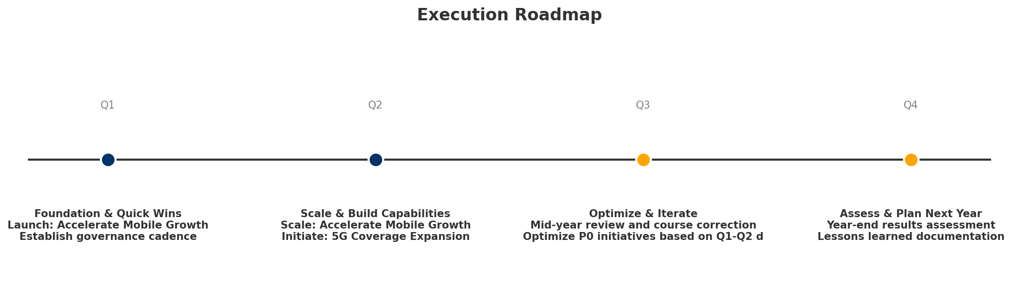
Decision 3: Define Execution
QUARTERLY ROADMAP & GOVERNANCE
Governance
Strategic Traps to Avoid
- Monthly Progress Review (Monthly
x Enter a price war
- Quarterly Strategic Checkpoint (Quarterly
x Attempt premium repositioning
- Mid-Year Strategic Adjustment (Semi-annual
x Delay core transformation
Key Risks & Mitigation
! Resource constraints delay P0 initiatives -- Ring-fence P0 budgets; establish escalation path for blockers
Key Message: Execute with discipline: monthly reviews, quarterly checkpoints, annual refresh
! Macro-economic slowdown reduces consumer spending -- Prepare value-tier offerings; shift mix toward B2B resilience
46

Slide 47
Analysis Summary
KEY TAKEAWAYS
01 Trends
Macro environment: Favorable. Key opportunities: Regulatory Environment, National Digital Strategy. Key risks: Regulatory Environment, Fiber Broadband Penetration Industry is in late growth phase. (+6.3% YoY (CQ2_2025 -> CQ4_2025)
02 Market
Malta telecom market totals EUR 101.0M in quarterly revenue; gaps in Assurances, Social/Brand; Market faces significant competitive headwinds.
03 Competition
In a 3-player market with medium competition intensity, GO plc leads with 63% revenue share. Target operator holds 10% share. Strongest competitive force: Existing Competitors.
04 Self
Ranked #3 of 3 operators in market; revenue EUR 10.0M; EBITDA margin 30.0%; stable but facing challenges; key strength: Digital Experience; key challenge: Brand Strength; Management outlook: Epic Malta growing mobile subscriber base as third operator. NJJ/Monaco Telecom investment commitment. 5G network expanding. Competitive pricing challenging GO and Melita.
SWOT
SWOT analysis identifies 4 strengths, 9 weaknesses, 3 opportunities, and 6 threats. The recommended strategic posture is cautious (WT-dominant).
05 Opportunities
SPAN matrix positions 21 opportunities: 1 grow/invest, 12 acquire skills, 4 harvest, 4 avoid/exit. Focus resources on the 1 grow/invest items for maximum strategic impact.
Key Message: Complete Five Looks analysis — see opportunity priorities for next steps
47

Slide 48
Data Provenance
SOURCES & METHODOLOGY
No provenance data recorded for this analysis
Key Message: All data points are traceable to original sources
48

Slide 49
Thank You
BLM Five Looks Strategic Analysis

