Slide 1
Default BLM Strategic Analysis
BLM (Business Leadership Model) Five Looks Analysis
Target Operator
Market
Analysis Period
Report Date
Salt Ch
Switzerland
CQ4_2025
2026-02-15
01 Trends (PEST) | 02 Market/Customer ($APPEALS) | 03 Competition (Porter) | 04 Self (BMC) | SWOT Synthesis | 05 Opportunities (SPAN

Slide 2
Report Contents
TABLE OF CONTENTS
01
Executive Summary
Key findings and recommendations
02
Look at Trends
PEST Framework — macro environment
03
Look at Market
$APPEALS — market changes & customer needs
T
Tariff Analysis
Pricing comparison — mobile, fixed & convergence
04
Look at Competition
Porter's Five Forces — competitive landscape
05
Look at Self
BMC + Capability — internal assessment
06
SWOT Synthesis
Strengths, Weaknesses, Opportunities, Threats
07
Look at Opportunities
SPAN Matrix — opportunity selection
Summary & Provenance
2
08
Conclusions and data sources

Slide 3
Data Quality Overview
DATA QUALITY
Total Data Points
High Confidence
Medium Confidence
Low/Estimated
20
0
0
20
0%
Unique Sources: 0
Data Conflicts: 0
Coverage: Partial
Key Message: 20 data points tracked, 0 high-confidence (0%
3

Slide 4
Executive Summary
Trends
Macro environment: Favorable. Key opportunities: Regulatory Environment, National Digital Strategy. Key risks: Regulatory Environment, Fiber Broadband Penetration Industry is in late growth phase. (+2.0% YoY (CQ2_2025 -> CQ4_2025)
Market/Customer
Switzerland telecom market totals CHF 3,110M in quarterly revenue; competitive strengths in Availability, Performance; gaps in Assurances; Market outlook is favorable with more opportunities than threats.
Competition
In a 3-player market with medium competition intensity, Swisscom leads with 67% revenue share. Target operator holds 8% share. Strongest competitive force: Substitutes.
Self Assessment
Ranked #3 of 3 operators in market; revenue CHF 245.0M; EBITDA margin 58.8%; stable but facing challenges; key strength: Digital Experience; key challenge: Brand Strength; Management outlook: FY2024 revenue CHF 973.2M (+4.4%), operating EBITDA margin ~60%, among highest in Europe. Mobile postpaid base exceeds 1.7M. Salt Connect magazine network score 952/1000 ('outstanding').
SWOT
SWOT analysis identifies 5 strengths, 7 weaknesses, 3 opportunities, and 2 threats. The recommended strategic posture is improvement-focused (WO-dominant).
Opportunities
SPAN matrix positions 19 opportunities: 3 grow/invest, 11 acquire skills, 2 harvest, 3 avoid/exit. Focus resources on the 3 grow/invest items for maximum strategic impact.
Key Message: Five Looks analysis completed — see details in following sections
4

Slide 5
01 Look at Trends
PEST Framework — Macro Environment

Slide 6
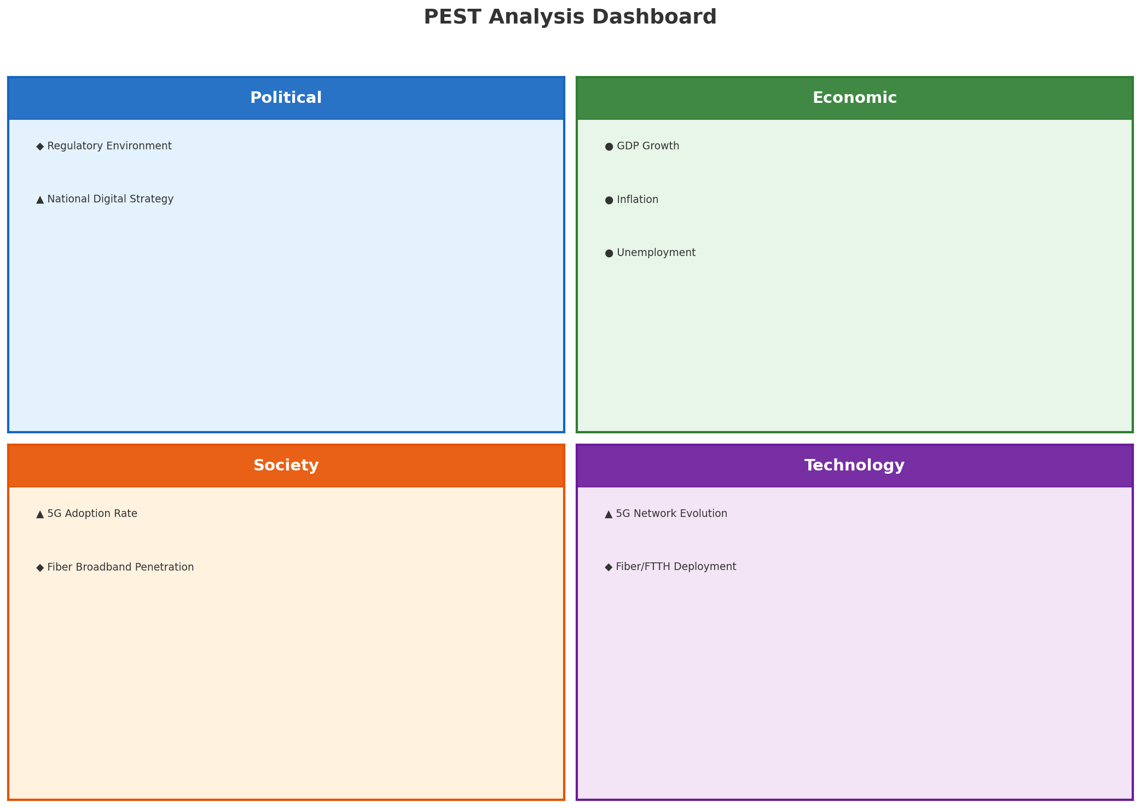
PEST Analysis Dashboard
MACRO ENVIRONMENT
Key Message: Macro environment: Favorable. Key opportunities: Regulatory Environment, National Digital Strategy. Key risks: Regulatory Environment, Fiber Broadband Penetration.
6

Slide 7
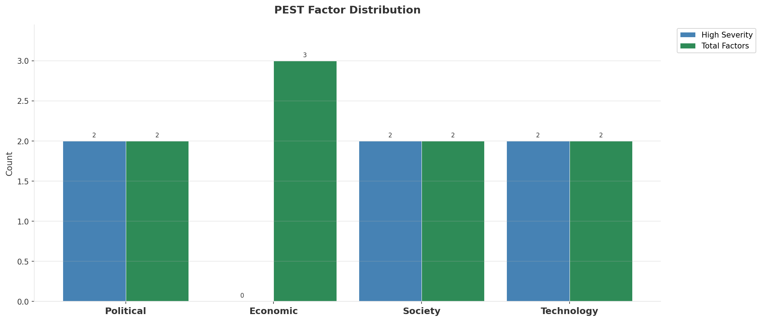
Industry Environment
INDUSTRY ANALYSIS
Market Size
Growth Rate
Concentration
Lifecycle
CHF 3.1B (quarterly, CQ4_2025
+2.0% YoY (CQ2_2025 -> CQ4_2025
CR4 = 100% (Swisscom: 66.9%, Sunrise: 25.2%, Salt Mobile: 7.9%
late_growth
• New Business Models:
• FWA (Fixed Wireless Access) as fiber alternative
• Network-as-a-Service for enterprise verticals
• Wholesale/MVNO partnerships for coverage monetization
• Technology Revolution:
• 5G SA enabling network slicing and enterprise services
• AI/ML for network optimization and customer experience
• Open RAN for vendor diversification and cost reduction
Key Message: Macro environment: Favorable. Key opportunities: Regulatory Environment, National Digital Strategy. Key risks: Regulatory Environment, Fiber Broadband Penetration Industry is in late growth phase. (+2.0% YoY (CQ2_2025 -> CQ4_2025)
7

Slide 8
Value Transfer Trends
VALUE MIGRATION
• Value shifting from voice/SMS to data and digital services
• B2B/ICT growing faster than consumer segment
• Fiber displacing copper and cable broadband
Key Message: Macro environment: Favorable. Key opportunities: Regulatory Environment, National Digital Strategy. Key risks: Regulatory Environment, Fiber Broadband Penetration Industry is in late growth phase. (+2.0% YoY (CQ2_2025 -> CQ4_2025)
8

Slide 9
02 Look at Market
$APPEALS — Market Changes & Customer Needs

Slide 10
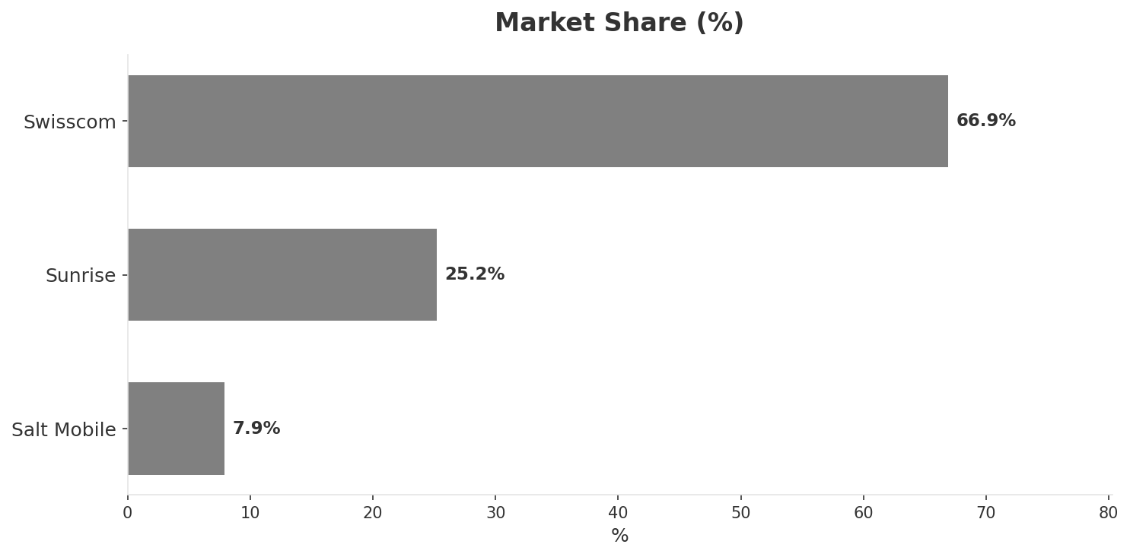
Market Change Panorama
MARKET OVERVIEW
Total Revenue (€M
Mobile Subs (K
Broadband Subs (K
Operators
3,110
11,580
3,530
3
Market Changes:
• Sunrise announces ~190 job cuts post-spin-off
Key Message: Switzerland telecom market totals CHF 3,110M in quarterly revenue; competitive strengths in Availability, Performance; gaps in Assurances; Market outlook is favorable with more opportunities than threats.
10

Slide 11
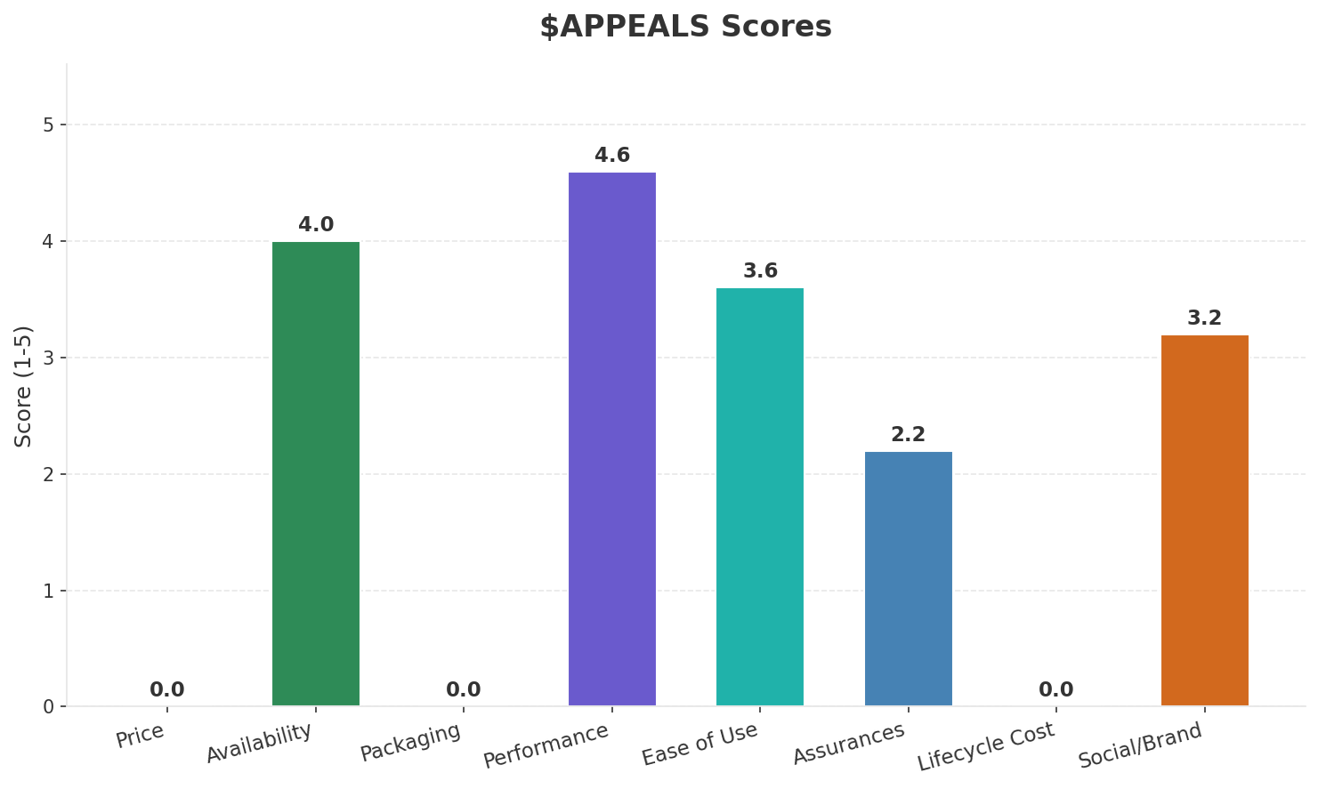
Customer Segments
SEGMENTATION
Consumer Premium Convergent
Trend: stable
Needs: Seamless quad-play convergence at competitive prices, True 10 Gbps fiber speeds delivered consistently
Consumer Value-Seeking
Trend: stable
Needs: More affordable unlimited mobile plans, Better price-to-quality ratio vs EU benchmarks
Consumer Digital-First / Young
Trend: stable
Needs: eSIM and fully digital onboarding, Flexible SIM-only plans with no contract
Enterprise & SME
Trend: stable
Needs: Private 5G networks for pharmaceutical and financial sectors, Cloud and cybersecurity managed services
Key Message: Switzerland telecom market totals CHF 3,110M in quarterly revenue; competitive strengths in Availability, Performance; gaps in Assurances; Market outlook is favorable with more opportunities than threats.
11

Slide 12
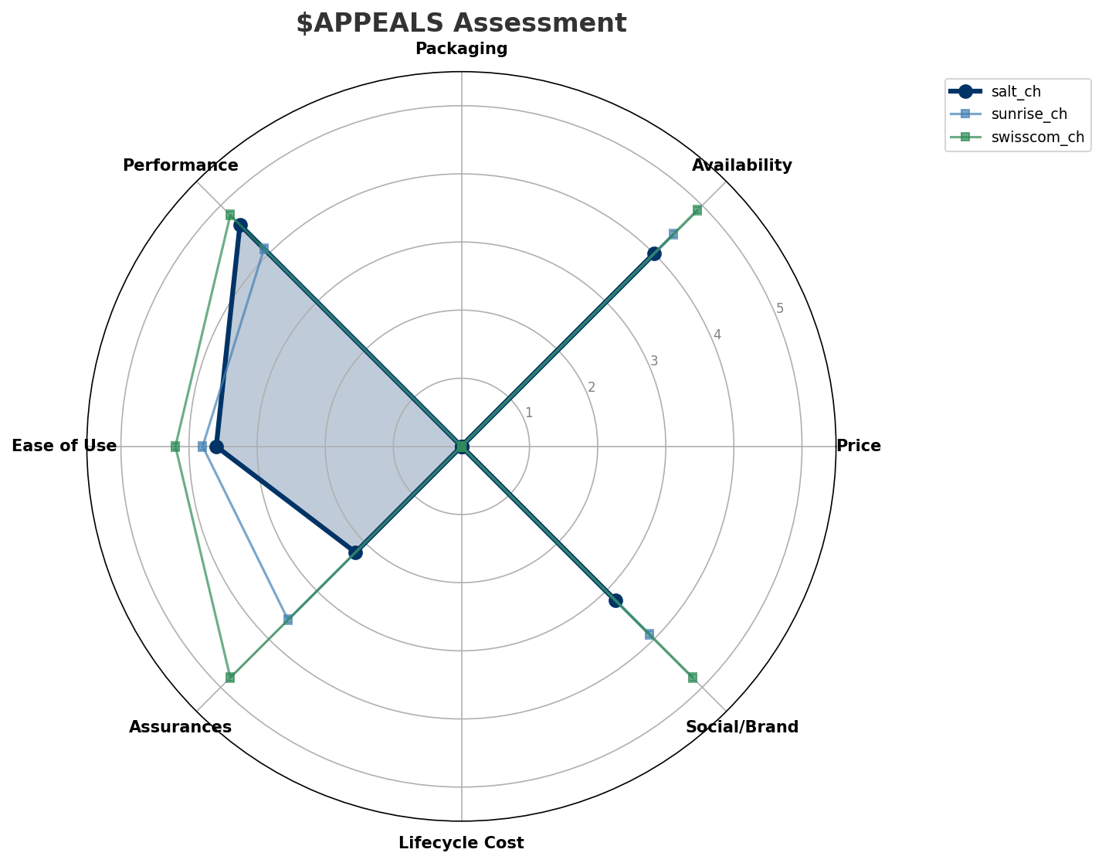
$APPEALS Assessment
CUSTOMER NEEDS
Key Message: Switzerland telecom market totals CHF 3,110M in quarterly revenue; competitive strengths in Availability, Performance; gaps in Assurances; Market outlook is favorable with more opportunities than threats.
12

Slide 13
Customer Value Migration
VALUE MIGRATION
Limited data to assess value migration trends
Opportunities:
• Sunrise announces ~190 job cuts post-spin-off
Key Message: Switzerland telecom market totals CHF 3,110M in quarterly revenue; competitive strengths in Availability, Performance; gaps in Assurances; Market outlook is favorable with more opportunities than threats.
13

Slide 14
Tariff Analysis
Mobile, Fixed & Convergence Pricing Landscape

Slide 15
Fixed & Convergence Pricing Landscape
DSL / CABLE / FIBER / FMC BUNDLES
Key Message: Fixed and convergence pricing overview
15

Slide 16
03 Look at Competition
Porter's Five Forces — Competitive Landscape

Slide 17
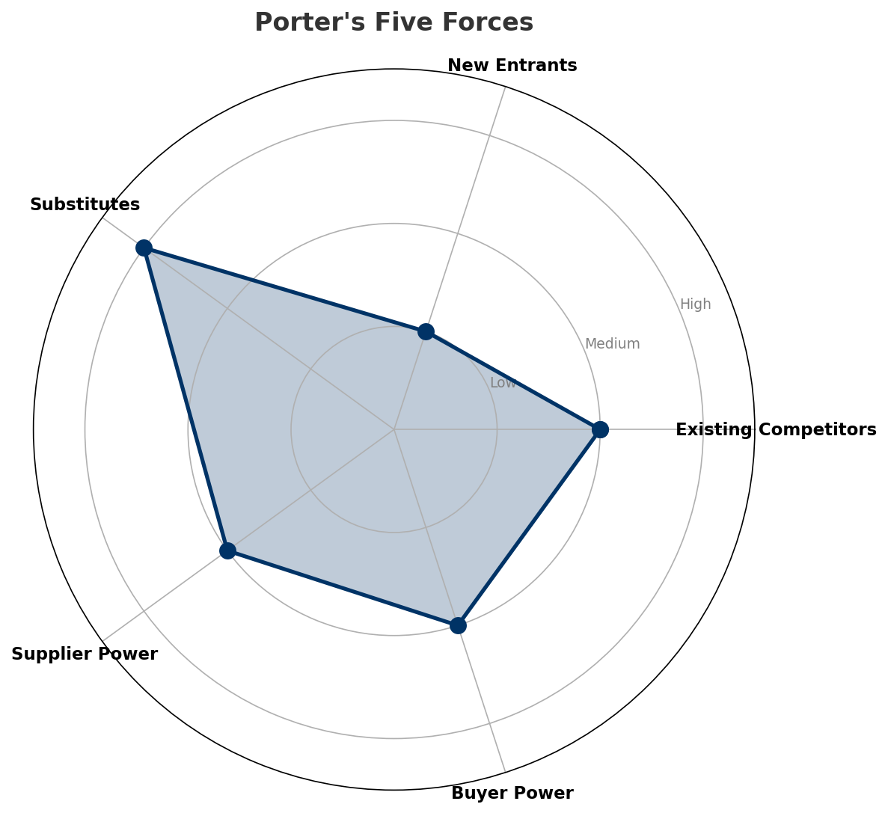
Porter's Five Forces
COMPETITIVE FORCES
Overall Intensity: MEDIUM
Key Message: In a 3-player market with medium competition intensity, Swisscom leads with 67% revenue share. Target operator holds 8% share. Strongest competitive force: Substitutes.
17

Slide 18
Competitor Analysis: Sunrise Ch
COMPETITOR DEEP DIVE
Revenue
EBITDA
Margin
Capex/Rev
€785M
€265M
33.8%
16.2%
+2.9% YoY
Strengths
Weaknesses
• Digital Experience: score 75 (market avg 80
• Innovation: score 75 (market avg 80
• Network Quality: score 82 (market avg 90
Strategy: Revenue-led profitable growth; subscriber acquisition focus
Key Message: Competitor analysis: Sunrise Ch
18

Slide 19
Competitor Analysis: Swisscom Ch
COMPETITOR DEEP DIVE
Revenue
EBITDA
Margin
Capex/Rev
€2,080M
€935M
45.0%
20.7%
-1.0% YoY
Strengths
Weaknesses
• Brand Strength: score 95 (market avg 79
• Customer Service: score 85 (market avg 77
• Distribution: score 95 (market avg 81
• Enterprise Solutions: score 95 (market avg 71
• Price Competitiveness: score 45 (market avg 69
Strategy: Market share expansion (investing for growth); subscriber acquisition focus; strong B2B/enterprise push
Key Message: Competitor analysis: Swisscom Ch
19

Slide 20
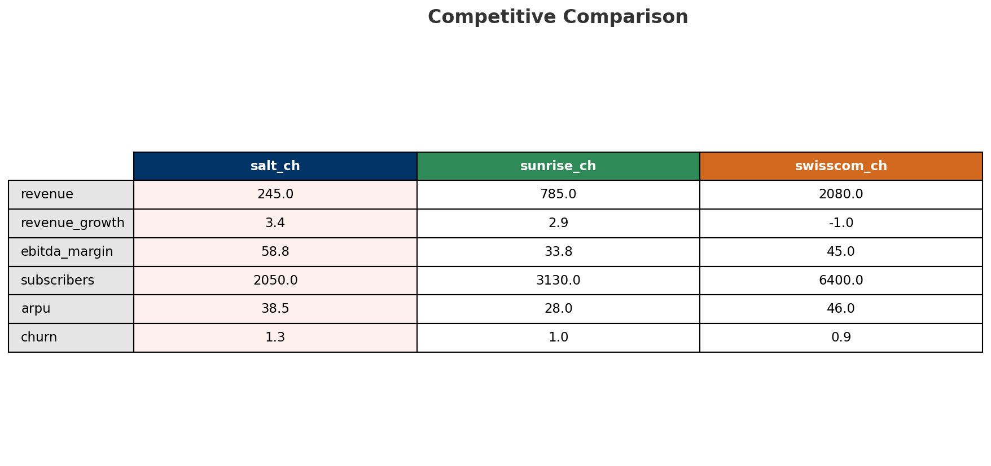
Competitive Landscape Summary
COMPETITION
Key Message: In a 3-player market with medium competition intensity, Swisscom leads with 67% revenue share. Target operator holds 8% share. Strongest competitive force: Substitutes.
20

Slide 21
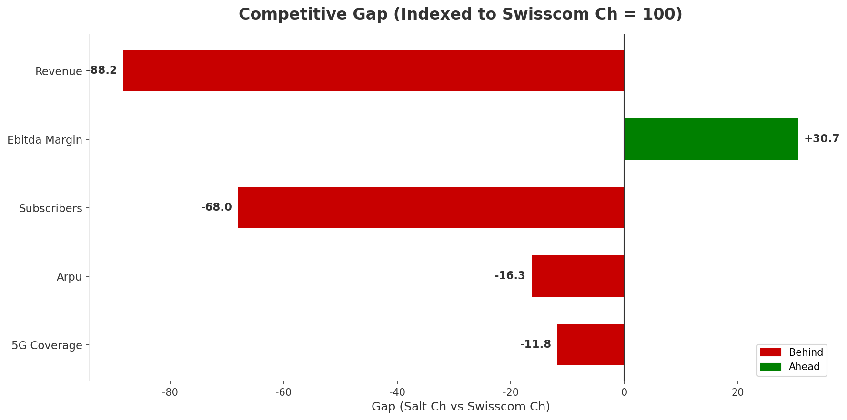
Gap Analysis: Salt Ch vs Swisscom Ch
COMPETITIVE GAP
Key Message: Gap analysis vs market leader Swisscom Ch
21

Slide 22
New Entrants Threat
MARKET ENTRY
• Entry barriers: High barriers: spectrum licensing, massive capex for network build, regulatory approvals, established brand loyalty
Key Message: New entrants threat level: low
22

Slide 23
04 Look at Self
BMC + Capability Assessment

Slide 24
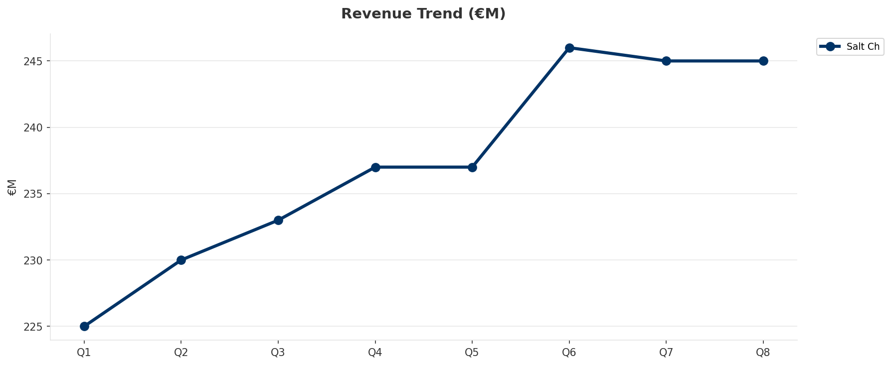
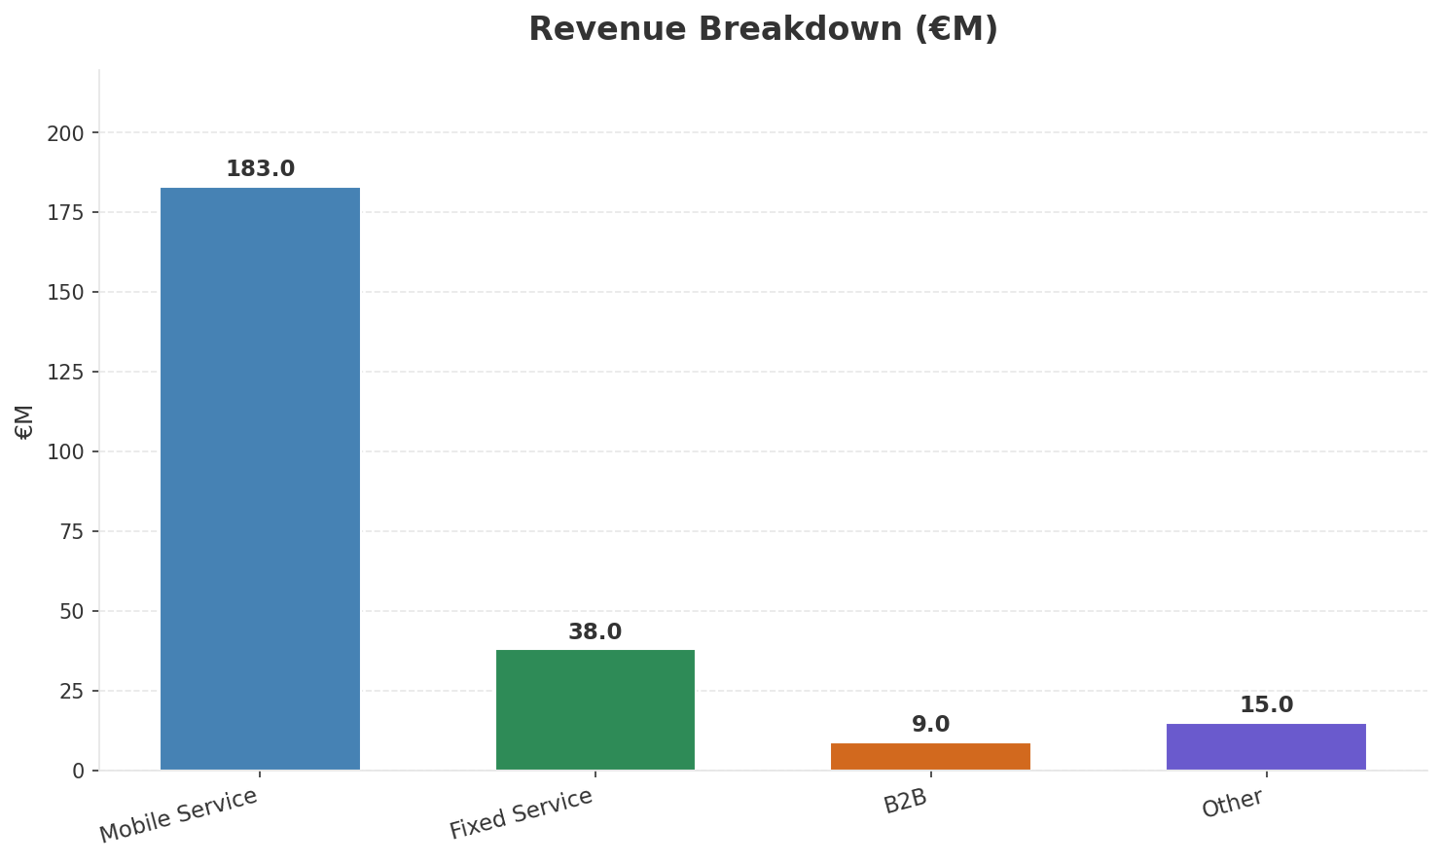
Operating Health Check
FINANCIAL HEALTH
Revenue
EBITDA
EBITDA Margin
Capex/Rev
€245M
€144M
58.8%
18.0%
+3.38% YoY
+-2.7% YoY
CAGR: +5.0% | Decelerating Growth
Key Message: Ranked #3 of 3 operators in market; revenue CHF 245.0M; EBITDA margin 58.8%; stable but facing challenges; key strength: Digital Experience; key challenge: Brand Strength; Management outlook: FY2024 revenue CHF 973.2M (+4.4%), operating EBITDA margin ~60%, among highest in Europe. Mobile postpaid base exceeds 1.7M. Salt Connect magazine network score 952/1000 ('outstanding').
24

Slide 25
Market Share Evolution
REVENUE SHARE TREND
Swisscom
Sunrise
Salt Mobile
66.9% #1
25.2% #2
7.9% #3
-0.2pp stable
-0.1pp stable
+0.3pp stable
Market Concentration: HHI 5,172 (Highly Concentrated) | CR3: 100.0% | Trend: Stable
Subscriber share: Mobile: 17.7% (+0.6pp) | Broadband: 7.5% (+2.0pp
Key Message: Revenue share: 7.9% (#3); stable (+0.3pp); market is highly concentrated (HHI 5,172).
25

Slide 26
Momentum Dashboard
MULTI-QUARTER TREND ANALYSIS
Revenue
EBITDA
Margin
+5.0% CAGR
+2.5% CAGR
-2.4% CAGR
Decelerating Growth (44/100
Decelerating Growth (28/100
Accelerating Decline (35/100
Key Message: Dominant momentum: Decelerating Growth — based on 3 KPI trend analyses
26

Slide 27
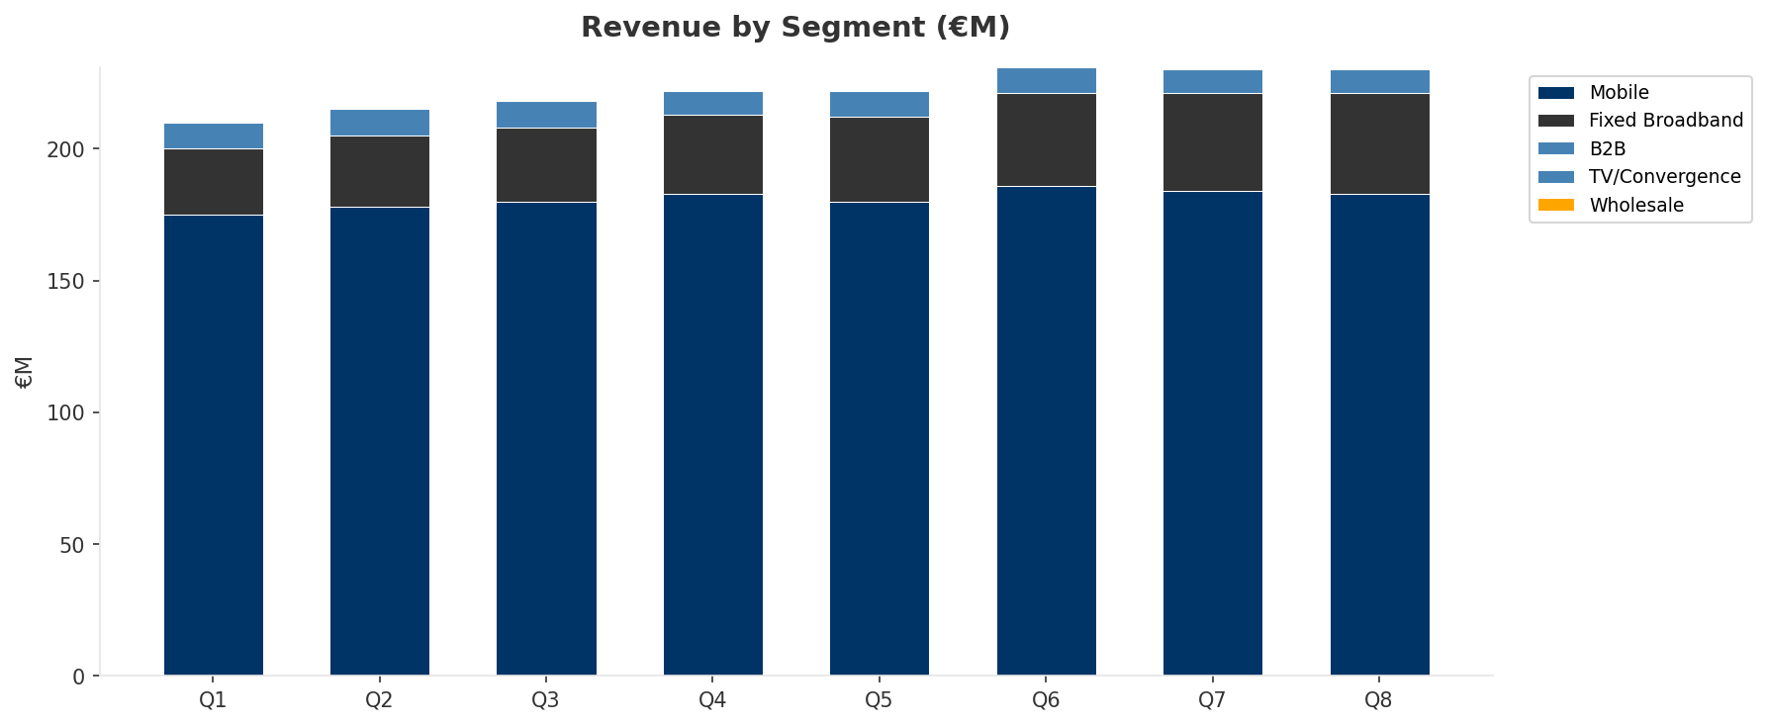
Revenue Composition Trend
SEGMENT REVENUE MIX OVER TIME
Key Message: Growing: Mobile, Fixed Broadband | Declining: B2B
27

Slide 28
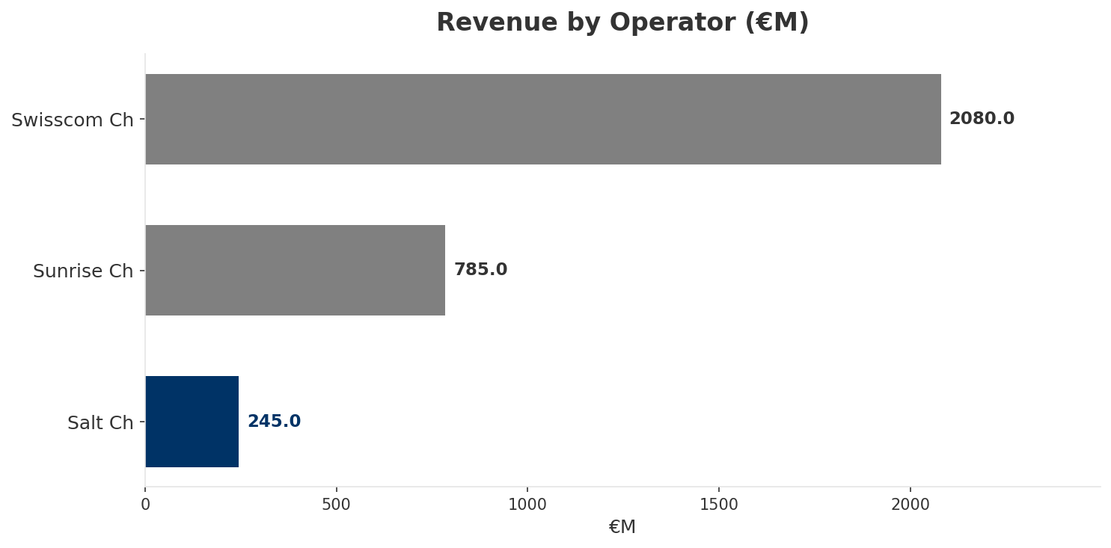
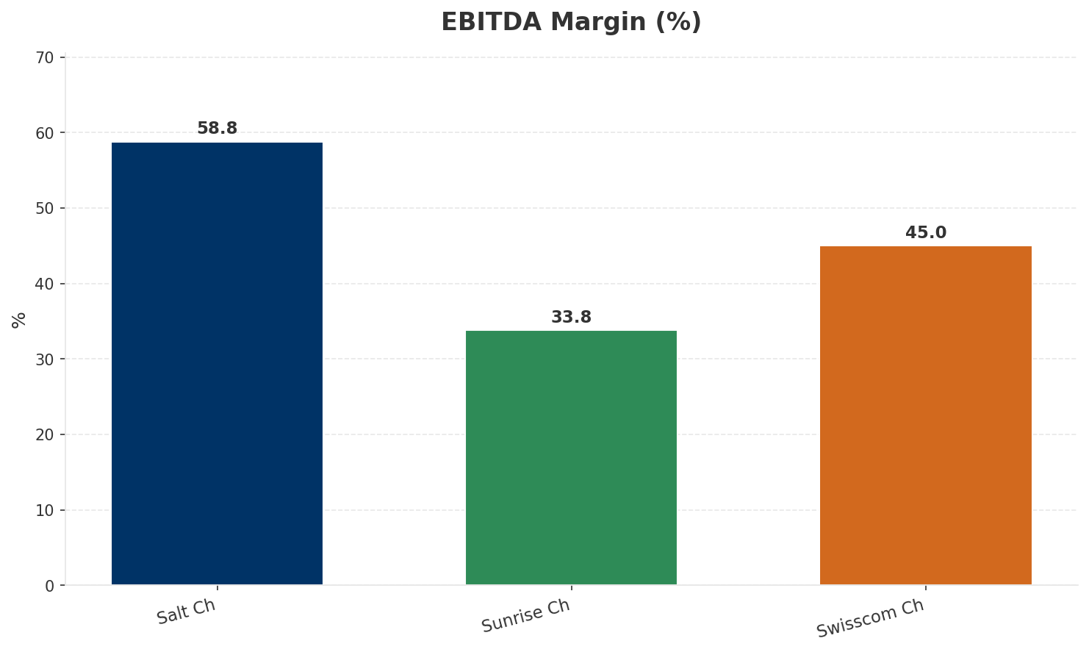
Revenue Comparison
COMPETITIVE BENCHMARKING
Key Message: Revenue and margin benchmarking across operators
28

Slide 29
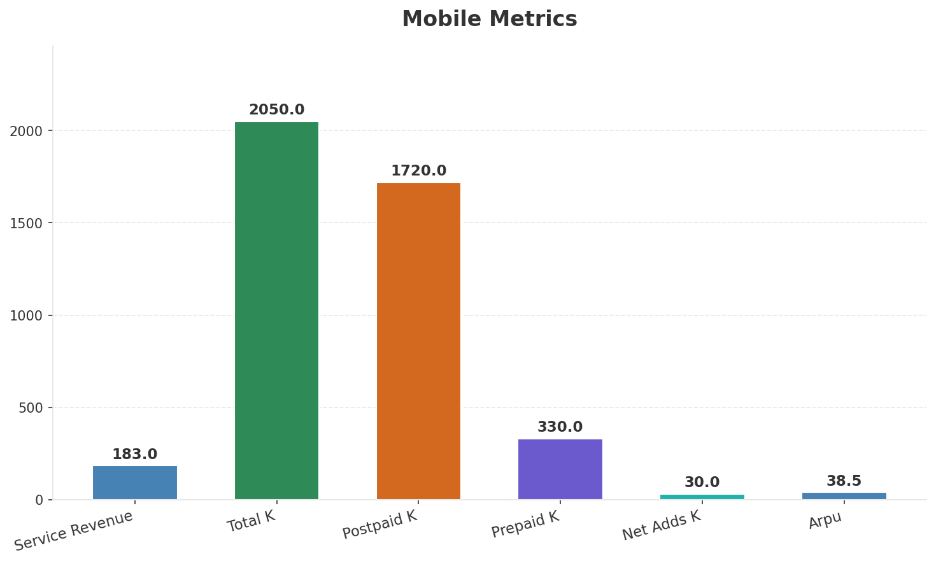
Segment Analysis: Mobile
SEGMENT PERFORMANCE
Service Revenue
Service Growth Pct
Total K
Postpaid K
€183M
0.0%
€2,050M
€1,720M
Health: STABLE
• revenue: stable
• subscribers: improving
• arpu: declining
• FY2024 revenue CHF 973.2M (+4.4%), operating EBITDA margin ~60%, among highest in Europe. Mobile postpaid base exceeds 1.7M. Salt Connect magazine network score 952/1000 ('outstanding').
Key Message: Mobile service revenue at 183.0M; down 0.0% YoY; ARPU 38.5
29

Slide 30
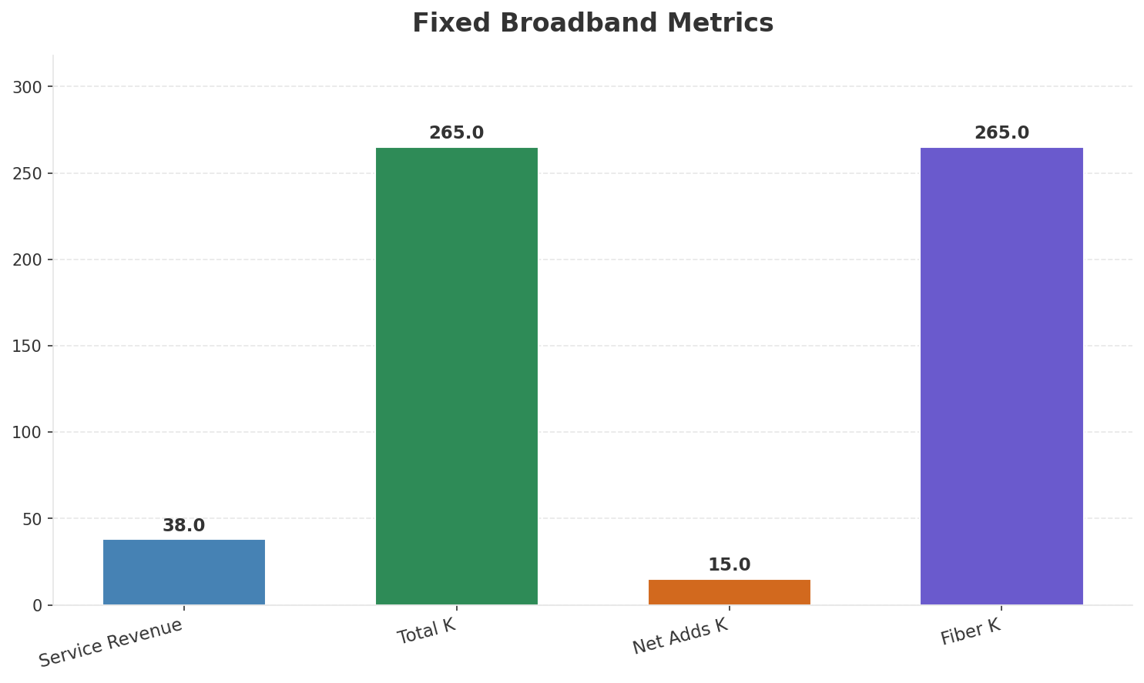
Segment Analysis: Fixed Broadband
SEGMENT PERFORMANCE
Service Revenue
Service Growth Pct
Total K
Net Adds K
€38M
26.7%
€265M
15
Health: STRONG
• revenue: improving
• subscribers: improving
• arpu: stable
• Salt Home broadband passed 250K subscribers in Q4 2024. Fixed service revenue growing 25%+ YoY. FTTH accessible to ~2.5M households via own-build + wholesale; targeting 3M by end 2025.
• revenue increased 2.7% QoQ
• subscribers increased 6.0% QoQ
Key Message: Fixed service revenue 38.0M; growth +26.7% YoY; Fiber subs 265K
30

Slide 31
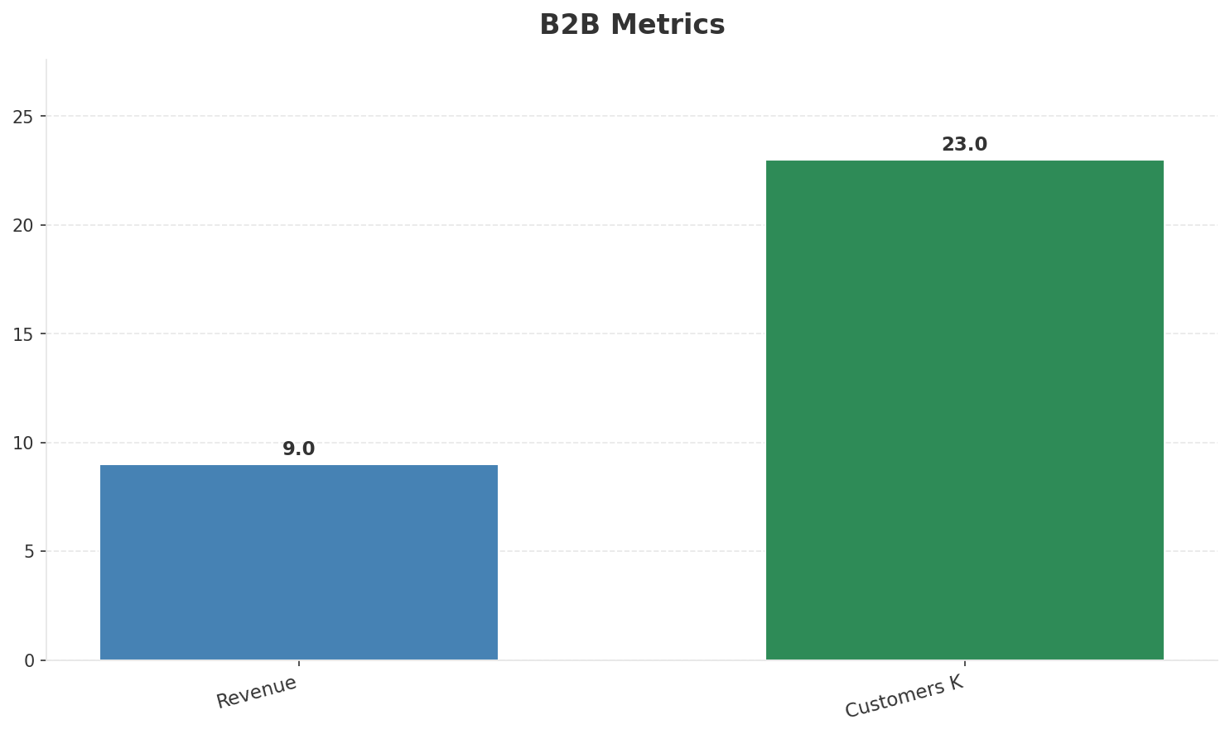
Segment Analysis: B2B
SEGMENT PERFORMANCE
Revenue
Growth Pct
Customers K
Share Of Revenue Pct
€9M
None
23
3.7%
Health: STABLE
• revenue: stable
• customers: stable
Key Message: B2B revenue 9.0M; 3.7% of total revenue
31

Slide 32
Segment Analysis: TV/Convergence
SEGMENT PERFORMANCE
Revenue
Total K
Net Adds K
Fmc Total K
None
0
None
None
Health: STABLE
• revenue: stable
• subscribers: stable
• fmc_subscribers: stable
Key Message: TV subscribers 0K
32

Slide 33
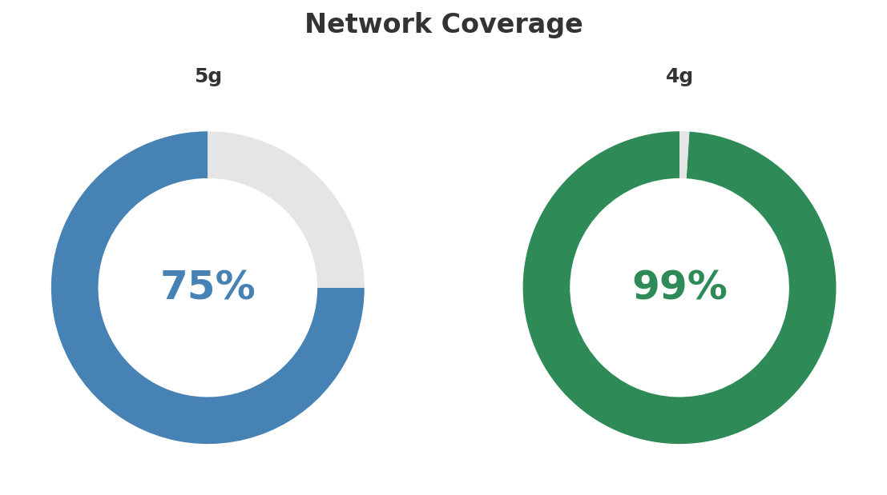
Network Analysis
INFRASTRUCTURE
Technology Mix:
Investment Direction: decreasing
• Mobile Vendor: Nokia/Ericsson
• Spectrum Mhz: 280
• Fiber Access: Own-build + Swiss Fibre Net wholesale
• 5G Band: 3500 MHz
Key Message: Network infrastructure and coverage assessment
33

Slide 34

Business Model Canvas
BMC
Key Message: Business model canvas overview
34

Slide 35
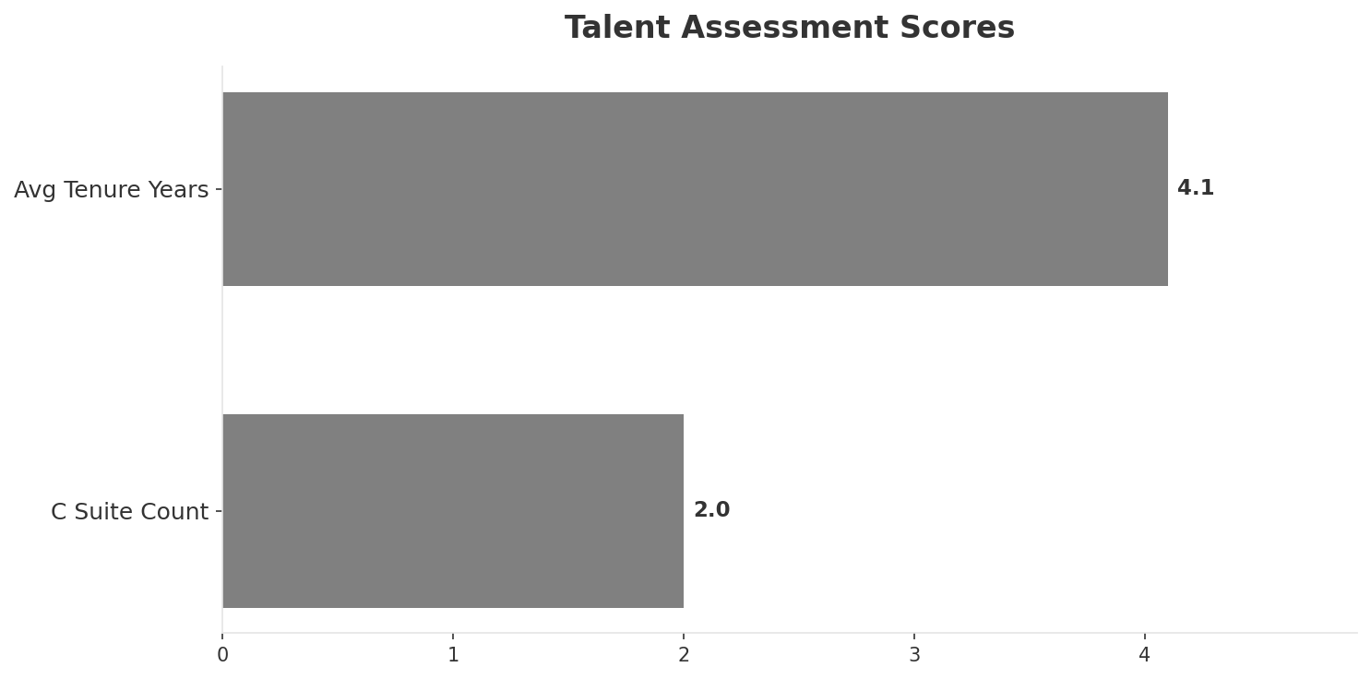
Organization & Talent
PEOPLE & CULTURE
Employees
C Suite Count
Avg Tenure Years
Key Leaders
1,150
2
4.1
['Max Nunziata (CEO)', 'Franck Bernard (CFO)']
Organization Culture:
Stable leadership team (avg tenure >3 years); Challenger culture reinforced by NJJ/Niel ownership. Agile, commercially aggressive. Engineering-focused. Digital-first operations.
Leadership Changes:
• Max Nunziata: (
• Franck Bernard: (
Key Message: Organization and talent assessment
35

Slide 36
Strengths, Weaknesses & Exposure Points
SELF ASSESSMENT
Strengths
Weaknesses
Exposure Points
• Digital Experience: score 85 (market avg 80
• Innovation: score 88 (market avg 80
• Price Competitiveness: score 92 (market avg 69
• Strong EBITDA margin at 58.8%
• Revenue on growth trajectory
• Brand Strength: score 65 (market avg 79
• Customer Service: score 72 (market avg 77
• Distribution: score 65 (market avg 81
• Enterprise Solutions: score 45 (market avg 71
• Network Coverage: score 80 (market avg 89
• Limited owned fixed broadband infrastructure vs Swisscom: Cannot compete on equal terms in fiber broadband
• Smallest mobile operator in a 3-player market: Scale disadvantage in procurement and content deals
Key Message: Ranked #3 of 3 operators in market; revenue CHF 245.0M; EBITDA margin 58.8%; stable but facing challenges; key strength: Digital Experience; key challenge: Brand Strength; Management outlook: FY2024 revenue CHF 973.2M (+4.4%), operating EBITDA margin ~60%, among highest in Europe. Mobile postpaid base exceeds 1.7M. Salt Connect magazine network score 952/1000 ('outstanding').
36

Slide 37
SWOT Synthesis
Strengths, Weaknesses, Opportunities & Threats

Slide 38
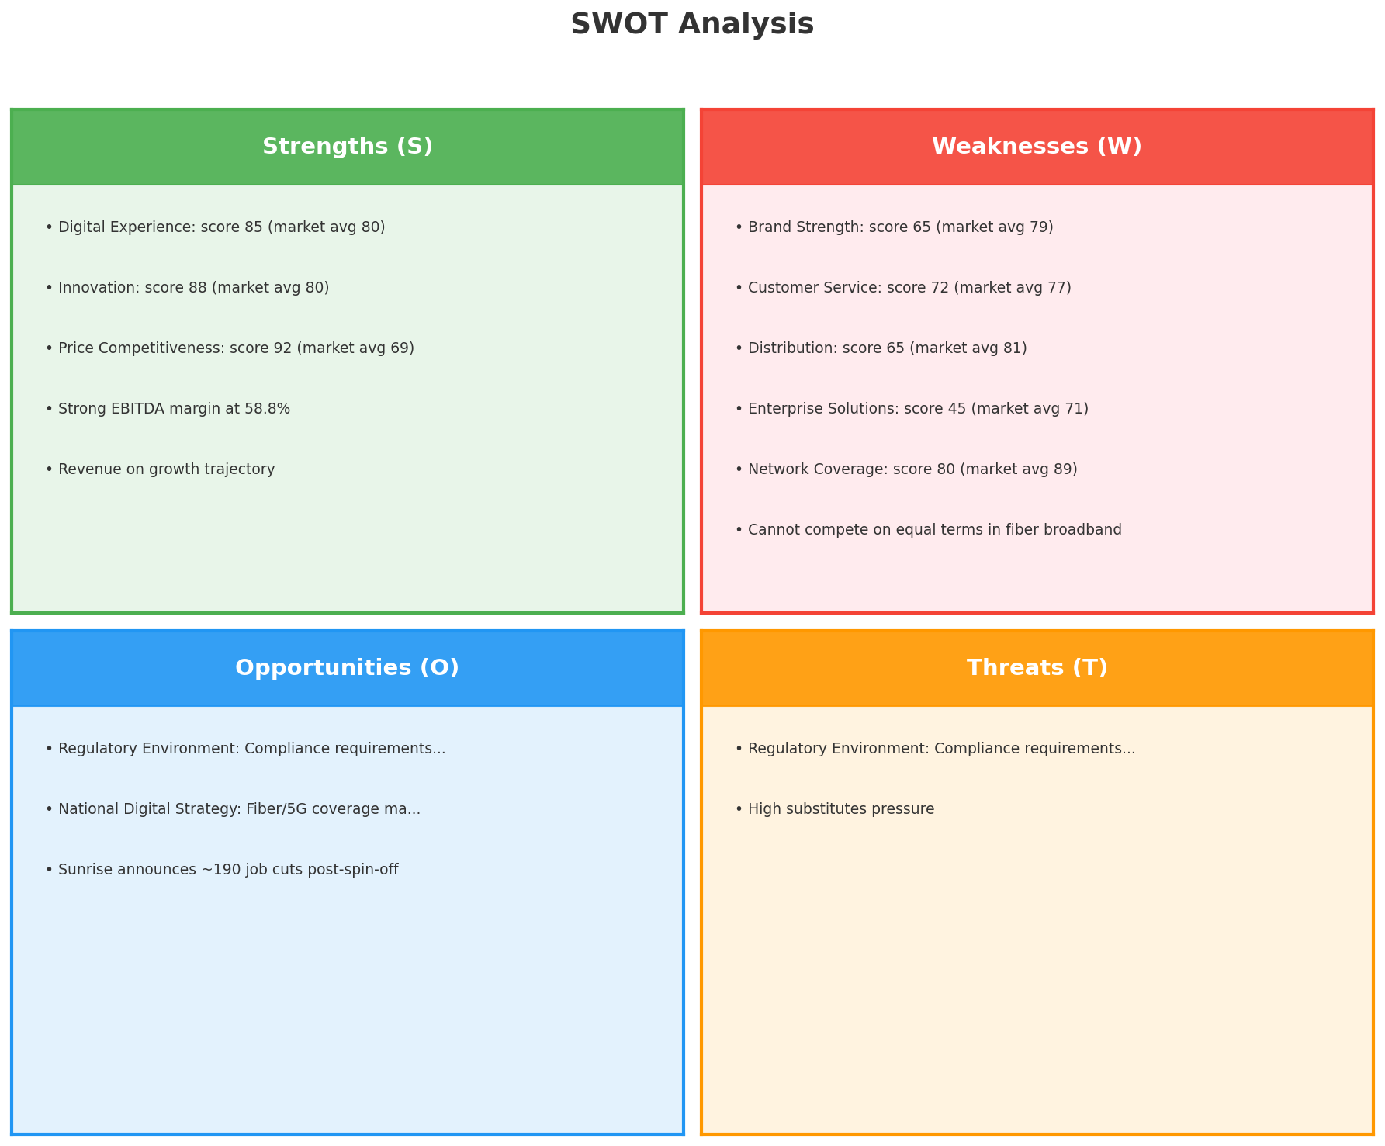
SWOT Analysis
STRATEGIC SYNTHESIS
SO:
Leverage 'Digital Experience: score 85 (market avg 80)' t...
WO:
Address weakness 'Brand Strength: score 65 (market avg 79...
ST:
Use strength 'Digital Experience: score 85 (market avg 80...
WT:
Mitigate weakness 'Brand Strength: score 65 (market avg 7...
Key Message: SWOT analysis identifies 5 strengths, 7 weaknesses, 3 opportunities, and 2 threats. The recommended strategic posture is improvement-focused (WO-dominant).
38

Slide 39
05 Look at Opportunities
SPAN Matrix — Opportunity Selection

Slide 40
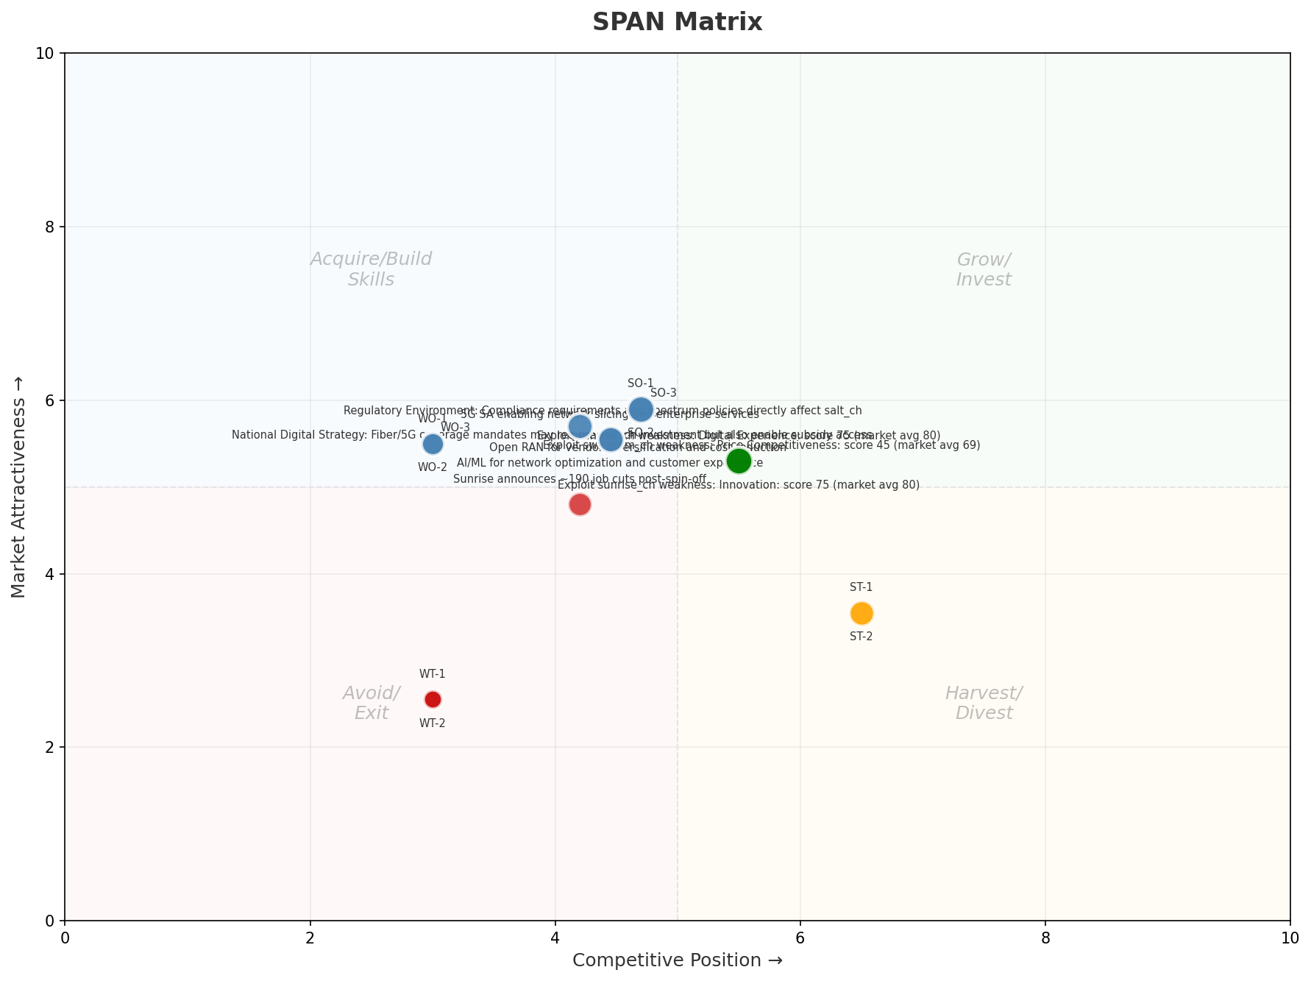
SPAN Matrix — Opportunity Positioning
OPPORTUNITY MAP
Key Message: SPAN matrix positions 19 opportunities: 3 grow/invest, 11 acquire skills, 2 harvest, 3 avoid/exit. Focus resources on the 3 grow/invest items for maximum strategic impact.
40

Slide 41
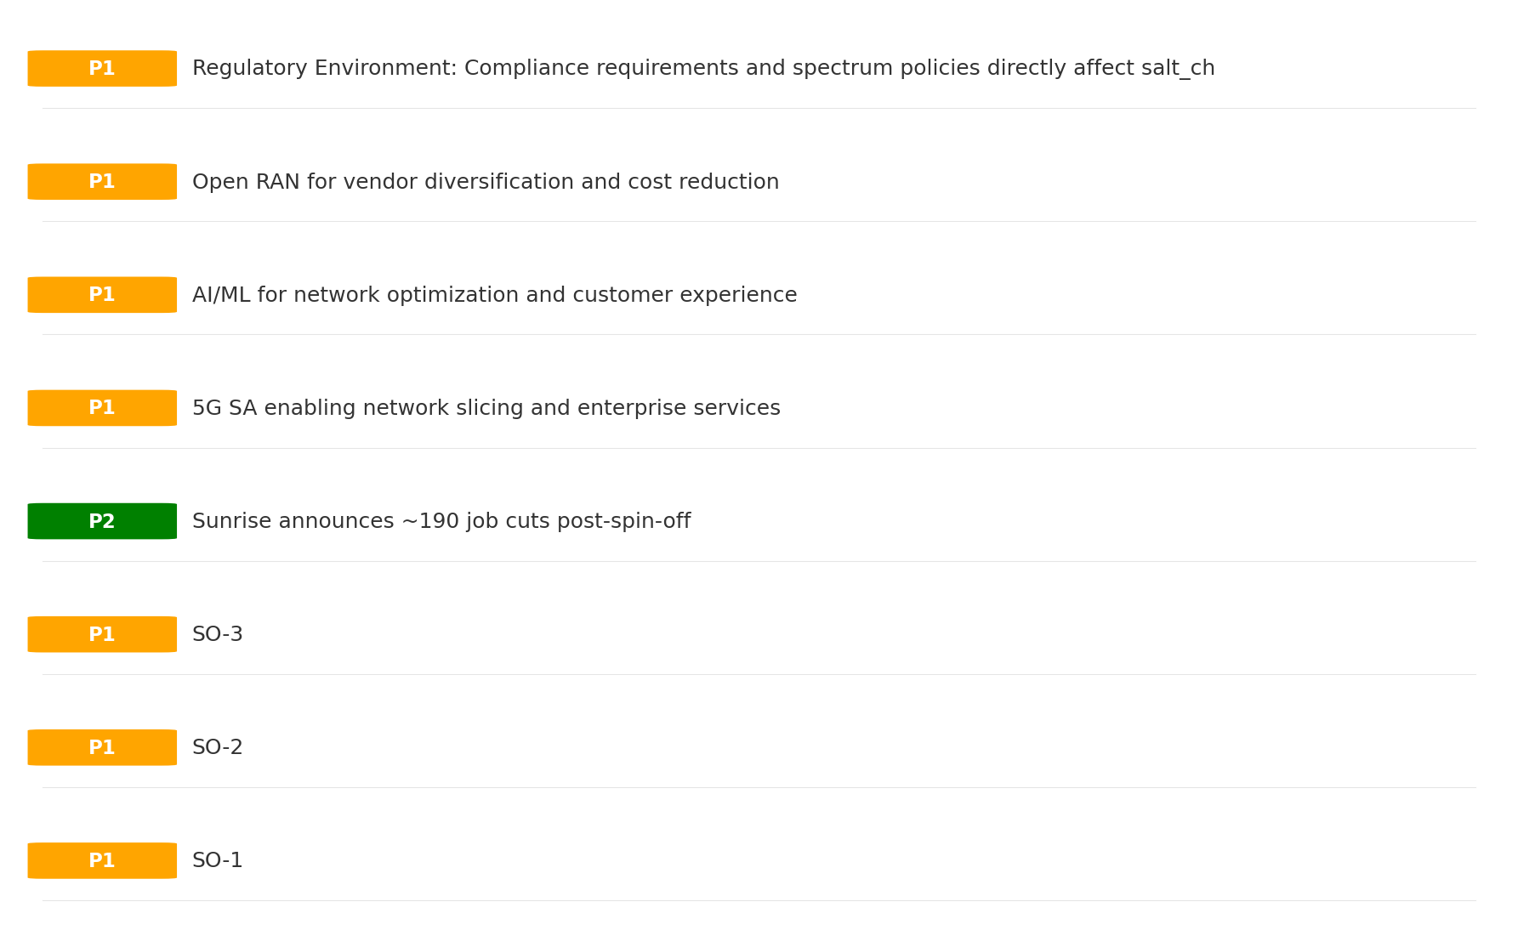
Opportunity Priority Ranking
PRIORITIES
Key Message: SPAN matrix positions 19 opportunities: 3 grow/invest, 11 acquire skills, 2 harvest, 3 avoid/exit. Focus resources on the 3 grow/invest items for maximum strategic impact.
41

Slide 42
Opportunity Details
DEEP DIVE
P1
SO-1
Market: N/A | Window:
Leverage 'Digital Experience: score 85 (market avg 80)' to capture the opportunity of 'Regulatory Environment: Compliance requirements and spectrum policies directly affect salt_ch'.
P1
SO-2
Market: N/A | Window:
Leverage 'Innovation: score 88 (market avg 80)' to capture the opportunity of 'National Digital Strategy: Fiber/5G coverage mandates may require salt_ch investment but also enable subsidy access'.
P1
SO-3
Market: N/A | Window:
Leverage 'Price Competitiveness: score 92 (market avg 69)' to capture the opportunity of 'Sunrise announces ~190 job cuts post-spin-off'.
P2
Sunrise announces ~190 job cuts post-spin-off
Market: N/A | Window:
Sunrise announces ~190 job cuts post-spin-off
Key Message: SPAN matrix positions 19 opportunities: 3 grow/invest, 11 acquire skills, 2 harvest, 3 avoid/exit. Focus resources on the 3 grow/invest items for maximum strategic impact.
42

Slide 43
Three Decisions
Strategy — Key Tasks — Execution

Slide 44
Decision 1: Define Strategy
TURNAROUND
As The Distant Third: stabilize core business, then selectively invest for turnaround
P0
P0
P1
P1
Growth Strategy
Competitive Strategy
Transformation Strategy
Customer Strategy
Focused growth in high-momentum segments: Fixed Broadband
Shore up competitive position — address: Brand Strength: score 65 (market avg 79
Accelerate fiber transition — converged network as competitive moat
Optimize value extraction in stable segments: Mobile, B2B
- Grow Fixed Broadband above market rate
- Improve segment profitability
- Close Brand Strength: score 65 (market avg 79) gap within 12 months
- Reduce customer churn
- Fiber homepass coverage +20%
- FMC bundle attach rate 50%+
- Upsell rate +10% in Mobile, B2B
- Cross-sell convergence bundles
Key Message: As The Distant Third, the strategic posture is Turnaround. As The Distant Third: stabilize core business, then selective
44

Slide 45
Decision 2: Define Key Tasks
2 P0 (IMMEDIATE), 2 P1 (1-2 YEARS), 1 P2 (3-5 YEARS
P0
Network
Accelerate Fixed Network Upgrade
Homepass coverage +15% | Speed tier upgrades
Drive DOCSIS/Fiber rollout to increase homepass and improve quality scores
P0
Business
Accelerate Fixed Broadband Growth
Fixed Broadband revenue +10% YoY | Market share gain
Fixed Broadband at €38M showing strong momentum — invest to scale
P1
Network
5G Coverage Expansion
5G pop coverage target | 5G attach rate
Expand 5G population coverage to strengthen mobile competitive position
P1
Customer
Customer Experience Enhancement
NPS +5 points | First-call resolution rate 80%+
Improve digital touchpoints and service resolution to boost NPS
P2
Efficiency
Operational Efficiency & Automation
Process automation 30%+ | Cost-to-serve reduction
EBITDA margin 58.8% — maintain through smart automation and resource reallocatio
Key Message: 5 critical tasks: 2 P0 (immediate), 2 P1 (1-2 years), 1 P2 (3-5 years
45

Slide 46
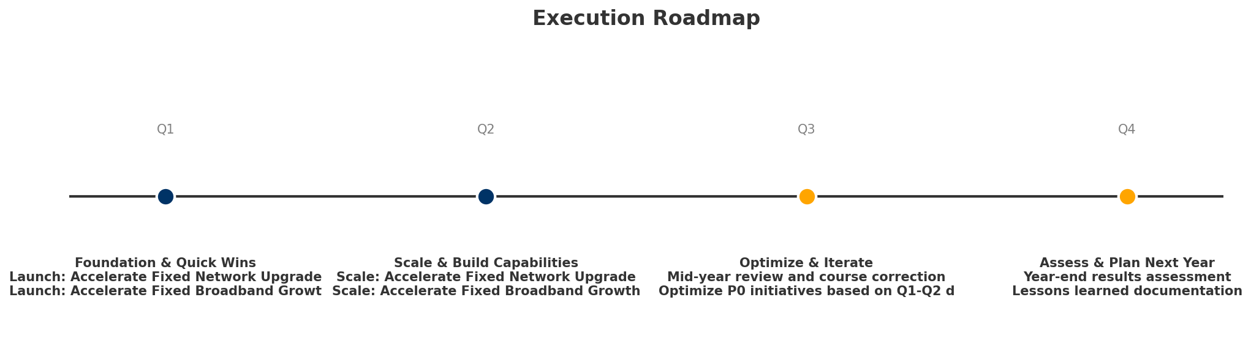
Decision 3: Define Execution
QUARTERLY ROADMAP & GOVERNANCE
Governance
Strategic Traps to Avoid
- Monthly Progress Review (Monthly
x Enter a price war
- Quarterly Strategic Checkpoint (Quarterly
x Attempt premium repositioning
- Mid-Year Strategic Adjustment (Semi-annual
x Delay core transformation
Key Risks & Mitigation
! Resource constraints delay P0 initiatives -- Ring-fence P0 budgets; establish escalation path for blockers
Key Message: Execute with discipline: monthly reviews, quarterly checkpoints, annual refresh
! Macro-economic slowdown reduces consumer spending -- Prepare value-tier offerings; shift mix toward B2B resilience
46

Slide 47
Analysis Summary
KEY TAKEAWAYS
01 Trends
Macro environment: Favorable. Key opportunities: Regulatory Environment, National Digital Strategy. Key risks: Regulatory Environment, Fiber Broadband Penetration Industry is in late growth phase. (+2.0% YoY (CQ2_2025 -> CQ4_2025)
02 Market
Switzerland telecom market totals CHF 3,110M in quarterly revenue; competitive strengths in Availability, Performance; gaps in Assurances; Market outlook is favorable with more opportunities than threats.
03 Competition
In a 3-player market with medium competition intensity, Swisscom leads with 67% revenue share. Target operator holds 8% share. Strongest competitive force: Substitutes.
04 Self
Ranked #3 of 3 operators in market; revenue CHF 245.0M; EBITDA margin 58.8%; stable but facing challenges; key strength: Digital Experience; key challenge: Brand Strength; Management outlook: FY2024 revenue CHF 973.2M (+4.4%), operating EBITDA margin ~60%, among highest in Europe. Mobile postpaid base exceeds 1.7M. Salt Connect magazine network score 952/1000 ('outstanding').
SWOT
SWOT analysis identifies 5 strengths, 7 weaknesses, 3 opportunities, and 2 threats. The recommended strategic posture is improvement-focused (WO-dominant).
05 Opportunities
SPAN matrix positions 19 opportunities: 3 grow/invest, 11 acquire skills, 2 harvest, 3 avoid/exit. Focus resources on the 3 grow/invest items for maximum strategic impact.
Key Message: Complete Five Looks analysis — see opportunity priorities for next steps
47

Slide 48
Data Provenance
SOURCES & METHODOLOGY
No provenance data recorded for this analysis
Key Message: All data points are traceable to original sources
48

Slide 49
Thank You
BLM Five Looks Strategic Analysis

